Slide 1
Powered by AWS Bedrock
Multi Agent RAG
Team : AgentNeo
Sumit Ghosh
sughosh4@in.ibm.com

Slide 2
Application Overview
What is RAG
RAG (Retrieval-Augmented Generation) is an AI technique that combines two powerful abilities:
Retrieval – finding useful information from a large set of documents or data.
Generation – using a language model to write a human-like response based on that information.
Application Overview
The Multi Agent RAG is an agent orchestration network where agents collaborate with each other to find information from knowledge repository consisting of vast set of documents and come back with summarized answer for a user query in an instant.
Problem Statement
Enterprises store knowledge across documents, wikis, and internal databases—making retrieval difficult.
Employees or HR Support struggle to find accurate company policy answers across multiple internal documents.
Application Support teams finds it difficult to search large/diverse knowledge bases during times of urgent need.
Need for a scalable AI assistant who can find information in an instant and come back with summarized information referring documents of diverse formats.

Slide 3
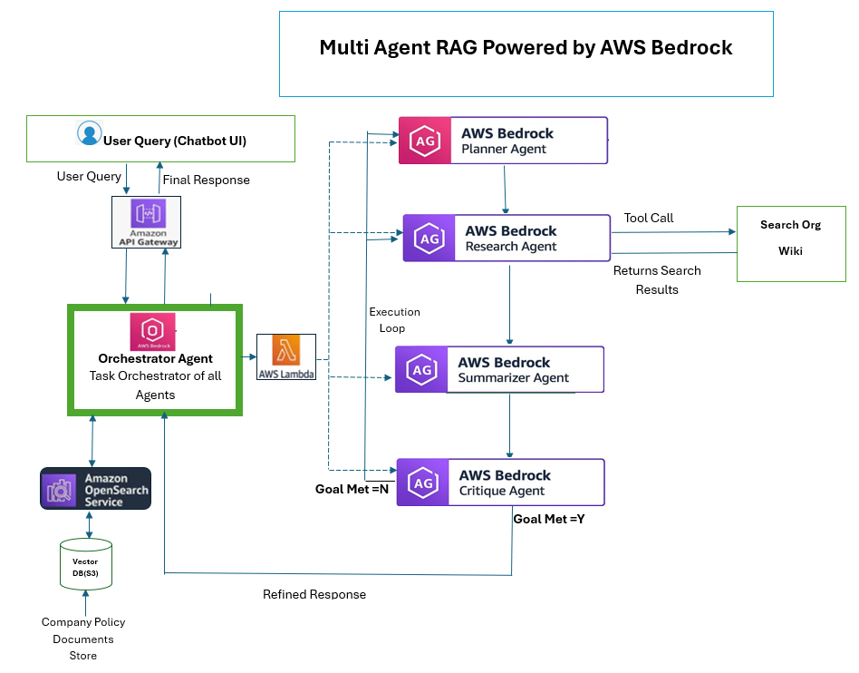
Architecture & Workflow
Workflow
User Submits Query via AWS API Gateway to Orchestrator Agent. Orchestrator Agent receives the user query. If the context isn’t strong enough from the vector database, it spins up an execution loop involving four sub-agents:
🧠 Planner Agent: Breaks the query into sub-tasks.
🔍 Research Agent: Searches external/internal sources.(Company Wiki)
📝 Summarizer Agent: Condenses findings.
✅ Critique Agent: Validates whether the goal is met.i.e if summary addresses the user query accurately. If yes, answer returned to user else execution loop repeated until satisfactory answer is obtained”
NOTE : The AI Model used to power the Agents is Anthropic Claude 3.5 Sonnet provisioned by AWS Bedrock

Slide 4
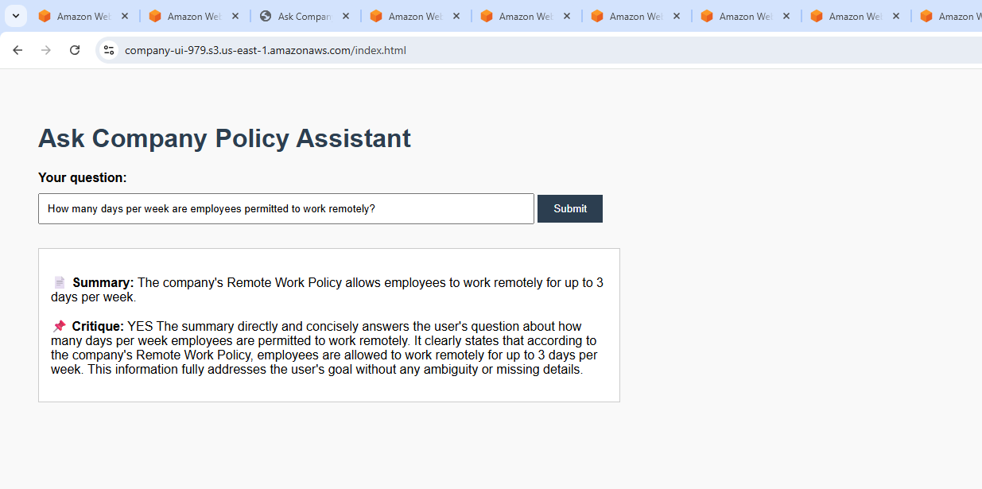
UI Interface
User Chatbot UI
User is provided with a Chatbot UI as below where user submits a natural language question. The agents collaborate to find answers in seconds from a vast repository of company documents and company wiki(eg:w3). Whether you’re in HR, IT Support , Or Application Support team , this AI assistant reduces time to search information, speeds up decisions, and improves employee experience.
Sample Query
Click Here to see Agent Orchestration

Slide 5
Conclusion
With AWS Bedrock, OpenSearch, and intelligent agents, we can scale smart search across large enterprises and bring about process efficiency .Below are some real world use cases
Real World Use Cases
1. Enterprise Policy & Compliance Assistant
✅ Use Case: Internal employee-facing assistant that answers company policy questions (like HR, travel, security policies) with source-backed responses and gap analysis for large corporations, banks, governments
2. Application Knowledge Base Assistant (Internal Tool Support)
✅ Use Case: An Application Knowledge Base Assistant helps IT teams Search internal software application knowledge base. Saves time spent searching scattered documentation, Improves productivity, Standardizes process execution
3. Legal Contract Review & Risk Analysis
✅ Use Case: AI assistant for lawyers, legal tech startups to upload or reference contracts and identify unclear clauses, risks, and missing legal protections. Speeds up legal review, reduces human errors
4. Financial Investment Analyst Assistant
✅ Use Case: Automates due diligence and analysis of companies or markets for portfolio managers for hedge funds and fintech platforms. Accelerates research, supports data-driven stock decisions
5. Healthcare Support System (for Doctors or Patients)
✅ Use Case: Helps Doctors, clinical researchers and Medical professionals search through millions of medical documents / journals/records speeding up diagnosis. Improves care quality, reduces doctor time on routine queries
Notes:
1. Enterprise Policy & Compliance Assistant
✅ Use Case: Internal employee-facing assistant that answers company policy questions (like HR, travel, security policies) with source-backed responses and gap analysis.
🏢 Who Uses This: Large corporations, banks, law firms, governments
💡 Business Value: Reduces internal HR helpdesk load, ensures compliance adherence
2. Application Knowledge Base Assistant (Internal Tool Support)
✅ Use Case: An Application Knowledge Base Assistant helps IT teams Search internal software application knowledge base
🏢 Who Uses This: IT support teams, Business analysts, Developers working across APIs or automation
💡 Business Value: Saves time spent searching scattered documentation, Reduces internal tickets to IT support, Improves productivity, Standardizes process execution
3. Legal Contract Review & Risk Analysis
✅ Use Case: AI assistant for lawyers to upload or reference contracts and identify unclear clauses, risks, and missing legal protections.
⚖️ Who Uses This: Law firms, legal tech startups, procurement teams
💡 Business Value: Speeds up legal review, reduces human errors
4. Financial Investment Analyst Assistant
✅ Use Case: Automates due diligence and analysis of companies or markets for portfolio managers.
💹 Who Uses This: Hedge funds, fintech platforms, retail trading tools
💡 Business Value: Accelerates research, supports data-driven decisions
5. Healthcare Support System (for Doctors or Patients)
✅ Use Case: Helps Doctors and Medical professionals search through millions of medical documents / journals/records speeding up diagnosis.
🏥 Who Uses This: Hospitals, telemedicine providers, clinical researchers
💡 Business Value: Improves care quality, reduces doctor time on routine queries

