Slide 1
ACOUSTIC SCENE CLASSIFICATION
Presented by –
Sumit Gaurav, 2402102012, M.Tech - CSP
EE641 – Advanced Signal Processing

Slide 2
TABLE OF CONTENTS
00
Introduction
01
Dataset Pre-Processing
02
Deep Learning Models
03
Results & Demonstration
04
Conclusion

Slide 3
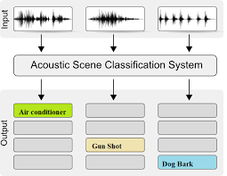
INTRODUCTION
Acoustic Scene Classification(ASC) Model
Acoustic Scene Classification (ASC) assigns semantic labels to audio segments based on the surrounding environment, enabling machines to "make sense" of sounds.
Some of the methods that are involved in the ASC include using Deep Learning models such as CNNs, CRNNs, which can capture complex sound patterns across diverse environments. These models use features like MFCCs and log-mel energies, representing the spectral properties of sound, while high inter-class variability allows for precise scene differentiation.
State-of-the-art approaches in Acoustic Scene Classification (ASC) –
Self-supervised learning with pre-trained models
GAN-based data augmentation
Deep Learning models but based on different features like I-vectors, Histogram of Oriented Gradients (HOG), and Local Binary Patterns (LBP)
Fig – ASC basic sytem

Slide 4
Dataset
01
Dataset preprocessing & state of the art dataset

Slide 5
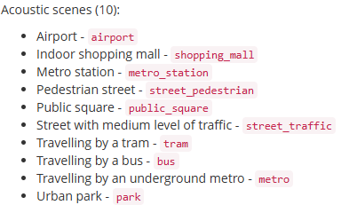
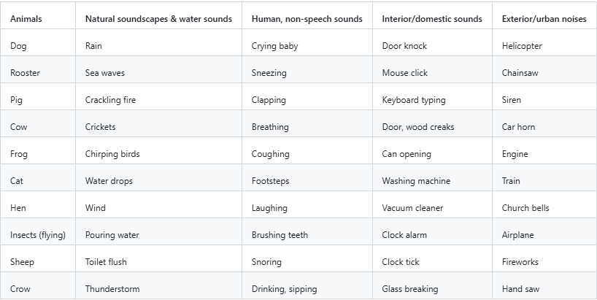
DATASET – state-of-the-art dataset
1. DCASE DATASET – TAU URBAN ACOUSTIC SCENE
Dataset: TAU Urban Acoustic Scenes 2022 includes recordings from 12 European cities, 10 scenes, using 4 devices plus synthetic data for 11 other mobile devices.
Devices: Recordings made with Device A (Soundman OKM II + Zoom F8 at 48kHz), Device B (Samsung Galaxy S7), Device C (iPhone SE), and Device D (GoPro Hero5).
Fig – Class labels TAU URBAN SCENE DATASET
2. Environmental Scene Classification - 50
Dataset: Contains 50 classes with 2000 labelled recordings with 5 major categories – animal sound, nature soundscape, human (non – speech) sound, domestic sounds, urban noises.
Accuracy: classifiers with MFCC & zero crossing rate features were evaluated on dataset to establish benchmark.
ESC – 10 subset had an accuracy ranging from 67% (k-NN) to 73% (RF). ESC – 50 dataset yields an accuracy of 32% (k-NN) to 45% (RF).
Fig – Class labels ESC – 50 dataset

Slide 6
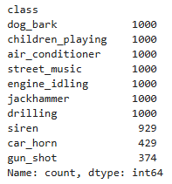
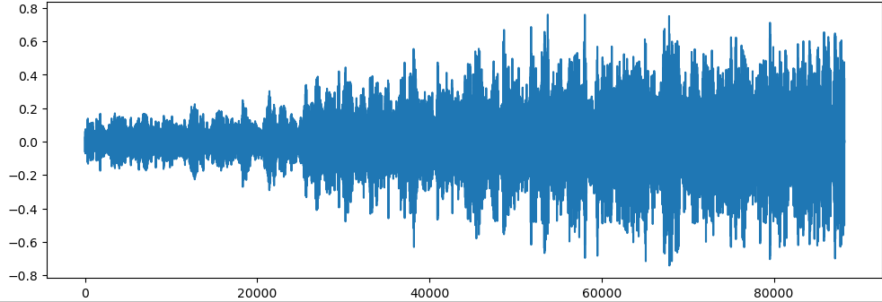
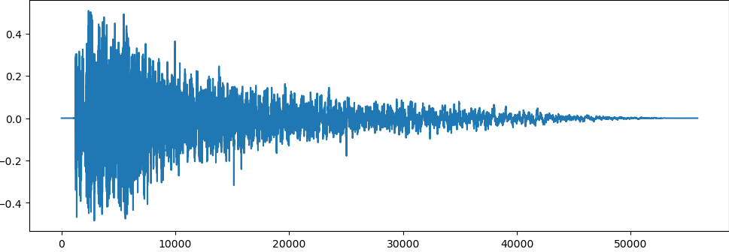
DATASET used
Dataset – UrbanSound 8K
This dataset (UrbanSound8K) contains 8732 labelled sound excerpts (<=4s) of urban sounds of 10 acoustic scenes.
Air conditioner, car horn, children playing, dog bark, drilling, engine idling, gun shot, jackhammer, siren, and street music
Number of audio recording present are 8732 and it is a balanced dataset.
Split the dataset in 80:20 ratio, for training considered 6985 data points and for testing 1747 data points.
Fig – Class labels URBANSOUND8K dataset
Fig – Graphical Rep. for signal – Siren
Fig – Graphical Rep. for signal – Gun Shot

Slide 7
METHODOLOGY
CRNN
Convolutional Layers – Two Conv2D layers with 64 & 128 filters are applied. Each uses ReLU activation function.
Recurrent Layers – A GRU or LSTM layer is used. Captures temporal dependencies across MFCC frames, enables model to understand sequential patterns.
Output Layers - A softmax output layer is used to predict probabilities for each of the ten classes.
Dataset Preparation – Loading UrbanSound8K and metadata about each audio file, including class labels & filepath.
Feature Extraction - MFCCs are extracted from each audio clip. It capture important aspects of the human auditory perception system.
Data Preprocessing – The feature vectors & their associated class labels are separated into input & output arrays. The dataset is split into training & testing sets (80% training, 20% testing).
Hyperparameters – No. of epochs = 100, batch size = 32 specifies model parameter.
Optimizer - Adam optimizer used for efficient gradient descent with adaptive learning rates.
A ModelCheckpoint callback is implemented to save the model that achieves the highest accuracy on the validation set.
CNN
Convolutional Layers – Two Conv2D layers with 64 & 128 filters used to capture local patterns in MFCC features.
Flattening & Dense Layers – 2D output from convolutional layers is flattened into a 1D vector to connect to fully connected layer.
Output Layers - A softmax output layer is used to predict probability dist. over all classes.
Model Evaluation – After training, the model’s performance is evaluated on the test set to check accuracy and ensure it generalizes well to unseen data.
Confusion Matrix - Used to visualize and diagnose class-level performance, helping to identify which classes are easily confused.
ANN
Convolutional Layers – Two Conv2D layers with 64 & 128 filters used to capture local patterns in MFCC features.
Flattening & Dense Layers – 2D output from convolutional layers is flattened into a 1D vector to connect to fully connected layer.
Output Layers - A softmax output layer is used to predict probability dist. over all classes.

Slide 8
DATA PRE-PROCESSING
Convert string labels into numeric format mapping each classes into integer.
Load the dataset using the filepath attached.
Metadata file includes information about each audio file, such as the class label, file name, and the fold number where the file is stored.
Extracts MFCC features for each audio sample using features_extractor.
These features are stored alongside the corresponding class label in extracted_features.
The model expects input data in 4D shape (samples, height, width, channels).
Feature Extraction (MFCC)
Dataframes & data for model i/p
Train – Test split
Dataset Loading
Iteration through metadata
Label encoding & one – Hot encoding
Reshaping
Librosa Load – Load the audio file & resample it to a uniform sample rate
MFCC Calculation – Code calculates 40 MFCC features which captures the frequency based char. of audio.
Feature Scaling – Averages MFCC values across time. Reduces complexity but retains important features.
Extracted features & corres. Class labels are stored in Pandas Dataframes.
The MFCCs & labels are separated, and converted into numpy arrays.
The dataset is split into training and testing sets, using an 80-20 ratio.

Slide 9
DL Models
02
Implemented Deep Learning models – ANN, CNN & CRNN

Slide 10
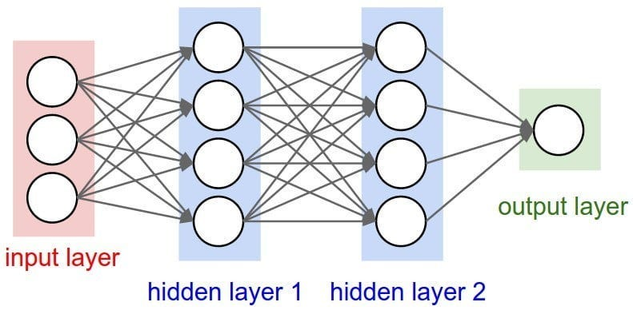
ANN ARCHITECTURE
Input Layers – Accepts 1D i/p vector of size 40 (MFCC feature). Starting point for feature processing.
Hidden Layers – Consists of three hidden layers with dense layers of 100, 200, 100 neurons. ReLU is used as activation function. Dropout rate is 0.5.
Output Layer - Number of neurons equals the number of output classes. Softmax to produce a probability distribution over the classes.
Feature Extraction - For a new audio file, MFCCs are extracted and scaled similarly to the training data. The feature vector is reshaped to match the input dimensions of the ANN.
Prediction - The numeric prediction is decoded back into the original class label for interpretability.
Training ANN
ANN Layers
Loss Function - Binary Cross-Entropy Loss is used, suitable for multi-class classification with one-hot encoded labels.
Training Parameters – Batch size 32 and epochs is 100 iterations. A model checkpoint is implemented to save the best-performing model during training, based on validation accuracy.
Predictions
Fig – Overview of the ANN structure

Slide 11
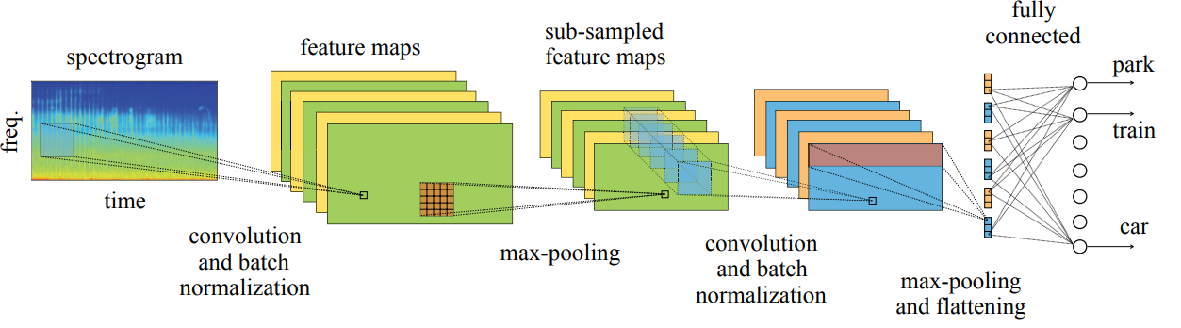
CNN ARCHITECTURE
Two Conv2D layers are used with 64 and 128, each of size (3,3).
ReLU activation function introduces non-linearity. MaxPooling2D with pool size (2,1) reduces dimensionality along the frequency axis.
Dropout rate of 0.3 reduces overfitting by randomly disabling neurons during training.
The final dense layer has the number of units equal to the number of with a softmax activation.
This converts the output to class probabilities, facilitating multi-class classification.
Flatten & Dense Layer
Convolutional Layer
Output Layer
Output from 2nd Conv2D layer is flattened to create a 1D feature vector that connects to dense layer.
Dense Layer – ReLU is activation function. Integrates the learned features for the final classification.
Fig – Overview of the CNN structure

Slide 12
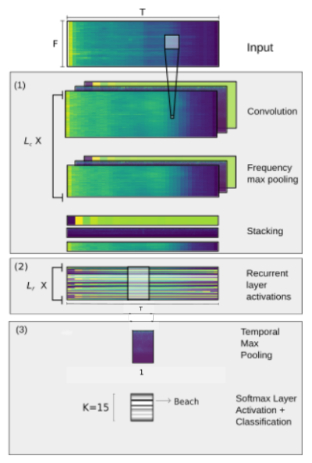
CRNN ARCHITECTURE
CRNN starts with convolutional layer designed to capture spatial hierarchy of features within MFCC i/p.
Conv2D layers – Two Conv2D layers with filters. Each uses ReLU activation function, followed by MaxPooling.
MaxPooling – To reduce spatial dimension, retains most significant features & reduce computational load. Dropout layers are used to prevent overfitting.
After flattening, the outputs pass through a dense layer with 256 units, activated by ReLU. Integrates the learned features for the final classification.
Output layer – softmax is the activation function. Predicts probabilities for each of ten classes.
Recurrent Layer
Convolutional Layer
Output Layer
A GRU (Gated Recurrent Unit) or LSTM is used as recurrent layer.
Captures temporal dependencies across MFCC frames.
Enables model to understand sequential patterns in acoustic events.
Fig – Overview of the CRNN structure

Slide 13
Research Aspects
03
State of the art models (Theoretical analysis)

Slide 14
Transformer-Based model
Leverage self-attention mechanisms to capture long-range dependencies in sequential data.
Dataset Pre-processing
Input Representation – Works on 2D representation like spectrogram or waveforms tokenized into patches.
Resampling – Audio is resampled to a standard rate.
Feature Extraction -
Log-mel spectrogram – Convert waveform to a time-frequency representation using Mel-scale filters
Patch Tokenization – Divide spectrogram into non – overlapping patches e.g. 16x16 pixels per patch.
Normalization – Normalize spectrogram values to a range suitable for training.
Augmentation –
SpecAugment – Apply time or frequency masking to spectrogram.
Model Working
Input – Spectrogram patches with positional encodings.
Self Attention Mechanism –
Compute similarity between patches to determine which part of audio are important for classification.
Captures global relationships in time and frequency.
Output – A probability distribution over acoustic scene classes.

Slide 15
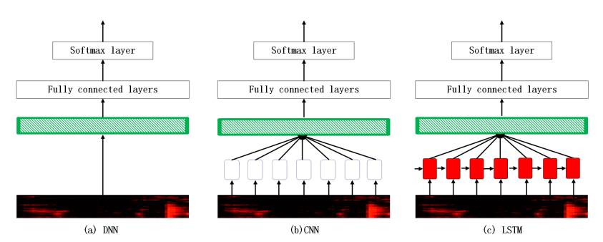
Model Description
Architecture
Patch Embedding Layer –
Converts spectrogram patches into vectors using linear projection.
Positional embeddings are added to encode temporal info.
Transformer Encoder –
Consists of many self-attention layers & feed forward networks (FFNs).
Self-attention computes relationship between all patches to capture global context.
Classification Head –
The token rep. entire input is used to aggregate global info.
A dense layer maps the token embedding to class probabilities.
Model Description
Training
Loss Function -
Cross-entropy loss for multi-class classification
Optimizer -
Adam or AdamW is used with learning rate scheduling.
Fig – Transformer Model for ASC

Slide 16
WaveNet model
Developed by DeepMinds for audio synthesis, can also be adapted for ASC. It operates directly on raw waveforms, modeling the signal's temporal dependencies.
Dataset Pre-processing
Resampling – Audio is resampled to a standard rate.
Quantization -
WaveNet uses quantized waveforms techniques like μ-law encoding to reduce data size while preserving information.
Quantized samples are converted into a one-hot encoded representation for input.
Segmentation - Long audio clips are segmented into smaller windows (e.g., 1-second chunks) to reduce computational load.
Augmentation – WaveNet can work on augmented raw audio, benefiting from techniques like noise addition or pitch-shifting.
Model Working
Input – Quantized waveform segments.
Feature Extraction -
The dilated causal convolutions model short- and long-range dependencies in the waveform.
Temporal Hierarchies -
Residual connections ensure efficient gradient flow and learning of hierarchical temporal features.
Output – A probability distribution over acoustic scene classes.

Slide 17
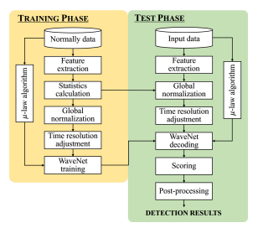
Model Description
Architecture
Dilated Causal Convolutions -
Convolutions ensure the model looks only at past samples (causal), preserving the sequence.
Dilations exponentially increase the receptive field, enabling modelling of long-range dependencies without excessive computation.
Residual Blocks -
Consist of dilated convolutions, ReLU activations, and skip connections.
Capture hierarchical temporal features.
SoftMax Output -
Provides class probabilities for ASC after aggregating features.
Model Description
Training
Loss Function -
Cross-entropy loss for scene classification
Optimizer -
Adam or SGD with weight decay
Fig – WaveNet Model for ASC

Slide 18
Results
04
Comparitive study for ANN, CNN & CRNN

Slide 19
RESULTS
 | ACCURACY | DESCRIPTION
ANN | 78.17 % | - Relies on averaged MFCC features, losing detailed information. - Cannot capture spatial or temporal patterns. - Simpler architecture leading to underfitting on complex data.
CNN | 92.62 % | - Learns spatial patterns in 2D features like MFCC or spectrograms. - Robust to variations due to pooling layers. - Limited by inability to capture temporal relationships.
CRNN | 92.44 % | - Combines CNN's spatial learning and RNN's temporal pattern modeling. - Captures both spatial and sequential information. - Handles overlapping classes better by analyzing feature evolution over time.

Slide 20
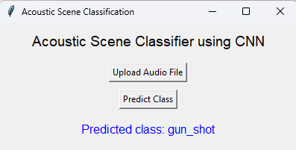
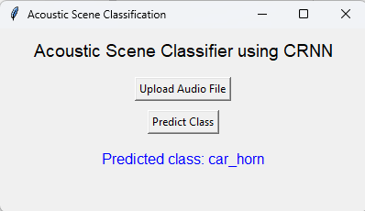
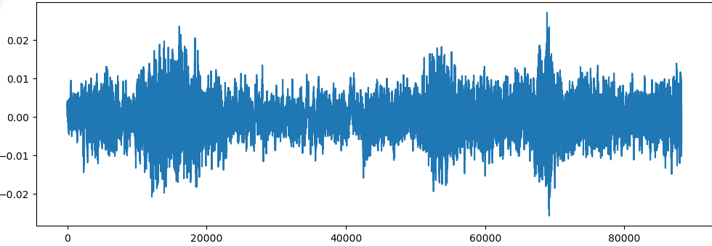

OUTPUT
Fig – GUI for ASC by uploading audio file
Fig – GUI for ASC by uploading audio file
Real time ASC using CRNN
Stored CRNN MODEL (keras file)

Slide 21
Conclusion
05
Summary and future scope for ASC

Slide 22
CONCLUSION
Acoustic Scene Classification(ASC) Model
ASC is transforming how devices and systems interact with the world by enabling intelligent audio context recognition. While ANNs are useful for simpler tasks, CNNs and CRNNs excel in handling complex audio environments.
State-of-the-art models for Acoustic Scene Classification, such as Transformer-based architectures and WaveNet, showcase remarkable capabilities in capturing global context and fine-grained temporal dependencies, respectively. By leveraging advanced preprocessing techniques like spectrogram generation or waveform quantization, these models achieve high accuracy and robustness, pushing the boundaries of audio classification tasks.
It has diverse applications. In smart devices and IoT, it enables context-aware features like adaptive ringtones. Surveillance systems use ASC to detect unusual sounds, improving safety. For **assistive technology**, it identifies environments, aiding visually impaired users. In **autonomous vehicles.

Slide 23
REFERENCES
Research Papers -
Acoustic Scene Classification using Deep learning models (CNN and CRNN)
LINK - https://ieeexplore.ieee.org/stamp/stamp.jsp?tp=&arnumber=9418177
A Convolutional Neural Network Approach for Acoustic Scene Classification
LINK - https://ieeexplore.ieee.org/abstract/document/7966035
ACOUSTIC SCENE CLASSIFICATION USING A CONVOLUTIONAL NEURAL NETWORK ENSEMBLE AND NEAREST NEIGHBOR FILTERS
LINK - https://dcase.community/documents/workshop2018/proceedings/DCASE2018Workshop_Nguyen_60.pdf
Dataset -
UrbanSound8K
LINK - https://www.google.com/url?q=https://goo.gl/8hY5ER&sa=D&source=editors&ust=1724337228690386&usg=AOvVaw 1eb1JSj-71IThF6zO4zDWT

Slide 24
THANK YOU
Sumit Gaurav, 2402102012
M.Tech - CSP

