Slide 1



Password Policy Compliance Auditor
A professional password security assessment tool built on real-world cybersecurity standards.
Python
SQLite
Flask
bcrypt
NIST SP 800-63B
OWASP Guidelines
Developed under the guidance of Mr. Manish Singh

Slide 2



Why This Project?
Weak passwords remain one of the leading causes of cyber attacks worldwide. Rather than building a basic password checker, the goal was to understand how professional organizations evaluate password security — and replicate that rigor in a real application.
Research-First Approach
Extensive research on password security, authentication standards, secure coding, and database security was conducted before writing a single line of code.
Industry Best Practices
Every feature was grounded in internationally recognized standards — not assumptions. NIST and OWASP guidelines drove every architectural decision.

Slide 3
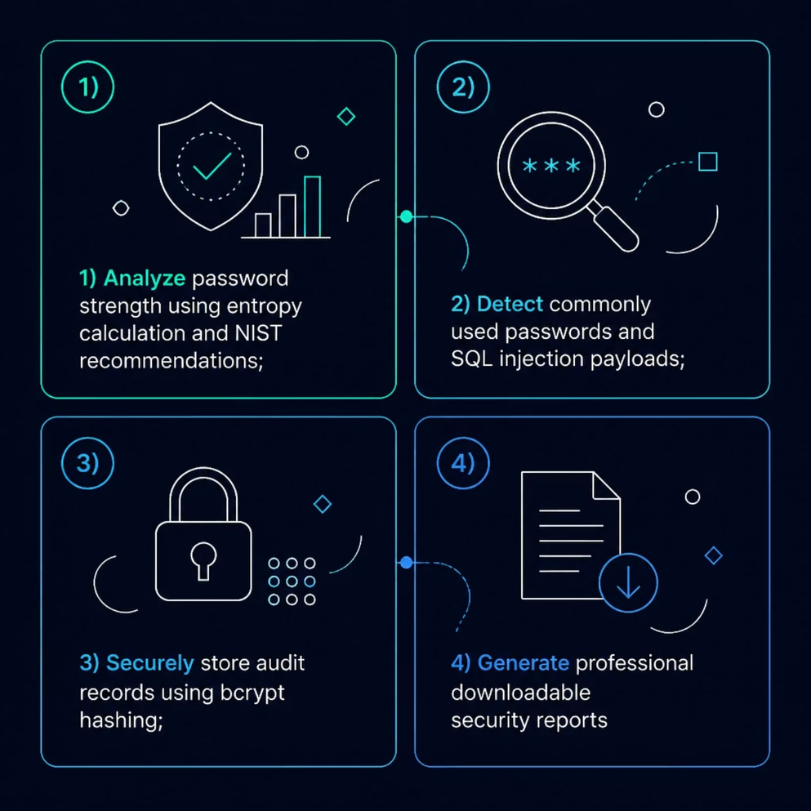
Project Objectives
The goal was to build a practical password auditing application capable of evaluating passwords using real-world cybersecurity principles — not simple character counting.
Analyze & Score
Evaluate strength using entropy and NIST criteria
Detect Threats
Identify common passwords and SQL injection payloads
Secure Storage
Store only bcrypt hashes — never plain text
Professional Reports
Generate downloadable, structured security assessments

Slide 4





Technology Stack
A modern, layered architecture designed for security, reliability, and maintainability — from frontend to database.
Frontend
Backend
Database
HTML5 · CSS3 · JavaScript — responsive, real-time interface with live strength meter
Python · Flask — clean RESTful architecture with secure input handling
SQLite · Parameterized Queries — injection-resistant data persistence
Security
Development
bcrypt · NIST SP 800-63B · OWASP — industry-standard hashing and guidelines
VS Code · GitHub — version-controlled, iterative development workflow

Slide 5
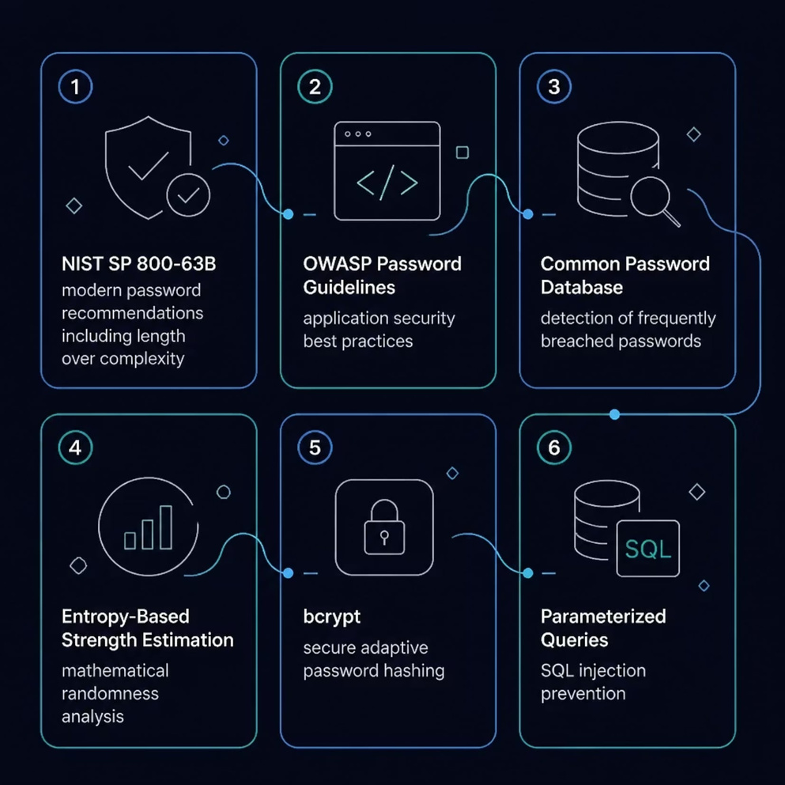




Industry Standards Implemented
Before development began, extensive research was conducted on internationally accepted password security practices. Each standard directly shaped a feature of the application.
NIST SP 800-63B
OWASP Guidelines
Modern password recommendations — length over forced complexity
Application security best practices for authentication systems
Common Password DB
Entropy Calculation
Detection of frequently breached and dictionary passwords
Mathematical analysis of password randomness and unpredictability
bcrypt Hashing
Parameterized Queries
Adaptive, salted hashing resistant to brute-force attacks
Complete protection against SQL injection in all database operations

Slide 6






Security Features Dashboard
Every feature was designed to mirror the depth of a professional security audit — not a toy checker.
Length & Composition
Entropy & Crack Time
Uppercase, lowercase, numeric, and special character detection with length analysis
Bitwise entropy calculation and estimated brute-force resistance
Threat Detection
bcrypt Hashing
Common password database lookup and SQL injection payload detection
Adaptive salted hash generation for all stored credentials
Dynamic Reports
Secure Audit Logging
Professional downloadable security assessments with compliance scores
Immutable records with timestamps, scores, and security ratings

Slide 7
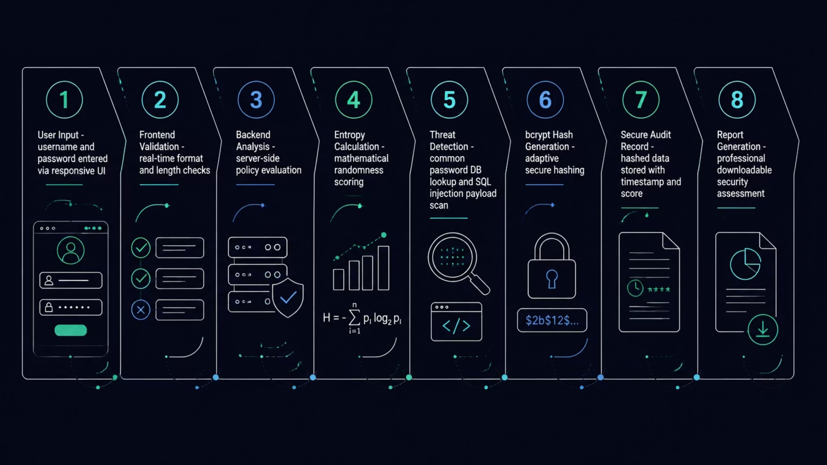
How It Works
A secure, multi-layered pipeline ensures every password is evaluated thoroughly before any result is returned or stored.
The pipeline is designed so that no plain-text password ever persists — hashing occurs before any database interaction, and threat detection runs in parallel with strength evaluation.

Slide 8
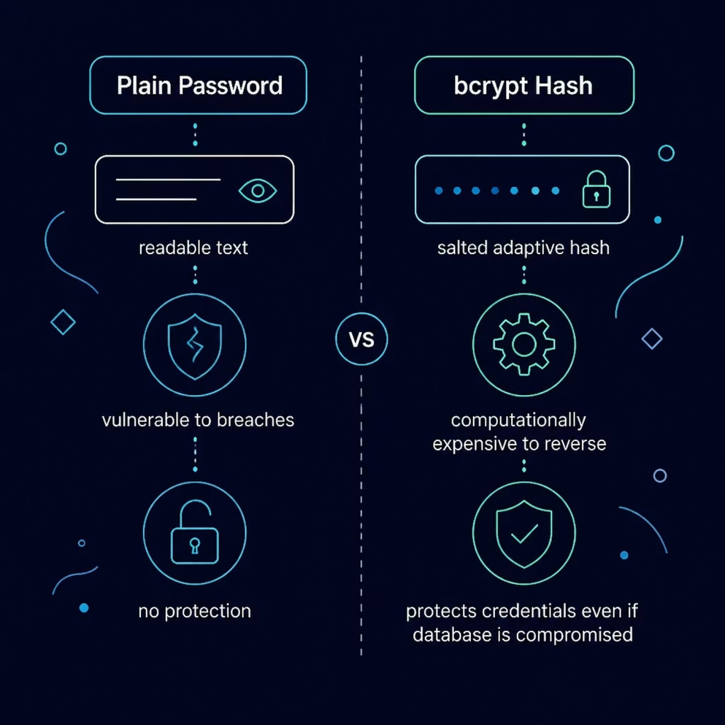
Secure Audit Logging
Plain Password ❌
Stored as readable text — vulnerable to data breaches, insider threats, and credential theft.
bcrypt Hash ✅
Salted, adaptive hash — computationally expensive to reverse, protecting credentials even if the database is compromised.
Hashing is non-negotiable in any system that handles authentication data. bcrypt's cost factor increases over time to stay ahead of hardware advances.
Each audit record securely stores: username, password length, compliance score, security checks performed, bcrypt hash, timestamp, and security rating — never the raw password.

Slide 9
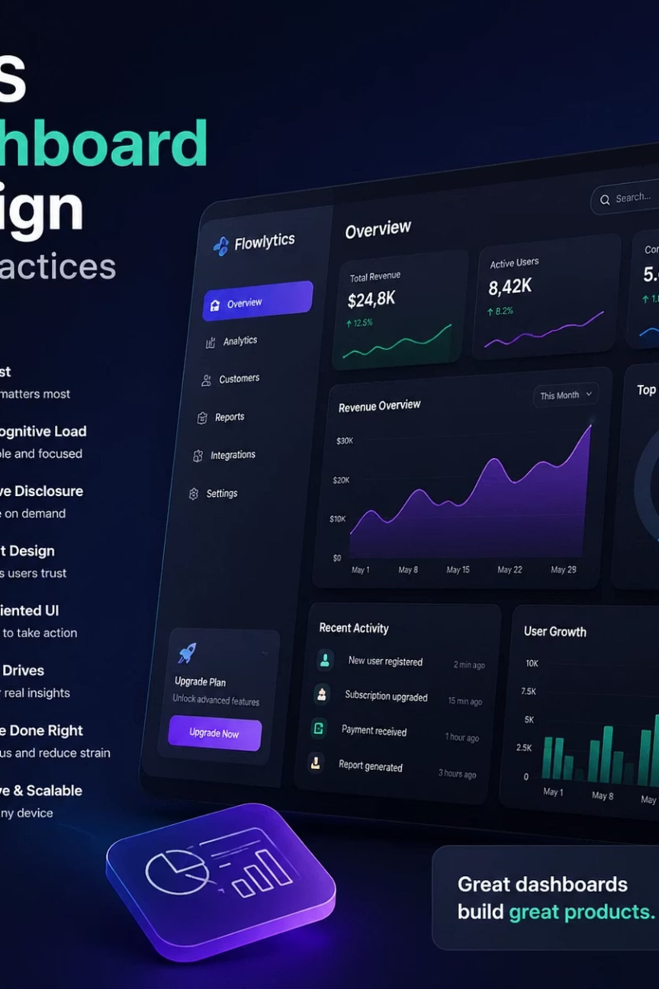
Professional User Interface
The interface follows modern application design principles — built for clarity, speed, and usability under real-world conditions.
Real-Time Feedback
Responsive Layout
Live password strength meter with animated progress bar and instant checklist updates as the user types
Cyber-themed design that adapts seamlessly across devices — desktop, tablet, and mobile
Interactive Reports
One-click generation of professional, downloadable security assessment documents

Slide 10
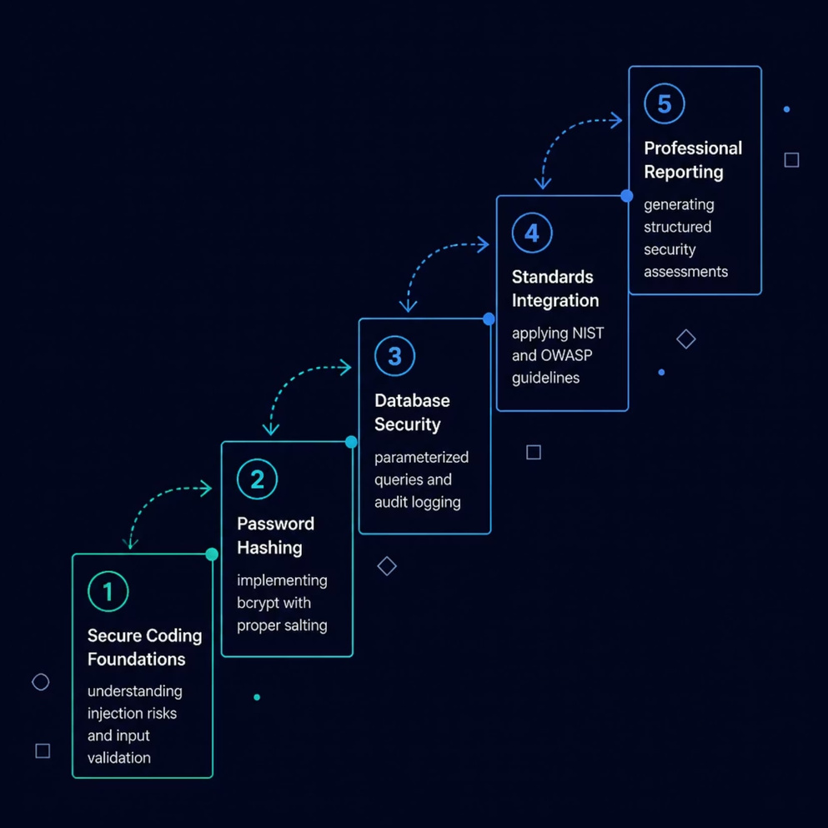




Challenges & Learning Journey
This project evolved through continuous research, testing, and refinement — each challenge deepened our understanding of real-world cybersecurity.
Secure Coding
Password Hashing
SQL injection prevention and input validation at every layer
bcrypt implementation with adaptive cost factors
Standards Integration
Security Reporting
Translating NIST and OWASP guidelines into working code
Designing professional, actionable audit outputs
We sincerely thank Mr. Manish Singh for his guidance and mentorship, which transformed this project from an academic idea into a professional security-focused application.

