Slide 1

DBMS COURSE PROJECT
SE-EWRS
Student Engagement & Early Warning Risk System
Finding struggling students early, before they fail
Course: Database Management Systems · Department of Mathematics
TEAM MEMBERS
Mohammad Adnan
Lucky Dhall
Raja
Sumit
Notes:
Speaker: Mohammad Adnan (about 0:30)
Good morning, everyone. We are Mohammad Adnan, Lucky Dhall, Raja and Sumit.
Our DBMS project is called SE-EWRS, the Student Engagement and Early Warning Risk System.
In simple words, it is a web application that helps teachers find struggling students early, so they can help them in time.
I will explain the problem. Lucky will explain the design and technology, Raja will explain the features and the database, and Sumit will show the demo.

Slide 2




Objective
What SE-EWRS does
The problem
Track
Colleges already record attendance, marks and portal logins
This data is usually checked only after a student fails
By then, it is often too late to help
Attendance, marks and online activity in one place
Score
A risk score (0–100) for each student in each course
Warn
Raise an alert automatically when risk is high
Act
Record the help given, such as counselling
Goal: find struggling students early, before they fail.
Notes:
Speaker: Mohammad Adnan (about 1:00)
Colleges already collect a lot of data about students: attendance, marks, and how often they log in to the learning portal.
But this data is usually checked only after a student fails an exam. By then, it is often too late to help.
We built SE-EWRS to change that. It collects attendance, marks and online activity, and calculates a risk score for every student in every course.
When the score is too high, it raises an alert automatically, and staff can record what they did to help.
Our goal is simple: find struggling students early, before they fail. Now Lucky will explain the design.

Slide 3



Project Design
Frontend
Backend
Database
React + Vite
FastAPI (Python)
MySQL 8
JSON over HTTP
SQL queries
What staff see in the browser
Dashboard, students, risk, alerts, reports
Charts with Recharts
Checks login and permissions
Runs the risk-scoring logic
62 API routes
Stores all the data
16 tables, 12 views
Procedures and triggers
One request, step by step
1
Staff clicks a page in React
2
FastAPI checks login and permission
3
MySQL runs the query or procedure
4
Result shows as charts and tables
Notes:
Speaker: Lucky Dhall (about 1:15)
Thank you, Adnan. Our system has three parts.
First, the frontend, built with React. This is what staff see in the browser: the dashboard, student pages, alerts and reports.
Second, the backend, built with FastAPI in Python. It receives each request, checks that the user is logged in and has permission, and runs the logic, such as the risk calculation.
Third, the MySQL database. It stores all the data, and it also does real work using views, stored procedures and triggers.
At the bottom you can see one request: the user clicks, the backend checks permission, MySQL runs the query, and the result comes back as charts and tables.

Slide 4






Technology Used
React + Vite
Tailwind CSS
Recharts
FastAPI (Python)
Builds the web pages staff use
Clean and simple page styling
Charts on the dashboard and reports
Backend server and API routes
SQLAlchemy
MySQL 8
JWT + Argon2
pytest + Vitest
Connects Python to MySQL (with PyMySQL)
Stores data; views, procedures, triggers
Secure login and hashed passwords
Automatic testing: 526 + 98 tests
Notes:
Speaker: Lucky Dhall (about 1:00)
These are the main technologies we used.
React and Vite build the web pages, Tailwind CSS gives them a clean look, and Recharts draws the charts.
On the server, FastAPI is our Python web framework, and SQLAlchemy with PyMySQL connects Python to MySQL. MySQL 8 is our database.
For security, we use JWT tokens for login, and Argon2 to store passwords safely as hashes.
We used pytest and Vitest for automatic testing. The project has 526 backend tests and 98 frontend tests. Now Raja will explain the features.

Slide 5




Main Features
Student management
Attendance
Assessments
Add, search, filter and view full student profiles
Mark a whole class at once: present, late, absent, excused
Assignments, quizzes and exams; wrong marks are rejected
Risk scoring
Alerts
Reports
A 0–100 score per student per course, with reasons
Raised automatically; one open alert per student-course
Seven reports with charts and CSV export
How the risk score is calculated
Low
0–29
Medium
30–59
High
60–100
Risk = 35% Attendance + 40% Academic + 25% Engagement
Missing data is left out, not counted as zero
Notes:
Speaker: Raja (about 1:30)
Thank you, Lucky. These are our six main features.
Student management lets staff add, search and filter students, and open a full profile. Attendance lets a teacher mark a whole class at once.
Assessments store assignments, quizzes and exams. The system rejects wrong marks, for example a mark higher than the maximum.
The heart of the project is risk scoring. As shown at the bottom, the score is 35% attendance risk, 40% academic risk and 25% engagement risk. Below 30 is low, 30 to 59 is medium, and 60 or more is high.
When a score reaches 30, an alert is raised automatically, and there can be only one open alert per student per course. There are also seven reports with charts and CSV export.
One important point: if data is missing, for example no marks yet, we do not count it as zero. We leave that part out, so no student is flagged unfairly.

Slide 6
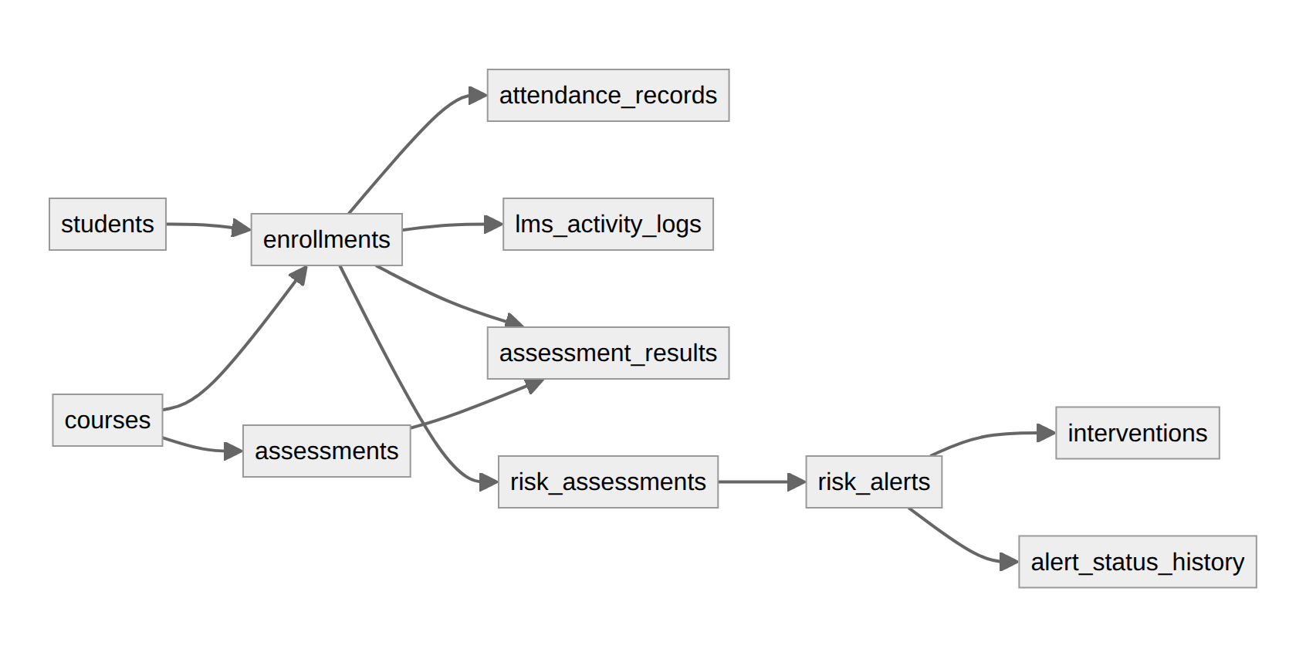
Database Design
Main relationships
Students and courses are many-to-many, joined by enrollments
Attendance, marks, activity, risk and alerts all point to one enrollment
16 tables in third normal form (3NF)
How MySQL helps the app
Constraints and triggers block wrong data
A stored procedure calculates the risk score
Triggers keep an audit log of changes
Every record links through the enrollments table
16
12
9
12
tables
views
procedures & functions
triggers
Notes:
Speaker: Raja (about 1:30)
Now the database design, which is the core of a DBMS project. We have 16 tables in third normal form.
The most important table is enrollments. It links a student to a course, so it handles the many-to-many relationship between students and courses.
As the diagram shows, every other record (attendance, marks, online activity, risk scores and alerts) is linked to an enrollment. So the database itself stops mistakes like recording attendance for a student who is not in that course.
The database also does real work: constraints and triggers block wrong data, a stored procedure calculates the risk score inside MySQL, and triggers keep an audit log of changes.
In total we have 16 tables, 12 views, 9 stored procedures and functions, and 12 triggers. Now Sumit will show the demo.

Slide 7
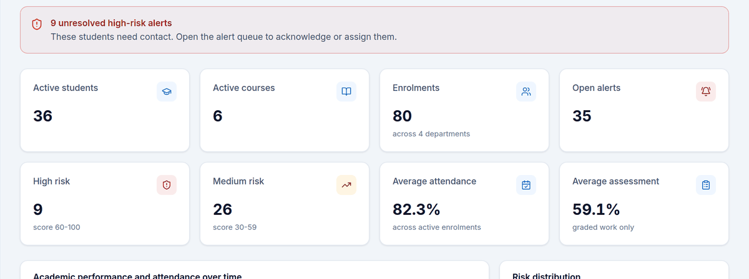
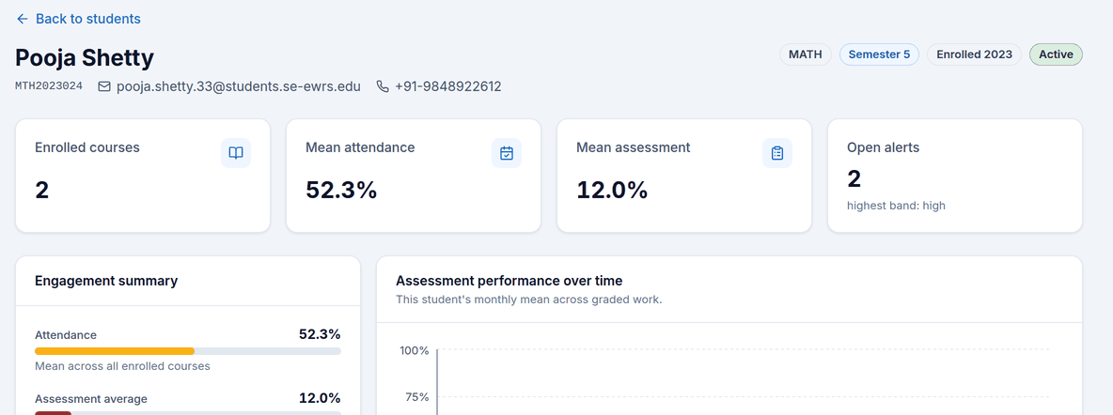
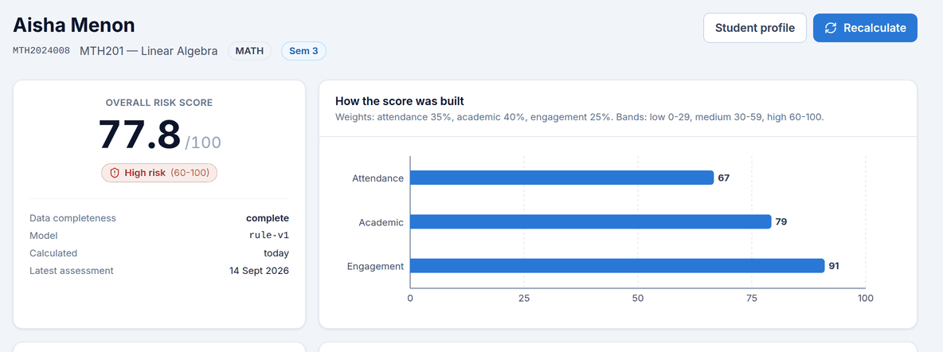
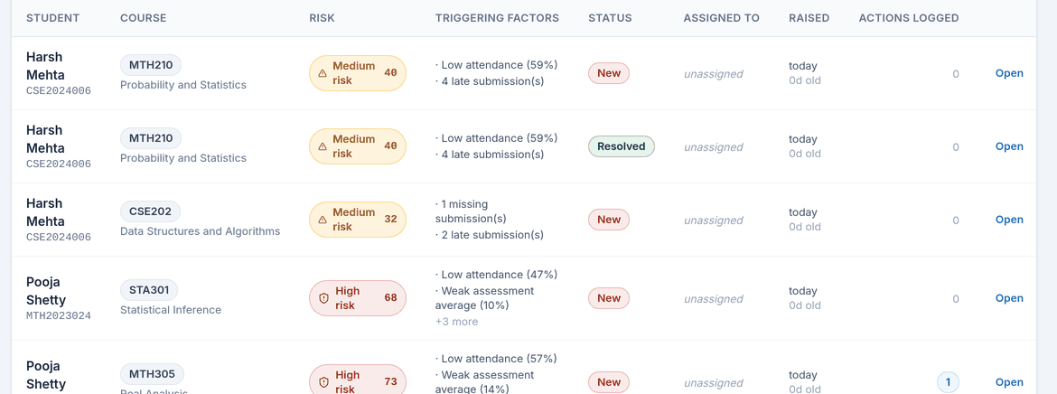
Demo
1 Dashboard: counters and risk overview
2 Student details: Pooja Shetty
3 Risk score: Aisha Menon, 77.8 (High)
4 Alerts: raised automatically
Notes:
Speaker: Sumit (about 2:30)
Thank you, Raja. I will now show the live system. [Log in as the administrator.]
This is the dashboard. It shows 36 students, 6 courses, 80 enrolments and 35 open alerts. The risk distribution is 9 high, 26 medium, 41 low, and 4 that need more data. Every number comes from SQL queries.
[Open Students, set Risk band to High, open Pooja Shetty.] This is a student profile. Pooja's attendance is 52.3% and her assessment average is 12%, so both of her courses are high risk.
[Open Risk analysis, then Aisha Menon in MTH201.] Here we see exactly how the score was built. Aisha scores 77.8 out of 100, which is high risk. The reasons are listed: 33% attendance, weak marks, 4 missing submissions and no online activity for 24 days.
[Open Alerts.] This is the alert queue. These alerts were created automatically. Staff can open an alert, move it from New to Acknowledged, In Progress and Resolved, and record an intervention such as a counselling session.

Slide 8

Conclusion
What we achieved
Future work
A working web app with five staff roles
A MySQL database: 16 tables, views, procedures and triggers
Clear risk scores with reasons, and automatic alerts
624 automatic tests; checked on a real MySQL 8 server
Connect directly to a real learning portal (LMS)
Send alerts by email or SMS
A separate view for students
Try machine-learning prediction next to the rule-based score
Thank you! Questions?
Notes:
Speaker: Sumit (about 0:45)
To conclude: we built a working web application on a MySQL database with 16 tables, views, procedures and triggers.
It gives clear risk scores with reasons, raises alerts automatically, and supports five staff roles. We tested it with more than 600 automatic tests and checked it on a real MySQL 8 server.
In the future, it could connect directly to a real learning portal, send email or SMS alerts, offer a view for students, and try machine-learning prediction next to our rule-based score.
Thank you. We are happy to answer your questions.

