Slide 1
Olist
Inventory Optimization

Slide 2
Agenda
Objective
Background
Data Cleaning
Key Findings
Recommendations
Appendix

Slide 3
Objective
Analyse the purchase behavior of the Olist customers and identify :
The top selling and least selling product categories by quantity and revenue.
The combinations of product categories frequently ordered together.
Action points to reduce the inventory cost.

Slide 4
Background
Olist, an E-commerce company faced losses recently due to high inventory costs.
To improve the profits and reduce losses, the company wants to optimize the inventory based on customer purchase behavior.
Company aims to get rid of the least selling products from inventory without any impact on the business.

Slide 5
Data Cleaning
The rows with missing values were identified and imputed with appropriate values.
The outliers were treated.
The analysis was done using Python and Tableau.

Slide 6
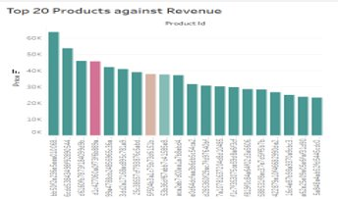
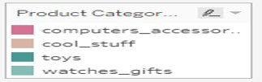
Top selling products by Revenue
The top selling products are listed in the chart.
Among the top 20 products based on Revenue, 17 of them belong to the ‘Toys’ category.
The other categories are ‘Computer accessories’ ,’Cool Stuff’ and ‘Watches_gifts’.

Slide 7
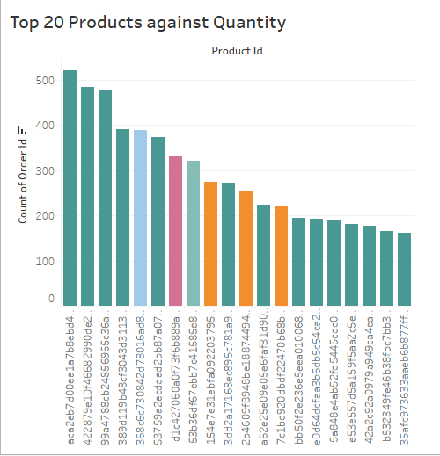
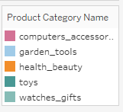
Top selling products by Quantity
The top selling products are listed in the chart.
Among the top 20 products based on Quantity, 14 of them belong to the ‘Toys’ category.
The other categories are ‘Computer accessories’ ,’garden_tools’,'health_beauty' and ‘Watches_gifts’.

Slide 8
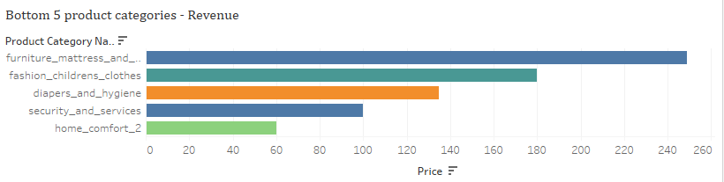
Least selling Product Categories by Revenue and Quantity
Home_comfort_2
Security_and_services
diapers_and_hygeine
fashion_childrens_clothes
furniture_mattress_and_upholestry

Slide 9
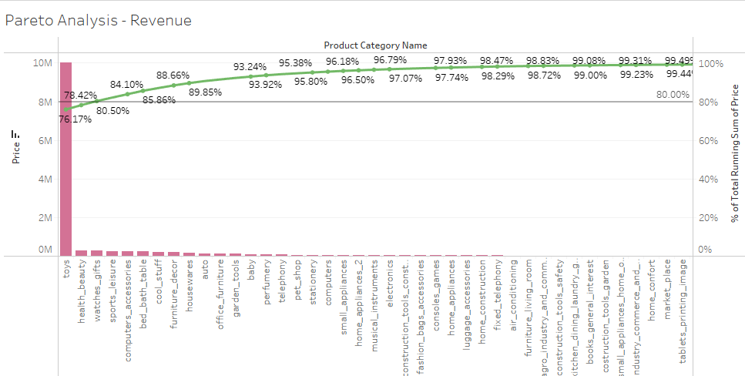
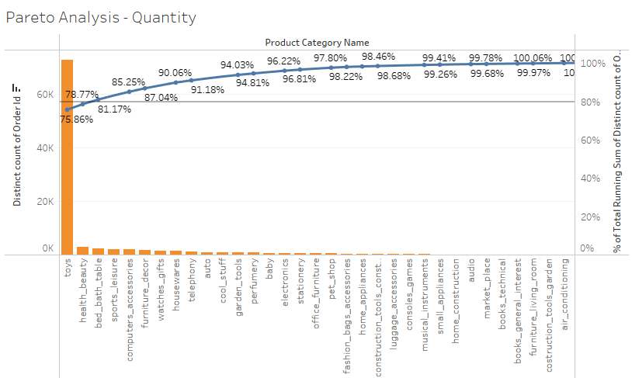
Pareto Analysis – Revenue and Quantity
'Toys' and 'Health_beauty' product categories account for 80 percent of sales in terms of both Revenue and Quantity.

Slide 10
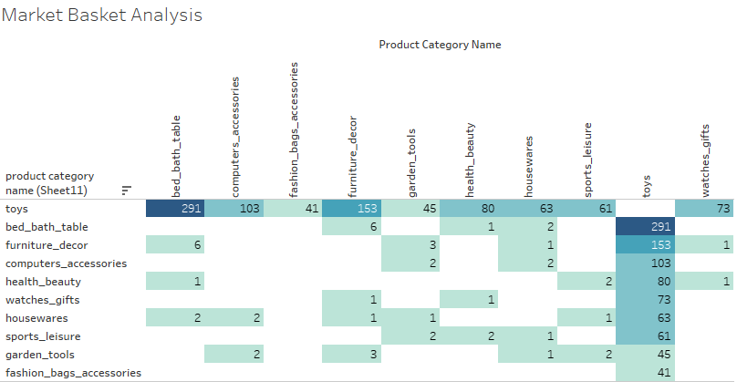
Top Product combinations
‘Toys’ and ‘Bed_bath_Table’ combination is the most frequently ordered combination.
‘Toys’ and ‘Furniture_décor' is the second most ordered combination.
It is followed by ‘Toys’ and ‘Computer Accessories’.

Slide 11
Key Findings
Top Selling Product Categories :
Toys
Computer_Accessories
Watches_gifts
Health_beauty
Most Preferred product Combinations:
Toys and Bed_bath_Table
Toys and Furniture_décor
Toys and Computer Accessories
Least Selling Product Categories:
Home_comfort_2
Security_and_services
Diapers_and_hygeine
Fashion_childrens_clothes
Furniture_mattress_and_upholestry

Slide 12
Recommendations
The company should focus more on the top selling product categories.
The most preferred product combinations need to be stocked up and listed among suggestions.
The company can either have less stock or can even completely remove the least selling product categories to save on inventory cost.

Slide 13
Appendix - Data Methodology
Thorough analysis was done on the dataset using below methodologies.
Understanding the data
EDA
Data Visualization
Interpretations
Reference
Detailed Methodology Document

Slide 14
Thank You

