Slide 1
DISEASE PREDICTION SYSTEM USING MACHINE LEARNING
Department of Computer Science & Engineering
Final Project Review | Department of Computer Science & Engineering
TEAM MEMBERS
2420030696 – SUMITH
2420030779 – DEEPAK
2420030779 – SAI TEJA
Guide: Dr. N. Sunanda, Project Guide | Academic Year: 2026–27
Notes:
Introduce the project, team and guide.

Slide 2
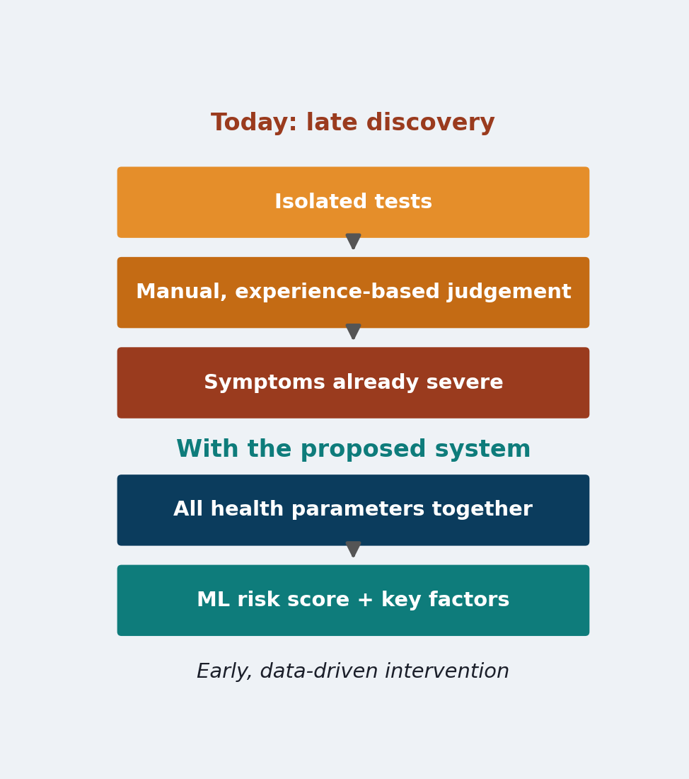



Introduction & Problem Statement
Background
Chronic diseases such as diabetes and heart disease are leading causes of illness, and machine learning can find risk patterns in routine patient data.
Problem Statement
Patients often learn of a chronic condition only when symptoms are severe, because checkups rely on isolated tests and manual judgement, not a consolidated risk assessment.
Motivation / Need
Patients and clinicians get early warnings and time to act; without it, diagnosis stays late and treatment becomes harder and costlier.
Notes:
Explain why late disease discovery is a problem and who benefits from early prediction.

Slide 3


Objectives & Scope
Objectives
1
Design and train ML classifiers (Logistic Regression, SVM, Random Forest) to predict disease risk from patient health parameters.
2
Achieve at least 85% accuracy, reporting precision, recall and F1-score per disease on UCI/Kaggle benchmark datasets.
3
Develop a web interface that returns a risk prediction with a confidence score in under 3 seconds.
4
Validate on multiple diseases and data sources so the design extends to new conditions with minimal rework.
Notes:
State the four objectives, including the 85% accuracy and under-3-second targets.

Slide 4

Literature Survey
S.No | Author(s) & Year | Method / Technique | Key Findings | Limitation / Gap
1 | Smith et al., 1988 | ADAP neural learning on Pima data | Forecast diabetes onset with ~76% sensitivity and specificity | Single disease; small dataset
2 | Detrano et al., 1989 | Probability algorithm on multi-site heart data | Validated coronary-disease diagnosis across international sites | Single disease; research tool only
3 | Ramana et al., 2011 | Classifier comparison on liver patient data | Showed ML can aid liver-disease diagnosis | Separate model for each disease
4 | Breiman, 2001 | Random Forest ensemble | Robust accuracy with feature-importance scores | Not packaged as an end-user tool
Research Gap
Existing work targets one disease, uses narrow features, gives black-box output and rarely offers a usable interface. Our objectives close this gap with a unified, explainable, web-based pipeline.
Notes:
Summarise the four studies and end on the research gap.

Slide 5





Proposed System & Methodology
STEP 1
STEP 2
STEP 3
STEP 4
STEP 5
Define Problem
Collect Data
Design
Implement
Test & Evaluate
Early disease risk from patient parameters.
UCI Heart (303) and Pima Diabetes (768), CSV.
Preprocess, then LR / SVM / Random Forest.
scikit-learn pipelines in 4 modules.
Accuracy, F1, ROC-AUC, 5-fold CV.
Key Novelty / Contribution
One shared preprocessing and model-selection pipeline serves several diseases, combines vitals, labs and lifestyle inputs, and reports the top contributing factors with every prediction.
Notes:
Walk through the five steps left to right, then state the novelty.

Slide 6
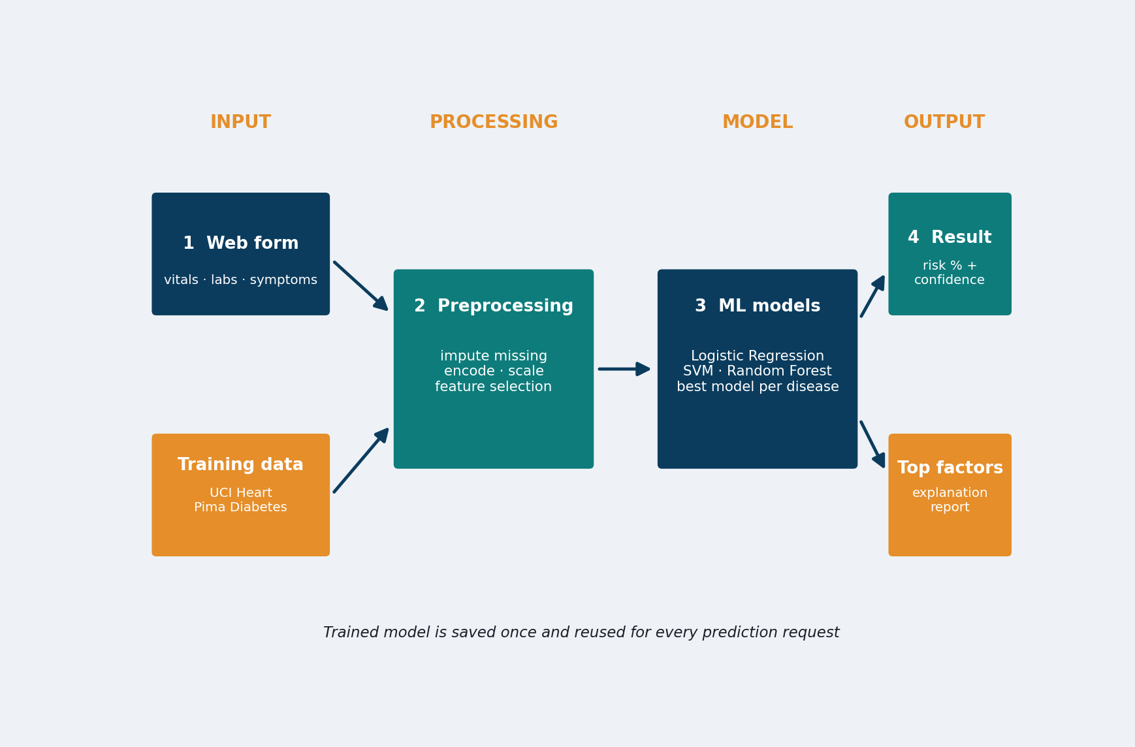
System Architecture
Components
1
Web Input Form
Collects vitals, labs, symptoms
2
Preprocessing
Imputes, encodes, scales
3
ML Model Layer
LR, SVM, Random Forest
4
Result & Explanation
Risk %, confidence, top factors
Notes:
Explain the flow: input form, preprocessing, ML models, result with explanation.

Slide 7


Hardware & Software Requirements
Hardware
Software & Tools
Libraries / Frameworks
Laptop / PC: multi-core CPU, 8 GB RAM
Storage: about 2 GB free disk
GPU not required (classical ML)
Internet for datasets and packages
OS: Windows 10/11 or Linux
Language: Python 3
Jupyter Notebook / VS Code
Git and GitHub
scikit-learn 1.8, pandas 3.0
NumPy, Matplotlib 3.10, Seaborn 0.13
Flask (web interface)
joblib (saved model); no database
Deployment / Platform: Local Flask web server; can move to cloud hosting
Notes:
Mention that classical ML needs no GPU; all libraries are open source.

Slide 8
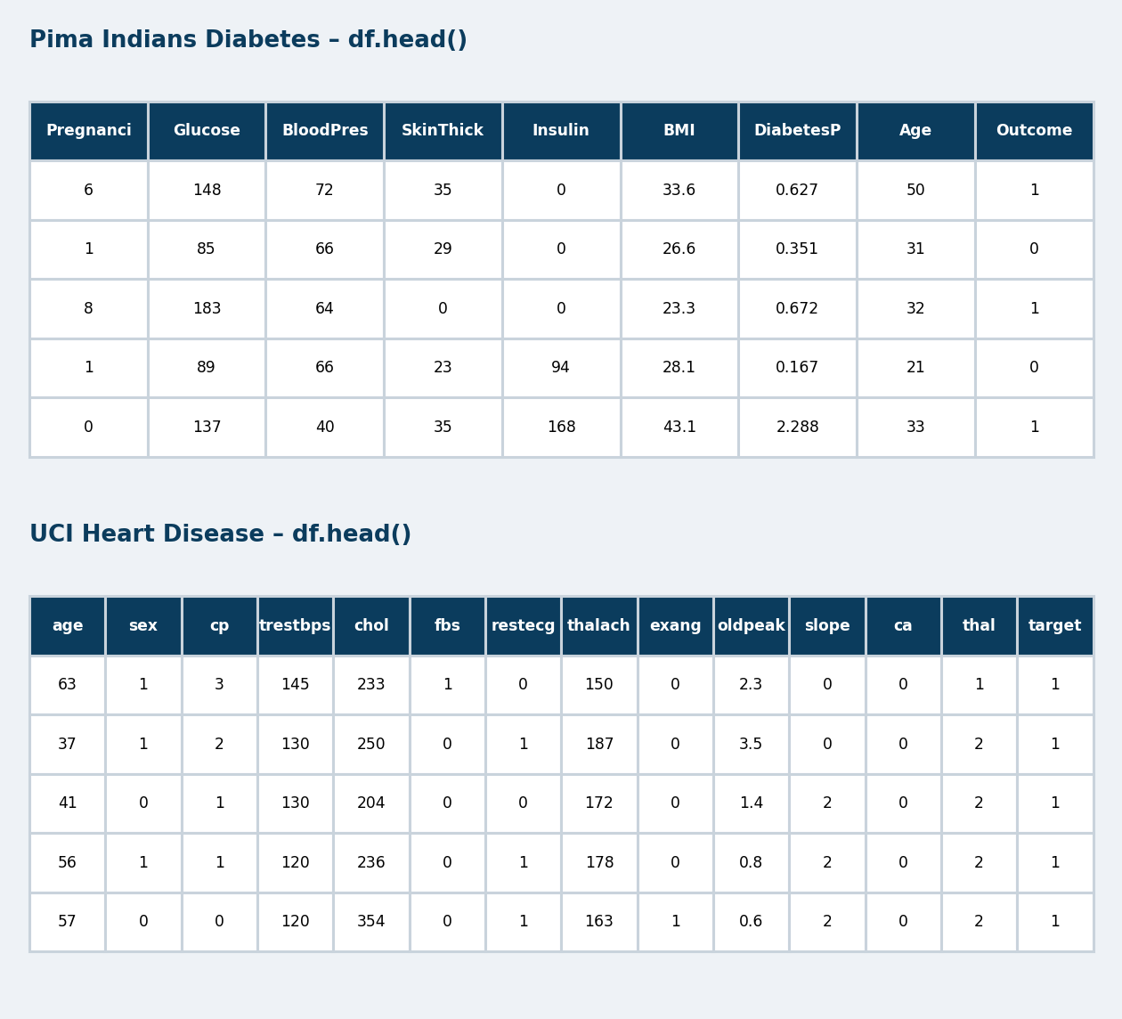
Dataset / Data Understanding
1,071
8 + 13
Records (Pima + Heart)
Features (Pima + Heart)
652
2
Missing values (Pima)
Target classes (binary)
Source: UCI Heart Disease (303) and Pima Indians Diabetes (768)
Features: vitals and lab values; target = disease / no disease
Quality: 652 hidden zeros in Pima, 1 duplicate in Heart, 35% diabetic cases
Notes:
Two public datasets: Pima Diabetes and UCI Heart Disease. Point out the hidden zeros in Pima.

Slide 9
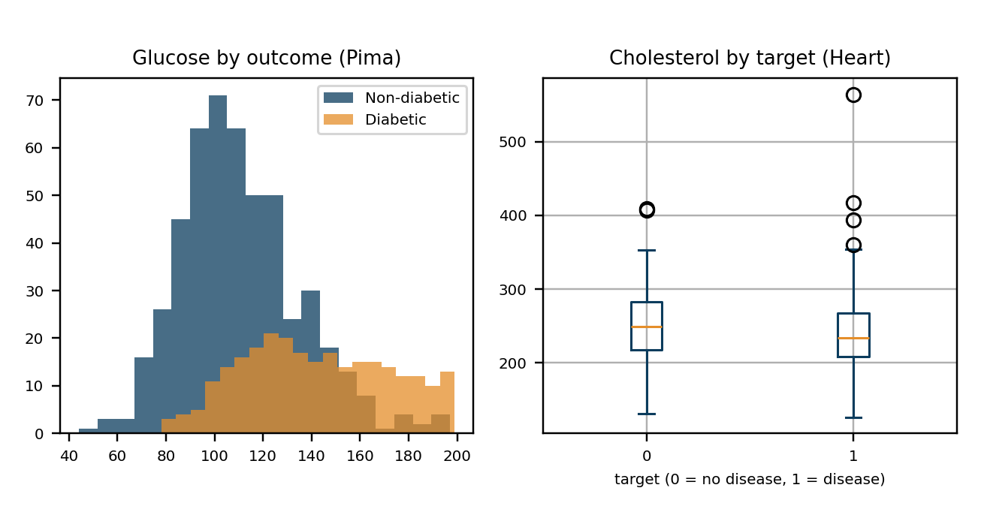
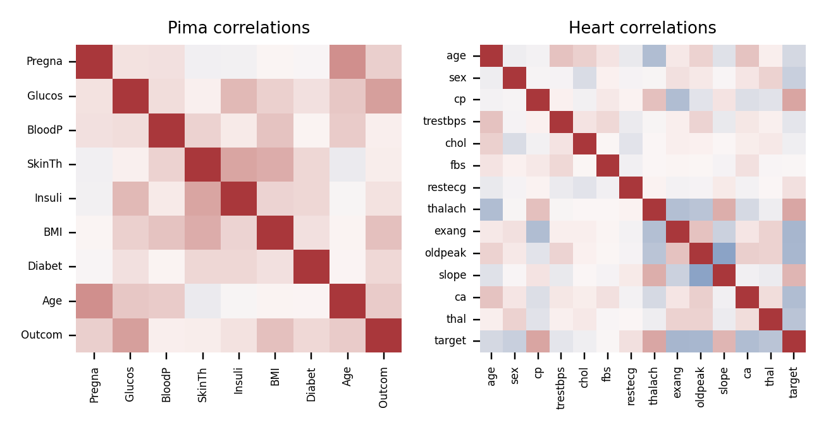



Data Preprocessing & Exploratory Analysis
Cleaning
Transformation
Feature Selection
Pima zeros in glucose, BP, skin, insulin, BMI treated as missing and median-imputed.
Numeric features standardised (StandardScaler); stratified 80/20 train–test split.
All 8 (Pima) and 13 (Heart) inputs kept; Random Forest importance ranks them.
Notes:
Show what the distributions and correlations revealed and how data was cleaned.

Slide 10
Module-wise Description
1
Data Acquisition & Preprocessing
2
Model Training & Evaluation
Purpose: Load datasets, clean, impute, scale
Input → Output: Raw CSV → model-ready features
Developed by: Sumith
Purpose: Train LR, SVM, RF; compare metrics
Input → Output: Features → trained model + scores
Developed by: Sumith & Deepak
3
Prediction & Explanation Engine
4
Web Interface
Purpose: Return risk %, confidence, top factors
Input → Output: Patient values → risk + reasons
Developed by: Deepak
Purpose: Form input and result display (Flask)
Input → Output: User entries → on-screen report
Developed by: Sai Teja
Notes:
Each module has one owner; every member should explain their own module.

Slide 11

Algorithms & Technologies Used
Logistic Regression
Support Vector Machine
Random Forest
Why chosen
Fast, interpretable baseline for binary risk.
Key parameters
max_iter = 1000, L2 penalty
Why chosen
Handles non-linear boundaries on small data.
Key parameters
RBF kernel, C = 1.0, probabilities on
Why chosen
Robust ensemble with feature importance.
Key parameters
200 trees, random_state = 42
Selection criteria: best ROC-AUC and recall on hold-out set, checked with 5-fold CV; Random Forest chosen
Notes:
Say why each algorithm was chosen and how the final one was selected.

Slide 12
Implementation / Model Building
Feature Selection
Code snippet / pseudocode
All clinical inputs kept (8 Pima, 13 Heart); importance used to explain.
# Key code: model building
X_train, X_test, y_train, y_test = \
train_test_split(X, y, test_size=0.2,
random_state=42, stratify=y)
pipeline = Pipeline([
("prep", impute_and_scale),
("model", RF(n_estimators=200))
])
pipeline.fit(X_train, y_train)
Preprocessing Pipeline
Median imputation → standard scaling → classifier.
Data Splitting
Stratified 80/20: Heart 242/61, Pima 614/154; plus 5-fold CV.
Configuration
RF 200 trees; SVM RBF, C=1; LR max_iter 1000; seed 42.
Notes:
Describe the build in order: split, preprocess, train. Show the key code only.

Slide 13
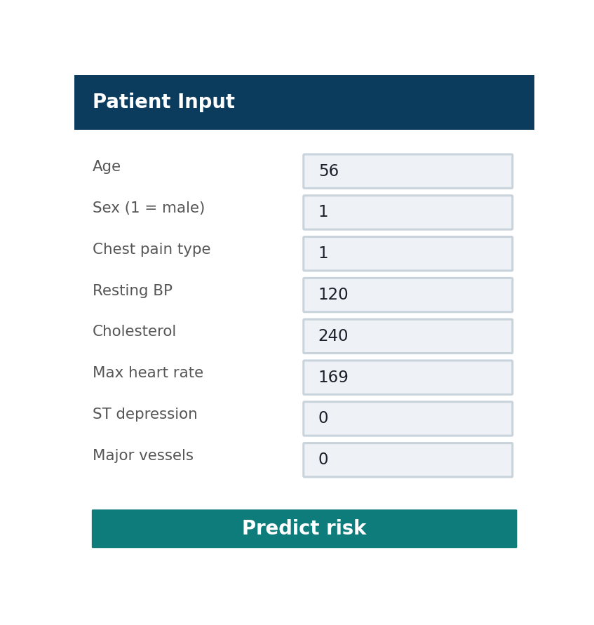
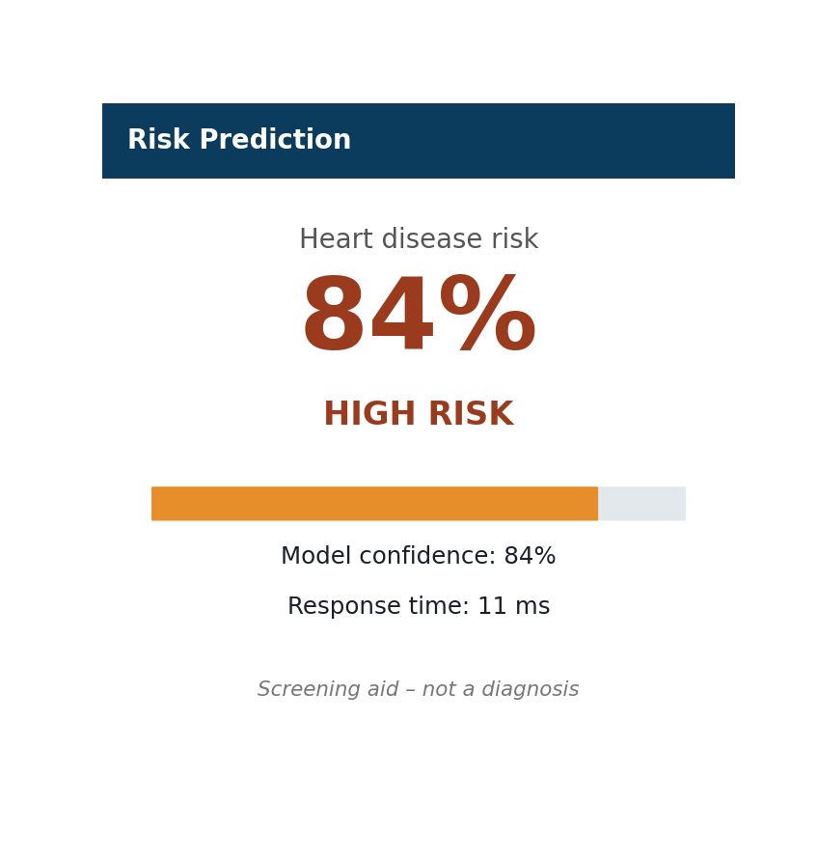
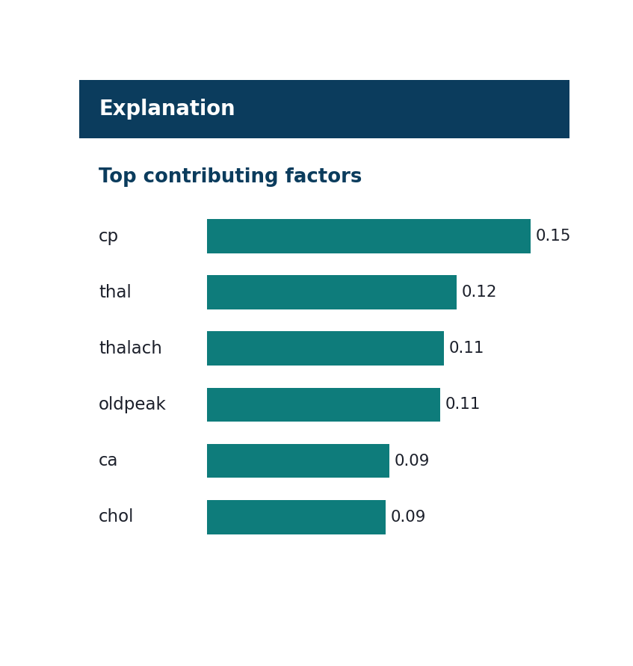
Working Prototype / Output Screens
Patient Input
Vitals and lab values entered by the user
Risk Prediction
Risk %, confidence and response time
Explanation
Top factors driving the prediction
Notes:
Walk through the three screens: input, prediction, explanation.

Slide 14
Results & Performance Comparison
Metric | Log. Reg. | SVM (RBF) | Rand. Forest
Accuracy | 0.80 | 0.82 | 0.82
Precision | 0.77 | 0.78 | 0.76
Recall | 0.91 | 0.94 | 0.97
F1-score | 0.83 | 0.85 | 0.85
ROC-AUC | 0.87 | 0.88 | 0.91
Best: Random Forest – ROC-AUC = 0.91
Hold-out test set: UCI Heart Disease, 61 patients. Pima Diabetes (154 patients): Random Forest accuracy 0.75, ROC-AUC 0.82.
Notes:
Heart disease results on the 20% hold-out set. Random Forest has the best ROC-AUC.

Slide 15
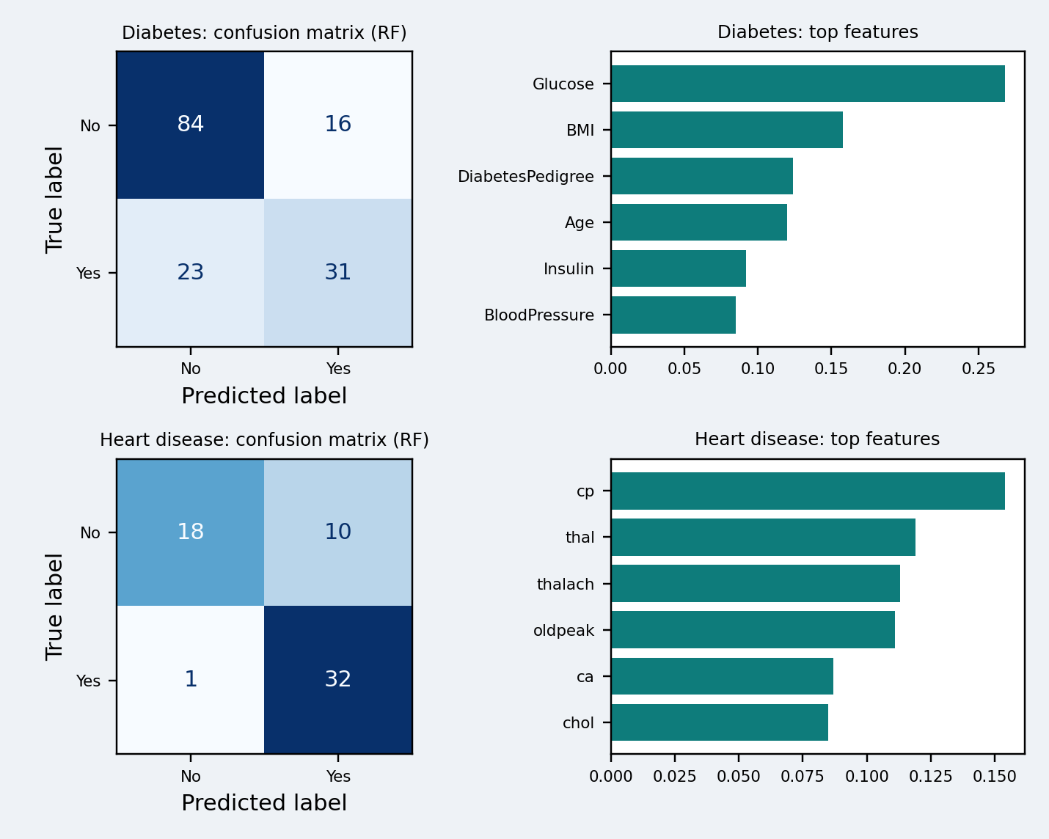
Analysis & Key Findings
91.2%
Best ROC-AUC, achieved by Random Forest (heart disease)
Interpretation: Heart: recall 0.97 and accuracy 0.82; diabetes: accuracy only 0.75.
Error analysis: Diabetes misses 23 of 54 true cases; heart gives 10 false alarms, 1 miss.
Key drivers: Glucose, BMI (diabetes); chest pain, thal, max heart rate (heart).
Notes:
Be candid: diabetes accuracy is only 75%, many true cases are missed.

Slide 16

Testing & Validation
Test ID | Test Description | Expected Result | Actual Result | Status
TC-01 | Load Pima and Heart datasets | 768 and 303 records | 768 and 303 loaded | Pass
TC-02 | Handle hidden missing values (Pima zeros) | No NaN reaches model | 652 imputed, none left | Pass
TC-03 | Single-prediction response time | Under 3 s | About 11 ms (median) | Pass
TC-04 | Accuracy against 85% target | 85% or higher | Heart 82%, Diabetes 75% | Fail
Functional Testing
Validation Method
Performance Testing
Data loading, preprocessing and prediction checked end to end
20% stratified hold-out plus 5-fold cross-validation
Accuracy, precision, recall, F1, ROC-AUC and response time measured
Notes:
Three tests pass; the 85% accuracy target is not yet met.

Slide 17


Challenges & Limitations
Challenges Faced
Limitations
Hidden zeros in Pima data → treated as missing, median-imputed
Small datasets risk overfitting → stratified split and 5-fold CV
Black-box trust → top factors shown with each prediction
Only two public datasets (303 and 768 records); liver data not yet trained
Accuracy below the 85% target (heart 82%, diabetes 75%)
Not clinically validated: a screening aid, not a diagnosis
Notes:
Pair each challenge with its fix and name the limitations openly.

Slide 18

Conclusion
Built a multi-disease ML pipeline (LR, SVM, Random Forest) on UCI Heart and Pima Diabetes data, with a web prediction interface.
1
Final Outcome
Random Forest led: heart 82% accuracy, 0.91 AUC; diabetes 75% accuracy, 0.82 AUC. This is below the 85% target.
82%
2
Best test accuracy: heart disease, Random Forest
Objectives achieved: 3 of 4 (85% accuracy target not met)
Prediction takes about 11 ms (target under 3 s), and the reusable pipeline can add new diseases such as liver disease.
3
Notes:
Revisit each objective: 3 of 4 achieved; the accuracy target remains open.

Slide 19



Future Scope & Applications
Improve Performance
Tuning, XGBoost / ensembles, class balancing
Applications
Screening support in clinics and hospitals
Telemedicine pre-consultation checks
Patient-facing health-check apps
Adopters: clinicians, health-tech firms, insurers
Expand Data / Features
Add liver and other diseases, larger multi-centre data
Deploy & Build an Interface
Cloud-hosted web or mobile app with a REST API
Scale & Secure
Patient-data privacy, authentication, reliable hosting
Notes:
Concrete next steps tied to the limitations, then real-world uses.

Slide 20
Team Contribution
Reg. No. | Name | Contribution / Modules Handled
2420030696 | SUMITH | Module 1 (data and preprocessing), Module 2 (with Deepak), literature survey, report sections 1–3
2420030779 | DEEPAK | Module 2 (model training), Module 3 (prediction engine), results analysis, testing
2420030779 | SAI TEJA | Module 4 (web interface), integration, demo preparation, slides and report formatting
Notes:
Each member can answer questions on their own modules.

Slide 21

References
[1] J. W. Smith, J. E. Everhart, W. C. Dickson, W. C. Knowler, and R. S. Johannes, “Using the ADAP learning algorithm to forecast the onset of diabetes mellitus,” in Proc. Symp. Comput. Appl. Med. Care, 1988, pp. 261–265.
[2] R. Detrano et al., “International application of a new probability algorithm for the diagnosis of coronary artery disease,” Am. J. Cardiol., vol. 64, no. 5, pp. 304–310, 1989.
[3] B. V. Ramana, M. S. P. Babu, and N. B. Venkateswarlu, “A critical study of selected classification algorithms for liver disease diagnosis,” Int. J. Database Manag. Syst., vol. 3, no. 2, 2011.
[4] L. Breiman, “Random forests,” Mach. Learn., vol. 45, no. 1, pp. 5–32, 2001.
[5] F. Pedregosa et al., “Scikit-learn: Machine learning in Python,” J. Mach. Learn. Res., vol. 12, pp. 2825–2830, 2011.
Project Links
GitHub: Team repository (link to be added)
Dataset: archive.ics.uci.edu (UCI Repository)
Demo video: Shown live during the presentation
Notes:
IEEE style references.

Slide 22
THANK YOU
Questions & Discussion
Team: Sumith, Deepak, Sai Teja
Guide: Dr. N. Sunanda, Dept. of Computer Science & Engineering
Notes:
Leave this slide up during questions.

