Slide 1
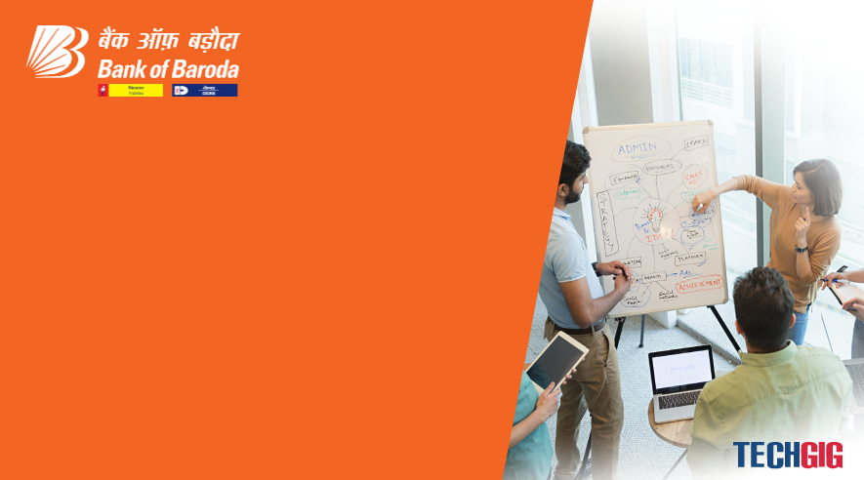

Bank of Baroda Hackathon - 2022
Technology Partner
Your Team Name : CODE BOTS
Your team bio :To improve technical skills and to provide efficient solutions for regarding queries with team efforts.
Date : 19/09/2022

Slide 2
Problem Statement?
Why did you decide to solve this Problem statement?
In current days everything is digitalised including the banking sector. But the cheque frauds are being happened by imitating the signature of the original signature holder. This leads to a great loss for everyone who is dealing with it. With our knowledge and skills we would give a solution for this as we have more knowledge and aware about this sector.

Slide 3
User Segment & Pain Points
Which user /advertiser segment would be early adopter of your product & why?
USER SEGMENT
The Signature of the customer who has account with the bank is first stored in the database and verified whenever needed.
In a situation where the bank needs to check the signature in the cheque who brought the cheque, the signature which is stored in the database is being compared and scanned with that.
If it matches, then the cheque is valid orelse it would be invalid and proceeded to further action.
PAIN POINTS
Sometimes cheque gets bounced and manual process takes too much time.

Slide 4
Pre-Requisite
What are the alternatives/competitive products for the problem you are solving?
Signature of the candidate
A graph with crest and trough to position it accordingly.
To verify the signature, a scanner to scan and an AI tool to compare the signature with the original signature which is given by the customer.

Slide 5
Azure tools or resources
Azure tools or resources which are likely to be used by you for the prototype, if your idea gets selected cloud based resources are used for storing and comparing signatures for the customers # Segmentation of cheque # Handwritten text extraction from cheque using OpenCV to crop # Signature future extraction and verification – PCA (Principle Component Analysis) # CNN model for signature identification

Slide 6
Any Supporting Functional Documents
Present your solution, talk about methodology, architecture & scalability
We have to develop a model to verify the bank cheques using OCR,CNN,SIFT and SVM. We should use Optical Character Recognition to identify the typographic characters with accuracy and efficiency.
In addition we need to perform CNN(Convolutional Nueral Network) give precise output for handwritten digits on the cheque.
Then to apply OCR technique to recognize and to achieve 95% accuracy and to separate a database to train the network and achieve a desired level of accuracy and efficiency and to use different data sets to test the trained models for matching the numbers into words.

Slide 7
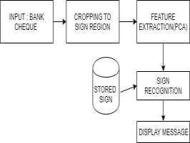
Key Differentiators & Adoption Plan
How is your solution better than alternatives and how do you plan to build adoption?
The only alternative for Automated Cheque processing was manual processing. Manual labour can be reduced by 75%, reduced processing and quality assurance checking times, Service Levels will improve significantly, process standardization will increase.

Slide 8
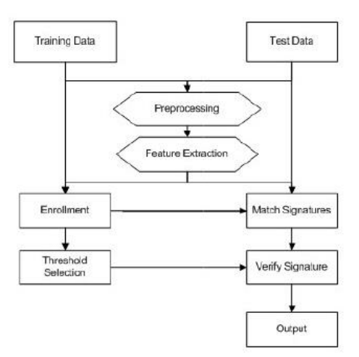
GitHub Repository Link & supporting diagrams, screenshots, if any
How far it can go?

Slide 9
Thank You
SUMITHRA.S
ROSHINI.R
THARUN.V

