Slide 1
Digital Portfolio
STUDENT NAME: SUMITHRA.M
REGISTER NO AND NMID: autunm1667saz241667424
DEPARTMENT: BCA
COLLEGE: MADRAS UNIVERSITY

Slide 2
PROJECT TITLE
DIGITAL PORTFOLIO

Slide 3


AGENDA
Problem Statement
Project Overview
End Users
Tools and Technologies
Portfolio design and Layout
Features and Functionality
Results and Screenshots
Conclusion
Github Link
3/21/2024 Annual Review

Slide 4

PROBLEM STATEMENT
In today’s digital era, having a personal portfolio is essential for students, developers, and professionals to showcase their skills, projects, and achievements. Many people struggle to present their work in an organized and attractive way. A portfolio website solves this problem by serving as a digital resume and personal brand identity.

Slide 5

PROJECT OVERVIEW
This project is a personal portfolio website built with HTML, CSS, and JavaScript. It highlights an individual’s: Introduction and About section Projects with details Skills and achievements Contact form It is simple, responsive, and user-friendly.

Slide 6

WHO ARE THE END USERS?
Students showcasing academic projects Job seekers displaying skills and resumes Freelancers presenting their portfolio Professionals highlighting achievements

Slide 7

TOOLS AND TECHNIQUES
HTML5 → Structure of the website CSS3 → Styling, layout, and responsiveness JavaScript → Interactivity (form handling, smooth scrolling) VS Code → Development environment GitHub → Hosting and version control

Slide 8
POTFOLIO DESIGN AND LAYOUT
Navigation Bar – Home, About, Projects, Contact Hero Section – Name, tagline, and call-to-action button About Section – Introduction and background Projects Section – Display of project cards with descriptions Contact Section – Form with Name, Email, and Message Footer – Copyright notice
8

Slide 9
FEATURES AND FUNCTIONALITY
✅ Responsive design (works on mobile & desktop) ✅ Smooth scrolling between sections ✅ Project cards with hover effect ✅ Contact form (with validation & alert message) ✅ Clean and minimal design

Slide 10
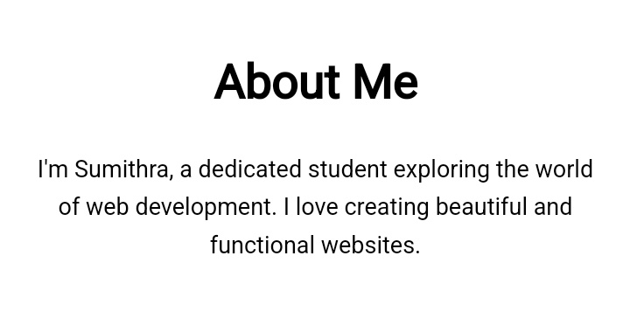
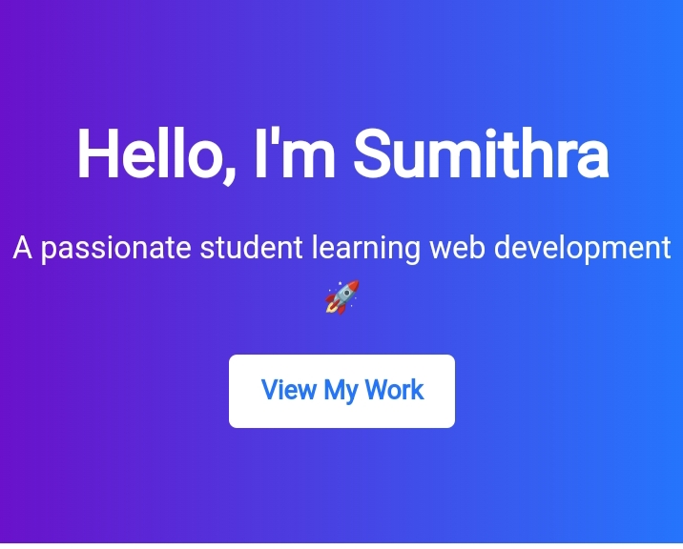
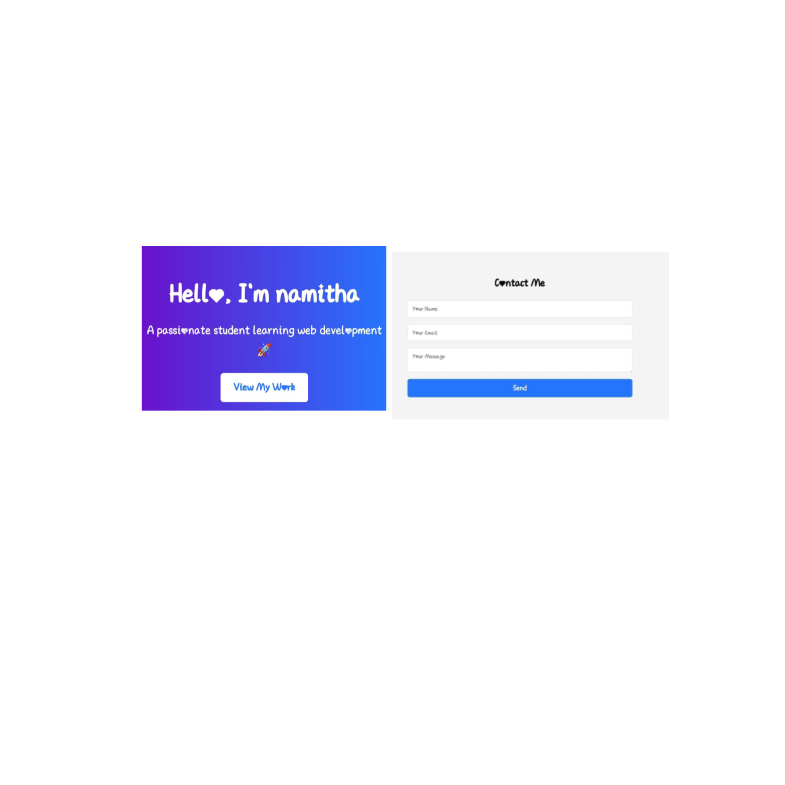

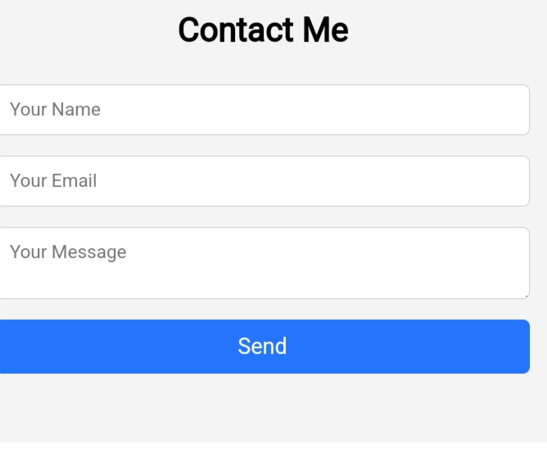
RESULTS AND SCREENSHOTS
3/21/2024 Annual Review
10

Slide 11
CONCLUSION
The portfolio website provides a digital platform to showcase skills and projects in an interactive and professional way. It is lightweight, responsive, and customizable for any student or professional.
11

