Slide 1
Phishing Awareness Training
Understanding Phishing Attacks & How to Stay Safe Online
Presented by:
Sumithra.E

Slide 2
Introduction to Phishing Attack
Phishing is one of the most common cyber attacks today.
It tricks users into sharing sensitive information.
Attackers pretend to be trusted organizations or people.
Phishing attacks mainly target:
Emails
Websites
Messages
Social media.

Slide 3
Types of Phishing Attacks
Email Phishing – Fake emails pretending to be legitimate.
Spear Phishing – Targeted attacks on specific individuals.
Smishing – Phishing through SMS messages.
Vishing – Phishing via phone calls.
Clone Phishing – Copy of a real email with malicious links.
Website Phishing – Fake websites designed to steal data.

Slide 4
Phishing in Email
Fake sender addresses that look real.
Urgent or threatening messages.
Suspicious links or attachments.
Requests for:
Passwords
OTPs
Bank details
Poor grammar or spelling mistakes.

Slide 5
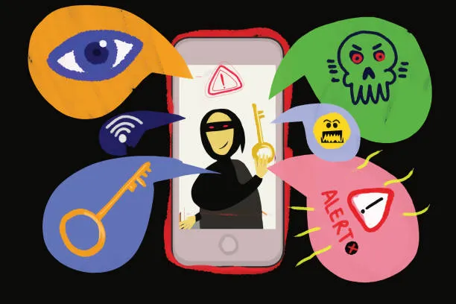
Example of Phishing Attack
Example Email:
“Your bank account will be blocked in 24 hours.
Click here to verify your details.”
Red Flags:
Urgency and fear
Unknown link
Asking for personal information
Fake sender domain

Slide 6
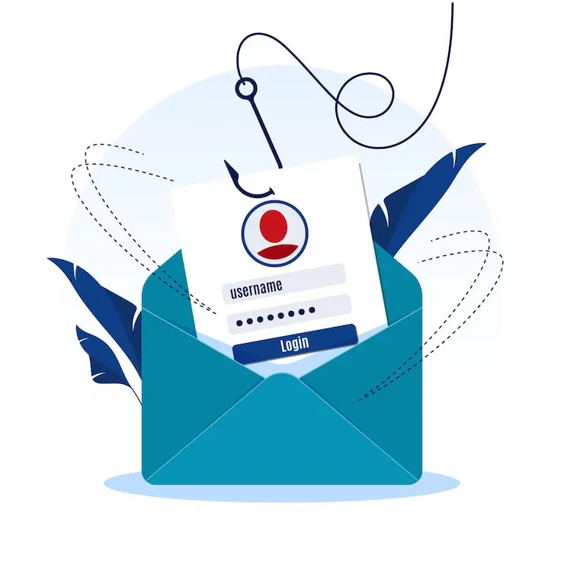
How to Avoid Phishing Websites
Always check the URL carefully.
Look for HTTPS and lock symbol.
Do not click links from unknown sources.
Avoid entering personal details on suspicious sites.
Verify websites through official apps or bookmarks.

Slide 7
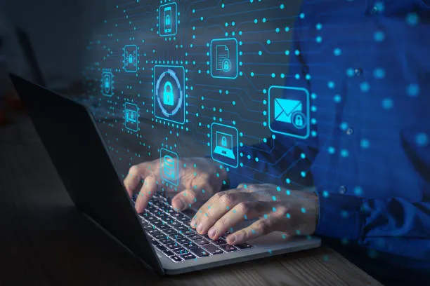
Social Engineering Tactics
Fear: “Your account is compromised”
Urgency: “Immediate action required”
Authority: Pretending to be bank, HR, or government
Trust: Fake rewards or offers
Curiosity: “See who viewed your profile”

Slide 8
Preventive Measures
Use strong and unique passwords.
Enable two-factor authentication (2FA).
Never share OTPs or passwords.
Regularly update software and browsers.
Educate yourself and others about phishing.

Slide 9
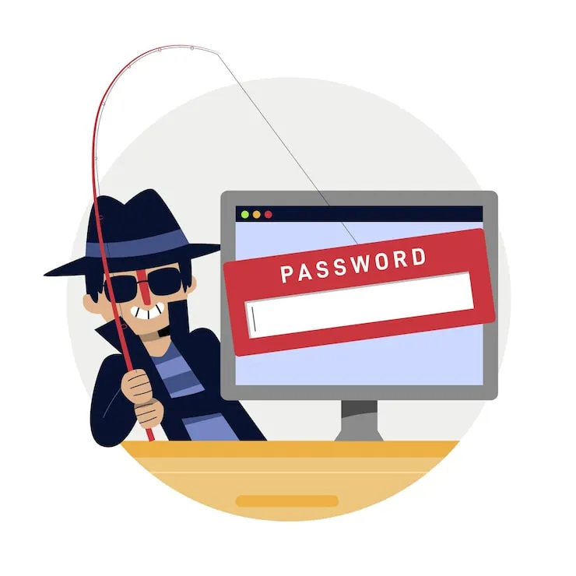
Defending Against Phishing Attacks
Verify emails before responding.
Use email spam filters.
Install security and antivirus software.
Report phishing emails to organizations.
Stay alert and think before clicking.

Slide 10
Tools & Thank You
Anti-Phishing Tools
Google Safe Browsing
Microsoft Defender
Spam Filters
Browser Security Extensions
Email Security Gateways
Thank You
Stay Alert • Stay Secure • Think Before You Click

