Slide 1
Digital Portfolio
STUDENT NAME: SUMITHRA P
REGISTER NO AND NMID: 2422k0222 &46CF226A9A059FE86F64FAEEC0856F6C
DEPARTMENT: Computer Science
COLLEGE: Sri vasavi college/Bharathiyar University

Slide 2
PROJECT TITLE: Student Portfolio

Slide 3


AGENDA
Problem Statement
Project Overview
End Users
Tools and Technologies
Portfolio design and Layout
Features and Functionality
Results and Screenshots
Conclusion
Github Link
3/21/2024 Annual Review

Slide 4

PROBLEM STATEMENT
Students often find it hard to present their skills and achievements effectively. Traditional resumes fail to showcase creativity and projects. A portfolio website is needed to display details in a clear, professional, and attractive way.

Slide 5

PROJECT OVERVIEW
This project is a responsive student portfolio website built using HTML, CSS, and JavaScript. It presents the student’s profile, education details, skills, and project highlights in a structured layout. The webpage features smooth scrolling navigation and a clean, modern design to create a professional online presence. .

Slide 6

WHO ARE THE END USERS?
Employers or recruiters who want to see your skills and projects. College teachers or examiners checking your work for evaluation. Friends or classmates who might want to collaborate with you. Student to update and share your portfolio as you grow.

Slide 7

TOOLS AND TECHNIQUES
HTML – Built the main structure with sections like Profile, Education, Skills, and Projects. CSS – Styled the page with colors, fonts, spacing, and responsive design using Flexbox. JavaScript – Added smooth scrolling and simple interactivity to make navigation user-friendly.
Code editor CODEPEN and hosting platform Github

Slide 8
POTFOLIO DESIGN AND LAYOUT
Header with profile name, and short description. Navigation bar links to About, Education, Skills, and Projects, Sections in cards: About Me, Education, Skills, Projects Clean, responsive design with consistent colors, fonts,
8

Slide 9
FEATURES AND FUNCTIONALITY
Shows my profile picture, name, and short introduction. Menu lets users jump to About, Education, Skills, Projects, Displays education, skills, and projects clearly. Works on all devices with a clean and simple design.

Slide 10
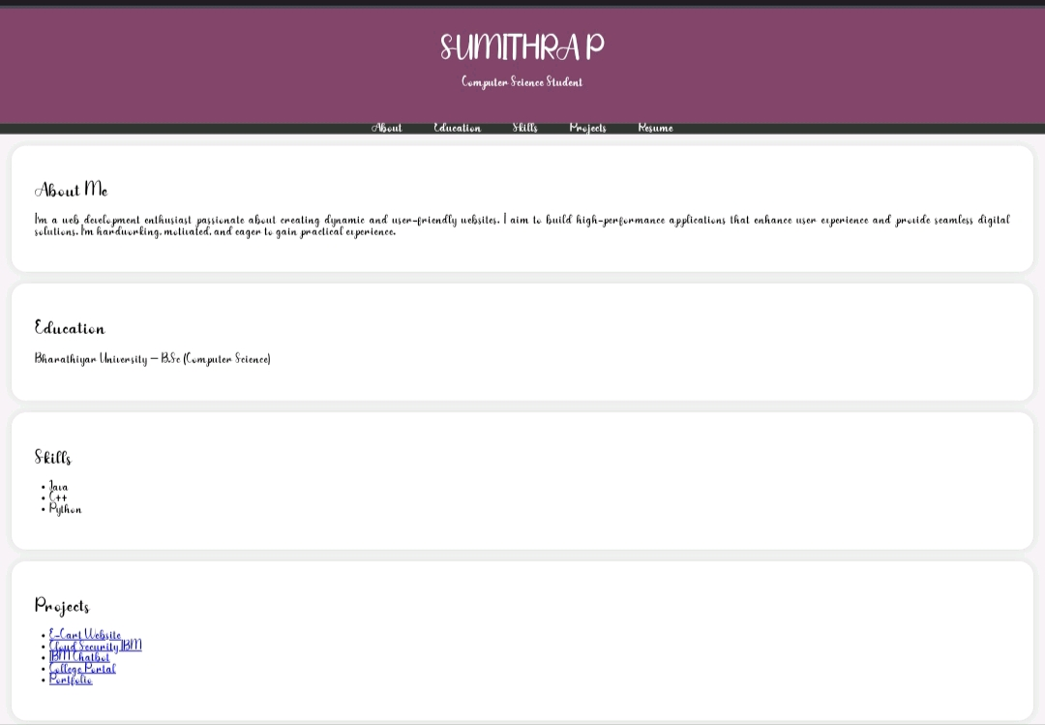

RESULTS AND SCREENSHOTS
3/21/2024 Annual Review
10

Slide 11
CONCLUSION
This student portfolio website effectively showcases personal details, education, skills, projects, and a .It is clean, easy to navigate, and responsive, providing a professional online presence for students to share with recruiters, teachers
11

