Slide 1
(, 14)
JOB-A-THON – AnalyticsVidhya September 2021
Problem Statement – Sales Prediction for one month
Dataset - Train Data 184571 rows X 15 columns (Include Sales as Target)
Test Date 22265 rows X 14 columns
Attributes - ID, Store_id, Store_Type, Location_Type, Region_Code, Date, Holiday, Discount, Order, Sales
Evaluation - The submission will be evaluated using the RMSLE metric.
Sales Prediction
There is two kind of approaches for this problem
Consider all the data set and make general model
Independently predict Sales for each stores
Modelling
Used Pycaret Regression for the modelling
Four base models have been fitted and tuned
Generated Stacking and Blending of the base models
I tried both approaches and found general model would be better since we achieved similar RMSLE for both methods.
Data Pre-processing
Dropped the Order features since we didn’t have it for the test(future) dataset
Created new features from Date: 'year', ‘day’ ,'quarter’, 'month', ‘weekday’ etc.
Since target feature was skewed dropped extreme values based on percentiles
Treated this features as categorical and used Label encoding :
Store_Type, Location_Type, Region_Code, 'Discount', 'weekday', 'Quarter', 'Month‘

Slide 2
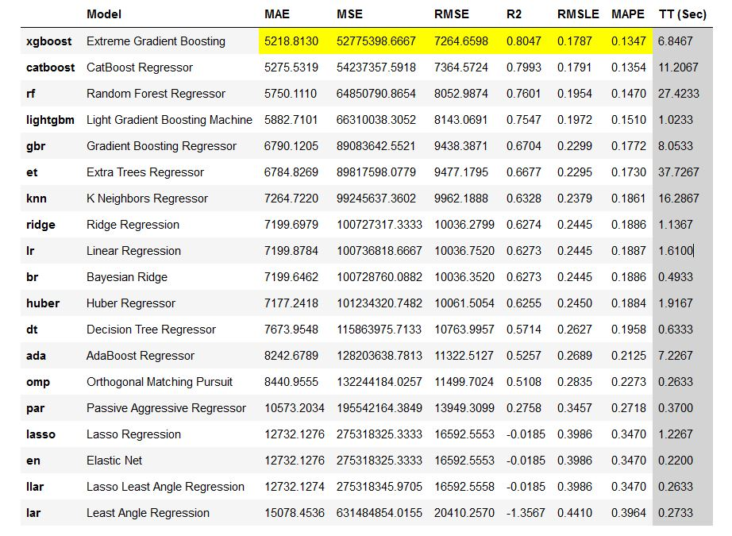
Compare Models :
We use base models as
Extreme Gradient Boosting
CatBoost Regressor
Random Forest Regressor
Light Gradient Boosting Machine

Slide 3
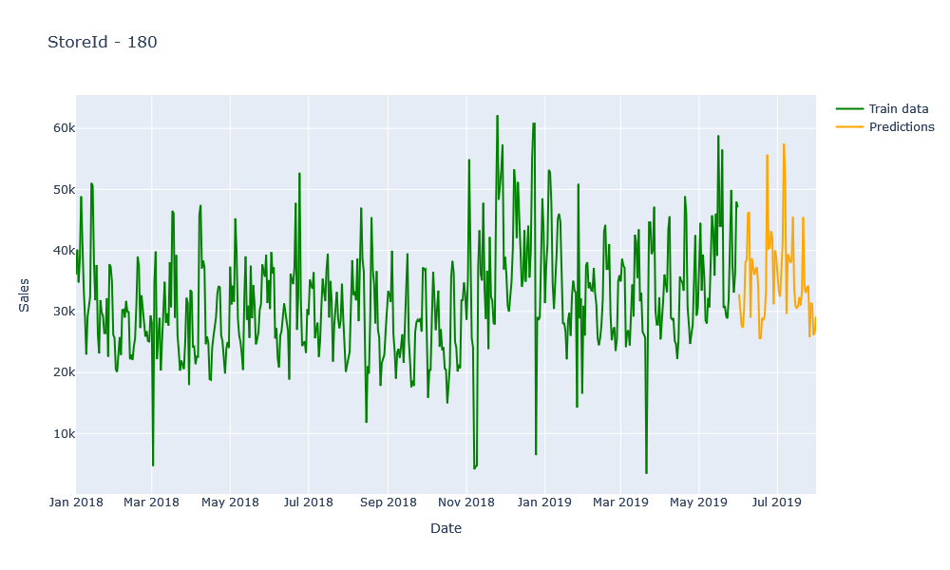
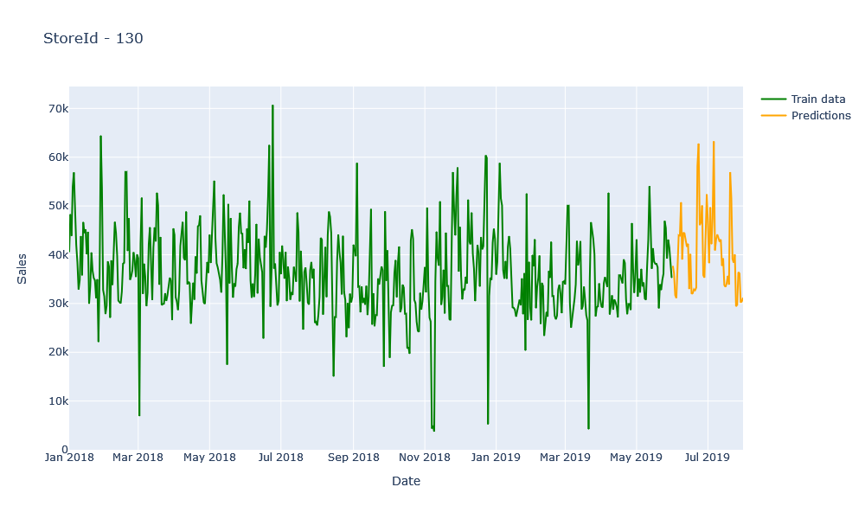
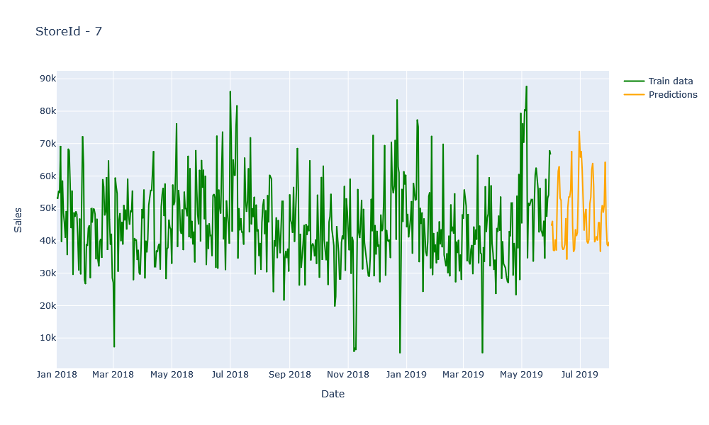
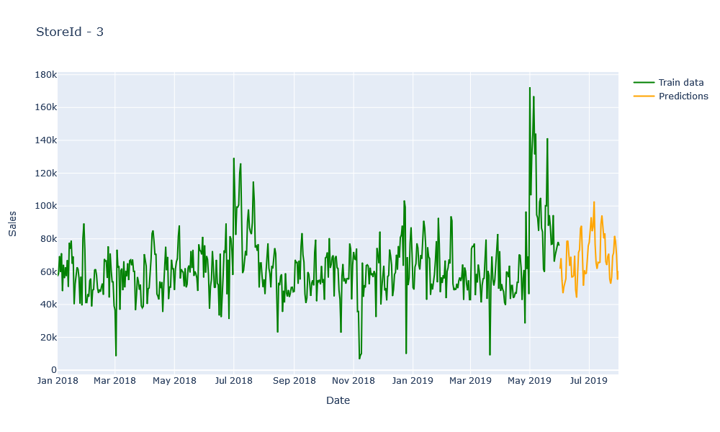
Forecasted Prices for few stores

Slide 4
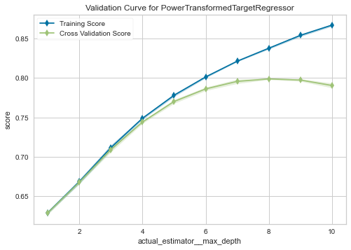
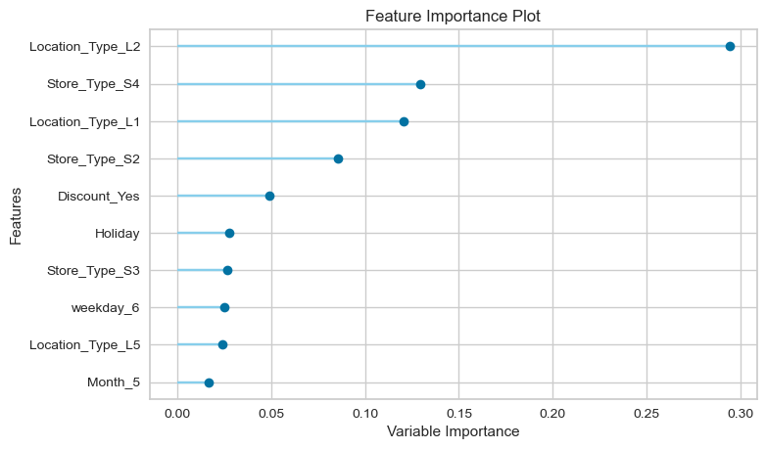
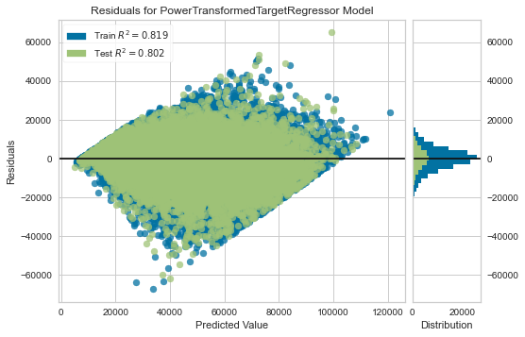
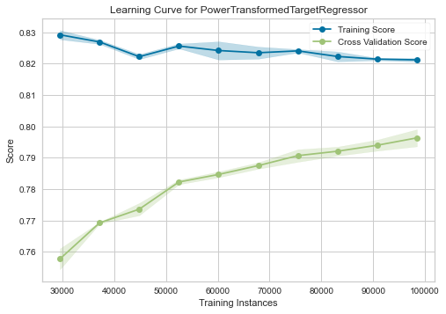
Extreme Gradient Boosting

Slide 5
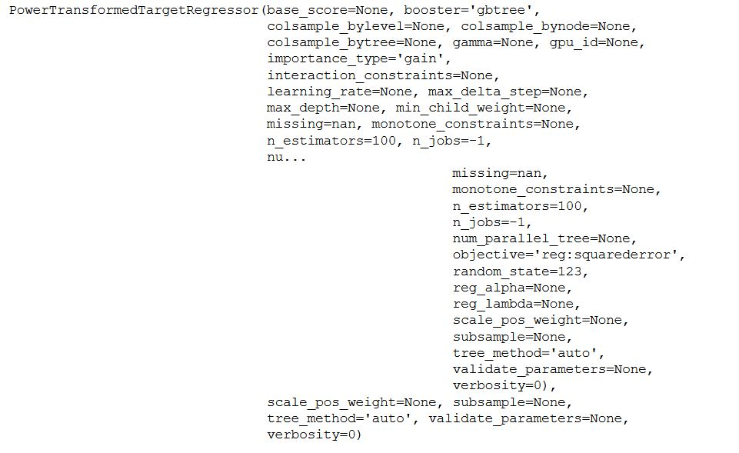
Final Extreme Gradient Boosting Model

