Slide 1
Conceptualizing the design from requirements

Slide 2
Agenda
How to lead the requirement collection effort
Using fit gap analysis
Blueprinting the solution architecture
Notes:
This learning path examines how to capture requirements. It is important to capture the customer’s needs accurately. This learning path explains how to capture requirements and identify functional and non-functional items, perform a fit-gap analysis and blueprint the solution.
It is a discussion heavy session
Note: If you have experienced students, you can decide to skip some of the slides and focus on discussions
Timing: This learning path takes 60 minutes plus 45 minutes for the exercise

Slide 3

Microsoft Learn modules
Propose a solution as a Solution Architect for Microsoft Power Platform and Dynamics 365
https://learn.microsoft.com/training/modules/propose-solution
Work with requirements as a solution architect for Microsoft Power Platform and Dynamics 365
https://learn.microsoft.com/training/modules/work-with-requirements
Perform fit gap analysis
https://learn.microsoft.com/training/modules/fit-gap-analysis
Notes:
Link to student courseware on Learn
Propose a solution as a Solution Architect for Microsoft Power Platform and Dynamics 365
https://learn.microsoft.com/training/modules/propose-solution
Work with requirements as a solution architect for Microsoft Power Platform and Dynamics 365
https://learn.microsoft.com/training/modules/work-with-requirements
Perform fit gap analysis
https://learn.microsoft.com/training/modules/fit-gap-analysis

Slide 4
Where are we in the project?
Project is a go…we are done with pre-sales
Initiate
Design
Implement
Analyze
Deploy
Notes:
The work has been commissioned, we are done supporting pre-sales and now need to turn the vision into an implementation
These stages are only for helping us structure the conversation and don’t imply a methodology, in fact depending on the methodology used e.g. scrum/agile you may visit these stages many times during the project.

Slide 5

What is the most important question you can ask a client?
Notes:
Classroom discussion
WHY???
Knowing the reasons for a request or requirement helps bring out the root problem, not just a feature request

Slide 6
Requirements collection
The most important question that you can ask a client: "Why?"
Notes:
Customer discovery and requirements collection is an ongoing process. Discovery is performed at the pre-sales stage, during project kick-off, and is continued though the iterations of your solution building. Knowing your customer, how they think, and what they need are vital ingredients to the success of a project.
The most important question that you can ask during the requirements gathering process is: "Why?“
Occasionally, however, that question must be asked in different ways. For example, when a customer says, "We need a button on this screen to do this thing," your why question might sound more like, "What do users need to have happen after completing their tasks on this screen?“
https://learn.microsoft.com/training/modules/discover-customer-needs/1-introduction
https://learn.microsoft.com/training/modules/work-with-requirements/2-capture-sessions
Note: This Learn module is essentially the group exercise that the students will undertake at the end of this learning path.

Slide 7
Solution Architect role at this point
Lead the discussions to evolve requirements to a level that a concrete solution can be designed
Identify the high-level components of the solution
Identify and create boundaries of what is in and out of scope and what integration is required
Propose proofs of concept to mitigate risk and/or provide needed clarification of proposed approaches

Slide 8
Evaluating requirements
How complete are they?
Look for common requirement problems
Look for gaps. What hasn’t been included?
Are regulatory, compliance and security requirements included and clear?
Develop a plan with the team to fill in the gaps and get to a point where you have usable requirements

Slide 9
What makes a good requirement?
Notes:
Classroom discussion
WHY???
Knowing the reasons for a request or requirement helps bring out the root problem, not just a feature request

Slide 10
Good requirements are…
Clear
Actionable
Feasible
Testable

Slide 11
Ensure clear requirements
Necessity
The requirement is not optional.
Cohesiveness
The requirement is not addressing more than one thing.
Consistency
Requirement is not at odds with another requirement.
Business need criterion
Effective definition/description criteria
Criteria for ability to execute
Criterion for documentation adequacy
Unambiguity
Requirement is not subject to interpretation.
Verifiability
Can be tested/demonstrated/inspected/analyzed.
Feasibility
Can be implemented within existing constraints.
Traceability
Documented and appropriately linked.
Notes:
http://en.wikipedia.org/wiki/Requirement#Characteristics_of_good_requirements
SMART requirements
INVEST user-story
As a talking point- how does this overall discussion make for a solution that you can actually deliver?

Slide 12



Who does the requirement serve?
Solution Perspective
Non functional Requirements
Data, Integration, Systems, Deployment Requirements
Scenarios
Personas (user / actor)
Business Perspective
Business Objectives
Outcomes
Scope
User Perspective
Notes:
Business Perspective define the needs of the organization with regard to the solution. They define what the solution must deliver to capitalize on a business opportunity or to manage business challenges
User Perspective address interaction of individual or groups of users with the system to achieve their goal. These have a special focus on information delivery mechanisms
Solution Perspective includes
QoS (aka NFR) – Operability, Performance, Security, Usability etc.
Deployment Requirement - describe the customer’s processes for deployment and identify any issues or constraints that may influence the solution design
Integration & interoperability requirement - any factors that may arise relating to the customer’s Production Environment & other systems with which the solution must inter-operate and/or co-exist. This should include any details on interoperability standards and how they might affect the solution design.

Slide 13
Is it feasible?
Will the users use it?
Is it technically viable?
Is the process feasible?
Are we solving problems or symptoms?
Do regulatory rules or law make it not feasible?
Notes:
Throughout the process of collecting requirements you should always be looking out to ensure requirements are feasible. As you perform the fit gap analysis and are doing a pass on each of the requirements it’s a good time to do a double check on the feasibility. It’s possible that when the information was originally captured you didn’t have the benefit of other details that might make a requirement less feasible. Determining a requirement has feasibility challenges should result in it being re-evaluated with the subject matter experts or possibly de-prioritized.
Will the users use the feature?
Now that you have gotten to know the users more there are considerations. For example, will we be able to create a feature that not only meets a requirement, but one that users will actually use? This could be an automated process that is too complex and actually might result in too much rework for common scenarios. This could be a feature that while it might solve the problem, is solved by an overly complex solution.
Is it technically viable?
There is a saying that you don’t get what you don’t ask for. That is true of requirements too, often times users envision fancy solutions to their challenge. As you look at each requirement you should ask “Can we do this with the current technologies we have available?”. Along with this are we building something consistent with how the platform is designed to work, or are we pushing beyond the normal limits? For example, if the volume of requests is so high, we would overrun the API limits for protecting the platform implementing as planned would not be feasible.
Is the process feasible, or did we miss the process?
As you review the requirements, they might clearly call out a business process like resolving new cases or a sales process. That’s great, for those we need to only validate they are reasonable and implementable. We should look to ensure we’ve covered exceptions that occur on a regular basis. It’s also possible that ten requirements individually didn’t identify a process but now when evaluating them as a whole a business process becomes more identifiable.
Do regulatory rules/laws make a requirement not feasible?
If you’re working in a regulated industry you need to check requirements against a knowledgeable expert on what is allowed and not allowed. It is easy when collecting ideas to get excited about a requirement only to later reflect on how it isn’t feasible because it conflicts with a regulatory rule or law.
The bottom line, as you finish collecting requirements it is the perfect time to reflect on the full set of requirements and ensure they are feasible as you work through your fit gap analysis or design the solution from the requirements.

Slide 14
Bad requirements are..
Vague
Not measurable
Not feasible
Notes:
Engage students in a discussion of their experience with bad requirements

Slide 15
Common requirement problems
Rebuilding legacy systems
Excessive dependencies
Written for how it was done 10 years go when the system you are replacing was built
Have non-functional requirements been provided?
How many users? Application load profile? Etc.…
Notes:
This is not a complete list, but designed to get them thinking about problems that might exist – use it to start a discussion
Its also not uncommon that a customer will bring over a requirement that was really a limitation of the old system not something that helps them get the job done

Slide 16
Common requirement problems
Not clear, they aren’t implementable
Requirements that reference other requirements creating bottlenecks
Design requirements. Pre-suppose implementation
e.g., When checked, trigger Power Automate cloud flow X
Requirement crosses boundaries that are out of scope
Notes:
This is not a complete list, but designed to get them thinking about problems that might exist – use it to start a discussion
Its also not uncommon that a customer will bring over a requirement that was really a limitation of the old system not something that helps them get the job done

Slide 17
Building better requirements
Elevate the discussion
Why does there need to be a checkbox?
Remove any design language
e.g., We don’t need to talk about plug-ins in requirements
Make it testable
Review the impact on other processes
Can you map it directly to a value?
Notes:
SA’s have to guide the team in some cases to get a good requirement. This starts with elevating it from design language and ending with something implementable and testable

Slide 18
How can we make this better?
As an account manager when I create an account a Power Automate flow should create a task so the account research team can compile company demographics, the flow should notify me when the task is completed.
Notes:
Classroom discussion
Example answer is on the next slide

Slide 19
How can we make this better?
As an account manager when I create an account a Power Automate flow should create a task so the account research team can compile company demographics, the flow should notify me when the task is completed.
As an account manager when I create an account the account research team needs to know to compile company demographics and notify me when completed so I can be more knowledgeable about the company when I contact them.
Classroom discussion
Notes:
This has design language suggesting a specific implementation. The real business need is that the account research team needs to compile company demographics for new accounts after creation by the account managers and notify the account manager after completed.

Slide 20
How can we make this better?
Accounts shall not have a credit limit over $1M during their first year.
Notes:
Classroom discussion
This is really ok, but it just a good sanity check to make sure we are on the same page
Could call out who is doing it and why…

Slide 21
Areas to target for greater detail
Handoffs between different teams within the organization
Anything that implies integration (internal or external)
Security, regulatory and compliance
Service level commitments to customers
Notes:
These are example areas to target as you break down the requirements and drive towards a clear picture of what the solution needs to look like.
Again, these are examples, not all solutions will have customers that are related, but that is useful to know also, not all will have products

Slide 22
Security, Regulatory, Compliance
Are there any specific requirements regarding storage of the data?
Must be housed in specific country
Specific laws that apply
Are there regulatory requirements that define business processes?
Specific turn around times on processes
Specific parties that must be involved in the transaction
Notes:
This is intended to be a discussion starter, not a complete list – have the class help you fill out the lists

Slide 23
What is the difference between functional and non-functional requirements?
Notes:
Classroom discussion
Example answer is on the next slide

Slide 24
Functional
Non-functional
As a sales user I need to be able to close an opportunity as lost and capture why it was lost so that we can improve our sales tactics in the future.
As a sales manager I need to be able to approve a discount on a quote so I can reduce the total price and give a discount to the customer.
As a staff accountant I want to be prevented from closing a batch that has pending items, so I do not have to re-open it later.
Availability
Compliance / regulatory
Data retention/residency
Performance (response time, etc.)
Privacy
Recovery time
Security
Scalability

Slide 25
Tips from other Solution Architects
Think about the user perspective
Turn off the solution brain part and LISTEN
Ask the same question a different way to make sure you get the same answer
Always keep focused on the desired outcome
Scenarios can help you see the big picture

Slide 26
Fit Gap Analysis
A process for identifying and documenting gaps between customer needs (requirements) and built-in capabilities
Commonly done with a spreadsheet, but can also be done inline in requirements/user stories

Slide 27
Considerations for fit gap analysis of requirements
Severity of the gap or category
Level of effort
Priority
Implementation Notes
Notes:
So now what
Fit gap analysis is simply a process to help you identify what needs to be done and to help size and prioritize. Some projects and methodologies do this explicitly and call it out, others accomplish the same result with different steps that might not be called fit gap. In fact, as an architect you will probably catch yourself doing it in your head as you mentally size up a requirement for how you would solve it.
Fit gap analysis makes sense when you are starting with some level of existing functionality. For business applications like Dynamics 365 that have a lot of built-in functionality it’s important because where there is a “fit” meaning it already solves the requirement it’s important to identify and not re-create it with custom developed feature. That also means it’s important that who is performing the fit gap analysis has a good understanding of the app out of the box features.
The mechanics of doing the fit gap analysis can vary greatly from doing it in your head on a small project to using a Microsoft Excel template, or perhaps leveraging Azure Dev Ops work items and capturing it inline. The tool used should help the process and not make it more difficult, but the real value is in the output from the analysis.
To perform a fit gap analysis, you should look at each requirement/user story and note at least the following for each:
Severity of the gap or category – This categorizes each item as either being a fit, configured, custom or other. The exact categories is up to your own descriptions. The goal is to broadly look at how much out of the box features you are using verses how much you have to customize.
Level of effort – This sizes the amount of work for the item, this could be low, medium high, or could be 1-10, or some teams even uses things like t-shirt sizes or planning cards. The important thing here is to be consistent.
Priority – Often this comes from the business, but the architect often needs to have some prioritized higher to help with the architecture foundation being put in place.
Implementation Notes – This describes the work to close the gap identified and backs up your assumptions you made in the other columns. For example, “Add a N:1 relationship to contact” might be enough to indicate it’s a configure category and what work is envisioned needs to happen. This is not detailed design specifications, but more of a high level back up for the fit gap analysis results.

Slide 28
Blueprinting the solution architecture
Map the requirements to implementation components
Identify at a high-level how requirements will be implemented at a level to allow design/implementation teams to finish the details
Use diagrams to communicate and document the solution and data architecture
Identify and execute proof of concepts/prototypes to reduce risk and to help complete the design
Notes:
Logical diagrams offer a great way to communicate how the system works

Slide 29



Blueprinting the solution architecture
Use logical diagrams to capture the high-level architecture topology without specific solution implementation choices
Integrated Processes and Systems
Healthcare
Community
Adverse
Events
Healthcare
Community
Intake
And
Response
Product
Complaints
Risk
Decisions
Signal
Detection
Risk
Comm.
Patients
Patients
Med Info
Inquiries
Regulators
Governance
Regulators
Notes:
Logical diagrams offer a great way to communicate how the system works

Slide 30
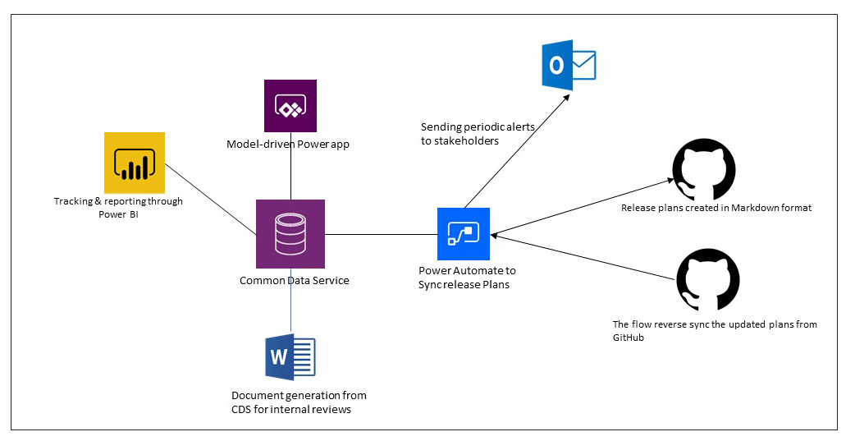
Blueprinting the solution architecture
High-level architecture diagrams can show how proposed solution architecture fits into overall enterprise architecture

Slide 31
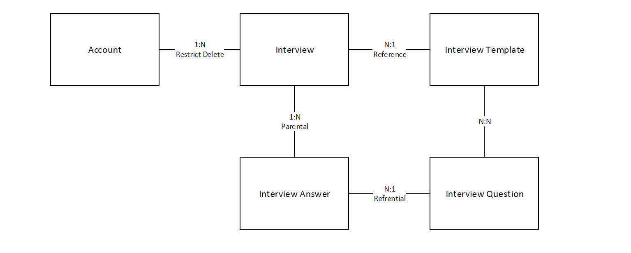
Blueprinting the solution architecture
Data model diagrams can illustrate key data relationships to support the solution architecture

Slide 32
Group exercise: Design from requirements
During this exercise, you will be reviewing project details for Contoso. This includes a set of requirements gathered from customer workshop sessions. You will use this information to design a high-level architecture and complete a fit gap analysis.
Evaluate project details
Complete project workbook:
High-level architecture diagram
Dynamics 365 apps used
Fit gap
Notes:
Exercise can be found here on GitHub
https://github.com/MicrosoftLearning/PL-600-Microsoft-Power-Platform-Solution-Architect/blob/master/Instructions/Exercises/Exercise02%5BPL-600%5D_Conceptualize_Design.md
https://github.com/MicrosoftLearning/PL-600-Microsoft-Power-Platform-Solution-Architect/blob/master/Instructions/Exercises/Exercise02%5BPL-600%5D_Project_Details.md
https://github.com/MicrosoftLearning/PL-600-Microsoft-Power-Platform-Solution-Architect/blob/master/Allfiles/Project%20Details.docx
Timing: 45 minutes

Slide 33

Check your knowledge

Slide 34

Check your knowledge
Conceptualizing the design from requirements
Which one?
A). None
B). A little
C). Lots
Learning Path 2
Use your PC or mobile device
Go to (insert polling app link of your choice)
Enter code: 123-45-678
Please participate
Notes:
Microsoft Learning recommends using polling to be completed for every 7 – 10 slides and preferably at the end of each section. This helps break classes up and adds more interactivity especially for remote classes.
In order to promote interactivity, WWL suggests the use of Mentimeter, Kahoot or a similar polling technology. Please feel free to adjust this slide as needed and populate with the instructions based on the polling tool of your choice.
Learn note:
Learn has Knowledge checks individually through the Learn modules
https://learn.microsoft.com/en-us/training/modules/propose-solution/6-check
https://learn.microsoft.com/en-us/training/modules/work-with-requirements/6-check
https://learn.microsoft.com/en-us/training/modules/fit-gap-analysis/6-check

Slide 35
Check your knowledge
What is the most important question that you can ask a customer during the discovery process?
What's the budget?
When?
How?
Why?
Solution
Answer=D
Notes:
The most important question that you can ask a customer during the discovery process is "Why?"

Slide 36
Check your knowledge
What types of questions are the best for gathering requirements from customer meetings?
Open-ended
Yes/No
Multiple choice
Solution
Answer=A
Notes:
Open-ended questions are the best for gathering requirements from customer meetings.

Slide 37
Check your knowledge
What is the difference between an objective and a pain point?
They are interchangeable.
Pain points define desired results. Objectives identify problems.
Objectives define desired results. Pain points identify problems.
Solution
Answer=C
Notes:
The difference between an objective and a pain point is that an objective defines desired results and pain points identify problems.

Slide 38
Check your knowledge
Which of the following options is considered a functional requirement?
Any credit card number that is used can't be stored in the Microsoft Dataverse environment.
Average screen load time for internal users that aren't mobile will be less than three seconds.
As a staff accountant, I want to be prevented from closing a batch that has pending items so that I don't have to reopen it later.
Solution
Answer=C
Notes:
As a staff accountant, I want to be prevented from closing a batch that has pending items so that I don't have to reopen it later.
The others are non-functional requirements

Slide 39
Check your knowledge
Which of the following options is considered a non-functional requirement?
External portal must handle 100 concurrent users who are performing case submission.
As a sales user, I need to be able to close an opportunity as lost and capture why it was lost so that we can improve our sales tactics in the future.
As a sales manager, I need to approve a discount on a quote so that I can reduce the total price and give a discount to the customer.
Solution
Answer=A
Notes:
External portal must handle 100 concurrent users who are performing case submission.
The others are functional requirements.

Slide 40
Check your knowledge
What be used to help illustrate key data relationships in the solution?
Integrations
Data model
Security model
User experience
Solution
Answer=B
Notes:
Data model diagrams can illustrate key data relationships to support the solution architecture

Slide 41
Check your knowledge
As part of the solution, you have proposed adding a component that you aren’t confident will solve the customer’s needs. What is the best way to reduce risk for this specific component?
Do nothing; resolve the risk later
Only demonstrate the part that the out-of-the-box app can do
Reject the requirement
Prototype
Proof of concept
Solution
Answer=D
Notes:
The best way to reduce risk is to show proof of concept.

Slide 42
Check your knowledge
Which of the following options can help you evaluate requirements in a fit gap analysis?
Severity
Priority
Level of effort
All of the above
Solution
Answer=D
Notes:
Severity, priority, and level of effort can help you evaluate requirements in a fit gap analysis.

Slide 43
Summary
Getting the requirements right early in the process and being agile along the life of a project will give you a better path to success
Ensuring requirements are clear, actionable, and implementable is essential for being able to establish the solution architecture
Identifying gaps between built-in capabilities and requirements using fit gap allows design to cover how gap will be solved

Slide 44
Closing slide

