Slide 1
Plan application lifecycle management

Slide 2
Agenda
Microsoft vision and Solution Architect’s role in ALM
Environment strategies
Defining a solution structure for your deliverable
Notes:
Solution architects for Microsoft Power Platform need to define the environment strategy and application lifecycle management (ALM) for transporting work from development to test to production.
Timing: This learning path takes 60 minute
Note: The lab for app composition has been removed from the course

Slide 3

Microsoft Learn module
Solution Architect series: Plan application lifecycle management for Power Platform
https://learn.microsoft.com/training/modules/application-lifecycle-management-architect/
Notes:
Link to student courseware on Learn
Solution Architect series: Plan application lifecycle management for Power Platform
https://learn.microsoft.com/training/modules/application-lifecycle-management-architect/

Slide 4
Microsoft Power Platform vision for ALM
Quick Start: Enable app builders to get set up with an environment with the latest build and connected to source control and make a change quickly
Build: Simplify tooling, consolidate portals and speed up inner loop
Deploy: Enable an automated repeatable (predictable) deployment methodology
Manage: Invest in additional environment management capabilities to offer more flexibility for app builders to use and dispose preconfigured environments as needed
Monitor: Application telemetry and feedback loop by design
Notes:
Solution Architects should understand the vision and journey Microsoft is on to shape how ALM is done for Microsoft Power Platform projects. As this journey evolves, Solution Architects should continue to shape their own plans to leverage the capabilities provided by the platform and tools.
Inner Loop – the iterative process that an app builder performs when creating an app and its components and local testing before sharing with the broader team

Slide 5
Solution Architect role in ALM
Lead the establishment of an application lifecycle management (ALM) plan
Evaluate and determine the amount and sophistication of the ALM that is appropriate for the project
Work with the various teams to support their efforts to implement the and execute the plan

Slide 6
Key Solution Architect ALM considerations
Environment Strategy – How many, what’s their purpose
Source Control – Where will the master copy of the solutions and code live
DevOps – What is the workflow for app builders and how/who will promote the app on its journey from dev to production
Deployment Configuration – How to configure each environment and what can be done to make this easier
Notes:
This includes helping the organization put in place proper governance for the solution

Slide 7
Environment vs. source control master copy
Environment centric
The dev environment is the master copy of all changes
Changes promote directly from dev -> test->prod
Source control centric
Source control is the master
Dev is re-created from source control (this can be automated and repeatable)
Changes from dev are checked into source control
Microsoft is encouraging and building tooling to support source control centric ALM
Notes:
Traditionally, Microsoft Power Platform projects have been more environment centric and many are moving towards Source Control centric
Source control centric encourage having a definitive master and ability to re-create development environments for any version tracked
Ideally all environments other than production should be 'throw away' - that is they can be deleted and recreated without any loss

Slide 8
Solutions Overview
Solutions are a container to track the changes you make to Dataverse, Power Apps and Power Automate flows
Solutions are how you transport and install changes to target environments
Microsoft Dynamics 365 apps are installed using solutions
3rd party apps provided by Independent Software Vendors (ISVs) also use solutions
Development
Test
Production
Notes:
Solutions are containers that track and manage customizations in a Dataverse environment
If you have multiple environments, each would have their own set of solutions. Solutions can include table metadata, forms, views, business rules, processes definitions and other assets required to run the app; including components created by developers like scripts or compiled code.
when you have a Dynamics 365 application like Sales or Service those are installed using the same solution framework. 3rd party ISVs also ship their products using solutions

Slide 9
Types of Solutions
Unmanaged
Managed
Used during development
Used to transport to other development environments
Used to distribute to non-development environments
Notes:
Unmanaged Solutions are to be used in development environments while you are making configuration changes to your application. Solutions are exported as unmanaged and checked into your source control system. Unmanaged solutions should be considered your source.
Managed solutions are used to deploy to any environment outside of development. This includes test, UAT, SIT, and production environments. Managed solutions should be generated by a build server and considered as a build artifact.

Slide 10
Solution Layering
Layering occurs on import of managed solutions
Layers describe the dependency chain of component from the root solution introducing it, through each solution that extends or changes the component’s behavior
Layers are created through extension of an existing component (taking a dependency on it) or through creation of a new component or version of a solution.
Application Behaviour
What the user sees
Unmanaged “layer”
Unmanaged Customizations
Unmanaged Solution C
Unmanaged Solution D
Managed Layers
1 per managed solution
Managed Solutions
Managed Solution B
Managed Solution A
System Layer* Dataverse Managed Layer
System Solution*
Base Dataverse tables

Slide 11
Solution Layering
Device Inventory App
Care Kudos App
What the apps and users see
Contoso Common
CDM Healthcare Extension
Common Data Model/System tables
Notes:
Solutions are layered. E.g. the contact form is customized in the CDM Healthcare Extension. The same form elements are modified in the Contoso Common solution. The end users will see the changes from the Contoso Common solution.

Slide 12
Defining the solution structure
One or more custom solutions should be created that contain the projects assets
Create a Solution Publisher and use for all solutions
Don’t use the default publisher or default solutions
Once defined, Solution Architect should communicate and ensure teams follow structure
Notes:
Generally it is always best to keep the solution structure as simple as possible

Slide 13
Deciding on one or more solutions
Use multiple solutions only for a tangible purpose, multiple solutions add complexity
Common patterns for multiple solution splitting is horizontal and vertical partitioning
Multiple solutions each require their own environments to ensure they remain independent
Care must be taken to manage dependencies
Teams must know what solution to put new components in

Slide 14
Example of Horizontal Solution Splitting
Visual Components | Processes & Plug-ins | Reports | Security | Main
Apps | Processes | Reports | Security Roles | Tables
Canvas Components | Plug-in Assemblies | Dashboards | Column Security Profiles | Choices
PCF Components | SDK Message Processing Steps |  |  | Client Extensions
Web Resources | Power Automate flows |  |  | Service Endpoints
 | Custom APIs |  |  | Connection Roles
Notes:
Can be all or some of these, but it should be for a purpose.
Care must be taken to ensure it doesn’t create a web of dependencies

Slide 15
Example of Vertical Layering
Contact: Track Specialized Relationships
Private Wealth Division
Greedy Insurance People Division
Retail Division
Contact: Track Basic Details
Really Large Bank, Inc.

Slide 16
Example of Vertical Layering
Specific Sports
Basketball
Baseball
…
Shared Base
Sports Management Base

Slide 17
Handling developer code assets
Solution aware developer code assets should be “built” on a build environment and not the developer's desktop
After built they should be deployed to an environment that the master solution will be exported from - or built into a solution that will be installed
Examples of code assets
Plug-ins
Form Scripts (could include TypeScript transpiling)
Power Apps Component Framework components
Notes:
Scripts should be bundled and minified

Slide 18
Non-solution/environment aware
ALM plan must consider how to handle these components of the overall project deliverables
Examples
Power BI visualizations
Microsoft Azure deployed components (e.g., Azure Functions, .NET web apps, etc.)
External integrated services
Notes:
Note: Power BI components in preview for solutions

Slide 19
Handling configuration and reference data
Configuration Migration Tool can help move data between environments maintaining the primary record identifier
Solution Environment Variables can be used for application configuration data that can be environment specific

Slide 20
Environment Variables
Tracked as a solution component
Decimal, JSON, Text, and Two Options are supported data types
Can have a default value, and a current environment value
Apps, flows and developer code can retrieve and modify values if permissions allow
Environment Variable Definition
1:N
Environment Variable Value

Slide 21
Environment Variables Example
Development
Test
Production
Var – From Email
Var – From Email
Var – From Email
Value – dev@contoso.com
Value – test@contoso.com
Value – prod@contoso.com
Var – Auto Approve
Var – Auto Approve
Var – Auto Approve
Default – Yes
Default – Yes
Value – No
Notes:
This diagram illustrates how environment variables can be used to tailor values for each environment
Note that you can provide a default value that is used if a current value is not specified in a particular environment

Slide 22
Updating Existing Managed Solutions – Import Options
Update – Applies changes, no removal of items occur, can’t be used if any patches in place
Upgrade – Default option, imports changes and applies them immediately including removing components not in new solution, old solution and any patches are removed
Stage for Upgrade – Similar to upgrade but it pauses after new solution is imported before removing components so you can do data migration etc. and then manually trigger the final apply of the solution

Slide 23
App Builder workflow
Solution Architect should establish the workflow for how app builders will make changes and promote them
Communication and work assignment should be managed to minimize conflicts
Shared app building environments can be less complex but doesn’t offer isolation between app builders and lack detail tracking of changes
Individual app building environments offer isolation and tracking but require extra effort to merge work and resolve conflicts

Slide 24
Promoting to production
Solution Architect leads the effort to define the process for how changes will be promoted from dev to production
This includes defining the # of stages e.g., Dev - >Test -> Prod as well as the processes to do the promotion regardless if manual or automated
Microsoft is building tools to support doing this with Azure DevOps using continuous integration (CI) and continuous deployment (CD)

Slide 25
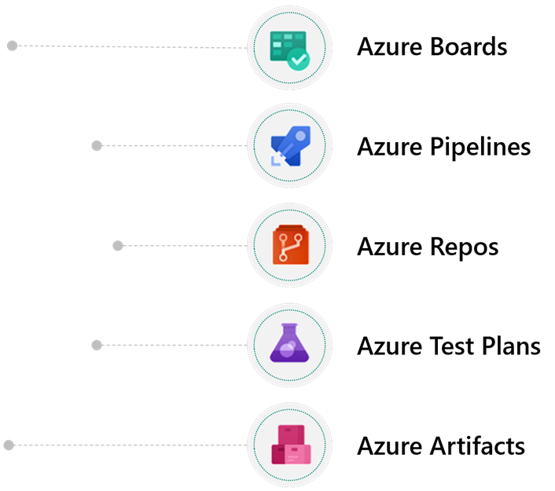
Azure Dev Ops
Notes:
Trainer- consider a demo here, many students have never done this before
Azure Boards - plan, track, and discuss work across your teams
Azure Pipelines – Use to automate CI/CD builds and releases
Azure Repos – Source Control to store and track changes
Azure Test Plans - Plan, execute, and track scripted tests
Azure Artifacts – publish solutions built by build pipelines

Slide 26
Using Azure Pipelines
Build pipelines can be used to
Create dev environments
Commit changes from dev to source control
Solution Checker
Automated Testing
To build output solutions from source control
Release pipelines can be used to
Take solutions from build pipelines and deploy them to one or more test/prod environments
Perform automated testing as part of release process
Pause for approvals before progressing to next environment
Notes:
https://learn.microsoft.com/en-us/azure/devops/pipelines/get-started/pipelines-get-started
Classic pipelines
Recommend using YAML

Slide 27
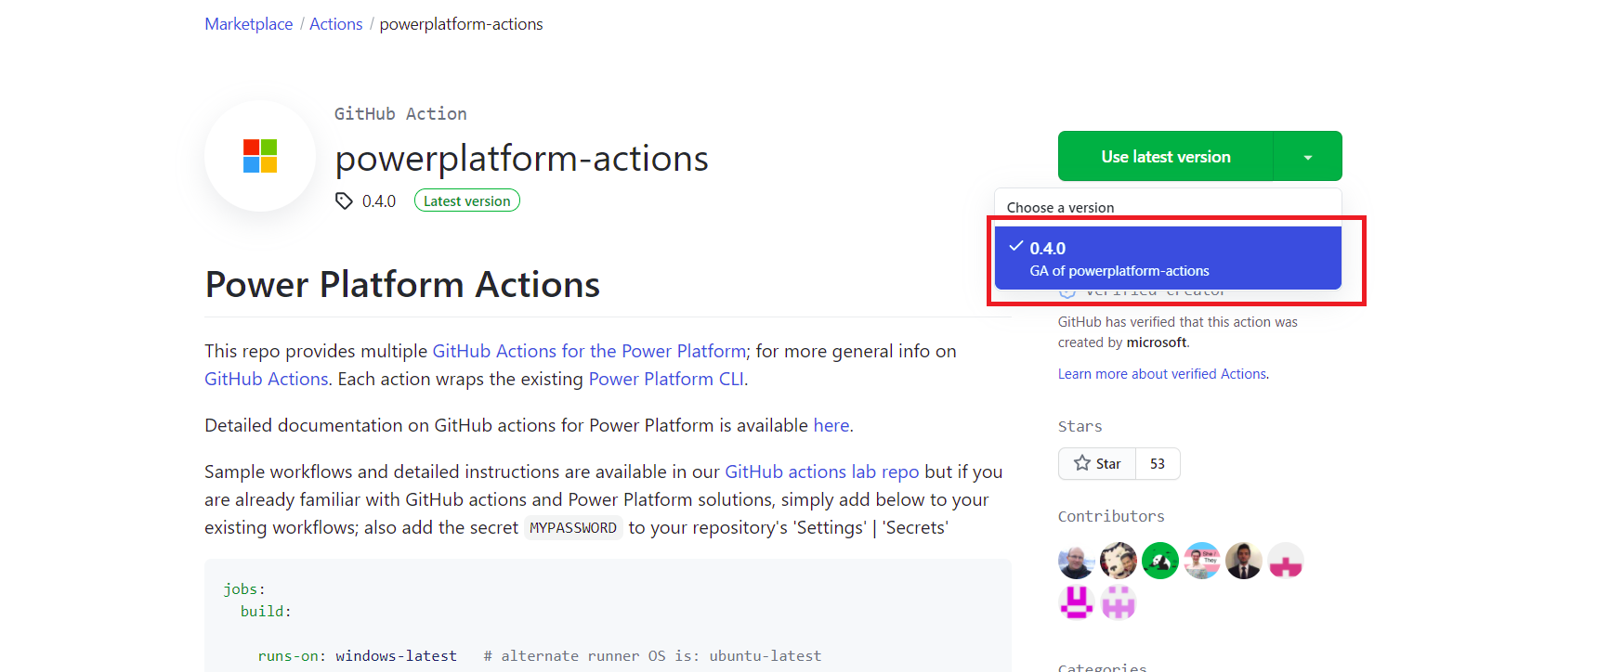
Alternatives to Azure DevOps
GitHub Actions
Notes:
https://github.com/marketplace/actions/powerplatform-actions

Slide 28
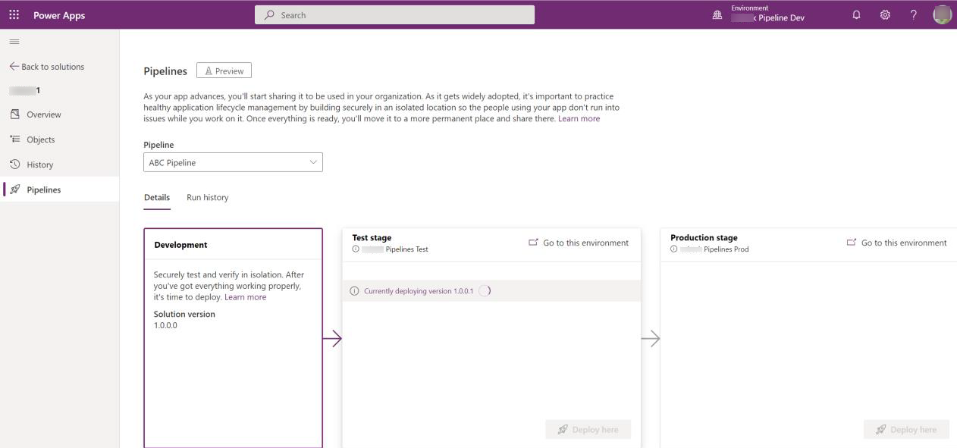
Alternatives to Azure DevOps
Power Platform Pipelines
Notes:
Feature of Managed Environments

Slide 29
Deployment Checklist
Proper environment access has been established e.g. Security Groups
Data loss prevention policies are correct for solution environments
Service Principals and service accounts necessary for connections are in place and configured after initial deploy
Environment settings have been documented and configured in each environment

Slide 30
Group exercise: App composition and solution segmentation
A solution is required to manage building security. A Minimal Viable Product (MVP) has been developed for Phase 1, visitor tracking, in the Microsoft Power Platform. All components are in a single solution.
Define the apps that need to be built
Determine the number of solutions and how solutions will be layered
Notes:
Note: This exercise used to be a lab but has been changed to an exercise
This is an optional lab that you can decide to exclude
Timing: 30 minutes
Exercise can be found here on GitHub
https://github.com/MicrosoftLearning/PL-600-Microsoft-Power-Platform-Solution-Architect/blob/master/Instructions/Exercises/Exercise06%5BPL-600%5D_App_Compositon.md
A solution is required to manage building security:
Tracking visitors
Access control
Parking passes
Inspections
Security staff shifts
Incidents
A Minimal Viable Product (MVP) has been developed for Phase 1, visitor tracking, in the Microsoft Power Platform.

Slide 31

Check your knowledge

Slide 32

Check your knowledge
Plan application lifecycle management for Power Platform
Which one?
A). None
B). A little
C). Lots
Learning Path 8
Use your PC or mobile device
Go to (insert polling app link of your choice)
Enter code: 123-45-678
Please participate
Notes:
Microsoft Learning recommends using polling to be completed for every 7 – 10 slides and preferably at the end of each section. This helps break classes up and adds more interactivity especially for remote classes.
In order to promote interactivity, WWL suggests the use of Mentimeter, Kahoot or a similar polling technology. Please feel free to adjust this slide as needed and populate with the instructions based on the polling tool of your choice.
Learn note:
Learn has Knowledge checks individually through the Learn modules
https://learn.microsoft.com/en-gb/training/modules/application-lifecycle-management-architect/7-check

Slide 33
Check your knowledge
You want to partition your solutions by creating separate solutions for each type of component. What is this called?
Horizontal splitting
Solution segmentation
Vertical layering
Solution
Answer=A
Notes:
Horizontal splitting refers to creating solutions that only contain components of the same type.

Slide 34
Check your knowledge
You need to remove a component that has already been deployed to production. What should you do?
Clone a patch
Clone solution
Import a new version of the solution with the Update option
Import a new version of the solution with the Upgrade option
Solution
Answer=D
Notes:
The Upgrade option removes components that are not in the new solution.

Slide 35
Summary
Establishing application lifecycle management process should be done at the start of the project
Having a repeatable process saves time and ensures consistent results
ALM is not a one size fits all, you must size it to fit your project

Slide 36

Closing slide

