Slide 1
Explore Power Automate architecture

Slide 2
Agenda
Discuss options for automation and custom logic
Review considerations for using triggers and common actions
Notes:
Solution architects are responsible for a solution’s overall design. Understanding the capabilities of Power Automate is imperative when designing the automation for the solution.
This learning path focuses on Power Automate and its capabilities for building robust cloud flows
Note: If you have experienced students, you can decide to skip some of the slides and focus on discussions
Timing: This learning path takes 45 minutes plus 15 minutes for the exercise
Note: Business Process flows have been removed from this learning path

Slide 3

Microsoft Learn module
Solution Architect series: Explore Power Automate architecture
https://learn.microsoft.com/training/modules/power-automate-architecture/
Notes:
Link to student courseware on Learn
Solution Architect series: Explore Power Automate architecture
https://learn.microsoft.com/training/modules/power-automate-architecture/

Slide 4
Options for automation and custom logic
Business Rules
Dataverse classic workflows
Power Automate
Dataverse Plug-ins

Slide 5

How do you decide when you should use options for automation and custom logic?
Notes:
Classroom discussion
Business rules vs classic workflows, vs Power Automate vs Dataverse plugins
Use this to start the discussion with the class, after the discussion use the next few slides to cover any key points not raised

Slide 6
Options for automation and custom logic
Business rules
Good for simple validation or setting of values
Optimized to run as part of the transaction for modifications that occur on the rows
No ability to use related rows or connectors
Can also be configured to run in model-driven apps for basic UX operations like hide/show
Available scope - single form, all forms, entity
Dataverse classic workflows
Power Automate
Dataverse Plug-ins
Notes:
Can be challenging if mixing with developer created Form Scripting, rule will not trigger script, and script will not trigger rules
Make sure to touch on table scope vs form where it runs on model-driven client only
Common challenges with Form Scripting – Not all columns on form rule won’t run
Can only reference columns on table, can use Calculated column with N:1 relationship to access related rows

Slide 7
Options for automation and custom logic
Business rules
Primary scenario is when real-time processing is required
Can only access related records in many-to-one relationships
Limited to operations on Dataverse data
Power Automate should be the first choice for background operations
Dataverse classic workflows
Power Automate
Dataverse Plug-ins

Slide 8
Options for automation and custom logic
Business rules
Primary choice for non-real time automation
Supports near real-time triggering from Microsoft Dataverse
Support for connectors and desktop automation
Asynchronous
Dataverse classic workflows
Power Automate
Dataverse Plug-ins

Slide 9
Options for automation and custom logic
Business rules
Custom logic is an extension of the Dataverse operation
Ability to modify the request and response on the fly
Able to handle complex logic
Requires code developer skills
Can be either synchronous or asynchronous
Dataverse classic workflows
Power Automate
Dataverse Plug-ins

Slide 10
Power Automate
Cloud flows
Desktop flows
Data and services via connectors
UI Automation (Robotic Process Automation)
1,000+ public connectors
Record windows and web app user interactions
Custom connectors for other REST APIs
Replay as part of cloud flow orchestration
Notes:
Will be covering desktop flows in a later session
Will focus on cloud flows for this session
Note: Business Process Flows are not part of Power Automate – they are a Dataverse/Model-driven app feature but are included with Power Automate documentation

Slide 11


Microsoft Dataverse connectors
Replaced by Microsoft Dataverse connectors
Deprecated
Dynamics 365
Use when not using solutions
Use when you need to integrate across environments
Microsoft Dataverse (legacy)
Use when flow is built in a solution
Use when talking to Microsoft Dataverse in the same environment
Microsoft Dataverse

Slide 12
What are considerations when choosing and using a trigger for a flow?
Notes:
Classroom discussion
Push the class to talk about triggers
If they are quiet, you can encourage them with:
How can you avoid indefinite loops?
What are good scenarios where when a row is selected is useful and any considerations for use?

Slide 13
Trigger Considerations
Use filters and scoping options to reduce unnecessary execution and indefinite loops
Remember update means column was included in request not that the value has changed
Button and selected row triggers aren’t currently visible from apps if flow is not in a solution
Notes:
Normal Microsoft Dataverse triggers do not provide

Slide 14
Getting data
When available specify columns that are required for flow
When referencing data previously retrieved earlier in the flow, the data is not updated automatically after the original step executes
With most Microsoft Dataverse triggers they provide all the columns and you don’t need to explicitly retrieve the row right after the trigger runs
When a row is selected doesn’t include N:1 lookup columns
Delete only includes the ID of the row no other columns
If the Microsoft Dataverse trigger doesn't provide some column values, get the row after the trigger runs
Notes:
Specify columns, if you don’t do this you can hit limits on data returned

Slide 15
Getting lists of data
Always filter the data on the connector not after using other actions
Fetch XML query filters can do more advanced criteria including related table
Enable pagination if you want more than one page of data
Page size is determined by the connector e.g., Microsoft Dataverse is 1024
Pagination is enabled via action settings
Limit is 100,000 rows, partition query if you need more
Notes:
You must visit Settings on actions to enable pagination

Slide 16
Updating data
Include only the columns that have changed
Avoids triggering other automation and audit logging
Use null expression to clear values
Can provide Microsoft Dataverse primary ID and upsert will occur, ensure you provide all the required columns

Slide 17
Your flow did the following: - Created an item in a SharePoint List - Tried to create a row in Microsoft Dataverse and failed When this failure happens you want to undo the create of the SharePoint list item, what should you do?

Slide 18
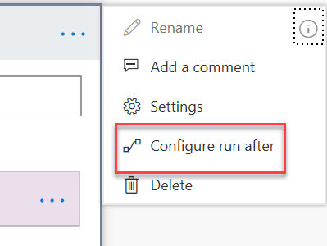
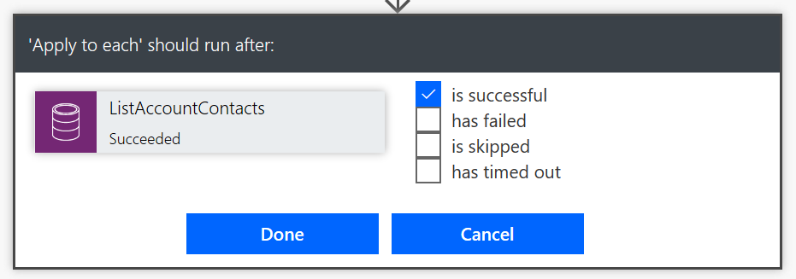
Handling Errors
Notes:
Use this to compensate (do some undo work) for prior errors or could be used to have logic when a timeout occurs like when an approval times out

Slide 19
Your flow needs to do the following in Dataverse: - Update the number of cases available on an account - Create a case - Create a phone call to follow up What can you do to ensure that all of these work or none of these work?

Slide 20
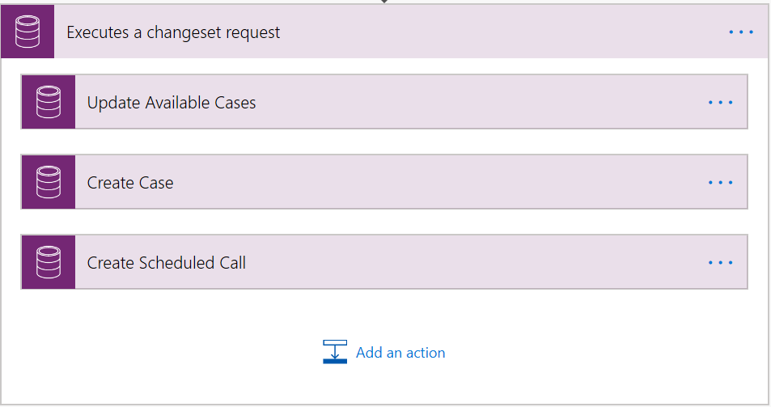
Using Changesets
Operations run in a transaction
Microsoft Dataverse Connector actions only
Notes:
all operations are considered atomic, which means that if any one of the operations fails, any completed operations will be rolled back
Flow has to be in a solution

Slide 21
Staying within the limits
Many operations like Apply for Each only work up to 100,000 rows and might require partitioning work when working with large sets of items
Do Until has default of 60 loops or 1 hour of execution
Connectors have throttling limits check the docs for details
Flows can execute for only up to 30 days, plan around if you have scenarios needing to run longer

Slide 22
What can your team do to make flows they build more maintainable?
Notes:
Classroom discussion
Answers on next slides

Slide 23
Building maintainable flows
Use meaningful naming conventions – consider admins and users
Rename each action e.g., Get List to Get Account Contacts
Use comments on actions to document purpose
Use child flows to prevent overly complex flows or repeated logic

Slide 24
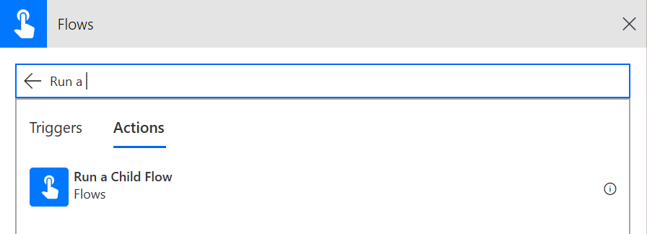
Using Child Flows
Allows breaking out parts of a flow into a reusable child flow
Trigger Support of child flows
Manually triggered button flow
Power Apps
HTTP Request
Respond with Power Apps or HTTP response
Requires Microsoft Dataverse connector
Notes:
Manual – Use this when you also want your child flow to be run interactively as well as a child flow.
Power Apps – This is the most general purpose way to use child flows – also allows reuse from a canvas app, but does not allow users to run manually. Definition of parameters is done visually
HTTP Request – This is the most powerful trigger for child flows, input options are defined with JSON sample or JSON schema and are not limited to the fixed parameters of the other options.
Child flows – Identify opportunities for reuse

Slide 25
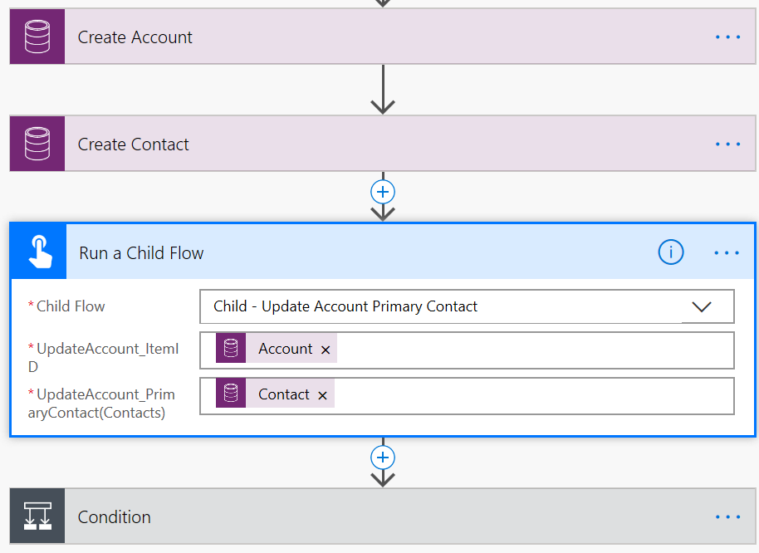
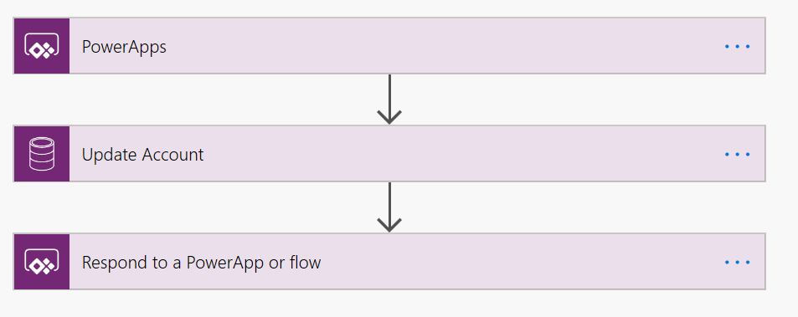
Example – using a child flow
Parent flow
Child flow
Notes:
Example – refactors out updating the primary contact on an account – could include other actions like scheduling call with new contact etc.

Slide 26
Microsoft Dataverse connector user security context
Instant Flows
Scheduled Flows
Automated Flows
Co-Owner or Run-Only
Co-Owner
Co-Owner
Allow using existing connection or require them to use their own
Uses existing connection, any owner can change
Uses existing connection, any owner can change
Can choose for each connection used
Settings are for all Run-only users, you can’t individually set
Notes:
Instant flows are Button triggers, and When a row is selected triggers

Slide 27
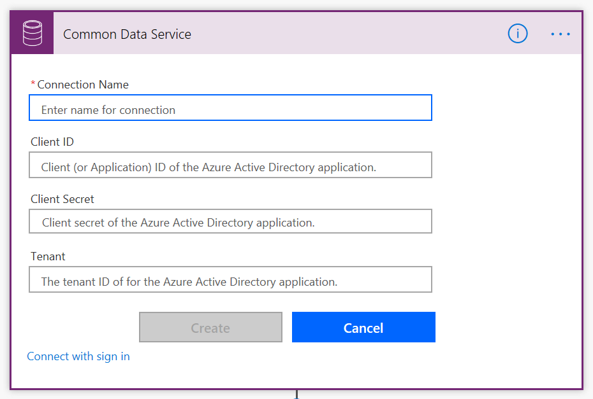
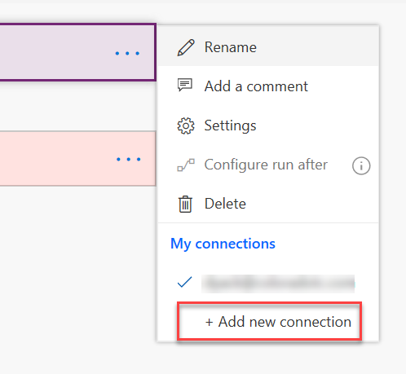
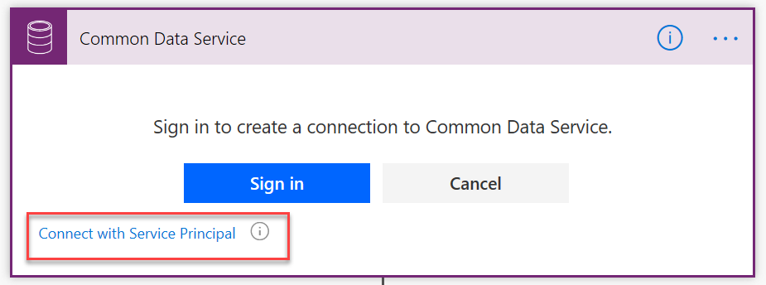
Using a service principal with Microsoft Dataverse Connector
By default, sign in uses interactive user that requires an appropriate license, and executes in the user's context
Using a service principal allows actions to be executed using a Microsoft Dataverse App User context
Notes:
Service principal’s with Microsoft Dataverse must be an app user in Microsoft Dataverse and have an appropriate security role ideally with minimal permissions required
This should be used instead of non-interactive users

Slide 28
Group exercise: Evaluate automation options
Review four scenarios and determine how to architect them using Power Automate.
Scenarios are based on the smart bed support requirements in exercise 2.
Evaluate needs
Discuss pros and cons of options
Notes:
Exercise can be found here on GitHub
https://github.com/MicrosoftLearning/PL-600-Microsoft-Power-Platform-Solution-Architect/blob/master/Instructions/Exercises/Exercise07%5BPL-600%5D_Power_Automate_architecture.md
and in the next few slides
See Exercise 2 for the information required https://github.com/MicrosoftLearning/PL-600-Microsoft-Power-Platform-Solution-Architect/blob/master/Instructions/Exercises/Exercise02%5BPL-600%5D_Project_Details.md
Discuss each scenario and address the question. Each group takes a turn leading the larger group discussion on the proposed approaches.
Timing: 15 minutes

Slide 29
Group exercise: Scenario 1
When working on a help request for a smart bed customer, Contoso’s support staff can request a replacement bed from the manufacturer. Each manufacturer provides a contact that can authorize the replacement. Once authorized, the support staff can inform the customer.
What would your design look like to implement this process?

Slide 30
Group exercise: Scenario 2
When a repair is required, the system needs to look up the customer’s support plan, check if they have available repair allowance / warranty, and if they do decrease the cost of the repair from their lifetime warranty allowance and prioritize the help request.
Your development team has proposed a plug-in – is that the best choice or how might you handle this in Power Automate?

Slide 31
Group exercise: Scenario 3
When a manufacturer has a defect, they issue a recall to fix the problem. They will provide Contoso a file that contains the serial numbers of the affected beds. Each serial number must be looked up to see if there is an active customer and the customer record must be tagged with the recall. For some large recalls this could exceed 200,000+ beds. The process must be designed so it can be restarted if the process fails without creating any duplication.
What would your design look like to implement this process?

Slide 32
Group exercise: Scenario 4
On create of a help request Contoso needs to calculate the customer deductible which is based a percentage determined by how old their bed is. The support staff needs this value displayed as soon as they create the record.
What would your design look like to implement this?

Slide 33

Check your knowledge

Slide 34

Check your knowledge
Explore Power Automate architecture
Which one?
A). None
B). A little
C). Lots
Learning Path 9
Use your PC or mobile device
Go to (insert polling app link of your choice)
Enter code: 123-45-678
Please participate
Notes:
Microsoft Learning recommends using polling to be completed for every 7 – 10 slides and preferably at the end of each section. This helps break classes up and adds more interactivity especially for remote classes.
In order to promote interactivity, WWL suggests the use of Mentimeter, Kahoot or a similar polling technology. Please feel free to adjust this slide as needed and populate with the instructions based on the polling tool of your choice.
Learn note:
Learn has Knowledge checks individually through the Learn modules
https://learn.microsoft.com/en-us/training/modules/power-automate-architecture/7-check

Slide 35
Check your knowledge
You need to perform a calculation using related rows in a one-to-many relationship. Which automation method should you use?
Business rules
Calculated column
Dataverse classic workflow
Power Automate cloud flow
Solution
Answer=D
Notes:
Power Automate cloud flow can access rows in one-to-many relationships and can loop through and process the data.

Slide 36
Check your knowledge
Which connector should you use to run a Dataverse custom action?
Dynamics 365
Power Apps
Microsoft Dataverse
Solution
Answer=C
Notes:
The Dataverse connector can perform CRUD and other advanced operations such as perform a bound action and perform an unbound action.

Slide 37
Check your knowledge
Which connector should you use for a child flow trigger?
Dynamics 365
Power Apps
Microsoft Dataverse
Solution
Answer=B
Notes:
Power Apps – This is the most general purpose way to use child flows

Slide 38
Summary
Power Automate should be your go to tool for automation and custom logic on Microsoft Power Platform projects
Solution Architects should work with their teams to ensure consistency in use and use flow reviews to improve quality
Always strive to use solutions for your automation

Slide 39
Closing slide

