Slide 1
Implement integrations with Power Platform

Slide 2
Agenda
Solution Architect’s role with integrations
What is integration and why do we need it
Platform features that enable integration
Microsoft Dataverse event publishing
Notes:
Solution architects for Microsoft Power Platform lead the design of integrations.
This learning path explores the issues that occur during integration with Power Platform solutions.
This is a discussion heavy session
Timing: This learning path takes 60 minutes plus 30 minutes for the exercise

Slide 3

Microsoft Learn module
Solution Architect series: Implement integrations with Power Platform
https://learn.microsoft.com/training/modules/integrations/
Notes:
Link to student courseware on Learn
Solution Architect series: Implement integrations with Power Platform
https://learn.microsoft.com/training/modules/integrations/

Slide 4
Solution Architect role with integration
Identify where integration is required
Lead the design how the integration will be implemented and included as part of the overall architecture
Lead the evaluation efforts of 3rd party integration tools when required
Ensure that the integration doesn’t make the solution too fragile
Consider integrations as part of overall disaster recovery plan
Notes:
Solution architects lead the identification of integrations in and out of Microsoft Power Platform.
Learn about integration and why it's needed.
Discover Microsoft Power Platform features that enable integration.
Use the capabilities of Microsoft Azure.

Slide 5

What is integration and why do we do it?
Notes:
Classroom discussion
Answers on following slides

Slide 6




Your app is just part of the picture…
Active
Directory
HR
Intranet
LDAP
Legacy
Enterprise SSO
identity
corporate apps
Presence
Your App
ESB
Video
Voice
ERP
Documents
Rules
IM
collaboration
business processes
Customer
portal
Enterprise
social
Campaigns
Data
warehouse
Listen and
respond
Master
data
social
data
Notes:
Use this slide to start the discussion of how the business app you are building is often just a part of an overall big picture. While it could be the users focus, connecting from there to a variety of other enterprise systems, or it could just be a participant in a larger business process flow that spans multiple enterprise systems

Slide 7
What is Integration?
Connecting one or more parts/components of systems to create a more unified experience or to ensure a more consistent outcome of a process
Results in a system that acts as one, not as individual parts executing on their own agenda
Often thought of as stitching together pieces to create a greater whole
Notes:
Integration is the connecting of one or more parts or components of systems to create a more unified experience or to ensure a more consistent outcome of a process.
This allows for things like data integrity, better user adoption, higher ROI…
Different parts can be connected or disconnected and integration is the process of determining how best to get them to work in a coordinated way

Slide 8
Why Integration Is Needed
Usability
Access from a common source
Real-time
Cost
Single source services = savings
Duplication
Reuse
Single, seamless, user interface
Reusing rather than reimplementing
Greater consistency and customer satisfaction
Volume
Up-to-date and accurate
Notes:
Here are six common variables involved in determining the necessity of integration. Each variable defines an inherent problem, which allows for rectification through integration.
From a user perspective, a common problem in enterprises is the variety of different systems they need to interact with to perform a job. Through integration, the tasks a particular user needs to perform can be provided in a single, seamless, user interface. Training costs and time to perform a task can be significantly decreased. This can also lead to greater consistency and customer satisfaction.
Where data volumes are large, or are changing regularly, it can be problematic to duplicate. Through integration, rather than by copying or migration, the data can be accessed from a common place.
It is important to have access to up-to-date information about customers. Because customer data can be managed by different teams or as part of a regulated process, it may not be possible to use the same system to support both business needs. Integration can make it possible to access up-to-date data in real-time, ensuring accuracy every time.
Some functionality is cheaper to access externally rather than reproduce. One example is address lookup. Integration to an external provider can be cheaper than replicating the capability from the raw mail service source data within the system.
Consistency of data is critical. One example is allocation of service resources to tasks. Duplication may end up in double-booking, resulting in an inability to deliver the service required. Although this capability may be required across multiple business areas, it is not uncommon for a single system to manage the allocation and offer that consistent service to other systems, an ability that integration can provide.
Reimplementing common functionality is expensive, particularly when ongoing maintenance and regression testing of enhancements are considered. An approach where common functionality is reused, rather than being re-implemented, can often be cheaper and lead to greater consistency. Integration can provide this vital undertaking.

Slide 9
Types of Integration
Process Integration
Application Integration
Data Integration
Data integration of heterogeneous data sources
Application integration of heterogeneous applications
Process integration of business processes
Notes:
Data Integration – simply combining data from different sources and presenting the user a unified view.
Application Integration – a higher level integration connecting at the application layer.
Process Integration - You have multiple disparate systems, and each of those systems is part of an overall business function.

Slide 10
What are common integration challenges?
Notes:
Classroom discussion
Integrations can be expensive, complex, and occasionally challenging.
Answers on following slides

Slide 11
Common integration challenges faced by a solution architect
Security boundaries
No real time connection to work with other system or data
Incompatible technologies
Company policies
Regulatory requirements or restrictions
Legacy systems
Too much data/missing data
Loss of knowledge of other systems
Lack of skills for the other systems
Notes:
Just as real are the perceived challenges
Expensive and Complex
Brittle - tightly coupled systems are hard to change
Loss of knowledge and/or particular skills can also be a challenge

Slide 12
Integration influencers
Volume of data being moved/accessed
Quality of data
Latency to access or work with other system
Security requirements
Reliability requirements
Impact of duplication of data or functionality
Fit with existing Microsoft Power Platform capability
Cost/Time/Resources
Internal politics
Notes:
Factors that will influence your design integrations include these

Slide 13
What are some things you have seen cause integrations to fail?
Notes:
Classroom discussion
Consider the projects that you've worked on that experienced issues with integrations and what might have caused the integrations to fail.
Answers on following slides

Slide 14
Causes of failure
Underestimating complexity of integrating
Poor user experience using the integrated solution
Increasing cohesion of components to creating a fragile system
Not knowing what Microsoft Power Platform does or doesn’t do well
Not knowing what the other product does or doesn’t do well
Source data poor quality/full of duplicates and dirty data
Notes:
Systems that are too tightly coupled then become hard to change independently.
Multiple partners/parties involved in building and not coordinated
Who is building integration doesn’t know the platform
Not being clear what the system of record is

Slide 15
Design integrations for resilience
Expect transient errors with your integrations
Include escalating retry logic with circuit breaker to eventually fail
Use queuing or other loosely coupled techniques to increase resiliency
Include in your designs how to handle common expected failures
Notes:
The solution architect needs to ensure that integrations are designed to be resilient:
Expect transient errors with your integrations.
Include escalating retry logic with the circuit breaker pattern to eventually fail.
Use queuing or other loosely coupled techniques to increase resiliency.
Include in your designs how to handle common expected failures.

Slide 16
Finding the perfect balance
No single right answer or solution
Each situation is unique
Identify Integration Opportunities
Research Evaluate Options
Prototype / Proofs of Concept
Develop/Configure/Procure Integration
Test/Verify/Deploy the Integration
Notes:
Every situation is unique, and you'll encounter various integration scenarios on projects.
This talks to how every situation is unique and while in the course we will talk about specific integration scenarios the ones you encounter in real projects may vary widely. While it’s good to be introduced to a technology and how to integrate, it is more important that you develop skills to evaluate real project needs that certainly won’t be as cookie cutter. Using the principals, ideas and concepts though you can navigate though a complex integration challenge.
In some cases it also is still cheaper to hire staff then to build the integration, as technologist, we often overlook non technical solutions that are still viable.
Do we really need the integration? Does it need to be real-time?

Slide 17

Integration Toolset
App Builders
Code Developers
Business Processes
Data synchronization
Canvas apps
Embedded canvas apps
Power Automate flows
Custom Connectors
ETL Tools
External Processes
Custom APIs
Plug-ins
Custom UI (PCF)
External Clients
Azure Logic Apps
Azure Service Bus
Virtual Entities

Slide 18
Data integration
When evaluating integrations, solution architects should categorize each piece of data because it will guide them toward the appropriate integration solution
High volatility / rapidly changing
High volume
Time sensitive
Batch processed
Regulated/ PII / Sovereign
Licensed
Notes:
When evaluating integrations, solution architects should categorize each piece of data because it will guide them toward the appropriate integration solution.
Ways that you can categorize data include:
Volatility - Determine if the data is highly volatile, that is, if it is rapidly changing.
Volume - Assess how large the volume of data is.
Time sensitive - Decide if the data needs to be real-time.
Batch - Evaluate whether the data must be processed in batch or if it must be processed on a transaction-by-transaction basis.
Regulated - Assess if the data contains personal information or if restrictions are in place on where the data can be stored.
Licensed - Determine if the data is licensed and if limitations are on data use.

Slide 19
Data Integration (server-side)
Event Based
Batch Based
Inbound
Near real-time
Well placed for 24x7 workloads
Can smooth intensive processing*
Spikes may require rate levelling
Processed in intervals
Often used for “dark hours” processing
Often time limited
Can reduce impact to daytime operations
Outbound
As above
Can broker event->batch processing through staging area
Should be asynchronous
As above
Pull model
Multiple concurrent “pulls” may have detrimental performance impact

Slide 20
Data Integration: Inbound
General push pattern is to use Microsoft Dataverse Web API
For batch, often abstracted by 3rd party tooling (KingswaySoft, Scribe, SSIS Adaptors)
For event-based, Power Automate and Azure Logic Apps are a good approach and often used between Microsoft Dataverse environments
Azure Functions can abstract the need to implement business logic within your enterprise integration layer
Performance vs Throughput
Design for multiple threads to overcome latency effects
In batch scenarios, use ExecuteMultiple to overcome latency effects
Remember to consider the sum of the whole (e.g. don’t authenticate on every request)
Pull pattern can be effective for data augmentation
Pull data from external system on-demand when row(s) retrieved
Virtual entities can be a good fit for this pattern
Notes:
Could also use Azure API Management in front of Azure Function to add more management
Consider the rate and API limits

Slide 21
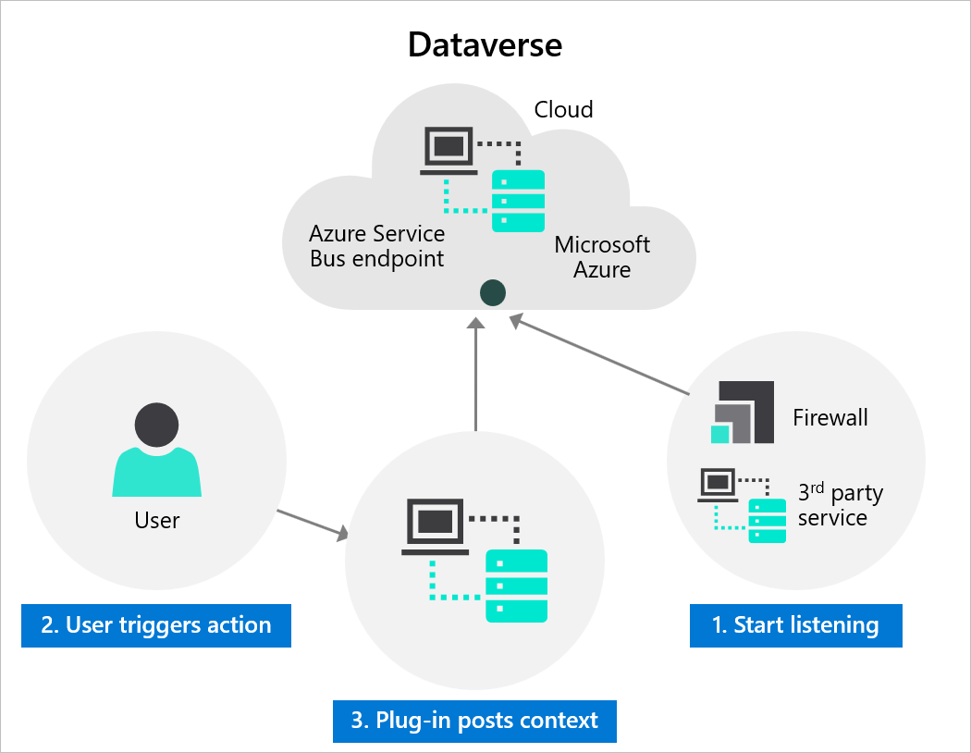
Data Integration: Outbound
Event-based push model
Microsoft Dataverse to Azure Service Bus
Use Azure Event Hub as listener if you require multiple subscribers
Event-based pull model
Power Automate is a good option
Power Automate is covered under process integration

Slide 22
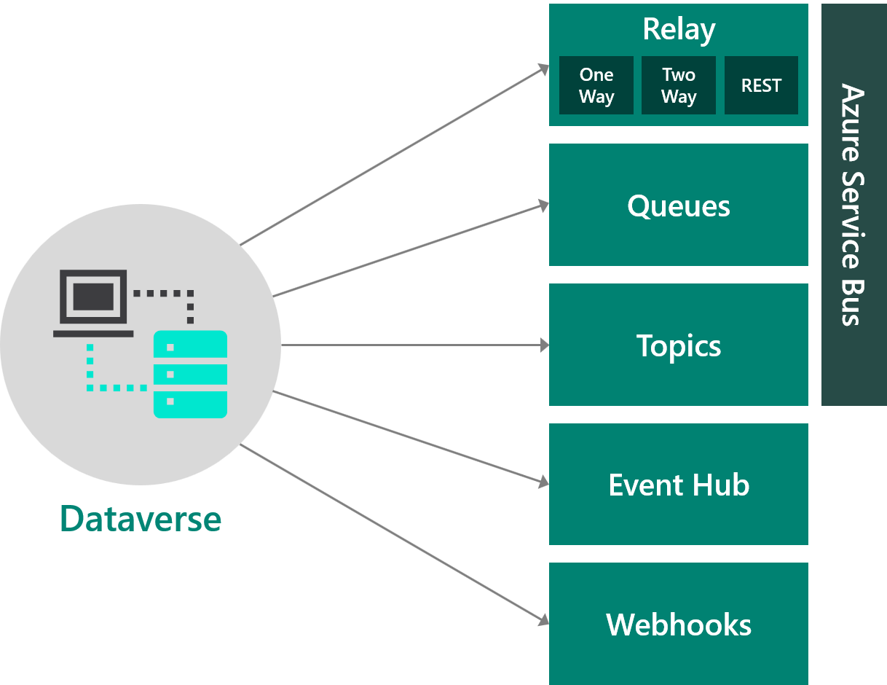
Publishing Events from Microsoft Dataverse for Apps
Notes:
The Dataverse platform supports outbound integration with Azure. Dataverse can send messages to Azure services by using the Event Framework, as shown in the following diagram.
Microsoft Azure Relay is a service that was previously part of Azure Service Bus but has been separated into its own service.

Slide 23
Service Bus use scenarios
Build reliable and elastic cloud apps with messaging
Protect your application from temporary peaks
Distribute messages to multiple independent backend systems
Decouple your applications from each other
Ordered messaging scaled out to multiple readers

Slide 24
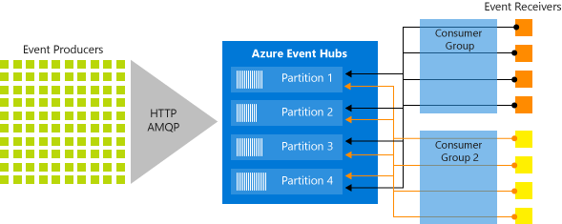
Event Hubs
Hyper-scale telemetry ingestion service designed for collecting, transforming and storing millions of events
Multiple applications can read data using publish and subscribe semantics
For example, publish to stream analytics, which in turn populates a Power BI dataset for visualization
Notes:
A consumer group is a view (state, position, or offset) of an entire event hub. Consumer groups enable multiple consuming applications to each have a separate view of the event stream, and to read the stream independently at their own pace and with their own offsets.

Slide 25
Webhooks vs Service Bus/Event Hubs
Azure Service Bus and Event Hubs is designed for high scale processing with full queuing support
Webhooks can only scale to the point your target web host can handle the volume
Webhooks can be synchronous or asynchronous – publishing to Azure can only be asynchronous
Webhooks can only publish JSON, no option for other formats
Both Webhooks and Azure publishing can be done programmatically

Slide 26
Publishing Events
Async Service
Manages Azure message jobs
View via web tools
Out of the Box
Custom Plug-in
Custom WF Activity
Register Provided ‘ServiceBusPlugin’
Hands Context to Async Service
Just register via plug-in tool
Custom code
Hands context to Async Service
Custom code
Hands context to Async Service

Slide 27
Process Integration
Use Power Automate or Logic Apps
Power Automate
Azure Logic Apps
Microsoft Dataverse Connector has more capability
Packaged as part of a solution
Can do UI automation
Access to SOAP APIs
Enterprise Integration including EDI
Good for ISV backend processing

Slide 28
Group exercise: Evaluate integration options
Review four scenarios and determine how to design the integrations
You can ask questions of your instructor
Evaluate requirements
Discuss pros and cons of options
Notes:
Discuss each scenario and address the question.
Timing: 30 minutes
Exercise can be found here on GitHub
https://github.com/MicrosoftLearning/PL-600-Microsoft-Power-Platform-Solution-Architect/blob/master/Instructions/Exercises/Exercise09%5BPL-600%5D_Evaluate_integration.md
and in the next few slides

Slide 29
Scenario 1: Property Environmental Hazard data
Your client has licensed property environment hazard data and would like an indicator on each property if a hazard exists and what the hazard is, and the date last reported.
You can ask questions of your instructor
You are meeting with the data provider contact what questions do you have?
How would you design this integration?
Notes:
Instructor notes:
There are currently 555,000 properties on the data
Approximately 1K records are changed or new each week
They provide an updated file once a week
The file is in JSON format and can be downloaded for a provided URL
Each property is identified by a County and Parcel ID in that county this is a unique key
There are 20 columns in the data
Answer

Slide 30
Scenario 2: Access to Property Tax Authority
You need to be able to show the current property tax amount and the amount of the last payment in the app when the user views a property.
Any problems with the transmission must be reported to Contoso’s manager.
You can ask questions of your instructor
How would you design this integration?
Notes:
Instructor notes:
The data can only be stored locally for 24 hours
They provide a REST API using OAuth to access the data
They have downtime each weekend for 2 hours
App is a model-driven application
Data is updated all the time
Answer
Custom Connector with Embedded Canvas Apps

Slide 31
Scenario 3: Outsourced customer support
Contoso has outsourced support to a 3rd party firm. New and changed customers needs to be transmitted to the 3rd party.
Any problems with the transmission must be reported to Contoso’s manager
You can ask questions of your instructor
How would you design this integration?
Notes:
Instructor notes:
The 3rd party has provided a JSON schema for the data they need
The 3rd party has provided a webhook url to post the data to
Possible Answers
Power Automate trigger on create/update use HTTP to post to webhook
Publish to Azure Service Bus Queue , Azure Function that publishes to webhook in proper format

Slide 32
Scenario 4: Customer Referral
Another division at Woodgrove wants to send customer referrals to you.
They have asked for API access to send the referral automatically from their system.
You can ask questions of your instructor
The referral creation process:
Create Account if name doesn’t exist
Create an Opportunity
Assign the opportunity to the sales team based on region
Create a task for the account research team to research the company
How would you enable this to happen?
Notes:
Instructor notes:
They are on the same internal network
They would send about 25 leads a week
Possible solution
Push back to do via e-mail, to queue with someone keying it
Could just give them a license

Slide 33

Check your knowledge

Slide 34

Check your knowledge
Implement integrations with Power Platform
Which one?
A). None
B). A little
C). Lots
Learning Path 11
Use your PC or mobile device
Go to (insert polling app link of your choice)
Enter code: 123-45-678
Please participate
Notes:
Microsoft Learning recommends using polling to be completed for every 7 – 10 slides and preferably at the end of each section. This helps break classes up and adds more interactivity especially for remote classes.
In order to promote interactivity, WWL suggests the use of Mentimeter, Kahoot or a similar polling technology. Please feel free to adjust this slide as needed and populate with the instructions based on the polling tool of your choice.
Learn note:
Learn has Knowledge checks individually through the Learn modules
https://learn.microsoft.com/en-us/training/modules/integrations/5-check

Slide 35
Check your knowledge
You need to allow an external system to push data into Dataverse. What should you use to make this integration efficient?
Alternate keys
Azure Service Bus
Azure Functions
Change tracking
Solution
Answer=A
Notes:
Alternate keys allow data to be pushed into Dataverse without knowing the unique ID (GUID) of the row. Alternate keys remove the need for a query to be run to find the GUID of the row.

Slide 36
Check your knowledge
You need to integrate with another system. You must ensure that the other system processes the data successfully. What should you use?
Azure Event Hub
Azure Relay
Azure Service Bus queue
Webhook
Solution
Answer=B
Notes:
Azure Relay allows messages to be posted and a response posted in return with the success or failure of the transaction.

Slide 37
Summary
Integrations helps use build a more complete solution that provide a better user experience/value than if the solutions were used individually
The Solution Architect must balance the integration techniques used to ensure a good user experience and availability of the solution

Slide 38
Closing slide

