Slide 1
Module 1: Configure Dynamics 365 Sales

Slide 2
Module agenda
Configure organization and management settings

Slide 3
Lesson 1: Configure organization and management settings

Slide 4
Dynamics 365 Sales overview
Model-driven app on the Common Data Service platform
Enables organizations to:
Build strong relationships with customers
Take actions based on insights
Close sales faster
Nurture sales from lead to order

Slide 5
Feature overview
Customer
Lead
Opportunity
Quote
Order
Invoice
Product Catalog
Notes:
A video demo is available at the following link: https://youtu.be/1GwysF50BqA
You may show the video above, or you may use this demo as an example and provide students with a live demo in your personal environment. Please be aware that the video is publicly hosted on YouTube.
Within every organization, there are people or organizations of people that are serviced. Whether the organization is a retail store, consulting organization, not-for-profit organization, or a telecommunications company, or an entity that receives goods or services. Within Dynamics 365 for Sales, the recipients of products and services are called “customers.” Businesses and organizations differ greatly, so the definition of customer may change from one to the next. Within Dynamics 365 for Sales, there are two types of customer records: Accounts and Contacts.
Account
Accounts are records that track organizations. In a business-to-business (B2B) sales or support scenario, accounts represent customers. An account can be a company, government entity, non-profit organization, club, or any other organization. Accounts tracked in Dynamics 365 for Sales commonly include the following:
Customers
Vendors
Partners
Reseller
Contact
Contacts are records that track people. A contact can be a customer, consultant, service provider, or other individual. In business-to-business scenarios where "customers" refer to accounts, a contact generally represents an employee of the account. In business-to-customer (B2C) scenarios, a contact is generally the customer. Dynamics 365 for Sales can also track organizational hierarchies using sub-contacts. This feature tracks professional relationships within an organization.
Lead
In Dynamics 365 for Sales, a “Lead” represents potential— for example, a potential sale or a potential contact or account with which an organization might do business. Many organizations implement lead qualification processes, during which leads are contacted, more information is gathered, and at some point, a decision is made about the lead's status. Generally, Leads should be considered temporary records, with the goal of converting them to some combination of account, contact, or opportunity records at the end of the qualification process.
For example, if a salesperson meets someone at a tradeshow and gets a business card, he or she might not know if this person is a viable customer. It is only after the salesperson has called this person or has followed up in some way that he or she can determine if this person’s needs align with what the salesperson and the organization can deliver. Once this is determined, the salesperson can determine whether the lead merits more attention. Viable customers are qualified. Others are disqualified.
Opportunity
In Dynamics 365 for Sales, an “Opportunity” is a qualified potential sale. An Opportunity record is used to track a qualified potential sale through the sales closing process. A qualified potential sale indicates that the potential customer has been contacted and information has been gathered about interest. The organization has determined the likelihood of the customer buying and decided that the potential is worth pursuing.
Opportunities can track very detailed information about a potential sale, including the following:
Competitors for the opportunity.
Products selected from the product catolog.
Estimated revenue, estimated probability of closing the deal and the estimated close date.
Which record the opportunity belongs in. Opportunities always must be associated with a customer record, which in Dynamics 365 for Sales can be either an account or contact.
All activities involved in closing the sale. This can include phone calls, letters and faxes sent, appointments, and emails sent. In addition, organizations can track a series of notes about the opportunity.
In many sales organizations, potential sales are reported using a sales pipeline. Sales managers use sales pipelines to determine where they might be at the end of a period in terms of sales numbers by product, region, or salesperson. Opportunity records within Dynamics 365 for Sales help to populate that sales pipeline.
Quotes
Dynamics 365 for Sales, “Quotes” help inform potential customers about the products and prices associated with the opportunity. Another way of understanding a quote within the application is to think of it as a proposal or an estimate. A quote that a customer accepts converts to a sales order. If a customer accepts a presented quote, a sales representative can use Dynamics 365 for Sales to create an order with the information contained in the Quote record with a single click. Additionally, from within the application, users can quickly revise quotes and even track a history of the quotes presented to a customer.
Order
In Dynamics 365 for Sales, an “Order” is placed when customers confirm requests for the product or service. Organizations receive and process orders, which then convert to invoices and revenue. Dynamics 365 for Sales can record these customer orders.
Additionally, some organizations integrate the sales order process into an accounting application such as Dynamics 365 for Finance and Operation. Commonly, within an integrated environment, organizations have Dynamics 365 for Sales users create sales orders within Dynamics 365 for Sales and then submit them into the accounting application. This illustrates how companies can leverage the application to support and streamline their entire sales life cycle and fulfill their customer relationship management strategies.
Invoice
In Dynamics 365 for Sales, “Invoices” are requests for payment from a business to its customers. Invoices are related to orders. Depending on the payment terms, an invoice can be generated from an order after it is fulfilled or when it is placed. It is important to note that although there is functionality that supports invoices and sales orders within Dynamics 365 for Sales, it should not be considered an accounting application. As such, many organizations leverage the invoicing functionality but only in integrated situations where the invoices are flowing from the accounting application into Dynamics 365 for Sales as read-only records.
Product Catalog
Within Dynamics 365 for Sales, organizations can track and manage the list of products and services they provide their customers. Additionally, they can establish different levels of pricing options and discounts based on various organizational criteria. For organizations that transact in multiple currencies, Dynamics 365 for Sales can track pricing for each product in different currencies and with different pricing options. There are four primary components of the product catalog within the application: Products, Units of Measure, Price Lists, and Discount Lists and there is also a Bundles and Product Families that is are group of products sold together.

Slide 6
Sales process overview
Application designed for out-of-the-box use or configuration to match unique business processes
Business process flows streamline sales processes
Lead
Opportunity
Quote
Order
Invoice

Slide 7
Common terms
Account
Data model
Sales Hub
Activities
Table
Security Role
AI
Column
Sitemap
Business Process Flow
Lead
Solution
COLAC
Opportunity
Unified Interface
Contact
Product Catalog
User
Customer
Rows
View

Slide 8
Data model overview
Tables
Formal representations used to model and manage business data
Example: Contact, Company, Project, Product
Columns
Information stored in a table
Types include text, money, or date
Relationships
Describe the ways that table rows can be associated with rows from other tables
Example: Employees (a table) work for companies (another table)
Security
Defines the way users interact with the data model, including row visibility to groups of users or row ownership

Slide 9
Configure the app
Sales territories
Auto-number settings
Fiscal year
Currencies
Goals

Slide 10
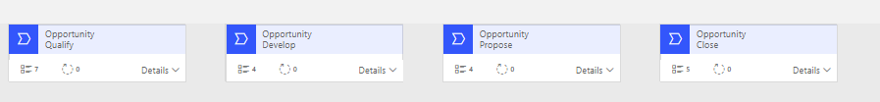
Customization options
Sales Hub app, Sales Professional app, or custom app
Security roles
Table forms and views
Business process flows

Slide 11
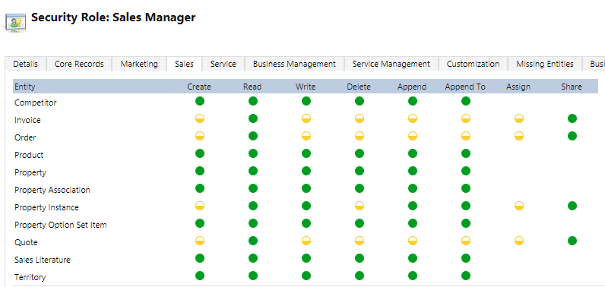
Security roles
Security privileges (row-level)
Create, Read, Write, Delete, Append, Append To, Assign and Share
Access levels (task-based)
Basic, Business Unit, Parent-Child Business Unit, Organization

Slide 12
Lab 1.1: Validate lab environment
Notes:
MB-210-Dynamics365forSales (microsoftlearning.github.io)

Slide 13

Closing slide

