Slide 1
Module 7: Create surveys with Dynamics 365 Customer Voice

Slide 2
Module agenda
Create a survey project
Create surveys with Dynamics 365 Customer Voice
Send Dynamics 365 Customer Voice surveys

Slide 3
Lesson 1: Create a survey project

Slide 4
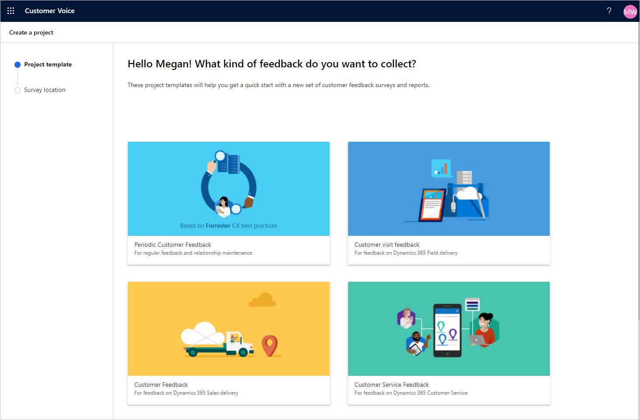
Introduction to Dynamics 365 Customer Voice
Tool for collecting and acting on feedback
Uses projects to sort groups of surveys
View survey invitations and responses

Slide 5
Projects in Dynamics 365 Customer Voice
Considerations for creating projects
What is the purpose of this project?
Who are the main stakeholders for this project that need to provide input?
Does the project cross over multiple departments that have a variety of needs?
Are clear objectives in place and are deliverables required for the project?

Slide 6
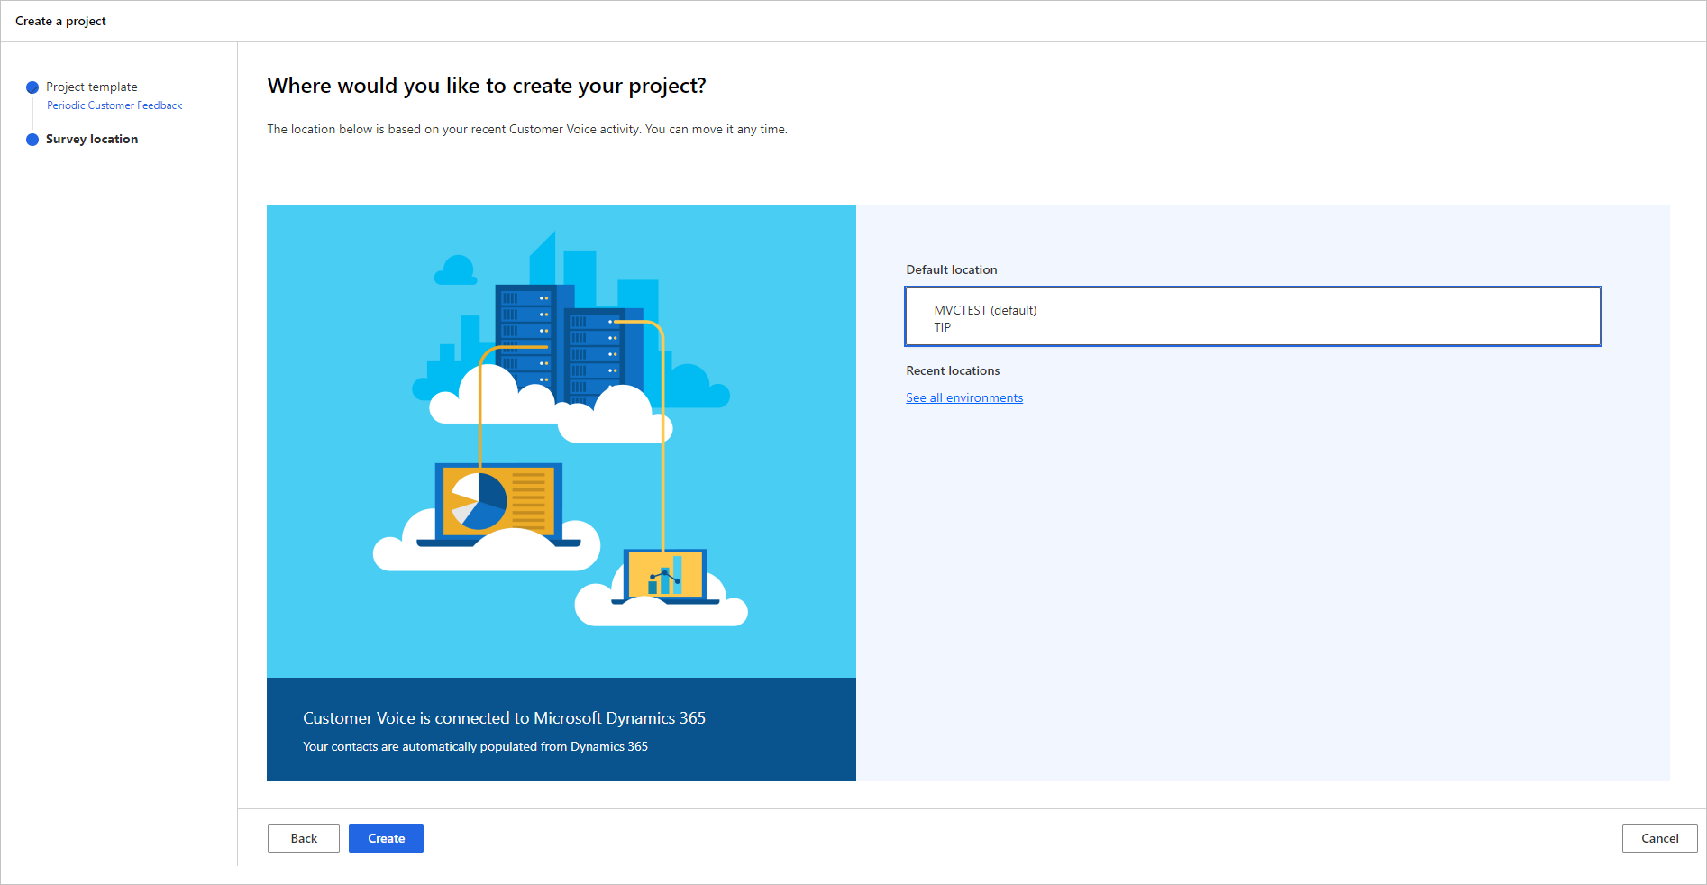
Create your first project
Suggested project templates:
Periodic customer feedback
Customer visit feedback
Customer feedback
Customer service feedback
Blank

Slide 7
Lesson 2: Create surveys with Dynamics 365 Customer Voice

Slide 8
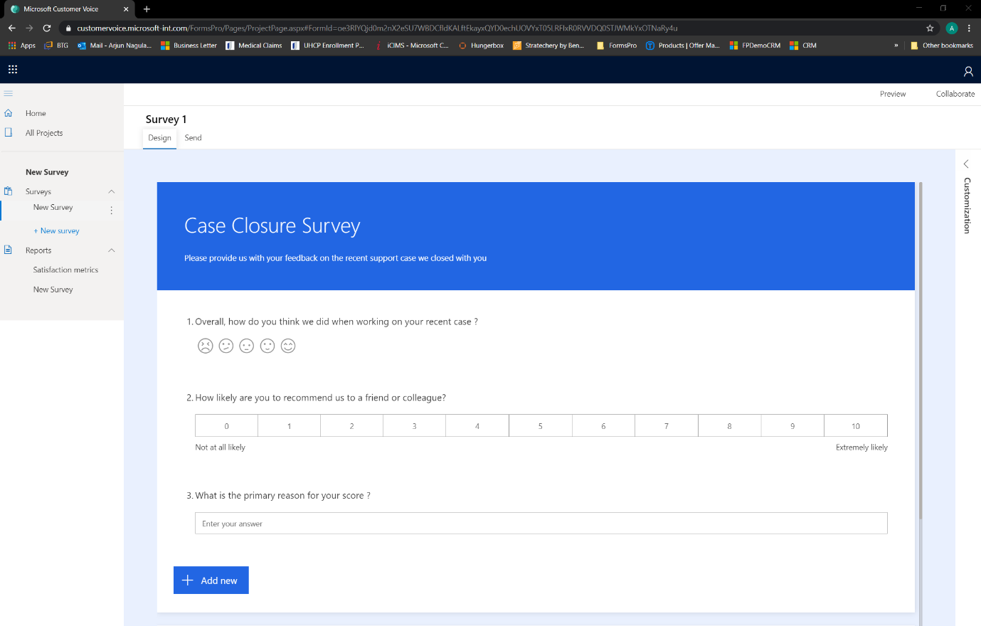
Introduction to surveys
Question types:
Choice
Text
Rating
Date
Ranking
Likert
NPS
File upload

Slide 9
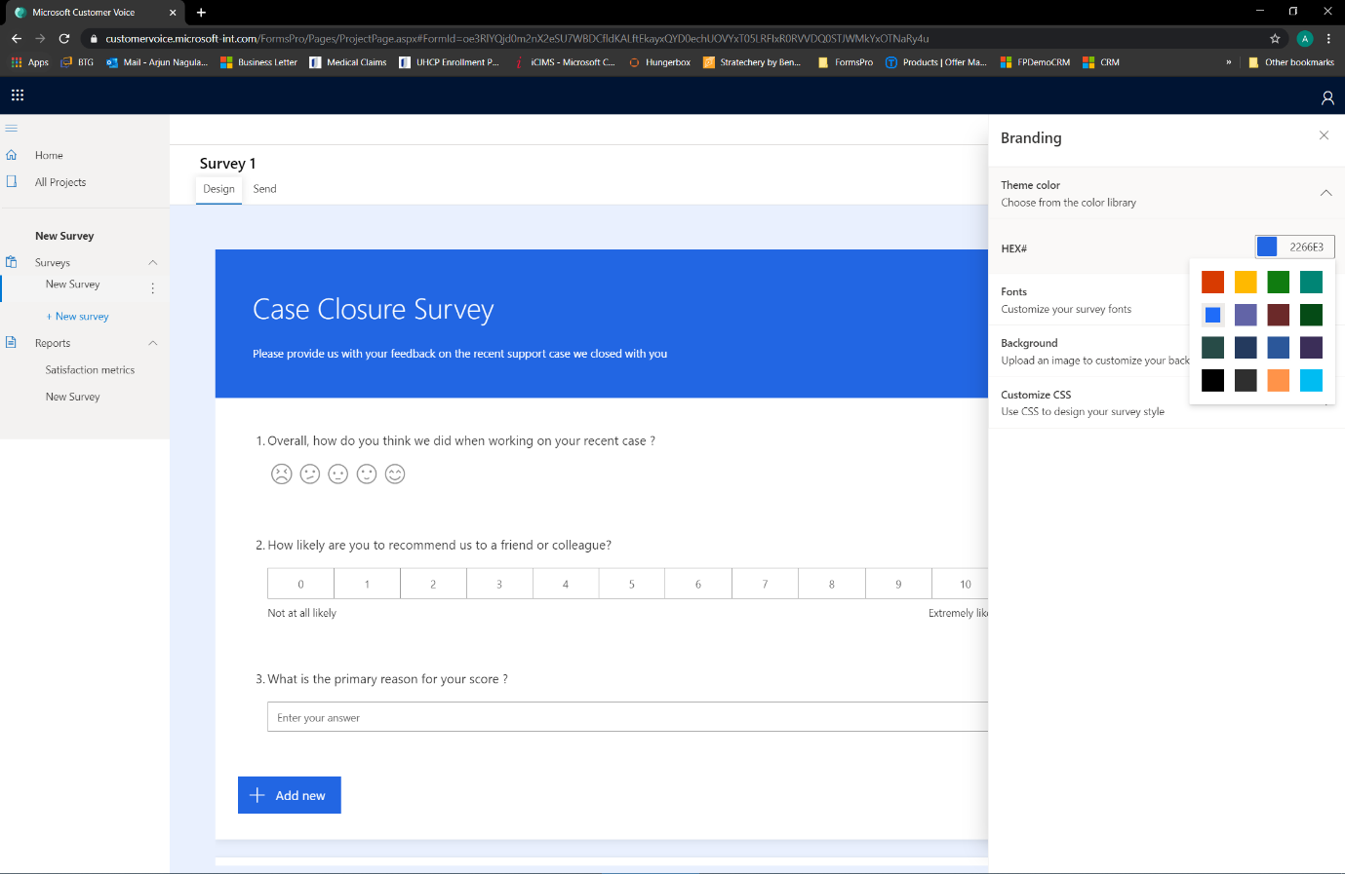
Add themes and branding
Use a theme
Add survey image or logo
Change font style, weight, color, and size
Customize thank you message and footer text

Slide 10
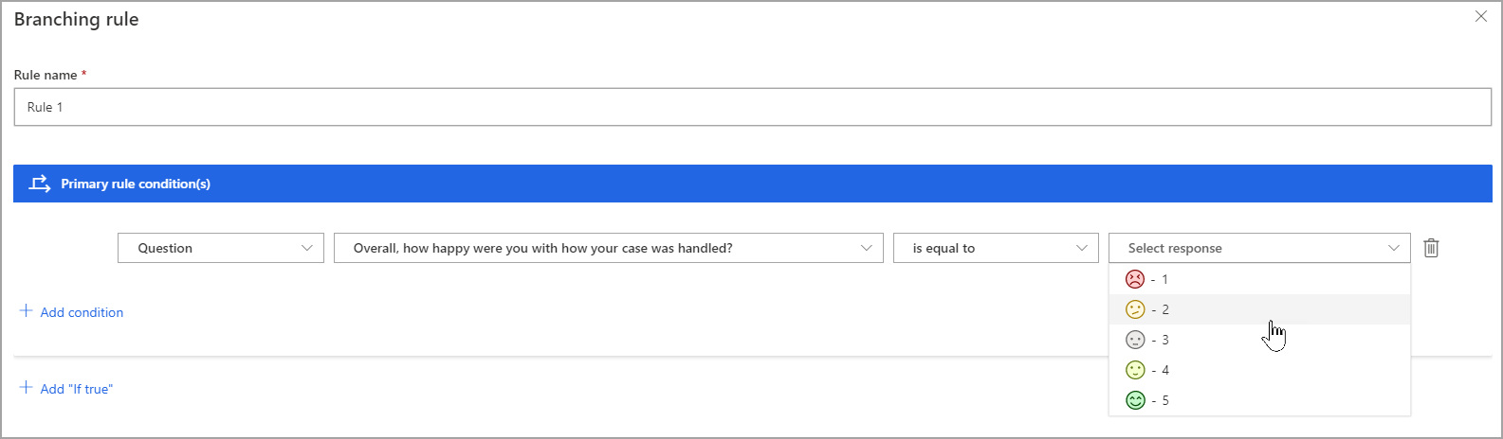
Use branching rules in a survey

Slide 11
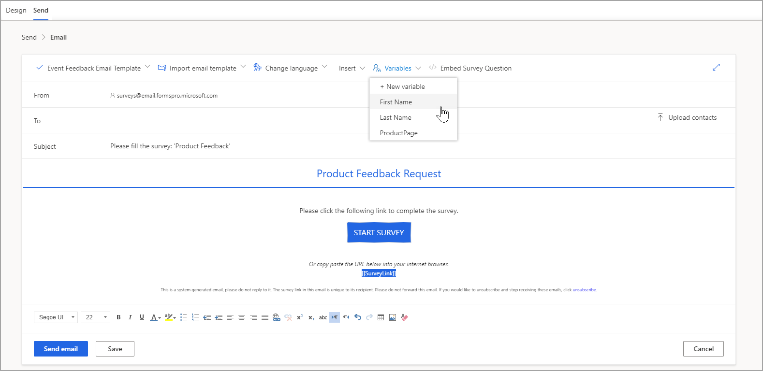
Use variables in a survey

Slide 12
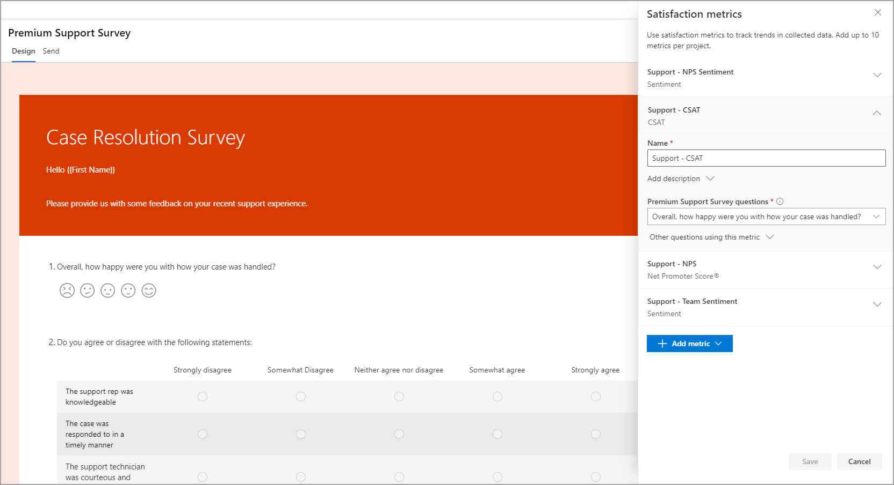
Add satisfaction metrics
NPS (Net Promoter Score)
Sentiment
CSAT (Customer Satisfaction)

Slide 13
Lesson 3: Send Dynamics 365 Customer Voice surveys

Slide 14
Introduction to sending surveys
Can use email templates with different salutations depending on purpose of template
Several components:
Subject
Survey link
Unsubscribe link
Variables (not required)
Logo (not required)
Images (not required)

Slide 15
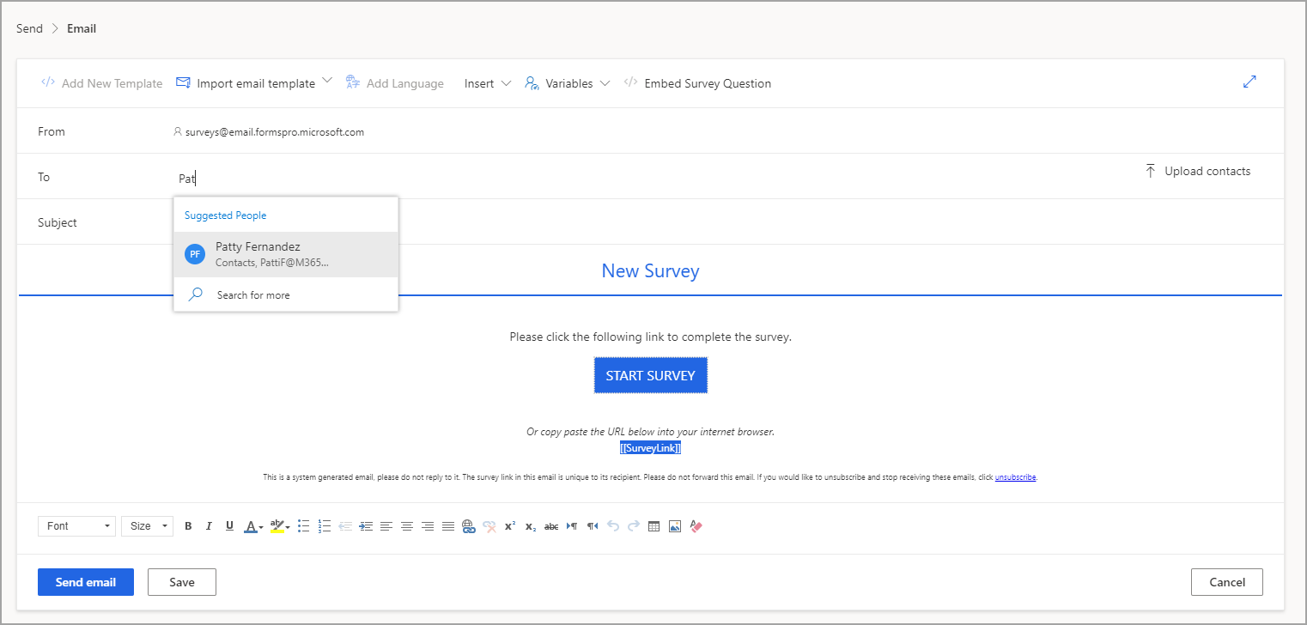
Email a survey

Slide 16
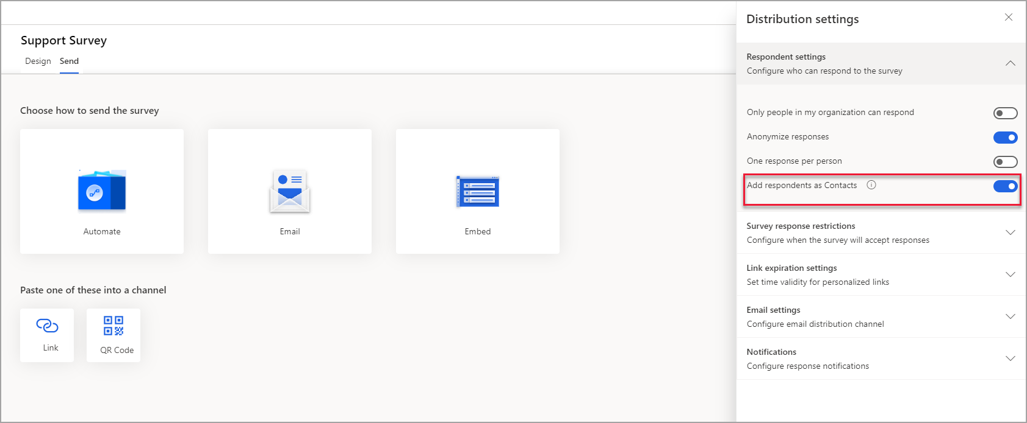
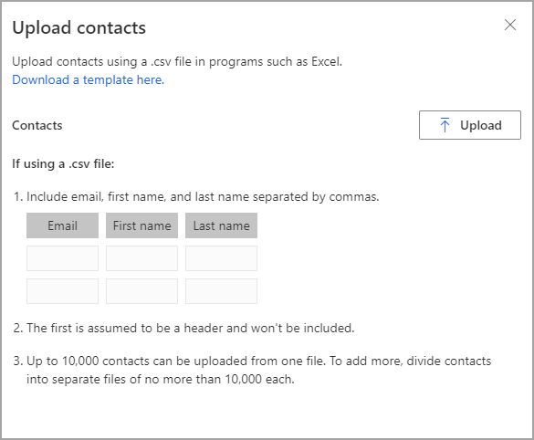
Upload CSV files

Slide 17
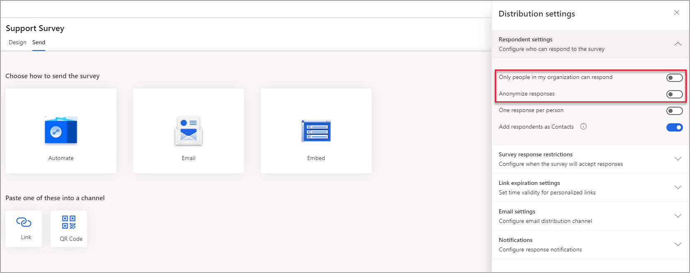
Use links and QR codes

Slide 18
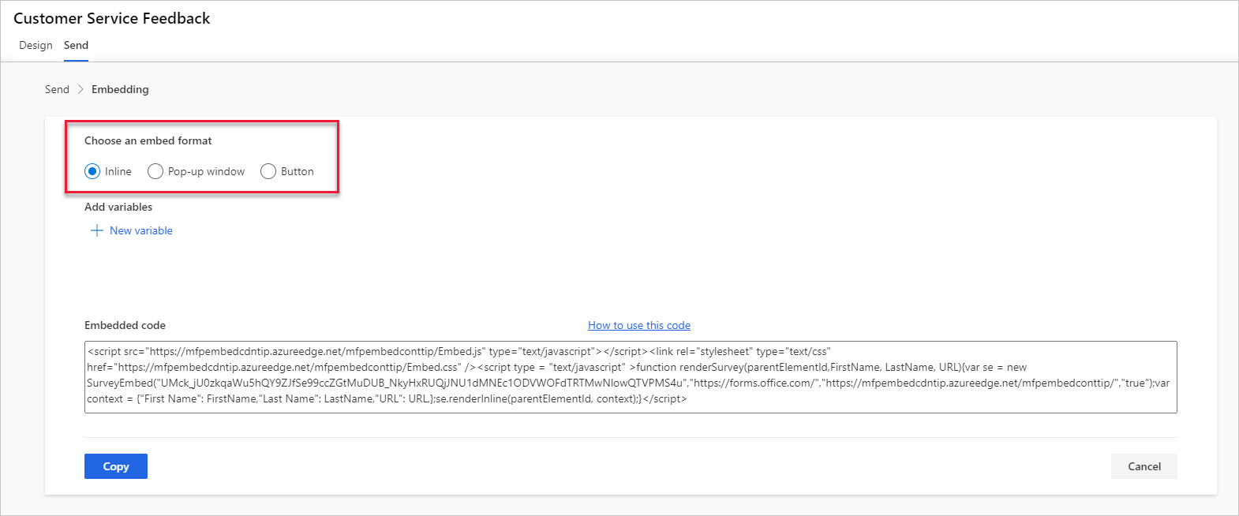
Embed survey in a website
Inline
Pop-up
Button

Slide 19

Closing slide

