Slide 1
Get started with Power Automate

Slide 2
Agenda
Power Automate overview
How to build an automated solution

Slide 3
Power Automate overview

Slide 4
Introduction
In this module, you will:
Learn the business value and features of Power Automate
See how Power Automate works and looks from a user’s perspective
Notes:
Important Note: You may have previously known Power Automate as Microsoft Flow. In October of 2019 Microsoft Flow was renamed to Power Automate to better convey the fact the service is able to more than just create workflows. You will see that you still use Power Automate to create flows. This note is here as you will see some confusion in legacy content around Microsoft Flow and flow.

Slide 5

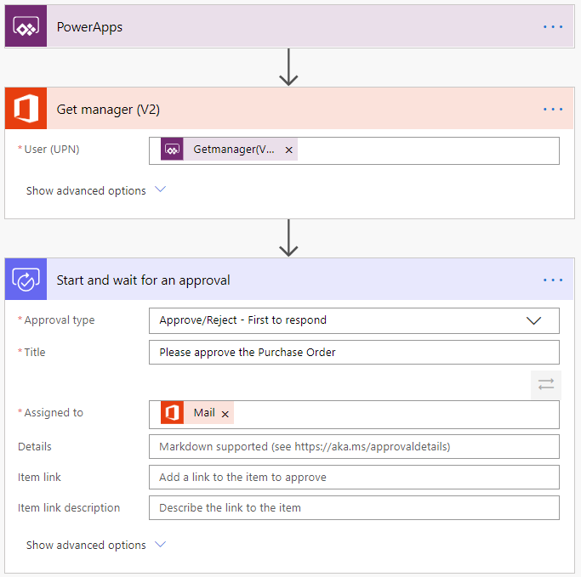
The value Power Automate brings
Common scenarios and capabilities:
Automating repetitive tasks
Guiding a user through a process
Connecting to external data sources
Automating desktop-based processes
Notes:
Do you find yourself downloading email attachments and then uploading the file to the database? Power Automate can help. Does the process of getting a new purchase order approved involve you taking a form from desk to desk to get sign off? Power Automate can help. Do you have to log into a website every morning, find the daily numbers, and then save those into another system? Power Automate can help.
Power Automate is all about having computers manage repetitive tasks. Power Automate allows anyone with knowledge of the business process to create a repeatable flow that when triggered, leaps into action and performs the process.
Common scenarios and capabilities of Power Automate:
Automating of repetitive tasks like moving data from one system to another
Guiding a user through a process so they can complete the different stages
Connecting to external data sources via one of the hundreds of connectors or directly via an API
Automating desktop based processes with robotic process automation (RPA) capabilities
Will dive into the example flow in next slides

Slide 6

What Power Automate offers
Intelligent automation for all
Automation at scale
Seamless, secure integration
Accelerated productivity
Intelligent automation
Efficiently scale automation across your organization
Allow everybody in your organization to automate workflows using their favorite on-premises and cloud-based apps and services. From end users, professional developers, to IT.
Securely integrate automation at every level
Confidently enable end users to build automated workflows in a secure, compliant manner, and focus your skilled IT resources on more complex, strategic work.
Accelerate productivity and focus on more strategic work
Minimize repetitive, manual, time-consuming tasks and create more time for your teams to focus on strategic work with easy to use low/no-code tools, templates, and connectors.
Increase efficiency through automated workflows with the power of AI.
Streamline how you work by combining the power of AI with automated workflows and business process.
Notes:
Manual, repetitive, and error-prone tasks are a drag on the strategic thinking needed to drive my business forward. To improve business processes, organizations need an efficient way to scale automation across my organization.
Some of the ways they can do this in Power Automate is through the power of the Microsoft 3 cloud services and combination of DPA +RPA in one single automation platform. Key capabilities include
Automate legacy software using bots and screen scraping (without APIs), with SaaS-based robotic process automation (RPA).
Automate across your widely used 1st and 3rd party apps and services (275+) without APIs
Power Automate is an end-to-end platform for data integration across on-premises software and cloud services.
Integrate your data from Dataverse to get a holistic view across your business.
Natively integrates with Microsoft’s three largest cloud services: Azure, Microsoft 365, and Dynamics 365.
Capitalize on cost-effective pricing for individuals and teams that scales to your needs.
Digital process automation (DPA) enables everyone to do their jobs without having to wait for information or request additional access.

Slide 7

Example: A purchase order approval
Approvals are a great process to build in Power Automate. They are often – defined yet manual. Check out the following scenario for an example:
A user starts the process by going into a Power Apps app and creating a purchase order request. Once they submit the request the information is sent to a Power Automate flow
The flow can be built to evaluate the request and then route the request based on criteria such as submitting user and request amount. The first action could be to send the request to the user’s manager. The manager could be automatically retrieved from Azure AD avoiding prompting for duplicate information
Notes:
Most organizations has some type of approval process that could benefit from automation.
Time off
Invoice approval
Project sign off

Slide 8
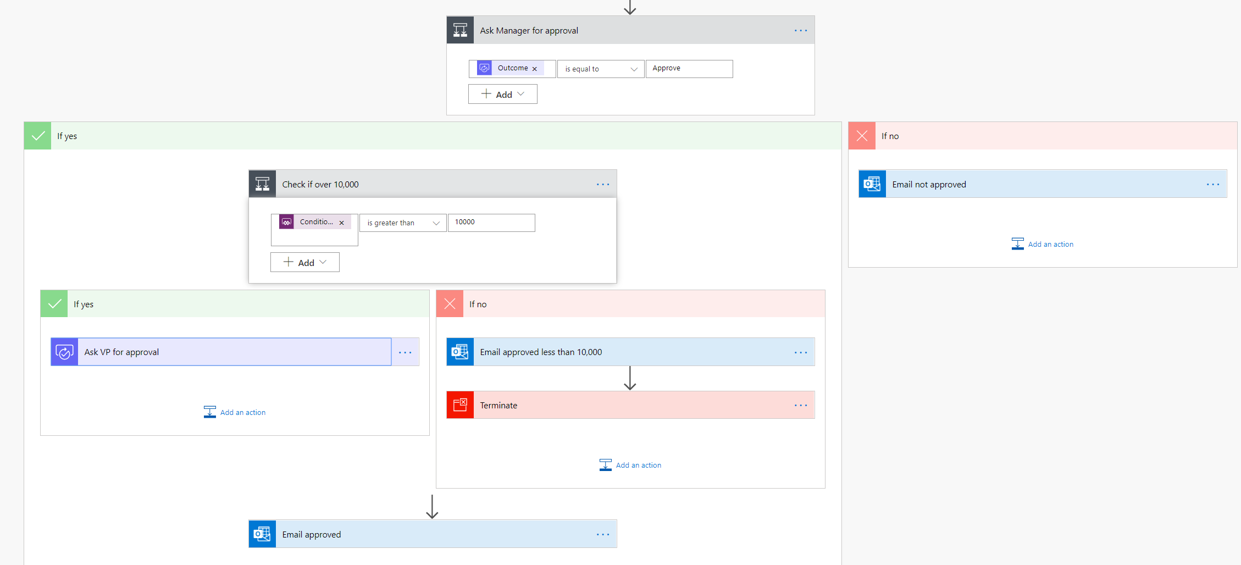
Example: A purchase order approval – continued
After the manager receives the approval and approves, the flow can then provide conditional logic. Typically this might be something like if the purchase order request is greater than $10,000 send it to VP if not then automatically approve the purchase order
Here is an example of what this flow may look like
Notes:
As you can see even the business process has many decision points. Your flow easily handles the decisions without you writing any code.

Slide 9
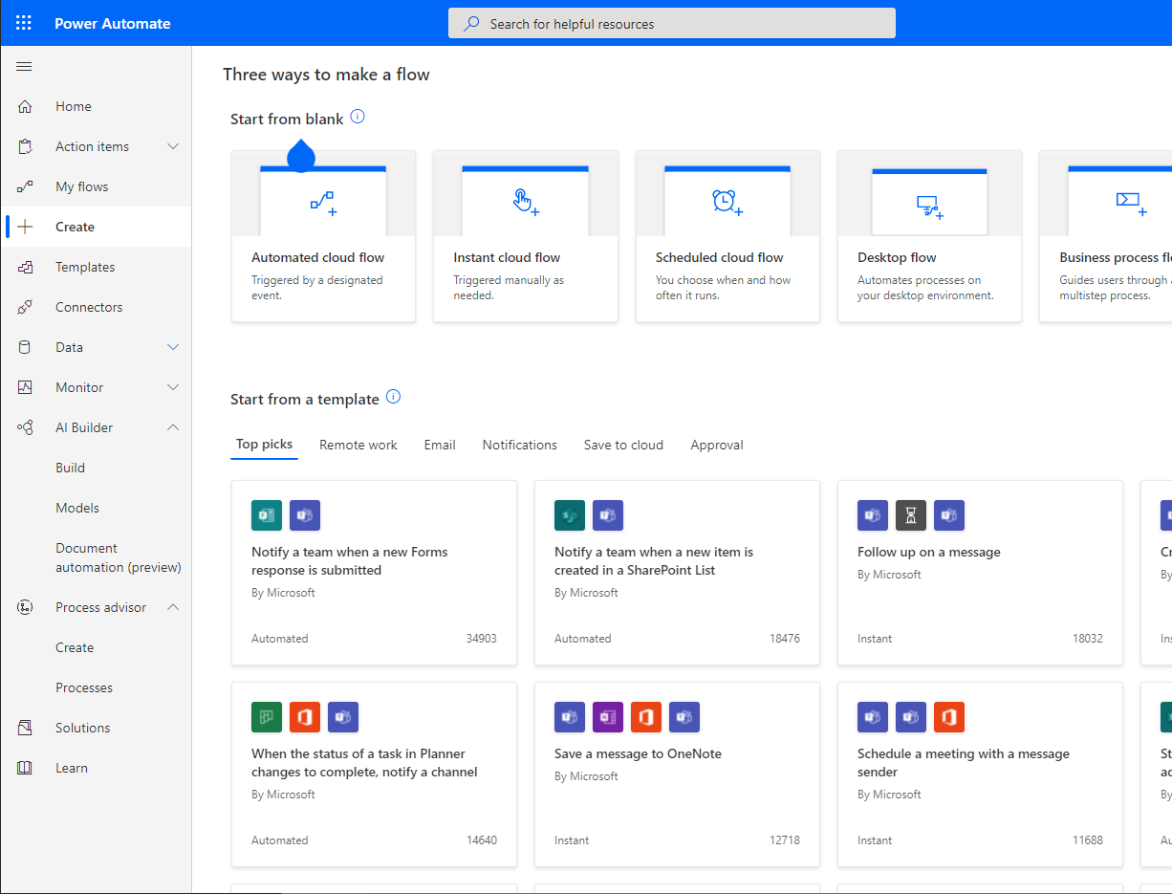
The three types of flows you can create with Power Automate
Power Automate works by creating flows, of which there are three types:
Cloud flows (API)
Instant
Automated
Scheduled
Business process flows (BPM)
Desktop flows (RPA)
Notes:
Power Automate works by creating flows, of which there are three types:
Event driven flows - These are flows that you build with a trigger and then one or more actions. There are a multitude of triggers and actions available, thanks to the existing connectors. You will see these as My flows and Team flows in Power Automate. The only difference between a My flow and a Team flow is ownership. With a My flow you are the sole owner, while a Team flow has more than one owner.
Business process flows - These flows are built to augment the experience when using Model-driven apps and Dataverse. Use these to create a guided experience in your Model-driven apps.
Desktop flows – Formerly known as UI flows. These robotic process automation (RPA) flows allow you to record yourself performing actions on your desktop or within a web browser. You can then trigger a flow to perform that process for you. You can also pass data in or get data out of the process, letting you automate even "manual" business processes.

Slide 10
Add artificial intelligence to your flow without writing code
To take advantage of these AI capabilities you must first build a model. From make.powerapps.com a wizard guides you through building and training the model. Currently, there are four available AI models available to build:
Form processor:
This model extracts text from an uploaded image or taken photo
Object detector:
This model identifies objects from an uploaded image or taken photo and then provides a count of the number objects present
Prediction:
This model predicts whether something will happen or not based on previous data history. More details in the following section
Text classification:
This model categorizes text by its meaning, making it is easier to analyze
Notes:
AI Builder is a Microsoft Power Platform capability that provides AI models that are designed to optimize your business processes. AI Builder enables your business to use intelligence to automate processes and glean insights from your data in Power Apps and Power Automate. With AI Builder, you don't need coding or data science skills to access the power of AI. You can build custom models tailored to your needs, or choose a prebuilt model that is ready to use for many common business scenarios.
Common business scenarios
Automate customer application processing: Model type - Document processing
Automate expense reports: Model type - Receipt processing
Categorize user feedback based on their focus: Model type - Category classification
Extract insights from product reviews: Model type - Entity extraction
Identify language of text: Model type - Language detection
Identify and classify customer feedback: Model type - Sentiment analysis
Translate support requests into your language: Model type - Text translation
Identify fraudulent transactions: Model type - Prediction
Get alerted to social media posts referencing your brand: Model type - Key phrase extraction
Automate contact list: Model type - Business card reader
Automate inventory taking: Model type: - Object detection
Take a photo of text and save it to a database: Model type - Text recognition

Slide 11
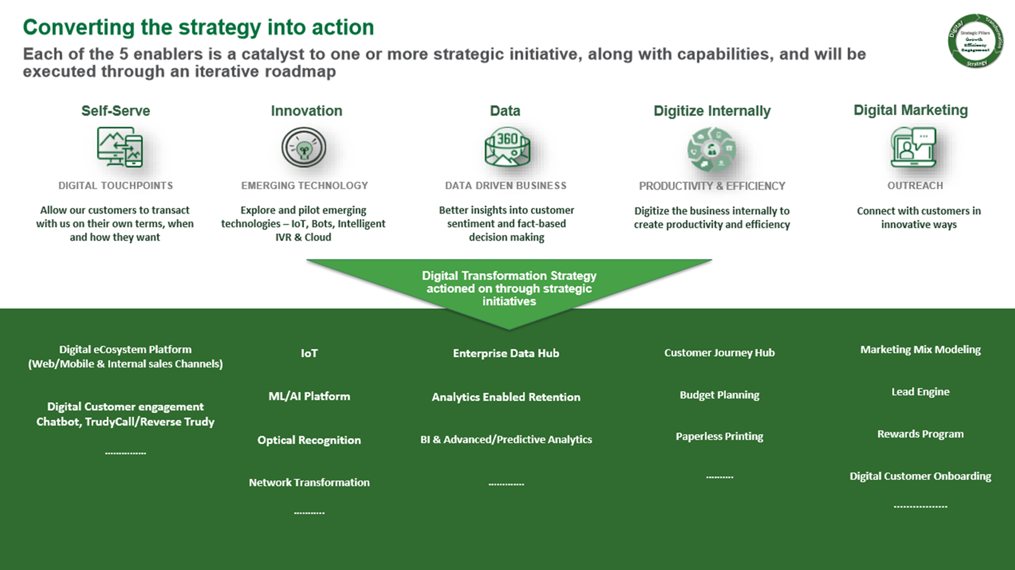
Customer case study: TruGreen
See full TruGreen case study here.
Notes:
This slide shows an infographic of their digital transformation strategy.
To provide better services they built a new artificial intelligence enabled virtual agent bot. The virtual agent was built without writing any code and instead used Power Virtual Agents to faciliate handling routine customer requests and to take action based on customer intent. To expose and interact with the back end data required they used Power Automate.
Tru Green used some of the hundreds of connectors avaiable for Microsoft Power Platform to connect to traditional data sources. Using these capabilities they had their first protype running in two days, once again without a single line of code.
In addition they had systems that didn't have APIs to be used by the connectors. For these systems they leveraged desktop flows. With desktop flows they were able to mimic onscreen actions that customer service associates used to perform manually via robotic process automation (RPA).
Now they have a fully functional virtual agent for interacting with their customers that can take action on the customers' intent in a meaningful way. This is just the first step as they continue to drive better customer experiences and more business value using these tools.
To read more about the virtual agents TruGreen has built and what they have planned next please see the full case study here: https://customers.microsoft.com/en-us/story/759484-trugreen-partner-professional-services-power-virtual-agents
In the next unit, you will get an overview of some of these solutions in Power Automate and learn how you can get started with building your own flows.

Slide 12
Power Automate in action
Demo: Create a flow with Power Automate
Notes:
A video demo is available at the following link: https://www.microsoft.com/en-us/videoplayer/embed/RE4mERh

Slide 13
Power Automate overview: Summary & knowledge check
Notes:
Microsoft Power Automate allows you to bring automation to your business processes. With a different type of flow to cover different business processes plus the ability to connect to data from hundreds of data source with a few clicks, Power Automate affords great flexibility. All it takes to get started is knowledge of your business process.
Now that you have reviewed this module, you should be able to:
Explain the difference between the different types of flows and where they are used
Design flows that pull data from many data sources and include artificial intelligence
Build a Power Automate flow by starting from blank or a template
Key takeaways
Here are the four key takeaways:
Power Automate is a web-based service for automating your business processes.
Power Automate has different offerings to meet your needs. Event-driven flows, business process flows, and desktop flows each have their own unique properties.
Power Automate can connect to hundreds of data sources with the built-in connectors or you can build your own custom connectors.
If you know your business process, you can bring automation to it with Power Automate and without writing any traditional code.

Slide 14
How to build an automated solution

Slide 15
Introduction to Automation
In this lesson, you will:
Create a flow from a template
Create a recurring flow on a schedule
Create a flow triggered by a button
Understand Business Process Flows

Slide 16
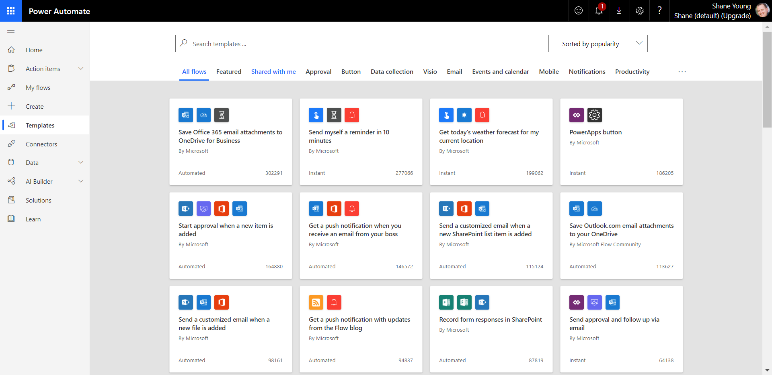
Create a flow from a template
Search using keywords for relevant templates
Example template: Create a flow to save email attachments to OneDrive for Business
Notes:
With the hundreds of triggers, actions and connectors, sometimes the hardest part about Power Automate can be figuring out where to get started. To help you get started, there are countless flow templates available to help you build a solution. To see all of the available templates you can sign into Power Automate , and select Templates from the left-hand menu.
From here, you can search by a specific word or phrase like "Common Data Service" (Dataverse) or you can browse based on category.
If you click on a specific template, you will see details about the template including the data sources it will connect to.
Create a flow to save email attachments to OneDrive for Business
From the list of templates search for "Save Office 365 email attachments to OneDrive for Business" and then click on the template to start using it.
Click Create Flow at the bottom of the screen to create the flow.

Slide 17
Important concepts in Microsoft Power Automate
Keep these concepts in mind when building flows:
Every flow has two main parts:
a trigger
one or more actions
Think of the trigger as the starting action for the flow
Actions are what you want to happen when a trigger is invoked.
Some examples of types of actions you can have in a flow include:
Loops
Switch
Do Until
Apply to each
Expressions
Notes:
Keep these concepts in mind when building flows:
Every flow has two main parts: a trigger, and one or more actions.
You can think of the trigger as the starting action for the flow. The trigger can be something like a new email arriving in your inbox or a new item being added to a SharePoint list.
Actions are what you want to happen when a trigger is invoked. For example, the new email trigger will start the action of creating a new file on OneDrive for Business. Other examples of actions include sending an email, posting a tweet, and starting an approval.
Some examples of types of actions you can have in a flow include:
Loops – Runs an action until conditions are met to move to the next step of the flow
Switch – Identifies a single case to execute based on the evaluation of input
Do Until – Executes a block of actions until a specified condition evaluates to true
Apply to each – Executes a block of actions for each item in the input array
Expressions – underlying definition that describes the actual logic that runs in your flow that can be manually written
You can also perform data operations in your flow, such as Compose, Create CSV table, Join, or Select. These concepts will come into play later when you build your own flows from scratch.

Slide 18
Trigger or run the flow
With Power Automate, you don’t think of running a flow the same way as you do with Power Apps. Instead, you perform the activity that triggers the flow to run.
When defining triggers, there are a few different types:
When something changes:
These are triggers that run when data is changed. It could be a new item created in SharePoint, a lead is updated in Dynamics, or when an event has been deleted from Outlook for example
On a schedule:
You can set up a flow to be triggered at a certain time of a day and with a recurrence. This allows for workflows such as checking every day at 8 AM if there are account renewals pending and if so, sending an email to the necessary people
On a button press:
This trigger takes shape in many different ways. This can be when a flow virtual button is run through the mobile app, or a physical button is clicked with 3rd party options, or even when a button is pressed inside of Power Apps. This gives you that control to “run” a flow on-demand
Notes:
With Power Automate, you do not think of running a flow the same way as you do with running a Power Apps app. Instead, you perform the activity that triggers the flow to run. In the case of the previous flow, instead of periodically running the flow manually, it would automatically run every time a new email is received with an attachment. This is because the flow has the trigger that determines when it should run.

Slide 19
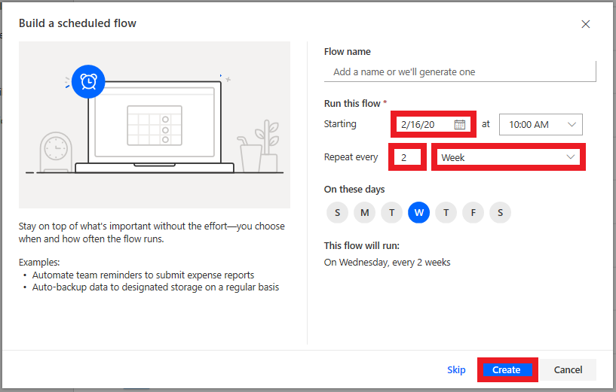
Scheduled flows
Scheduled flows can run:
Once a day, an hour, or a minute
On a date that you specify
After a number of days, hours, or minutes that you specify
Notes:
Create the flow:
For example, if you want the flow to run every two weeks, enter 2 in the Interval field, and select Week in the Frequency field. You can also specify the day of the week your flow should run. The text at the bottom of the dialog box explains your inputs in plain language.
Specify advanced options
For example, set up the flow as shown in the following graphic to start it no earlier than noon (Pacific time) on Monday, January 1, 2018, and to run it every two weeks, at 5:30 PM (Pacific time) on Tuesday.
Use the compose action
Use the Data Operation - Compose (compose) action to save yourself from entering identical data multiple times when you are designing a flow.
**Follow steps on Build recurring flows - Learn | Microsoft Docs to build a recurring flow (can do as demo or individual exercise)

Slide 20
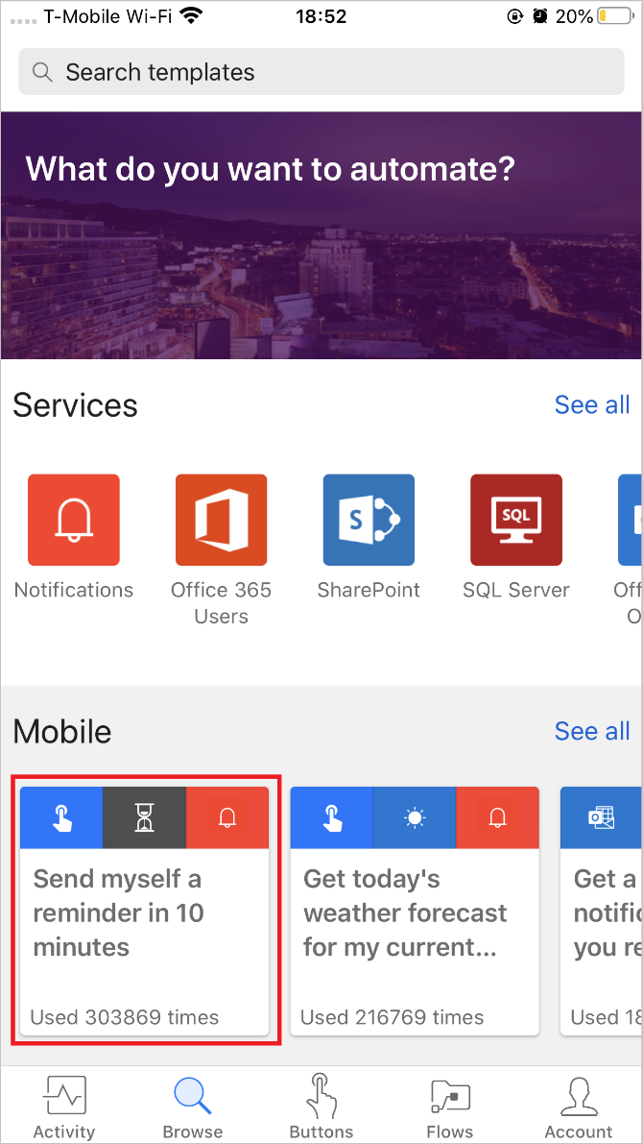
Button flows
Create a Flow using a button through the Power Automate mobile app
Activity Feed
Browsing
Buttons
Managing Flows
How button flows are started
Buttons are flows that are started through a manual action.
Notes:
Create a Flow using a button through the Power Automate mobile app
First, you'll need to download and install the Power Automate mobile app from your app store.
After it's installed, start it and sign in.
When you first start the app, you'll see the Activity Feed. The Activity Feed is the place to see what's happening with your flows. It won't be the full experience you'd expect from your PC, but it will show you useful details.
For example, you'll see a flow's last activity. You can see whether the flow succeeded or failed. If it failed, you'll see which step it failed on.
**Follow steps on Build a button flow - Learn | Microsoft Docs to build a button flow (can do as demo or individual exercise)

Slide 21
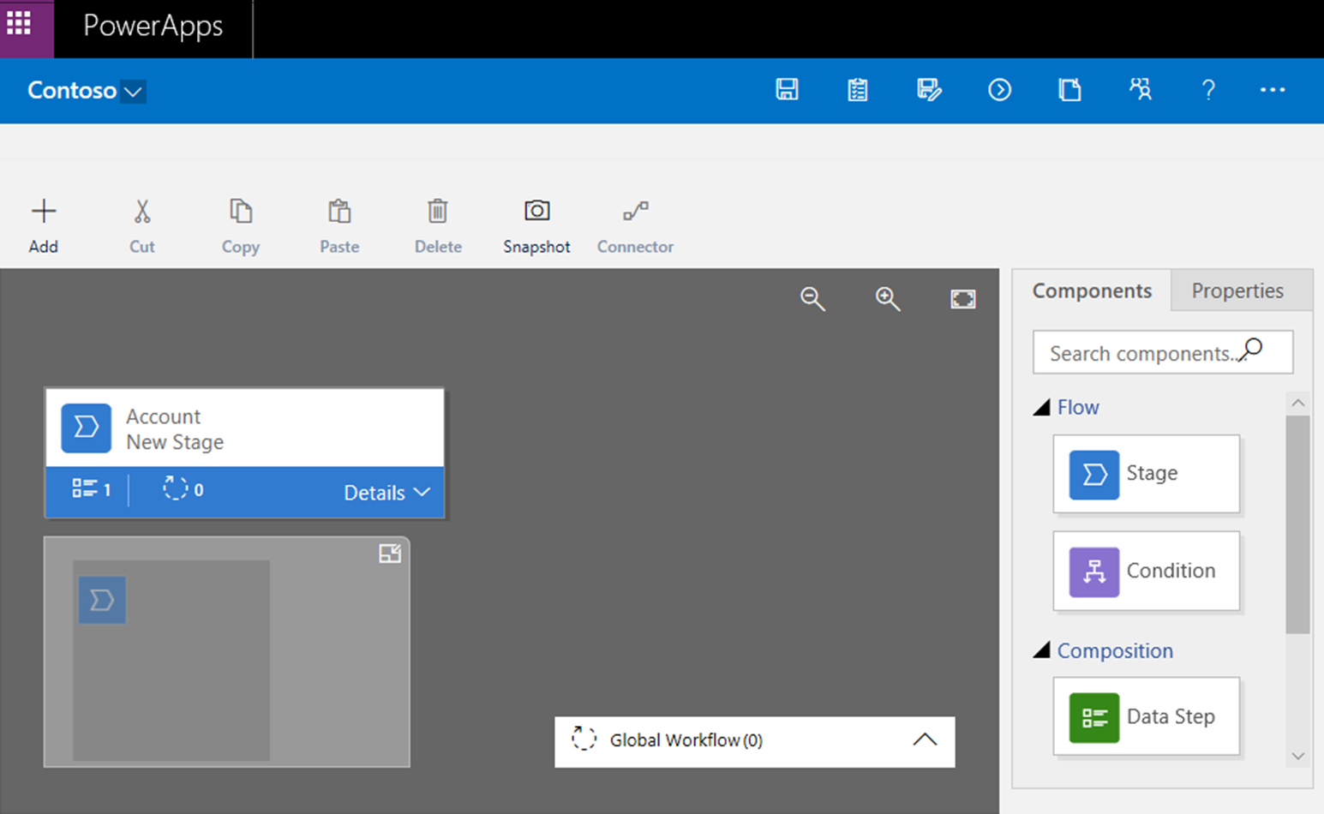
Understand business process flows
Used to guide a user through the steps of your business process when working with model-driven apps and Dataverse
Notes:
Stage Name: You can change the stage name after you create the stage.
Table (entity): You can change the table for any stage except the first one.
Stage Category: A category lets you group stages by the type of action. It's useful for reports that will group records by the stage that they're in. The options for the stage category come from the Stage Category global option set. You can add more options to this global option set and change the labels of existing options. You can also delete options, but we recommend that you keep the existing options. If you delete an option, you won't be able to add it back later. If you don't want an option to be used, change the label to Do not use.
Relationship: Enter a relationship when the preceding stage in the process is based on a different table than the current stage. For the current stage, select Select relationships, and then specify the relationship that should be used when the flow moves between the two stages. We recommend that you specify relationships, because they provide the following benefits:
Attribute maps are often defined for relationships. These attribute maps automatically carry over data between records. Therefore, they help minimize the amount data entry that's required.
When you select Next Stage on the process bar for a record, any records that use the relationship are listed in the process flow. Therefore, the reuse of records in the process is promoted. In addition, you can use workflows to automate the creation of records. Users then just have to select the workflow instead of creating a record. Therefore, the process is streamlined.
Set Process Flow Order: If you have more than one business process flow for a table (record type), you must specify which process is automatically assigned to new records. On the action bar, select Order Process Flow. For new records or records that don't already have a process flow associated with them, the first business process flow that a user has access to will be used.
Enable Security Roles: A user's access to a business process flow depends on the privileges that are defined for the business process flow in the security role that's assigned to the user. By default, only the System Administrator and System Customizer security roles can view a new business process flow.
**No exercise for this topic. Optional to perform a demo if time allows.

Slide 22
How to build an automated solution: Summary & knowledge check
Notes:
In a world of increasing distraction, it is more important than ever to alleviate repetitive or menial tasks to better focus on the important work at hand. Power Automate allows businesses to do just that by leveraging hundreds of connectors, templates, triggers and actions to allow beginners and advanced developers alike to craft powerful workflows and increase business efficiency.
Now that you have reviewed this module, you should be able to:
Create a flow from a template
Create a recurring flow on a schedule
Create a flow triggered by a button
Create an approval request flow and utilize the approval center
Create a business process flow
Key takeaways
Here are the four key takeaways:
Power Automate has hundreds of connectors to ensure you can create useful solutions that integrate with all your business programs.
Power Automate has hundreds of templates that combine actions and triggers from connectors to create workflows useful for any business scenario.
Automation can save your business time and energy spent on repetitive tasks and make your business run more smoothly.
Power Automate's approval center allows users to easily see and manage approvals from a variety of flows to ensure ease of use and efficiency.

Slide 23

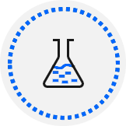
Lab
Lab 1: How to build an
automated solution

Slide 24
Closing slide

