Slide 1

GetTrained
INFO 6150 -- Web Design and User Experience Engineering (Fall 2018)
- Bhargavi Sabbisetty – 001497937
Aman Gupta - 001448126
Hardik Soni – 001498969
Sumit Janawlekar – 001448296

Slide 2
What's GetTrained about?
GetTrained allows you as an instructor create courses and nominate users to learn the course
The users are notified for the courses they are nominated
Users can view the list of courses they are nominated for
Instructors can view the list of courses they created
The beauty of the system is anyone in the system can be an instructor and a user
Actors in the system:
Admin
Users
Can be an instructor or a learner

Slide 3
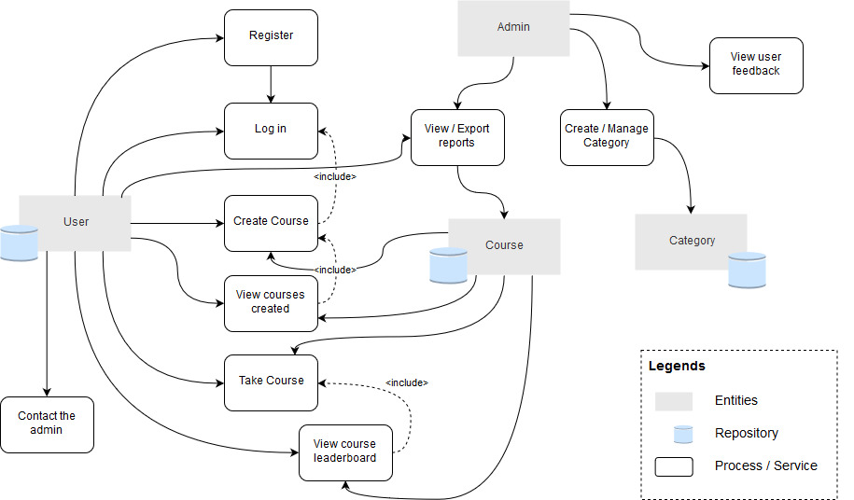
Screenshots – Object Model

Slide 4
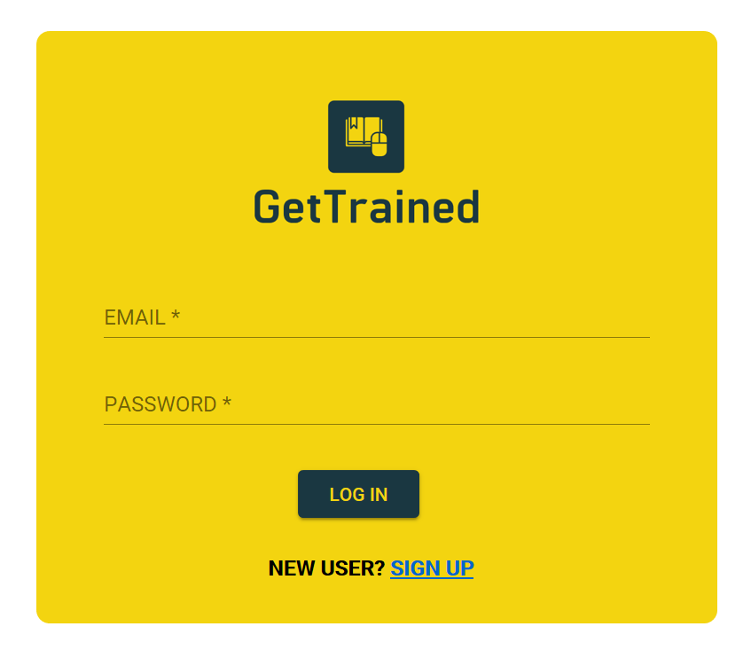
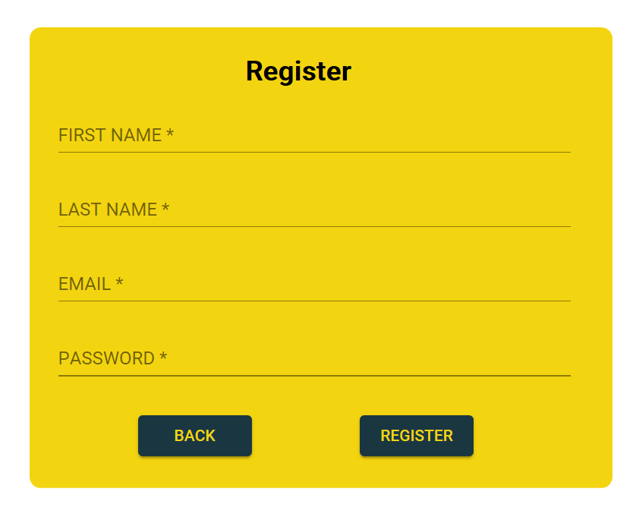
Screenshots – Login & Registration Screen

Slide 5
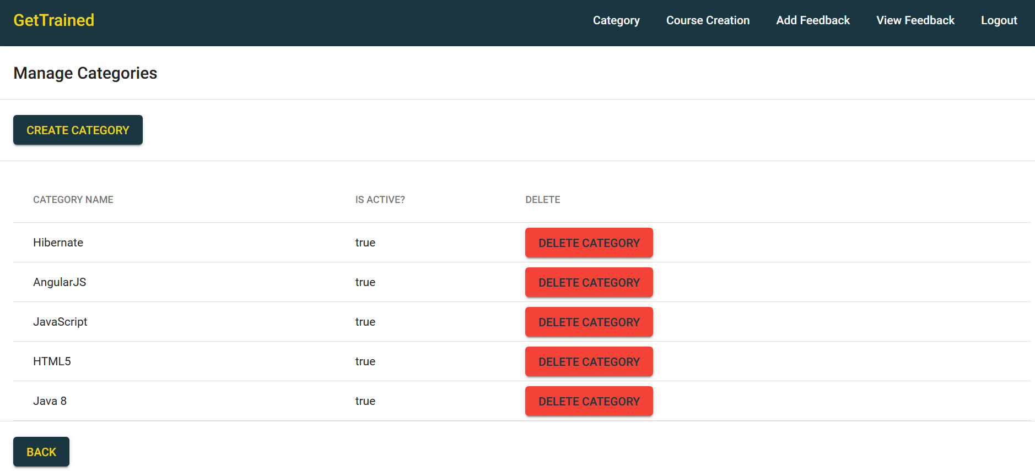
Screenshots – Manage Course Categories Screen

Slide 6
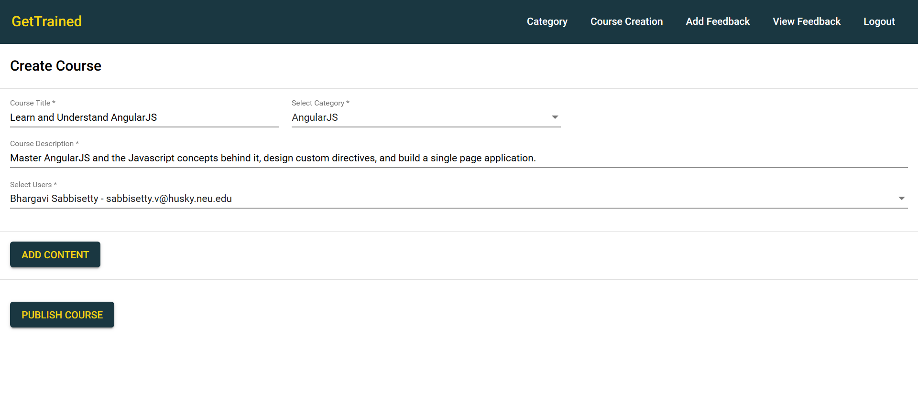
Screenshots – Create Course Screen

Slide 7
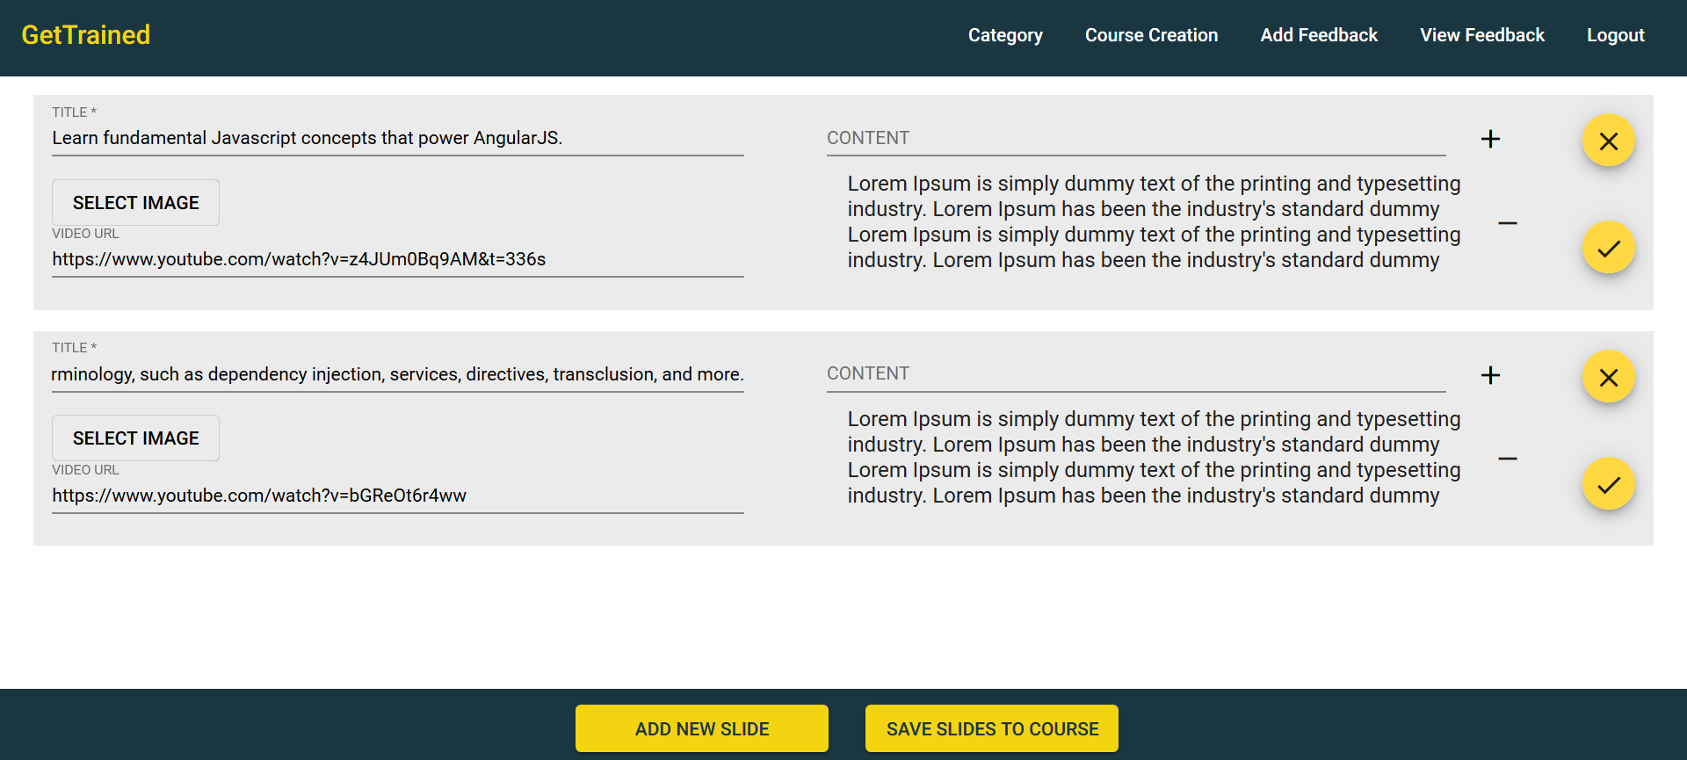
Screenshots – Manage Course Content Screen

Slide 8
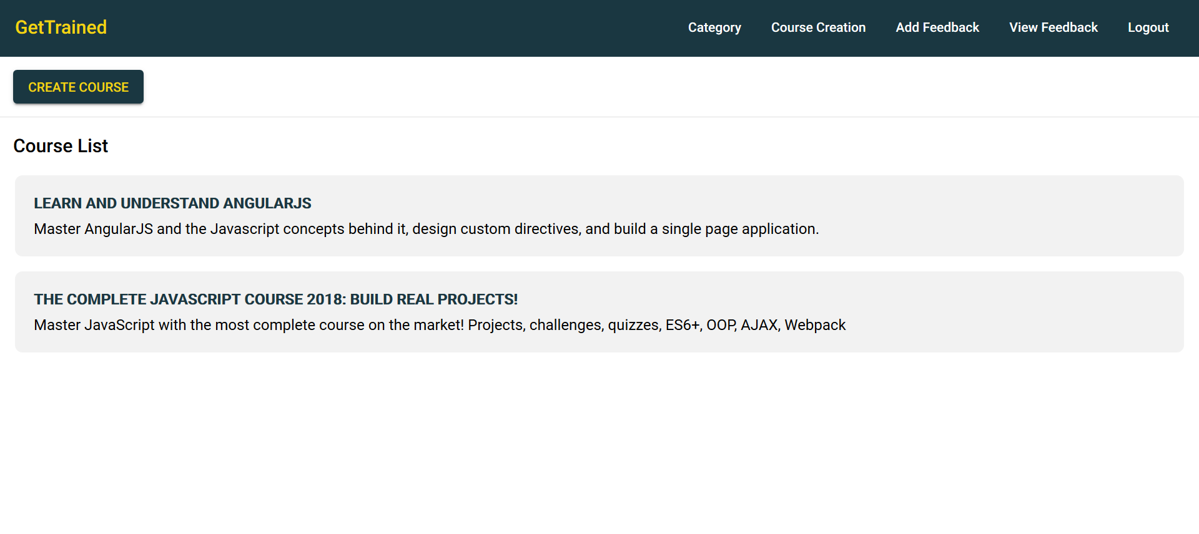
Screenshots – Course List Screen

Slide 9
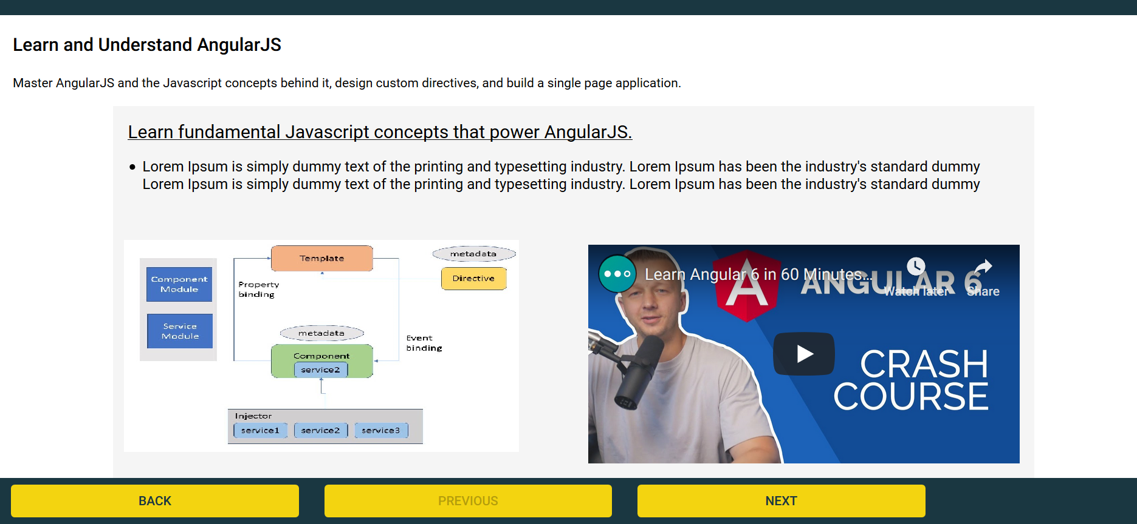
Screenshots – View Course Screen

Slide 10
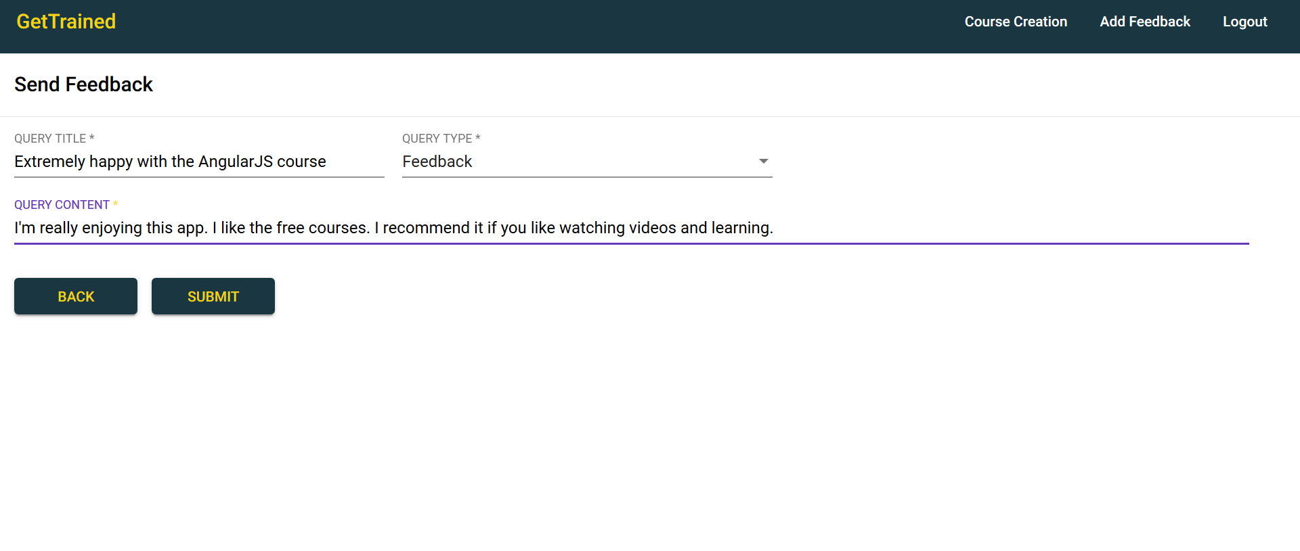
Screenshots – Create Feedback Screen

