Slide 1

Titanium Mobile:
Introductory Lab Session
Kevin Whinnery
Twitter: @kevinwhinnery | http://kevinwhinnery.com
More Information:
Twitter: @appcelerator | http://appcelerator.com
http://www.appcelerator.com | Code Strong!

Slide 2
Today’s Presentation
What is Titanium (Mobile)?
High level Titanium Mobile Architecture
API Overview
Lab Session: A Simple TwitPic Client
http://www.appcelerator.com | Code Strong!

Slide 3
Want to give this talk?
This presentation is designed for reuse
Give this talk at your user group
Slides, Code, Examples, and Notes available at github.com/kwhinnery/MeetupPack
Tweet @appcelerator and let us know you’re giving a #titanium presentation!
http://www.appcelerator.com | Code Strong!

Slide 4
What is Titanium (Mobile)?
Titanium is a framework for building native applications using web technologies
Desktop Platforms: Win32, Mac, Linux
Mobile Platforms: iPhone, Android
Open Source (Apache 2.0 License)
Website: http://appcelerator.com
Source: http://github.com/appcelerator
http://www.appcelerator.com | Code Strong!

Slide 5
Why Titanium?
Native Apps
  Responsive
  Leverage Device Capabilities
Web Tech
  Common Skill Set
  Fast Development
Best of both worlds
One set of technologies, many platforms
http://www.appcelerator.com | Code Strong!

Slide 6
Titanium Mobile – Architecture
UI API contains mappings to native UI components
Navbar, Tabbar, Toolbar, Menus
Dialogs, Alerts, Buttons
Application Source Files
(HTML, CSS, and JavaScript)
Phone API contains mappings to native phone capabilities
Geo, Accelerometer, Maps, Sound
Database, File System, Network
Your Application
Your Application
UI API
Phone API
UI API
Phone API
JavaScript - Objective-C Bridge
JavaScript - Java Bridge
iPhone Objective-C API
Android Java API
Native iPhone App
http://www.appcelerator.com | Code Strong!
Native Android App

Slide 7
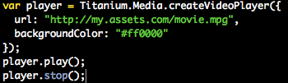
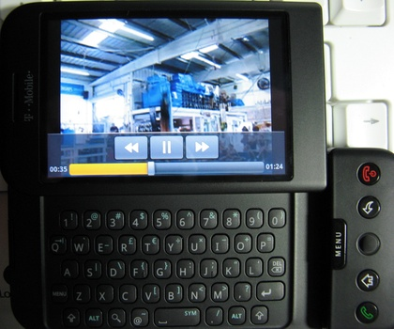

Media APIs
Stream or package audio and video
content
http://www.appcelerator.com | Code Strong!

Slide 8

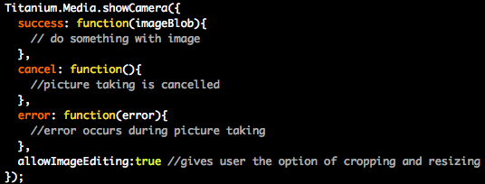
More Media APIs
Interact with the iPhone or Android
built-in cameras
http://www.appcelerator.com | Code Strong!

Slide 9
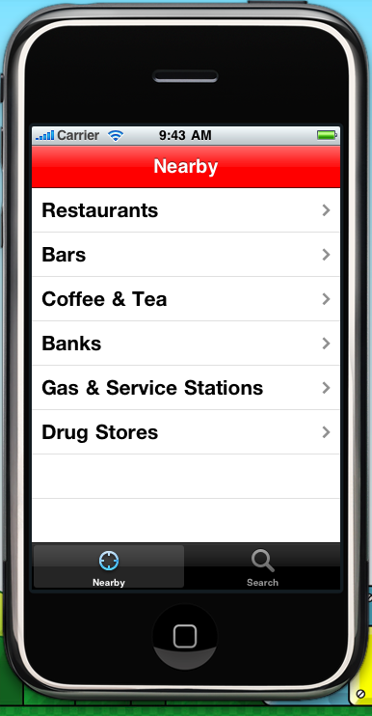
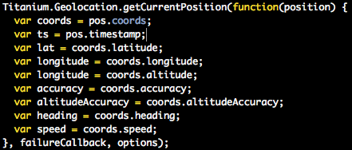
Geolocation API
Use Geolocation to leverage your
user’s position in the world
http://www.appcelerator.com | Code Strong!

Slide 10
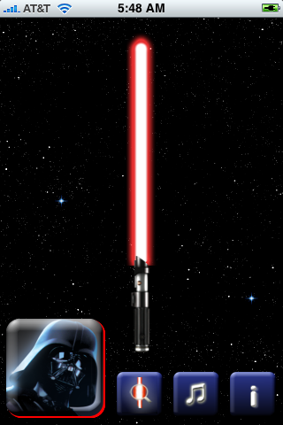
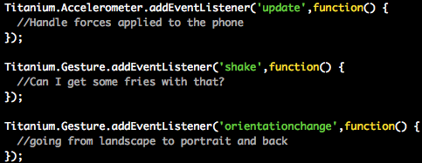
Accelerometer API
Use advanced gestures and track movement to create groundbreaking user interfaces
http://www.appcelerator.com | Code Strong!

Slide 11



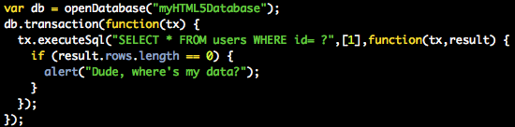
Database and File System
Access a SQLite Database (synch or asynch) and the platform file system
http://www.appcelerator.com | Code Strong!

Slide 12

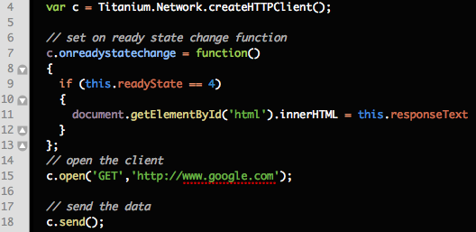


Network
XHR-style object for remote data requests.
http://www.appcelerator.com | Code Strong!

Slide 13
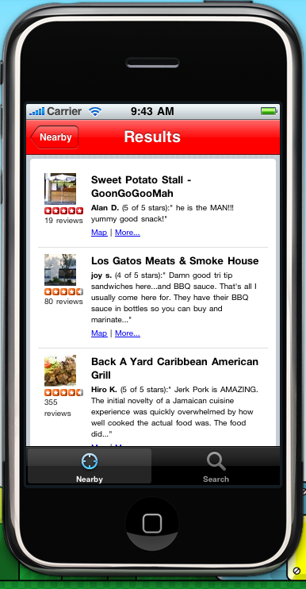
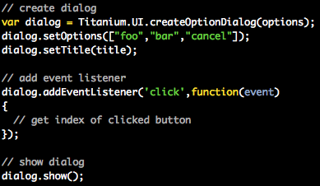
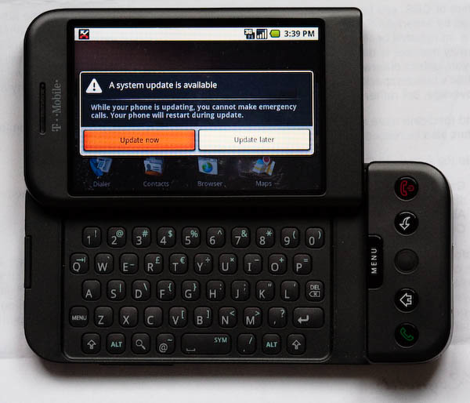
Native UI Controls
Use native controls through a JavaScript interface.
http://www.appcelerator.com | Code Strong!

Slide 14
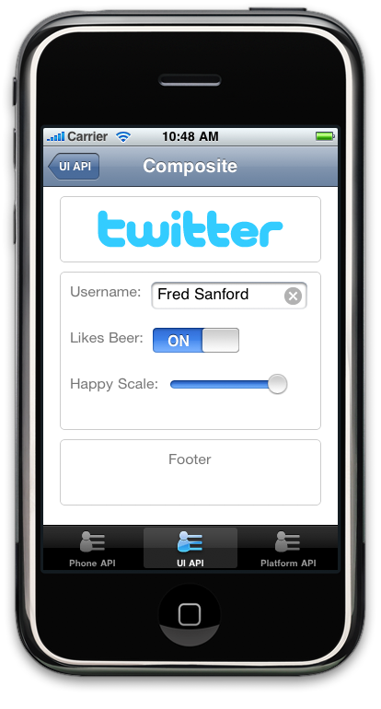
Native iPhone UI
Tab Bar
Nav Bar
Table View
Alert / Options
Group Views / Text
Many More
http://www.appcelerator.com | Code Strong!

Slide 15
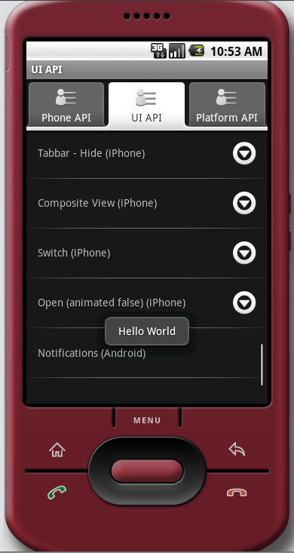
Native Android UI
Tab Bar
Table View
Alert / Options
Activity Indicator
Notifications
Many More
http://www.appcelerator.com | Code Strong!

Slide 16
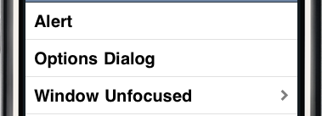
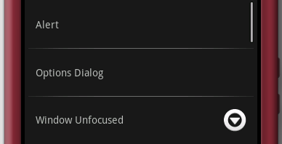
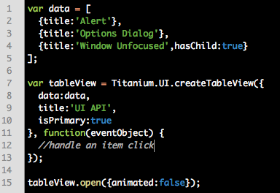
Common APIs
iPhone Table View
Android Table View
Same Code Creates Both
http://www.appcelerator.com | Code Strong!

Slide 17
More APIs
Platform / OS Data
Application Properties
Logging
More always coming
http://www.appcelerator.com | Code Strong!

Slide 18
Still Want More?
Kitchen Sink - Full API Demo
Codestrong.com has Examples and Guides
http://www.codestrong.com/timobile/samples/
http://www.appcelerator.com | Code Strong!

Slide 19
Titanium Developer
Developer is a Titanium Application
Projects created/managed via Titanium Developer
Titanium Developer deploys code to simulators
Developer also helps with testing and packaging for devices
Requires sign-up for Appcelerator Network (support, e-mail list, other services)
http://www.appcelerator.com | Code Strong!

Slide 20
Hello World!
Prerequisites
  iPhone and/or Android SDK
  Titanium Developer
  Titanium Mobile Beta Access
Your First Project
  Generate application files
  Project Structure
  Configuration Options
http://www.appcelerator.com | Code Strong!

Slide 21
Resources
Documentation: codestrong.com
Support: support.appcelerator.net
Use support for bugs, problems, or feature requests
Examples: github.com/kwhinnery
Dev Chat: #titanium_app (irc.freenode.net)
Titanium Core Development Mailing List: groups.google.com/appcelerator-titanium
http://www.appcelerator.com | Code Strong!

Slide 22
Titanium Mobile Lab
Objective: TwitPic Client Application
APIs: UI Controls, Photo Gallery, Camera, HTTP Client, Properties
Third Party Library of Choice: jQuery
NOTE: Titanium does not depend on ANY 3rd party JavaScript library - use whatever you like
Extra Credit - Start Hacking Your App!
http://www.appcelerator.com | Code Strong!

Slide 23
Bootstrapping
SDK: iPhone SDK (Mac)
Source: github.com/kwhinnery/MeetupPack
SnapostLiteStarter
REQUIRED: 0.4.0 SDK version
If you need it: http://bit.ly/9gBbk
Import SnapostLiteStarter into developer
http://www.appcelerator.com | Code Strong!

Slide 24
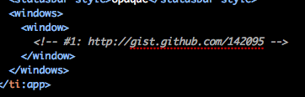
How we roll
‘Code by numbers’
Snippets highlighting APIs and concepts
http://www.appcelerator.com | Code Strong!

Slide 25
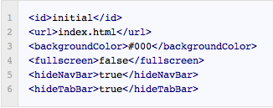
#1 - Configuration
$ROOT/tiapp.xml
Configure initial windows/tabs/options
http://gist.github.com/142095
http://www.appcelerator.com | Code Strong!

Slide 26

#2 - Scripts and Stylesheets
$ROOT/Resources/index.html
Include Titanium UI JS and CSS
http://gist.github.com/142106
http://www.appcelerator.com | Code Strong!

Slide 27
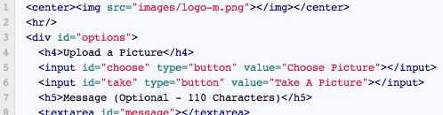
#3 - HTML and CSS
$ROOT/Resources/index.html
$ROOT/Resources/index.css
Develop HTML and CSS as normal
http://gist.github.com/142108
http://www.appcelerator.com | Code Strong!

Slide 28
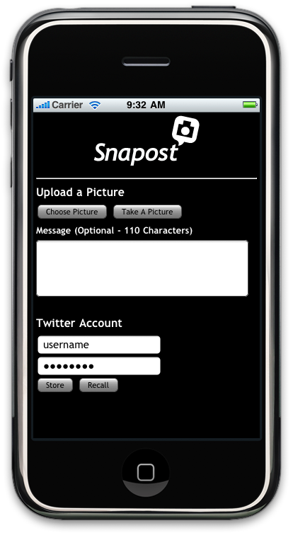
Checkpoint
You should now have something that looks like this -->
http://www.appcelerator.com | Code Strong!

Slide 29
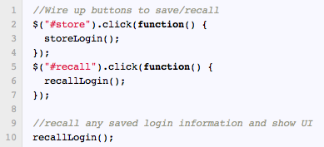
#4 - Twitter Acct: Buttons
$ROOT/Resources/index.js
Add click handlers to buttons
http://gist.github.com/142112
http://www.appcelerator.com | Code Strong!

Slide 30
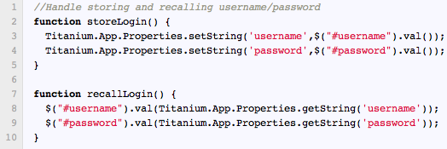
#5 - Store Account Info
$ROOT/Resources/index.js
Use properties API to persist configuration
http://gist.github.com/142115
http://www.appcelerator.com | Code Strong!

Slide 31
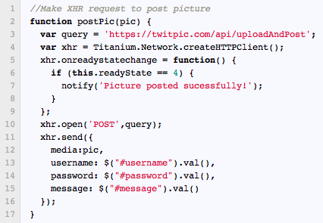
#6 - XHR request to TwitPic
$ROOT/Resources/index.js
Use HTTPClient to post to TwitPic
http://gist.github.com/142118
http://www.appcelerator.com | Code Strong!

Slide 32
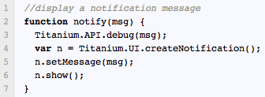
#7 - Create Notification
$ROOT/Resources/index.js
Use Titanium UI to create a notification
http://gist.github.com/142129
http://www.appcelerator.com | Code Strong!

Slide 33
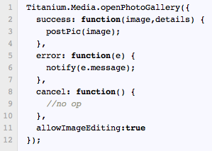
#8 - Photo Gallery
$ROOT/Resources/index.js
Allow user to choose an existing photo
http://gist.github.com/142133
http://www.appcelerator.com | Code Strong!

Slide 34
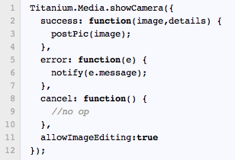
#9 - Camera
$ROOT/Resources/index.js
Allow users to take and post a picture
http://gist.github.com/142140
http://www.appcelerator.com | Code Strong!

Slide 35
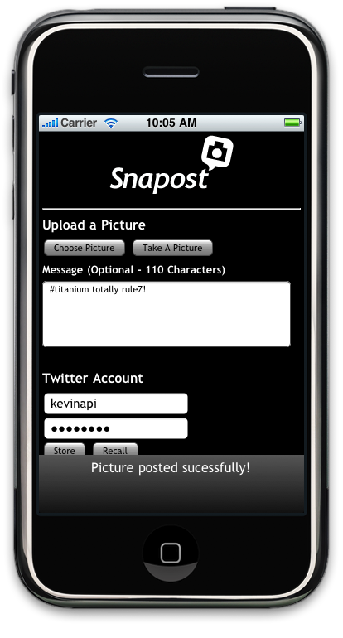
Done!
Your app should allow you to post pictures using a valid Twitter account -->
http://www.appcelerator.com | Code Strong!

Slide 36

Next Steps
Deploy to device (non-trivial for iPhone)
Submit to app store (or Enterprise store)
Make (or save) your company millions!
Buy me a Grain Belt Premium -->
http://www.appcelerator.com | Code Strong!

Slide 37
Independent Hacking
We encourage you to hack at your own project
Get help from instructor
Get help from #titanium_app on IRC
Submit a ticket (support.appcelerator.net)
Refer to resources slide for more
Thanks for your time!
http://www.appcelerator.com | Code Strong!

