Slide 1
Components of Motherboard, SMPS Cables & I/O Panel

Slide 2
Motherboard Introduction
- Main circuit board of a computer.
- Connects and allows communication between CPU, memory, storage, and peripherals.

Slide 3
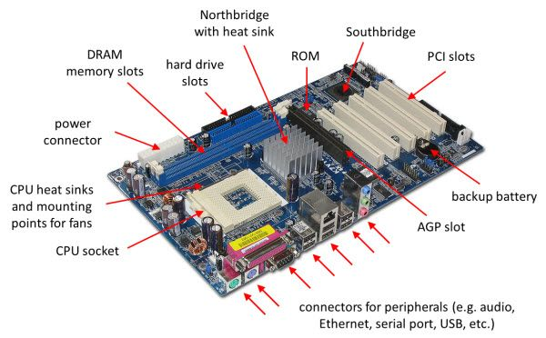

Slide 4
Components of Motherboard
- CPU Socket – Holds the processor.
- RAM Slots – For memory modules.
- Chipset – Manages communication between CPU, RAM, storage.
- BIOS/UEFI Chip – Starts the computer during boot.
- Expansion Slots – For GPU, sound card, etc.
- SATA Ports – For HDDs, SSDs, optical drives.

Slide 5
More Motherboard Components
- 24-pin ATX Power Connector – Supplies power to motherboard.
- 4/8-pin CPU Power Connector – Supplies power to CPU.
- I/O Ports (Back Panel) – Connects USB, HDMI, LAN, audio.
- CMOS Battery – Stores BIOS settings and system clock.
- Cooling Fan Headers – Power for CPU/case fans.
- Internal Connectors/Headers – Front panel buttons, LEDs, USB ports.

Slide 6
SMPS (Power Supply)
- Converts AC to DC power.
- Provides required voltages (+3.3V, +5V, +12V) to components.

Slide 7
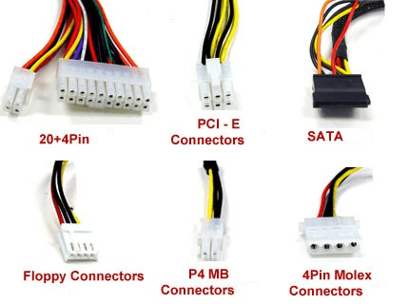

Slide 8
SMPS Cables & Purpose
- 20+4 Pin ATX – Powers motherboard.
- P4/8-pin CPU Connector – Powers CPU.
- PCI-E (6/8-pin) – Powers graphics card.
- SATA Connector – Powers HDDs, SSDs, DVD drives.
- Molex (4-pin) – Older HDDs, fans, accessories.
- Floppy Connector – Legacy floppy drives.

Slide 9
I/O Panel Introduction
- Located on back of motherboard.
- Provides connection to external devices.

Slide 10
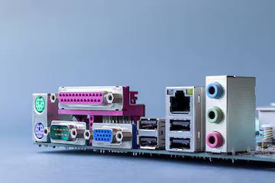

Slide 11
I/O Panel Ports
- USB Ports – Keyboard, mouse, pen drives.
- Video Ports – VGA, HDMI, DisplayPort for monitors.
- Ethernet Port – Wired internet connection.
- Audio Jacks – Microphone, headphones, speakers.
- PS/2 Ports (Legacy) – Old keyboard/mouse.

Slide 12
Conclusion
- Motherboard: Heart of computer.
- SMPS: Provides power through cables.
- I/O Panel: Connects computer to external devices.

