Slide 1
Uber – History, Evolution, Milestones, Challenges, and Use of AI
A complete overview of Uber’s journey from a small idea to a global AI-powered transportation company.

Slide 2
Introduction
• Uber transformed urban transport through technology.
• Founded on the idea: 'Book a cab with one tap.'
• Made travel easier, faster, and reliable.
• More than a taxi app – a data-driven AI platform.

Slide 3
Founders and Early History
• Founded in 2009 by Garrett Camp and Travis Kalanick in San Francisco.
• Idea came in Paris (2008) when Camp couldn’t find a taxi.
• Launched as UberCab → later renamed Uber.
• First test rides in 2010 – instant hit!

Slide 4
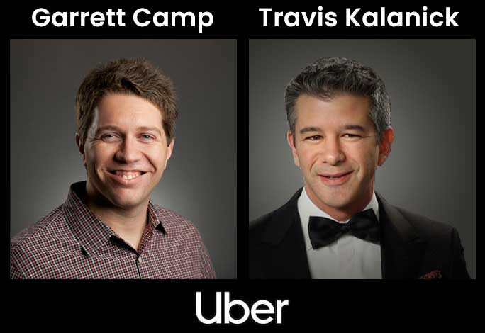

Slide 5
Uber’s Evolution and Growth
• 2011: Expanded to NYC, Paris, London.
• 2014: Entered India, China; launched Uber Eats.
• Ride types: UberX, UberPOOL, UberBlack, UberMoto.
• 2019: Completed 10+ billion rides.

Slide 6
Important Milestones
• 2009 – Founded
• 2010 – First ride
• 2011–13 – Expansion in US & Europe
• 2014 – Uber Eats, entered India
• 2015 – UberPOOL, tracking
• 2016 – Self-driving tests
• 2019 – IPO
• 2023 – AI route optimization

Slide 7
AI: The Brain of Uber
• AI powers every Uber operation.
• Used for ride matching, pricing, routing, safety, and support.
• Learns from billions of rides and user patterns.

Slide 8
AI in Ride Matching
• AI finds the nearest driver in seconds.
• Considers location, traffic, and driver availability.
• Ensures quick and efficient matching.

Slide 9
AI in Dynamic Pricing
• Also called surge pricing.
• AI adjusts fares based on demand and supply.
• Encourages drivers to move to high-demand areas.

Slide 10
AI in Route Optimization
• Predicts fastest routes using real-time data.
• Avoids traffic jams.
• Improves accuracy of arrival times.

Slide 11
AI for Safety
• Detects unusual trip patterns.
• Alerts if driver deviates or stops suddenly.
• Monitors driving behavior (speed, braking).

Slide 12
AI in Customer Support
• Chatbots solve queries automatically.
• Handles lost item reports, fare issues, cancellations.
• 24x7 instant assistance.

Slide 13
AI in Forecasting & Self-Driving Cars
• Predicts future ride demand by location/time.
• Guides drivers to busy areas.
• Developing AI-powered autonomous cars.

Slide 14
Challenges Faced by Uber
• Legal issues in many countries.
• Safety concerns.
• Driver dissatisfaction.
• Competition from Ola, Lyft, Grab.
• Leadership controversies (2017).

Slide 15
How Uber Overcame Challenges
• Enhanced safety: live GPS, panic button, verification.
• Driver support: insurance, bonuses.
• AI to improve ETA and reduce cancellations.
• Leadership reform under Dara Khosrowshahi.

Slide 16
Future of Uber with AI
• Self-driving vehicles and drone deliveries.
• AI for accident prediction and carbon reduction.
• Personalized ride experiences and greener travel.

Slide 17
Conclusion
• Uber revolutionized transport with AI and innovation.
• Overcame safety and legal challenges.
• From a simple idea to a global AI-powered mobility platform.
• Future: smarter, safer, and more sustainable travel.

