Slide 1

Git/ GitHub 101
Sumit Kadu
19 Oct 2019

Slide 2
Agenda
Introduction
What is VCS?
What is Git/ GitHub
Overview
Create Your GitHub Account
Git Fundamentals
Repository
Branch
Commit
Merging & etc.
Common Git Commands
Practice
Bigger Picture – How it works in enterprise world
Q&A
Common Git Commands
Practice
Bigger Picture – Enterprise GitHub

Slide 3
VCS & Git
What’s a version control system?
A version control system, or VCS, tracks the history of changes as people and teams collaborate on projects together. As the project evolves, teams can run tests, fix bugs, and contribute new code with the confidence that any version can be recovered at any time. Developers can review project history to find out:
Which changes were made?
Who made the changes?
When were the changes made?
Why were changes needed
What’s a distributed version control system?
Git is an example of a distributed version control system (DVCS) commonly used for open source and commercial software development. DVCSs allow full access to every file, branch, and iteration of a project, and allows every user access to a full and self-contained history of all changes. Unlike once popular centralized version control systems, DVCSs like Git don’t need a constant connection to a central repository. Developers can work anywhere and collaborate asynchronously from any time zone.

Slide 4
History of VCS & Git
1972 SCCS (Source Code Control System) – Unix Only, Worked on Development Environment Only
1982 RCS (Revision Control System) – Cross platform, Text Only, Development Environment Only
1986 CVS (Centralized Version System) – File focused
1995 Perforce – Still the biggest repository inside Google
2000 SVN (SubVersion) – Non-Text files, Track directory structure, transaction unit = directory
2004 TFS (Microsoft Team Foundation Server) – Came to replace VSS, Tight Visual Studio Integration, 2010 Came with MSDN (Costly)
2005 DVCS (Distributed Version Control System) Git & Mercurial – Built after BitKeeper, a proprietary source-control management (SCM) system
Notes:
Built by Linus Torvalds. after many developers of the Linux kernel gave up access to BitKeeper, a proprietary source-control management (SCM) system that they had formerly used to maintain the project. The copyright holder of BitKeeper, Larry McVoy, had withdrawn free use of the product after claiming that Andrew Tridgell had created SourcePuller by reverse engineering the BitKeeper protocols. The same incident also spurred the creation of another version-control system, Mercurial.

Slide 5
Why Git
Advantages of using source control
Without version control, team members are subject to redundant tasks, slower timelines, and multiple copies of a single project.
To eliminate unnecessary work, Git and other VCSs give each contributor a unified and consistent view of a project, surfacing work that’s already in progress.
Seeing a transparent history of changes, who made them, and how they contribute to the development of a project helps team members stay aligned while working independently.
Why Git?
According to the latest Stack Overflow developer survey, more than 70 percent of developers use Git, making it the most-used VCS in the world. Git is commonly used for both open source and commercial software development, with significant benefits for individuals, teams and businesses.
Git lets developers see the entire timeline of their changes, decisions, and progression of any project in one place. From the moment they access the history of a project, the developer has all the context they need to understand it and start contributing.
Developers work in every time zone. With a DVCS like Git, collaboration can happen any time while maintaining source code integrity. Using branches, developers can safely propose changes to production code.
Businesses using Git can break down communication barriers between teams and keep them focused on doing their best work. Plus, Git makes it possible to align experts across a business to collaborate on major projects.

Slide 6
GitHub
How GitHub fits in
GitHub is a Git hosting repository that provides developers with tools to ship better code through command line features, issues (threaded discussions), pull requests, code review, or the use of a collection of free and for-purchase apps in the GitHub Marketplace. With collaboration layers like the GitHub flow, a community of 15 million developers, and an ecosystem with hundreds of integrations, GitHub changes the way software is built.
How it works
GitHub builds collaboration directly into the development process. Work is organized into repositories, where developers can outline requirements or direction and set expectations for team members. Then, using the GitHub flow, developers simply create a branch to work on updates, commit changes to save them, open a pull request to propose and discuss changes, and merge pull requests once everyone is on the same page.

Slide 7
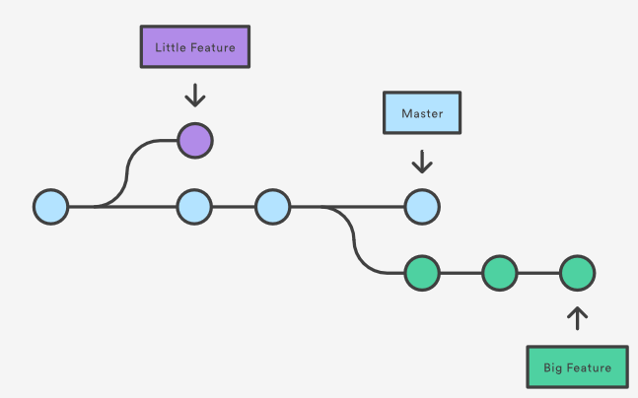
Key Components
Organization
An organization is a collection of user accounts that owns repositories. Organizations have one or more owners, who have administrative privileges for the organization. Organizations can also be used for namespacing—for example, http(s)://[hostname]/[organization name]/ takes you to an organization's profile on GitHub Enterprise Server, while http(s)://[hostname]/[organization name]/[repository name]/ takes you to a repository's profile.
Branch
A branch in Git is simply a lightweight movable pointer to one of the commits. The default branch name in Git is master . As you start making commits, you're given a master branch that points to the last commit you made. Every time you commit, the master branch pointer moves forward automatically.
Repository
A repository, or Git project, encompasses the entire collection of files and folders associated with a project, along with each file’s revision history. Through platforms like GitHub, Git also provides more opportunities for project transparency and collaboration. Public repositories help teams work together to build the best possible final product.

Slide 8
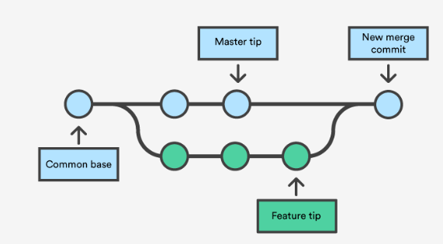
Key Components
Tagging
Tags are ref's that point to specific points in Git history. Tagging is generally used to capture a point in history that is used for a marked version release (i.e. v1.0.1). A tag is like a branch that doesn’t change. Unlike branches, tags, after being created, have no further history of commits.
Merging
Git merge will combine multiple sequences of commits into one unified history. In the most frequent use cases, git merge is used to combine two branches.

Slide 9
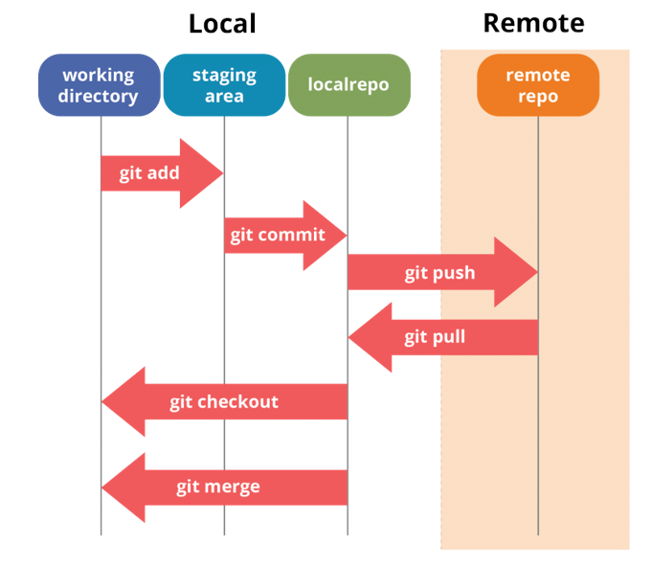
How Git works
To use Git, developers use specific commands to copy, create, change, and combine code. These commands can be executed directly from the command line or by using an application like GitHub Desktop or Git Kraken

Slide 10
Common Git Commands
Basic Commands:
git init initializes a brand new Git repository and begins tracking an existing directory. It adds a hidden subfolder within the existing directory that houses the internal data structure required for version control.
git clone creates a local copy of a project that already exists remotely. The clone includes all the project’s files, history, and branches.
git add stages a change. Git tracks changes to a developer’s codebase, but it’s necessary to stage and take a snapshot of the changes to include them in the project’s history. This command performs staging, the first part of that two-step process. Any changes that are staged will become a part of the next snapshot and a part of the project’s history. Staging and committing separately gives developers complete control over the history of their project without changing how they code and work.
git commit saves the snapshot to the project history and completes the change-tracking process. In short, a commit functions like taking a photo. Anything that’s been staged with git add will become a part of the snapshot with git commit.
git status shows the status of changes as untracked, modified, or staged.
git branch shows the branches being worked on locally.
git merge merges lines of development together. This command is typically used to combine changes made on two distinct branches. For example, a developer would merge when they want to combine changes from a feature branch into the master branch for deployment.
git pull updates the local line of development with updates from its remote counterpart. Developers use this command if a teammate has made commits to a branch on a remote, and they would like to reflect those changes in their local environment.
git push updates the remote repository with any commits made locally to a branch.

Slide 11


Practice
Create GitHub Account
Install Git (For Windows or Mac) & Install GitHub Desktop
Create a repository
Create a branch
Add a file/ update file/ delete file
Commit & Push to branch
Resolving conflicts
Merging using PR/ Direct merging
Git Command Line, Git Bash?
GitHub Desktop, Git Kraken, Git GUI?

Slide 12
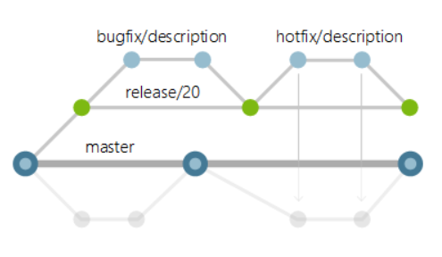
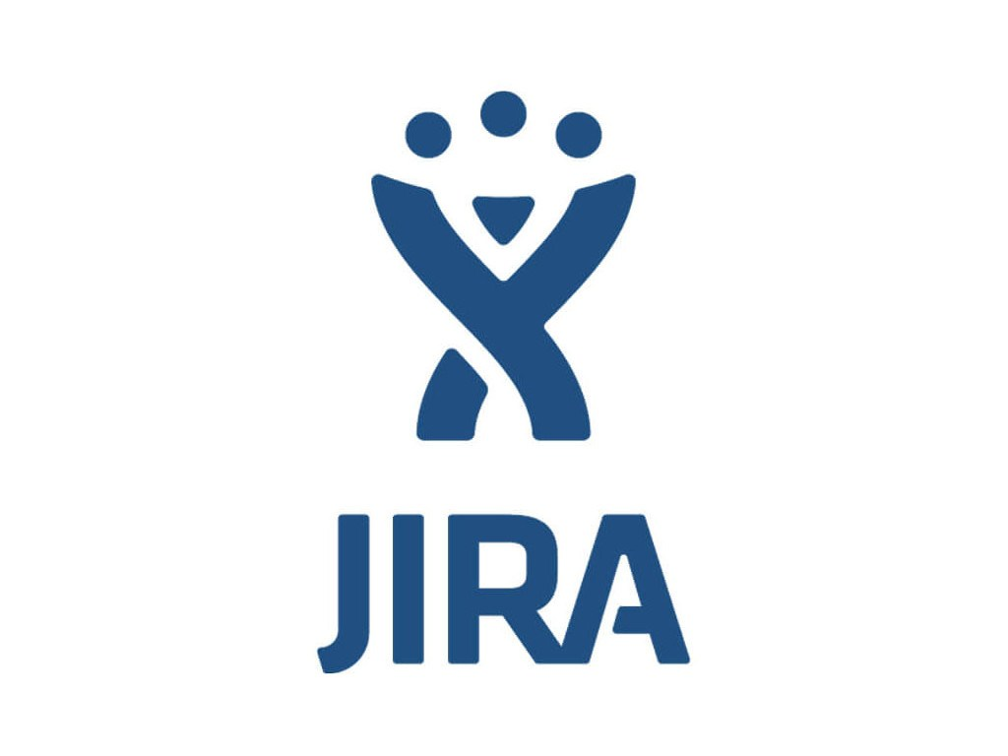

Git in Enterprise Projects
Branching Strategy
Integration with VSTS, JiRA
Open Source/ Community Projects

Slide 13
References
Git Image - https://git-scm.com/downloads/logos
https://guides.github.com/introduction/git-handbook/
Complete git reference: https://git-scm.com/docs
Branching Strategy - https://docs.microsoft.com/en-us/azure/devops/repos/git/git-branching-guidance?view=azure-devops
Git History - https://en.wikipedia.org/wiki/Git
History of VCS - https://www.lynda.com/ALMTFS-tutorials/history-version-control/106788/115979-4.html

Slide 14
Q&A

