Slide 1
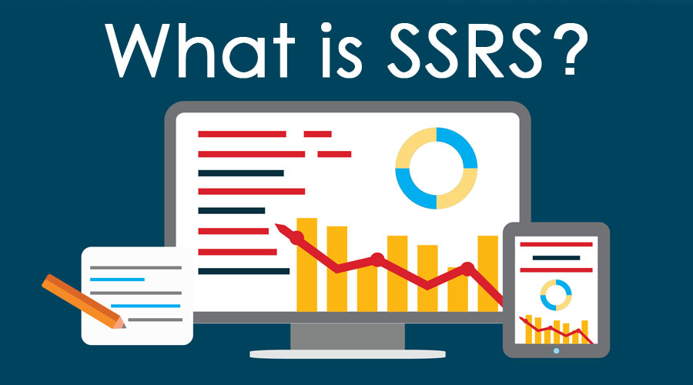
SSRS Overview
Sumit Kadu
6 Jan 2020

Slide 2
Agenda
Introduction
How to install SSRS?
Report Builder
SSDT/ Visual Studio
SSRS Fundamentals
Data Source
Data Set
Report
Common Report Controls
Practice/ Learn about
Textbox, Headers, Footers, Table/ Matrix controls
Parameterized report/ data sets
Taking a look at inbuilt functions provided by SSRS
Grouping
Charts
References
Q & A

Slide 3
Getting Started
How to install SSRS
Install Report Builder/ Visual Studio (For report development)
Install SSDT (SQL Server Data Tools)
Provides Reporting Services, Analysis Services & Integration Services
Install SQL Server (Express/ Developer/ Enterprise edition) – During install make sure to select Reporting Services component, its not selected by default
There are different modes to install Reporting Services (Either ‘Install & Configure’ OR ‘Install Only’)
If install Only is selected, you would need to configure Reporting Server manually post install using ‘Reporting Service Configuration Manager’
Report Server – This is a server where SSRS report is deployed (can be configured through configuration manager)
Report Server default URL – http://<server>/ReportServer
Reports Web Portal – http://<server>/Reports
SQL Server Reporting Database –
It is required for SSRS report server to store some data
Can be a local DB or Remote DB
Check references slide for links

Slide 4
SSRS Components
Report
Adding a new report to the project
Sub Reports
Data Set
Adding an embedded / shared data set for the report
Different properties available to configure data set
Data Source
Adding a Data Source (Embedded & Shared)
Different properties available to configure a data source

Slide 5
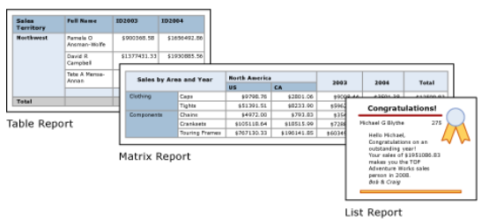
Common Report Controls
Textbox | Image | Line | Rectangle | Map | Chart
Table/ Matrix - The table and matrix data regions can display complex data relationships by including nested tables, matrices, lists, charts and gauges. Tables and matrices have a tabular layout and their data comes from a single dataset, built on a single data source. The key difference between tables and matrices is that tables can include only row groups, whereas matrices have row groups and column groups
List - Lists are a little different. They support a free-layout that and can include multiple peer tables or matrices, each using data from a different dataset. Lists can also be used for forms, such as invoices.

Slide 6
Practice
Hands-On Lab
Create basic table report (we will cover in our session)
Create Matrix report
Create a report using column chart
Create a report using sub report
Deployment (we will cover in our session)
Deploy using visual studio
Deploy manually using Report Server Web Portal

Slide 7
References
SSRS Tutorials - https://docs.microsoft.com/en-us/sql/reporting-services/reporting-services-tutorials-ssrs?view=sql-server-ver15
Installation help - https://docs.microsoft.com/en-us/sql/ssdt/download-sql-server-data-tools-ssdt?view=sql-server-ver15

Slide 8
Thank you

