Slide 1
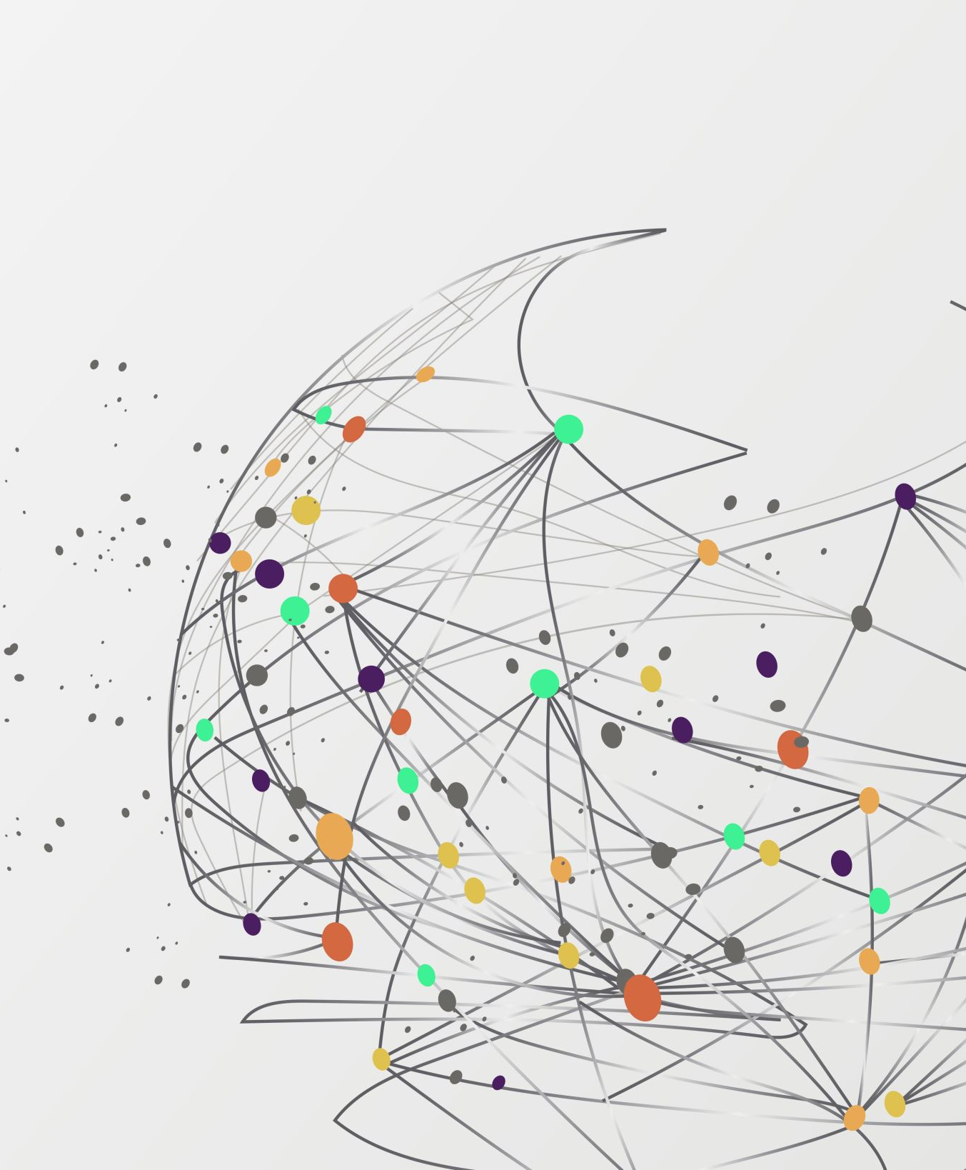
PROJECT : “REALtIME CHAT APPlication”
PERFORMED BY :
SUMIT KUMAR
(20BCS8226)

Slide 2


Problem Identification :
Suppose a person wants to chat with another person without revealing his phone number or any personal detail, then on which platform should they interact ?

Slide 3
Solution Offered :
In this application, neither the phone number of one person can be known by other person (the case with WhatsApp),
nor any profile details will be visible to others (the case with Facebook).
Message delivery in real time.
Have features like authentication, authorization and interactive UI.

Slide 4


Tools / Technology Used :
NodeJS:
Open source
Cross-platform runtime environment
Library that is used for running web applications outside the client’s browser.
React:
JavaScript library
Build UIs.
Build single-page applications.

Slide 5



HTML:
Allows to create and structure sections, headings, links, paragraphs, etc.
Uses tags and elements.
CSS:
Define styles for web pages.
Describes look and formatting of a document.
JavaScript:
Text-based programming language
Used both on client-side and server-side
Allows you to make web pages interactive.

Slide 6
Learning Obtained :
Learnt languages like JavaScript, CSS, HTML.
Frameworks like React, NodeJS.
API integration.
How to use Google Firebase.
Connection between website and cloud database.
Deployment of website on the web.
Learnt how to maintain confidence.
How to ask query from another person.
Patience
Time Management

Slide 7
T H A N K Y O U

