Slide 1
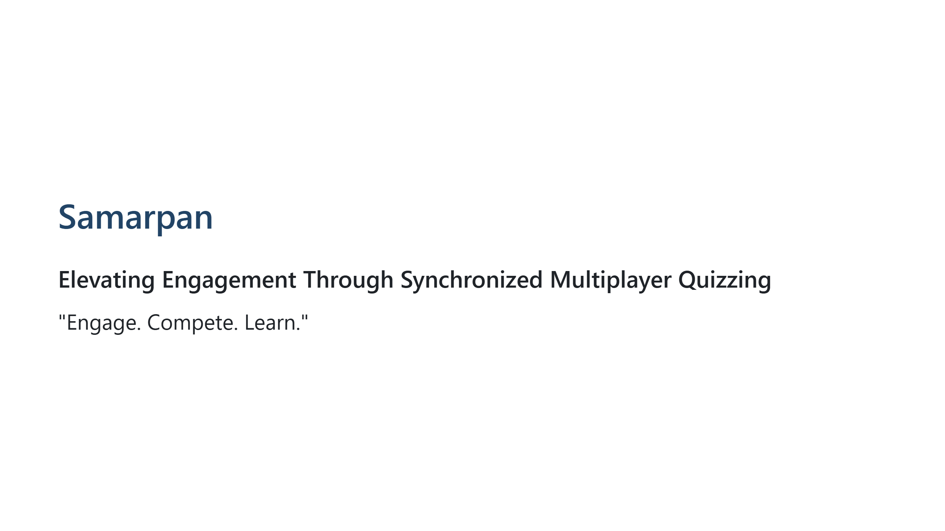
Notes:
Good morning, judges. We are the team behind Samarpan. Education and training today are fighting a losing battle against declining attention spans. We are here to change that by turning assessment from a solitary chore into a highly engaging, synchronized multiplayer experience. Let us show you how.

Slide 2
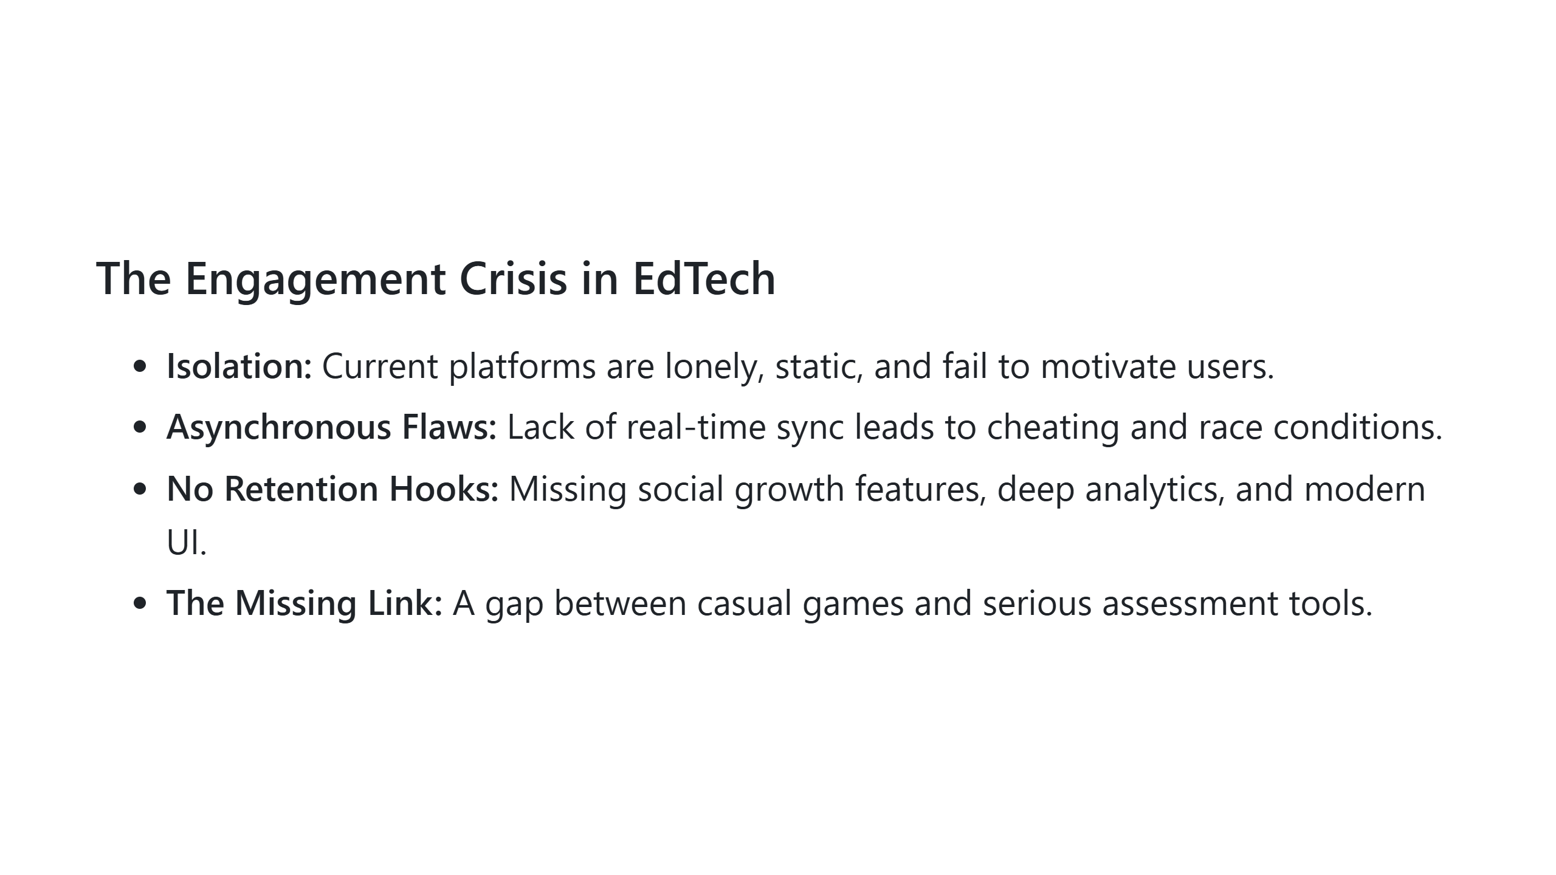
Notes:
What are today's platforms missing? They are incredibly isolating and static. When you take a quiz on a standard platform, it feels like a test. There is no real-time sync, no social competition, and absolutely no retention hooks. Users drop off because the experience is boring. We realized that bridging the gap between engaging multiplayer gaming and serious assessment is the massive opportunity missing in today's market.

Slide 3
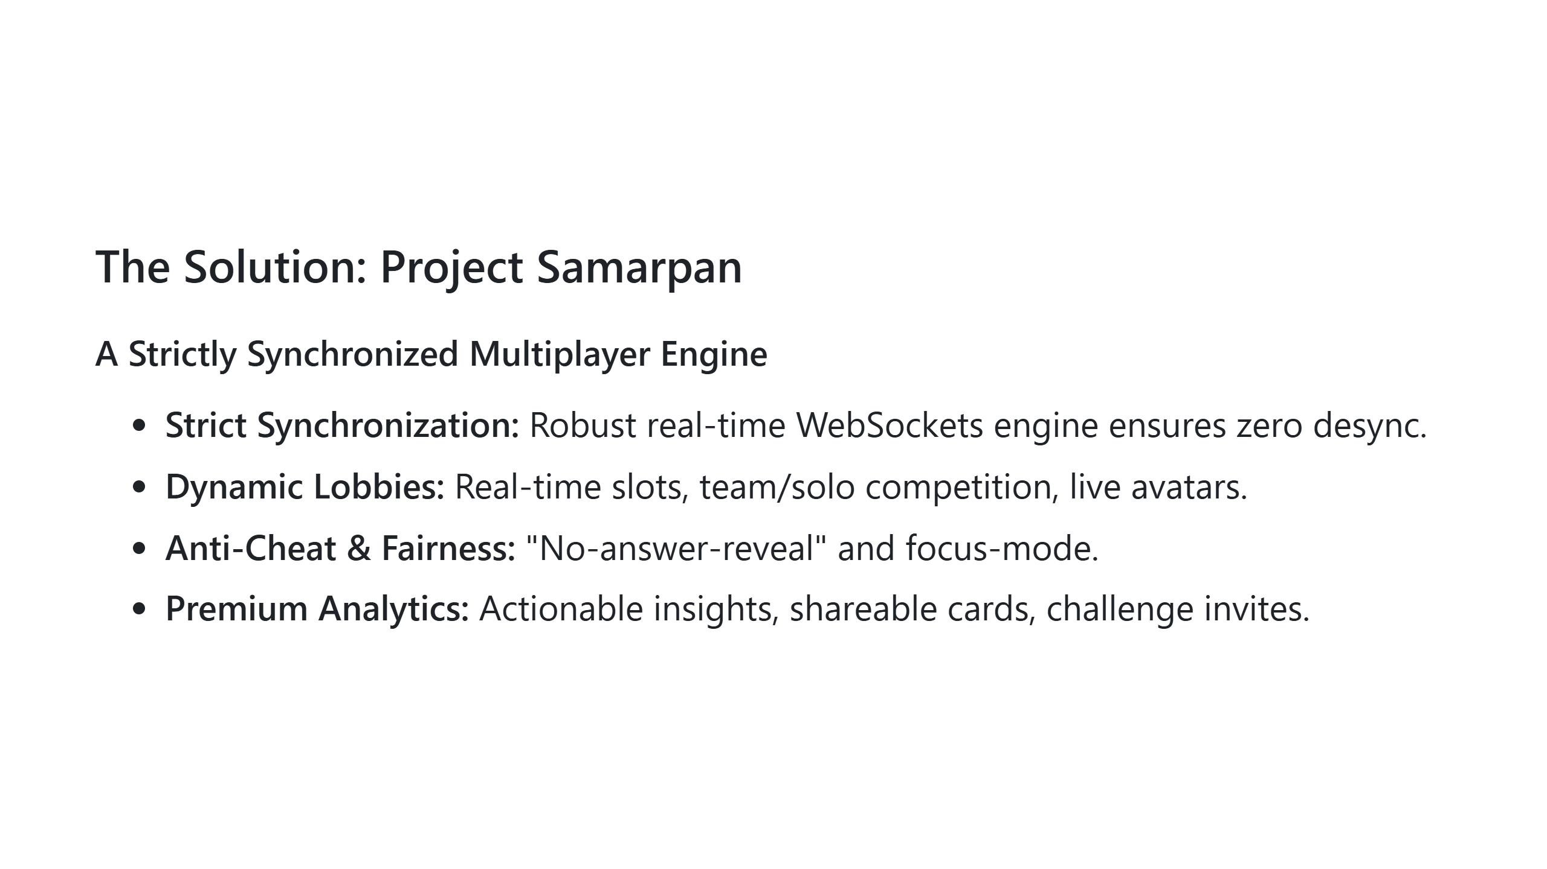
Notes:
Our solution is Samarpan. We’ve built a strictly synchronized, real-time multiplayer quiz engine. Unlike competitors, our server controls the pace—meaning no race conditions and a completely fair, cheat-proof environment. We’ve integrated dynamic lobbies, focus modes, and deep analytics. It’s not just a quiz; it’s an event. The technology is scalable, the UI is premium, and the experience is unmatched.

Slide 4
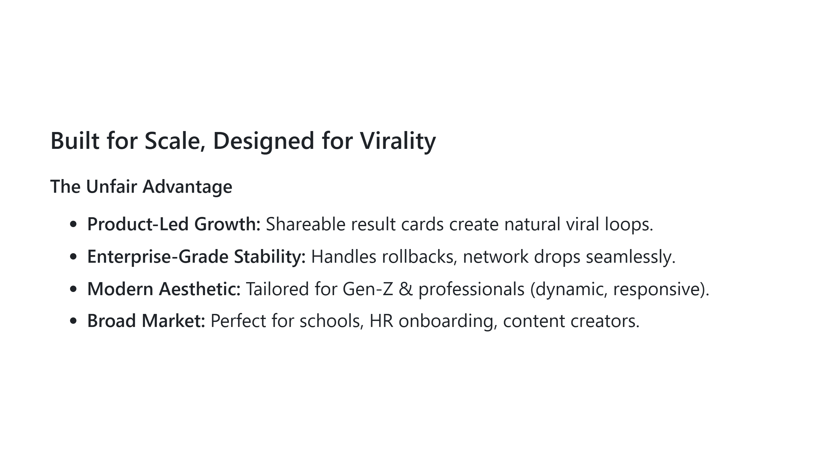
Notes:
Why will we succeed where others have stalled? Because Samarpan is designed with built-in product-led growth. Every result card is shareable; every quiz can spawn challenge invites. Furthermore, we’ve solved the hardest technical challenge: real-time state synchronization at scale. Our modern, premium design appeals instantly to younger demographics and professionals alike, making it highly adaptable for both B2B corporate training and B2C education.

Slide 5
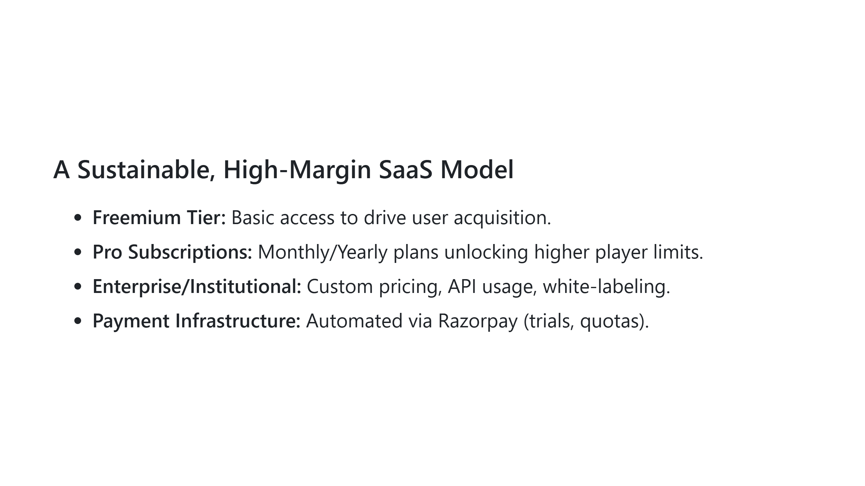
Notes:
To build a real startup, we need a real revenue engine. We operate on a freemium SaaS model. The free tier drives our viral acquisition. From there, hosts, teachers, and creators can upgrade to Pro subscriptions for higher player caps and advanced analytics. For schools and corporate training, we offer Enterprise tiers. We have already integrated Razorpay to handle automated billing, trials, and feature gating. This ensures a low cost of operation while maximizing our recurring revenue.

Slide 6
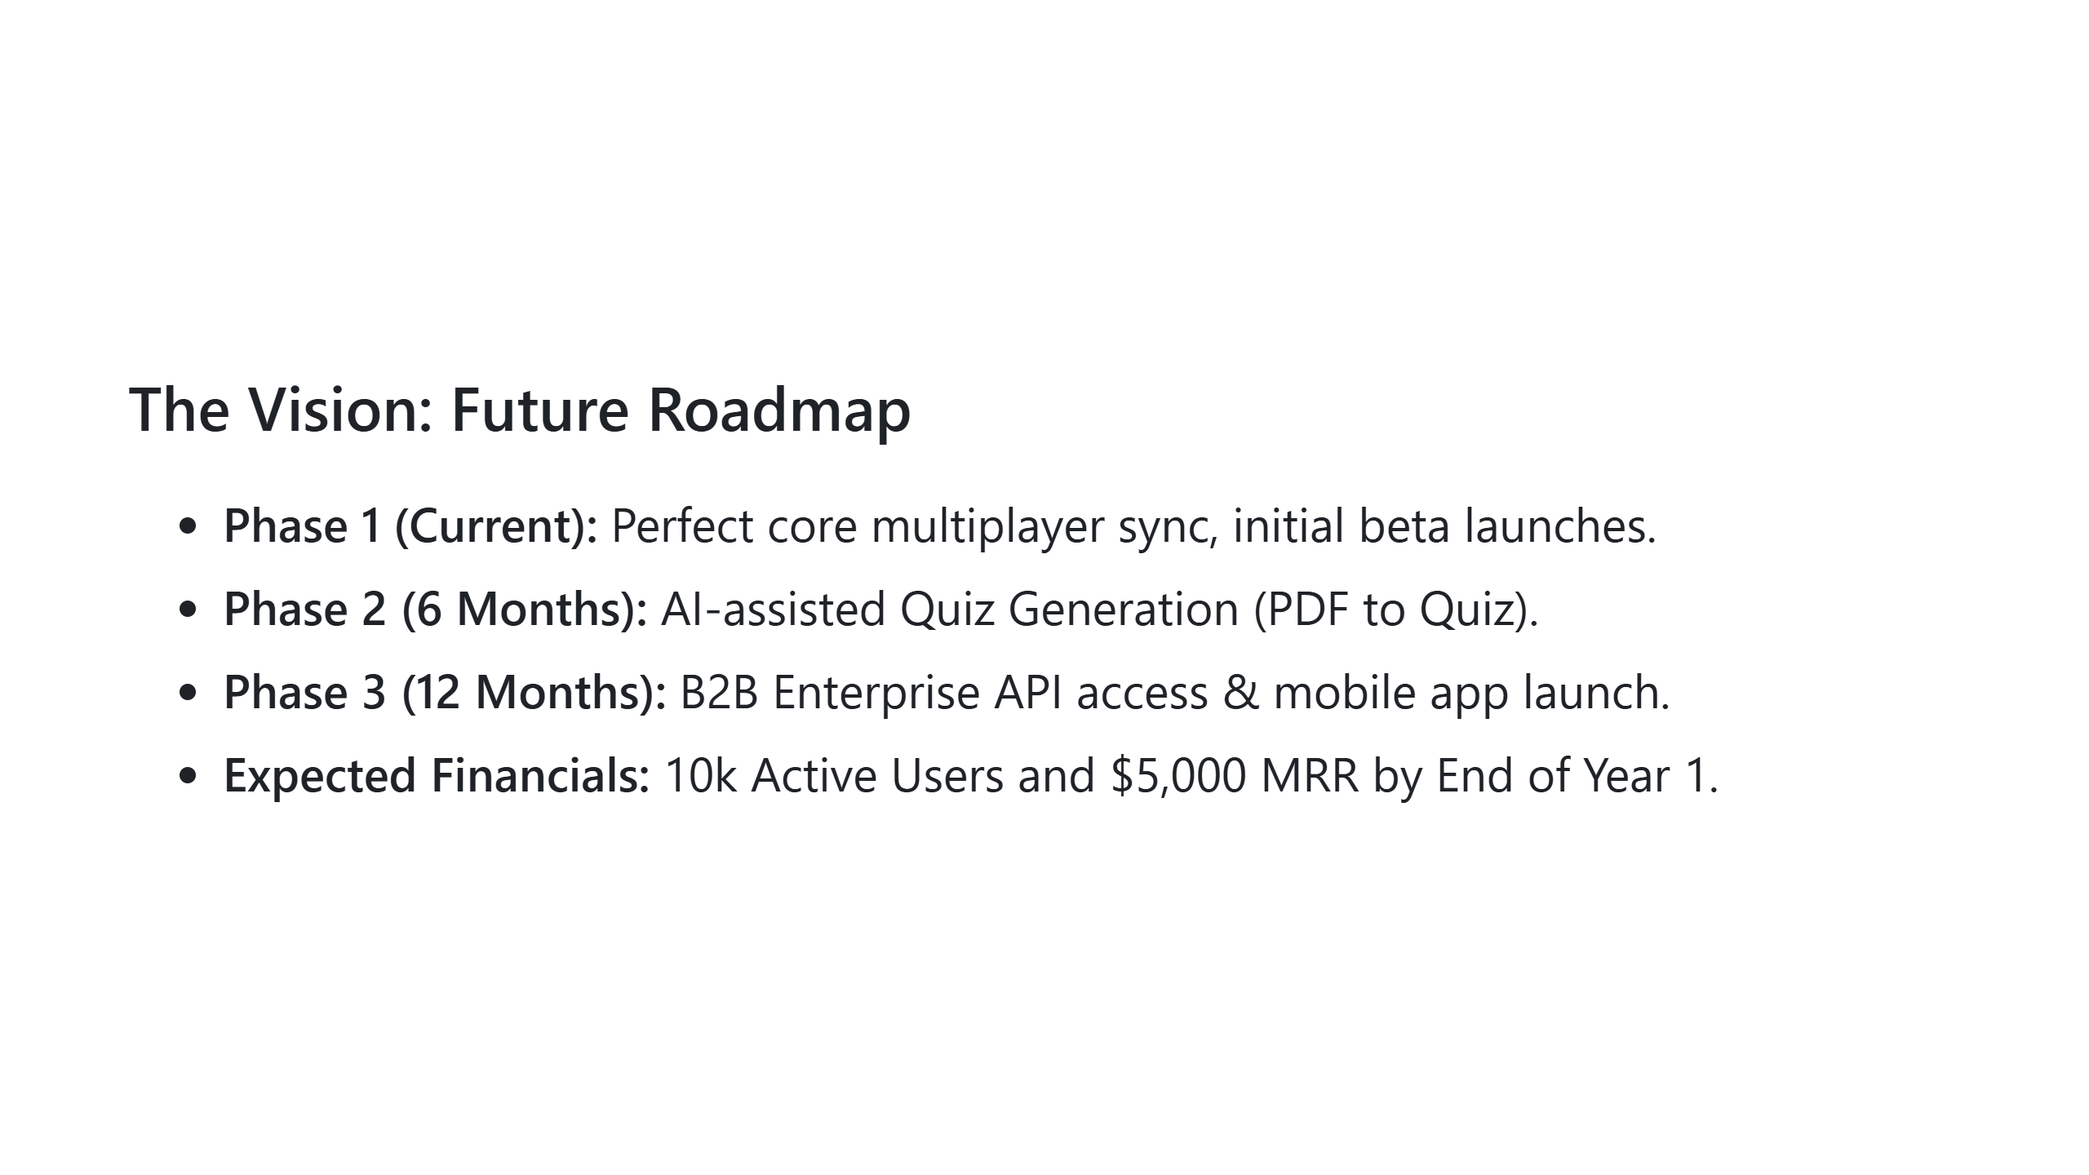
Notes:
Our roadmap is aggressive but achievable. Right now, our core engine is complete. In the next six months, we will introduce AI-assisted quiz generation—allowing teachers to upload a syllabus and instantly generate a multiplayer event. By next year, we will open our API to integrate directly into existing HR systems and LMS platforms. Based on our market testing, we project reaching $5,000 in Monthly Recurring Revenue by the end of our first year.

Slide 7
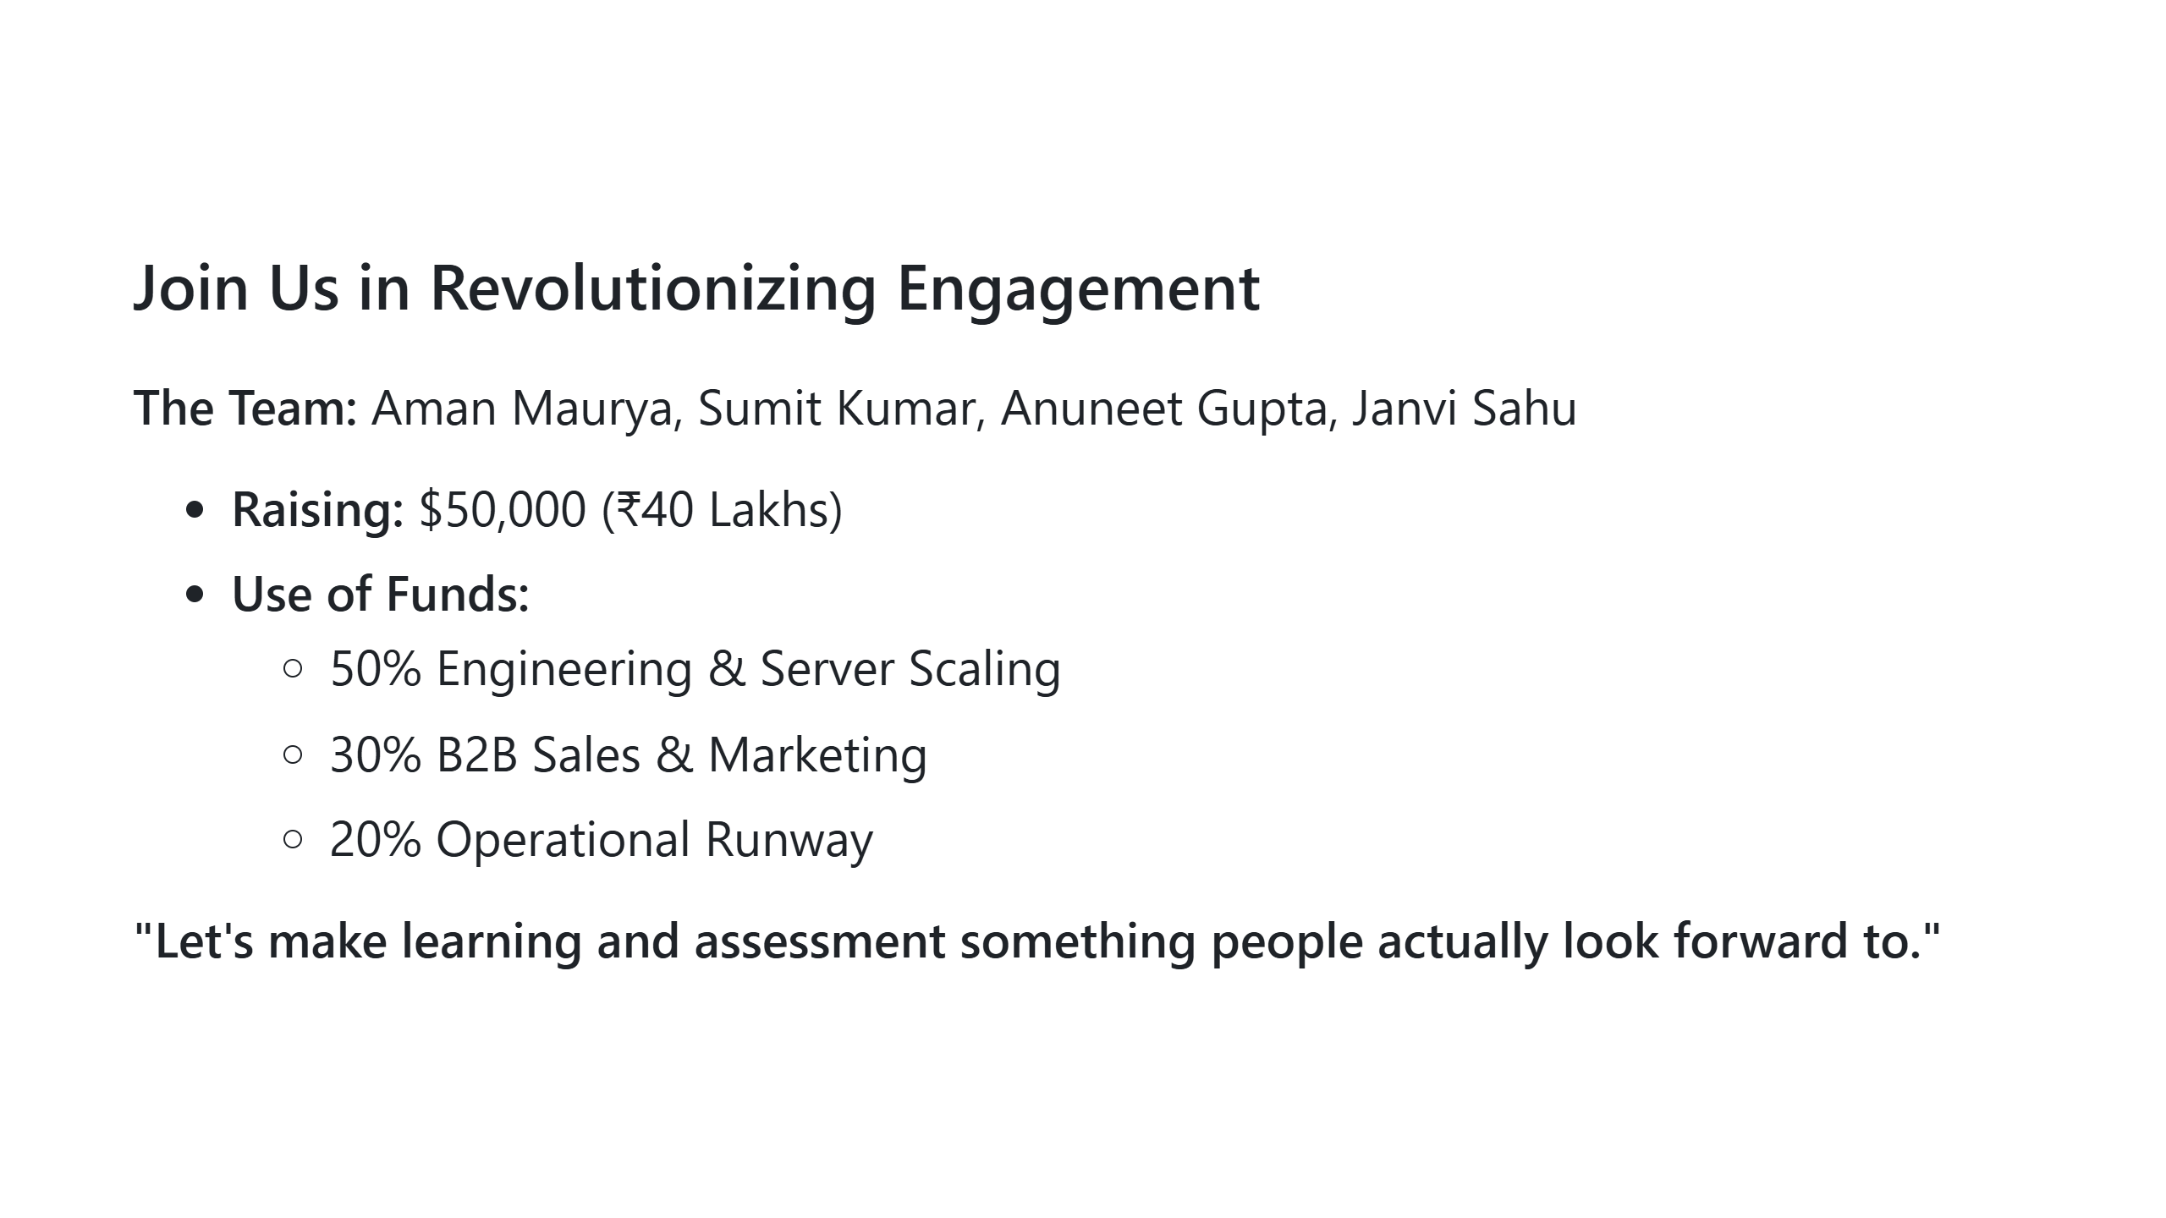
Notes:
We are a team of four dedicated engineers: Aman, Sumit, Anuneet, and Janvi. We have built the technical foundation that most startups outsource. Today, we are seeking seed funding to scale our server infrastructure and execute our B2B go-to-market strategy. We have the product, we have the vision, and with your backing, we can capture this market. Thank you, and we’d love to answer your questions.

