Slide 1
NETWORKING
NAME – SUMIT KUMAR
VISHISHT SCHOOL OF MANAGEMENT

Slide 2
OSI MODEL/ Reference model
OSI Model -→ Open system interconnection model
Founder → ISO in 1976
It is created to remove monopolys
Sender
Data Flow
Software
1st | Application Layer ( HTTP/HTTPS/SMTP)
2nd | Presentation Layer ( Encryption /De-)
3rd | Session Layer (End To End )
4th | Transport Layer (Segmentation )
5th | Network Layer ( IP Address)
6th | Data Link Layer
7th | Physical Layer (Medium)
Receiver
7th | Application Layer
6th | Presentation Layer
5th | Session Layer
4th | Transport Layer
3rd | Network Layer
2nd | Data Link Layer
1st | Physical Layer
Segment
Hardware
Pockets
Frame
Bits
Data
Flow
Flow
Data
Flow
Data

Slide 3
TCP / IP Modal
Addressing
Network Issue
Routing
TCP :- Transmission Control Protocol
Us Defination is created This Protocol in 1970 Named was LAN / ARPA net but in some time changed it’s name DARPANET .
Name Reduction
Flow Error Control
Inter Probability
Application Layer DNS/DHCP/SMTP/FTP/TFTP /SMTP/POP3
 | Transport Layer / Host to Host
 | Internet Layer / network layer (ICMP/IGMP/AARP/RARP)
 | Network Access Layer
1st | Application Layer
2nd | Presentation Layer
3rd | Session Layer
4th | Transport Layer
5th | Network layer
6th | Data Link Layer
7th | Physical Layer
Data
Segmentation
Pockets
Frame
Bit
OSI Model
TCP /IP Model

Slide 4
Network
Network is a combination of way to communication and connectivity
What is computer ?
A computer is electronic device which works Arithmetically & Logically
Types of Networks Cable:-
There are four types of networks cable
(I) UTP
(II) STP
(III) CO – OXIAL
(IV) Fiber Cable
cable distance resistance
UTP RJ45 100 M EMI / RFI
STP RJ45 100 M Low EMI / RFI
CO – Oxial BNC / AUI 200 - 500 M
fiber optic ST / SC / MIC /SMA 2 KM – 100 KM
BNC => British Novel connector
RJ => Register Jack

Slide 5

Note:- ( com-com) if you use same device to connect each – other then use cross cable [ - - - - - - - - ] Note:-( com- rou / com- switch) if you use different device to connect each other then use straight cable [________]
Pc 1
Pc 2
IP-10.0.0.1
IP-10.0.0.2
Pc 3
Pc 4
Pc 5
IP-10.0.0.3
IP-11.0.0.2
IP-10.0.0.5

Slide 6
History of Computer Networks
* The Advanced Research Projects Agency Network (ARPANET) developed by the United state Department of defense was the World's first operational network ,and the predecessor of the global internet
* Established in 1969 ,ARPANET served as tested for new networking technologies , linking many universities and research center .
* The first two nodes that formed the ARPANET were UCLA (University of California at Los Angels ) and the stanford Research Institute , following shortly thereafter by the University of Utah .

Slide 7
Types of Computer Networks
LAN
* A LAN is Local Area Networks. This would include net works where the computer are relatively close together .
* LAN would be within the same office ,a single building , or several buildings close together .
WAN
* WAN Cover a large geographical area .
* WAN are mostly uses leased line or public phone line as their backbone

Slide 8
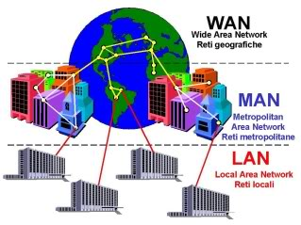

Slide 9
Standard Organization
* ISO → ( International Organization for Student )
* ITU – T → (international Telecommunication Union Telecommunication )
* IEEE → ( institute of Electrical and Electronic Engineer )
* ANSI → (American National Standard Institute )

Slide 10
Topology
* The actual layout of a networks and its media is called Topology
Factors
* Cost
* Scalability
* Bandwidth Capacity
* Ease of Installation
* Easy of fault finding and maintenance

Slide 11
Topology
Topology refers to physical or logical arrangement of network
Physical topology
Bus
Ring
Star
Mesh
Hybrid
Single Node

Slide 12
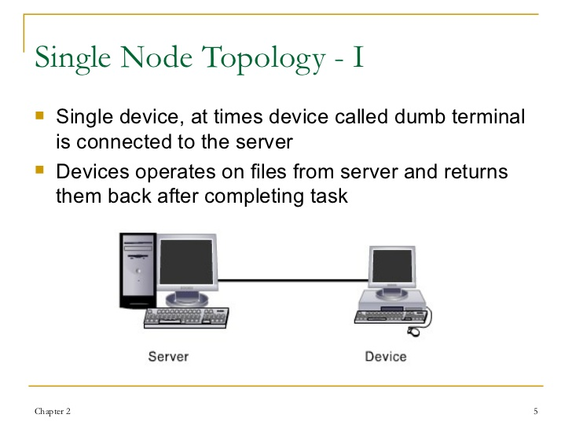
Single Node Topology

Slide 13
Single Node Topology
Advantage
* Easy to install ,configure and manage
* Least expensive
* Single cable is required
Disadvantage
* Network consists of single device
* Dump terminal is dependent on server

Slide 14
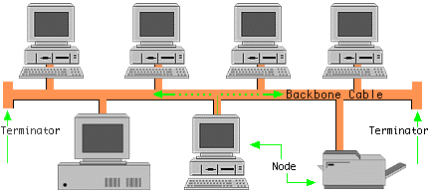
BUS TOPOLOGY
All device are connected to a common cable called backbone / trunk cable
Operates in daisy chain fashion
Medium is shared that's why create collision

Slide 15
BUS topology
Advantage
* Installation of
device is easy
* Works better for smaller networks
* Less expensive
Disadvantage
* If backbone cable break, entire net work gets down
* Difficult to isolate problems
* Limited number of device can be
attached
* Server is at one end and device are at different position
* 50 ohm terminators are used
* Device are not responsible for data transmission

Slide 16
Star Topology
* Each device is connected to a central device called hub / switch through cable
* data passes through hub before reaching destination

Slide 17
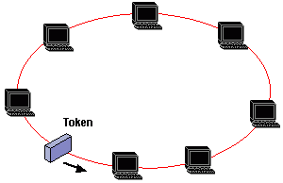
Ring Topology
* Device are connect in a closed loop
* All device have equal access to media
* Device Waits for its turn to transmit
* Most common type is Token Ring Network
(I) Token LAN Card (ii) Token NIC

Slide 18
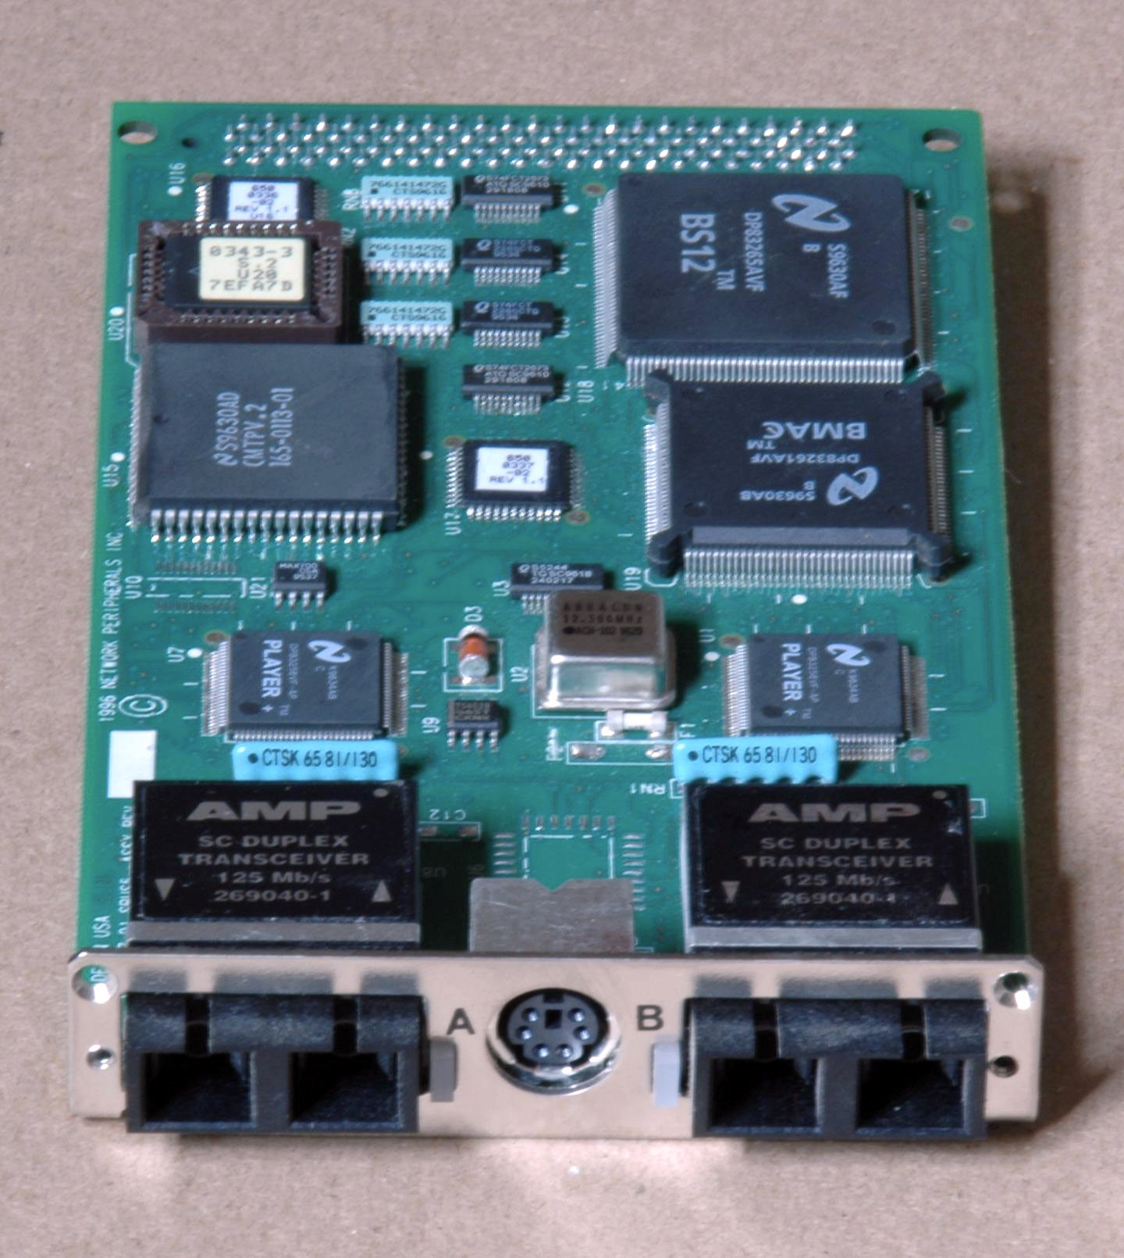
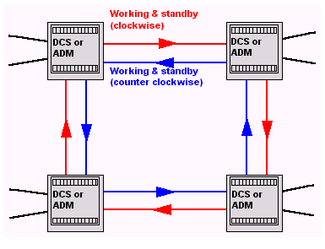
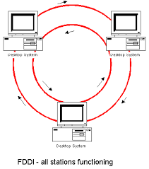
Dual Ring Topology
* Consists of two independent primary and secondary ring
* Secondary ring is redundant ,used only when primary stop function
* Dual ring topology is connected with FDDI.
=> FDDI → Fiber Disturbuted Data Interface.

Slide 19
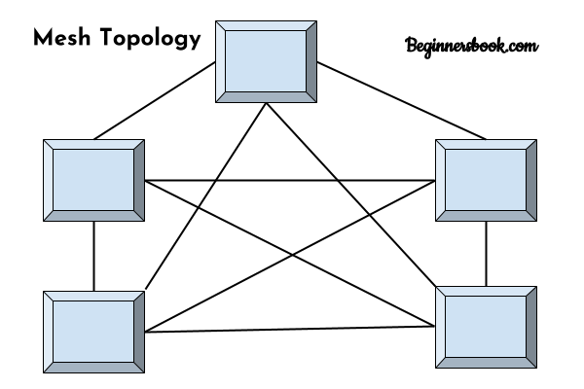
Mesh Topology
Used in WAN to interconnect LAN
Ever device is connected to every other device
Use router to
derermine the best path of communication

Slide 20
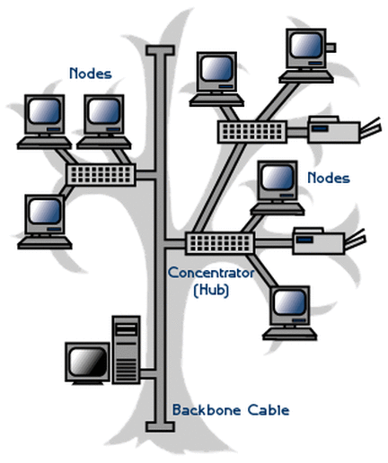
Tree Topology
Combination the Characteristic of linear bus and star topology
Device are wired to root hub
Twisted pair cable is commonly used
Lowest level device are smaller computer

Slide 21
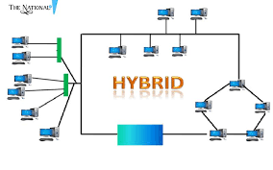
Hybrid Topology
Combination two or more different physical topology
Commonly Star – Bus or Star – Ring
Also known as special topology and useful for
corporate office

Slide 22
What is ip address
Address ---- Physical ---- MAC Address
---Logical ----- IPV₄ , IPV₆ ( Private ,public)
q. What is MAC address ?
Media Access control
Physical address in Laptop / Hardware address
BIA address in Switch
MAC address is Global unique
MAC Address always of NETWORK interface card ( Bluetooth ,WI-FI, Ethernet) ,If you change your NIC you got your MAC address has changed .
* MAC address always contain 48bit ,( 16 byte).
24 bit + 24 bit
OUI Vender Specific
MAC ADDRESS

Slide 23
* OUI => Origination Union Identification
* MAC address Represented in Hexadecimal
Example = AE-CD-GH - 69 -49-AB
24 bit 24 bit
* MAC address contains 12 Hexadecimal value
* INIA provide starting of 24 bit value and other 24 provide by vender
* INIA provide 6 Hexadecimal character of MAC address to company and other 6 character assign by vender

Slide 24
IP Address
An IP (Internet Protocol) address is a unique identifier for computer on an IP network.
An IP address is a 32 bit binary number .
It is usually represented as 4 decimal value , each represent 8 bit.
It is in the range 0 to 255 (known as octets) separated by decimal points . This is known as “dotted decimal “ notation .
Example : 140.0.15.12

Slide 25
IP classes
There are 5 different address classes of IP
* Class A → 1 to 127
* Class B → 128 to 191
* Class C → 192 to 223
* Class D → 224 to 239
* Class e → 240 to 255

Slide 26
IPV₄ HEADER
bit
32 | 4 version | 4 IHL |  | 8 TOS |  | 16 Total Length
32 | 16 Identifier |  | 3 Flag |  | 3 Fragment Off Set
32 | 8 TTL |  | 8 Protocal |  | 16 Cheak sum
32 | 32 source Address
32 | 32 Destination address
 | Option ( 0 - 40 ) bit
The minimum value of IPV₄ is 20 byte ,and maximum value is 20 + 40 = 60 byte
8 4 2 1
The field of IPV₄ is :- 0 1 0 0 = 4 *
IHL – Internet Header Length
TOS – Types of service
TTL – Time To Leave

Slide 27
IPV₄ = INTERNET PROTOCOL
* How to find network ID
Note – here N =1 , H = 0;
Class A N H H H 10.15.12.14 , (10.0.0.0 Network ID)
Class B N N H H 128.45.2.0 , ( 128.45.0.0 Network ID)
Class C N N N H 192.45.20.30 (192.45.20.0 Network ID)
* Note When Host vale are 0 then IP is always Network ID
* How to find Broadcast Id
Note – here H = 255;
Class A N H H H 10.15.12.14 , (10.255.255.255 Broadcast ID)
Class B N N H H 128.45.2.0 , ( 128.45.255.255 broadcast ID)
Class C N N N H 192.45.20.30 (192.45.20.255 broadcast ID)
* Note When Host Value is 255 then IP is Broadcast
* How to find subnet mask
Note – here N = 255, H = 0;
Class A N H H H 10.15.12.14 , (255.0.0.0 subnet mask)
Class B N N H H 128.45.2.0 , ( 255.255.0.0 Subnet Mask)
Class C N N N H 192.45.20.30 (255.255.255.0 Subnet Mask)
* Note when then N value is 255 and H value 0 then IP show Subnet mask
IPV₄ contain 32 bit logical address 4 bit each octact
Maximum value of octact 255 ,and minimum 0
IP Address => Network ID + Host ID
= class of IP Address
Class A 0—to—127 ( 127.0.0.0 is adobe to Microsoft)
* If you want check 127.0.0.0 range then ping IP on CMD
Class B 128—to—191
Class C 192—to—223
Class D 224—to– 239 Multicast reserve
Class E 240—to –255 special purpose
* IP always Identify by first octact
192 .180 . 10 . 0
8 bit. 8bit. 8bit .8bit
Note :-Default bit reserved for class A = 8 bit
class B = 16 bit
class c = 24 bit

Slide 28

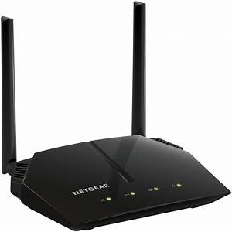
Subnetting
Different Network ID on each Router Interface
Router is a Internetworking Device
when we communicate with different network then we use Router
The Used of One IP a one side interface Router Can’t we use second side interface of Router .
* What is subnetting and What use in IP address
Because IPV₄ is limited in IT and we can save IP Address follow some steps .
(i) Private IP Address
(ii) IPV₆
(iii) Subnetting
Means of Subnet :- Subnet -> Network Within a Network / Logical Division Of IP Address
Due to subnetting
* Subnetting use for save Waste IP Address
First interface
2 ^{nd} interface
10 com
60
com
40 com
50 com

Slide 29
We Required 6 IP 1 IP each interface for subnetting
Interface B/N two Router Line
With Different IP
50 computer
2 IP Required B/N 2 Router
40 computer
N H H H
IP 10.0.0.1
Class A
2²⁴ – 2 =
Useable IP
N N H H
IP 128.10.0.1
Class B
2¹⁶ – 2 = 65534
Usable IP
Router1
Router2
100 computer on interface
150 computer on interface
N N N H
IP 201.10.20.1
Class C
2⁸ – 2 = 254
Useable IP
IP 200.10.20.1
Class C

Slide 30
find :- subnet mask , broadcast id ,convert ip into binary to decimal
out the subnet mask of this IP Address
Given IP | 115 . | 10 . | 10 . | 20 |  | note :- Total add of Binary is called Subnet Mask
Class A
solve | N | H | H | H | First is always Network ID of any IP And Last is always Broadcast Id
 | 1 | 0 | 0 | 0
 | 128 64 32 16 8 4 2 1 |  |  | 128 64 32 16 8 4 2 1 |  |  | 128 64 32 16 8 4 2 1 |  |  | 128 64 32 16 8 4 2 1
write here | 1 1 1 1 1 111 |  |  | 0 0 0 0 0 0 0 0 . |  |  | 0 0 0 0 0 0 0 0 . |  |  | 0 0 0 0 0 0 0 0
subnet mask | 255 . |  |  | 0 . |  |  | 0 |  |  |  | 0
broad cast ID | 115 |  |  | 255 . |  |  | 255 . |  |  |  | 255
How Can you write IP Address Decimal into Binary
Given IP:- | 192. | 168. | 37 . | 200
solve :-
power | 7 | 6 | 5 | 4 | 3 | 2 | 1 | 0
Base | 2 | 2 | 2 | 2 | 2 | 2 | 2 | 2
 | 128 | 64 | 32 | 16 | 8 | 4 | 2 | 1
 | 1 | 1 | 0 | 0 | 0 | 0 | 0 | 0 | 192
 | 1 | 0 | 1 | 0 | 1 | 0 | 0 | 0 | 168
 | 0 | 0 | 1 | 0 | 0 | 1 | 0 | 1 | 37
 | 1 | 1 | 0 | 0 | 1 | 0 | 0 | 0 | 200
We Can’t done Subnetting , If Class A , Class B, Class C , of IP Default /8 , /16 , 24
Table
Binary |  |  |  |  |  |  |  | Decimal | SNO
1 | 0 | 0 | 0 | 0 | 0 | 0 | 0 | 128 | 1
1 | 1 | 0 | 0 | 0 | 0 | 0 | 0 | 192 | 2
1 | 1 | 1 | 0 | 0 | 0 | 0 | 0 | 224 | 3
1 | 1 | 1 | 1 | 0 | 0 | 0 | 0 | 240 | 4
1 | 1 | 1 | 1 | 1 | 0 | 0 | 0 | 248 | 5
1 | 1 | 1 | 1 | 1 | 1 | 0 | 0 | 252 | 6
1 | 1 | 1 | 1 | 1 | 1 | 1 | 0 | 254 | 7
1 | 1 | 1 | 1 | 1 | 1 | 1 | 1 | 255 | 8

Slide 31
Subnetting a/q to host
 | Given IP 197.10.10.0
step 1 | 197 . | 10 | 10 | 0 | class c
step 2 | Convert into Binary of Host bit
 | 197 | 10 | 10 | 10 | 0 0 0 0 0 0 0 0
step 3 | Search Maximum requirements of IP
 | Then Write
 | n
 | 2 | - | 2 | >= | 40
note :- Here - 2 is represent to 1st and last IP ,due to always reversed for Network ID and Broadcast ID
Let's Solve | n
10 c
40 c
 | 2 | - | 2 | >= | 40
 | 1
= | 2 | - | 2 | >= | 0
 | 2
= | 2 | - | 2 | >= | 2
 | 5
= | 2 | - | 2 | >= | 30
 | 6
= | 2 | - | 2 | >= | 62
step 4 | convert Decimal Value into Binary |  |  |  |  |  | now H = 0, N= |  | 1
 | 197 | 10 | 10 | 0 0 0 0 0 0 0 0 |  |  | Here n = | 6
 | 197 | 10 | 10 | 1 1 0 0 0 0 0 0 |  | then Add the value 1 in decimal
 | 8 | 8 | 8 | 2 | 6 bit H
 | 197 | 10 | 10 | 192 | ---------- | Last subnet IP
 | 255 | 255 | 255 | 192 | -------- | subnet mask
 | 197 | 10 | 10 | 191 | -------- | Last Broadcast ID
step5 | Check how many subnetting done with this IP 197.10.10.0/24
 | 197 | 10 | 10 | 0 | / 26 | 1st subnet ID
 | 197 | 10 | 10 | 63 | /26 | Broadcast ID
Then Add 1st Network binary value to find 2nd subnet
 | 197 | 10 | 10 | 64 | / 26 | 2nd Subnet ID
 | 197 | 10 | 10 | 127 | /26 | Broadcast id
 | 197 | 10 | 10 | 128 | /26 | 3rd Subnet ID / 2nd Last
 | 197 | 10 | 10 | 191 | /26 | Last Broadcast ID
 | 197 | 10 | 10 | 192 | /26 | 4th Subnet ID
note :- Maximum number of Subnettng of this ip 197.10.10.0/24 is (4th)
30 c
20 c

Slide 32
` | given IP 12.0.0.0 Class A
Step 1 | 12 . 0 . 0 . 0
step 2 | Convert into Binary of Host bit
 | 12 . 0 0 0 0 0 |  |  | 0 0 0 .0 0 0 0 |  |  |  | 0 0 0 0 .0 0 0 0 0 0 0 0
step 3 | Search Maximum number of host side of IP
 | Then Write
 | N
 | 2 |  |  | - |  |  |  | 2 |  |  |  |  |  |  | >= | 60
note :- Here - 2 is represent to 1st and last IP ,due to always reversed for Network ID and Broadcast ID
Let's Solve | n
 | 2 |  | - | 2 |  | >= |  | 60
 | 1
= | 2 |  | - | 2 |  | >= |  | 0
 | 2
= | 2 |  | - | 2 |  | >= |  | 2
 | 5
= | 2 |  | - | 2 |  | >= |  | 30
 | 6
= | 2 |  | - | 2 |  | >= |  | 62 |  |  |  |  |  |  |  |  |  | Here n = 6
step 4 | convert binary into decimal |  |  |  |  |  |  |  |  |  |  |  |  |  |  |  |  | now H = 0, N= 1
 | 12 . | 1 1 1 1 1 1 1 1 . |  |  |  |  | 1 1 1 1 1 1 1 1 . 1 1 0 0 0 0 0 0
 | 12 . | 255 . |  |  | 255 . |  | 192 |  |  |  |  |  |  |  |  |  | then Add the value 1 in decimal
 | 12 . | 255 . |  |  | 255 . |  | 192 |  |  | ----------------------------------→ |  |  |  |  |  |  | Last subnet IP
 | 255 . | 255 . |  |  | 255 . |  | 192 |  |  | -------------------------------→ |  |  |  |  |  |  | subnet mask
 | 12 . | 255 . |  |  | 255 . |  | 191 |  |  | ----------------------------------→ |  |  |  |  |  |  | Last Broadcast ID
step6 | cheack how many subnetting done with this IP 197.10.10.0/24
 | 12 . |  |  | 0 . |  |  |  | 0 . | 0 |  |  | / 26 |  | 1st subnet ID
 | 12 . |  |  | 0 . |  |  |  | 0 . | 63 |  |  | /26 |  | Broadcast ID
Then Add 1 st Network binary value to find 2nd subnet
 |  | 12 . |  | 0 . |  | 0 . |  |  | 64 |  |  |  | / 26 | 2nd Subnet ID
 |  | 12 . |  | 0 . |  | 0 . |  |  | 127 |  |  |  | /26 | Broadcast id
 |  | 12 . |  | 0 . |  | 0 . |  |  | 128 |  |  |  | /26 | 3rd Subnet ID
 |  | 12 . |  | 0 . |  | 0 . |  |  | 191 |  |  |  | /26 | Last Broadcast ID
 |  | 12 . |  | 0 . |  | 0 . |  |  | 192 |  |  |  | /26 | 4th Subnet ID
 |  | 12 . |  | 0 . |  | 1 . |  |  | 0 |  |  |  | /26 | 5th subnet ID
 |  | 12 . |  | 0 . |  | 1 . |  |  | 63 |  |  |  | /26 | Broad
 |  | 12 . |  | 0 . |  | 1 . |  |  | 64 |  |  |  | /26 | 6th subnet ID
 |  |  |  |  |  |  |  |  | 127 |  |  |  | /26 | Broad
 |  | 12 . |  | 0 . |  | 1 . |  |  | 128 |  |  |  | /26 | 7th net
 |  |  |  |  |  |  |  |  | 191 |  |  |  | /26 | Broad
 |  | 12 . |  | 0 . |  | 1 . |  |  | 192 |  |  |  | /26 | 8th net
 |  | 12 . |  | 0 . |  | 2 . |  |  | 0 |  |  |  | /26 | 9th net
 |  | 12 . |  | 255 . |  | 255 . |  |  | 128 |  |  |  | /26 | 2nd last net

Slide 33
Subnetting from Network Bit
 | step 1 | 157.110.88.0 | Class B
 |  | N N H H
 |  | 157.110.0.0 | Network ID
 | step 2 | 157.110.00000000. | 00000000
 | step 3 | 2^{n} - 2 >= 30
 |  | 2¹ - 2 >=0
 |  | 2 ²- >=2
 |  | 2 ³- 2>=6
 |  | 2 ⁵- 2 >=30 | n = 5
 | step 4 | 157.110.00000000. | 00000000
 |  | N | H
 |  | 4 | 2 1 128 32 16 8 4 2 | 1
 |  | 157.110. 1 1 1 1 1 0 | 0 0 . 0 0 0 0 0 0 | 0
 |  | 21 BIT | 11 Bit
 | 255.255.0.0 |  | Default Subnet Mask
 | 255.255.248.0 |  | Subnet Mask
 | 157.110.248.0 |  | Last Subnet IP
 | 157.110.0.0 /21 |  | 1ST Subnet ID
 | 157.110.7.255 |  | Broadcast ID
 | 157.110.8.0 /21 |  | 2nd subnet ID
 | 157.110.15.255 /21 |  | Broadcast ID
 | 157.110.16.0 /21 |  | 3rd Subnet ID
 | 157.110.31.255 /21 |  | Broadcast ID
 | 157.110.32.0 /21 |  | 4th subnet ID
10 c
4 c
30 c
How many Host to Connect in This Subnet :- 200.10.20.10/26
IP :- | 200.10.20.10 |  |  | class c
solve :-
 | Total Bit - Network BIT |  |  |  | 32 - 26 = | 6
:- | 2⁶ – 2 = 62
Here Usable Host of this Subnet IS 62 only
note :- Always use /30 B/N two Router
20 c

Slide 34
Variable length subnetting mask (vlsm)
* Subnetting in VLSM A/q to requirement of computer each side .
* And VLSM helps to save maximum IP Address
Step 1:- |  | 197.10.10.0
 |  | N N N H
 |  | 197.10.10.0 0 0 0 0 0 0 0
 |  | 255.255.255.0 -------- |  | Subnet Mask
Step 2 :- |  | 2^{n} – 2 >= 30
 |  | 2⁵ – 2 >=30 | N = 5
Step 3:- |  | 197.10.10.0 0 0 0 0 0 0 0
 |  | 197.10.10.1 1 1 0 0 0 0 0
 |  | 197.10.10.224------------------ |  | Last Subnet
 |  | 197.10.10.0/27----------------- |  | 1st subnet ID
 |  | 197.10.10.31/27--------------- |  | 1st Broadcast
 |  | 255.255.255.224--------------- |  | Subnet Mask
Jump to reprocess to find 2nd subnet IP Value
 |  | 197.10.10.32 / |  | Continue ….
 | 3rd Process
Step 1 :- | 197.10.10.0
 | N N N H
 | 197.10.10.0 0 0 0 0 0 0 0
 | 255.255.255.0 ------------------ |  | Subnet Mask
Step 2 :- | 2^{n} – 2 >= 10
 | 2⁴ – 2 >= 10 | N = 4
Step 3 :- | 197.10.10.0 0 0 0 0 0 0 0
 | 197.10.10.1 1 1 1 0 0 0 0
 | 197.10.10.240 ------------ |  | Last subnet
 | 255.255.255.240 ---------------- |  | Subnet mask
 | 197.10.10.64/28 ------------- |  | 3rd subnet ID
 | 197.10.10.79 /28 --------------- |  | 3rd Broadcast
Jump to reprocess to find 4th subnet ip Value
 | 197.10.10.80 / |  | Continue ……..
5th Process for router
Step 1 :- | 197.10.10.0
 | N N N H
 | 255.255.255.0--------- |  | Subnet mask
Step 2 :- | 2^{n} – 2 >= 2
 | 2² – 2 >=2 | N=2
Step 3 :- | 197.10.10.00000000
 | 197.10.10.1 1 1 1 1 1 0 0
 | 197.10.10.252 --------- |  | Last subnet
 | 255.255.255.252------ |  | Subnet mask
 | 197.10.10.88/30 ------ |  | 5th subnet ID
 | 197.10.10.89 /30 ----- |  | 5th Broadcast
 | 197.10.10.90/
128 64 32 16 8 4 2 1
Given IP 197.10.10.0 Class C
4
10
2nd Process
Step 1:- |  | 197.10.10.0
 |  | N N N H
 |  | 197.10.10.0 0 0 0 0 0 0 0
 |  | 255.255.255.0 --- |  |  | Subnet Mask
Step 2 :- |  | 2^{n} – 2 >= 20
 |  | 2⁵ – 2 >=20 | N = 5
Step 3:- |  | 197.10.10.0 0 0 0 0 0 0 0
 |  | 197.10.10.1 1 1 0 0 0 0 0
 |  | 197.10.10.224- |  |  | Last Subnet
 |  | 197.10.10.32/27 |  |  | 2nd subnet ID
 |  | 197.10.10.63/27-- |  |  | 2 ^{nd} Broadcast
 |  | 255.255.255.224- |  |  | Subnet Mask
Jump to reprocess to find 3nd subnet IP Value
 |  | 197.10.10.64 / |  | Continue ….
 | 4th Process
Step 1 :- | 197.10.10.0
 | N N N H
 | 197.10.10.0 0 0 0 0 0 0 0
 | 255 .255.255.0 ------------------ |  |  | Subnet mask
Step 2 :- | 2^{n} – 2 >= 4
 | 2³ – 2 >= 4 |  | N = 3
Step 3 :- | 197.10.10 . 0 0 0 0 0 0 0 0
 | 197.10.10.1 1 1 1 1 0 0 0
 | 197.10.10.224 -------------------- |  |  | Last subnet IP
 | 255.255.255.224 ---------------- |  |  | Subnet mask
 | 197.10.10.80 / 29 ---------------- |  |  | 4th subnet ID
 | 197.10.10.87 /29 ----------------- |  |  | 4th Broadcast
Completed four |  | Jump to reprocess for 5 step to router IP
 | 197.10.10.88 / |  |  | Continue …..
2
20
30

Slide 35
Super Netting :-
Super netting is the combination of of some small network .
Super netting is break form of a large network in small network .
Combination two IP Address or more IP network with common subnet mask or CIDR
IT Reduce Routing table entries
 | Let’s IP :- 198.10.20.0 /24
 | Let’s IP 2:- 198.10.21.0 /24
Step 1:- | Convert into binary of IP
 | 128 64 32 16 8 4 2 1
 | 0 0 0 0 0 0 0 0--------------0
 | 1 1 0 0 01 1 0 ---------- | -------198
 | 0 0 0 0 10 1 0 ------- | -------10
 | 0 0 0 1 0 1 0 0 ---------- | --------20
 | 0 0 0 1 0 1 0 1 ---------- | --------21
Step 2 :- | Write on series 1st and 2nd IP
1 1 0 0 0 1 1 0 . 0 0 0 0 1 0 1 0 . 0 0 0 1 0 1 0 0 . 0 0 0 0 0 0 0 0
1 1 0 0 0 1 1 0 . 0 0 0 0 1 0 1 0 . 0 0 0 1 0 1 0 1. 0 0 0 0 0 0 0 0
+ 1 1 0 0 0 1 1 0 . 0 0 0 0 1 0 1 0 . 0 0 0 1 0 1 0 0 .0 0 0 0 0 0 0 0
 | 23 bit N | H
 | 198.10.20.0 / 23 --- one super net ID
Example :- | Let’s IP :- 198.10.98.0 /24
 | Let’s IP 2:- 198.10.99.0 /24
 | Let’s IP 3 :- 198.10.100.0 /24 |  |  |  |  | 110000110 . 00001010 . 01100010 . 0
 | Let’s IP 4 :- 198.10.101.0 /24 |  |  |  |  | 110000110 . 00001010 . 01100011 . 0
 | Let’s IP 5 :- 198.10.102.0 /24 |  |  |  |  | 110000110 . 00001010 . 01100100 . 0
 | Let’s IP 6 :- 198.10.103.0 /24 |  |  |  |  | 110000110 . 00001010 . 01100101 . 0
 | Binary |  | Decimal |  |  | 110000110 . 00001010 . 01100110 . 0
 | 00000000-----------0 |  |  |  |  |  | 110000110 . 00001010 . 01100111 . 0
 | 110000110------------198 |  |  |  |  |  | + 110000110 . 00001010 . 01100000 . 0
 | 00001010---------------10 |  |  |  |  |  | 21 bit N 11 bit H
 | 01100010-----------98
 | 01100011-------------99 |  |  |  |  |  | 198.10.96.0 / 21 Super net ID
 | 01100100--------------100
 | 01100101------------101
 | 01100110-------------102
 | 01100111-------------103

Slide 36
Ipv₆
IPV⁶ Address is a mode of 128 BIT ,divide into 8 / 16 Bits Segments or Block
Internet stream address transmission is known as IPV₅
Features of IPV₆ :-
-> Large address space 34*10³⁸ =
-> Simplified Header
-> End To End Connectivity -> NO Need of NAT , Every HOST Can directly reach other HOST
-> Auto Configuration – IPV₆ support both stateful and stateless auto configuration mode it Lost Device therefore absent of DHCP does not offer .
Fast forwarding routing
IPSC – Security
No Broadcast
Mobility
Smooth Transition - Dual State - NAT – PT - Tralling
IPV₆ -> 128bit
-> 8 ockact
-> no class
->no Broadcast
Backward Incompatible

Slide 37
IPV₆ Header
IPV ₆ -----→ 128 bit
IPV ₆ -----→ 40 byte Header
IPV₄ ----→ 20 byte Header
Bit
32 | (4bit) Version | (8bit) Traffic Class | (20bit) Flow Level
32 | (16bit) Payload | (8bit) Next Header | (8bit) HOP Limit
28 | Source Address (16byte )
128 | Destination Address (16byte)
Bytes | 4 + 4 + 16 + 16 = 40 .
Version :- IT represent the Version of IP
UDP :- User Datagram Protocol
HOP Limit :- 254 routing maximum
TCP :- Transmission Control Protocol

Slide 38
Convert binary to Decimal or HEXA in IPV₆
Hexa | Binary | Convert
 | 8 4 2 1 | 2 6 A B
0 | 0 0 0 0 | 0010 . 0110 .1010 . 1011
1 | 0 0 0 1
2 | 0 0 1 0 | F A A 7
3 | 0 0 1 1 | 1111 . 1010 . 1010 . 0111
4 | 0 1 0 0
5 | 0 1 0 1 | 0000 1111 0010 0111 0010 1000
6 | 0 1 1 0 | 0 F 2 7 28
7 | 0 1 1 1
8 | 1 0 0 0
9 | 1 0 0 1
A – 10 | 1 0 1 0
B – 11 | 1 0 1 1
C – 12 | 1 1 0 0
D – 13 | 1 1 0 1
E – 14 | 1 1 1 0
F – 15 | 1 1 1 1
Rule 1:- if two blocks present contusions Zero then replace with :: and segments in 4bit
Rule 2:- ‘ ::’ must we used represent the largest number of zero 0
Rule 3:- remove decoding zero .
IPv₆ - FFFF : A800 : CDEF : 0000 :0000 :A001 : 00A8 : AD00
4 bit | 16 bit / 2 byte
 | Like - FFFF : A800 : CDEF :: A 001 : 00A8 : AD00
Types of IPV₆ :-
(i) Unicast (ii) Multicast (iii) Anycast
(i) -> Global address - > Public IP
(ii)-> Link Local - > Auto Generated
(iii)> Unique Local - > Private IP
Unicast – one to one communication
Multicast – one to many communication
Anycast – one to all communication / the anycast is very similar to the multicast .
Global Address :- This address is just like IPV₄ Public address
Note :- The Range of 2001 : : /16 is assigned to Global Registered
Like then start :- ( 2000 : :/3)
( 0010 : :/3 )
Global Routing Prefix | Subnet ID | Interface ID
48 bit | 16 bit | 64 bit
Interface ID = MAC address + 16 bit (subnet ID) or 48 + 16 = 64 bit

Slide 39
Link local and Unique Local Address
Link Local Address :- Automatically Generated for each IPV₆ network interface
Note :- reserve for Private IP start with FE80 :: /10
FE80 :- F – 1111 ,E – 1110 ,8 – 1000 ,0 ---- binary
Always start with FE80 and must 48 bit are zero (0) ,This IP is not Routable in internet
How you make a interface ID :- The second half of the address ( last 64 bit ) is always Use for interface ID MAC address is unique 48 bit HEXA format interface ID takes advantages of the MAC Address features .
Host Divide MAC address into two 24 bit – Transport layer .then inset 16 bit tlex value FFFF B\N these two halves
FE80 : 0000 : 0000 : 0000 : | Interface ID
64 bit | 64 bit
IPV₆ -> 128 bit
64 bit 64 bit
N H
Vender ID unique Device ID/NIC ID
1st---→ 00 | 11 | 22 | AB | CD | EF -→ Mac Address
24 bit 24 bit
2nd -→ 00 | 11 | 22 FF | FF AB | CD | EF
Extended unique Identification
3 ^{rd} -→ 0 0 0 0 0 0 0 0----→ 7th bit
8 4 2 1 ------→ compliment (1)
0 0 1 0
4 ^{th} interface ID :- 02 | 11 | 22 | FF | FF | AB |CD |EF
5th :- 0 2 1 1 2 2 F F F F A B C D E F .
Note :- Unique Local Address :- Unique local address or unicast address :- unique address ( started with FC00 :: /7 ) that is valid with a site or organization or B\N limited number of site
* Similar to Private IP Address, these are not routable in the internet
FC00 | Global | D(company ) | Subnet | Interface
48 bit |  |  | 16 bit | 64 bit

Slide 40
Transmission from IPV₄ and IPV₆
:: 1 /128 is the loopback address
:: FFFF : 0 : 0 /96 are the IPV₄ Mapped
FE80 :: /10 are the Link local
2001 : 01B8 :: /32 are the documentation
FF00 :: /8 are Multicast address
:: /128 is the unspecified address
Step 4 :- write down in series with partition in 4 bit for
convert Hexa-decimal.
1100 0000 . 1010 1000 . 0000 1010 . 0001 1100
Step 5 :- create Table
8 4 2 1
0 0 0 0 Decimal Hexa- decimal
1 1 0 0--------→12--------→C
1 0 1 0--------→10--------→ A
1 0 0 0 --------→8
0 0 0 1---------→1
Putting value in Hexa-decimal of converted binary of IPV₄
1100 0000 . 1010 1000 . 0000 1010 . 0001 1100
C 0 A 8 0 A 1 C => C0A8 : 0A 1C
Step 6 :- Final converting of IPV₄ into IPV₆
198.168.10.28 --------→ IPV₄
:: FFFF : C0A8 : 0A1C --------→ IPV₆
0000 : 0000 : 0000 : 0000 : 0000 : FFFF : C0A8 : 0A1C ---------→IPV₆
OR
:: FFFF : C0A8 : A1C
=> Convert IPV₄ into IPV₆
network reserved
Step 1 IPV₆ :- ::FFFF : 0 : 0 /96→ are the IPV₄ Mapped
Step 2 Expend in full :-
-> 0000 : 0000 : 0000 : 0000 : 0000 : FFFF : 0000 : 0000
16 bit + 16bit + 16bit+16bit +16bit +16bit 32 bit
96bit ---→ network
Step 3 Let’s IPV₄ :- 192.168.10.28 = 32bit ( convert into binary)
128 64 32 16 8 4 2 1
0 0 0 0 0 0 0 0
1 1 0 0 0 0 0 0----→192
1 0 1 0 1 0 0 0---→168
0 0 0 0 1 0 1 0---→10
0 0 0 1 1 1 0 0--→ 28

Slide 41
NAT Protocol Translator
Dual Stock Routing (DSR) in IPV_{4/6}
Source
DNS
IPV₆ Server
IPV₆
IPV4/IPV6
IPV₄
IPV₆
IPV₄ System
IPV₆ System
IPV₄
_{Host}
NAT Device
IPV₄
Destination
IPV₆

Slide 42
Domain name server ( dns )
DNS is a host name to IP Translate( Resolve ) service
It is an application Layer Protocol
6 Top label Domain include ( .com .org .mail .edu .net .biz) forward and reversed DNS lookup.
Highly targeted for Hacking Purpose
IT Use TCP Port 53 and UDP Port 53
Today ,DNS Support 13 Root No. Server (A to M)
DOMAIN Server
Generic
Country
INVERSE
IP to DOMAIN Name
* There are two way to resolved Lost name to IP Address ,The first is by create a host table on each router ,and the second its to build a DNS Server
.NET .COM .ORG .GOV . MAIL .EDU
.UK .IN .CN .USA

Slide 43
Root Name Server
Top Level Server
Authoritatively Name Server
* Hierarchy of Name Server :- ISP to HOST
How to resolved IP address to DNS Host Name ( Itrative Method )
HOST
CCNA.COM
Local Name Server
CCNA.COM
Root Name Server
1
2
7
3
6
Router
140.10.10.0
CCNA.IN
4
CCNA.IN
Name Server
5
Name Server
User
Target Found :- 140.10.10.0 IP
And full Details with Name .
CCNA .IN
Opened

Slide 44
Domain host configuration protocol (DHCP)
DHCP :- IT Automatically assign IP address to DHCP client
It is based on client – Server Model
DHCP Works at Application Layer
IP Address assigned is known as Dynamic IP Address
DHCP IP Address Range is called Scope
Boot IP Address is the another method to allocated IP , But MAC address Must be enter Manually in a Boot Table
DHCP is a dynamic Boot IP
IT use UDP port 67 & 68 at transport Layer
Note :- DHCP Server can provide :-
IP Address
Subnet Mask
Domain Name
Default Gateway
DNS server Address
Wing Server Address
DORA Process :- Discover Offer
Request Acknowledgement
* Works on Layer 2 , Data Link Layer / Layer 3 Network Layer
:- DHCP Discover ( port 68)
:- DHCP Offer (port 67)
:- DHCP Request (port 68)
DHCP Acknowledgement (port 67)

Slide 45
DORA Processes
DHCP Massage
Description
DHCP Discover
Port 68
UDP Broadcast from DHCP client to local available sever .
Layer 2 Broadcast :- FFFF . FFFF . FFFF . FFFF . FFFF . FFFF
Layer 3 Broadcast :- 255 . 255 . 255 . 255
DHCP Offer
Port 67
DHCP Server to client in Request to DHCP Discover with offer of configuration para-meter ( IP Address 140.10.20.30)
DHCP Request
Port 68
Client then Broadcast to the server a DHCP Request with IP Massage asking from the offered IP Address ( 140.10.20.30) and passable
DHCP Acknowledgement
Port 67
Server to client with Configuration pass-meter index continue Network Address

Slide 46
BCF in DHCP :- Broad cast Flag
* BCF -> 0 ( Unicast )
* BCF → 1 (Broadcst )
DHCP
Server
Port 67
IP :- 0.0.0.0
Subnet Mask :- 255.255.255.255 , Destination MAC :- FFFF .FFFF.FFFF .FFFF
1
2
Offer IP :- 192.14.10.10
Request IP :- 192.10.10.10
Subnet mask :- 255.255.255.255
Port 68
Client
3
4
Acknowledgement

Slide 47
Arp :- ( address resolution protocol
Logical Address / Physical Address
ARP find MAC address of a Host from its IP Address
IT is Layer 2 => Data Link (MAC Address )
ARP request is a broadcast ,but ARP Response It a Unicast
The ARP Concept used in IPV₄ Environment
ARP is never Generated The Device of other number
ARP Generated always same network ID
ARP of 4 types:-
(I) ARP
(ii) Proxy ARP
(iii) Gratis ARP
(iv) Reverse ARP
* Format of ARP
A
10.0.0.0
B
10.0.0.4
Hard ware Type | Protocol Type
Hardware Length | Protocol Length |Operation
(MAC) Sender H/W Address
(IP) Sender IP Address
(MAC ) Target H/W Address
(ip) Target protocol Address
sw
C
10.0.0.2
D
10.0.0.1
* Four things to need send Data
Data | Source |Destination |Source | Destination
IP | IP | MAC | MAC
CAM Table
IP -------- MAC
10.0.0.0--------- A
10.0 0 .2 --------- C
10.0.0.4 ---------- B
10.0.0.1 ------------ D
ARP | 10.0.0.0 | 10.0.0.4 | A | FF:FF:FF:FF:FF:FF
Req. | Request Broadcast
ARP | 10.0.0.4 | 10.0.0.0 | B | A
Rep. | Replay – Unicast

Slide 48
ARP Generate Through the Router
ARP | 10.0.0.1 | 10.0.0.2 | A | FF:FF:FF:FF:FF:FF
Request. | Request to router from Gateway
 | To find PC 2
Gate way
C 10.0.0.2
Gate way
D 20.0.0.2
01/0
0/1
ARP | 10.0.0.2 | 10.0.0.1 | C | A
Replay | Replay from Router Through Gateway
ARP | 20.0.0.2 | 20.0.0.1 | D | FF:FF:FF:FF:FF:FF:
Request . | Request from router through gateway to find pc2
Router | Table
G side | IP
0/1 | 10.0.0.0
01/1 | 20.0.0.0
ARP | 20.0.0.1 | 20.0.0.2 | B | D
Replay | Replay from pc 2 through Gateways for Router
A
10.0.0..1
B
20.0.0.1

Slide 49
Proxy ARP
When Router found it’s Both interface same subnets value then generate the PARP .it’s self
Data | 192.168.1.1 | 192.168.1.69 | A |FF:FF:FF:FF:FF:FF
Request
ARP | 192.168.1.69 | 192.168.1.1 | C | A
Rep.
C
D
Router | 192.168.1.70 | 192.168.1.69 | D |FF:FF:FF:FF:FF:FF
Request
192.168.1.3/26
0/1
192.168.1.70/26
01/1
Arp | 192.168.1.69 | 192.168.1.70 | B | D
Replay
Route | Table
0/1 | 192.168.0.0
01/1 | 192.168.0.0
A
192.168.1.1/26
B
192.168.1.69/26

Slide 50
Smtp :- simple mail transfer protocol
Mode of SMTP Server
SMTP is a application layer protocol
It use TCP port 25
It few web email service mail Gmail use unofficial TCP port 465 for SMTP \
SMTP is push Protocol
SMTP Request each massage in 7 – bit ASCII Format
SMTP is used by the client to send email service
* Command SMTP :-
Hello and EHLO
Mail From
RCPT :- Identify inter Recipients Data
DATA
RSET :- Reset the connection if it encounter or error
NOOP :- Empty massage like ping check the Response –less of other end
Quit :- Terminate the protocol
MTA
Client
Send Mail Queue
UA
UA :- User Agent
MTA :- mail Transfer Agent
TCP
Port 25
Sender
Receiver
MTA
Server
UA
Recipient
Mail box

Slide 51
SMTP Command Value
* positive Condation Performance
211→ System Error
214→ Help
220→ Service Ready
221→ Service Closing
* Transient Negative Complete Replay
421 → Service NA
450→ Mail Box NA
451 → Command Aborted
* Permanent Negative complete Replay
500 → Syntax Error
554 → Transaction Failed
1 Connection Established
MTA Server
220 service ready
MTA client
Hello/EHLO
250 – ok
2nd Mail Transfer
MTA client
MTA Server
Mail From
250 – ok
RCPT
250 – ok
DATA
250 – ok
3rd Connection Transmission
MTA client
Quit
MTA Server
221 Server closed

Slide 52
FTP
FTP :- File Transfer Protocol
Stable two connection
It Achieve Through the session Layer
It use TCP Port no. 21
* Data structure in FTP
File structure – Bytes Form
Record Structure – Sequence Record
Page structure – index Page
Transmission Mode of FTP
→ stream mode – Continuous Stream Bytes
→Block mode – Transaction Block
→ Compressed mode – compress the large file in small in sending time .
TCP / IP
Or
Internet
Control Access
Disk
User interface
FTP Command
Control Access
Data transfer Process
Data transfer Process
Transfer file command
Get ,
Put ,
Send
Connect to remote Host command
User
Open
Pass
Terminate session command
Close
quit
Client
Server
Data connection use the port no . 20 to the send file
Control connection use port no . 21 to receive the file
Disk

Slide 53
SFTP ,TFTP ,POP3/IMAP , HTTP / HTTPS , PHTTP
SFTP :- Secure file transfer protocol
Data Is encryption
SFTP use SSH / SSL / TLS
User TCP / IP port no. 22
POP3 :- Post office protocol version 3
pop3 server listen on port no. 110
and the SSL Secure server listen port no 995
In pop3 the mail access single device at a time
HTTP:- Hyper text transfer protocol
Its works application layer
Works on port no. 80
It is Client server protocol
TFTP :- Trivial file Transfer protocol
Mainly use for transferring file within a local area Network
It Use UDP port no. 69
IMAP :- Internet message access protocol
The IMAP server listen on port no. 143 and IMAP with SSL security server listen port 993
In IMAP the mail access with multiple device
HTTPS:- Secure Hyper text transfer protocol
Its works Transport layer
Works on port no. 443
PHTTP :- Proxy Hyper Text Transfer Protocol
Proxy can perform numeric function
Caching
Filtering
Local Balancer
Logging
Client
HTTPS
Proxy
Proxy
Server

Slide 54
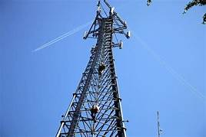

Telecom concept of tdd and fdd
TDD :- Time Division Duplex
FDD :- Frequency Division Duplex
TDM :- Time Division Multiplex
TDMA :- Time Division Multiplex Access
FDM :- Frequency Division Multiplex
FDMA :- Frequency Division Multiplex Access
TDD → Unpaired Band
→ Spectrum Efficient
UL / DL
TDD
2300 MHz
Band 40
M.S
B.T.S
A →
B →
C →
D →
E →
TDM Commutator
TDMA → Like a application
T
D
M
Freq.
* M.S → Mobile Station
* UL → Uploading
* DL → Downloading
* B.T.S → Base Transmission Service
E |D |C |B |A
Time → Running
Freq. →constant
A
B
C
D
E
F
G
Time

Slide 55
FDD – Paired Band
Concept of Modulation
=> Modulation is the process of one or more program of properties of a periods wave from the career single with a modulating signal that tropically contains information to be Transmitted
* Digital Modulation :-
ASK → Amplitude Shift Keying
FSK → Frequency Shift Keying
PSK → Phase Shift Keying
UL
D L
ASK → signal – 1 , No Signal – 0
M.S
B.T.S
900
1800 MHz
800
1
1
0
1
890 – 915 UL
935 – 960 DL
signal
Example of ASK is Optical Fiber

Slide 56
2 ^{nd} FSK
3 ^{rd} PSK
Constellation Diagram
Reference signal
PSK |_ BPSK→ Binary PSK
3st
Signal - 1
No Signal – 0
BPSK - Diagram
1st
Constellation Diagram
0
1
0
1
1
1
1
0
A
1
0
180⁰
0⁰
Signal
BPSK – Sig -
H - feq
H - feq
Low- feq
H - feq
2st
Reference Diagram
- A
Receiver
0⁰
180⁰
0⁰
180⁰
90
0
180
360
270

Slide 57
BPSK
|_> QPSK → Quadrant Phase Shift key2
|_> 2^{K} => 2² = 4
1st
Reference Diagram
3st
QPSK Diagram
90
90
0
360
180
360
180
270
01
10
00
11
receiver
2st
Constellation Diagram
A
01
Electrical
Frequency
90⁰
10
0
-A
180⁰
0⁰
receiver
90⁰
180⁰
0⁰
270⁰
11
01
10
00
11
270⁰

Slide 58
Digital Modulation Technique
|_> 8 – PSK , B-PSK,QAM , 8 – QAM ,16 – QAM
|_> 8 – Binary Phase Shift Keying
|_> 2³ = 8 , ( 3bit)
1
2
A
90
90⁰
010
A/2
011
45⁰
45
135
135⁰
001
0
180
360
100
0⁰
180⁰
000
-A/2
225
315
- A
101
225⁰
315⁰
111
110
270⁰
270

Slide 59
3
101
011
111
100
A
A/2
8 – PSK Electrical frequency
0
- A/2
- A
Receiver
225⁰
135⁰
315⁰
180⁰
101
011
111
100

Slide 60
2
8 – QAM Quarterfinals Amplitude mass
|_> PSK + ASK = QAM
|_> 2³ = 8
|_> 2A * 4 Phase = 8 QAM
90⁰
1
A
A
90⁰
011
135⁰
A/2
A/2
010
45⁰
0⁰
360⁰
180⁰
A/4
0⁰
101
100
000
315⁰
180⁰
- A/4
001
-A/2
225⁰
- A/2
110
- A
270⁰
111
270⁰
-A

Slide 61
3
8 QAM Electrical Frequency
101
101
101
100
A
A/2
A/4
0⁰
- A/4
- A/2
- A
receiver
180⁰
90⁰
270⁰
180⁰
101
101
101
100
101

Slide 62
16 – QAM
|_> 2 AMP * 8 Phase = 16 QAM
|_> 2⁴
1
AMP Diagram
2
Phase Diagram
135⁰
0101
0111
90⁰
0011
45⁰
A
90⁰
0110
0100
0010
A/2
180⁰
0000
0001
45⁰
135⁰
1001
1000
0⁰
0
360⁰
1100
1010
1110
180⁰
- A/2
315⁰
225⁰
1101
1111
225⁰
1011
270⁰
315⁰
- A
270⁰

Slide 63
3
A
1010
0011
1110
A /2
A/4
0
- A/4
- A / 2
- A
225⁰
45⁰
315⁰
Receiver
1010
0011
1110

Slide 64
* GSM Architecture
|→ Global System for Mobile ( 2G)
M.S = Equipment + sim
M.S
BTS
BSC
MSC
GMSC
M.S →Mobile Station
BTS→ Base Trans-receiver Station
BSC→ Base Station Controller
MSC→ Mobile Switching Center
GMSC→ Gateway MSC
HLR→ Home Location Registration
VLR→ Visitor Location Registration
AUR→ Authentication Center
EIR→ Equipment Identity Registration
SIM→ Subscription Identity Module
IMSI→MCC + MNU + NSIN
EIR
HLR
PSTH
ISDM
AUC
VLR
Function’s BTS :-
Encryption
Encode
Modulation
Frequency Lapping
Function’s BSC :-
Manage Radio Resource
Handless Call Setup
Radio Power Controller
Function’s MSC :-
Call Setup
Call Routing
Chenal Allocate
Billing

Slide 65
How many improve speed in 4G in comparison to 3G /Advance mobile /wireless communication
2G – GSM
2.5G – GPRS – General pocket Radio Service
2.75G – EDGE – Enhanced Data rate (8 – PSK ) for GPRS Evolution
3G – WCDMA / UMTS – universal Mobile ( 16- QAM ) Telecommunication System
3.5G – HSPA – ( HSDPA + HUUPA ) – High Speed pocket Access
3.75G – HSPA Advance (H++)
3.9G – LTE – long transmission evolution ( 64 / 256 QAM)
4G – LTE Advance
5G – IMT

Slide 66
GSM
Function’s HLR :-
IMSI Number
MSI SON
Supplementary Service
Subscribe Status Permanently
Authentication Key
Function’s VLR :-
TMSI – temporary Mobile Subscriber
Location Area (current ) Identity
MSRN – Mobile Subscriber Resource Number
IMSI – Attach /Detach
AUI – K_{i} ,K _{c} , RAND
| | |- Algorithm
| |- A₈
|- A₃
Function’s EIR:-
White List (IMEI Number)
Grey List
Black list
* Authentication in GSM :-
1 Authentication - Present illegal Use of the GSM N/W
2 Ciphering – Encrypt Communication B/N BTS and Mobile
* Rand – 128 bit
* K₁ – 128 bit
* S.RES – 32 bit signed Response
* K_{c} – 64 bit Ciphering Key
* A₃ – Authentication
* A₈ – Generation of ciphering Key
* A₅ – Encryption
Lability Use in GSM :-
* Handover And Handoff in GSM
Soft handover (make before break )
Hard Handover ( break before make )
Intra BSC Handover
Inter BSC Handover
Inter MSC Handover

Slide 67
2G Architecture
M.S
MSC
HLR
AUC
IMSI
IMSI
K₁
sim
IMSI
IMSI
K_{i}
K₁ R
A₃
RAND
K₁ R
A₈
K _{I} Rand
K _{I} Rand
SRES , Kc ,RAND
A3
SRES , Kc ,RAND
Kc
A8
SRES
K_{C}
RES
RAND
SRES ,K_{C} ,RAND → Triplet
If SRES = RES
RES , Kc
Authentication done

Slide 68
* Frequency Channel in GSM (200KHz)
Physical Channel
ARFCN 7 Time S/O + no
Logical channel
Traffic channel
Control channel
Traffic channel
Traffic channel
Broadcast Ch
Common Control Ch
Dedicate Control Channel
Full Rate
13 Kbps
96 kbps
48 kbps
24 kbps
Half Rate
65 kbps
Frequency control Ch
Paging Ch
Synchronization
SDC Ch
Random access Ch
Broadcast Control Ch
FAC Ch
Access Grant Ch
SAC Ch
Cell Broadcast Ch

Slide 69
3G Architecture (UTMS)
RNC
IU -CS
MSC Server
GMSC
CS – Domain
ISDN , PSTN
MGW
Voice Call
Node B
CS
UTRAN ➔
HLR ,EIR ,AUE
WCDMA
PS
internet
Internet
IU -PS
SGNS
GGSN
Other PLMN
N/W
CG
BG
Core N / W
M.S

Slide 70
3G Architecture (U MTS)
Feature / Function :-
=> UTMS – Universal Mobile Tele-communication System
RNC – Radio N/W Controller
SGSN – Service GPRS Supported Node
GGSN – Gateway GPRS Support Node
CG – Charging Gateway
BG – Border Gateway
PS – Pocket Switch
CS – Circuit Gateway
MGW – Media Gateway
3G BW – 5MHz (3.84 MHz)
SGSN :-
Routing
Charging / Billing
Auto connection
Location Current VLR / Current Cell
GGSN :-
Medium / Like a Mediators
Kind of Router
Protocol Conversation
Current SGSN Address
* Band – 2100 MHz / 1800MHz

Slide 71
4G Architecture (LTE ) 3.9G
Works on:-
➔ MME :- Paying , Authorizes , Hardware, select SGN.
➔SGW :- Routing and forwarding user data pocket
PDN :- Gateway -UEIP Allocation
HSS :- User Database ( IMSI ) Service Subscription user Identification and address
PGRF :- QOS , Charging
* 4G is the major communication of Hardware
EPC – Evolved Pocket cor
Variable band with ( B/ w)
|→ 1.4 MHz, 3.5 ,10 ,15 ,20 ,40
|→ 40 Band ( india ) 2300 MHz
Data Rate 300 mbps – DL / 75 mbps – UP
Multiple access technique
|→ UL – SC – FDMA
|→ Dl – Bf DMA
E Node B
EPC
IMS
* MME – Mobility Management Entity
* SGW – Serving Gateway
* PDN – Gateway – Pocket Data N/W Gateway
* HSS – Home subscriber Service
* PCRF – Policy Charging Rule Function
* 4G only working on IP Address
LTE KPI- key Performance indicator
* Radio N/W KPI
Accessibility
Retainability
Mobility
Availability
Traffic
Modulation 64 QAM ,256 QAM

Slide 72
Working of 4G
HHS
(HLR)
Response
It is supported for call or internet
MME
SI - C
S11
S1 - U
S – GW
E Node B
X2
internet
UE
X2
PDN –GW
Here :-
It is supported to Control & Hardware
PCRF
GX
E Node B
E - UTRAN
EPC

Slide 73
* How my mobile get IP address in 4G N/W
UE
E Node B
MME
SGW
PGW
Attach request
Dynamic IP Allocated
PDN Connection Registration
Create session
Create session request
UE Gated IP Address
peer entity
UE IP Attach Accepted
UE IP = 10.0.0.1 Attach Accept
IP Pool
internet
UE IP Response
UE IP response

Slide 74
Wi-fi
1st IEEE 802.11 release on 1997
→ Worked on 2.4 GHz
2nd IEEE 802.11b Release on 1999
Operating frequency – 2.4 GHz
Max Data net ---- 11 mbps
-> wi-fi :- Wireless Fidelity ,
it is not a full form
→ Founder :- Vic Hoyes Father of wi-fi 1990
802.11 :- The started work on this version in 2 feb 1980 and it is the first concept of wi-fi
IOT is happing now ,wi-fi enable built ,home security , monitoring and controlled system
Wi-fi signal are strong in Europe .due to higher Transmission power
3rd IEEE 802.11a Release on 2002
Operating frequency ---→ 5GHz
Data rate -→ 15 to 54 mbps
Multiplex technique ---OFDM
Effective range is small due to Higher Frequency
4th IEEE 802.11g release on 2003
Operating frequency ---2.4GHz
Transmission Technique ----OFDM
Back word Compatible
5th IEEE 802.11n release on 2009
Supported MIMO
Operating frequency ---- 2..4GHz and 5GHz
Data rate ------ 600 mbps
7th IEEE 802.11ad Release on 2010
Named as wi-gig
Operating frequency ------60 GHz
Data rate ---------- 7 Gbps
6th IEEE 802.11ac release on 2013
Wider Channel ----80 or 160 MHz v/s 40 MHz
Higher Modulation ----256 QAM
Supported MIMO , Operating Frequency -----5 GHz

Slide 75
Router and routing command
Router :- connect between 2 different network
→ There are three types of router
(i) Access layer :- Router which are used by the small Organization and also known as Desktop or company’s layer router
(ii) Distribution layer :- Router which are used by JSP and also known as ISP Layer Router
(iii) core :- use by the global ISP
Some port of router :-
1 AUI 2 Serial port 3 Console port 4 IMP
5 Auxiliary Port

Slide 76
1 :- AUI port :- Attachment Unit Interface ( Lan to the Router )
2 :- Serial port :- it known as WAN port
|------ 26 pin female port
|-------It is used for remote location to the router ( V.35 cable )
3:- Console port :-n It is known as local administrators port
|--- It is generally used for initial configuration password recovery
|-- it is in RJ45 Connector
4:- IMP :- It is the most dedicated port on the router because of it make less used of console port
5:- Auxiliary port :- It is remote Administrator port

Slide 77
Basic command of router configuration
* Router > → Starting of router configuration
|--- Router > enable ( Press enter )
Router # -→ it’s enable Mode / Privilege Mode
|--- Router # config t ( press enter )
Router ( Config ) # → It’s Configuration Terminal Mode
|-------Router ( Config t ) # running – Config ( Press enter )
|------for Check Running status of Router
Router ( Config t ) # Show startup – config ( Press enter )
|----- For check Startup configuration of router
Router ( Config t ) # Do Wr ( Press Enter )
|------ For save your running command

Slide 78
Configuration password or user name in your router
1:- Host name
# Enable
# Config t
# Hostname Sumit
Sumit ( Config ) # Do Wr
3 :- Console Mode Password
# Enable
# Config t
# Hostname Sumit
Sumit ( Config ) # Do Wr\
Sumit ( config) # Enable Password 123456789
Sumit ( Config ) # Do Wr
Sumit ( Config ) # Line Console 0
Sumit ( Config –line) # Password 1234567
Sumit ( Config-line ) # Login
Sumit ( Config – line)# Do Wr
4 :- VTY Mode Password
# Enable
# Config t
# Hostname Sumit
Sumit ( Config ) # Do Wr\
Sumit ( config) # Enable Password 123456789
Sumit ( Config ) # Do Wr
Sumit ( Config ) # Line Console 0
Sumit ( Config –line) # Password 1234567
Sumit ( Config-line ) # Login
Sumit ( Config – line)# Do Wr
Sumit ( config- line) # line VTY 0
Sumit ( Config –line) # Password123456
Sumit ( Config – line) # login
Sumit ( Config – line) # Do Wr
2 :- privilege Mode Password
# Enable
# Config t
# Hostname Sumit
Sumit ( Config ) # Do Wr
Sumit ( config) # Enable Password 12345
Sumit ( Config ) # Do Wr
Privilege mode :- Password for Input In router
Console Mode :- Password for Input in router With Through CLI Mode
VTY Mode :- password for input in router through my computer

Slide 79
How to configure ip and subnet mask your router
1 :- Conti8nue with CLI dialog box
|---- No ( press enter )
|----- Router > : Enable ( press enter )
|---- Router # : Config t ( Press enter )----→[ Privilege mode ]
|---- Router ( Config ) # : Interface - GigabitEthernet 0 /0
|--------( press enter )----[ Config t ]
|---- Router ( config – if) # : Ip address 10.0.0.1 255.0.0.0
|-----( press enter )-----[ interface ]
|---- router ( config – if ) # : No shut Down
|-----( Press enter ) --------[ line Up]
10.0.0.1

Slide 80
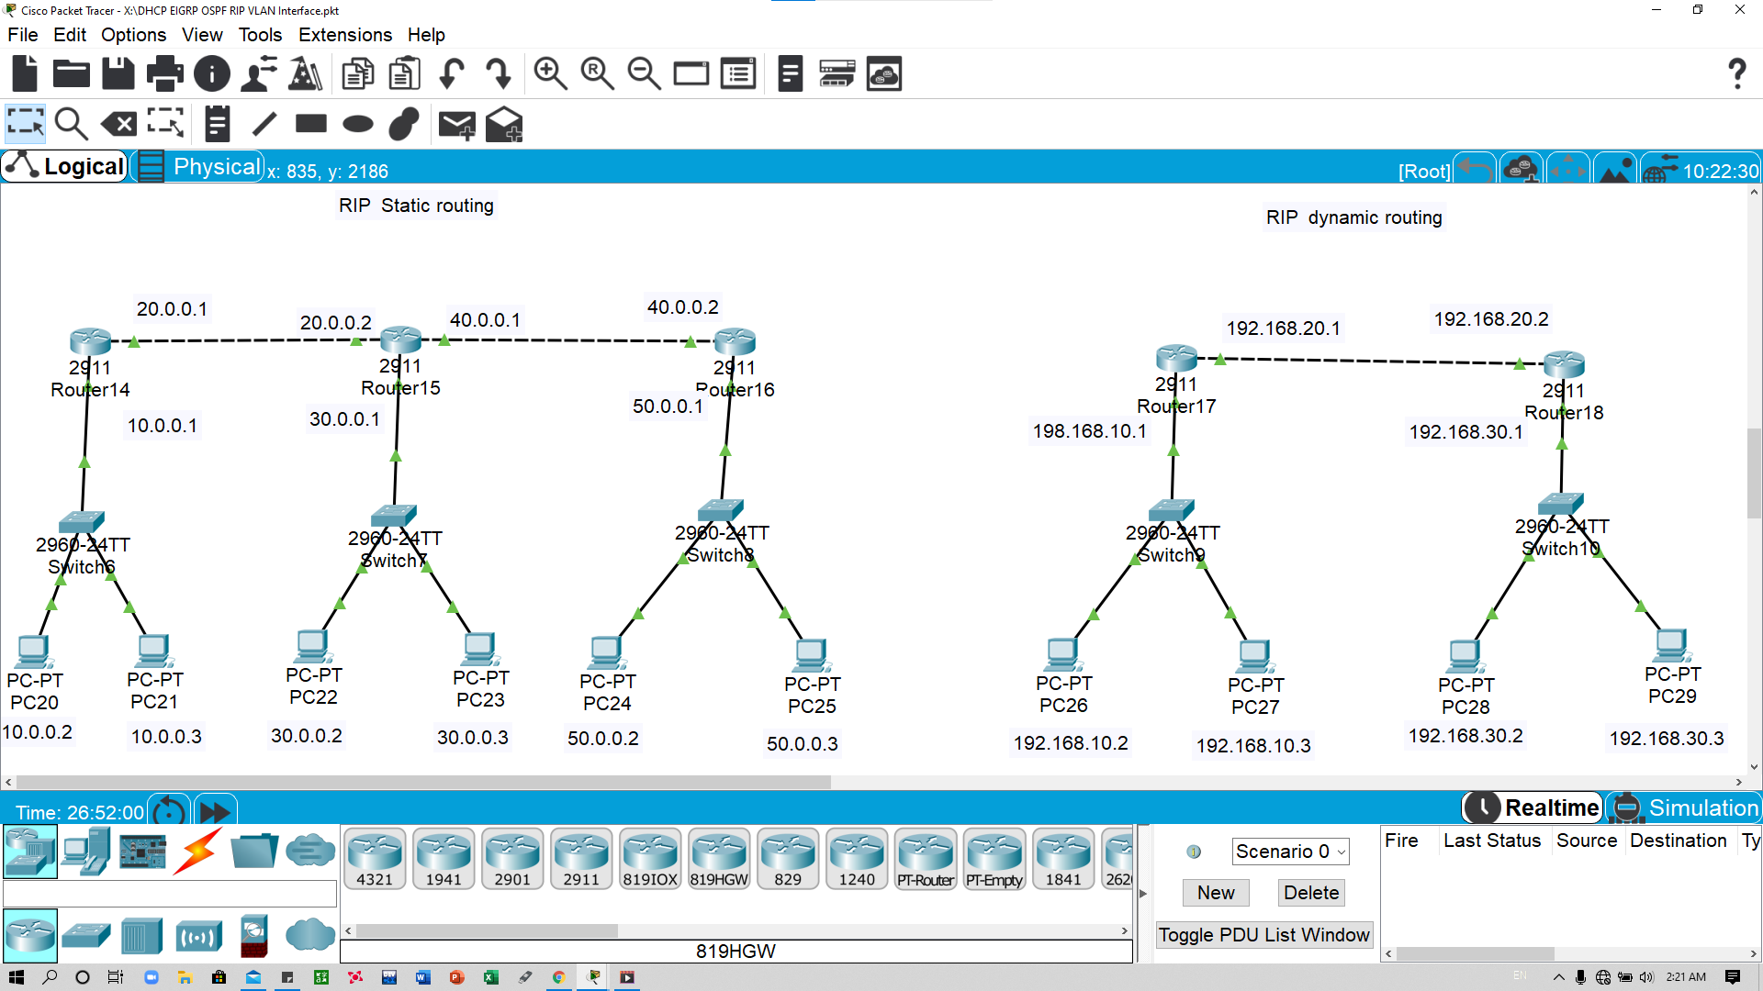
Rip routing ( static )
-→ router 1st Configuration Ip of each interface
2nd Routing with each other network
* Adding those network isn’t available in this router
# : En
# : Config t
# : interface gigabitEtherner 0 / 0
# : ip Address 10.0.0.1 255.0.0.0
# : No Shut down
# : Do wr
# : exit
# :Config t
# : interface GigabitEthet 0 / 1
# : Ip address 20.0.0.0 255.0.0.0
# : No Shutdown
2nd -------- routing with other 2nd router’s network
# en
# : config t
#: Ip Address 30.0.0.0 255.0.0.0 20.0.0.2 ( press enter )
#: Ip Address 40.0.0.0 255.0.0.0 20.0.0.2 ( press enter )
#: Ip Address 50.0.0.0 255.0.0.0 20.0.0.2 ( press enter )
# : Do wr ( Press enter )
** Do Same process for 2nd and 3rd Router and it’s networks .

Slide 81
Rip routing ( Dynamic )
-→ router 1st Configuration Ip of each interface
2nd Routing with each other network
* Routing those network those available in this router
# : En
# : Config t
# : interface gigabitEtherner 0 / 0
# : ip Address 192.168.10.1 255.255.255.0
# : No Shut down
# : Do wr
# : exit
# :Config t
# : interface GigabitEthet 0 / 1
# : Ip address 192.168.20.1 255.255.255.0
# : No Shutdown
2nd -------- routing with other 2nd router’s network
# en
# : config t
#: Ip Address 192.168.10.1 ( press enter )
#: Ip Address 192.168.20.1 ( press enter )
# : Do wr ( Press enter )
* Here isn’t Necessarily for network subnet mask in RIP Dynamic Routing.
** Do Same process for 2nd and 3rd Router and it’s networks .

Slide 82
Eigrp routing
EIGRP :- Enhanced Interior Gateways Routing Protocol
Cisco Property protocol
Classless Routing protocol
In class all features of EIGRP
Metric (32 bit ) : compositive
Administrative Distance is internal 90 or extend 170
Supports IP and Apple Talk protocol
Up – date are multicast
Works with different update Algorithm ( dual )
Hello packets are Send every 5 Second.
Convergences is firstest
Cisco properties Protocol
Classless routing protocol
Including all features of EIGRP
Metrical ( 32 bit ) : Compositive metric

Slide 83
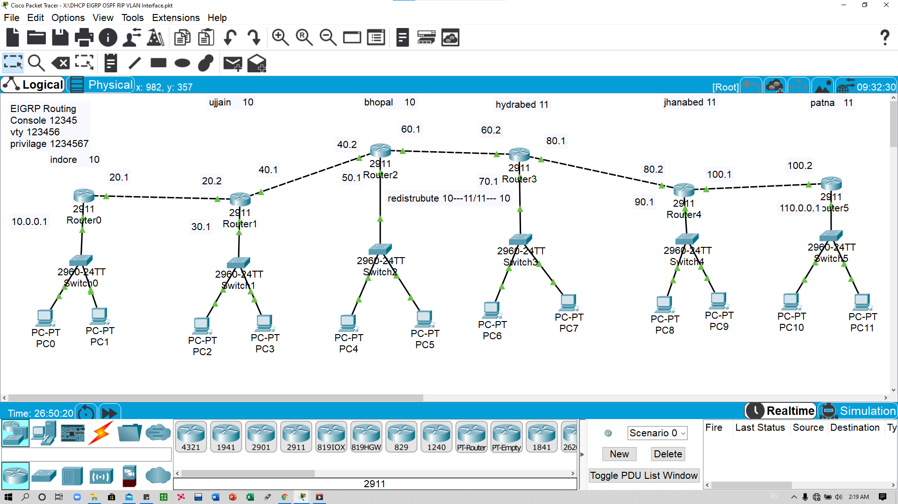
Eigrp routing

Slide 84
EIGRP Routing
1 :- Configure IP Address on router of each Interface
2 :- Routing with each other with some important command same autonomous number
3 :- Redistribute of different autonomous number with each other
2 :- Routing EiGRP for Router 3
# : enable
# : Config t
# : router _ EIGRP _ 10
# : Network _ 50.0.0.0
# : Network _ 40.0.0.0
# : exit
# : Router _ EIGRP _ 11
# : Network _ 60.0.0.0
# : Do wr
3 edistribution router 3 and 4
# : enable
# :config t
#: Router EIGRP 10
# : redistribute EIGRP 11
# : exit
# : Router EIGRP 11
# : redistribute EIGRP 10
#: Do wr
1 :-configure Ip Address on 0/0 interface
# : enable
# : Config t
# : interface Gigabitethernet 0/0
#: Ip Address 10.0.0.1 255.0.0.0
# : No shutdown
# : do wr
2 :- Routing EiGRP for Router 1
# : enable
# : Config t
# : router _ EIGRP _ 10
# : Network _ 20.0.0.0
# : Network _ 10.0.0.0
# : Do wr
1 :-configure Ip Address on 0/1 interface
# : enable
# : Config t
# : interface Gigabitethernet 0/1
#: Ip Address 20.0.0.1 255.0.0.0
# : No shutdown
# : do wr
2 :- Routing EiGRP for Router 2
# : enable
# : Config t
# : router _ EIGRP _ 10
# : Network _ 20.0.0.0
# : Network _ 30.0.0.0
# : Network _ 40.0.0.0
# : Do wr
2 :- Routing EIGRP for Router 4
# : enable
# : Config t
# : router _ EIGRP _ 11
# : Network _ 60.0.0.0
# : Network _ 70.0.0.0
# : Network _ 80.0.0.0
# : Do wr

Slide 85
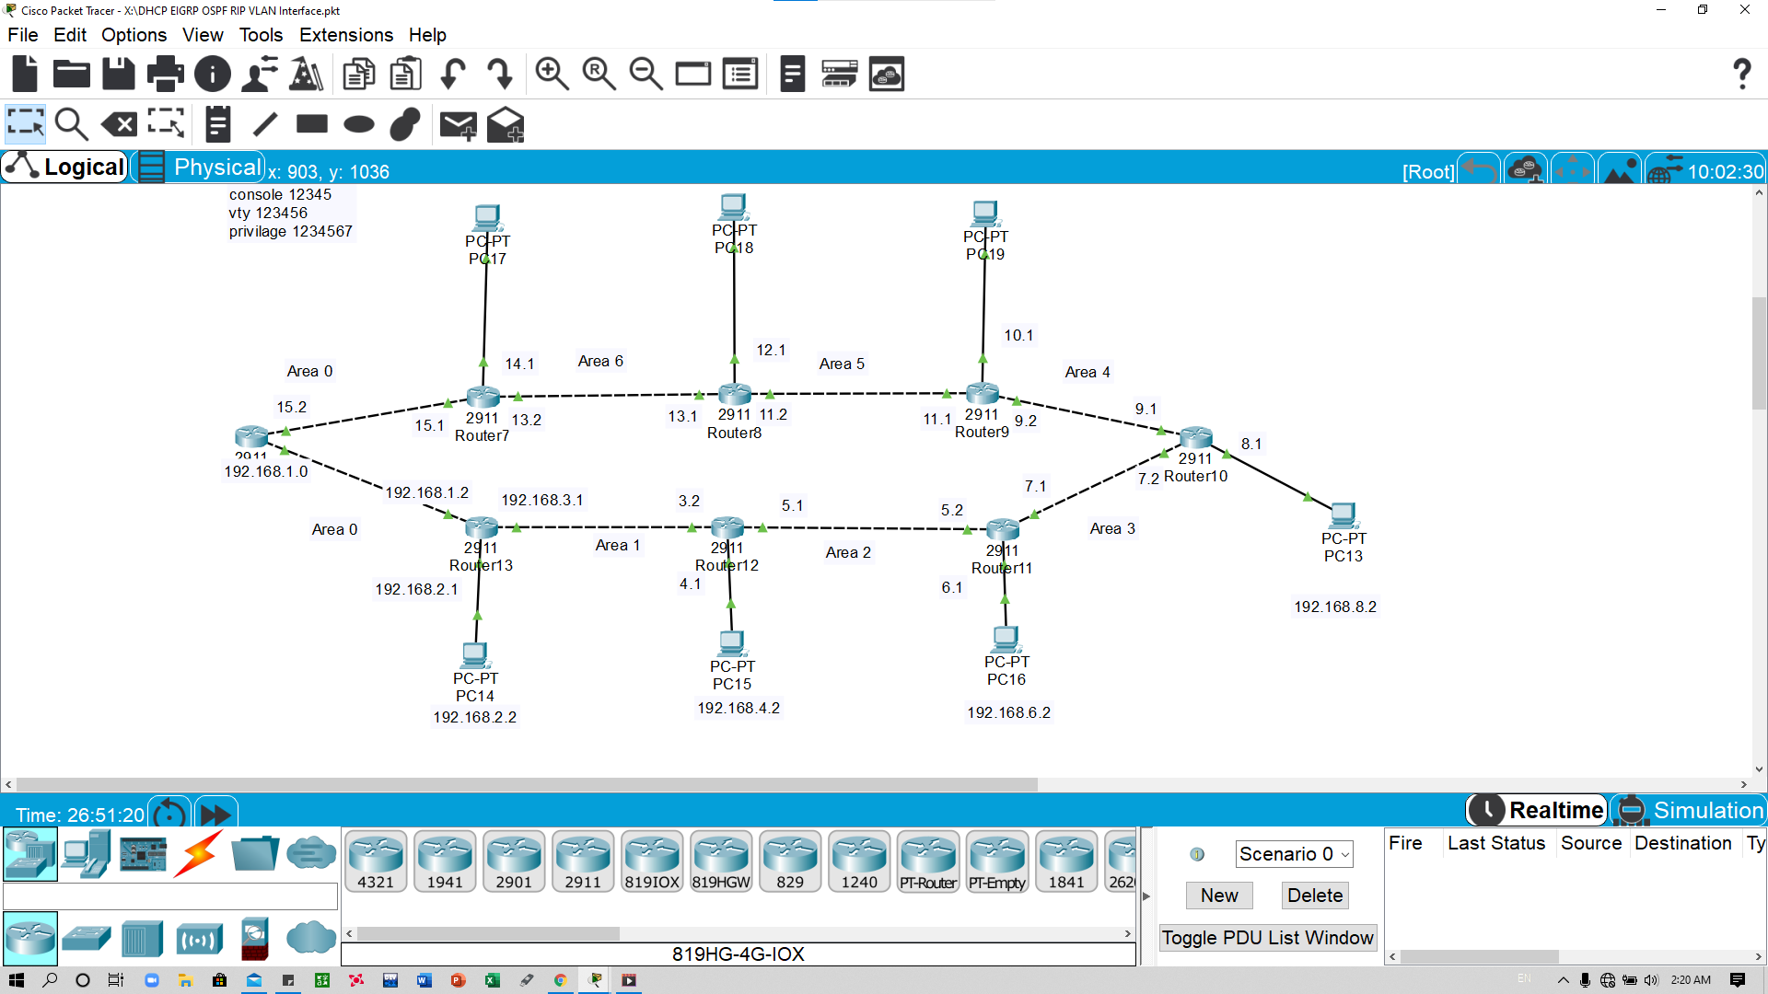
Routing OSPF
1 :- Configure Ip address Each interface
2 : routing OSPF With wildcard mask with decided area 0
( * here 0 is Base area )

Slide 86
Routing OSPF
1 :- Configure Ip address Each interface
2 : routing OSPF With wildcard mask with decided area 0
( * here 0 is Base area )
1 :- Configure ip address Router 1
# : Enable
# : Config t
# : interface Gigabitethernet 0 /0
# : Ip address 192.168.1.0 255.255.255.0
# : No shutdown
2 :- Routing OSPF on router 1
# : enable
# : config t
# : router OSPF 10
# : Network 192.168.1.0 0.0.0.255 area 0
# Network 192.168.2.1 0.0.0.255 area 0
# do wr
1 :- Configure ip address Router 1
# : Enable
# : Config t
# : interface Gigabitethernet 0 /1
# : Ip address 192.168.2.0 255.255.255.0
# : No shutdown
2 :- Routing OSPF on router 2
# : enable
# : config t
# : router OSPF 10
# : Network 192.168.1.0 0.0.0.255 area 0
# Network 192.168.2.0 0.0.0.255 area 0
# Network 192.168.30.0 0.0.0.255 area 1
# Do wr

Slide 87
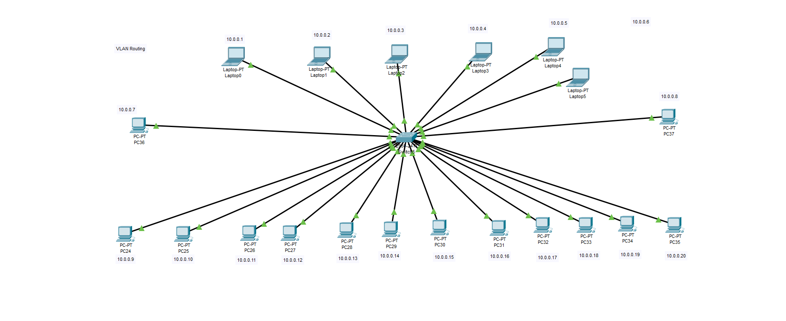
VLAN :- Virtual local area network
1st :- Click on switch device and go to CLI mode to create VLAN 2 or 3
2nd :- Configure VLAN of interface for VLAN 2 or 3

Slide 88
VLAN :- Virtual local area network
1st :- Click on switch device and go to CLI mode to create VLAN 2 or 3
2nd :- Configure VLAN of interface for VLAN 2 or 3
1st : - Click on switch and go to CLI mode
|----- switch >: enable
|---switch # config t
|---- Switch ( config ) # VLAN 2
2nd :- Configure vlan interface in VLAN 2
# Enable
# Config t
# Interface Fastethernet 0/1 / 0/2 / 0/3
(* if your choice )
# switchport _ access _ VLAN 2
You want to select range then
# en
# config t
# interface range Fastethernet 0/2 – 9
# switchport _ access _ VLAN 3
# do wr
1st : - Click on switch and go to CLI mode
|----- switch >: enable
|---switch # config t
|---- Switch ( config ) # VLAN 3

Slide 89
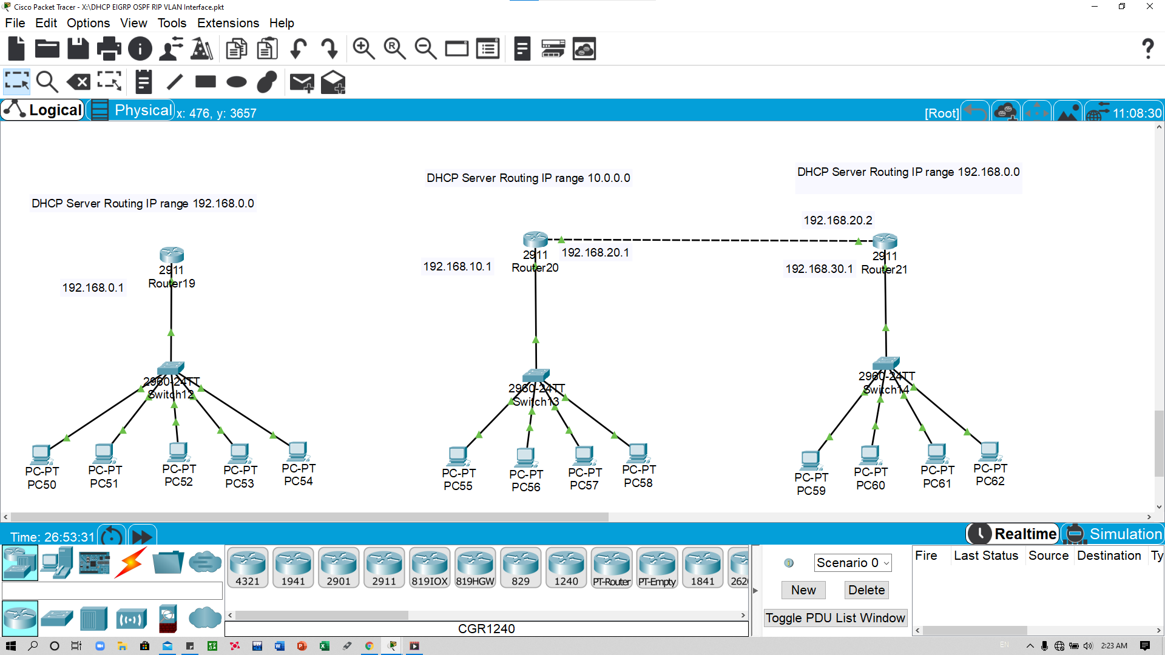
DHCP Server
1st :- Configure Ip address of router each interface
2:- :- Configure DHCP server Command and add computer
1st : - configuration Ip address
# : enable
# : config t
# : Interface GigabitEthernet 0/0
#: Ip Address 192.168.10.1 255.255.255.0
# :do wr
# : exit
2nd configure DHCP server each interface
# : Enable
# : Config t
# : Ip _ DHCP _ pool_ sumit ( press enter )
# :Network 192.168.10.0 255.255.255.0 ( press enter )
#: default – Router _ 192.168.10.1 ( press enter
* It is 0/0 interface working

Slide 90
1st :- Configure Ip address on router interface
3rd :- Routing between all routers and device of each interface
2nd :- create pool for Router 1 and create pool for helper router
4th :- configure helper routing address
2nd:- Create Pool for Router 1
#: enable
#: config t
#:ip _ DHCP _ pool _ sumit
#: network _ 192.168.10.0 255.255.255.0
#: Default – router 192.168.10.1
2nd:- Create Pool for Router 2
#: enable
#: config t
#:ip _ DHCP _ pool _ kumar
#: network _ 192.168.30.0 255.255.255.0
#: Default – router 192.168.30.1
DHCP Server With helper
4th :- Configuration helper routing command on 2nd router interface
#: enable
#: config t
#: interface GigabitEthernet 0/1
#: ip _ helper – address 192.168.20.1

Slide 91
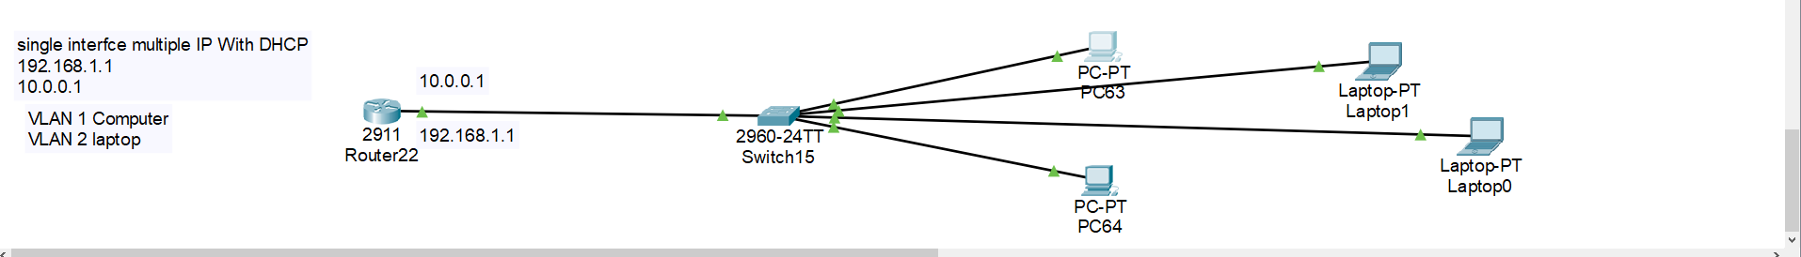
DHCP Server single router but multiple DHCP pool Interface
1st :- Configure VLAN for selected Ip ( 0/4 – 9 ) on switch
2nd :- configure Sub – interface for create Multiple DHCP pool for each Network
3rd :- configure DHCP pool for each Network
4th :- Configure trunk On switch for router interface
1st :- configure vLAN
Switch> : enable
Switch #: config t
Switch ( config ) #: VLAN 2
Switch ( config ) do wr
Switch ( Config ) #: interface FastEthernet _ 0/4 – 5
Switch (config )# : Switchport _access_VLAN 2
Switch ( config)# : do wr
continue

Slide 92
2nd :-Configure sub-interface for network 1 ( 192.168.10.1) on router
# : enable
#: config t
#: interface _ gigabitEthernet 0/0.2
#: Encapsulation dot1Q _ 2
#:ip _ Address _ 192.168.10.1 _ 255.255.255.0
# : do wr
2nd :-Configure sub-interface for network 1 ( 10.0.0.0) on router
# : enable
#: config t
#: interface _ gigabitethernet 0/0
# :no shutdoen
#: interface _ gigabitEthernet 0/0.1
#: Encapsulation dot1Q _ 1
#:ip _ Address _ 10.0.0.1 _ 255.0.0.0
# : do wr
3rd :- Configuration pool for network 192.168.10.0 on router
#:enable
#: config t
#:ip_DHCP _ pool _ kumar
#:network _ 192.168.10.0 _ 255.255.255.0
#:Default – router _192.168.10.1
#: do wr
3rd :- Configuration pool for network 10.0.0.0 on router
#:enable
#: config t
#:ip_DHCP _ pool _ sumit
#:network _ 10.0.0.0 _ 255.0.0.0
#:Default – router _10.0.0.1
#: do wr
#: exit ( for configure 2 DHCP pool network )
4th :- Configure trunk on switch
# : enable
#: config t
# : interface fastethernet 0/5
#: switchport _ mode _ trunk (enter )

Slide 93
ACL P routing
ACL :- Access Control List
ACL is the set of rule which is allow or deny moving graphic through the router
There are the types of rule
Standard ACL Rule ( 1 – 99 ) ----- Near to destination
Extended ACL rule ( 100 – 199 ) Near to source or destination

Slide 94
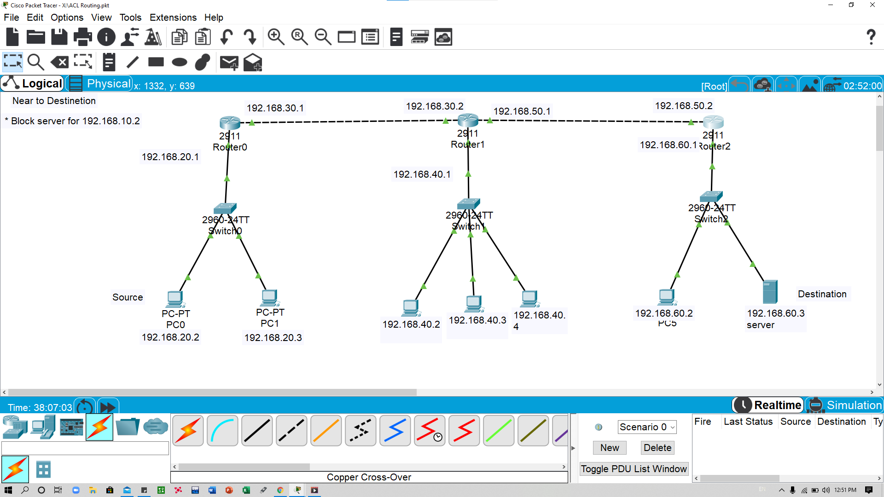
Standard ACL
1 :- Configure Ip Address of router
2:- Configure routing between each other
3 :- configure Rule on route for Block Service
continue

Slide 95
1st :- configure ip router 1
# en
#: config t
#: interface gigabitethernet 0/0
#: ip address 10.0.0.1 255.0.0.0
#: no shutdown
# : interface gigabitethernet 0/1
#: ip address 20.0.0.1 255.0.0.0
# : no shutdown
3rd :- configure rule for block service on router 3
#: enable
#: config t
#: access _ List _?
< 0 – 99 > Standard Rule
< 100 – 199 > Extended rule
#: Access _ list _ 10 deny host 10.0.0.5
#: access _ list _ 10 permit any
#: interface gigabitEthernet 0/1
#: ip _ Access – Group 10 in in
# : Do wr
To Show your access group
Router # : Show Access – group
To remove your access Group
Router (config ) #: interface Gigabit ethernet 0/1
Router (config ) # : No ip _ Access – group 10
2nd :- routing with RIP Dynamic mode
#: enable
#: config t
#: Router_ RIP
#: Network 10.0.0.0
#: Network 20.0.0.0
# : do wr

