Slide 1
PYTHON

Slide 2
WHAT IS PYTHON ?
=> Python is one of the general purpose , High level , Object oriented and Interpretend Programming languyage -> Python was developed by GUIDO VAN RASSUN in 1989 while working at CENTRUM WISKUNDE & Informatica ( CWi ) at Netherland -> But offically Python was made available to Public in 1991 ,The offical date was 20th Feb 1991
-> The predecessor of python prommaming language is ABC Programming Language -> Python software is maintained by PSF ( Python Software Foundation ) -> www.Python.org -> The name python was seleced from the TV Show “ Monty Python ‘s Flying Circus “ Witch was broadcast in BBC from 1969 to 1974
-> Python software has two version . |-- Python 2X ---> outdated version |-- Python 3X ---> Currenrt Version ( 3.11.2) * Python does not support backward compatibility . -> Python is recommended as first programming language for beginess.

Slide 3
Features of Python
Installation of Python
Rentime application Developing Python |- Web Development | |- django , pyremid | |-GUI application | |- tinker |-Console Based Application
| |- REPL
| |- Red - Evaluate - print - loop
|- Software devlop - Bulding Tool
|- Business Application | |- ERP
| |-E-Comm
|- Standerd application
|- Image Processing Application
|- DS / AI / Ml |- numpy
|-Panda
1. www.python.org |- Download -- win 7 -- Select Version
2. open Downloaded file
|- Install Now / Select path - Close
3. Open Python to Check |- Search box type python < enter >
1. simple and easy to learn
2. Freeware and open source
3. Dynamic programming language
4. plateform independant language
5. poartable
6. interpreted programming language
7. High level language
8. Procedured and object oriented
9. Robust
10. Extersible programming language
11. Embedded programming language
12.Support Thired party API

Slide 4
What is Features ? in python
1. simple and easy to learn .
-> Python is a simple programming language which we read python program we feel like reading english statement
-> * Python language provide rich set of modules or API
-> * Python programming provide inbuild facility called Garbage collector , which collector un-used memory repace and improve the performance of python based app.
Example :- Lab 1. -- simple and easy to learn
>>> 3+2 <enter> ---- 5 output >>> print(“hello world”) <enter> -- Hello world
>>>print(calender.month(2023,5))<enter> -- error
>>> import calender<enter>
>>>print(calender.month(2023,5) <enter> -- output
>>>import random<enter>
>>>print(randam.randint(50,500))<enter> -- 167 s
>>>import math<enter>
>>>print(math.sqrt(625)<enter> -- 25 -- output
>>> import cmath<enter>
>>>print(cmath.pi)<enter> -- 3.1425 -- output
# => Python provide developer Friendly syntax so that use can develop error forfree programs in a limited span of time
continue.....

Slide 5
2. Freeware and Open source
=> We can use python software without any license and it is freeware
=> It’s source code is open , so thet we can customized based on our requriement the father of python G.V.rassum developed Cpython
This Cpython customised by many companies called “Python distribution “
-> These are late of pyton distribution (a) Jython or Jpython - used for runtime java based application
(b) Iron Python / iPython - Used for runtime C# ,.Net application
(c) Micro python - used for developing micro cntroller
(d) Anaconda python - used for runtie bigdata / Hadoop application
(e) Ruby python - Used for runtime ruby based data application
(f) PyPy
(g) Stockless python
continue.....

Slide 6
Lec:- 3
What is compiler and interpreter ?
6. * Q :- Is Python Interpreter language or Compiler prrogramming language ?
# Both Compiler and interpreter are program that convert the source code (HLL) to Machine Code ( LLL)
Compiler
1. A compiler takes the entire program in one go
2. * The Compiler Generate on Intermidiate Object Code
3. * Compiler Convert High-level program that be High memmory Required exected many time
4. Errors are displayed after entire program is check
5. Compileris used by C,C++ , C# ,Java
Interpreter
1. An interpreter takes a single line of code at a line
2. The interpreter never provide any intermidate object code
3. Interpreter Convert High level program Each time it is Executed
4. Error are displayed line by line
5. Less Memmory Required
6. Interpreter used by Python , PHP , Ruby
PVM reads line by line of byte code and
Converted into Machine understandable by
Code( Binary Code ) and it is read by OS
and Processor and gives result
# Python Execution Enviroment
Byte Code
Compiler Phase
Execution Phase
file.py
File.PYC
Py.Compiler
Line By Line
Python Vertual Machine
or
Just in time Compiler
Interpreter code
Python Compile Version
Source Code
HLL
Interpreter

Slide 7
* How is python Interpreter Programming Language ?
-> When we execute any python program , internally two phase took place they are
1. Compiler phase
2. Execution Phase
* Both are line by line which interpreter programming language
1. Compiler Phase :-
The python compiler , read the source code line by line and converted into intermeadiate code of python of
python called “ Byte code “ Science python compiler converting the source code into byte code line by line
hence it is interperter
2. Execution Phase :-
The Pvm ( python vertual machine ) read line by line of byte code and converted into machine
understandable code and it is read by operating system and processor and gives final result of the program

Slide 8
Lec :-4
4 Q :- * Is python Plateform indipendent programming language or Why ?
-> * Data Types |- Data types is allocating memory space to our inputs
* OS -> Which is allocated resources or deallocated resouces is know as OS
=> data Types
Dos unix os
int 2 bytes 4bytes 1bytes
float 4 8
double 8 16
char 1 1
* C/C++ programming language and whose corresponding data types varying this memory space from one OS toanother OS , Therefore these are plateform dependent .
-> In the Java :- Data type are treated as a key
Dos unix
short 2 2
int 4 4
byte 1 1
long 8 8
boolean 0 0
* As java data type takes some memmory space of all type of OS and hence java is Plateform independent
* Pre - define data types can store single value only . not multipal value
ex- 99.9999999999999999999999999999
“sumit kumar”
‘a’ ,’b’
continue.....

Slide 9
-> Once we write a pyton program it can run on only plateform without rewriting once again
-> Internally PVM is responsible to convert into machine understandable form .
-> Python is one of the plateform independent language because “ in python program execution enviroment all value are stored in the from “Object “
-> All the Object can store unlimited number of value and they will not depends on any OS
-> Python programming language is one of the porm independent because python programming store all the value in the from “Object “ with unlimited size .
Ex. -
>>> a=99.99999999999
>>>print(a) -- 99.99999999
>>> typr(a)
>>> ‘ class int ‘
>>> s[“sumit kumar ,89 , “delhi”]
>>> print(s) --- sumit kumar 89 delhi
>>> s.append(“Aabc”)
>>> s.append(89898989)
>>>print (s) -- sumit kumart 89 delhi Aabc 898989889

Slide 10
Lec-6
3. Why Python is dynamically typed and High level language ?/
1 Statically typed programming language
2.Dynamically typed Programming language
1. In statically programming language it is mandatory to specify the data type otherwise we will get compile time Error
example:- C,C++,Java, .Net
2. In Dynamically Typed programming language , it is not neccessary to specify the data type for the variable become python programmig environment will automatically assigh the data type depend on value
example:- python
This dynamically typed nature will provide more flexibility to the program
>>> a=10
>>>b=20
>>>c=a+b
>>>print(c) ---30

Slide 11
Lec -6
=> Extensible ,Embedded and Robust , Thired Party support API
-> Extensible -- An extensible programming language mean thet you can attach language program in python
ex:- python program or code can be called part of C,C++, JAVA
-> Embedded -- We can use python program in any other language program i.e - we can embed python
program any where
-> Robust -- A programmig is said to be eobust if and only if it always provides user friendly error message when end user commits mistake at implamention level
-> To get user friendly error message , we use Exception handling features
-> Since python programming provides exeption handling facility and hence python is one the robust ( strong ) programming language
-> Support third Party API - - the python support for making use of third party API(module) for developing the real time application with high performance with precise code

Slide 12
Value or Literal - 100,200,300 -- Intergers _Whole Number
|- Intergeral Value
* A B C a b c
Distrac nameor identifier 100 100 100 X Y z
Memory
* True or False -- Boolean Type Data
Lec - 7
=> Data Representation in Python
* During Execution of program , identifier can change , therefore they are called
Variable
=> To , represent that data in python programming we required 3 things
1. Literals
2. Data types
3. Indentifier / Vriable / Object
1. Literials :- Literials are nothing but input value passing to the program
i.e - Numeric Litreal
Boolean Litreal
String Litreal
-> all the literals are stored in main memory by allocating sufficient amount of memory by the help of data types
-> To process these value or literals stored in main memory , as programmer w must give disting name to the create memory space
-> Scence the distint name make us to identify the literals / Value for processing and hence distinct name called “ identifiers”
-> Programmatically Identifiers value can be changed diring execution of the program and hence indentifiers are called “ Vriable “
-> Hence the type of value in main memory in must be stored in main memory in the form of variable

Slide 13
=> Defination of Variable
-> A variable is an identifiers , whose value can be changed during Execution of the program
-> All The variable in python are called Object
-> Behind of all Object , These exist a Class
-> Rules for using variable in python Programing
1. A variable combination of alphabets digits and a special symbol underscore ( _ )
2. The first letter of variable name must start with alphabet or ( _ ) Underscore
3. Within the variable name special symbol are not allowed except Underscore ( _ )
4. No Keyword to be use as variable name because all the Keyword are having special meaning to the language compiler
5. All pre - defined class name ( int , float , etc ) can be use as variable
Lec - 8
=> Date types in python
* -> The main parpose of data types is that to allocate sufficient amount of memory space for input of the program
-> This Input represent the type of data present inside a variable
-> In python use are not required to specify the type Explicity based on input provide the type will be assigned automatically hence python is dynamically typed language
-> In python programming , we have have14 data type and they
Classified into type
a = 100 Interger Value
Variable Input Litreal
Identifiers a 100 Space
Object
input object ID

Slide 14
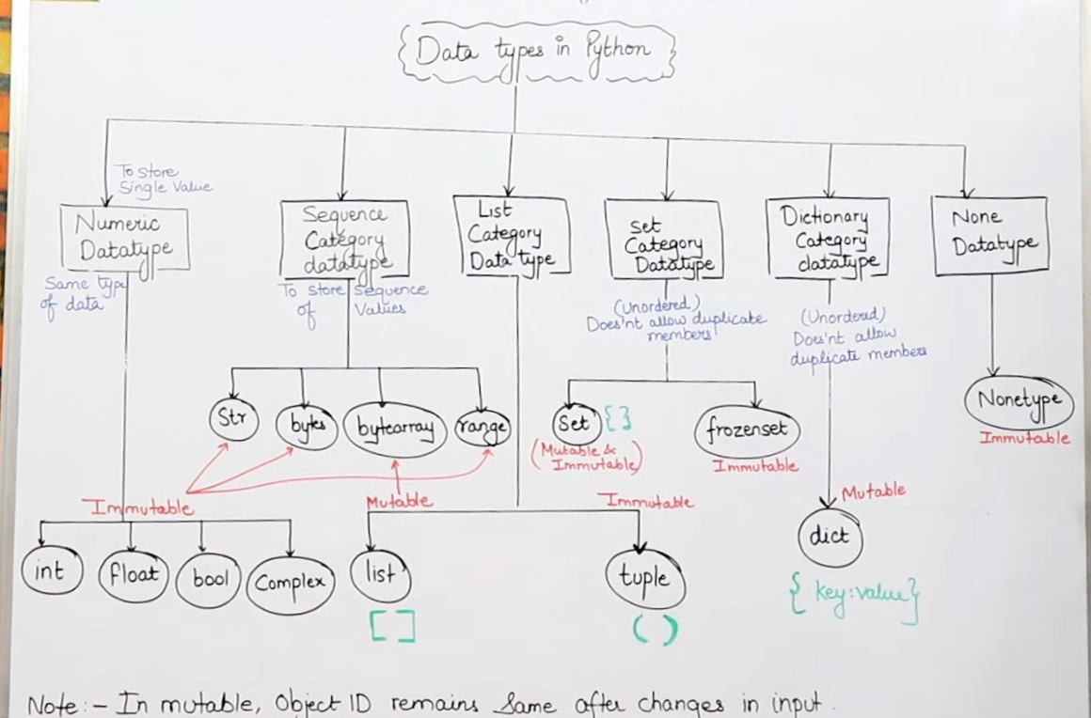
Data Types IN Python

Slide 15
Lec - 9
=> Int Data Type
-> Type () - to check the type of variable
-> Id () - to get memory address of object
-> print () to print the value
=> Int data type
-> We can use int data type to represent whole number / intergerws value are nothing but data without decimal plan
e.g - print (a) ---> 100
type (a) --> < class ‘ int ‘>
id (a) ----- > < 123456780 >
* -> In python 2 we here long datatype to represent very large intergerals value
-> But in python 3 these is no long type Explicity and we can represent long also by using int type only
-> With ‘ int ‘ data type , we can also store number system data
-> In any programming long uage ( pyrhon , c , c++ ) we have 4 type of number system .
They are : -
1 Decimal Nuumber system
2 Binary number system
3 Octal number system
4 Hexa Decimal Number system
>>> a = 100
>>> Print (a) --- 100
>>> print ( a , type(a)) -- 100 < class ‘int’>
>>>print (id(a)) --- 500

Slide 16
2 :- Binary Number System
-> The digit in binary no. system are
Digit : 0 , 1
Total no. og digit - 2
Base - 2
-> To Store binary data in python programming , binary data must be preceded with Either 0B or 0b Syntex : - Variable name : -0b or 0B -> Even we store binary data , but where you print the value , python gives result in Decimal no.
-> Binary -- 0b * into Decimal
-> octa 0O -- / 8
-> Hexa 0X -- /16
3 :- Octal number system
-> The digit is octal number system are :-
Digit -- 012345467
Total -- no. 8 () ₈
Base -- 8 ()₈
-> Base is literals are called Octal no. system
-> To store octal data in python Programming octal data must be preceded with 0O or 0o
syntex :- Variable Name = 0o or 0O
ex - (3412)₈ ---------->(1802)₁₀
3*8 ³ + 4*8 ² + 1*8 ¹ + 2*8 ⁰ = 8*512 + 256 + 8 + 2 = 1802
>>> a = 0o3412
>>> print(a)

Slide 17
4. HexaDecimal number system
-> The digites in Hexadeciamal no. system are 0,1,2,3,4,5,6,7,8,9,A,B,C,D,E,F
Total no. of digits -> 16
Base - () ₁₆
-> Base 16 Literals are called Hexadecimals
-> To store Hexadecimal data in python , Hexadecimal data store from 0X or 0x
syntax : - Variable name = 0X Hexadecimal value
>>> a = 0x 01011001
>>> print (a)
>>> b = face
>>> print(b)
=> Lec - 10
Base Conversion technique in Python
-> The purpose of base conversion technique in pyhton is that “ converting “ one base value into another base value
-> In python , use have 3 base conversion function they are :-
bin() ---- inbult function
oct() --- inbult function
hex() -- inbuilt function
* def () is not there , as it is already defaut no. system in python
-> bin () - This function used for converting other number system data into binary number system
syntax - variable name = bin ( decimal / octal / Hexa )
for ex :-
>>> a = 100
>>> b = bin (a)
>>> print (b)
>>> -

