Slide 1

Shopping Website Project
Rock Mart - Your One-Stop Shop

Slide 2


Introduction
Rock Mart is a shopping website designed to provide users with a seamless online shopping experience.
It offers a wide range of products with user-friendly navigation.

Slide 3
Features
- User-friendly interface
- Secure payment gateway
- Product search and filtering
- Responsive design for all devices
- Wishlist and cart functionality
- Record the employ attendance by the online image

Slide 4

Project Objective
Key Goals
Simulate e-commerce features
Enhance frontend UI/UX
Interactive JS-based animations

Slide 5

Technologies Used
- HTML, CSS, JavaScript for frontend
- Backend: Node.js or Python (Django/Flask)
- Database: MongoDB
- Hosting: AWS
- Deployment: render.com
- Project Space: github.com

Slide 6

Project Structure
File Overview
HTML: index, cart, macbook, profile, delivery list
JS: index.js, indexprofile.js, mbcaart.js

Slide 7
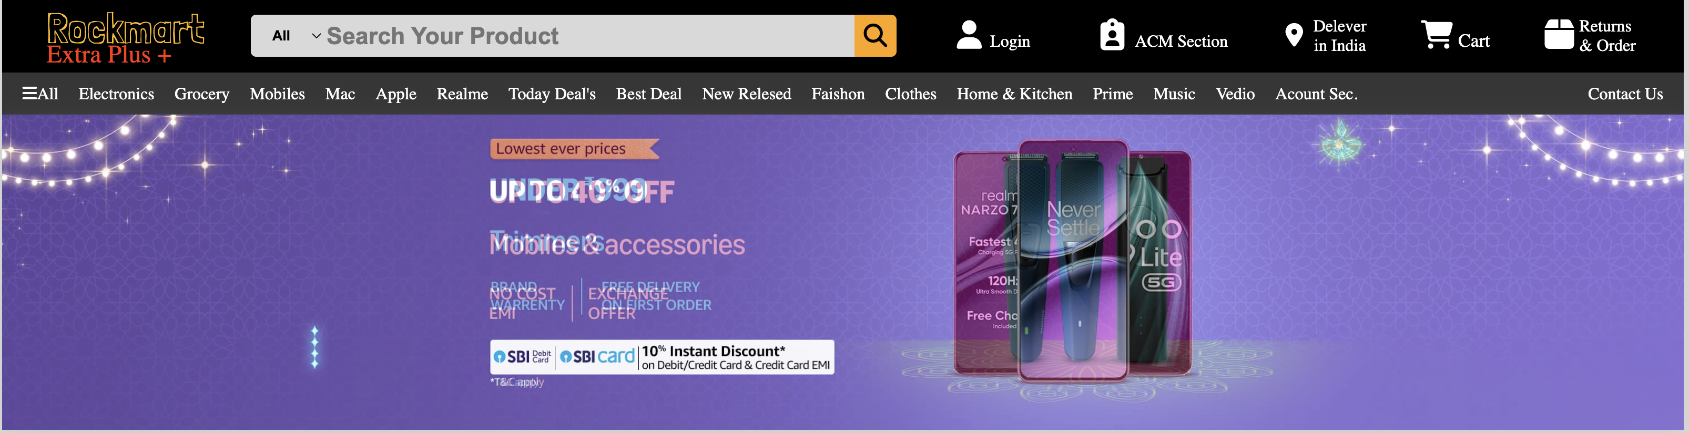
Homepage Features
Key Elements
Logo & Navigation
Search Bar with Select Filter
Product Categories

Slide 8

Navigation System
Custom Select & Category Links
Dropdown selectors
Category-based browsing
Links to various sections

Slide 9
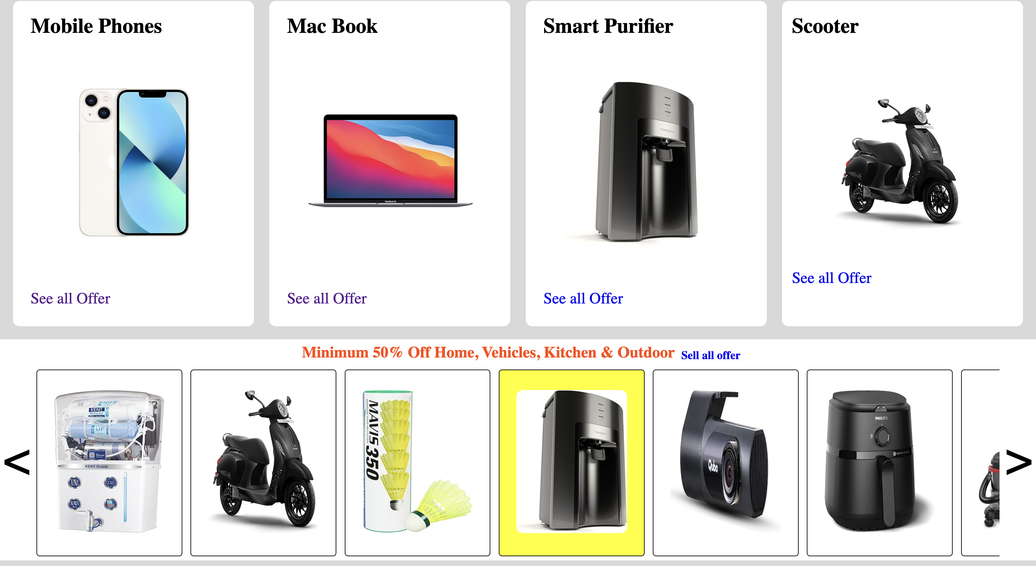
Product Carousel
Slider Implementation
JS-based translateX animation
Prev/Next buttons for horizontal scroll

Slide 10
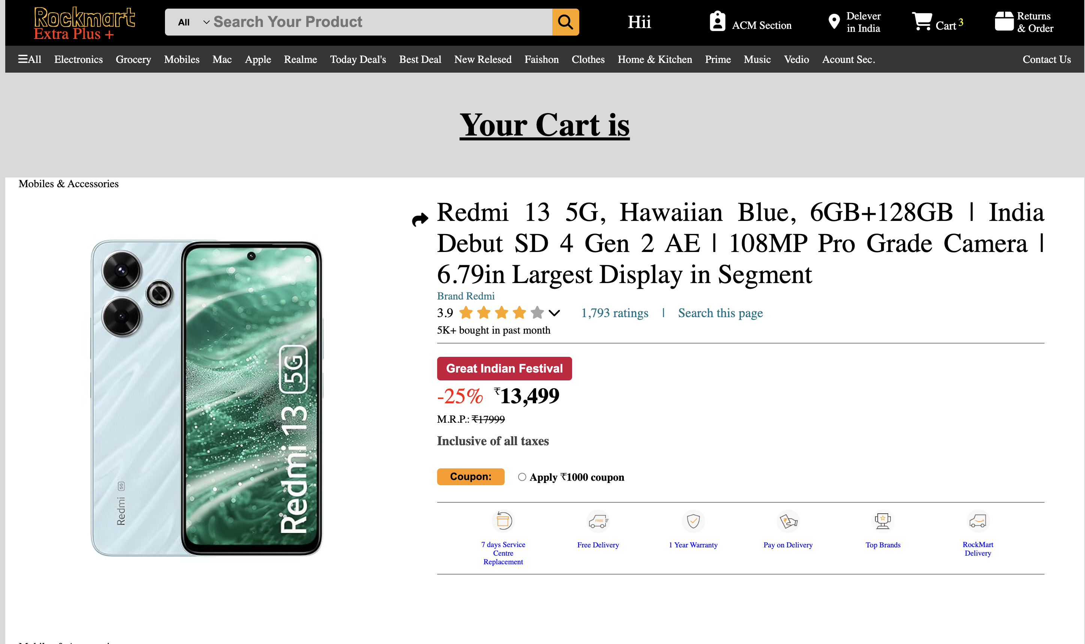
Cart Page
Add & Manage Products
Product summary
Price comparison
Apply coupon functionality

Slide 11

Strengths of RockMart
What Works Well
Modern layout
Category organization
Interactive JS components

Slide 12

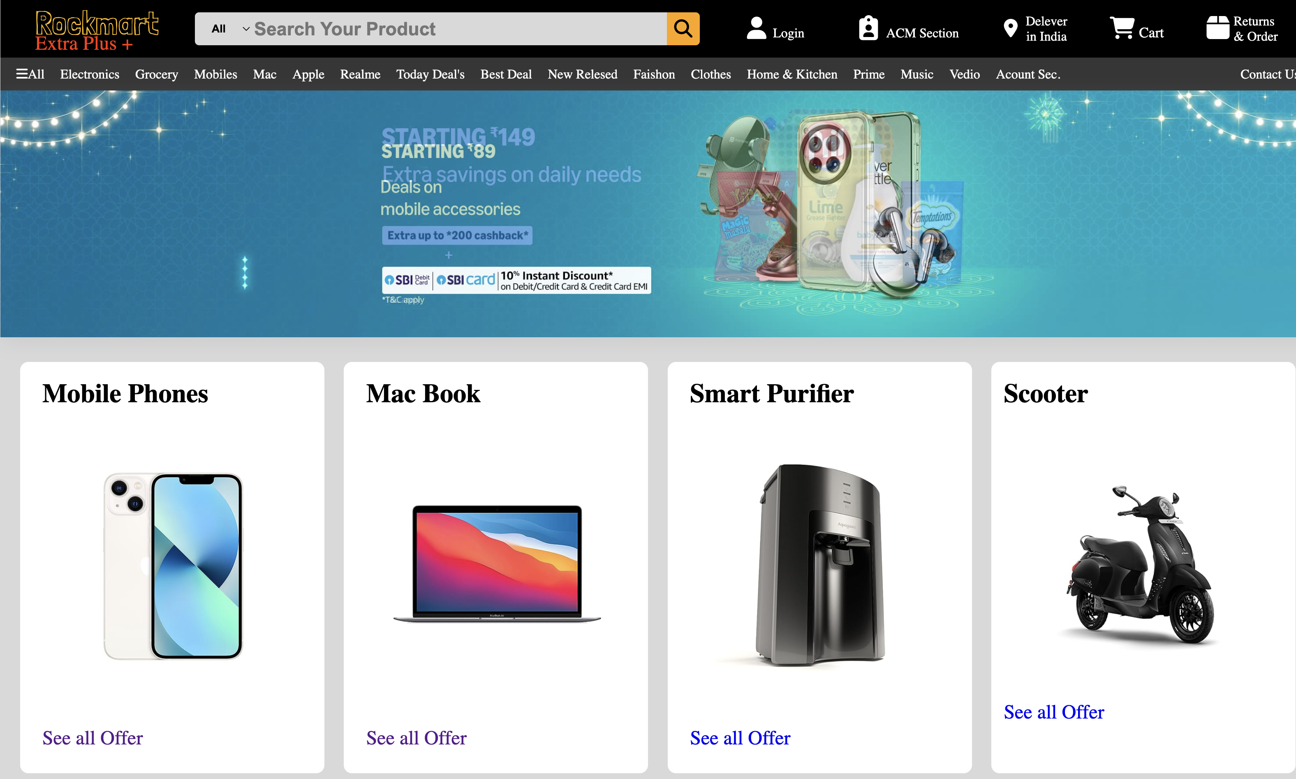
Screenshot or description of the homepage layout.

Slide 13
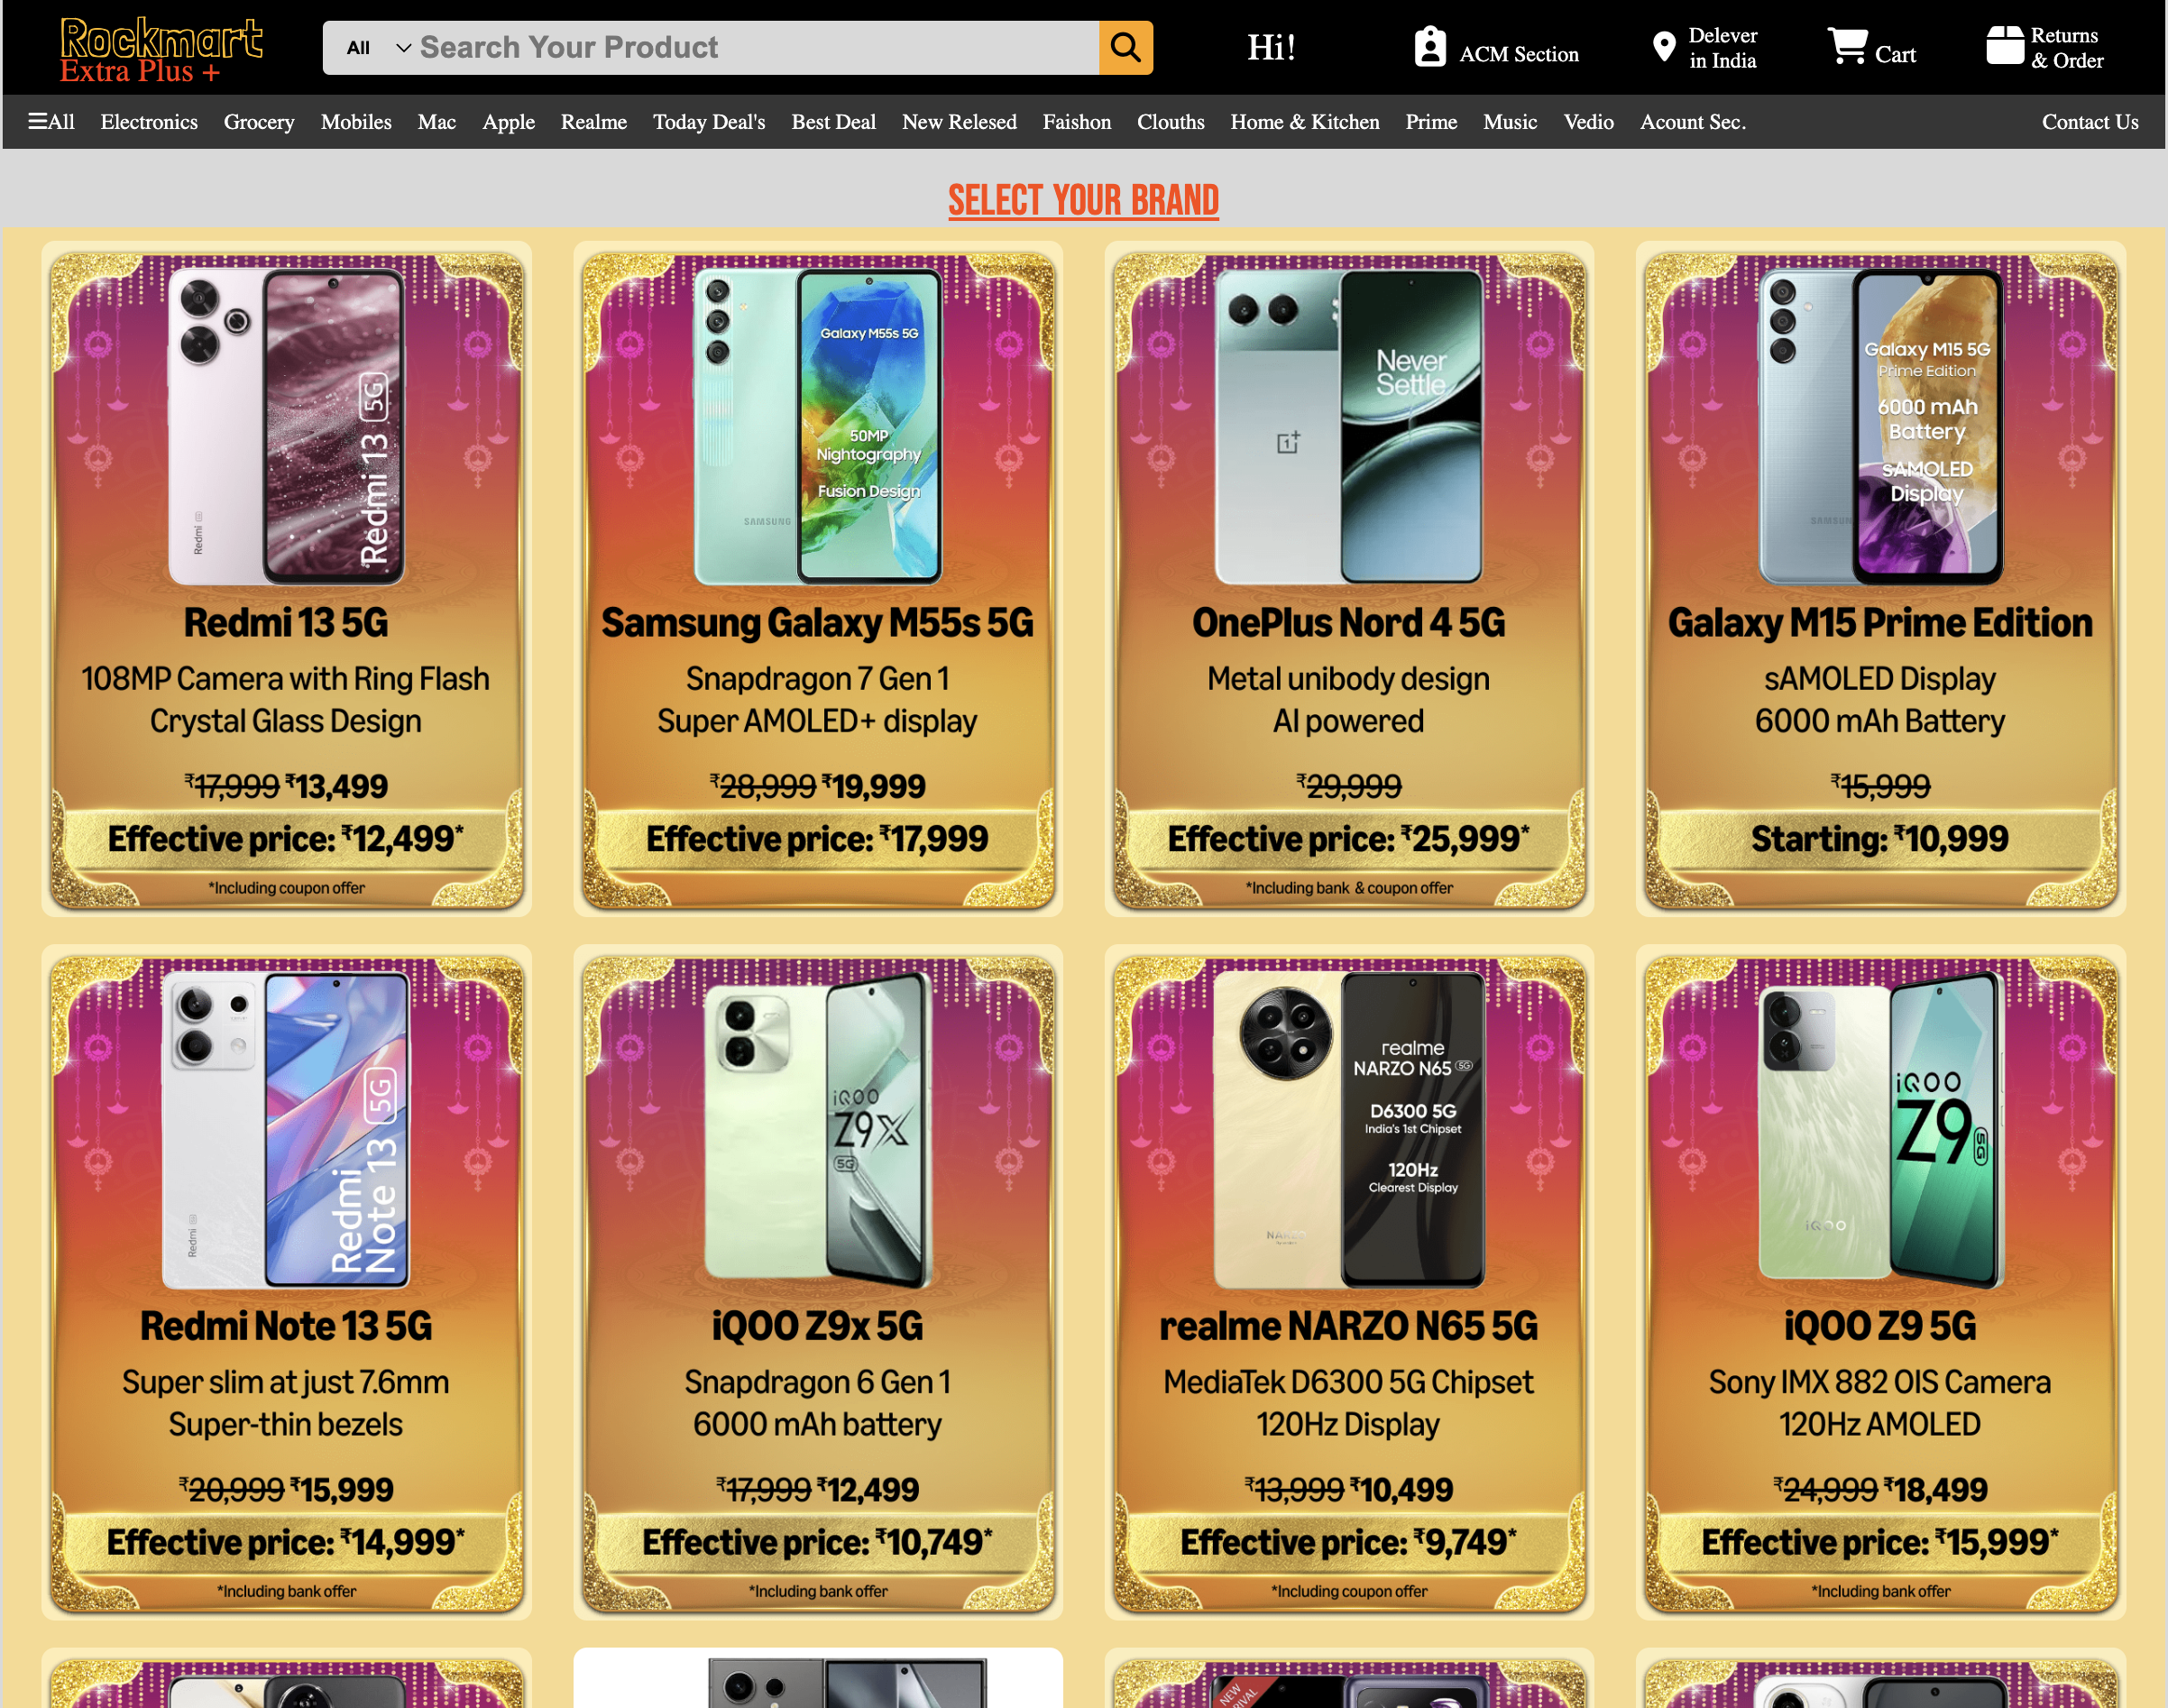
Screenshot or description of the product page.

Slide 14

Challenges Faced
- Implementing secure payment integration
- Optimizing website performance
- Ensuring cross-browser compatibility
- Managing database efficiently

Slide 15
Future Enhancements
- Adding AI-based product recommendations
- Expanding product categories
- Implementing a mobile app
- Enhancing user analytics
- User can record family member Cloth Size data for easy shoping

Slide 16
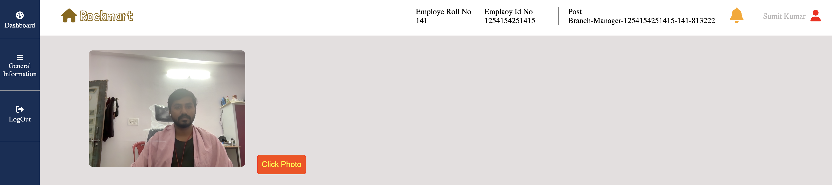
Online Attendance Recorder
OAR is the way to record the employ attendance by the online image clicker method for admin Security.
Prevent the Attendance Scam.
Record the live image of the Employ.

Slide 17

Conclusion
Rock Mart aims to revolutionize online shopping by providing a user-friendly, secure, and feature-rich platform, secure employee environment.

Slide 18
Members:
Project Manager: Sumit Kumar
Editor: Swayam Prakash Mishra(Frontend-Backend-Director)
Coordinator: Sujal Prasad Gupta (Backend Specialist, MongoDB Incharge)

Slide 19

Thank You
Presented by: Sumit Kumar , Swayam Prakash Mishra, Sujal Prasad Gupta.

