Slide 1
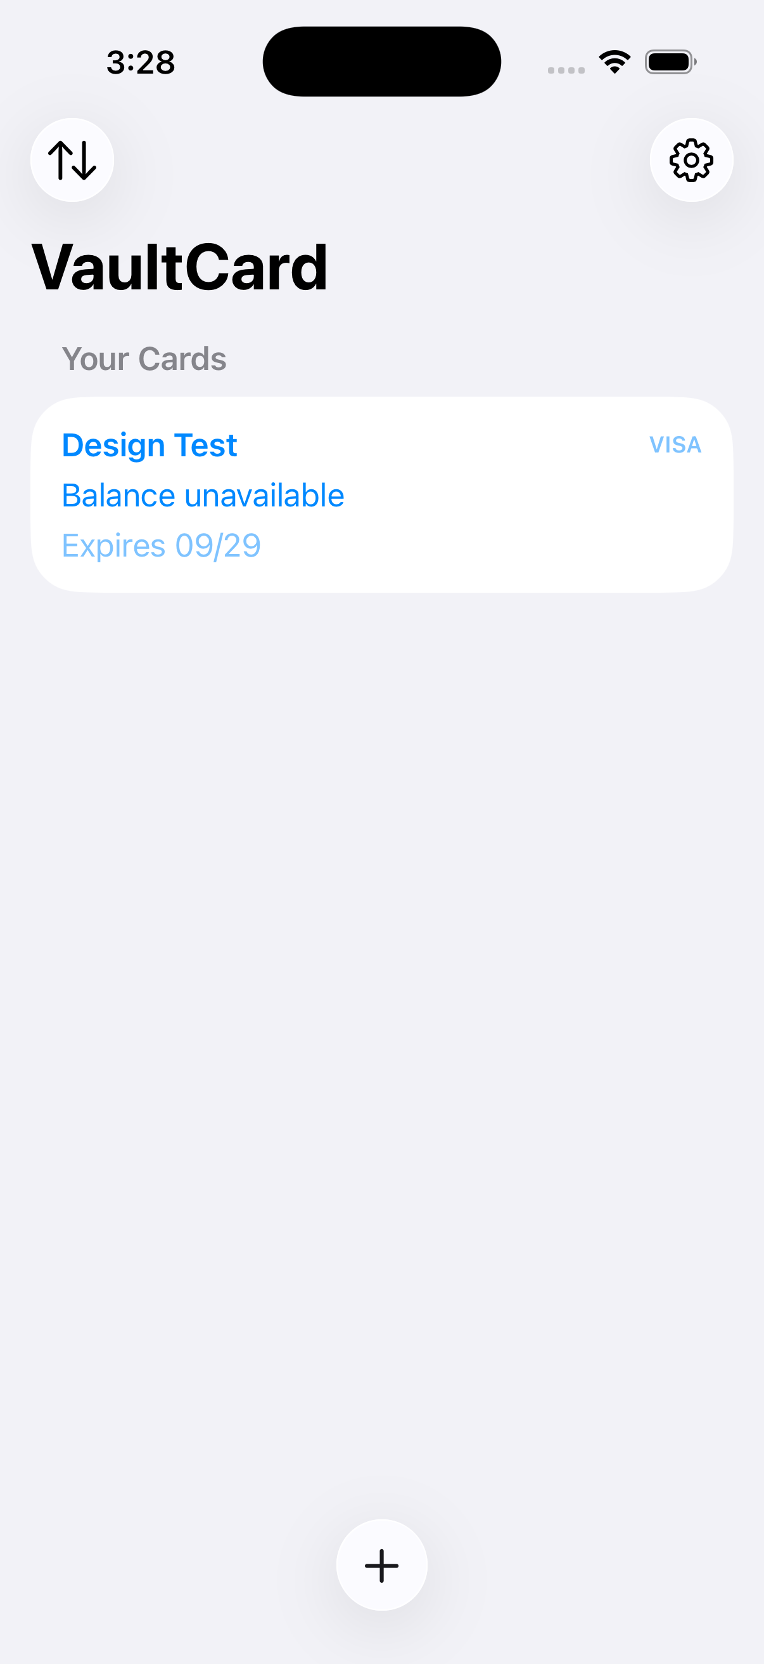
DESIGN HANDOFF
VaultCard UI
inventory
Current native iOS screens, interaction states, and functional coverage for redesign.
iPhone 17 Pro Simulator · 13 captured states · August 2026
VAULTCARD · CURRENT UI
01
Notes:
[Sources]
- /Users/shaikali/Documents/vaultcard/.codex-tmp/vaultcard-ui-handoff/screens/07-card-list.png
- /Users/shaikali/Documents/vaultcard/ios-native/VaultCard/VaultCardApp.swift
[/Sources]

Slide 2
The implementation has four functional zones
Use this map as the redesign coverage checklist.
01
Onboarding
02
Vault
Three trust-and-value messages lead into the vault.
Empty and populated states organize saved cards.
03
Card management
04
Preferences
Scan or type, validate, save, reveal, refresh, and delete.
App lock, analytics, and notification controls live in Settings.
VAULTCARD · CURRENT UI
02
Notes:
[Sources]
- /Users/shaikali/Documents/vaultcard/ios-native/VaultCard/VaultCardApp.swift
[/Sources]

Slide 3
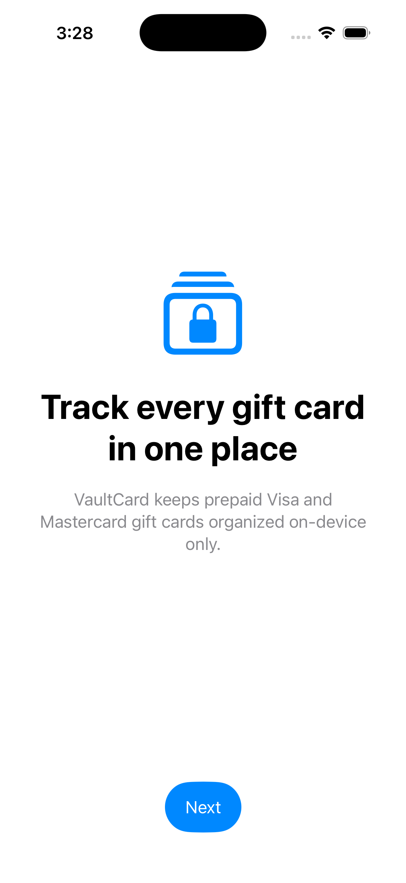
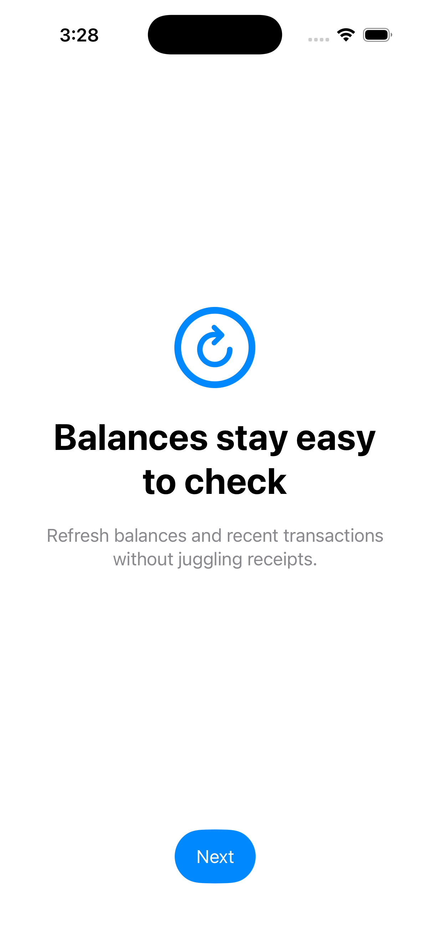
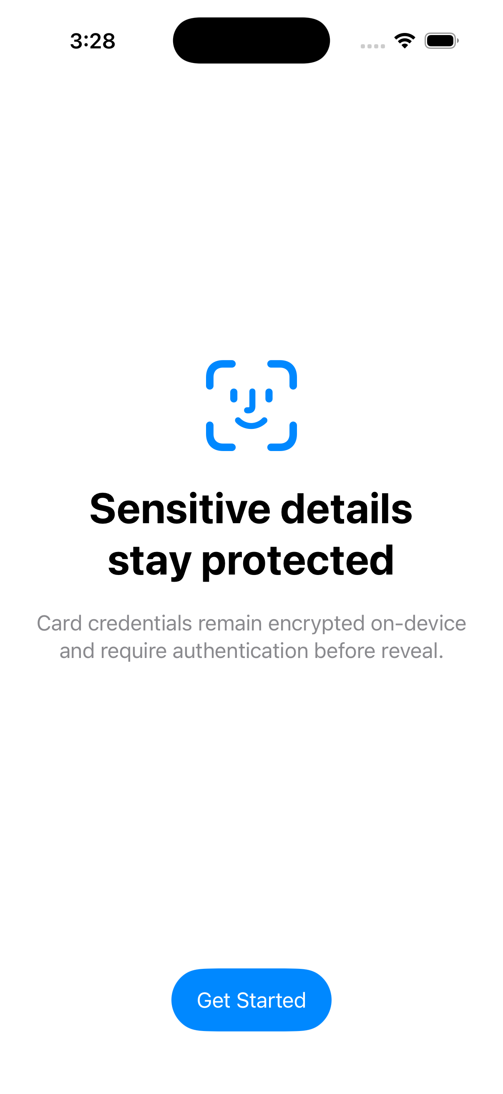
Onboarding repeats one visual formula
Each page swaps the icon and message while keeping the same structure.
1 · Organize
2 · Check balances
3 · Protect details
VAULTCARD · CURRENT UI
03
Notes:
[Sources]
- /Users/shaikali/Documents/vaultcard/.codex-tmp/vaultcard-ui-handoff/screens/01-onboarding-organize.png
- /Users/shaikali/Documents/vaultcard/.codex-tmp/vaultcard-ui-handoff/screens/02-onboarding-balance.png
- /Users/shaikali/Documents/vaultcard/.codex-tmp/vaultcard-ui-handoff/screens/03-onboarding-security.png
[/Sources]

Slide 4
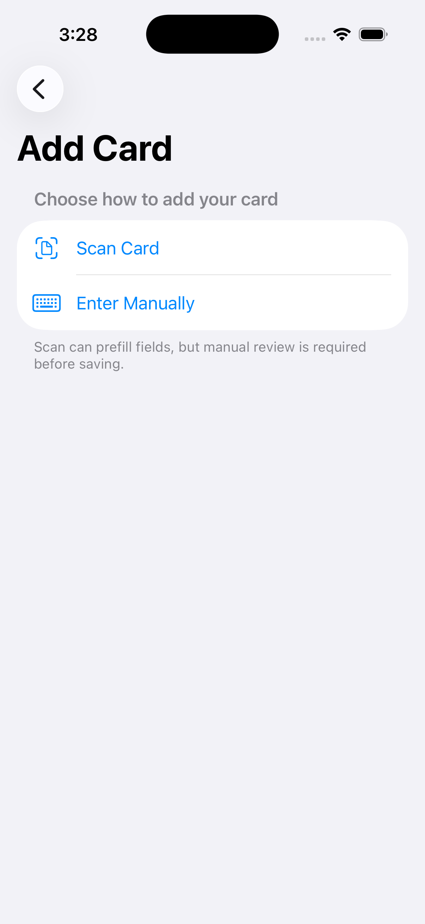
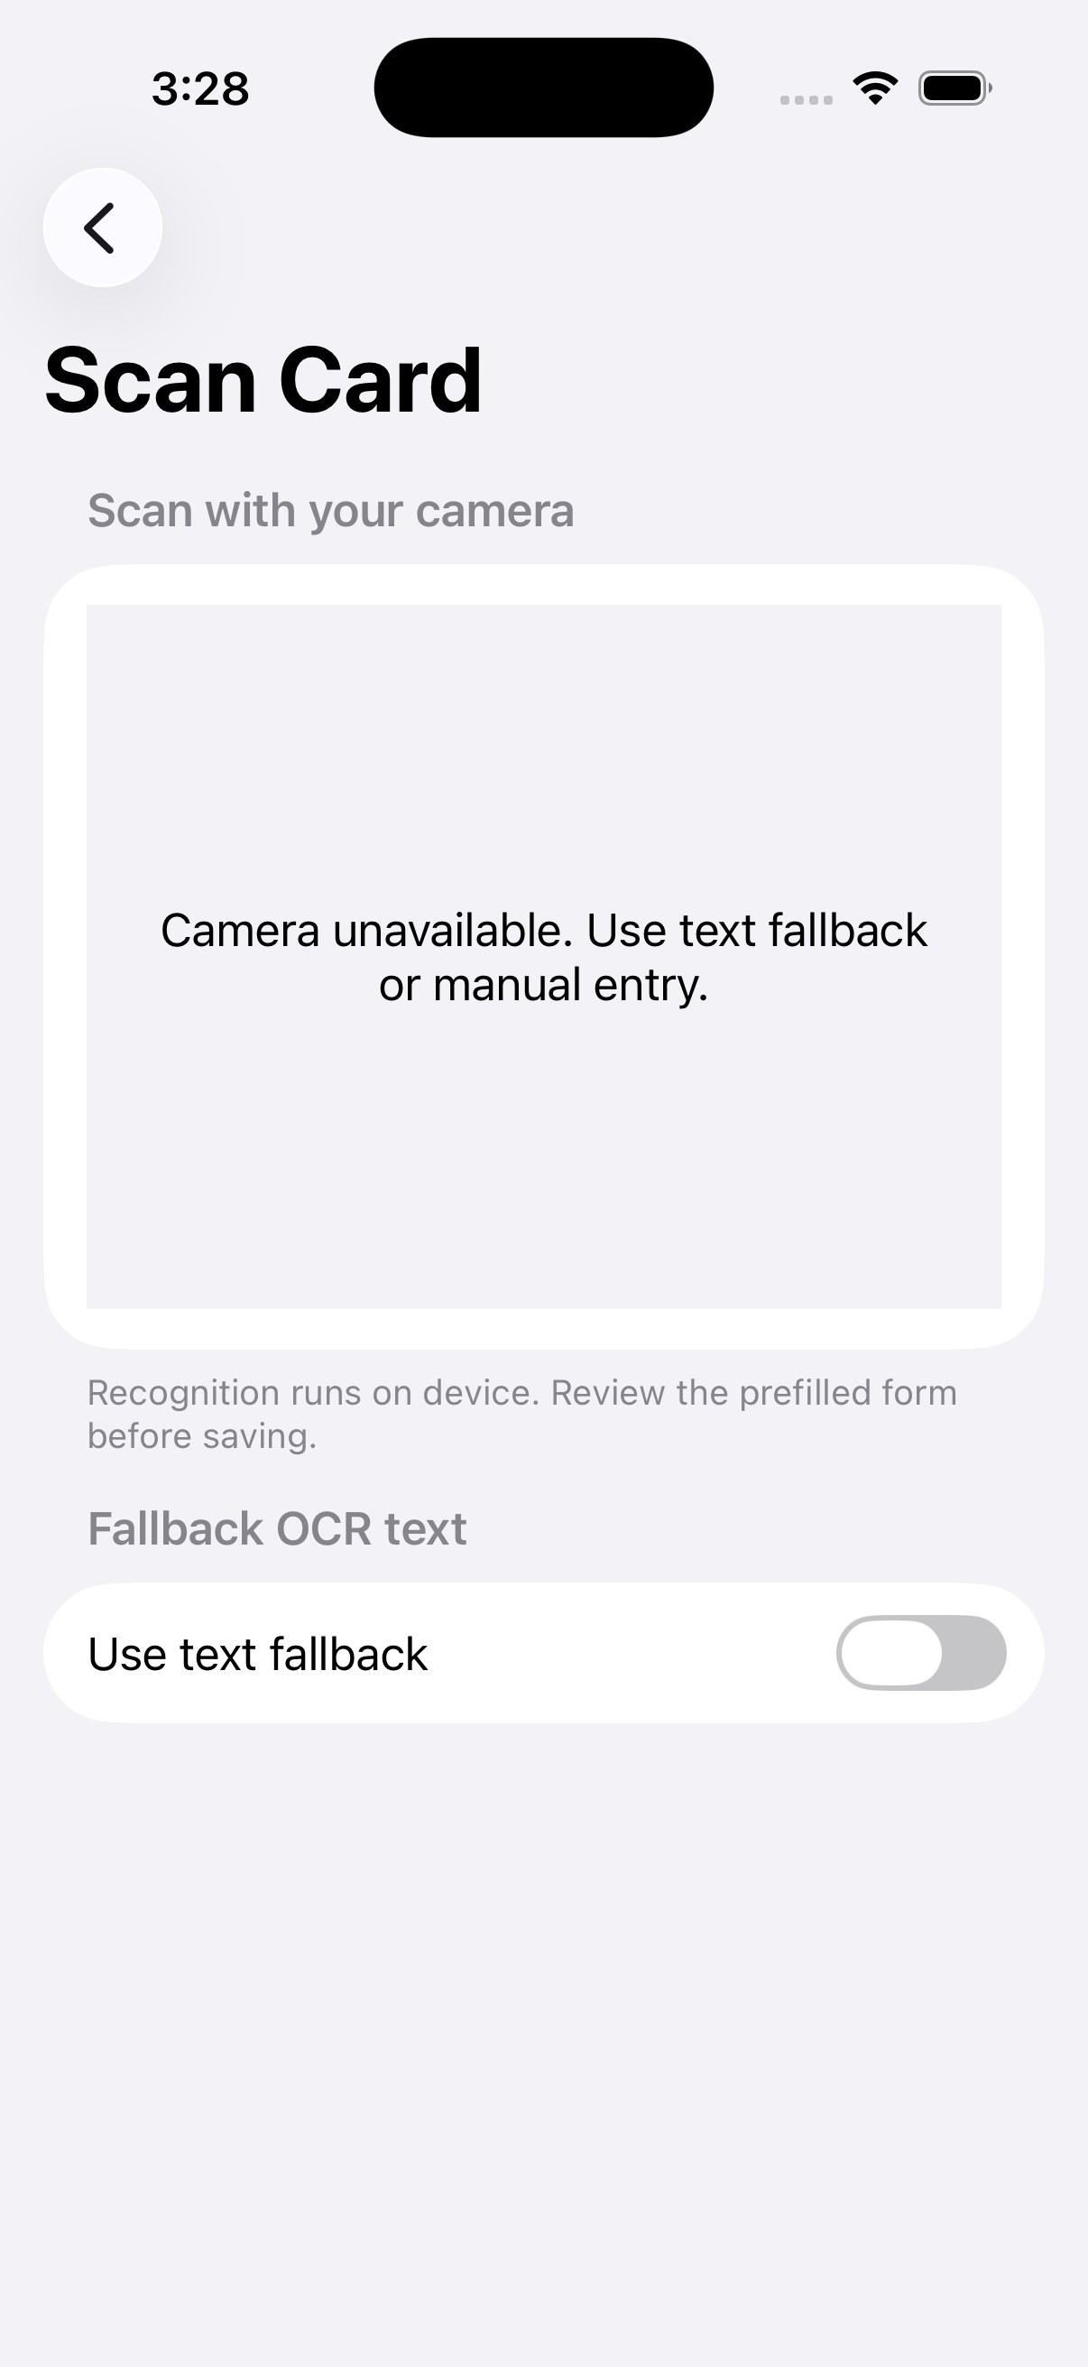
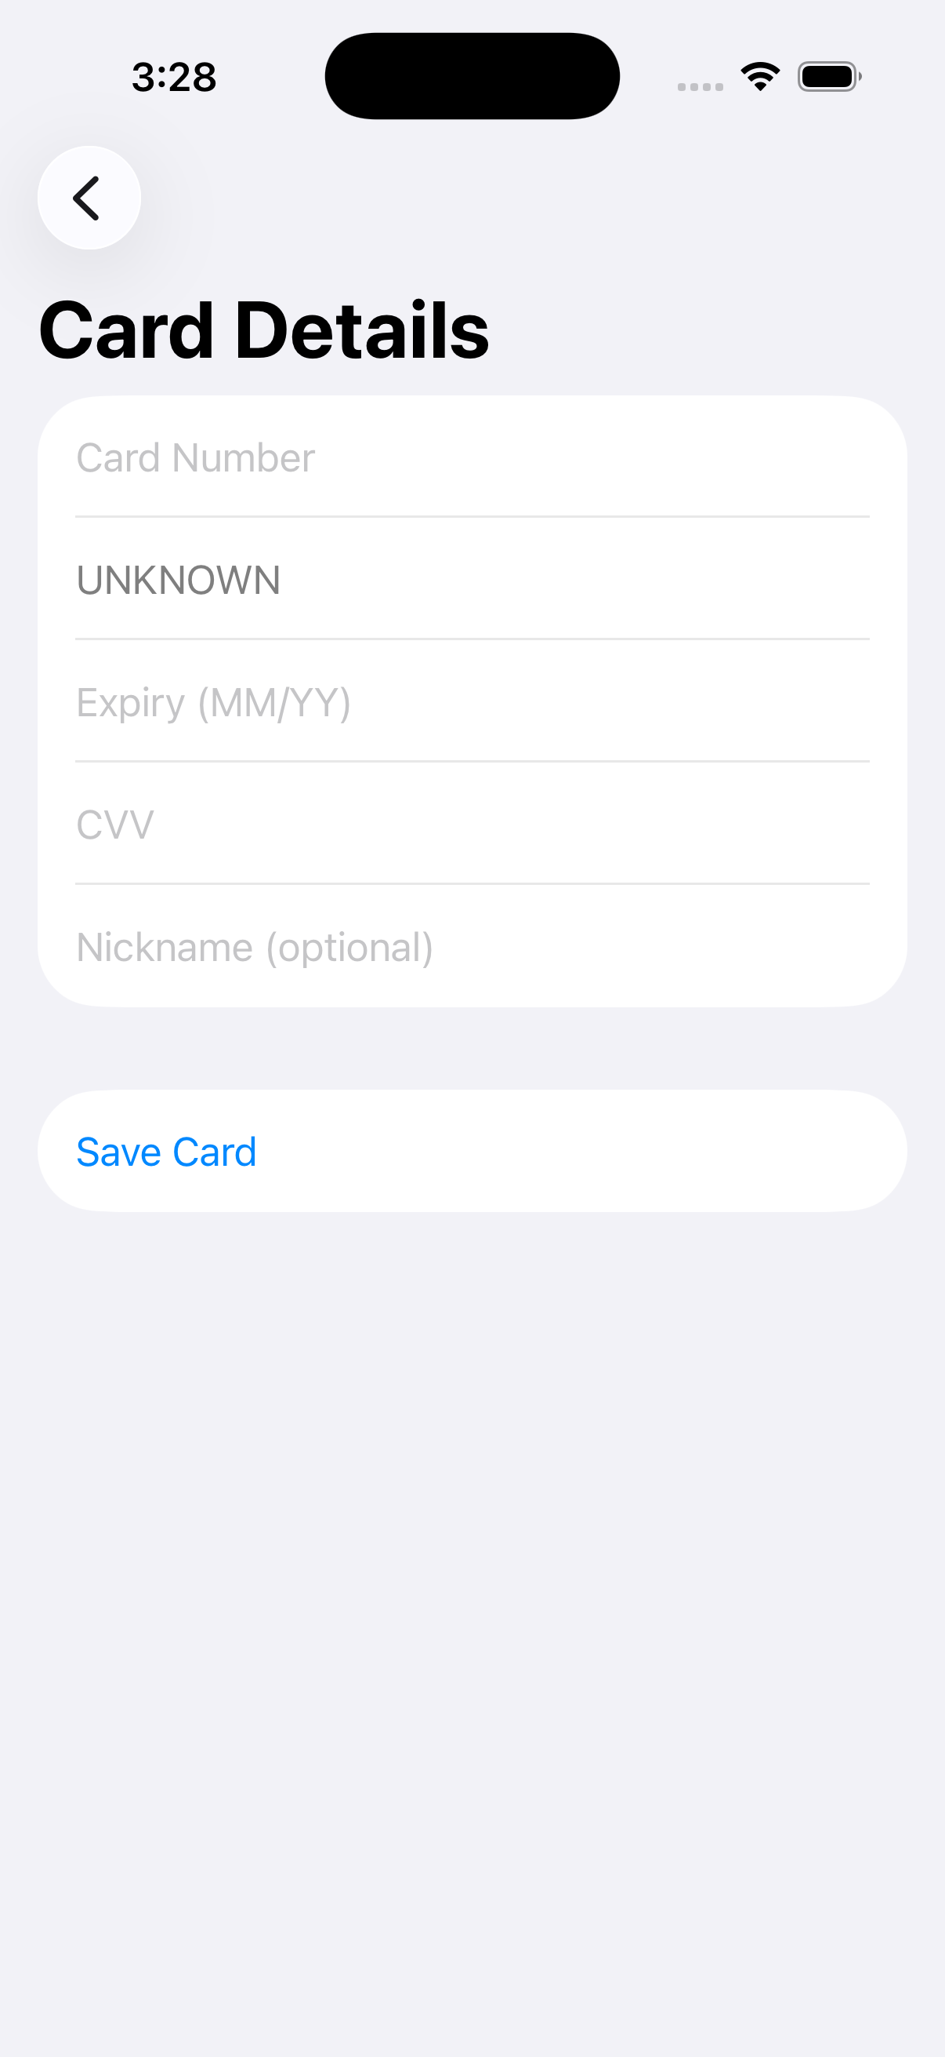
Card entry branches, then converges
The scanner falls back to text; both routes converge on the same review form.
Choose method
Scan or fallback
Review and save
VAULTCARD · CURRENT UI
04
Notes:
[Sources]
- /Users/shaikali/Documents/vaultcard/.codex-tmp/vaultcard-ui-handoff/screens/04-add-choice.png
- /Users/shaikali/Documents/vaultcard/.codex-tmp/vaultcard-ui-handoff/screens/12-scan-card.png
- /Users/shaikali/Documents/vaultcard/.codex-tmp/vaultcard-ui-handoff/screens/05-manual-entry.png
[/Sources]

Slide 5
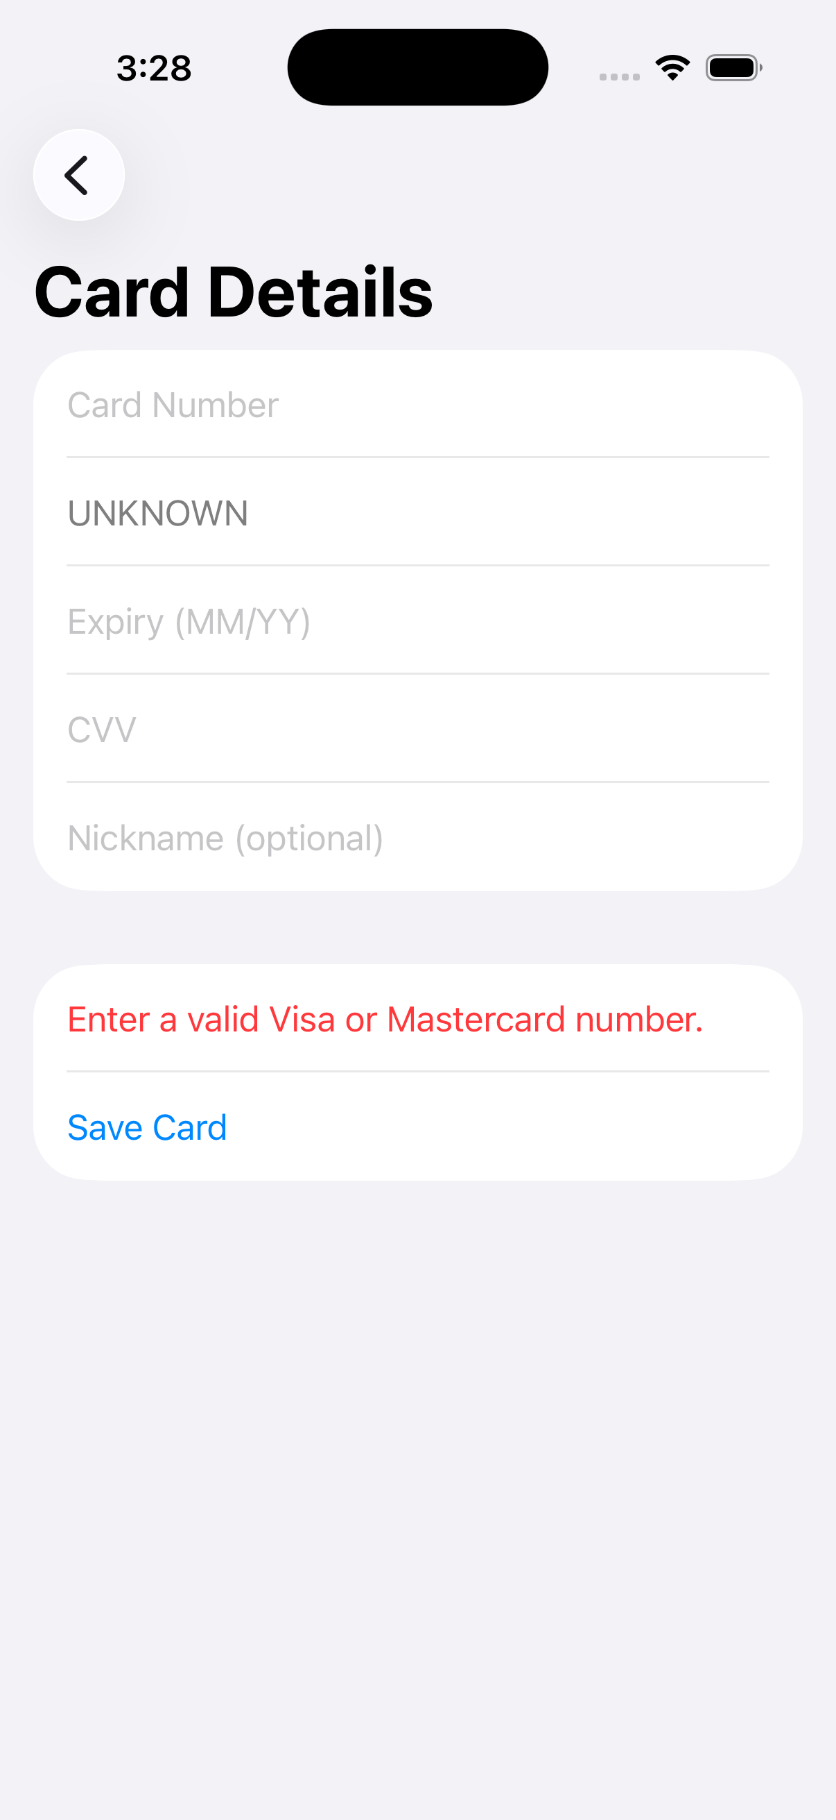
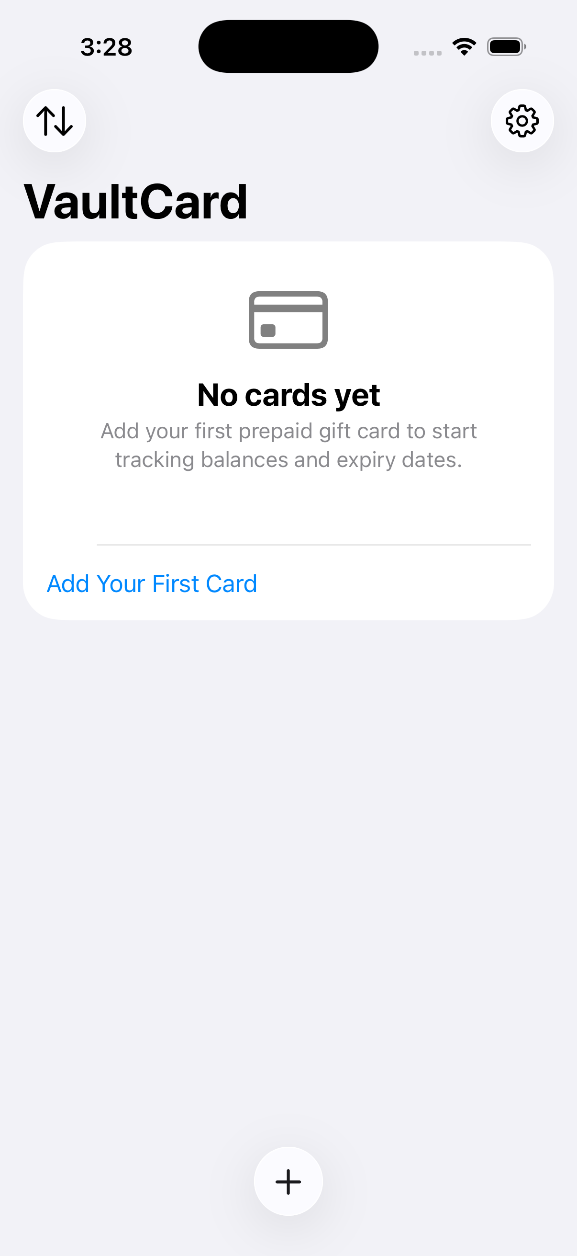
Validation feeds directly into two vault states
The current experience uses inline errors, a single empty-state card, and a compact saved-card row.
Validation error
Empty vault
Populated vault
VAULTCARD · CURRENT UI
05
Notes:
[Sources]
- /Users/shaikali/Documents/vaultcard/.codex-tmp/vaultcard-ui-handoff/screens/06-validation-error.png
- /Users/shaikali/Documents/vaultcard/.codex-tmp/vaultcard-ui-handoff/screens/07a-empty-vault.png
- /Users/shaikali/Documents/vaultcard/.codex-tmp/vaultcard-ui-handoff/screens/07-card-list.png
[/Sources]

Slide 6
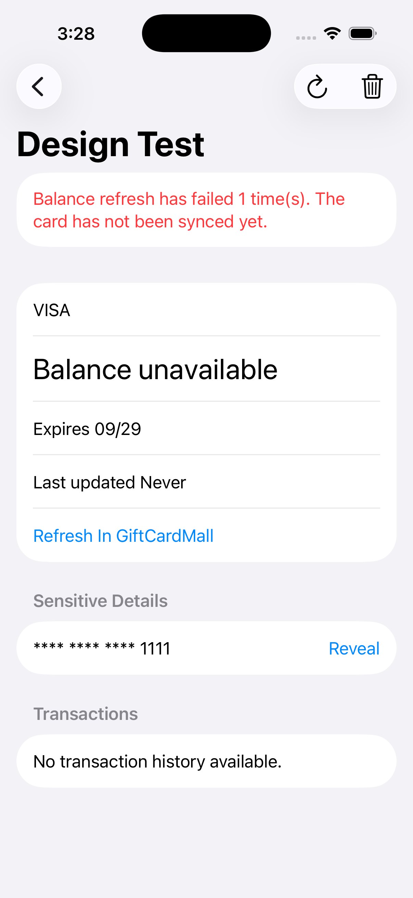
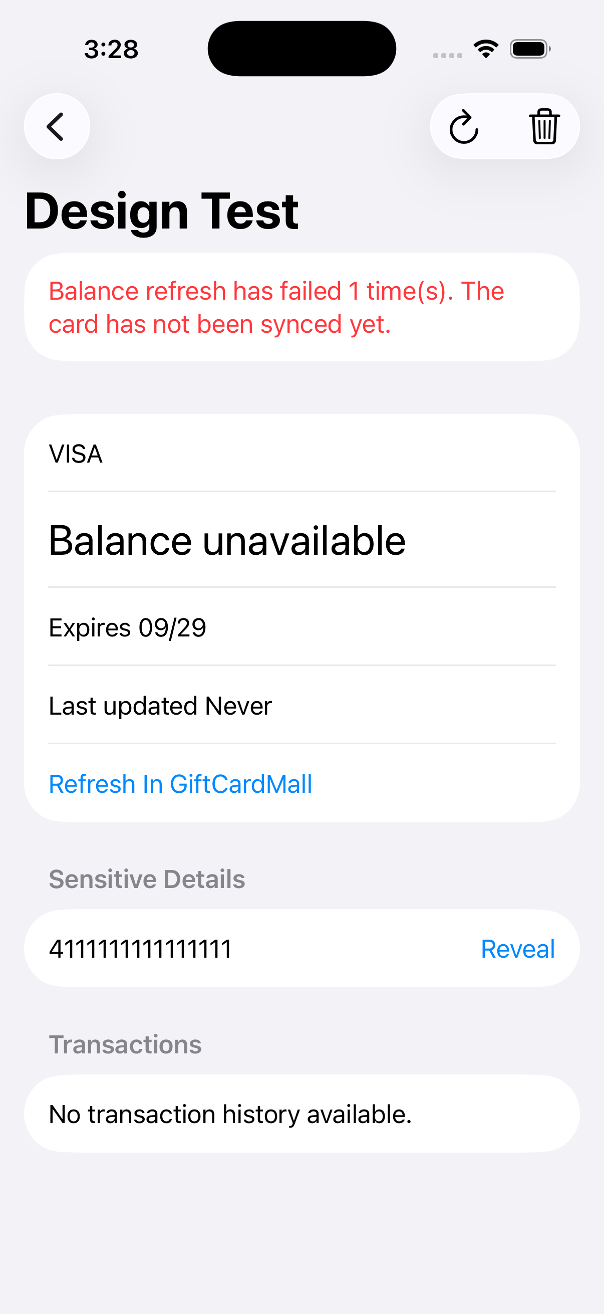
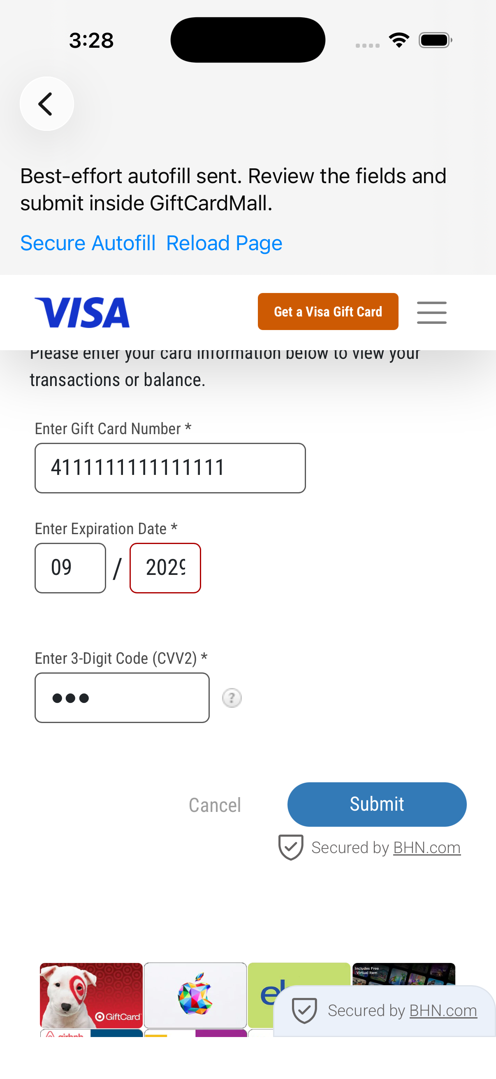
Secure details lead into external refresh
Revealing credentials changes one row; balance refresh opens embedded GiftCardMall content.
Masked details
Revealed details
GiftCardMall refresh
VAULTCARD · CURRENT UI
06
Notes:
[Sources]
- /Users/shaikali/Documents/vaultcard/.codex-tmp/vaultcard-ui-handoff/screens/08-card-detail.png
- /Users/shaikali/Documents/vaultcard/.codex-tmp/vaultcard-ui-handoff/screens/09-card-revealed.png
- /Users/shaikali/Documents/vaultcard/.codex-tmp/vaultcard-ui-handoff/screens/10-giftcardmall.png
[/Sources]

Slide 7
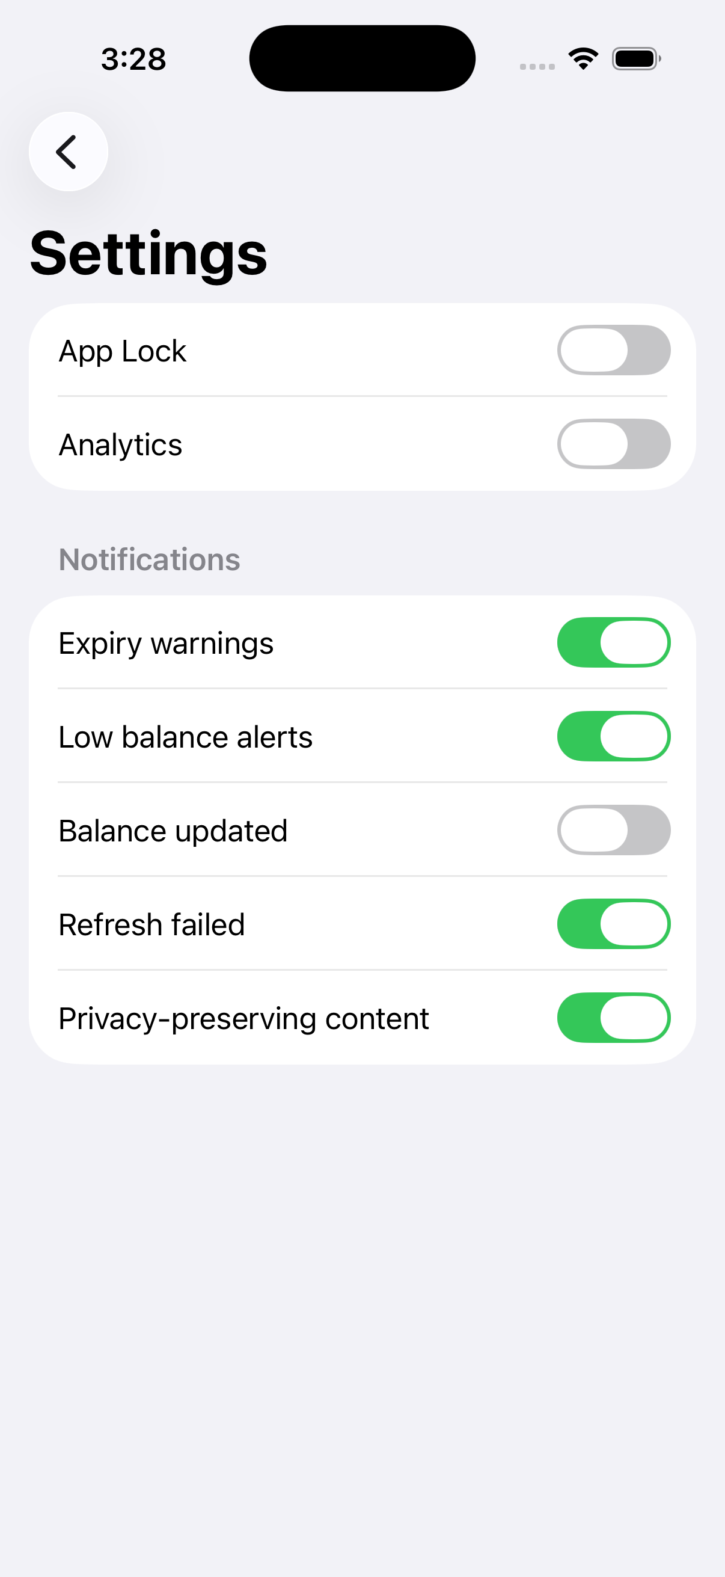
Settings closes the current-state inventory
The redesign can change the expression while preserving the functional contract.
Preserve
Reimagine
• Local-first trust
• Clear add / save / reveal flow
• Explicit validation and destructive actions
• Complete notification preference coverage
• Visual identity and emotional tone
• Card artwork and information hierarchy
• Empty, error, loading, and success states
• The transition into third-party content
Coverage note
Startup-failure and physical-device permission alerts are implementation states, not stable product screens, and are not included here.
VAULTCARD · CURRENT UI
07
Notes:
[Sources]
- /Users/shaikali/Documents/vaultcard/.codex-tmp/vaultcard-ui-handoff/screens/11-settings.png
- /Users/shaikali/Documents/vaultcard/ios-native/VaultCard/VaultCardApp.swift
[/Sources]

