Slide 1

Faculty of Engineering And Technology
Department of Artificial Intelligence and Data Science
Notes:
This is the title slide for respective colleges/institutions while we retain the DMIHER logo on top always.

Slide 2

PRESENTATION
TOPIC
Computer Graphics
NAME OF STUDENT: Pawan Dilip Chaudhari
ROLL NO.: DMET1223020
DEPARTMENT OF Artificial Intelligence and Data Science
FACULTY OF ENGINEERING AND TECHNOLOGY, DMIHER (DU), SAWANGI (MEGHE), WARDHA
DATE: 01-11-2025

Slide 3
PROGRESS PRESENTATION
OF MOOCS COURSE

Slide 4
CONTENTS
Introduction
Course Summary
Key Insights of Week 1
Key Insights of Week 2
Key Insights of Week 3
Key Insights of Week 4
Key Insights of Week 5
Key Insights of Week 6
Key Insights of Week 7
Key Insights of Week 8
Screenshot of Assignment 1
Screenshot of Assignment 2
Screenshot of Assignment 3
Screenshot of Assignment 4
Screenshot of Assignment 5
Screenshot of Assignment 6
Screenshot of Assignment 7
Screenshot of Assignment 8
Assessment scores
Screenshot of Progress of the course
Certificate of the examination

Slide 5
Introduction
Graphics pipeline is use for process the modeling objects to final image rendering.
Graphics systems is use for hardware (GPU, monitors) and software that support image generation.
Boundary representation (B-Rep) it represents objects by their surfaces, edges, and vertices.
Splines and spatial partitioning shows smooth curves for shapes; dividing scenes into smaller parts for efficiency.
Applications of graphics is Widely used in games, movies, CAD/CAM, and virtual reality.
Computer Graphics is the art and science that powers everything from blockbuster movie effects and immersive video games to architectural design and medical imaging.

Slide 6
Course Summary
Evolution of computer graphics and challenges in creating realistic images of computer graphics has grown from basic line drawings to advanced 3D visuals.
Basics of graphics pipeline and fundamental graphics systems is the process of turning models into images step by step. It works with both hardware like GPUs and software that manage rendering.
Object representation methods including B-Rep and splines for B-Rep represents objects using their surfaces, edges, and vertices. Splines are smooth curves used for modeling shapes more accurately.
We laid the groundwork by exploring the history and core components of a graphics system. The key takeaway was understanding the Graphics Pipeline—the step-by-step factory process that turns 3D data into a final image.

Slide 7
Key Insights of Week 1
Introduction to computer graphics and its applications in gaming, movies, CAD, and simulations.
Historical development of graphics, from simple 2D line drawings to advanced 3D rendering.
Major challenges such as achieving realism, handling large data, and improving speed.
Overview of the graphics pipeline as the foundation for generating images.
Resolution is the total number of pixels (width x height). Higher resolution means more detail
Color Depth (Bit Depth) is the number of bits used to represent the color of a single pixel (e.g., 24-bit "True Color" offers over 16 million colors).

Slide 8
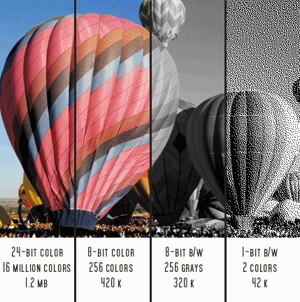
Key Insights of Week 1
Resolution: The total count of pixels (e.g., 1920*1080).
Color Depth: The number of bits per pixel (e.g., 24-bit for True Color).
Raster (Bitmap): Pixels; great for photos; scales poorly.
Vector: Mathematical descriptions; great for logos/fonts; scales perfectly.

Slide 9
Key Insights of Week 2
Understanding the structure and stages of the graphics pipeline in detail.
Basics of graphics systems including display devices, input devices, and GPUs.
Introduction to object representation methods like Boundary Representation (B-Rep).
Use of splines and spatial partitioning to represent curves and manage complex scenes.
The inevitable visual defect, or "jaggies," caused by approximating a smooth line onto a square grid.
The core line-drawing algorithm used in graphics hardware because it achieves maximum speed.

Slide 10
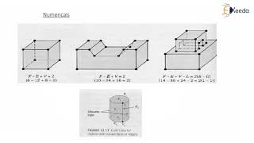
Key Insights of Week 2
How it Works: It completely avoids slow floating-point arithmetic and relies only on simple integer arithmetic (addition, subtraction, comparison).
The Decision: It uses a simple integer decision parameter to check which of the two potential next pixels is mathematically closest to the ideal line path.

Slide 11
Key Insights of Week 3
Study of geometric transformations such as translation, rotation, and scaling.
Introduction to homogeneous coordinates for simplifying transformations.
Learning transformation composition by combining multiple operations using matrices.
Extending transformations into 3D space and integrating them into the graphics pipeline.
The key transformations are Translation (movement), Rotation (orientation), and Scaling (size change).
Mathematical functions to precisely change an object's position, size, or orientation.

Slide 12
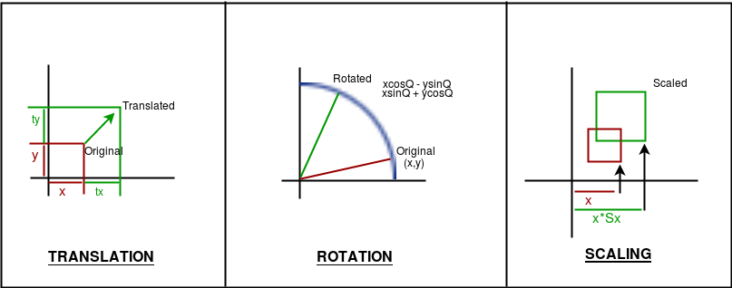
Key Insights of Week 3
Homogeneous Coordinates: A crucial mathematical trick where an N-dimensional point is given an N+1 coordinate (e.g., (x, y) (x, y, 1)).
Matrix Advantage: This trick allows Translation to be represented as a matrix multiplication, just like Rotation and Scaling.
Efficiency: Multiple sequential transformations are combined by multiplying their matrices into one Composite Transformation Matrix, which is applied to all object vertices in a single step.

Slide 13
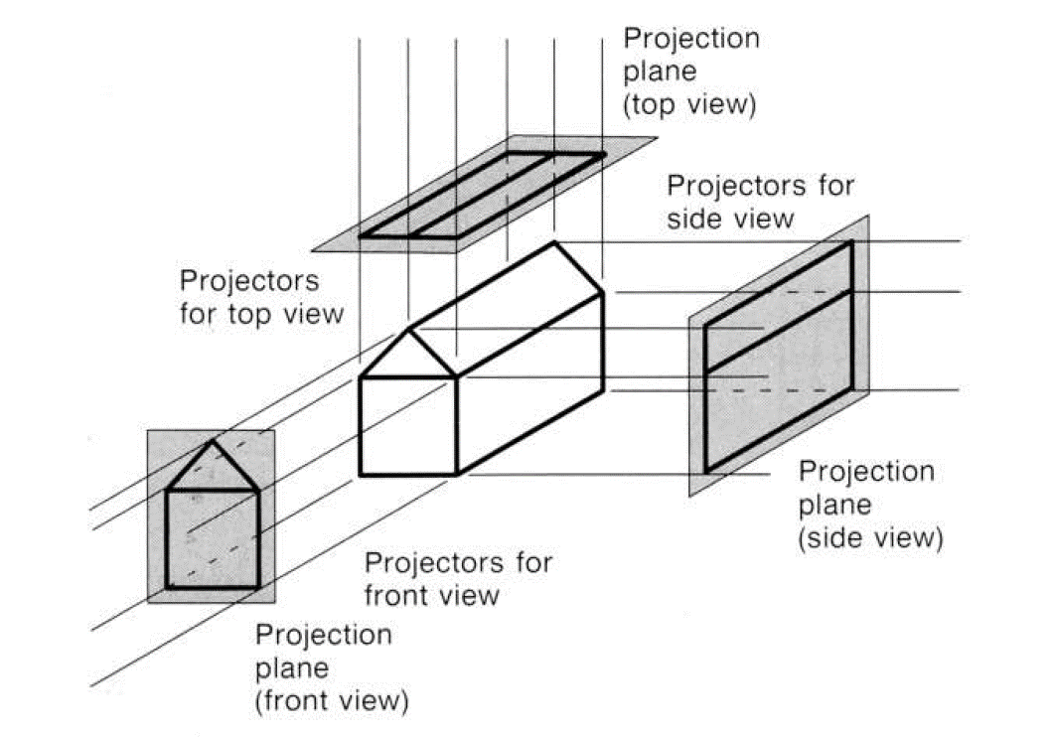
Key Insights of Week 4
Perspective Projection:
Result: Realistic visual effect.
Mechanism: Objects farther away appear smaller, and parallel lines converge to a vanishing point.
Orthographic Projection:
Result: Non-realistic, technical view.
Mechanism: Objects do not scale with distance, and parallel lines remain parallel.

Slide 14
Key Insights of Week 5
Texture Creation & Color Models: Representing colors in multiple formats (HSV, RGB, CMY, etc.) and generating realistic surface details.
Camera Transformation: Converting scene coordinates into the viewing system of the camera.
Projection Techniques: Mapping 3D objects onto 2D planes through parallel and perspective methods.
Viewport–Window Mapping: Adjusting and fitting the final image to match the screen or display region.
When rendering a 3D scene, the system must determine which surfaces are visible to the camera and eliminate those that are blocked (occluded) by closer objects.

Slide 15
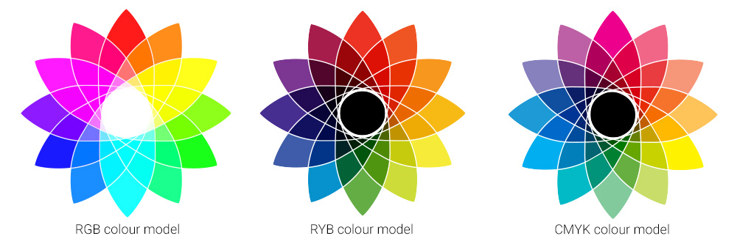
Key Insights of Week 5
Method: The industry standard, hardware-accelerated Image-Space technique.
Mechanism: A special memory buffer is created to store the depth (Z-value) of the closest surface rendered at every pixel location.
Process: When a new fragment is processed, its Z-value is compared to the stored value. If the new Z is smaller (closer), the new color is drawn.
Key Advantage: It makes the rendering process order-independent, meaning polygons can be processed in any sequence.

Slide 16

Key Insights of Week 6
Basics of Clipping & 2D Shapes/Lines: Cutting off the parts of objects that fall outside the viewing area.
2D Region and 3D Object Clipping: Keeping only the needed parts of surfaces and volumes inside the scene.
Removing Hidden Parts – I & II: Methods to decide which sides of objects can be seen and which stay blocked (like using depth checks or painting order).

Slide 17
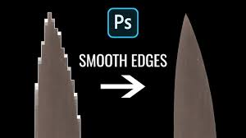
Key Insights of Week 7
Powerful pixel methods to draw shapes and sharpen image quality.
Pixel Drawing of Shapes – I & II: Turning lines, circles, and figures into clean screen patterns.
Text & Shape Filling: Accurate ways to color inside objects and show characters clearly.
Edge Smoothing: Techniques to remove jagged outlines and create polished visuals.

Slide 18
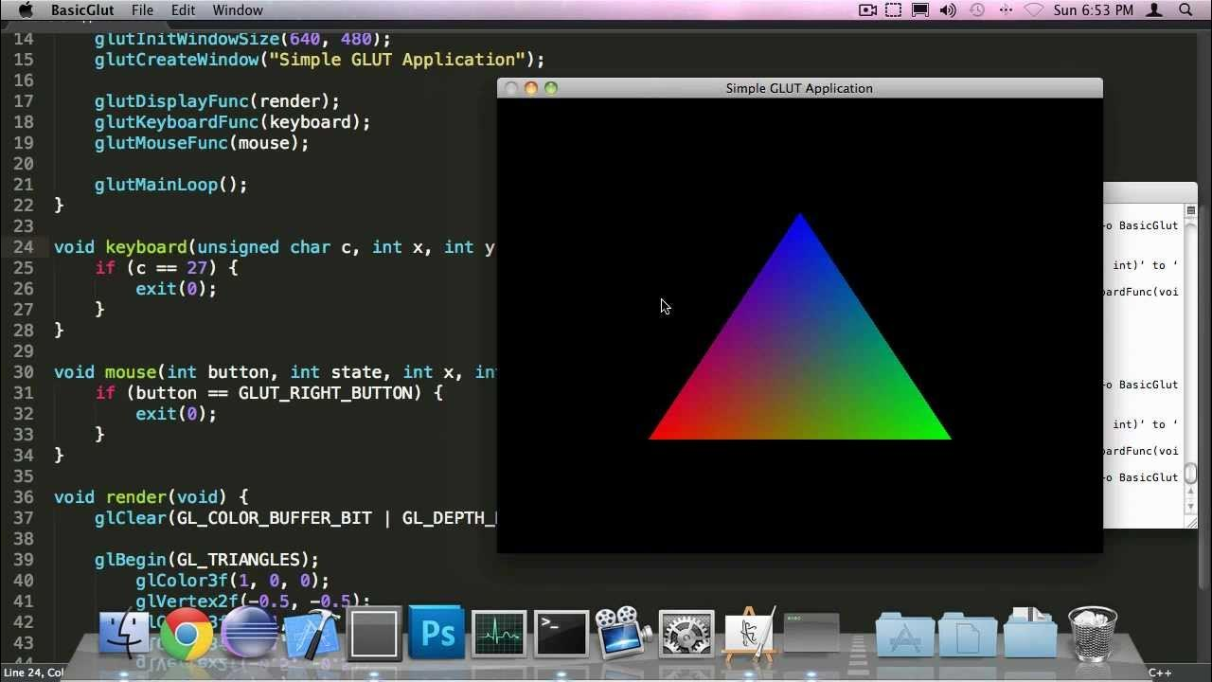
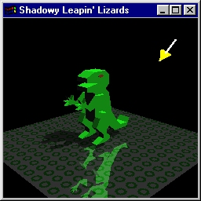
Key Insights of Week 8
Graphics I/O Devices – Input/output devices for visualization (monitors, tablets, VR, etc.)
GPU & Shaders – GPU accelerates rendering; shaders enable lighting, textures, transformations.
OpenGL Programming – Basics of rendering 2D/3D objects and interactive graphics applications.
Hands-on Focus – Emphasis on applying OpenGL for practical graphics.
Integration – Bridging hardware, software, and applications in graphics.

Slide 19

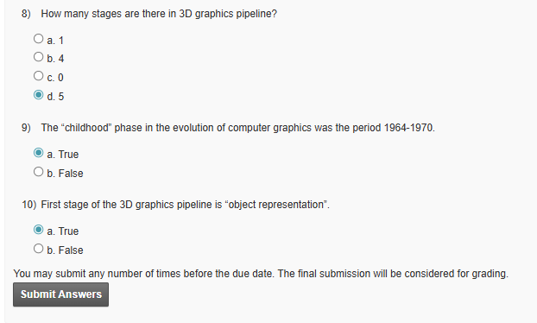
Screenshot of Assignment 1

Slide 20

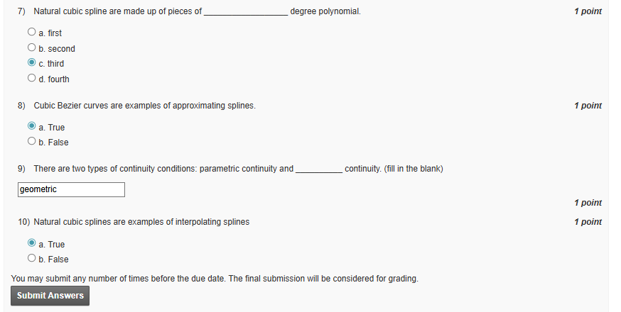
Screenshot of Assignment 2

Slide 21

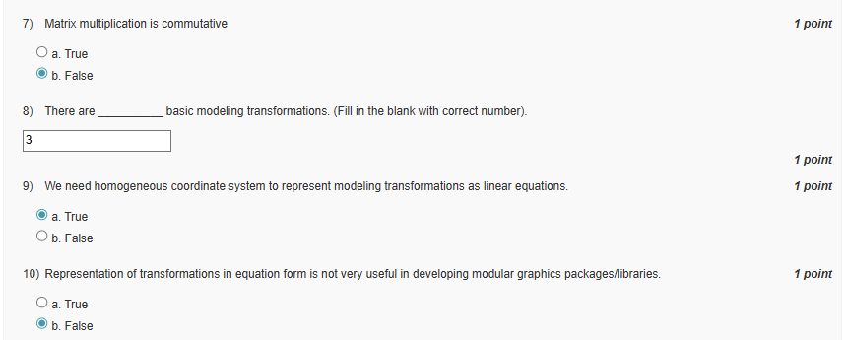
Screenshot of Assignment 3

Slide 22
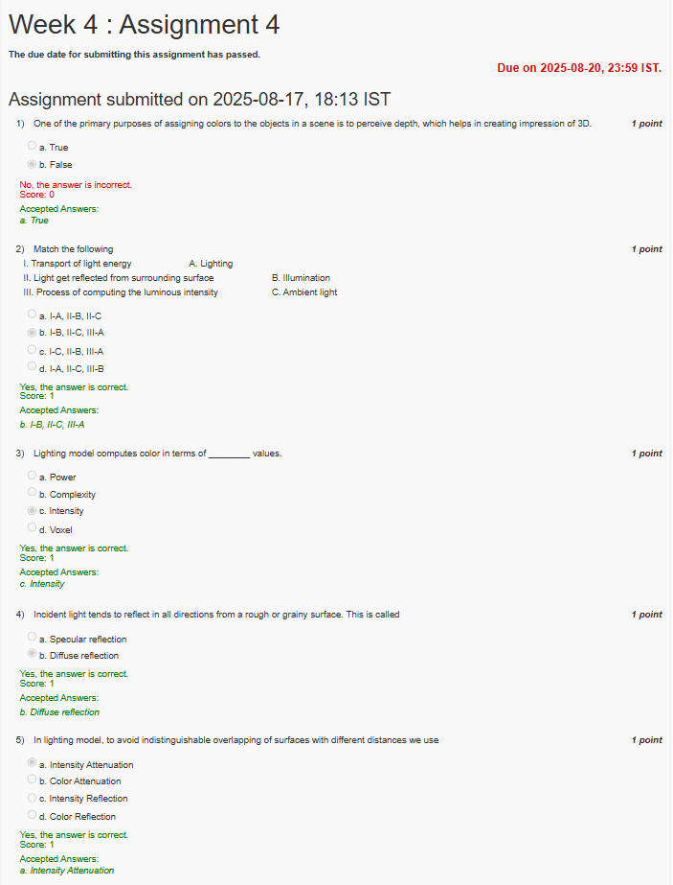
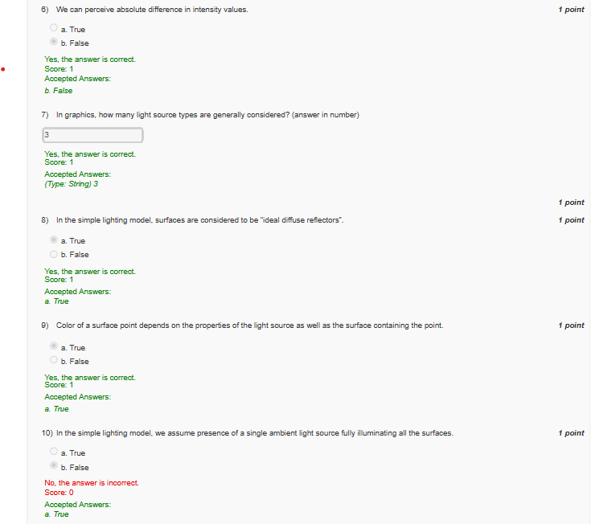
Assignment 4

Slide 23
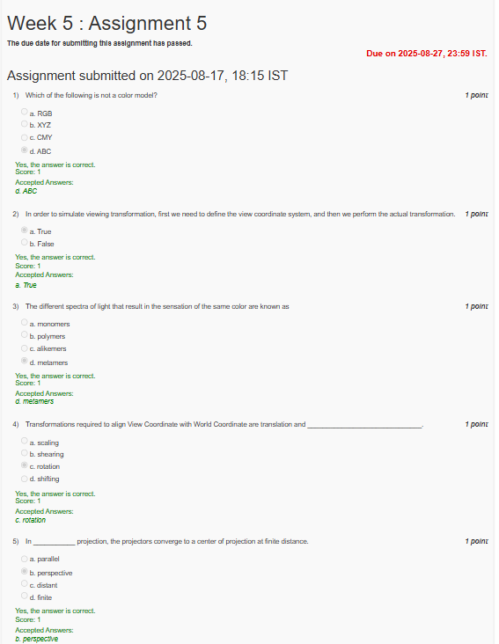
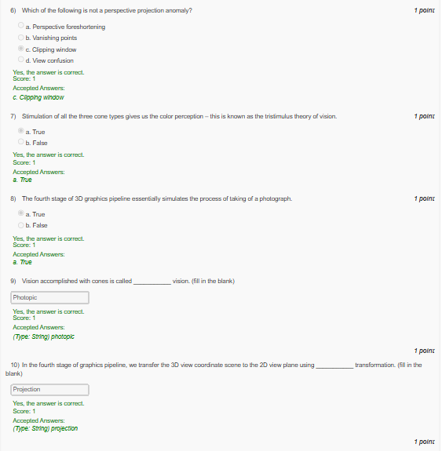
Assignment 5

Slide 24
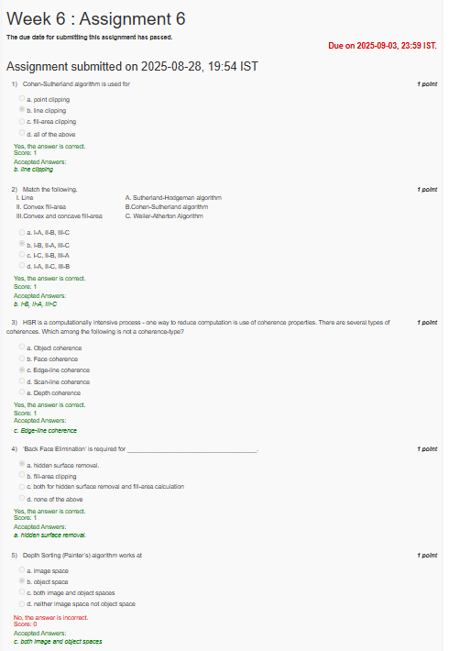
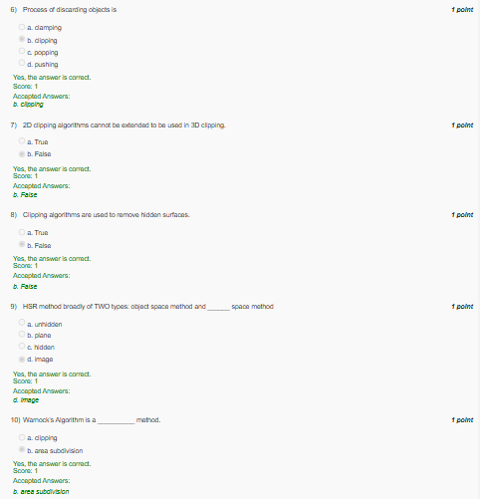
Assignment 6

Slide 25
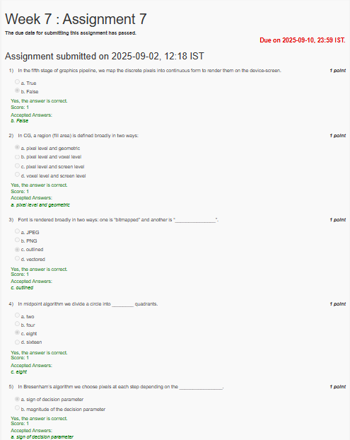
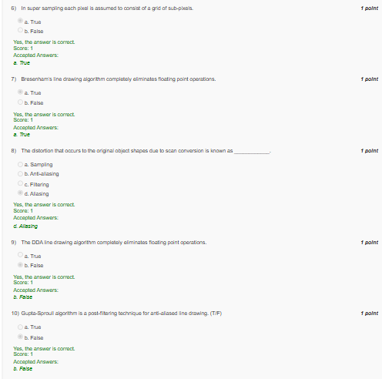
Assignment 7

Slide 26
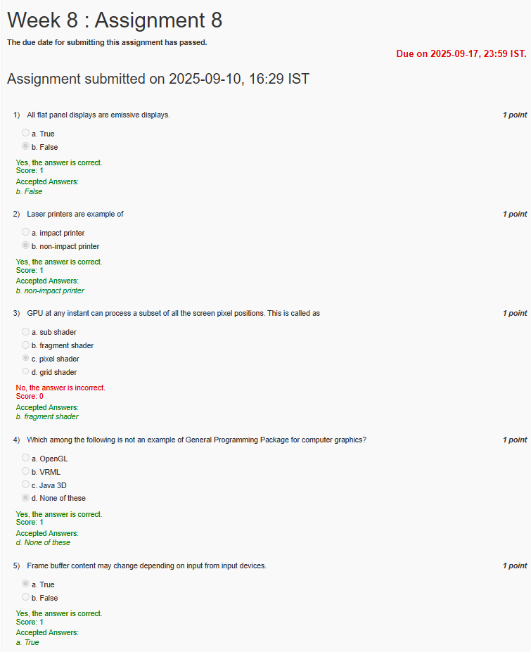
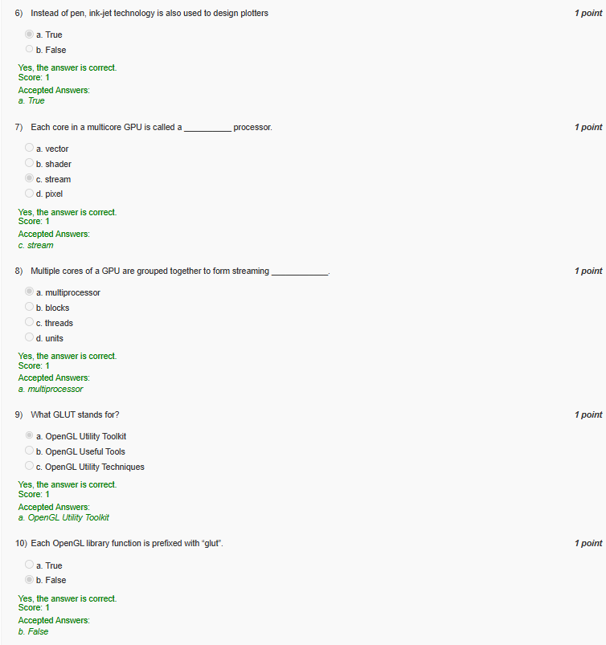
Assignment 8

Slide 27
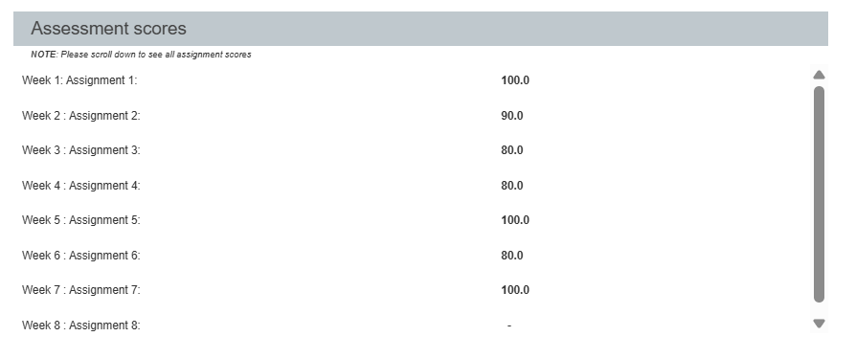
Assessment scores

Slide 28
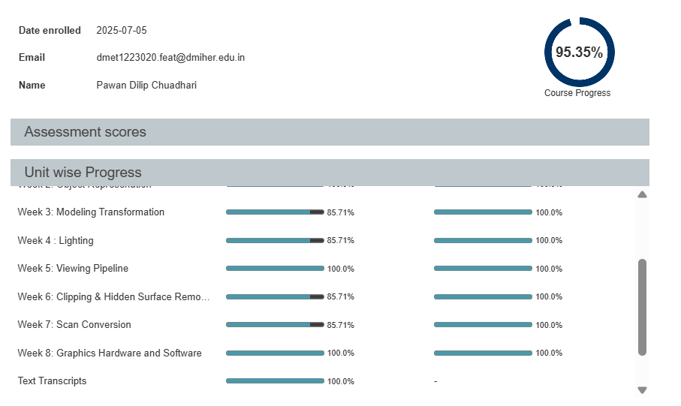
Screenshot of Progress of the course

Slide 29
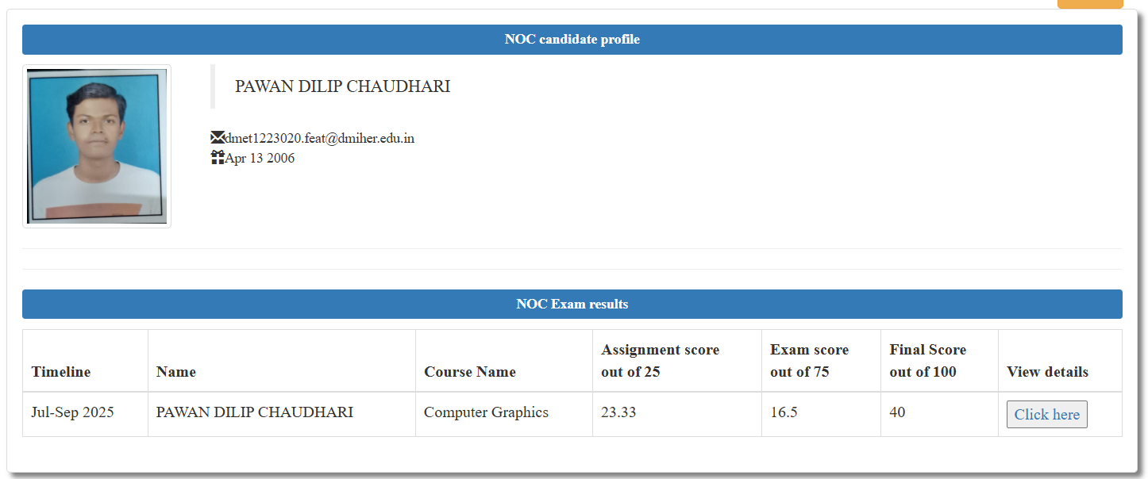
Certificate of the examination

Slide 30
Thank You

