Slide 1

B.Tech Computer Science and Engineering
CSE1904 – Capstone Project – Final Review
Project Domain: Artificial Intelligence in Healthcare
Proposed Title:
AI Driven personalized sleep breathing pattern classification for sleep apnea detection May 2024
Project Team Members:
SUMIT KUMAR MANDAL (20BCE2885)
NAMAN AGRAHARI (20BCE2886)
AVIRAL SHARMA ( 20BCE2918)
under the guidance of
Prof. RA.K. Saravanaguru,
Professor, Department of Information Security,
School of Computer Science and Engineering (SCOPE), VIT Vellore Campus.

Slide 2

Table of Contents
Aim or Objective of the Project
Motivation
Analysis & Literature Survey
Working Principle
Experimental Results & Analysis
Conclusion & Future Development

Slide 3


Slide 4
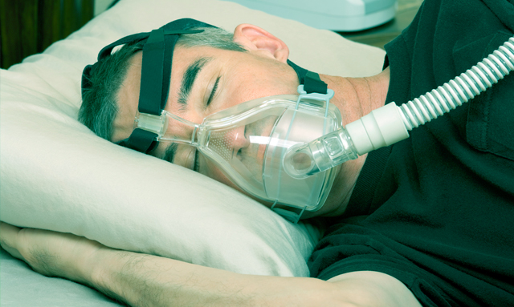
This Photo by Unknown Author is licensed under CC BY-SA-NC

Slide 5
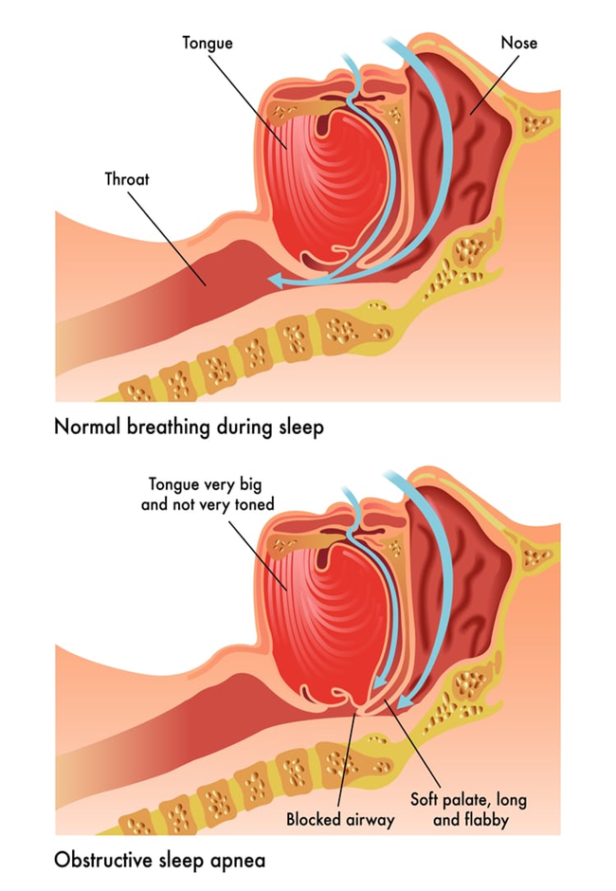
Sleep Apnea
Sleep apnea is a sleep disorder characterized by pauses in breathing or shallow breaths during sleep.
These interruptions in breathing can happen multiple times per hour and may lead to fragmented sleep, daytime drowsiness, and other health complications if left untreated.

Slide 6
Objective
Enhance Sleep Apnea Detection:
Improve sensitivity and specificity of sleep breathing pattern categorization.
Accurately identify minute alterations indicative of sleep apnea onset.
Develop an Adaptive Model:
Create a dynamic model that adapts to individual sleep patterns.
Enhance detection capabilities tailored to each person's unique physiology.
Prioritize Ethical Compliance and Privacy:
Ensure ethical use of personal health data.
Implement robust privacy safeguards in accordance with healthcare regulations.
Optimize Model Performance:
Continuously refine the AI model to enhance accuracy and efficiency.
Strive for the highest level of performance in sleep apnea detection.

Slide 7
MOTIVATION
To explore the clinical relevance and potential implications of utilizing electrocardiography (ECG) signals in polysomnography (PSG)
Investigation of how ECG signals can provide valuable insights into the cardiovascular aspects of sleep apnea, aiding in diagnosis, risk stratification, and treatment planning.
To evaluate the effectiveness of integrating machine learning algorithms with ECG signal analysis to enhance diagnostic accuracy and efficiency, ultimately improving patient outcomes.

Slide 8
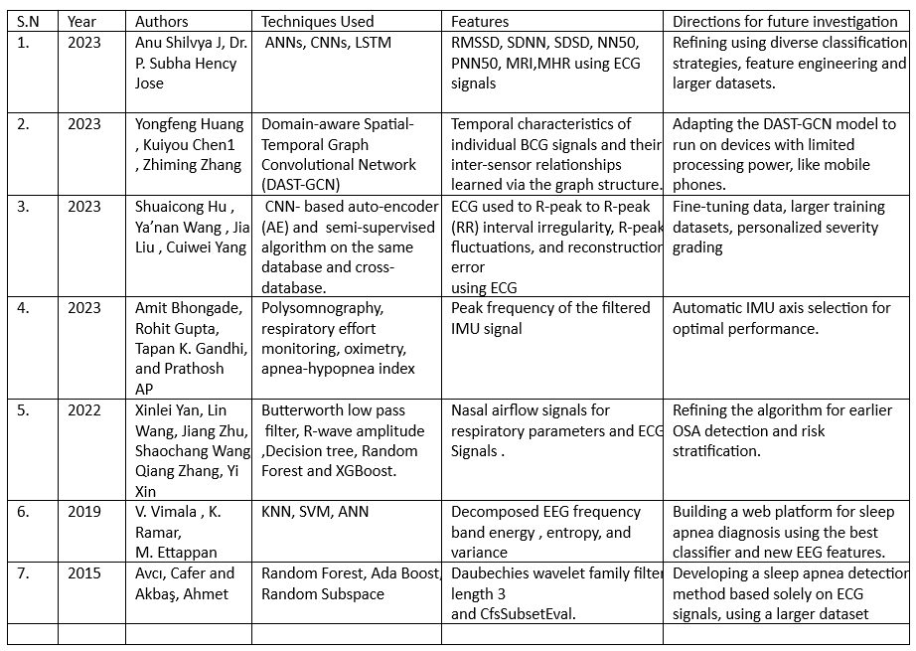
ANALYSIS & LITERATURE SURVEY
.

Slide 9
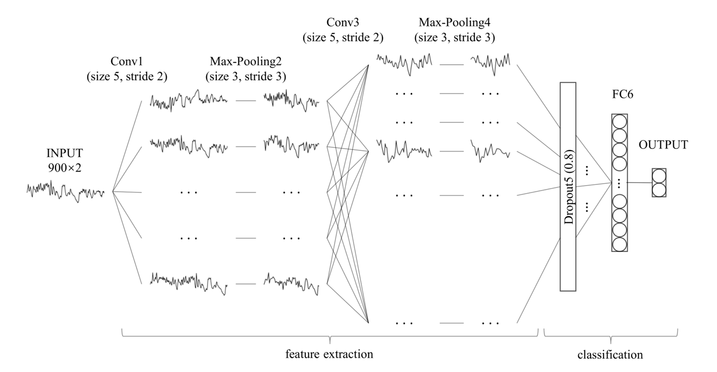
WORKING PRINCIPLE
Modified LeNet-5

Slide 10
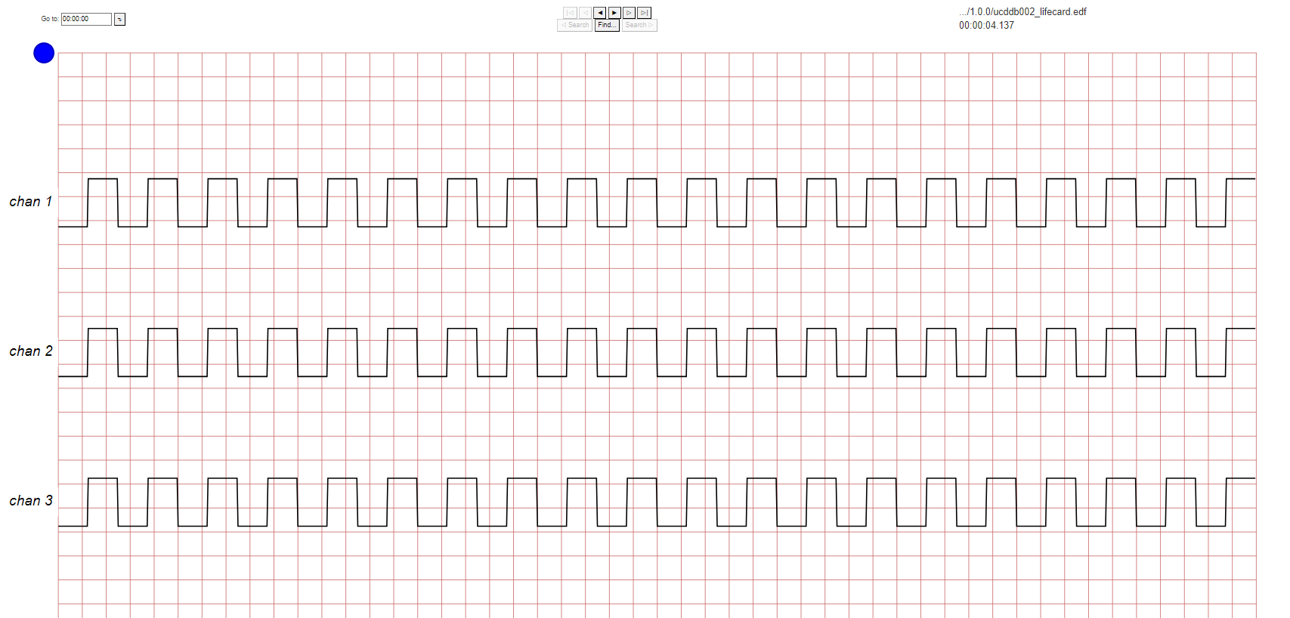

WORKING PRINCIPLE
The project begins with the acquisition of the PhysioNet Apnea-ECG dataset, comprising 70 single-lead ECG recordings, expert annotations, and relevant metadata.
Pre-processing involves applying the Hamilton algorithm for R-peak detection, followed by RR interval and amplitude extraction.
Feature extraction is conducted to derive informative features related to RR intervals and amplitudes crucial for SA detection. These features are then normalized using min-max normalization to ensure uniform scales.
The machine learning model implementation utilizes a modified LeNet-5 architecture for SA detection, incorporating one-dimensional convolution, dropout layers, and reduced complexity for optimal performance. Traditional machine learning models like SVM, KNN, LR, and MLP are also considered.
Evaluation metrics such as Specificity, Sensitivity, and Accuracy are employed to assess model performance. Results are analyzed to determine the effectiveness of the proposed methodology in improving diagnostic capabilities for sleep apnea detection.

Slide 11
WORKING PRINCIPLE
DATASETS MODULE
This module deals with the acquisition and description of dataset used in the project. We have used a PhysioNet Apnea-ECG Dataset. [https://physionet.org/content/ucddb/1.0.0/ ]
Description
Dataset: PhysioNet Apnea-ECG dataset from Philipps University.
Contents: 70 single-lead ECG signal recordings.
Sets: Released set (35 recordings) and withheld set (35 recordings).
Sampling: Signals sampled at 100 Hz.
Duration: Recordings ranged from 401 to 587 minutes.
Annotation: Expert annotations for 1-minute segments indicating apnea (labelled as SA) or normal.
Event Classification: No distinction between hypopnea and apnea; all events categorized as obstructive or mixed (central events excluded).
Recording Classes:
Class A: AHI ≥ 10, with at least 100 SA segments throughout.
Class B: AHI ≥ 5, with 5 to 99 SA segments.
Class C (Normal): AHI < 5.

Slide 12
WORKING PRINCIPLE
PRE-PROCESSING MODULE
This module focuses on the preprocessing steps applied to the ECG signals before feature extraction and model training. The preprocessing involves extracting RR intervals and amplitudes from the ECG signals. The Hamilton algorithm is used to detect R-peaks, from which RR intervals and amplitudes are calculated. Preprocessing also includes handling noisy RR interval data using a median filter and ensuring even spacing with cubic interpolation.
RR intervals : Time intervals between successive R waves in an electrocardiogram (ECG) signal, representing the heart's beat-to-beat variability
Amplitudes : Magnitude of electrical activity generated by the heart muscle during each heartbeat.
Hamilton Algorithm : Examines the ECG signal's shape to pinpoint the most noticeable peaks linked to the heart's contraction phase. This helps determine the time intervals between heartbeats, known as RR intervals.

Slide 13
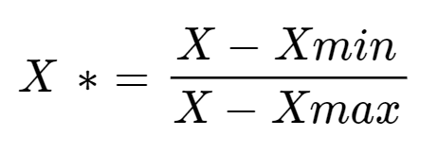
WORKING PRINCIPLE
FEATURE EXTRACTION MODULE
Feature extraction is performed to derive informative features from the pre-processed ECG signals. Specifically, features related to RR intervals and amplitudes are extracted, as they are deemed crucial for SA detection.
We chose 12 features related to RR intervals and 6 features related to amplitudes, which had been shown to be important in SA detection. Some machine learning methods, like KNN, are sensitive to the scales of features. To make sure all features are on a similar scale, they used a technique called min-max normalization.
MIN-MAX NORMALIZATION
This process rescales each feature so that its values fall between 0 and 1, making it easier for the model to learn from them.

Slide 14
WORKING PRINCIPLE
MACHINE LEARNING MODEL MODULE
This module involves the implementation of machine learning models for SA detection. Two approaches are mentioned: a CNN-based approach (using LeNet-5 architecture) and traditional feature engineering-based techniques (SVM, KNN, LR, MLP). The modified LeNet-5 architecture is described, emphasizing changes such as one-dimensional convolution, dropout layer addition, and reduced complexity. Traditional machine learning models are trained and evaluated using selected features.

Slide 15
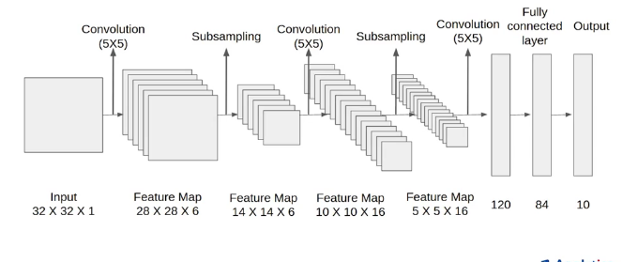
WORKING PRINCIPLE
STANDARD LENET-5

Slide 16
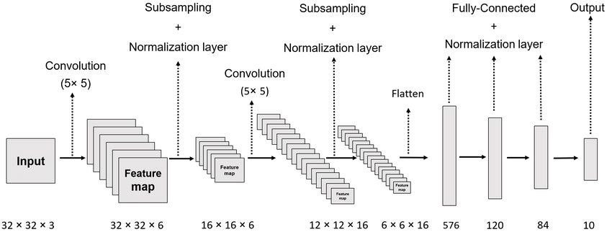
WORKING PRINCIPLE
MODIFIED LENET-5

Slide 17
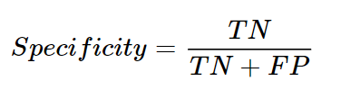
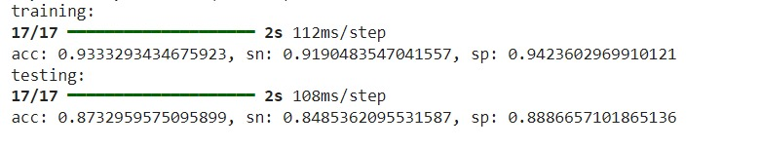


WORKING PRINCIPLE
EVALUATION METRICS MODULE
This module discusses the evaluation metrics used to assess the performance of the SA detection models. The evaluation metrics used to assess the performance of the proposed method are Specificity (Sp), Sensitivity (Sn) & Accuracy (Acc).

Slide 18
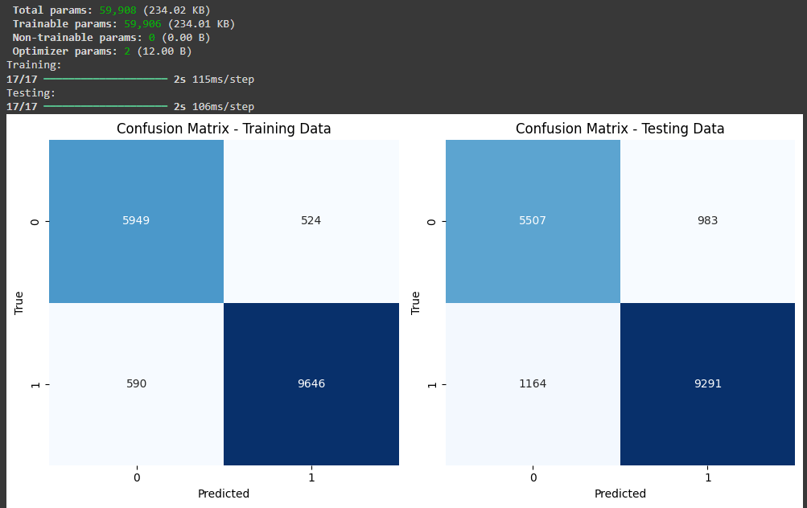
EXPERIMENTAL RESULTS & ANALYSIS

Slide 19
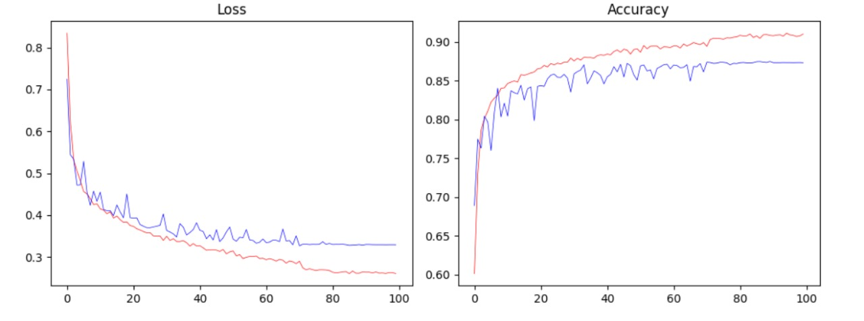
EXPERIMENTAL RESULTS & ANALYSIS

Slide 20
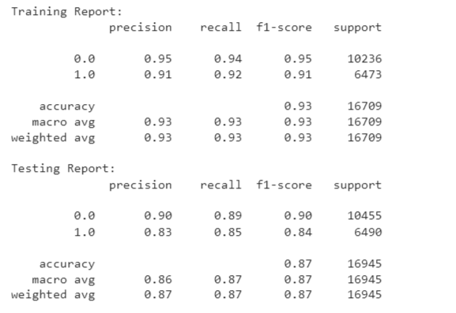
EXPERIMENTAL RESULTS & ANALYSIS

Slide 21
CONCLUSION & FUTURE DEVELOPMENT
Impressive Performance of Modified LeNet-5: Our modified LeNet-5 model showcases exceptional performance in accurately predicting sleep apnea (SA) based on ECG segments.
Robustness of Model Evaluation: The withheld set evaluation demonstrates the robustness of our model, with high specificity, sensitivity, accuracy, and AUC metrics. Our model effectively distinguishes between individuals with and without SA, providing reliable diagnostic support.
Superiority over Traditional Methods: Comparative analysis against SVM highlights substantial improvements across all evaluation metrics, reaffirming the efficacy of our approach. Our modified LeNet-5 outperforms traditional methods, underscoring its potential in advancing SA detection capabilities.
Future Directions: Further refinements to our method can expedite the development of ECG-based SA detection tools for clinical application. Incorporating additional datasets can address limitations and enhance the robustness and applicability of our proposed method. Exploration of utilizing single-lead ECG signals for SA detection in home healthcare settings using wearable devices presents promising avenues for future research.
Clinical Implications: Advancements in SA detection can significantly impact clinical practice, facilitating early diagnosis and personalized treatment planning. Continued research efforts aim to refine and optimize ECG-based SA detection methods for broader clinical adoption and improved patient outcomes.

Slide 22
References
Anu Shilvya, J., & Jose, P. S. H. (2023). Obstructive Sleep Apnea Detection from ECG Signals with Deep Learning. 2023 International Conference on Sustainable Computing and Smart Systems (ICSCSS), Sustainable Computing and Smart Systems (ICSCSS), 2023 International Conference On, 384–388. https://doi-org.egateway.vit.ac.in/10.1109/ICSCSS57650.2023.10169207
Huang, Y., Chen, K., & Zhang, Z. (2023). Domain - Aware Spatial-Temporal Graph Convolutional Network for Sleep Apnea Detection via Multivariant BCG Signals. ICC 2023 - IEEE International Conference on Communications, Communications, ICC 2023 - IEEE International Conference On, 5515–5520. https://doi-org.egateway.vit.ac.in/10.1109/ICC45041.2023.10278967
Hu, S., Wang, Y., Liu, J., Yang, C., Wang, A., Li, K., & Liu, W. (2023). Semi-Supervised Learning for Low-Cost Personalized Obstructive Sleep Apnea Detection Using Unsupervised Deep Learning and Single-Lead Electrocardiogram. IEEE Journal of Biomedical and Health Informatics, Biomedical and Health Informatics, IEEE Journal of, IEEE J. Biomed. Health Inform, 27(11), 5281–5292. https://doi-org.egateway.vit.ac.in/10.1109/JBHI.2023.3304299
Bhongade, A., Gupta, R., Gandhi, T. K., & Ap, P. (2023). A Portable Low-Cost Respiration Rate Measurement System for Sleep Apnea Detection. 2023 45th Annual International Conference of the IEEE Engineering in Medicine & Biology Society (EMBC), IEEE Engineering in Medicine & Biology Society (EMBC), 2023 45th Annual International Conference of The, 1–5. https://doi-org.egateway.vit.ac.in/10.1109/EMBC40787.2023.10340446
Yan, X., Wang, L., Zhu, J., Wang, S., Zhang, Q., & Xin, Y. (2022). Automatic Obstructive Sleep Apnea Detection Based on Respiratory Parameters in Physiological Signals. 2022 IEEE International Conference on Mechatronics and Automation (ICMA), Mechatronics and Automation (ICMA), 2022 IEEE International Conference On, 461–466. https://doi-org.egateway.vit.ac.in/10.1109/ICMA54519.2022.9856347
Vimala, V., Ramar, K. & Ettappan, M. An Intelligent Sleep Apnea Classification System Based on EEG Signals. J Med Syst 43, 36 (2019). https://doi.org/10.1007/s10916-018-1146-8
Avcı, C., & Akbaş, A. (2015). Sleep apnea classification based on respiration signals by using ensemble methods. Bio-Medical Materials and Engineering, 26(s1), S1703-S1710. https://doi.org/10.3233/BME-151470

Slide 23

Queries?

