Slide 1

Market Data Storage and Analysis for investors
Presented by:-
SUMIT MEHTA

Slide 2

INTRODUCTION
This dataset has information about companies, their stock prices, trading activities, financial deals, and performance metrics like revenue and profit. It helps understand how companies are doing in the market and their overall financial health.

Slide 3

ABOUT PROJECT
This project studies financial and market data using python libraries tools like NumPy, Pandas, Matplotlib and Scrapy. It looks at trends in revenue, profit, stock prices, trading volumes, and market value. By organizing and comparing data, the project helps to understand how companies and industries are performing.

Slide 4
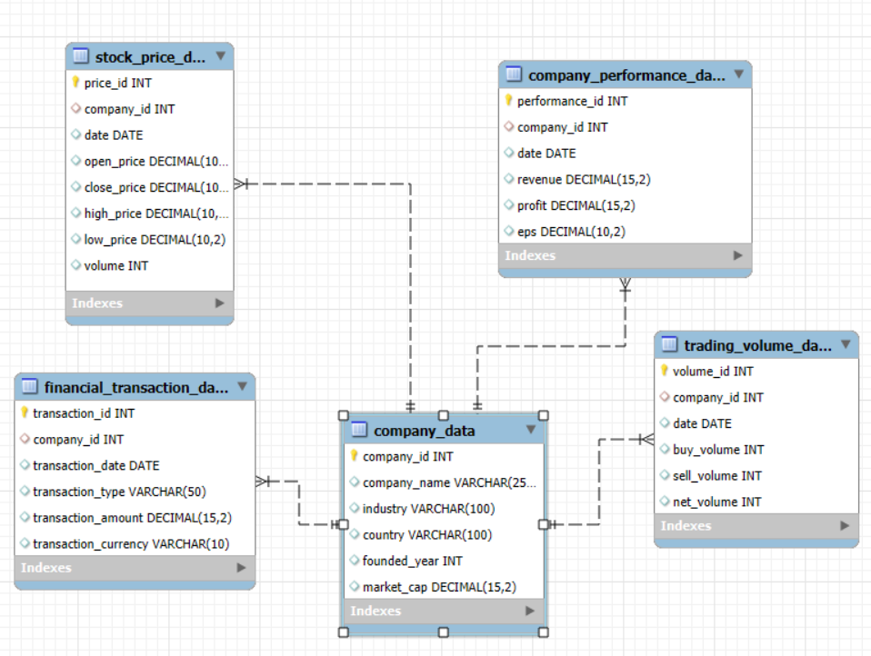
EER DIAGRAM

Slide 5
Tables of the Dataset
company_data : Contains company details like name, industry, country, founding year, and market capitalization.
stock_price_data : Records daily stock prices including open, close, high, low, and trading volume.
trading_volume_data : Tracks buy, sell, and net trading volumes for each company on a specific date.
financial_transaction_data : Captures details of financial transactions like amount, type, and currency for each company.
company_performance_data : Provides financial performance metrics including revenue, profit, and EPS for each company on specific dates.

Slide 6
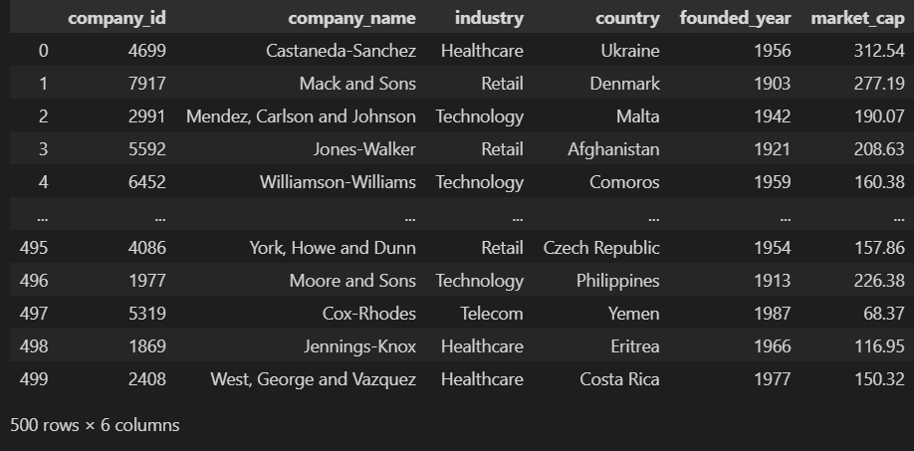
Table Overview
Company data :

Slide 7
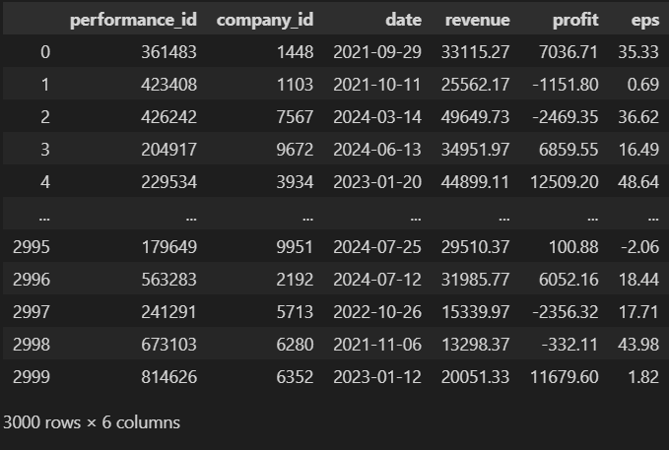
Company performance data :

Slide 8
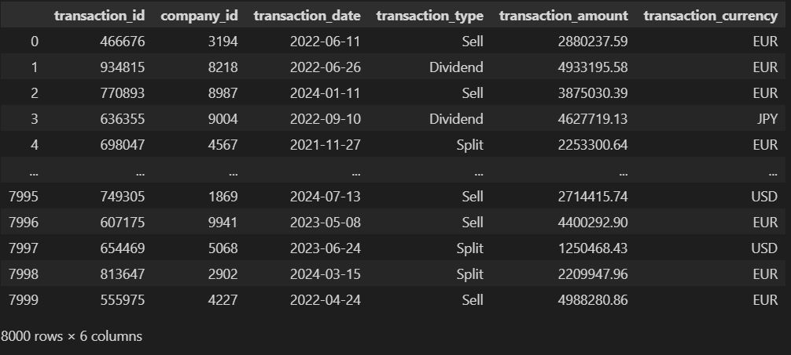
Financial transaction data :

Slide 9
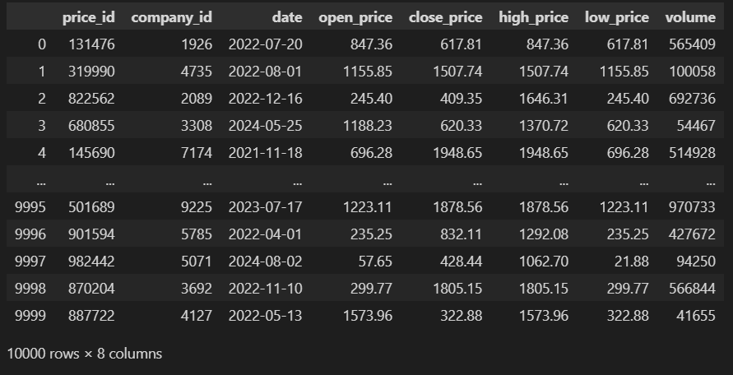
Sock price data :

Slide 10
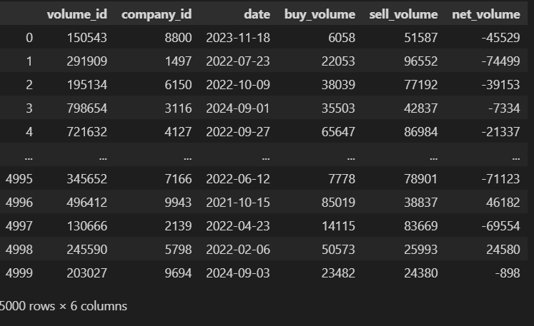
Trading volume data :

Slide 11
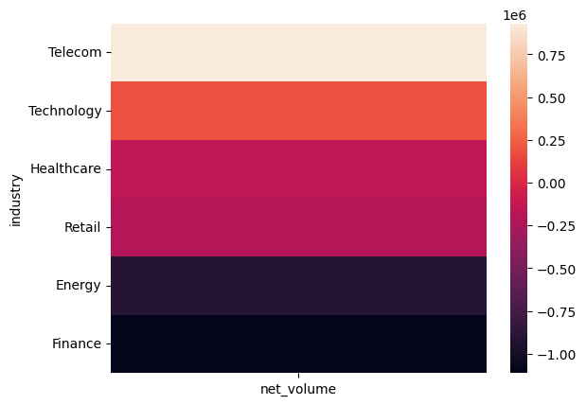
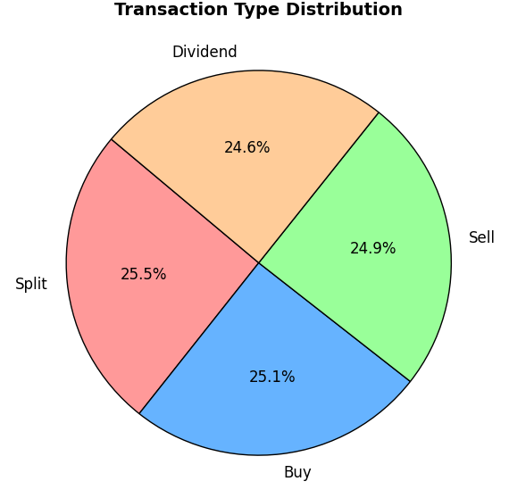
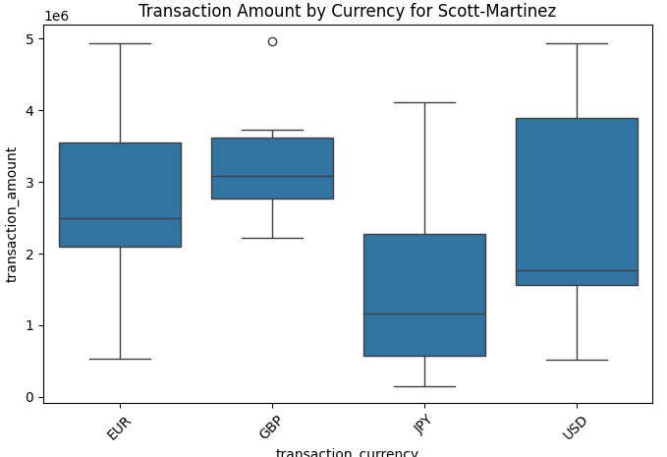
visualization
Which industry has the highest positive net volume?
WHICH TRANSACTION TYPE IS USE BY MOST OF THE COMPANIES
Which currency has the most variability in transaction amount ?

Slide 12
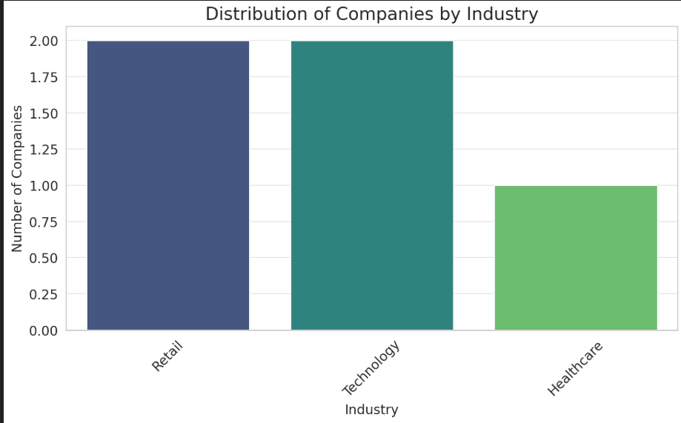
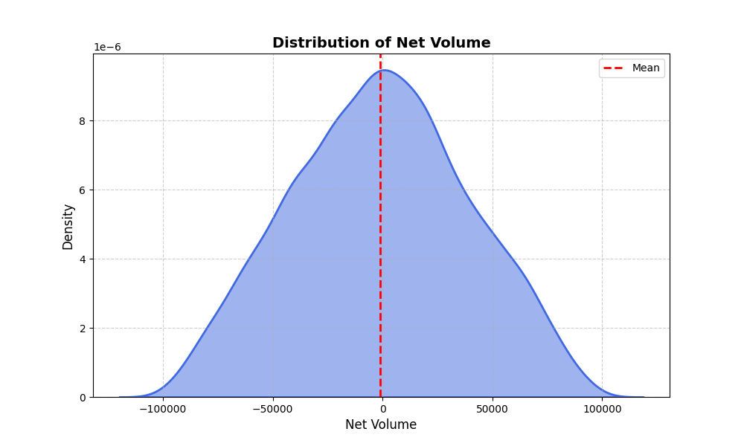
Which industry has the highest number of companies?
"Net Volume," highlighting its central tendency, spread, and overall shape. Understanding these characteristics helps in analyzing and interpreting the behavior of the Net Volume variable.

Slide 13
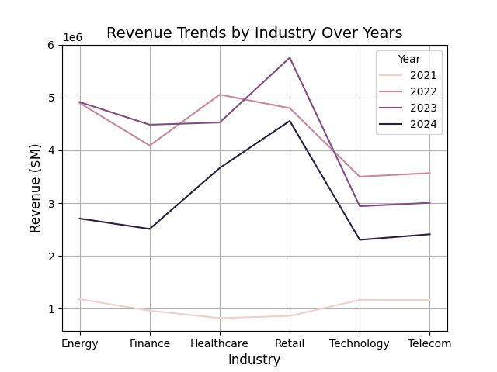
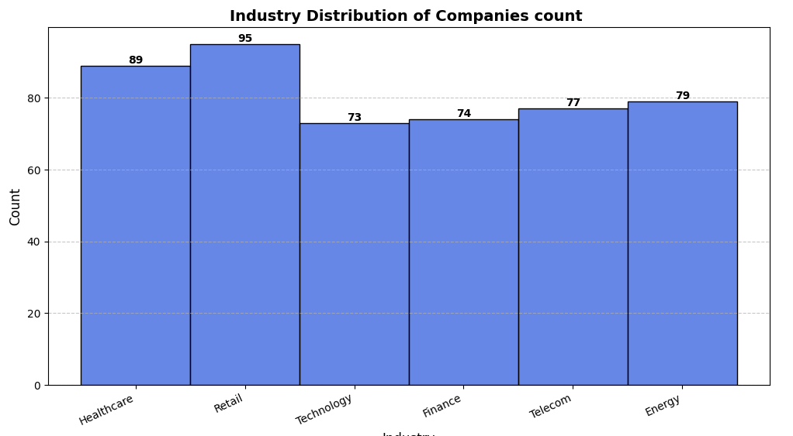
COMPANY OVERVIEW
To Ananlysis the company and industry constribution in market
How the Revenue of industry over years ?
Industry distribution of companies count

Slide 14
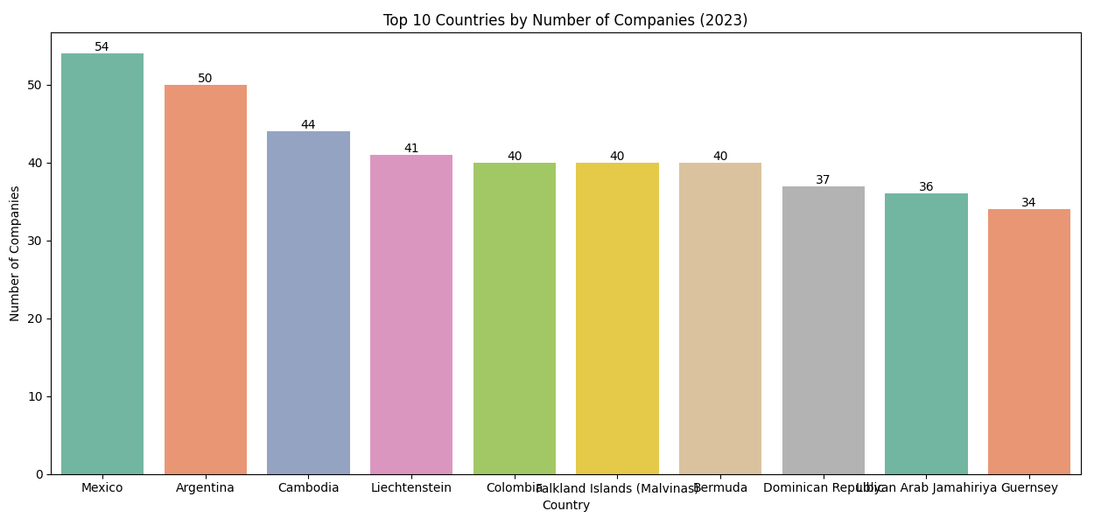
What is impact of number of companies on Top 10 countries
Transaction types of company

Slide 15
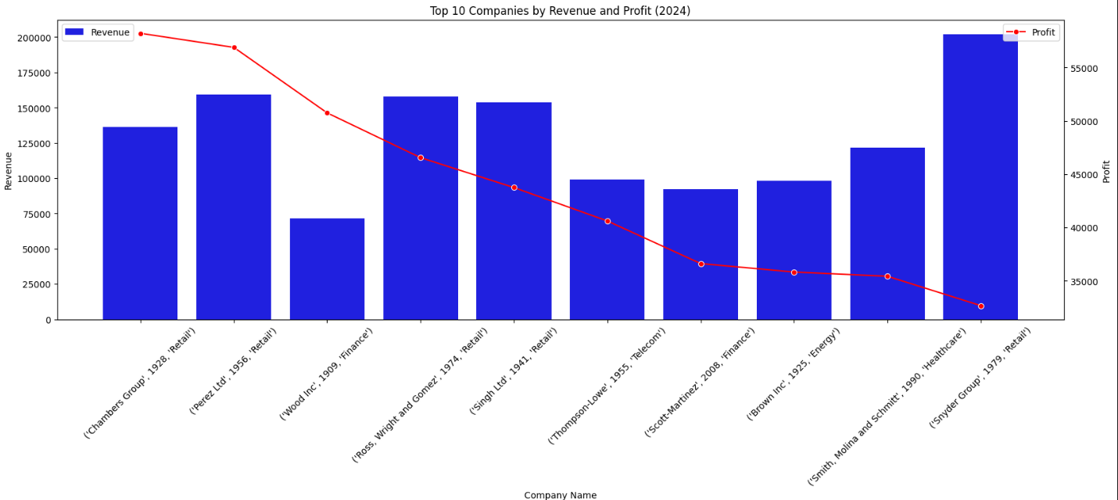
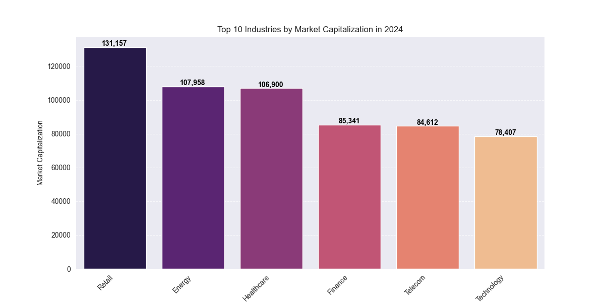
Financial Performance
To Ananlysis How company financial performance in the market
How the Top 10 companies made the profit with there revenue ?
How the market capitalization is distribution in industry

Slide 16
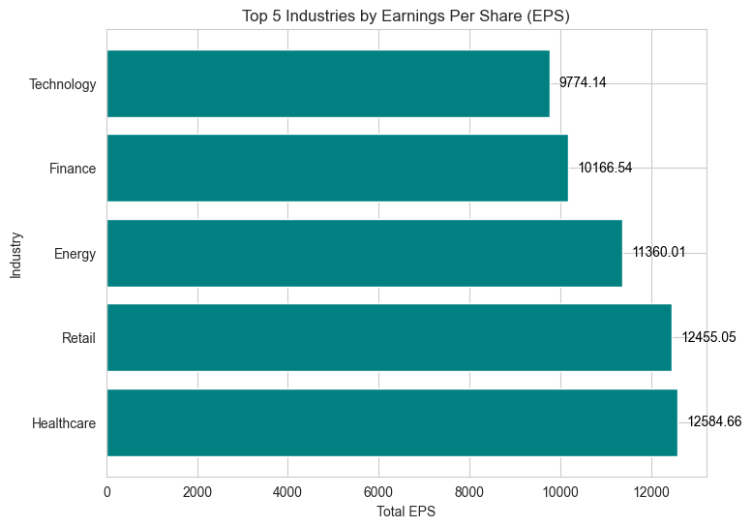
Top 5 Industries by Earnings Per Share (EPS)
Transaction amount by currency

Slide 17
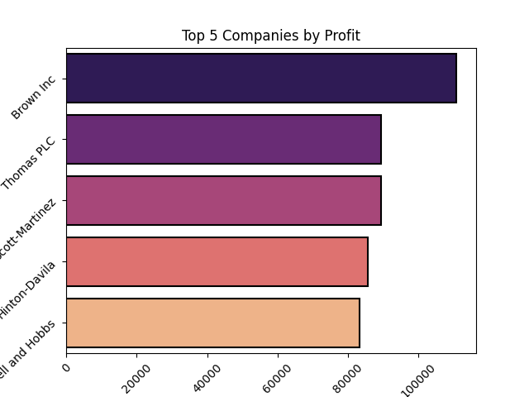
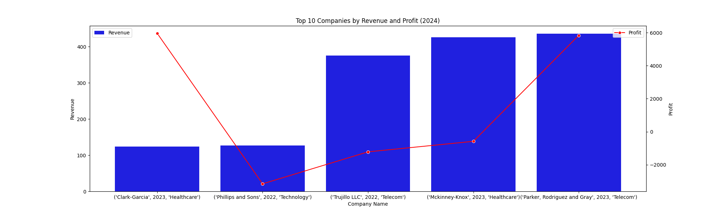
Market Trends & Predictions
To Ananlysis to the Market Trends
How the startup company revenue and profit ?
Top 5 companies by profit ?

Slide 18
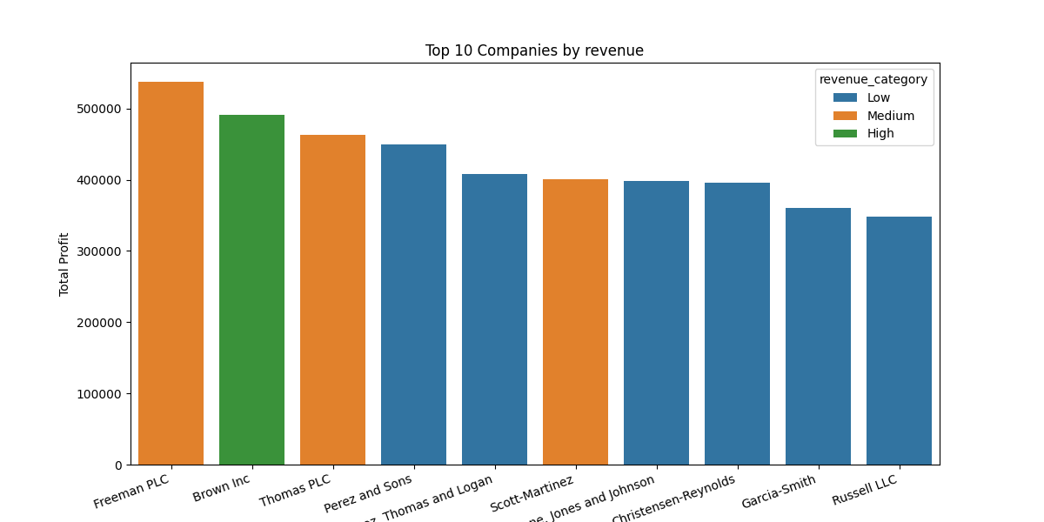
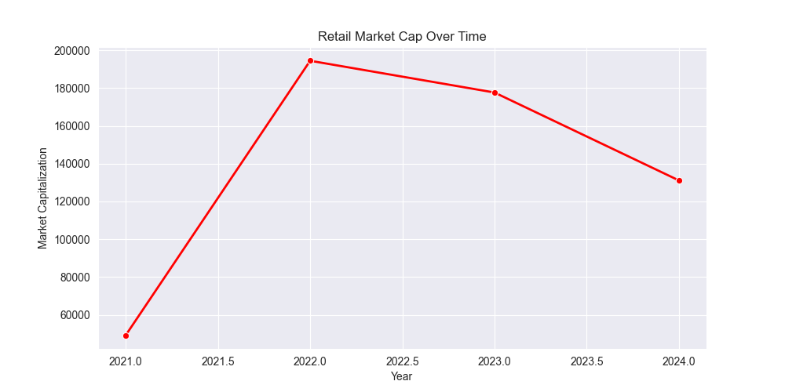
Top 10 companies revenue by profit category

Slide 19
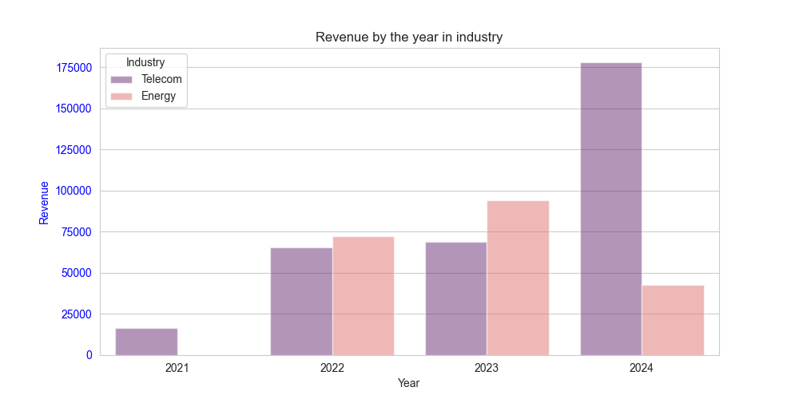
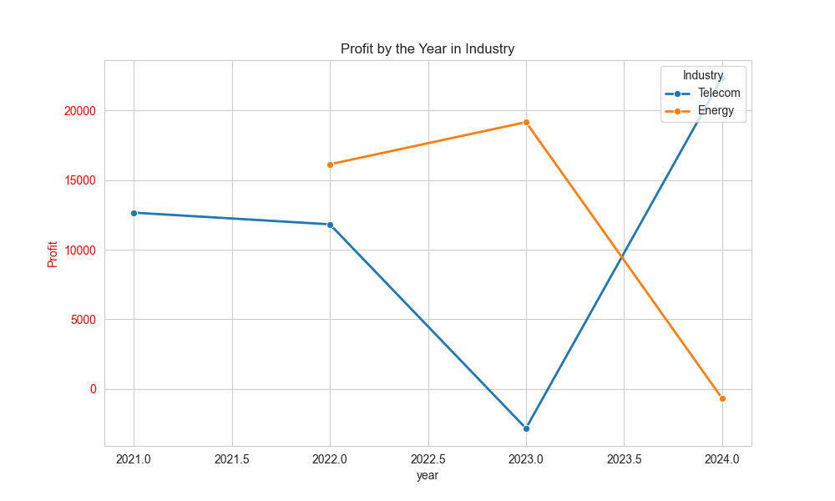
Investment Insights
Freeman PLC : This company is operating in two industry in 1954 Energy(Libyan Arab Jamahiriya) and 2001 Telecom (Cambodia). The data spans from 2021 to 2024 and includes revenue, profit, and earnings per share (EPS) figures. Key observations include

Slide 20
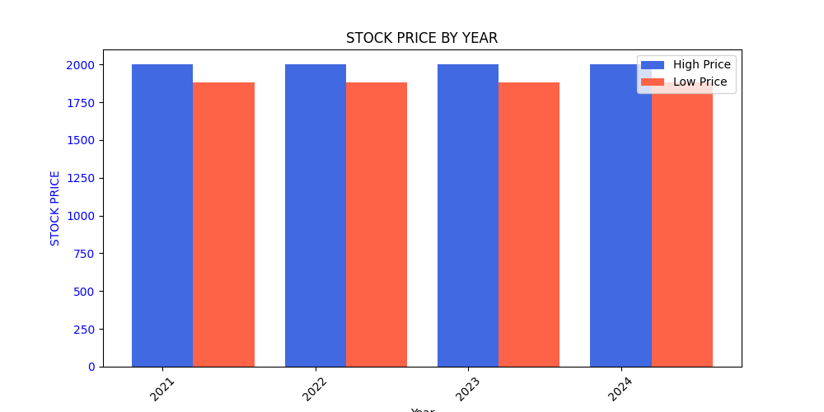
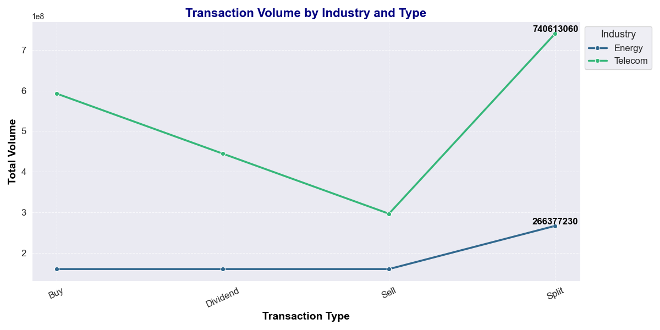
Business Model:- This company is experiencing good revenue growth each year, but the profit growth is not as satisfying when compared to the trend. For investors, the Telecom industry can be a good option for long-term investment.

Slide 21
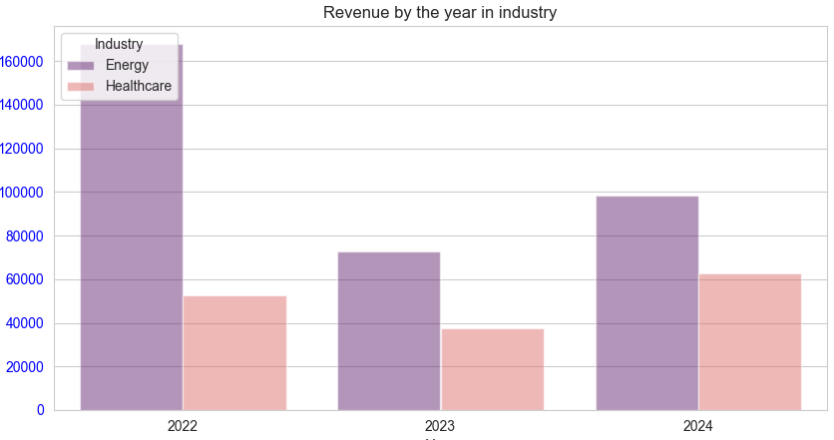
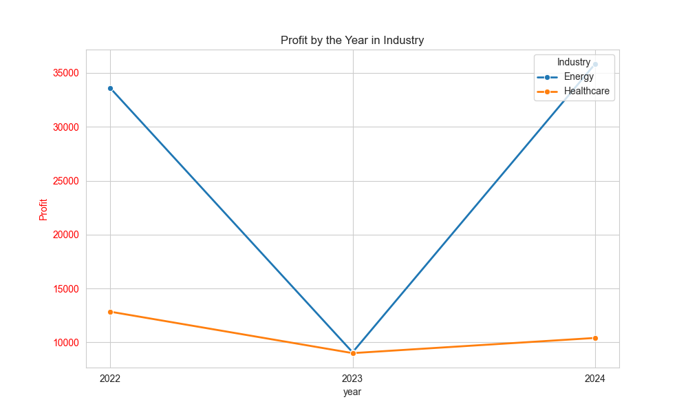
Brown Inc : This company operating in different industries and locations. in 1925 Energy (Mozambique) and 1994 Healthcare (Suriname). The data spans from 2021 to 2024 and includes revenue, profit, and earnings per share (EPS) figures. Key observations include

Slide 22
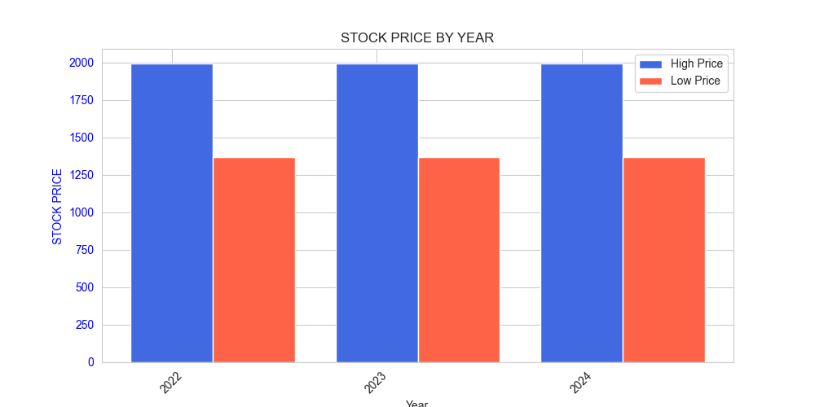
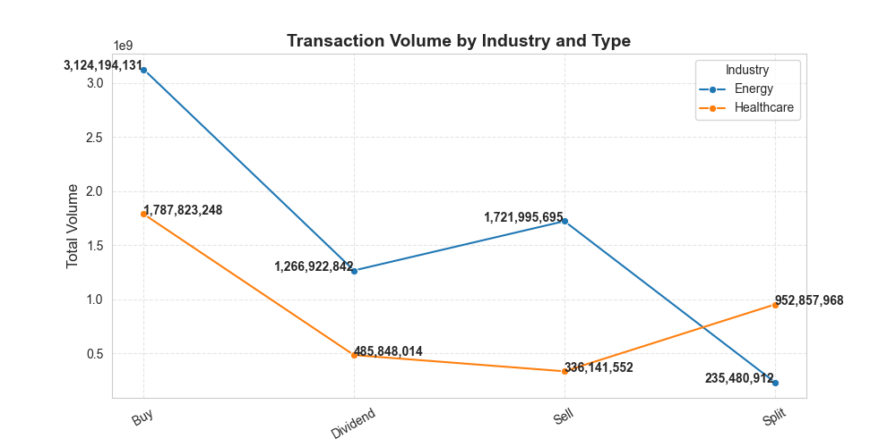
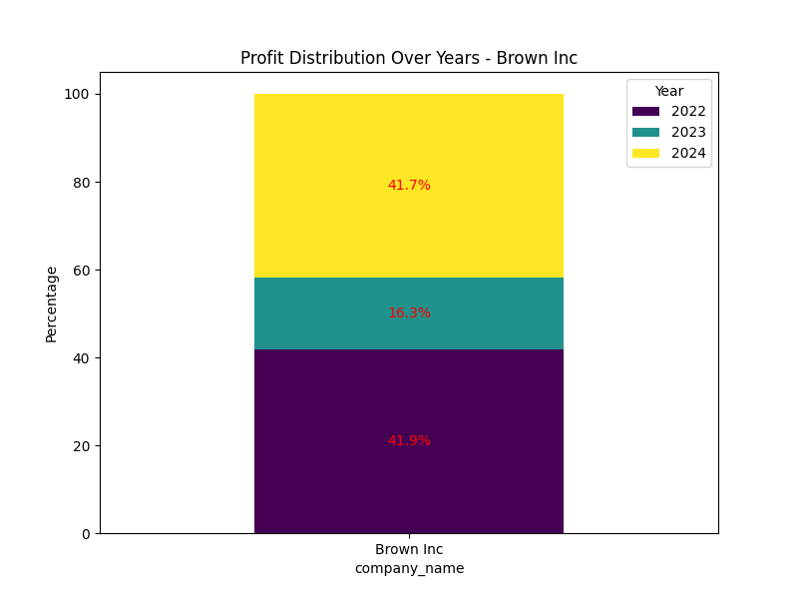
Business Model:- This company is experiencing good profit growth each year, but the revenue growth is not as satisfying when compared to the trend. For investors, the ENERGY industry can be a good option for investing to get more profit .

Slide 23
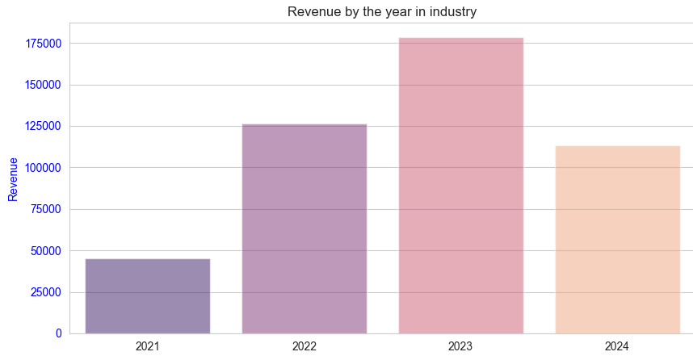
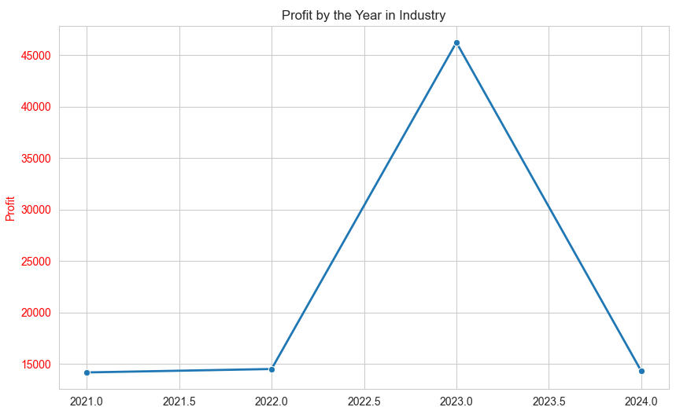
Thomas PLC: This company IS an retail company based in Italy 1998. The data spans from 2021 to 2024 and includes revenue, profit, and earnings per share (EPS) figures. Key observations include

Slide 24
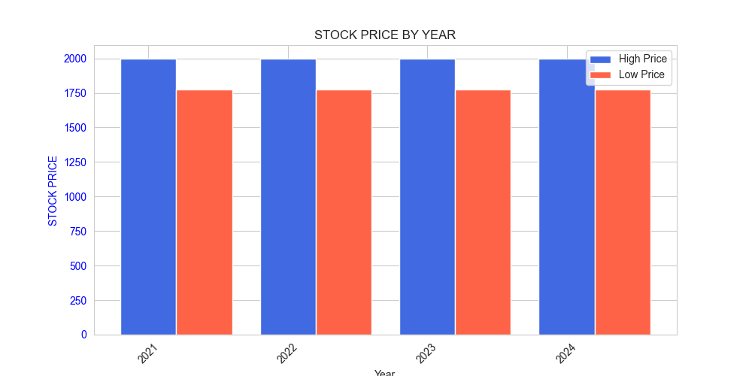
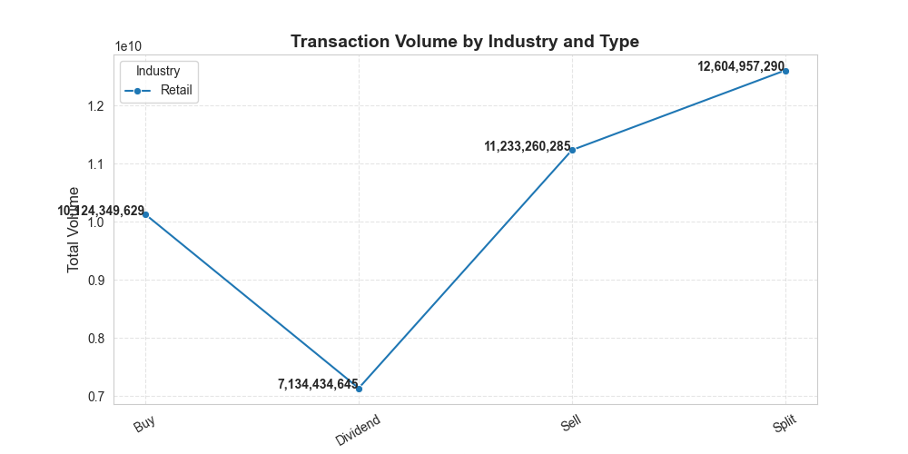
Business Model:- This company is showing good revenue growth each year, and profit growth is less satisfying when compared to the trend. This is mainly because, as investors, it's good for growth with company profit. It's good for no risk with long-term, with mostly profit.

Slide 25
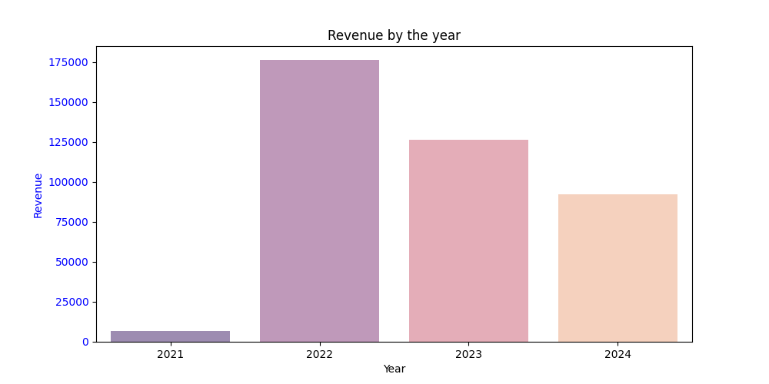
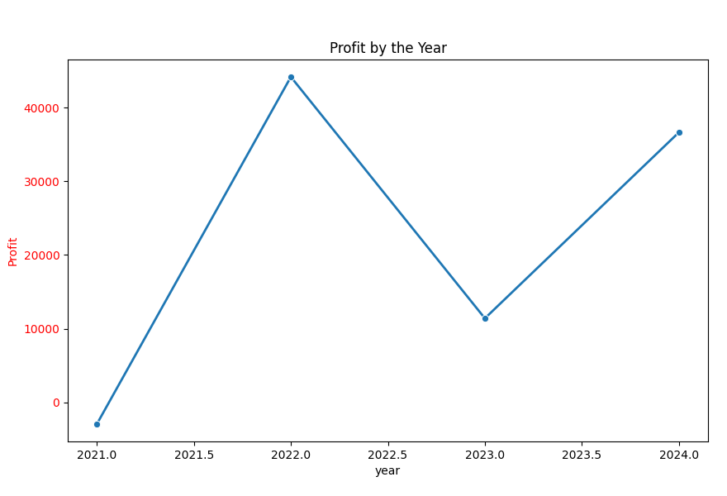
Scott-Martinez : This company is a finance company based in Mexico 2008. The data spans from 2021 to 2024 and includes revenue, profit, and earnings per share (EPS) figures. Key observations include

Slide 26
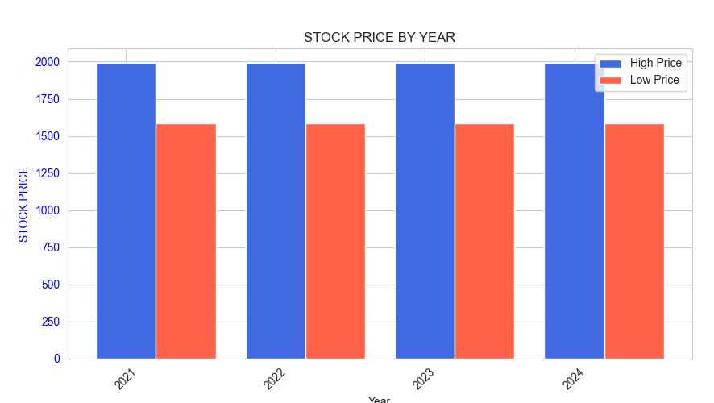
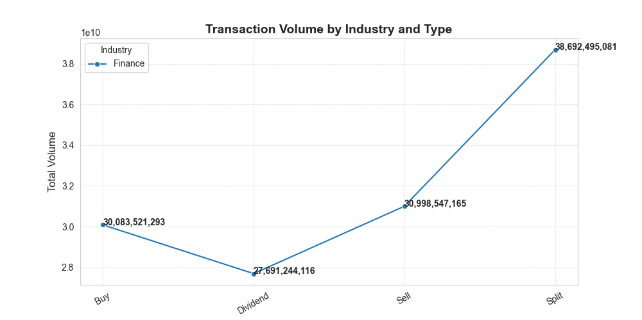
Business Model:- This company is has less time to growth in year the treand and his profit and revenue is good growth by year for as investr is good investment to less amount with good profit

Slide 27
Clark-Garcia : This company is a Healthcare company based in Bahamas 2015. The data spans from 2021 to 2024 and includes revenue, profit, and earnings per share (EPS) figures. Key observations include
Industry | HIGH PRICE | LOW PRICE
Healthcare | 1529.04 | 377.1

Slide 28

conclusion
- Retail industry shows the highest revenue trends but comes with higher risks.
- Thomas PLC and Brown Inc are top companies in profitability and investment potential.
- Mexico and Argentina have strong market presence in trading volume.
- Energy and Healthcare industries provide long-term stability for investors.
- Diversification and risk assessment are key strategies for investment success.

