Slide 1
Docker Fundamentals
dotnetmastery.com

Slide 2
TOPICS COVERED
Docker Fundamentals (container, images, docker hub)
Install docker desktop
Download ‘Hello world’ docker image and run first container
Run static HTML image in a docker container
Port mapping in docker
Working with tags and docker image
Docker container commands
Removing docker image and container
Docker File instructions (FROM,COPY,WORKDIR,ARG,EXPOSE,RUN,ENTRYPOINY,VOLUMES)
Create .NET application with Docker Support
Understand default docker file in .NET Application
Manually create docker file for .NET Application
Run .NET built image and container on local machine.
Push local image to docker hub
Deploy container to azure
dotnetmastery.com

Slide 3
WHAT IS DOCKER?
“Packaging solution to simplify software deployment”
dotnetmastery.com

Slide 4
DOCKER TERMINOLOGY?
Container
Images
dotnetmastery.com

Slide 5
DOCKER COMPONENTS?
Virtual Machine
Docker
VM 1
VM 2
VM 3
App 1
App 2
App 3
Docker Container 1
Docker Container 2
Docker Container 3
bins/lib
bins/lib
bins/lib
App 1
App 2
App 3
Guest OS
Guest OS
Guest OS
bins/lib
bins/lib
bins/lib
Hypervisor
Hypervisor
Host OS
Host OS
Infrastructure
Infrastructure
dotnetmastery.com

Slide 6
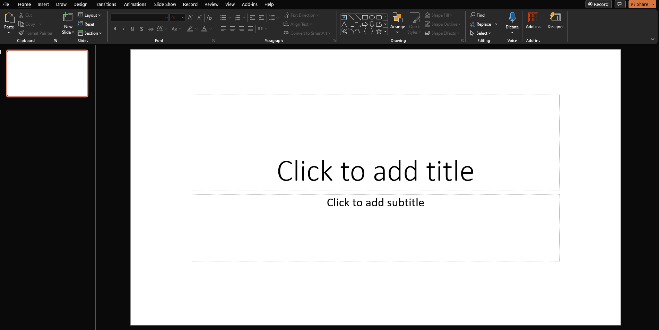
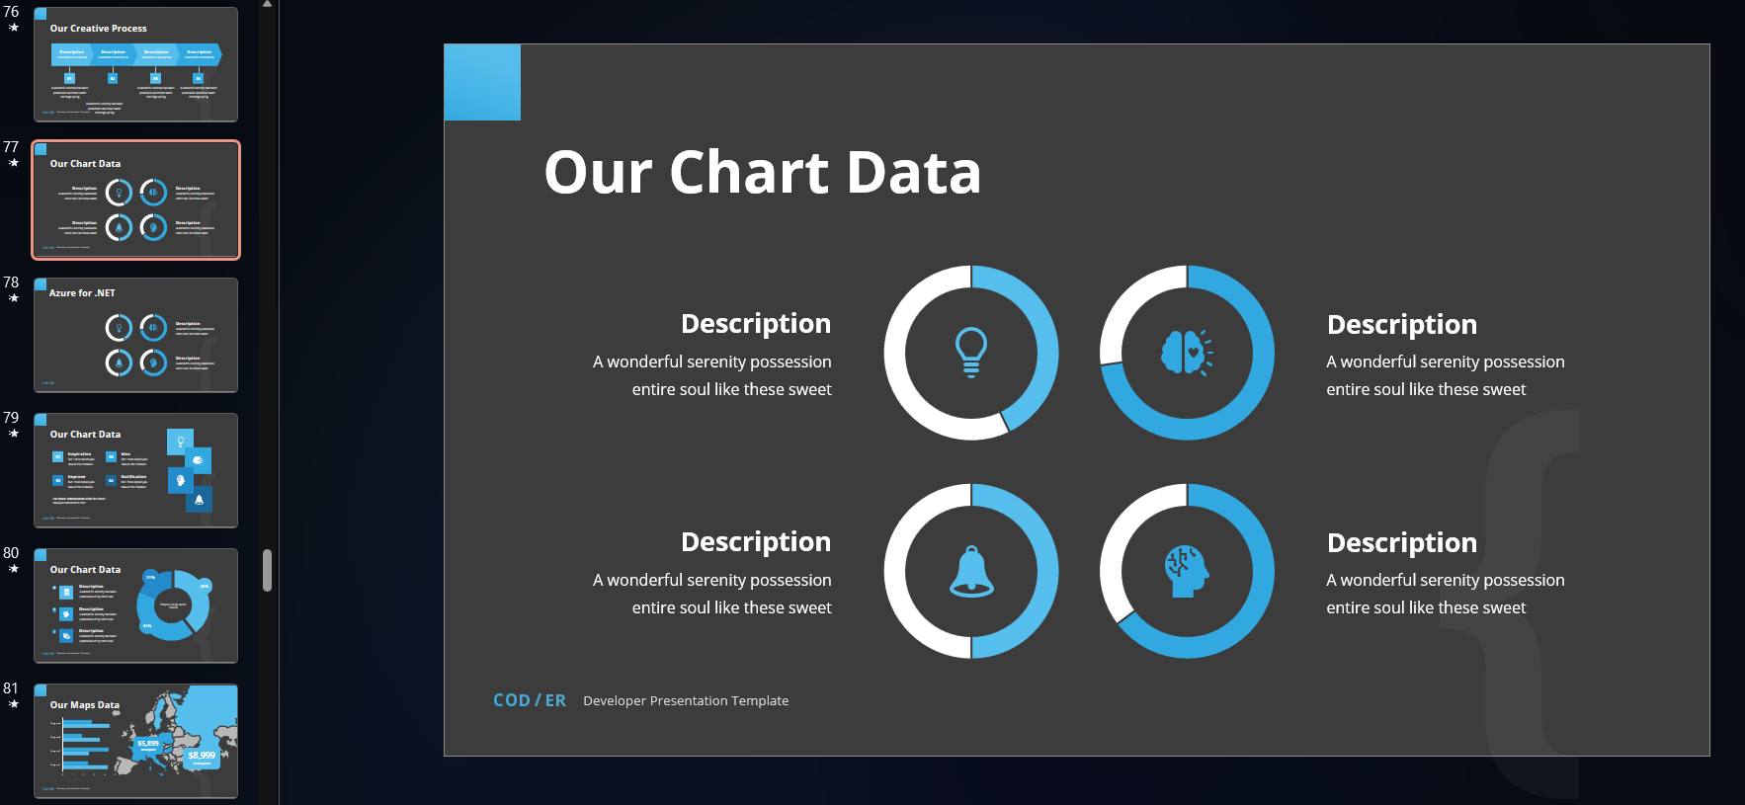
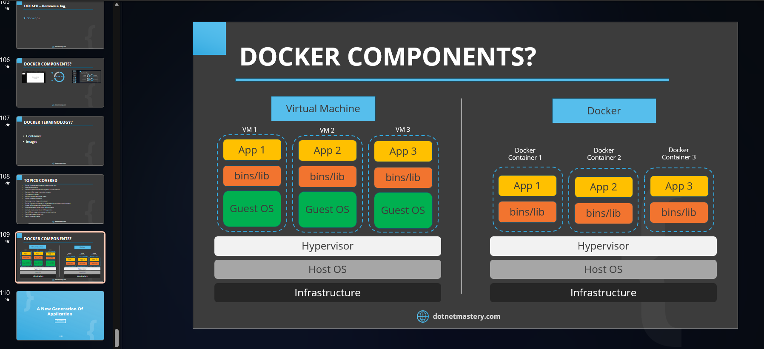
DOCKER IMAGE LAYERS
Image Layer 1
Add Some Fonts and Styles
to Image layer 1
Image Layer 2
Tw
Fb
In
Final Image
Add Some more colors
and pictures
dotnetmastery.com

Slide 7
IMAGE AND CONTAINER
Nginx
Add HTML Files
Final Image
dotnetmastery.com

Slide 8
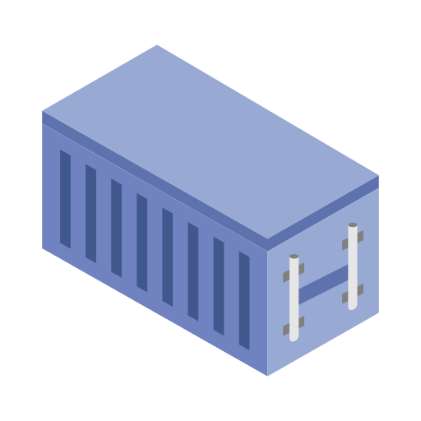
IMAGE AND CONTAINER
Nginx
Add HTML Files
Final Image
dotnetmastery.com

Slide 9
IMAGE AND CONTAINER
.NET SDK
Image 1
Restore NuGet packages on csproj file
Copy all Files & .NET Build
Image 2
.NET Publish
Final Image
dotnetmastery.com

Slide 10
IMAGE AND CONTAINER
.NET SDK
Image 1
Restore NuGet packages on csproj file
Copy all Files & .NET Build
Image 2
.NET Publish
Final Image
dotnetmastery.com

Slide 11
A New Generation Of Application
Thank You

