Slide 1
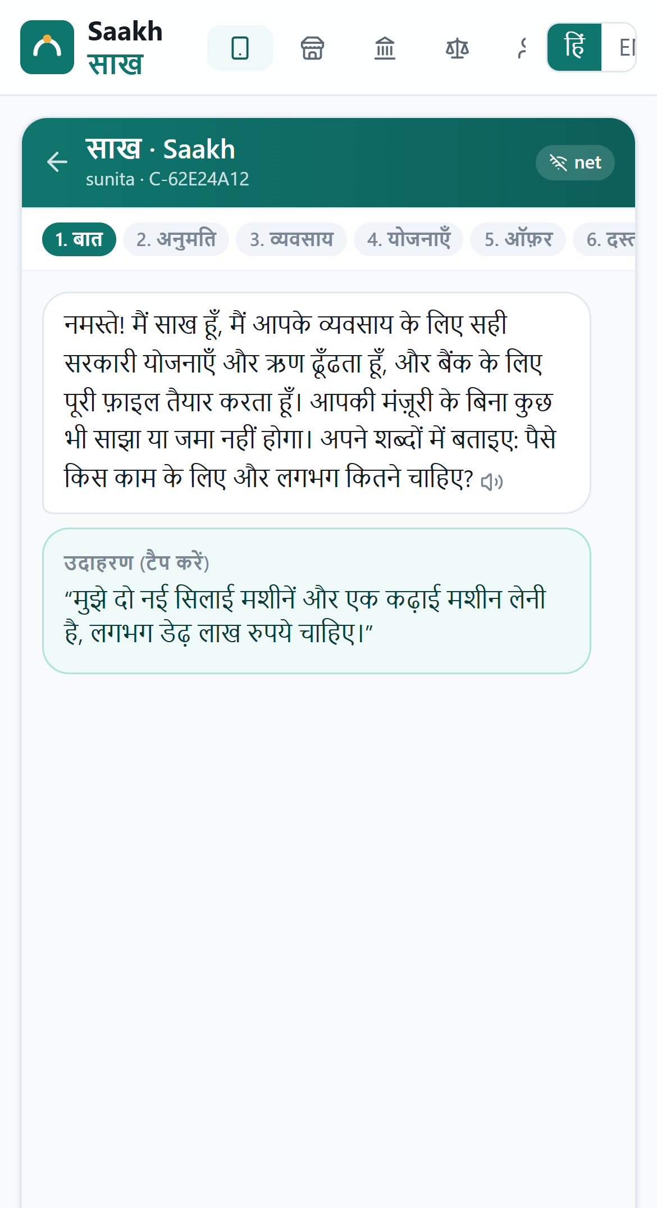
TECH4BHARAT 2026 · PROBLEM 3.2 FORMAL CREDIT AND SCHEMES · AGENTIC AI
Saakh साख
From UPI trail to bank-ready credit
An AI agent that helps India's invisible micro enterprises reach formal credit and the government schemes built for them, with their consent, a cited source for every claim, and their approval before anything is sent.
Team Soliloquy
Sumit Mukherjee (Team Lead), IIT Kharagpur
Notes:
Saakh means creditworthiness: the trust a business has earned. Our agent turns the trust small businesses already earn in UPI payments into formal credit. It works for the entrepreneur, in Hindi, by voice, with consent and approval at every step.

Slide 2

Viable businesses, invisible to banks
Meet Sunita, a tailor in Barabanki
₹30 lakh cr
7.6 crore
addressable MSME credit gap, about 24% of demand
MSMEs on the Udyam portal, 99.3% of them micro
Stitches for about 60 paying customers a month, mostly paid by UPI
No ITR, so the bank cannot see her
Qualifies for PM Vishwakarma and MUDRA; nobody has told her
Repays a moneylender ₹1,200 every Monday on a ₹50,000 loan, about 57% a year
SIDBI with Crisil, May 2025
Parliamentary Standing Committee, Mar 2026
24 to 36%
40 to 50%
interest paid to moneylenders when formal credit fails
of PMEGP applications rejected by banks, driven by credit-score reliance
The barrier is not creditworthiness. It is paperwork, scheme complexity and months of branch visits.
Tech4Bharat problem brief
Parliamentary Standing Committee, Mar 2026
Notes:
The brief describes businesses with genuine UPI flows but no ITR or audited statements. They miss schemes and end up with moneylenders. SIDBI and Crisil put the addressable MSME credit gap at about 30 lakh crore rupees. A March 2026 parliamentary committee report counts 7.61 crore MSMEs on Udyam, 99.3 percent micro, and finds banks rejecting 40 to 50 percent of PMEGP applications, driven by reliance on credit scores. That is exactly the gap cash-flow underwriting closes.

Slide 3









One agent, about two minutes, a bank-ready file
1
2
3
4
5
Talk
Consent
Understand
Match
Ask
Hindi, Hinglish or English, by voice
4 separate, purpose-bound artefacts
Cash flow, seasons, moneylender loans
10 scheme pathways, every rule cited
Only questions that change an outcome
6
7
8
9
Offer
Build
Approve
Track
A loan sized to lean and busy months
17 papers become 9 items, DPR generated
The owner approves the exact file
The branch gets a pre-appraised file
Built on India's digital rails: UPI, Account Aggregator, DigiLocker, Udyam. In the prototype these are simulated adapters with production-shaped interfaces, labelled SIMULATED.
Notes:
This is the whole journey. The entrepreneur talks, consents, answers a handful of questions, picks an offer and approves the file. Everything between is the agent's work.

Slide 4
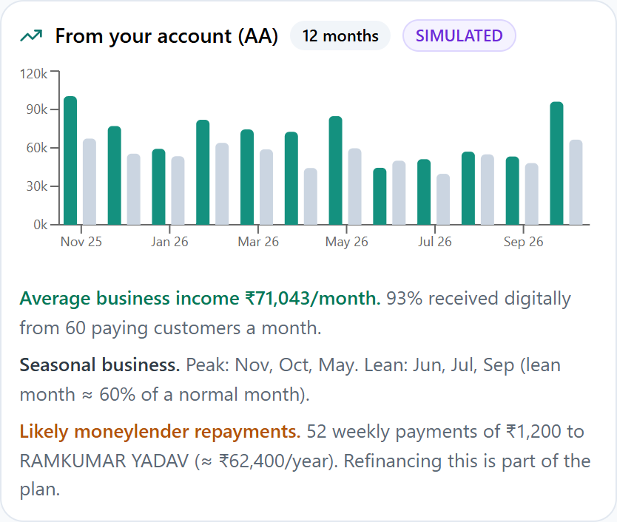



It reads the business, not the paperwork
Moneylender found
52 weekly payments of ₹1,200 to one person: flagged as an informal loan, about 57% a year, and refinanced in the offer.
Seasons, not averages
Lean months run at about 60% of normal, so the repayment plan shrinks when income does.
Evidence, minimal data
Turnover, B2B buyers and bounces are derived with evidence. Account Aggregator data is processed in memory and never stored.
Notes:
With consent, the agent reads up to 12 months of statement. It finds the moneylender, the seasons and the B2B buyers, and states how many months it actually read. Short uploads are flagged everywhere, including the project report.

Slide 5
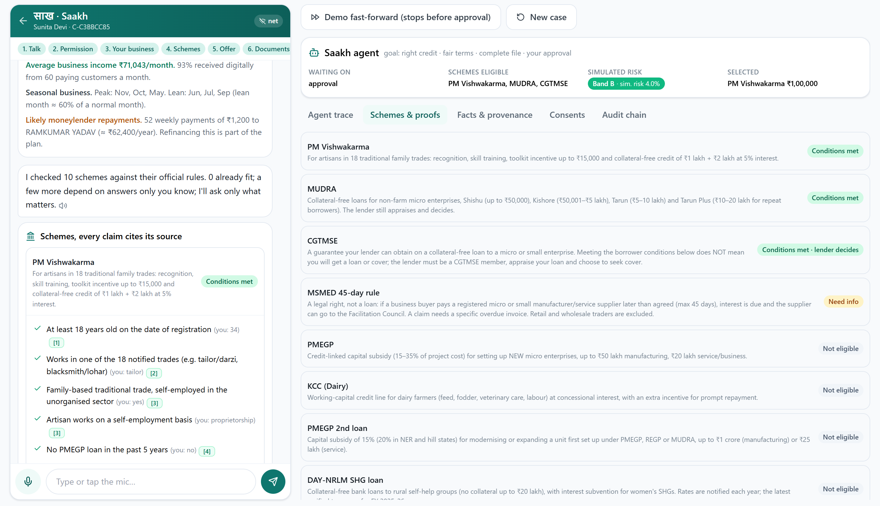
Every scheme claim comes with its source
Conditions met
every criterion passes, each with its citation
Provisional
rests on a self-declaration an agency verifies
Needs info
the agent asks the one most decisive question
Lender decides
e.g. CGTMSE cover is the bank's choice
Not available
e.g. Stand-Up India, period ended March 2025
10 scheme pathways · rules are data (YAML) · the loader refuses any rule without a citation · unknowns never become "eligible"
Notes:
The rule engine is three-valued: met, not met, or unknown. Every criterion cites an official source with its verification level. Results also separate what the lender decides and what an agency must verify, so we never overstate eligibility.

Slide 6
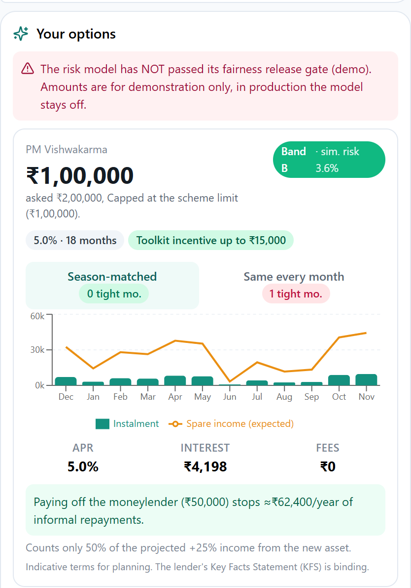




A loan sized to the seasons, not a fixed EMI
12 → 0
tight months for a dairy unit over a 36-month loan: same-every-month EMI vs a season-matched schedule with the same present value
Sized from disposable cash flow and risk policy, with only half of the projected uplift from the new asset
Key Facts Statement-style APR, interest and fees, shown before choosing
Refinances the moneylender: for Sunita, it stops about ₹62,400 a year of informal repayments
An honest "not now" with a path back, when a loan would strain the business
Notes:
A flat EMI ignores seasons; that is why small borrowers miss payments. Saakh keeps the present value the same but shifts instalments to busy months. The dairy example goes from 12 tight months to none.

Slide 7
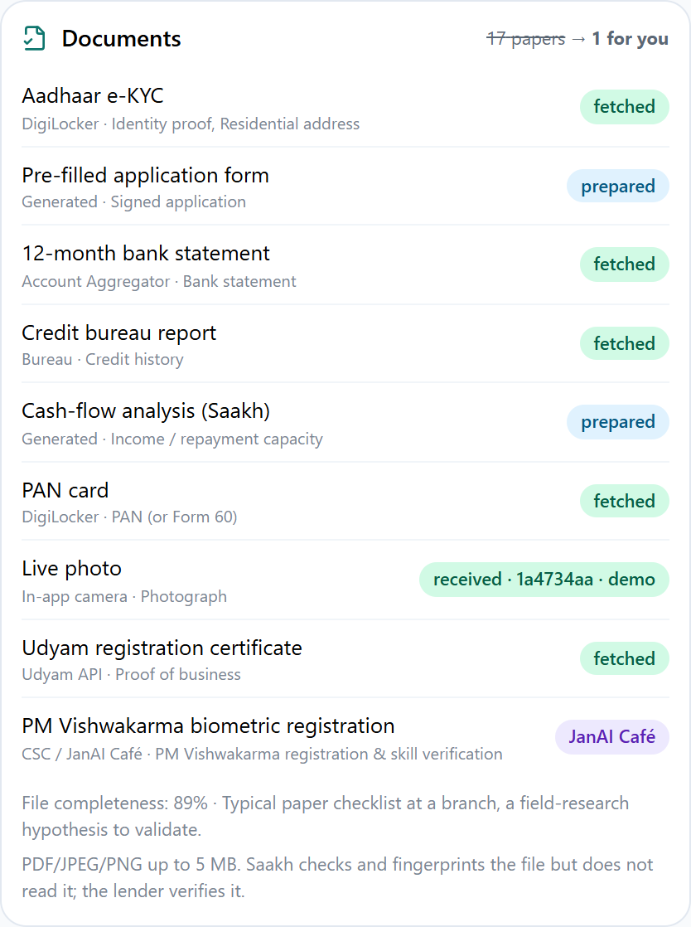
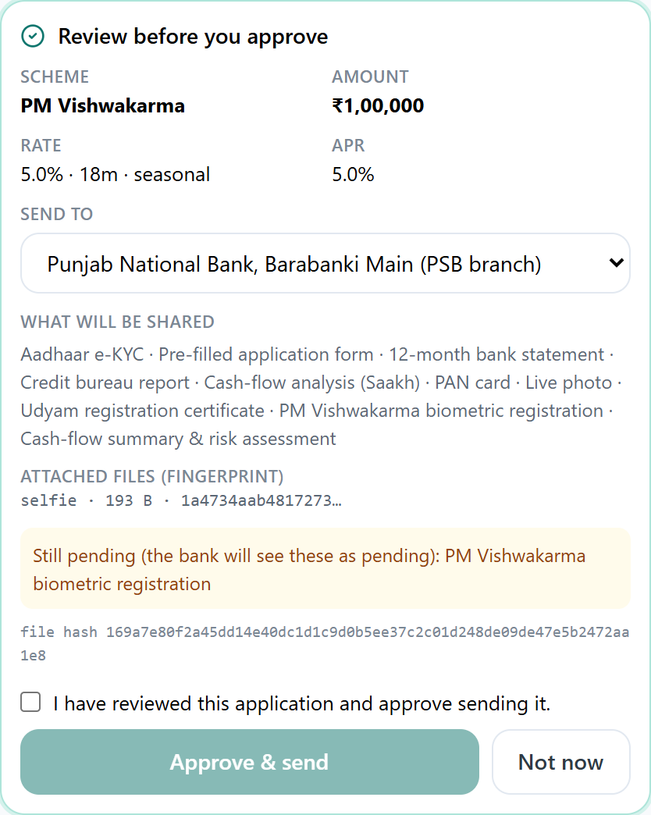
From 17 papers to 9 items, approved as an exact file
Minimum-effort set cover
Most items are fetched or generated: pre-filled form, cash-flow analysis, project report PDF. Physical steps go to a JanAI Café.
Bound to a fingerprint
Approval covers the SHA-256 of the file and of every attachment. Any change voids it; a sent copy is superseded until re-approved.
Revocable
Withdrawing consent withdraws the file and erases its contents from the bank's copy.
Notes:
The document planner solves a minimum-effort set cover over what lenders and schemes require. The approval screen lists exactly what is shared, with whom, at what APR, and what is still pending. Nothing is sent before the owner approves.

Slide 8
A real agent: plans, acts, recovers, and asks the human
Entrepreneur
Goal-driven planner
e-KYC (DigiLocker)*
Bank statement (AA)*
Phone, Hindi voice, offline queue; or a JanAI Café operator with the owner's one-time codes
Persistent case memory; re-plans after every event, so it resumes after a dropped network, a declined consent, a new fact or a lender query
Credit bureau*
Udyam*
Scheme rule engine
Cash-flow analytics
Code-level guard
Consent ✓ approval hash ✓ go-ahead ✓ before any tool runs
Scorecard and sizing
Document set cover
Bank branch
Sees only its own files; frozen, approved view; versioned decisions
Human checkpoints
Project report (DPR)
Lender LOS submit*
Every consent, outward action, offer choice and final approval
Recovery: the bank-data call times out by design; the agent retries with backoff, then falls back to a statement upload or a café visit. * simulated adapters. Eligibility, risk and amounts come from auditable engines, never from generated text.
Notes:
This is what makes it agentic rather than a chatbot: a goal, a plan that is re-derived after every event, tools behind a guard, recovery from failure, and humans at the consequential points. The language layer is deterministic and testable, so every decision is reproducible.

Slide 9





Trust is enforced in code, not promised
Purpose-bound consent
Revocation that deletes
Tamper-evident audit
ReBIT-style artefacts with expiry. Decline any one and the agent asks instead.
Withdrawing or expiry erases derived data, chat cards and the bank's copy, on a schedule.
A hash-chained log that stores no personal or financial values.
Exact-file approval
Lender isolation
Strict inputs
SHA-256 binds the file and attachments; café codes are one-time, per step, 10-minute.
Each branch sees only its files; decisions are versioned, final and idempotent.
Every event is type-checked; actions are accepted only at their checkpoint.
Notes:
The brief asks for consent, approval and data minimisation. Each is enforced in code and covered by automated tests, including concurrency cases such as a bank deciding while the owner revokes.

Slide 10
Fairer than the checklist, and honest when a gate fails
BLOCKED, by design
1 of 7 fairness gates fails (ST vs General, −7.3 pp on the test split; −1.85 pp on a fresh draw). The rule fails closed: production refuses score-based offers until the gap is explained.
Monotone, explainable points table; reason codes for every score
Gender, caste, religion and location are never inputs
AUC 0.736, calibration error 0.6%; a boosted-tree challenger gains nothing
Labels come from a synthetic generator: these numbers show the pipeline works, not real-world performance. Lender data is needed before any real use.
Notes:
On the synthetic population, cash-flow scoring reaches 76% of creditworthy borrowers against 6% for a document checklist, at a lower default rate, and is far fairer across gender and geography. One of seven fairness gates fails, so the model is marked blocked. We show that rather than hide it.

Slide 11
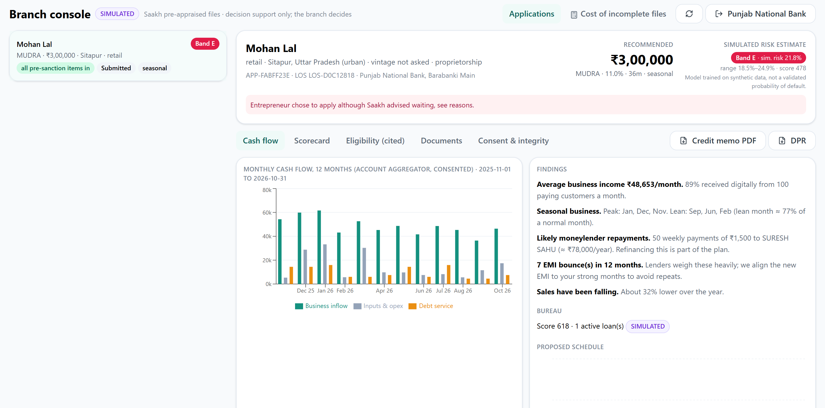
For the bank: a pre-appraised file it can trust
≈ ₹79,000
rework cost avoided per branch per month (about 105 officer-hours)
Credit memo and project report PDFs
Reason codes, cited eligibility, integrity proofs
Fingerprint-checked document downloads
Declines need the bank's own reasons
Rework estimate uses editable assumptions (60 files a month, 45% incomplete today vs 5%, 2.2 rework cycles of 1.6 hours, ₹750 per officer-hour) to be replaced with field measurements.
Notes:
For the branch manager, the value is a complete, consented file with a cash-flow assessment and proofs, instead of rework. The calculator in the app lets a bank put in its own numbers.

Slide 12



Free for the owner, paid for by those who save
Entrepreneur
Banks and NBFCs
DICs and scheme agencies
SHG federations, BCs, JanAI Cafés
Pays nothing
₹150 to 400 per complete file + success fee
Programme and outreach budgets
Assisted-service fee per journey
Removes the 10 to 15% agent cut and months of visits.
Rework alone costs about ₹1,300 per file today.
Cohort screening helps them meet PMEGP and PM Vishwakarma targets.
Screen 40 members in seconds; earn per completed file.
Near-zero marginal cost per file, so growth is bounded by distribution, not compute.
Notes:
The owner never pays. The bank pays because a complete, pre-appraised file is cheaper than rework, and the fee is priced below the measured rework cost. Agencies and federations pay for reach.

Slide 13

Large market, national rails, local jobs
Go to market
₹30 lakh cr
Jobs
1
Pilot: one bank branch and one SHG federation
MSME credit gap
Direct: café and business-correspondent operators paid per assisted journey; field verification for physical steps
Indirect, the real lever: every eligible-but-unreached unit that gets funded can hire. PMEGP alone reports about 87 lakh jobs from 10.7 lakh units since 2008-09
Source: Parliamentary Standing Committee on Industry, Mar 2026
7.6 cr
2
Regional rollout with that lender
MSMEs on Udyam
3
National: AA, ULI, DigiLocker rails and the CSC / JanAI Café network
99.3%
Scales without rewrites: a new scheme is a YAML file with citations; the scorecard refits per lender; more Indian languages plug into the same parser design.
of them micro
Notes:
The market is the credit gap itself. Distribution runs through lenders, federations and cafés. Jobs come from the operators who run assisted journeys and, above all, from micro units that can finally hire.

Slide 14
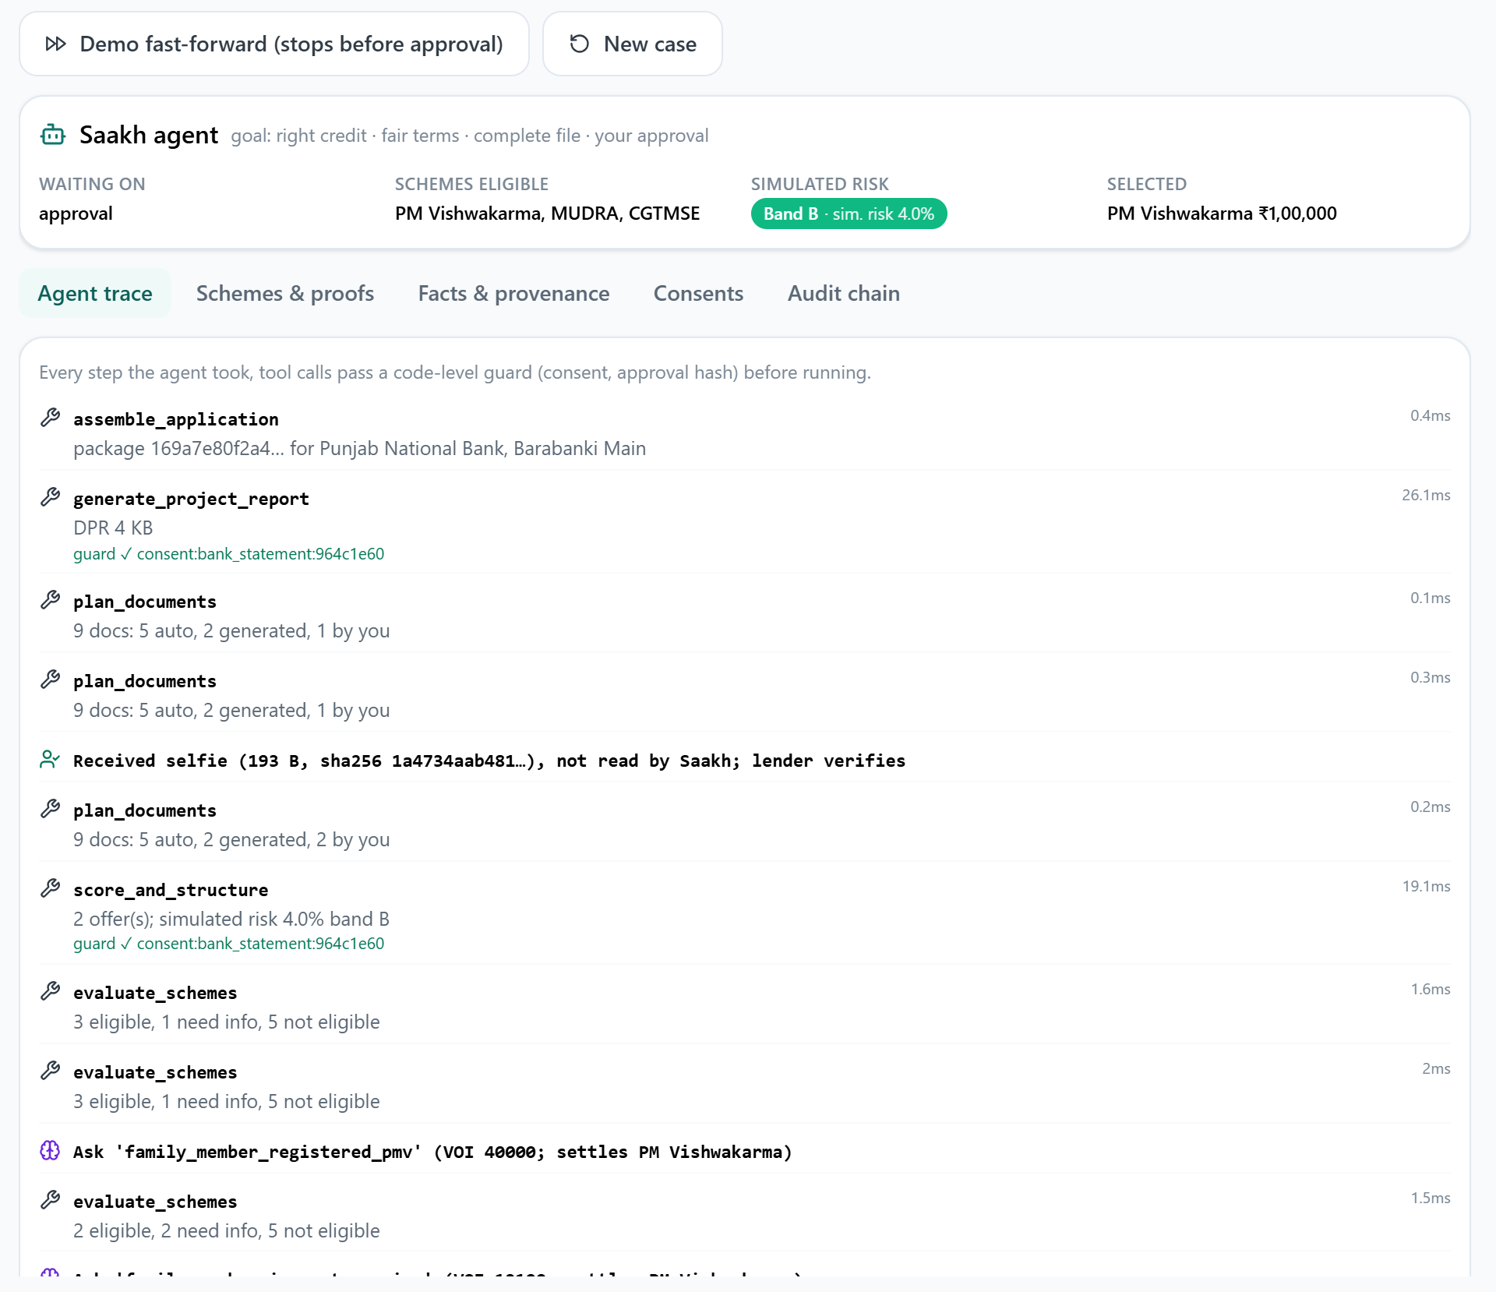
Working today, end to end
126
10
automated tests, including concurrency and consent-lifecycle cases
scheme pathways with cited official sources and verification levels
6
6
synthetic personas, Hindi and English, voice in and read-aloud out
rounds of independent code review; every finding and verdict published
Also in the prototype: offline queue, JanAI Café assisted mode, branch console, governance view, SHG federation screening. Stack: FastAPI, React PWA, SQLite, numpy/scipy scorecard. Integrations without open APIs are simulated and labelled.
Notes:
Everything shown runs today. The trace on the left is the agent's own log: each tool call, its guard check, the retry, and the questions it chose to ask.

Slide 15

What we will measure next
Next 30 days
Field research plan
Interviews and branch time study; refine questions and document weights
15 to 20 owners across six business types, 3 to 5 branch managers, 2 to 3 loan agents, one SHG federation or café
The organisers' six questions become hypotheses, each tied to a product decision it would change
Branch time-and-rework log per file, to replace our cost assumptions with measured numbers
Funnel and consent-decline rates measured by the product itself
By the finale
Pilot design with a branch and an SHG federation; measured rework numbers
2027
AA and ULI sandbox integration; scorecard refit on lender data with the same fairness gates; more languages
Notes:
We have not run interviews yet, and we say so. The plan turns each research question into a hypothesis that would change a specific product decision, and the product already measures most of them.

Slide 16


Saakh turns trust already earned into formal credit
Agentic
Trusted
Viable
Plans, uses guarded tools, recovers from failure, and stops for the human at every consequential step
Consent, cited proof, exact-file approval and revocation, all enforced in code and tested
Free for owners, paid by lenders who save on rework; scales on India's digital rails
Live demo: saakh.onrender.com
github.com/sumitmukherjee7/saakh
Team Soliloquy · Sumit Mukherjee (Team Lead), IIT Kharagpur
Notes:
Agentic, trusted and viable. The code, model card, business model and every cited source are in the repository. Thank you.

