Slide 1

Restaurant recommender system

Slide 2
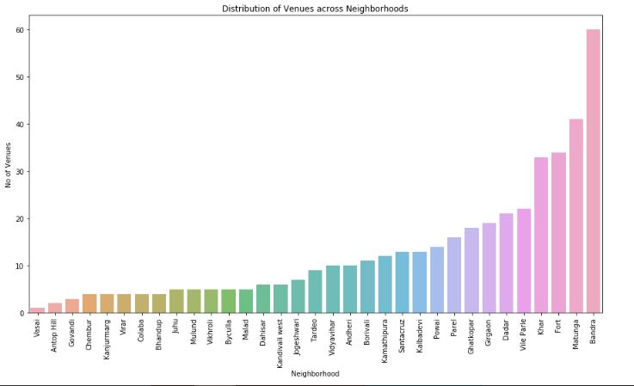
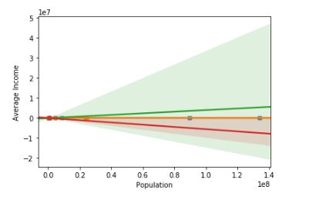
Methodology
Recommender System
Machine learning
Exploratory analysis
Inferential analysis

Slide 3
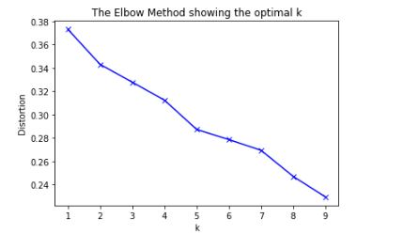

Slide 4
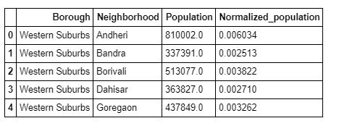
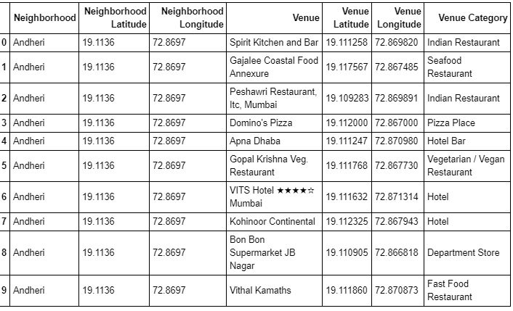

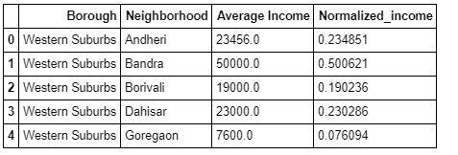
Datasets

Slide 5
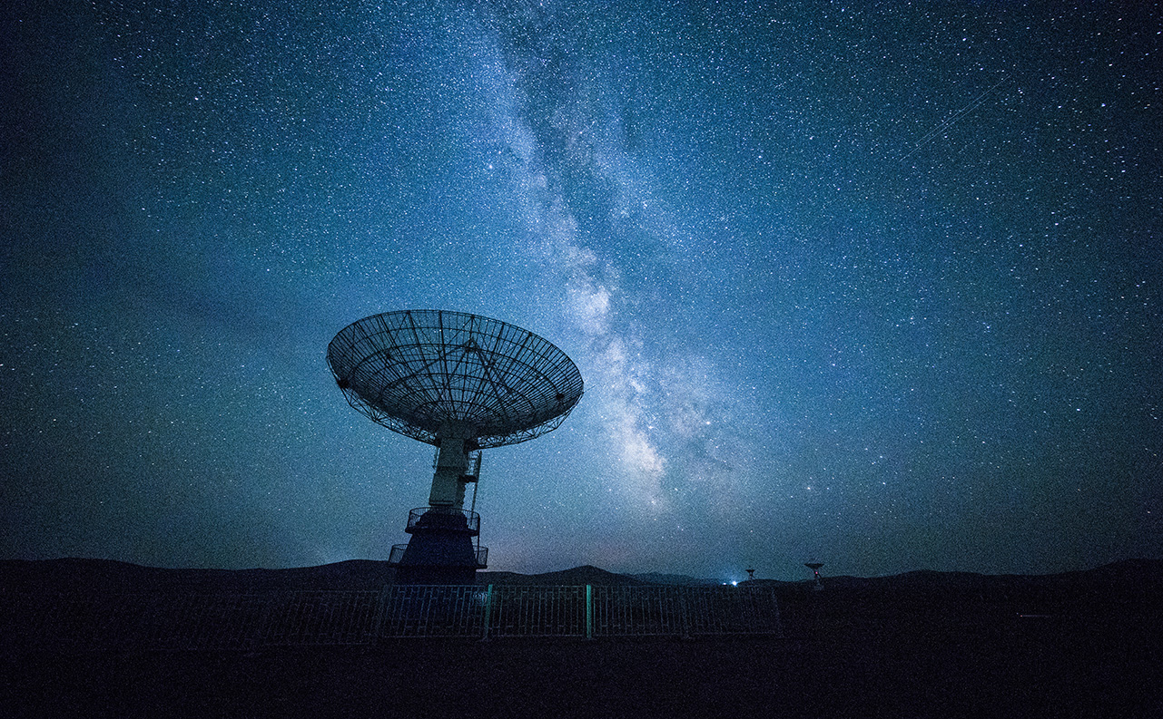
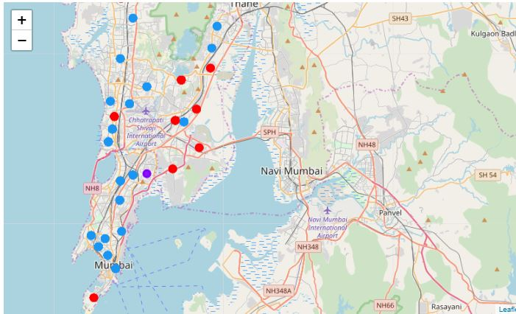
Clustering

Slide 6

Results and conclusion

Slide 7

Thank You!
Mukund.sumit@gmail.com

