Slide 1

Ramrao Adik Institute of Technology
Department of Computer Engineering
TE Project Mock 1 Presentation
On
“SportsMatrix”
By
22CE1283 Utkarsh Mishra
22CE1253 Sumit Nawde
22CE1233 Nalin Padalwar
22CE1280 Ronit Mohare
Guided by
Vishakha Gaikwad

Slide 2
Outline
Introduction
Literature Survey of the existing systems
Limitations of the existing systems
Problem statement
System Design
Technologies and methodologies
Conclusion
References
TE Mini Project Mock Presentation

Slide 3
Introduction
Importance of Player Performance Metrics:
In modern sports, analyzing player performance using data is crucial for gaining a competitive edge. Metrics like speed, dribbling, and passing accuracy are essential for evaluating a player’s contribution to the team.
Current Challenges:
Traditional evaluation methods are often subjective, leading to inconsistent assessments. There is a lack of accurate, real-time analysis tools for comparing player performances objectively.
Limitations of Existing Solutions:
Most existing systems focus on basic statistics and fail to provide comprehensive insights into advanced metrics like decision-making speed and overall impact on gameplay.
TE Mini Project Mock Presentation

Slide 4
Real-World Observations
Variability in Player Assessments:
Coaches and analysts frequently have differing views on player performance due to subjective observation methods.
Demand for Data-Driven Decision-Making:
Teams require accurate data to inform strategic decisions, from selecting players to in-game tactical adjustments.
Limitations of Current Technology:
Many systems do not incorporate advanced analytics, such as machine learning, which could provide more comprehensive insights into player effectiveness.
TE Mini Project Mock Presentation

Slide 5
Motivation
Learning from Professional Teams:
Top-tier teams use advanced analytics for strategic benefits. This project aims to make similar tools accessible to a broader range of sports teams.
Need for Objective Evaluation:
The inconsistency in assessing players’ contributions to team success highlighted the need for a reliable, data-driven approach.
Enhancing Player Development:
Detailed performance metrics enable coaches to create personalized training plans, ultimately boosting player growth and team performance.
TE Mini Project Mock Presentation

Slide 6
Objectives
Comprehensive Analysis Tool:
Build a system capable of tracking and analyzing key metrics like speed, dribbling, and passing accuracy.
Fair Player Comparison:
Facilitate unbiased comparisons of players, supporting teams in making informed, data-backed decisions.
Insightful Recommendations:
Generate valuable insights to help coaches and analysts refine strategies and enhance player performance.
TE Mini Project Mock Presentation

Slide 7
Literature Survey of the existing systems
Current player analysis systems include wearable tracking devices, video analytics, and statistical software. Popular solutions like Catapult, StatsBomb, and Opta provide basic metrics such as distance covered, speed, and pass accuracy. Bust this is not enough as:
Coaches and Analysts demand detailed, actionable insights for strategic decision-making.
Players seek personalized feedback to enhance performance and skill development.
Scouts and Recruiters require objective metrics for talent identification and player comparison
Existing solutions provide essential metrics but lack comprehensive contextual analysis. There is a growing need for affordable, advanced analytics tools that offer actionable insights for diverse user groups. The proposed project aims to bridge these gaps by integrating real-time tracking with advanced machine learning analytics.
TE Mini Project Mock Presentation

Slide 8
Limitations of existing systems
Existing player analysis tools, including wearable trackers and video analytics platforms, provide basic performance metrics but lack comprehensive insights. They predominantly focus on physical statistics such as speed, distance, and heart rate, overlooking cognitive aspects like decision-making and spatial awareness.
Current systems fail to capture contextual in-game scenarios, limiting strategic analysis, there is an inadequate use of machine learning models for predictive insights, such as injury prevention or tactical recommendations. High costs restrict usage to elite teams, leaving smaller clubs and academies underserved.
TE Mini Project Mock Presentation

Slide 9
Problem statement
Current systems are expensive and complex to understand
We want to develop a cost effective, advanced player analysis system that integrates real-time tracking with machine learning models. Gives accurate analysis of a player, i.e. current stats, key areas for development, development drills, diet. While also suggesting the best suitable position for a player to play in. A comprehensive system incorporating all playing style and tactics, which will be a coach’s handbook for team tracking and development.
TE Mini Project Mock Presentation

Slide 10
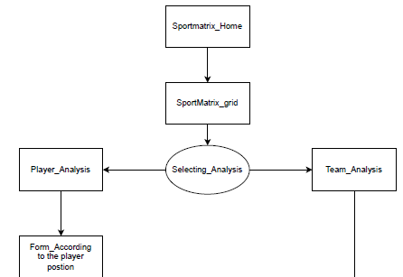
System Design
Sportsmatrix_home: The index page of the website
SportsMatrix_grid: Second page, utility is to show (tactical) playing 11’s positions to choose from.
Selecting _Analysis: Depends on the demand of the user, they can choose either of the two
Player_analysis
Team_analysis
Form: Here, the user selects the position of the player and enters the stats of the player
TE Mini Project Mock Presentation

Slide 11
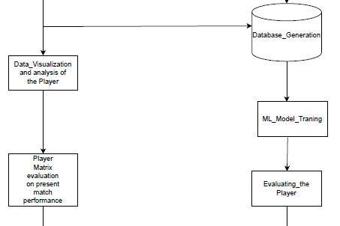
System Design
Database_generation: The data entered of the player is entered into the database.
Data_visualization: Here the analysis of player is done and shown to the User.
Player_match_performance: Here, the player’s performance in his last match is displayed with his previous performaces and predict future trends.
ML_model_training: The input data is used to train the ML model
Evaluating_player: Analysis of player stats
TE Mini Project Mock Presentation

Slide 12
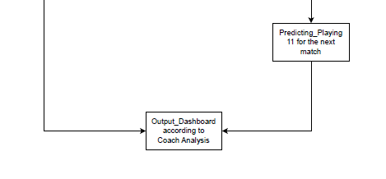
System Design
Predicting_starting_11: Based on past recorded playing trends, best team is suggested.
Output_dashboard: Last page, shows detailed information of player, their areas development and future in playing 11
TE Mini Project Mock Presentation

Slide 13
Technologies and methodologies
Flask (Python):Backend, to process and manage information.
HTML/CSS/JavaScript: Front-end web technologies used to develop this web interface and visualizations.
Chart.js: Creating dynamic charts.
Software Requirements:
Operating System: Windows 10, macOS, or any Linux distribution.
Python: Version 3.8 or higher for running the backend (Flask and ML models).
Flask: For building the web application.
Chart.js: For generating performance graphs.
Browser: Google Chrome, Firefox, or any modern browser to view the application.
Libraries:
Flask
Pandas (for data processing)
Chart.js (for visualization)
TE Mini Project Mock Presentation

Slide 14
Conclusion
Due to specific roles applying specifically to attackers, midfielders, and defenders, the SportMatrix project has been able to successfully provide an evidence-based tool for the analysis of football player performance. Customized feedback regarding areas the player needs to improve in real-time suggestions regarding their strengths and weaknesses will be offered. The outcomes of results are as follows: Position-Based Analysis: specifically aligned with the respective position of the player to obtain more relevant information Real-Time Feedback The real-time analysis of the performance of an interactive web interface. Other statistical highlights: scores, passes assist, tackles made and many more. This project helped to incorporate machine learning in the trend analysis process, which further provides critical hands-on experience in data processing and web development. In a general term, SportMatrix was effective for the athletes and trainers since it provided them with opportunities to read into performance indicators and pinpoint aspects in which they had to improve themselves.
TE Mini Project Mock Presentation

Slide 15
References
Håkon Maric Solberg, Mehdi Houshmand Sarkhoosh, Sushant Gautam, Saeed Shafiee Sabet, Pål Halvorsen, Cise Midoglu. **PlayerTV: Advanced Player Tracking and Identification for Automatic Soccer Highlight Clips, arXiv preprint arXiv:2407.16076, 2024.
Gurpreet Kaur, Harsh Maheshwari, Deepanjal Uppal, Aditya Prakash Rai. Advanced Football Analysis System Using Machine Learning and Computer Vision, International Research Journal of Modernization in Engineering Technology and Science (IRJMETS), Volume 6, Issue 11, Pages 64054, 2024.
Guillem Miralles. AI-Driven Soccer Formations Analysis: Exploring Player Data for Strategic Insights, Medium, 2023. [https://guillemmiralles1.medium.com/ai-driven-soccer-formations-analysis-exploring-player-data-for-strategic-insights-part-i-797b713a966c]
Data Overload. Challenges and Limitations of Sports Analytics: What We Still Don't Know, Medium, 2023. [https://medium.com/@data-overload/challenges-and-limitations-of-sports-analytics-what-we-still-dont-know-d6e1d34a445a]
Mixed Knuts. The Limitations of Player Analysis in Football, Mixed Knuts Blog, 2013. [https://mixedknuts.wordpress.com/2013/05/21/the-limitations-of-player-analysis-in-football/]
TE Mini Project Mock Presentation

Slide 16
Thank You

