Slide 1


Slide 2
base has three member variables: x, y and z which are public, protected and private member respectively.
publicDerived inherits variables x and y as public and protected. z is not inherited as it is a private member variable of base.
protectedDerived inherits variables x and y. Both variables become protected. z is not inherited If we derive a class derivedFromProtectedDerived from protectedDerived, variables x and y are also inherited to the derived class.
privateDerived inherits variables x and y. Both variables become private. z is not inherited If we derive a class derivedFromPrivateDerived from privateDerived, variables x and y are not inherited because they are private variables of privateDerived.

Slide 3
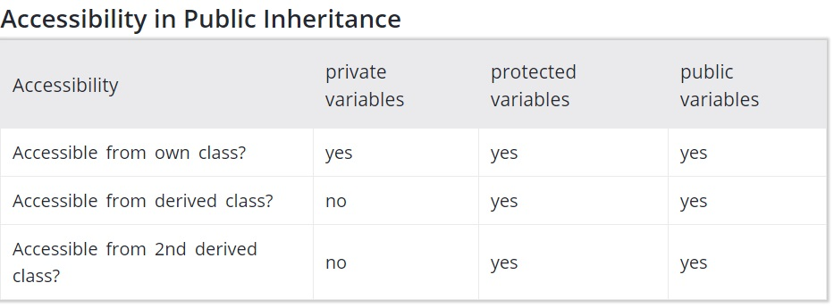

Slide 4
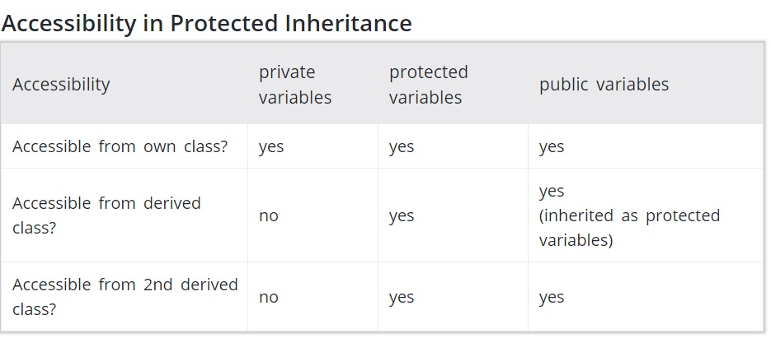

Slide 5
