Slide 1


Enhancing Leukemia Diagnosis through Machine Learning: A Customized ResNet50 Approach (Modigari Narendra & Sumit Negi )
InCACCT-2024: 2nd International Conference on Advancement in Computation & Computer Technologies
Sumit Negi
Post graduate student, VIT Chennai
Paper ID: 1808

Slide 2
Table of Content
Abstract
Introduction
Literature/ Related Work
Methodology/Proposed Work
Results
Conclusion
Future Scope*

Slide 3
Abstract
Abstract—Leukemia, a form of cancer affecting the blood and bone marrow, presents a significant challenge in healthcare due to its varied subtypes and complex classification process. This study addresses the need for accurate and efficient leukemia classification, with a specific focus on acute lymphoblastic leukemia (ALL), by proposing a comprehensive methodology integrating machine learning techniques. Through meticulous data preprocessing, including Otsu’s Thresholding for segmentation and feature extraction using the ResNet50 convolutional neural network (CNN), the study establishes a robust foundation for leukemia image analysis. With the Lazy Predict library, the research streamlines model selection, ultimately leading to the development of a customized ResNet50 CNN model. This model with additional layers for feature extraction and classification, demonstrates superior performance compared to traditional approaches, achieving an accuracy of 0.87 and a balanced accuracy of 0.83. Notably, the custom model exhibits faster inference times, indicating its potential for real-time leukemia diagnosis. By advancing computer-assisted leukemia diagnosis, this research contributes to improving healthcare outcomes and lays the groundwork for future applications of machine learning in leukemia management

Slide 4
Introduction
Research findings reveal that blood cancer ranks as the sixth leading cause of human mortality.
Leukemia, a form of blood cancer, can be successfully cured when detected and treated at an early stage.
In cases where there are discrepancies in the statistics, pathologists carefully examine a subset of infected cells to determine malignancy and leukemia subtype.
An innovative leukemia identification system utilizes input in the form of microscopic images of human blood cells, which are then subjected to processing and data extraction.
Image processing techniques are employed to handle microscope-captured samples, aiming for swift and precise disease diagnosis to inform effective strategies.
This system has a wide range of applications, including disease prevention, curative treatments, therapy optimization, and treatment evaluation.
The primary goal is to generate an indicator that can not only determine cell malignancy but also identify the specific type of leukemia.
Leukemia is categorized into four main types: acute myeloid leukemia, acute lymphocytic leukemia, chronic myeloid leukemia, and chronic lymphocytic leukemia.

Slide 5
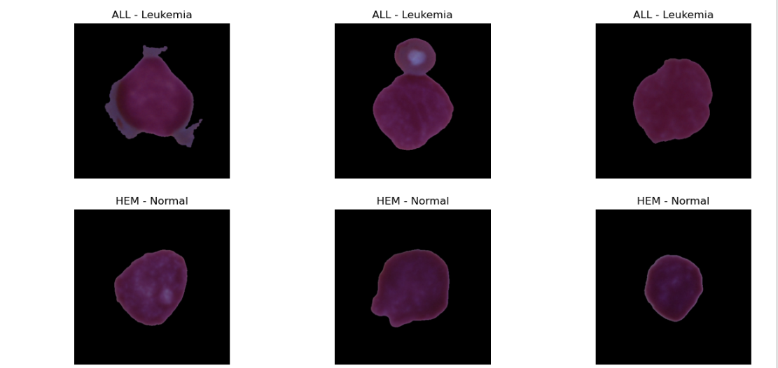
Introduction

Slide 6
Literature Review
Reference | Segmentation | Features | Classifier | Findings
P. K. Das, P. Jadoun, and S. Meher, ‘‘Detection and classification of acute lymphocytic leukemia,’’ in Proc. IEEE-HYDCON, Sep. 2020, pp. 1–5 | K-means | Color,shape texture, (GLCM) P.C.A | S.VM | Some potential disadvantages could include the need for high-quality images The proposed method yields promising results with 96.00% accuracy and 92.64% sensitivity. The presented CLAHE dynamically increases the contrast level of the image and also improves the image quality successfully.
P. P. Banik, R. Saha, and K.-D. Kim, ‘‘An automatic nucleus segmentation and CNN model based classification method of white blood cell,’’ Expert Syst. Appl., vol. 149, Jul. 2020, Art. no. 113211. | K-means | N/A | C.N.N | - Achieves state-of-the-art performance in accuracy, kappa index, ADC, and TPR for four public databases, but not in precision, recall, and specificity quality metrics. - Presents a generalized method for segmenting white blood cell nuclei and localizing them through statistical analysis on four public databases.
S. Mishra, B. Majhi, and P. K. Sa, ‘‘Texture feature based classification on microscopic blood smear for acute lymphoblastic leukemia detection,’’ Biomed. Signal Process. Control, vol. 47, pp. 303–311, Jan. 2019. | Triangle method of thresholding | DOST PCA-LDA | ADBRF | Utilizes DOST to extract texture features and reduces dimensionality via LDA and PCA. Uses relevant features for classification on an ADBRF classifier. Uses Y component of CMYK image and triangle thresholding for pre-processing input images. The proposed method yields superior accuracy (99.66%) as compared to existing schemes.

Slide 7
Refrence | Segmentation | Features | Classifier | Findings
G. Jothi, H. H. Inbarani, A. T. Azar, and K. R. Devi, ‘‘Rough set theory with Jaya optimization for acute lymphoblastic leukemia classification,’’ Neural Comput. Appl., vol. 31, no. 9, pp. 5175–5194, Sep. 2019. | B.S.A | Color,texture shape, Statistical Wavelet | Roughset | BSA-based clustering algorithm segments leukemia blast cells in an image. Various features (morphological, wavelet, color, texture, and statistical) are extracted from the segmented image. Hybrid TRS-based supervised algorithms reduce the dimension of the feature set. The Jaya algorithm is used to classify healthy and unhealthy acute lymphoblastic leukemia cells.
. Mishra, B. Majhi, and P. K. Sa, ‘‘GLRLM-based feature extraction for acute lymphoblastic leukemia (ALL) detection,’’ in Recent Findings in Intelligent Computing Techniques. Singapore: Springer, 2018, pp. 399–407 | Watershed algorithm | GLRLM | SVM | GLRL matrix extracts textural features for Acute Lymphoblastic Leukemia (ALL) classification Used with Support Vector Machine (SVM) for classification Accuracy of 96.97% Automatic system more reliable and computationally less expensive than manual operator identification GLRL-based feature extraction technique can be used for detecting other diseases
. R. Reena and P. M. Ameer, ‘‘Localization and recognition of leukocytes in peripheral blood: A deep learning approach,’’ Comput. Biol. Med., vol. 126, Nov. 2020, Art. no. 104034. | Deeplab v3+ | N/A | Alexnet | High accuracy in localizing and recognizing leukocytes (IoU: 0.85, accuracy: 96.5%) Pre-trained networks improved speed and accuracy Accurate classification of all 5 leukocyte categories Outperformed other detection systems (Faster R-CNN, YOLOv2) in average precision (@IoU = 0.5)

Slide 8
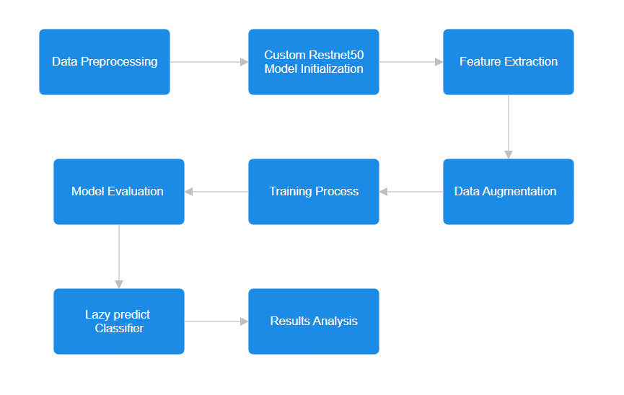
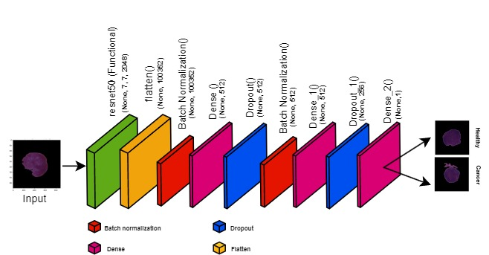
Methodology/Proposed Work

Slide 9
Methodology/Proposed Work
CNN Integration:
Utilize ResNet50 CNN for feature extraction from leukemia images.
Classifier Ensemble:
Employ LazyPredict library for simultaneous classification by multiple classifiers.
Custom Model Development:
Design a customized CNN model based on ResNet50 for enhanced performance.
Preprocessing Techniques:
Apply Otsu's Thresholding and data augmentation for improved segmentation and model generalization.
Efficiency Optimization:
Remove black areas in images to enhance model training efficiency.
Performance Evaluation:
Evaluate model performance using standard metrics and compare with traditional approaches.
Visualization and Validation:
Visualize preprocessed images and validate results for accuracy and reliability.

Slide 10
Results
Custom ResNet50 Model Performance:
Achieved an overall accuracy of 0.87 and a balanced accuracy of 0.83.
Outperformed traditional models, showcasing effectiveness in leukemia classification tasks.
Top Performing Classifiers:
AdaBoost Classifier and XGBoost Classifier both achieved an accuracy of 0.87 in the custom model.
Inference Time Comparison:
Custom model demonstrated faster inference times, with most classifiers completing tasks in less than 10 seconds.
Performance Metrics Comparison:

Slide 11
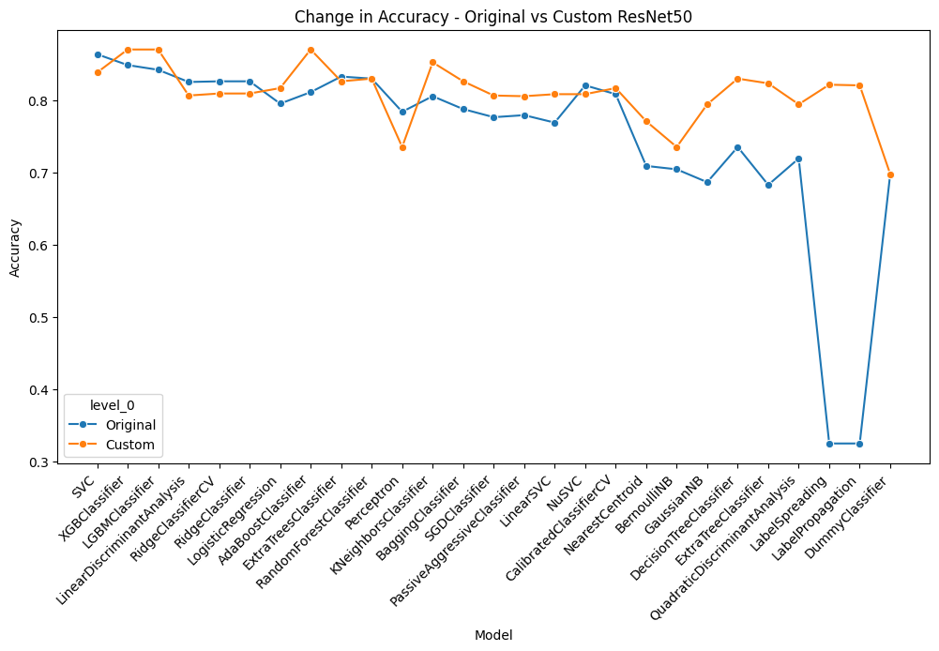
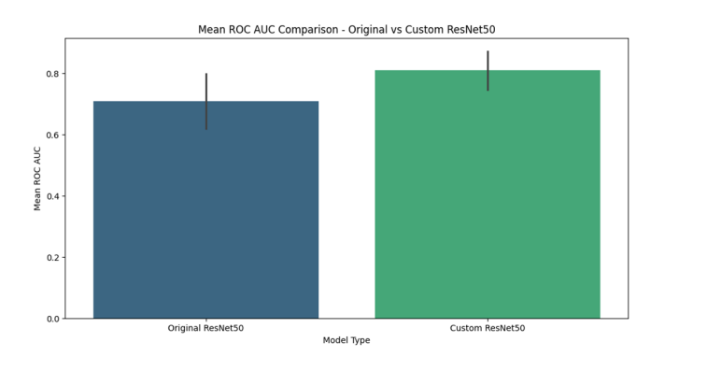
Results

Slide 12
Results
Model | Accuracy | Balanced Accuracy | ROC AUC | F1 Score | Time Take(s)
SVC | 0.86 | 0.80 | 0.80 | 0.86 | 91.80
XGBClassifier | 0.85 | 0.79 | 0.79 | 0.84 | 77.70
LGBMClassifier | 0.84 | 0.78 | 0.78 | 0.84 | 47.41
LinearDiscriminantAnalysis | 0.83 | 0.78 | 0.78 | 0.82 | 20.74
RidgeClassifierCV | 0.83 | 0.78 | 0.78 | 0.82 | 16.90
RidgeClassifier | 0.83 | 0.78 | 0.78 | 0.82 | 2.69
LogisticRegression | 0.80 | 0.76 | 0.76 | 0.80 | 3.43
AdaBoostClassifier | 0.81 | 0.76 | 0.76 | 0.81 | 133.90
ExtraTreesClassifier | 0.83 | 0.76 | 0.76 | 0.82 | 9.38
RandomForestClassifier | 0.83 | 0.76 | 0.76 | 0.82 | 44.31
Perceptron | 0.78 | 0.75 | 0.75 | 0.79 | 1.51
KNeighborsClassifier | 0.81 | 0.75 | 0.75 | 0.80 | 2.11
BaggingClassifier | 0.79 | 0.75 | 0.75 | 0.79 | 342.86
SGDClassifier | 0.78 | 0.74 | 0.74 | 0.78 | 6.47
PassiveAggressiveClassifier | 0.78 | 0.74 | 0.74 | 0.78 | 2.76
LinearSVC | 0.77 | 0.74 | 0.74 | 0.77 | 36.30
NuSVC | 0.82 | 0.73 | 0.73 | 0.81 | 117.89
CalibratedClassifierCV | 0.81 | 0.72 | 0.72 | 0.79 | 96.80
NearestCentroid | 0.71 | 0.71 | 0.71 | 0.72 | 1.08
BernoulliNB | 0.70 | 0.70 | 0.70 | 0.71 | 1.26
GaussianNB | 0.69 | 0.70 | 0.70 | 0.70 | 1.26
DecisionTreeClassifier | 0.74 | 0.70 | 0.70 | 0.74 | 44.96
ExtraTreeClassifier | 0.68 | 0.63 | 0.63 | 0.69 | 0.95
QuadraticDiscriminantAnalysis | 0.72 | 0.54 | 0.54 | 0.62 | 26.74
LabelSpreading | 0.33 | 0.52 | 0.52 | 0.19 | 11.81
LabelPropagation | 0.33 | 0.52 | 0.52 | 0.19 | 10.95
DummyClassifier | 0.70 | 0.50 | 0.50 | 0.57 | 0.81
Model | Accuracy | Balanced Accuracy | ROC AUC | F1 Score | Time Taken(s)
AdaBoostClassifier | 0.87 | 0.83 | 0.83 | 0.87 | 1.04
LabelSpreading | 0.82 | 0.83 | 0.83 | 0.83 | 9.09
SVC | 0.84 | 0.83 | 0.83 | 0.84 | 2.37
LabelPropagation | 0.82 | 0.83 | 0.83 | 0.83 | 6.39
CalibratedClassifierCV | 0.82 | 0.83 | 0.83 | 0.82 | 0.48
LogisticRegression | 0.82 | 0.83 | 0.83 | 0.82 | 0.09
SGDClassifier | 0.81 | 0.83 | 0.83 | 0.81 | 0.03
RidgeClassifierCV | 0.81 | 0.83 | 0.83 | 0.82 | 0.02
RidgeClassifier | 0.81 | 0.83 | 0.83 | 0.82 | 0.03
PassiveAggressiveClassifier | 0.81 | 0.83 | 0.83 | 0.81 | 0.06
LGBMClassifier | 0.87 | 0.83 | 0.83 | 0.87 | 0.14
LinearDiscriminantAnalysis | 0.81 | 0.83 | 0.83 | 0.81 | 0.08
NuSVC | 0.81 | 0.83 | 0.83 | 0.82 | 9.00
LinearSVC | 0.81 | 0.83 | 0.83 | 0.82 | 0.07
XGBClassifier | 0.87 | 0.82 | 0.82 | 0.87 | 0.09
GaussianNB | 0.79 | 0.82 | 0.82 | 0.80 | 0.04
QuadraticDiscriminantAnalysis | 0.79 | 0.82 | 0.82 | 0.80 | 0.06
KNeighborsClassifier | 0.85 | 0.82 | 0.82 | 0.85 | 0.19
DecisionTreeClassifier | 0.83 | 0.82 | 0.82 | 0.83 | 0.11
RandomForestClassifier | 0.83 | 0.81 | 0.81 | 0.83 | 2.48
NearestCentroid | 0.77 | 0.81 | 0.81 | 0.78 | 0.10
BaggingClassifier | 0.83 | 0.81 | 0.81 | 0.83 | 0.35
ExtraTreesClassifier | 0.83 | 0.81 | 0.81 | 0.83 | 1.87
ExtraTreeClassifier | 0.82 | 0.81 | 0.81 | 0.83 | 0.05
Perceptron | 0.74 | 0.79 | 0.79 | 0.75 | 0.09
BernoulliNB | 0.74 | 0.79 | 0.79 | 0.75 | 0.05
DummyClassifier | 0.70 | 0.50 | 0.50 | 0.57 | 0.03
. PERFORMANCE METRICS ON RESTNET 50 USING LAZY PREDICT
CUSTOMIZED RESNET50 MODEL PERFORMANCE METRICS

Slide 13
Conclusion
Custom ResNet50 model achieved high accuracy (0.87) and balanced accuracy (0.83).
Outperformed traditional models in leukemia classification.
Faster inference times make it suitable for real-time diagnosis.
Advances in healthcare outcomes through technology.
Sets the stage for future machine learning applications in leukemia management.
The study demonstrated the effectiveness of machine learning in leukemia classification.
Custom ResNet50 model showcased superior performance metrics.
Lazy Predict library streamlined model selection process.
Potential for real-time leukemia diagnosis enhances patient care.
Research contributes to the evolving field of computer-assisted leukemia diagnosis.

Slide 14
Future Scope
Explore ensemble learning techniques to further enhance classification accuracy.
Investigate the integration of deep learning models for more intricate feature extraction.
Implement real-time monitoring systems for continuous leukemia detection and tracking.
Collaborate with medical professionals to validate model outputs and optimize clinical utility.
Extend research to other types of cancer for comprehensive diagnostic solutions.

Slide 15
Guidelines
Presentation of paper in conference is mandatory. Without this paper will not be published on IEEE Xplore Digital Library
Author can present paper in any mode (either offline or online), as per choice provided by them.
Duration of Presentation (8-10 Minutes).
Number of Slides (7-12).
Table of content provided here is just a sample, author can change it as per their research work (if required).
Conference will be held on 02-03 May 2024.
Detailed schedule of presentation (along with Zoom Meeting Link) will be shared with authors between 27-28 April 2024.
Submit your PPT and Presenter Information by 25.04.2024. Drive link will be shared soon.
NO CHANGE IN TITLE AND LIST OF AUTHORS IS ALLOWED NOW.
WITHOUT PRESENTATION OF PAPER AND E-COPYRIGHT TRANSFER TO IEEE PAPER WILL NOT BE PUBLISHED IN IEEE.

