Slide 1


Slide 2
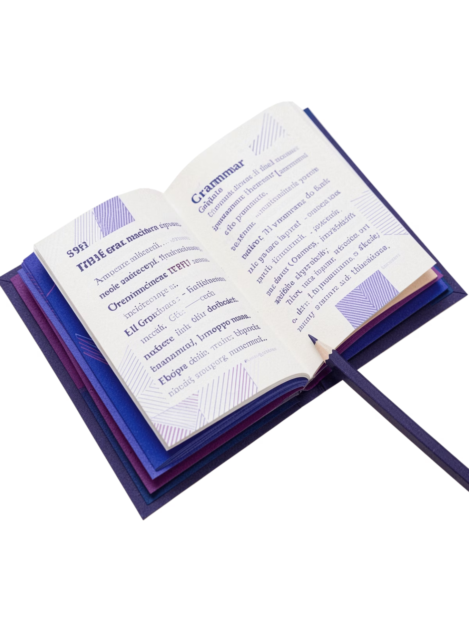
Understanding Pronouns: Your Essential Guide
A clear, visual walkthrough of one of grammar's most powerful tools — from basics to advanced types.

Slide 3
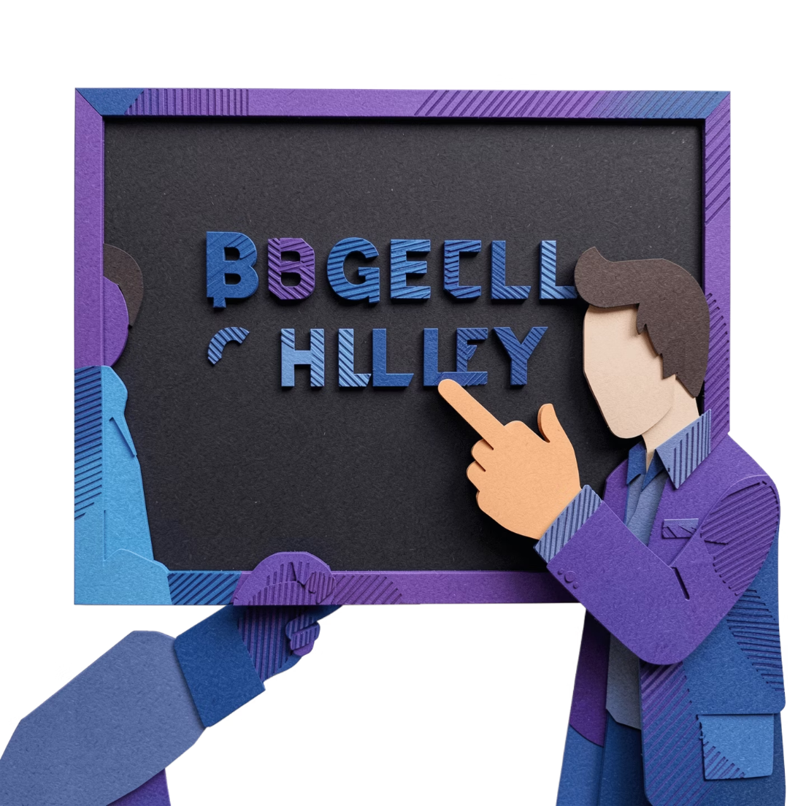


THE BASICS
What is a Pronoun?
A pronoun is a word that replaces a noun or another pronoun in a sentence. Rather than repeating a name or object over and over, pronouns step in to keep language natural and efficient.
Pronouns make sentences flow smoothly and reduce awkward repetition.

Slide 4
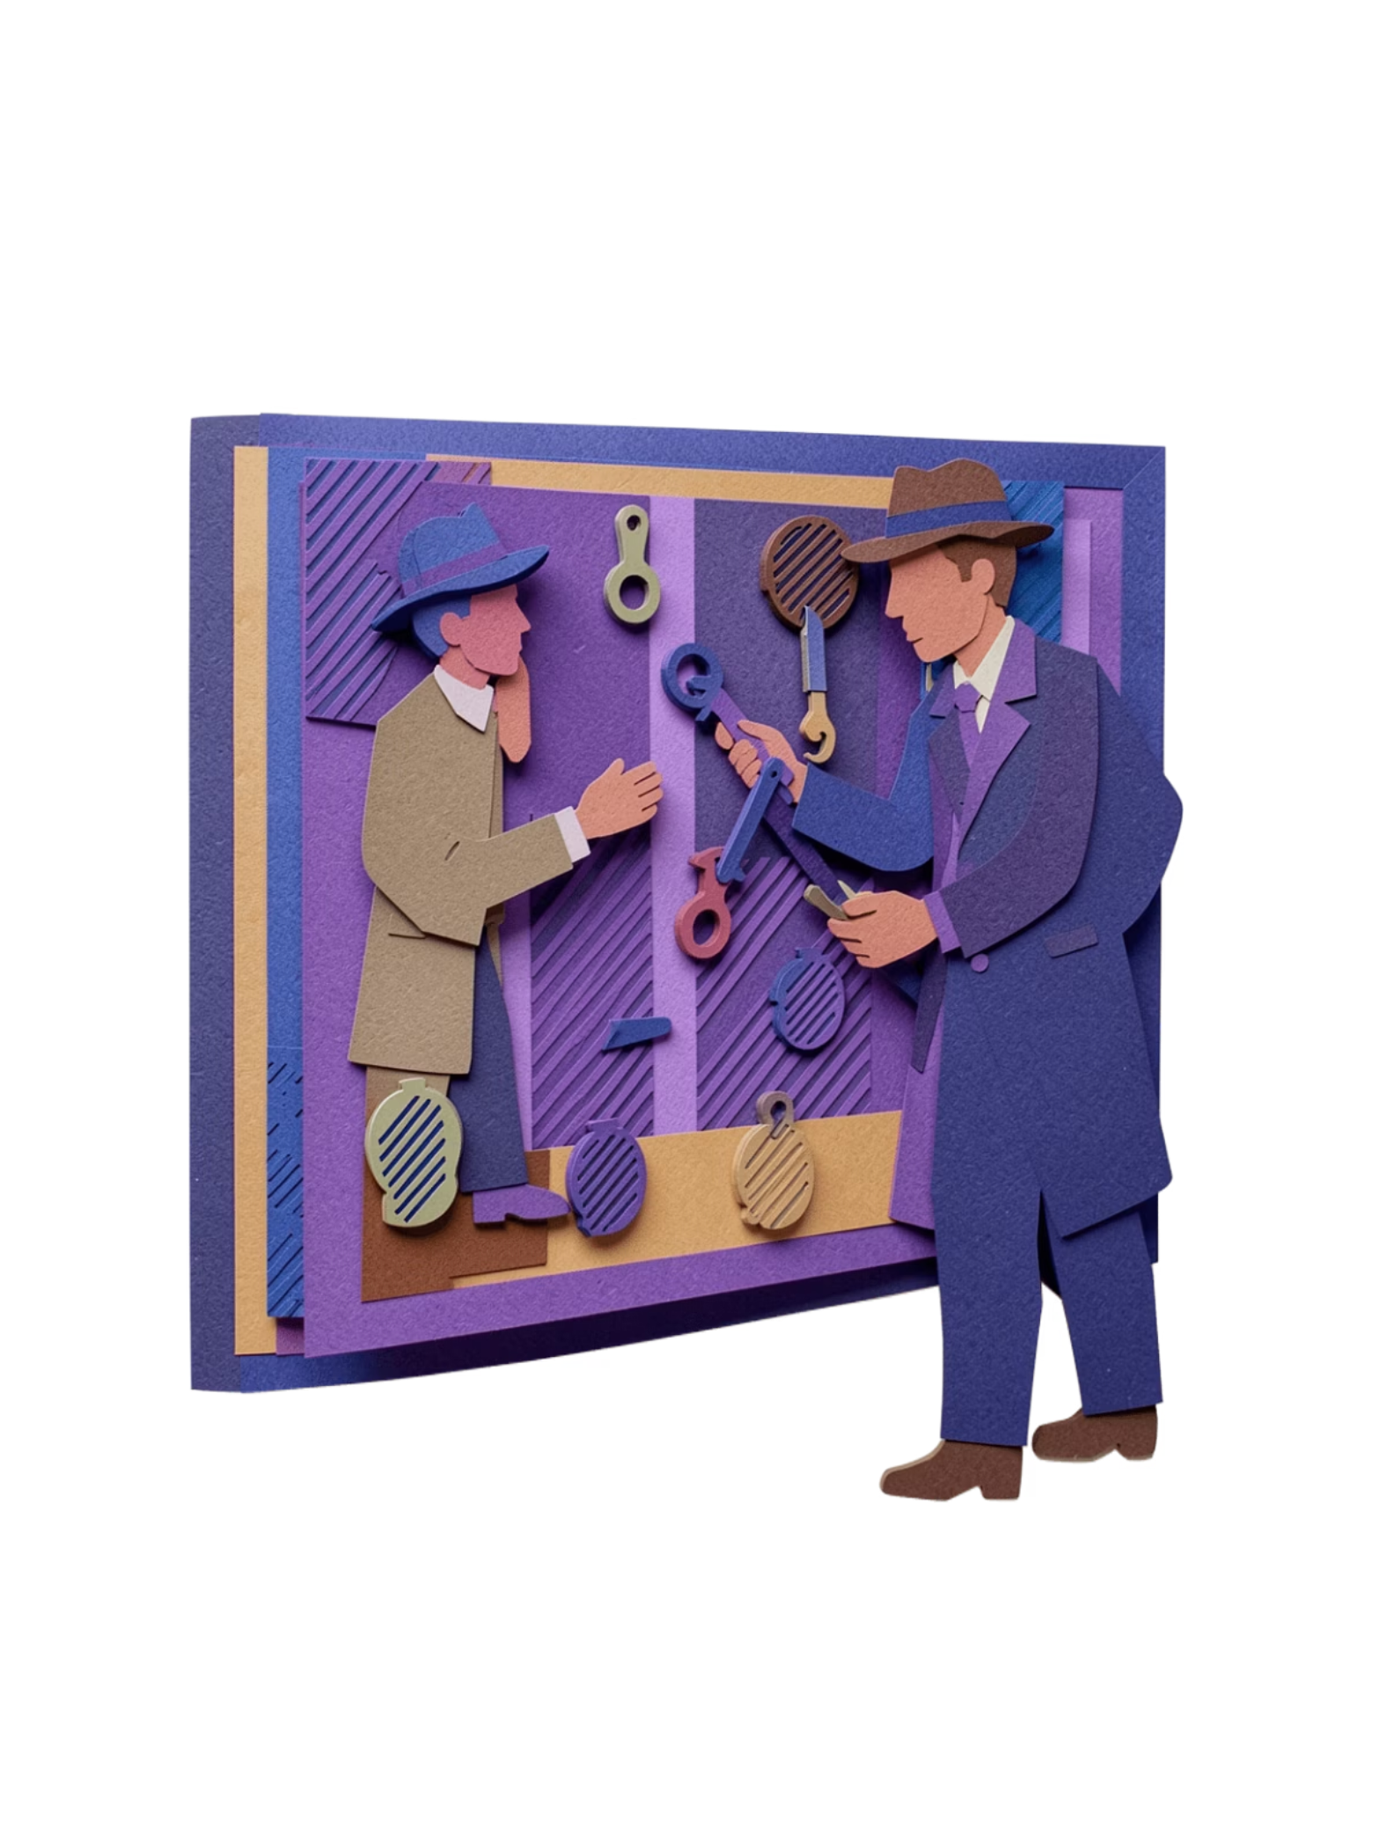
The Antecedent: Who's Who?
An antecedent is the specific word that a pronoun refers back to. Every pronoun needs a clear antecedent to avoid confusion.
The Antecedent
Ray said he wanted to audition. → Ray is the antecedent — the noun being replaced.
The Pronoun
Ray said he wanted to audition. → He is the pronoun standing in for Ray.

Slide 5
Why Use Pronouns?
Avoid Repetition
Improve Clarity
Pronouns are essential tools for clear, readable writing. They eliminate clunky repetition and help ideas connect seamlessly across sentences.
Replace repeated nouns with a concise pronoun substitute.
Pronouns link ideas between sentences, guiding the reader smoothly.
Instead of "Sarah loves Sarah's dog," we say "Sarah loves her dog."
Natural Flow
Speech and writing feel more natural when pronouns are used correctly.

Slide 6
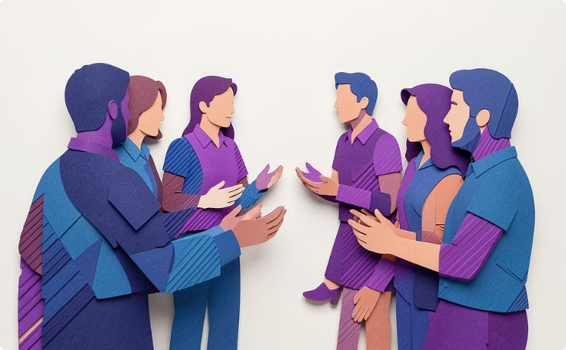
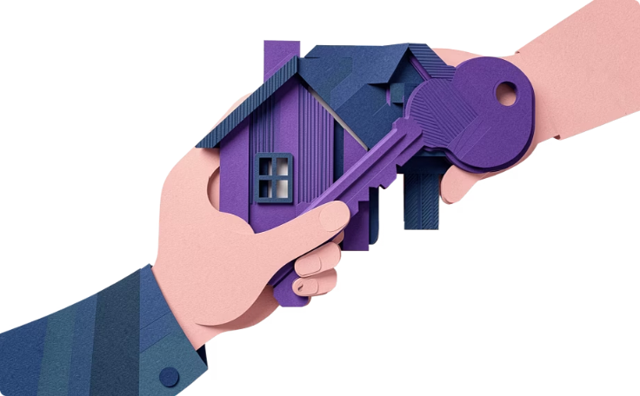
PRONOUN TYPES · PART 1
Personal & Possessive Pronouns
Personal Pronouns
Possessive Pronouns
Refer to specific people or things.
Show ownership or belonging.
First person: I, we
Second person: you
Third person: he, she, it, they
My, your, his, her
Its, our, their
Example: "That is her book."

Slide 7
PRONOUN TYPES · PART 2
Reflexive & Intensive Pronouns
Both types share the same words — but their roles in a sentence are very different.
Reflexive Pronouns
Intensive Pronouns
Reflect the action back onto the subject. They are essential to the sentence's meaning.
Add emphasis to a noun or pronoun. Remove them and the sentence still makes sense.
"She taught herself to code."
"The president himself signed the letter."
Forms: myself, yourself, himself, herself, itself, ourselves, yourselves, themselves
Same forms as reflexive — context determines the type.

Slide 8
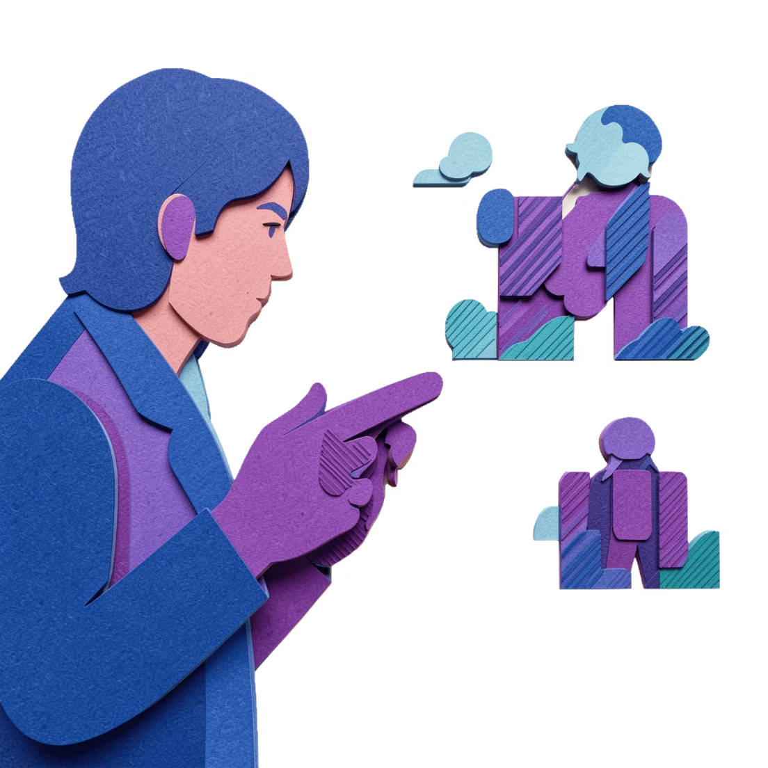
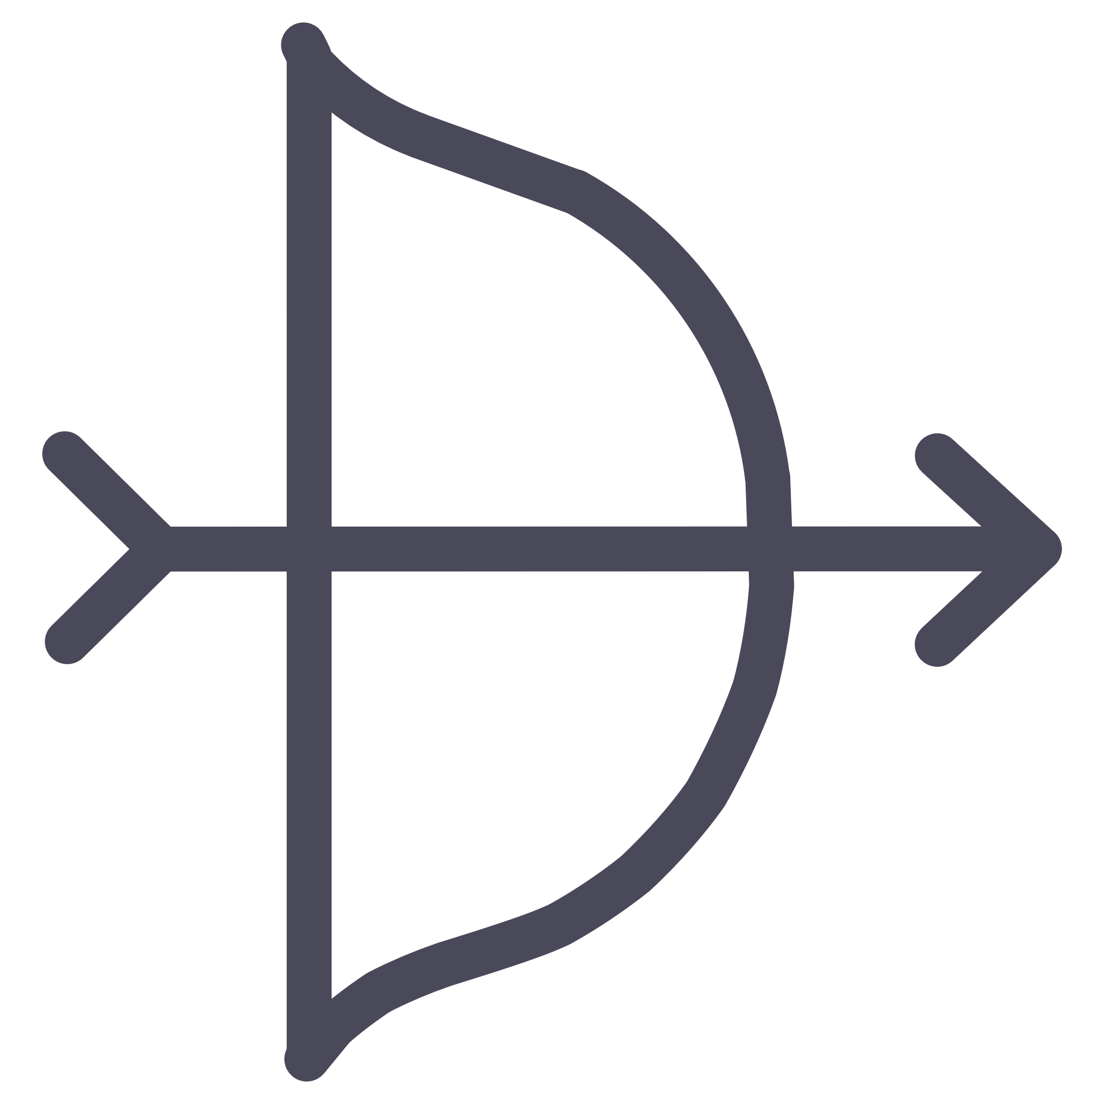

PRONOUN TYPES
Demonstrative Pronouns
Demonstrative pronouns point directly to specific nouns — either nearby or far away — without naming them outright.
Near: This / These
Far: That / Those
"This is my favorite book."
"Those are the ones I chose."

Slide 9
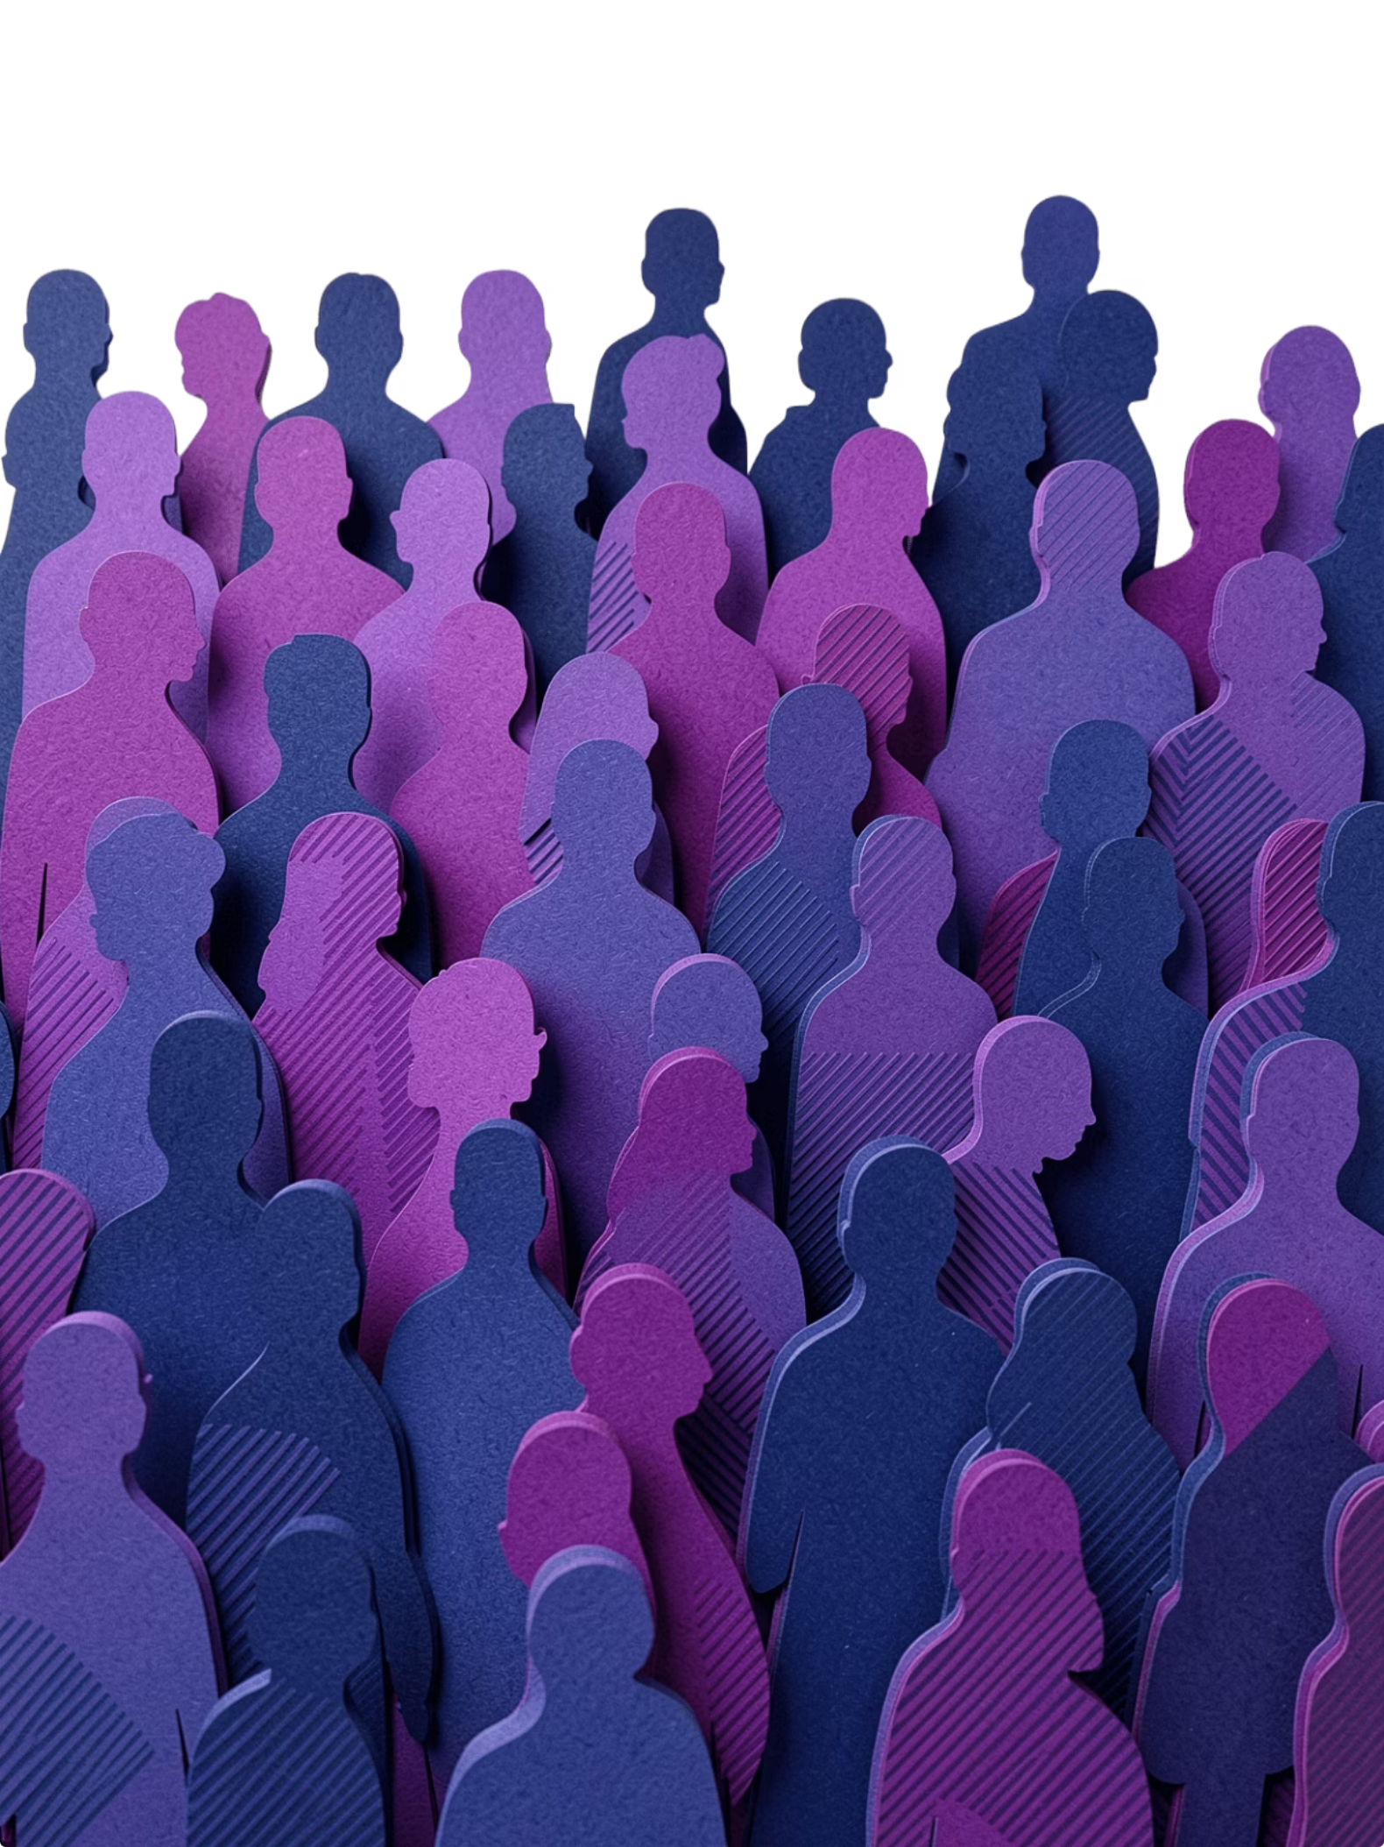




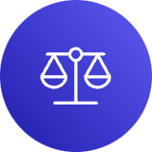


Indefinite Pronouns
Indefinite pronouns refer to non-specific people, places, or things. They are among the most commonly used pronouns in everyday speech.
Singular
Plural
someone, anyone, everybody, nobody, everything, nothing
few, many, both, several, others
Either/Or
all, some, any, none, most — can be singular or plural depending on context
Example: "Someone left their umbrella by the door."

Slide 10

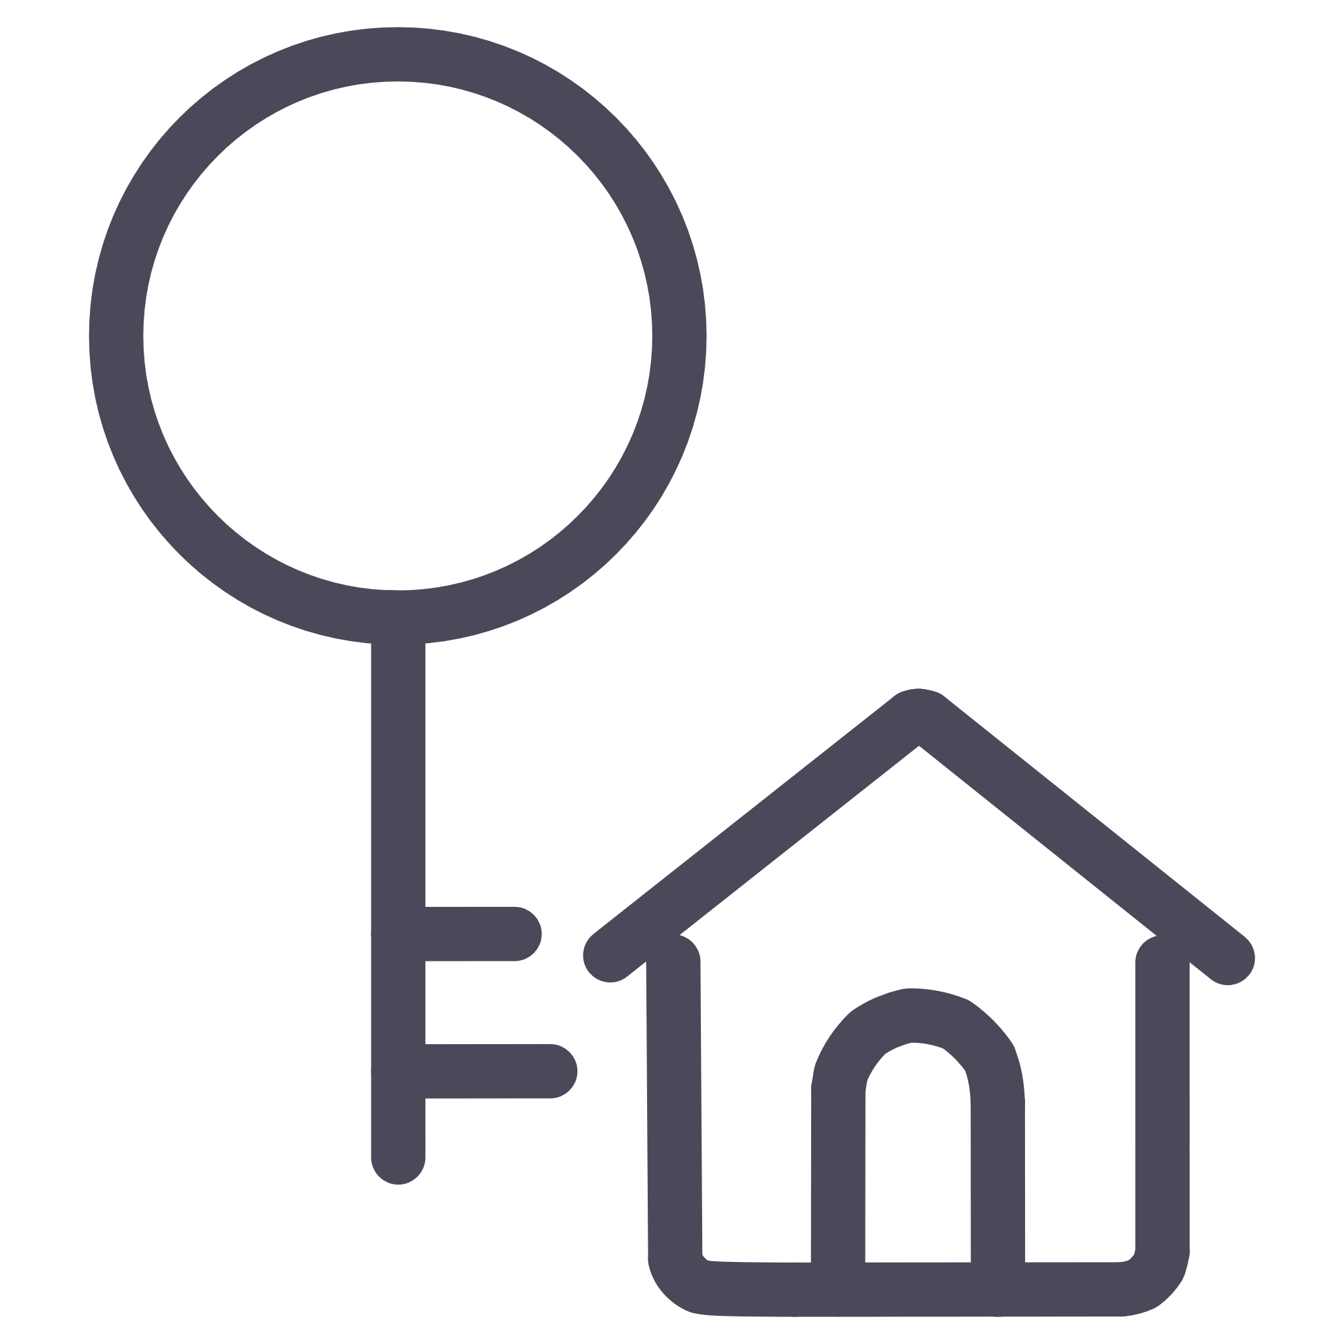
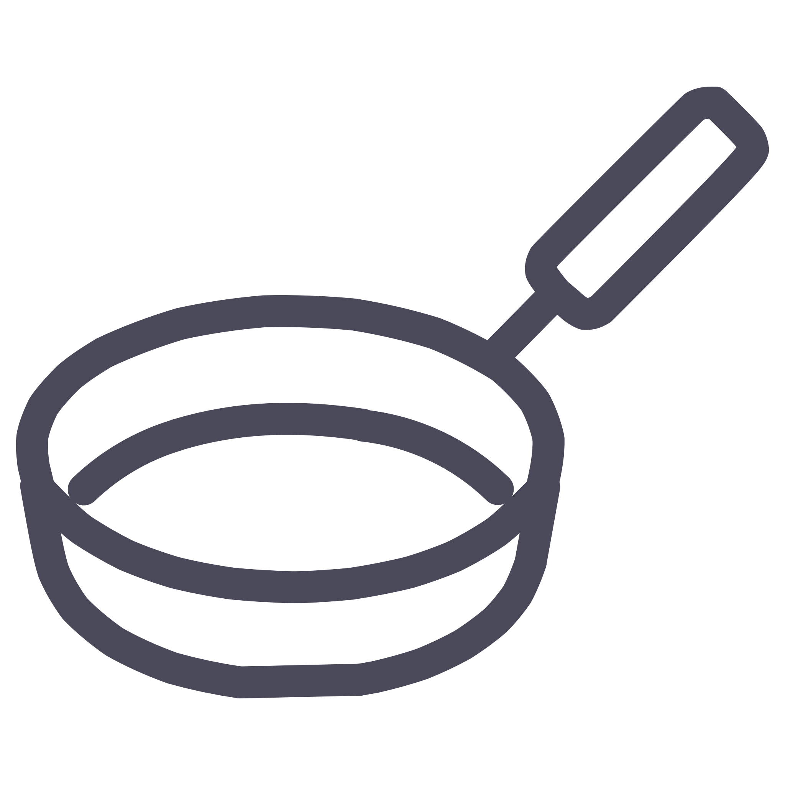
PRONOUN TYPES
Relative Pronouns
Who / Whom
Relative pronouns introduce dependent clauses that give more information about a noun. They connect two ideas into one flowing sentence.
Refers to people. "The teacher who inspired me."
"The book that I read last summer was amazing."
The clause "that I read last summer" modifies book — linked by the relative pronoun that.
Whose
Shows possession. "The student whose essay won."
Which / That
Refers to things. "The car which broke down."

Slide 11
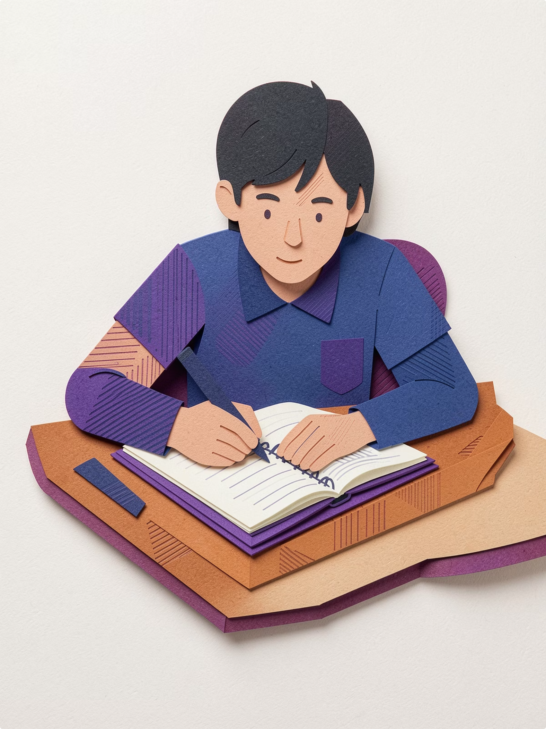

Practice Makes Perfect!
Understanding pronouns is the foundation of clear, confident communication. Now that you know the types, start noticing them everywhere.
Spot them while reading
Identify pronouns and trace them back to their antecedents in books, articles, or emails.
Use them intentionally in writing
Replace repeated nouns with the correct pronoun to keep your writing smooth and professional.
Review the types regularly
From personal to relative, each pronoun type plays a unique role — knowing all of them sharpens your grammar.

