Slide 1
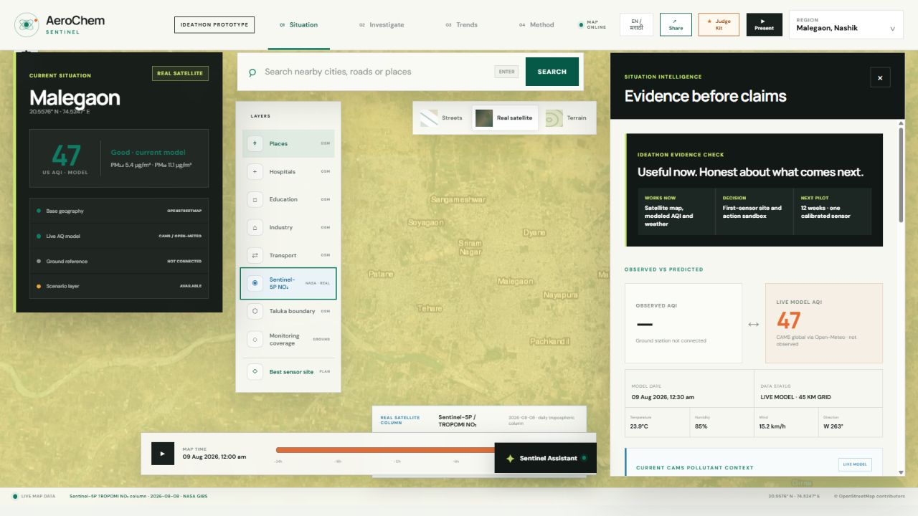
SAMARTHYA 2026 · IDEATHON PARTICIPANT
AeroChem
Sentinel
Regional atmospheric evidence, translated into a practical first monitoring decision.
MALEGAON · MAHARASHTRA
sumitpawar2006.github.io/aerochem-sentinel
AEROCHEM SENTINEL
01
Notes:
Khushi opens: Malegaon needs local pollution evidence. AeroChem Sentinel turns transparent regional model context into a first monitoring and intervention decision.
[Sources]
- https://sumitpawar2006.github.io/aerochem-sentinel/
- Dashboard screenshot refreshed 09 Aug 2026 from the working prototype.
[/Sources]

Slide 2
THE MONITORING GAP
Regional context is useful—but not local proof.
45 km
0
1
CAMS global grid used for current context
verified ground observations connected today
calibrated sensor proposed for the pilot
The prototype does not hide this gap. It makes the gap actionable.
Use the regional model for situational awareness, select the best first field site, then publish validation evidence before claiming ward-level accuracy.
AEROCHEM SENTINEL
02
Notes:
Vaishnavi explains: CAMS gives a 0.4-degree global atmospheric model, approximately 45 km. That is not a local sensor. Our scientific contribution is to preserve that distinction and define the validation path.
[Sources]
- https://open-meteo.com/en/docs/air-quality-api
- AeroChem Sentinel project data contract and Method panel.
[/Sources]

Slide 3
WORKING PROTOTYPE
A real Sentinel-5P layer anchors the live model context.
NASA GIBS NO₂ column · 08 Aug 2026 | CAMS US AQI 47 · 09 Aug 2026
NASA GIBS = atmospheric column · CAMS numbers = near-surface model · neither is a sensor reading
AEROCHEM SENTINEL
03
Notes:
Sumit enables the Sentinel-5P layer in the live site. Emphasize the labels: NASA GIBS supplies the dated atmospheric NO2 column, while the numeric HCHO, NO2 and AQI values remain CAMS near-surface model context. Neither is presented as a ground-sensor reading.
[Sources]
- https://open-meteo.com/en/docs/air-quality-api
- https://gibs.earthdata.nasa.gov/layer-metadata/v1.0/TROPOMI_L2_Nitrogen_Dioxide_Tropospheric_Column.json
- Dashboard snapshot refreshed 09 Aug 2026 at Malegaon coordinates.
[/Sources]

Slide 4
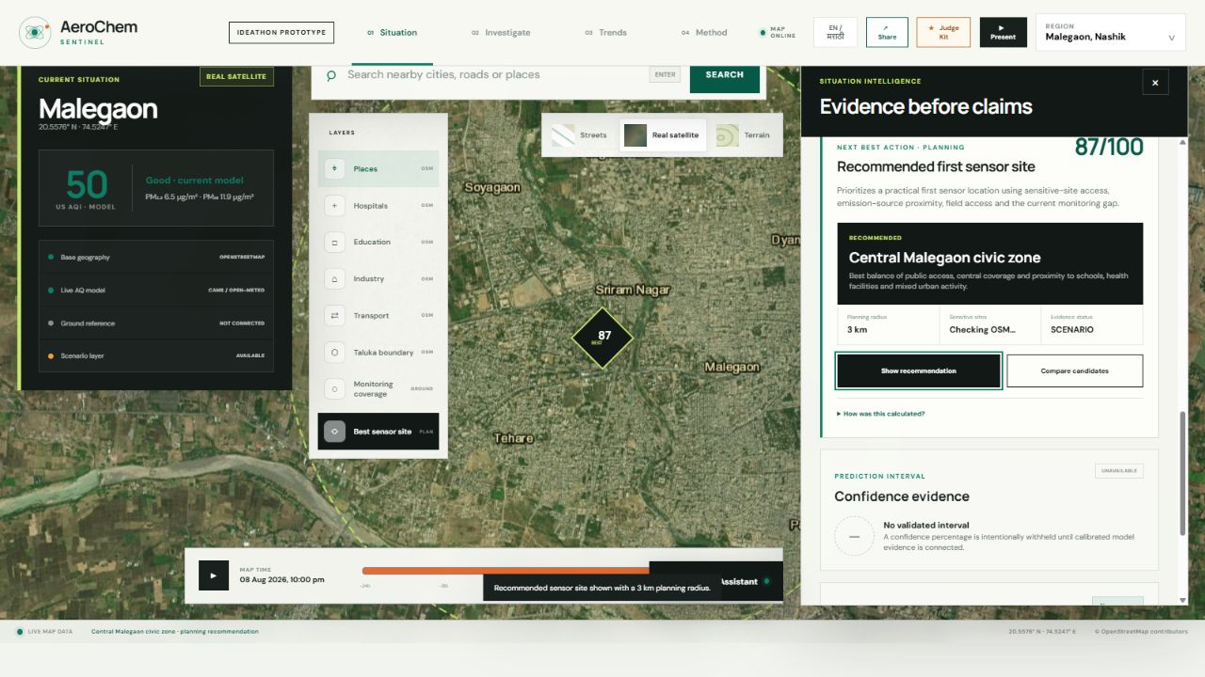
FIRST DECISION
Start where one sensor creates the most learning.
87/100
Central Malegaon civic zone
3 km planning radius
54 mapped sensitive sites
4 candidates compared
Transparent planning heuristic—not measured pollution proof.
AEROCHEM SENTINEL
04
Notes:
Sumit shows the recommended site. State exactly how to trust it: the weights, candidates and 3 km planning radius are visible. Field verification and permission checks happen in weeks 1 and 2.
[Sources]
- AeroChem Sentinel data/decision-model.json
- https://www.openstreetmap.org/copyright
[/Sources]

Slide 5
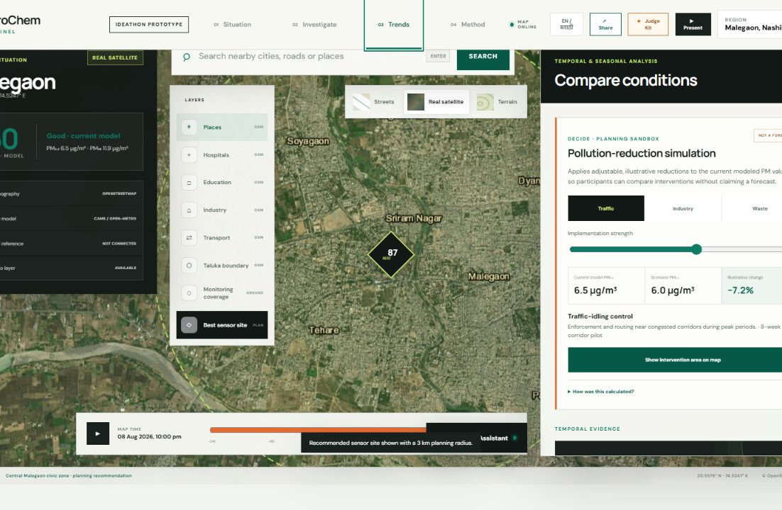
ACTION + FEASIBILITY
Test one action—then validate it in the field.
12 weeks
from site verification to public review
₹1.86 lakh
editable year-one planning assumption
Calibrate → compare → publish MAE / RMSE / R² → review one ward intervention
Simulation percentages are illustrative, not forecasts.
AEROCHEM SENTINEL
05
Notes:
Khushi presents feasibility. The intervention tool is an assumption sandbox, not a forecast. The pilot is designed to replace blank validation fields with published evidence.
[Sources]
- AeroChem Sentinel data/decision-model.json
- AeroChem Sentinel Method and Trends panels.
[/Sources]

Slide 6
THE ASK
Approve a 12-week
validation pilot.
01
Install and co-locate one calibrated sensor.
02
Publish time-aware validation metrics and uncertainty.
03
Give schools, clinics and civic teams a five-minute brief.
Khushi · Domain & problem | Vaishnavi · ML & data | Sumit · Dashboard & integration
LIVE DEMO → sumitpawar2006.github.io/aerochem-sentinel
AEROCHEM SENTINEL
06
Notes:
Sumit closes with the ask. Do not end with a feature list. Ask for the pilot that converts regional context into local validation and community communication.
[Sources]
- AeroChem Sentinel Complete Project Manual
- AeroChem Sentinel Samarthya 2026 project deck
- https://sumitpawar2006.github.io/aerochem-sentinel/
[/Sources]

