Slide 1
Pandas Hack
Team :- Kungfu Pandas

Slide 2

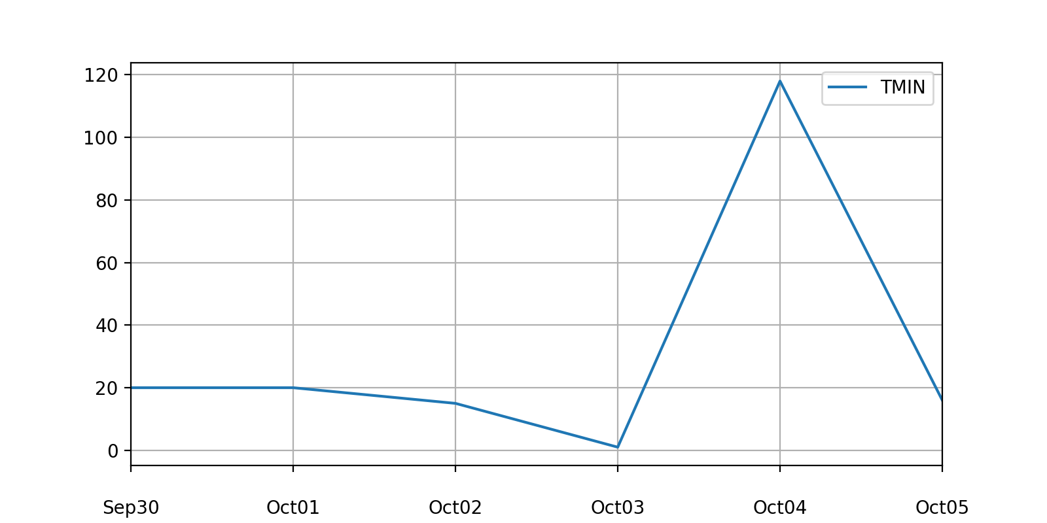
#ISSUE:- 24784 Locators off by one day
d = { '2017-10-01': 20, '2017-10-02': 20, '2017-10-03': 15, '2017-10-04': 1, '2017-10-05': 118,
'2017-10-06': 16, } df.plot(x='DATE', y='TMIN’, kind='line', ax=ax)

Slide 3
RESOLUTION.
Introduced Hack to

Slide 4
#ISSUE:- 24784 ResOLVED.
d = { '2017-10-01': 20, '2017-10-02': 20, '2017-10-03': 15, '2017-10-04': 1, '2017-10-05': 118,
'2017-10-06': 16, } df.plot(x='DATE', y='TMIN’, kind='line', ax=ax)

