Slide 1
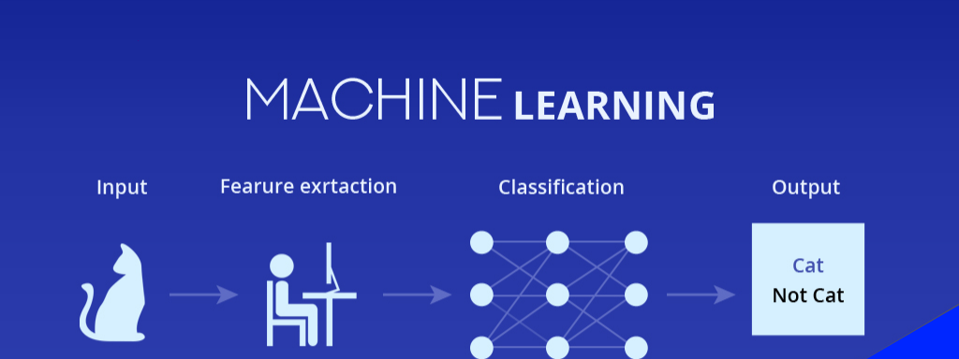
Machine Learning
Week 2

Slide 2
Agenda
Classification
Logistics classification
KNN
Naïve Bayes
Clustering
K means

Slide 3
Agenda
SVM
Regression
Classification
Image Processing
OpenCV

Slide 4
Projects
Face Detection
Face Recognition
Color Marker Detection
Facial Expression Detection
Biometric Attendance System (Homework)
Notes:
Is face Recognition is classification?

Slide 5
Classification

Slide 6
Classification
Unlike regression where you predict a continuous real number, you can use classification to predict a category.

Slide 7
Examples
Email: Spam / Not Spam
Will Customer buy your product (Yes / No)?
Which Party a person is going to vote for (2024)?
Modi (BJP)
Me
Others
Notes:
One can not live without google.
Gmail email spam
Product - Life insurance

Slide 8
Binary Classification
Ex – Unknown Ecommerce product
If x >= 0.5, predict y = 1
If x < 0.5, predict y = 0
Decision Boundary
Yes
Buy
No
Age

Slide 9
Logistic Regression (classification not regression)

Slide 10
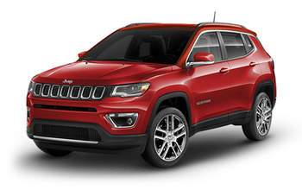
Problem Statement
Will customer purchase SUV Car or not?

Slide 11
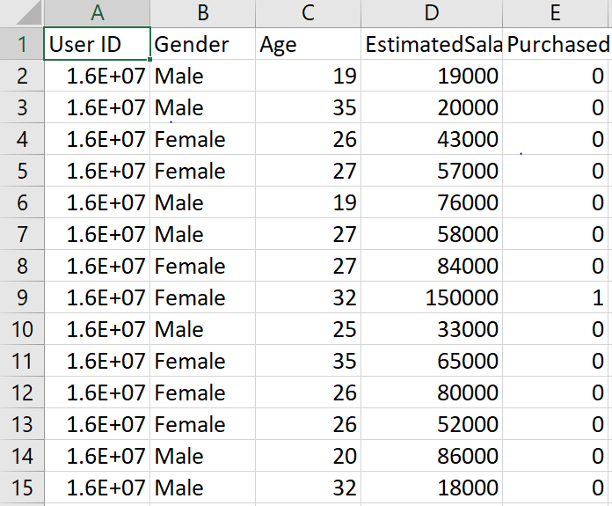
Dataset
We are going to take two features
Age
Salary

Slide 12
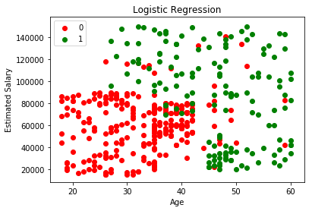
Dataset

Slide 13

Vector - Vector Multiplication
1. Transpose
b = ${\left[\begin{matrix}2 \\ 4 \\ 3\end{matrix}\right]}^{T}$= $\left[\begin{matrix}2 & 4 & 3\end{matrix}\right]$
2. $b^{T}x$
$\left[\begin{matrix}b_{0} & b_{1} & b_{2}\end{matrix}\right] ∗\left[\begin{matrix}x_{0} \\ x_{1} \\ x_{2}\end{matrix}\right]$ = $b_{0}$ $x_{0}$ + $b_{1}$ $x_{1}$ + $b_{0}$ $x_{2}$
${and x}_{0}$ = 1

Slide 14
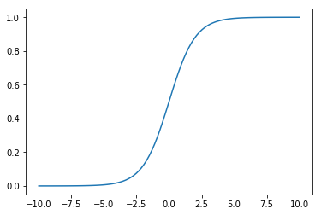

Sigmoid or Logistic Function
${z= b}_{0}$+ $b_{1}$ *$Age$ + $b_{2}∗salary$
$$z =g\left(b^{T}x\right)$$
$$y^{p}=\frac{1}{1+ⅇ^{−z}}$$
0 <= $y^{p}$<= 1
$x$ – inputs or features
$b^{}$ - weights of features or coefficients

Slide 15
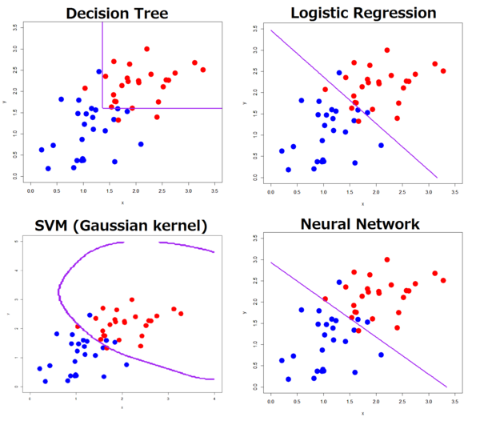
Decision Boundary
A decision boundary or decision surface is a hypersurface that partitions the underlying vector space into two sets, one for each class.

Slide 16
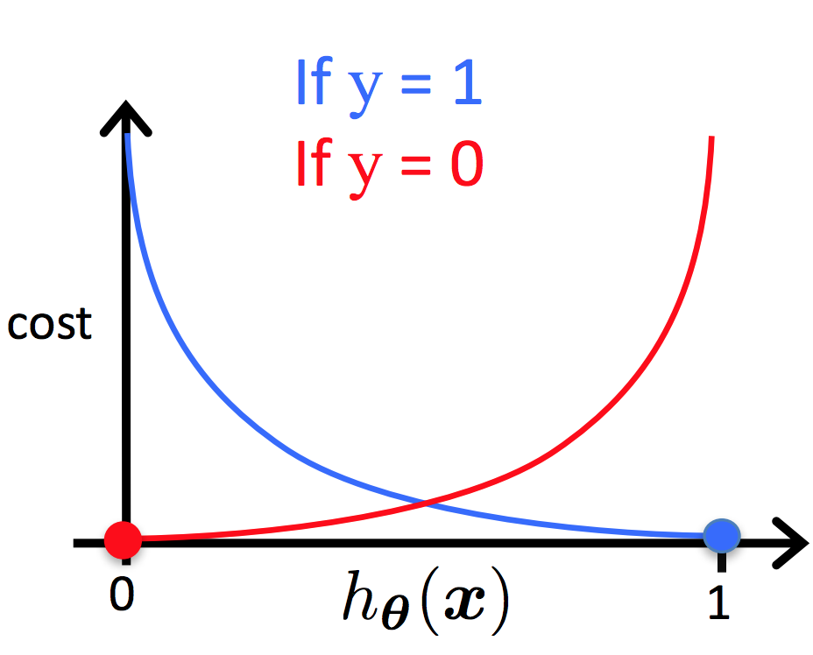

Cost Function
$E_{(y^{p}, y)}$ = $\left\{\begin{matrix}−\log\left(y^{p}\right) if y=1 \\ −\log\left(1 −y^{p}\right)if y=0\end{matrix}\right\}$
$y^{p}$ - probability of y (0 <= y <= 1)
y – binary value of y
$C_{(y^{p}, y)}$ = $−\frac{1}{m}Σ\left[y∗\log\left(y^{p}\right)+\left(1 −y\right)∗\log\left(1 −y^{p}\right)\right]$

Slide 17

Gradient Descent – Learning Algorithm
Gradient descent is a first-order iterative optimization algorithm for finding the minimum of a function.
$$b_{j}=b_{j}−α \frac{∂}{∂b}c_{\left(b_{0},b_{1},b_{2},.. bη\right)}$$

Slide 18
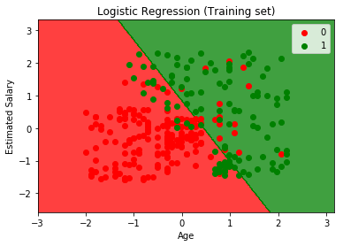
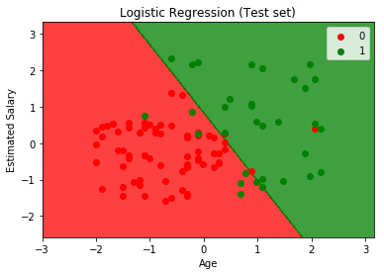
Result

Slide 19
KNN (K-Nearest NeighborS)

Slide 20
Problem Statement
Will customer purchase SUV Car or not?

Slide 21
Dataset
We are going to take two features
Age
Salary

Slide 22
Dataset

Slide 23
KNN
Y
X

Slide 24
How it works?
STEP 1 – Choose the number K of neighbors
STEP 2 – Take the K nearest neighbors of the new data points, according to the Euclidean distance
STEP 3 – Among these K neighbors, count the number of data point in each category
STEP 5 -Model is ready
STEP 4 – Assign the new data point to the category where you counted the most neighbors

Slide 25
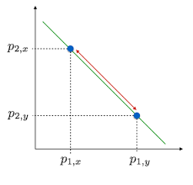

Euclidean distance
Euclidean Distance between P1 and P2 =
$$D\left(p_{1},p_{2}\right)=\sqrt{{\left(x_{2}−x_{1}\right)}^{2}+{\left(y_{2}−y_{1}\right)}^{2}}$$

Slide 26
KNN
Y
Y
X
X

Slide 27
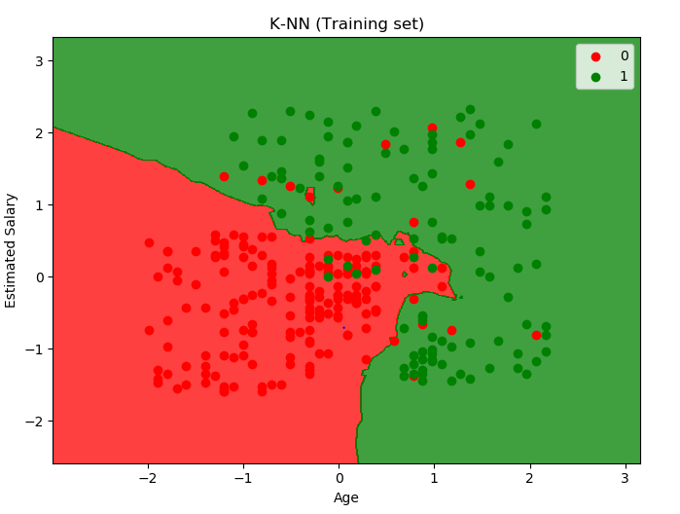
Result

Slide 28
clustering

Slide 29
Classification
Clustering is like classification, but the basis is different. In clustering you don’t know what you are looking for, and you are trying to identify some segments or clusters in your data.

Slide 30
K-Means

Slide 31
K-mean
Y
Y
X
X

Slide 32
How it works?
STEP 1 – Choose the number K of clusters
STEP 2 – Select at random K points, the centroids
STEP 3 – Assign each data point to the closest centroid => that forms K clusters
STEP 4 – Compute and place the new centroid of each cluster
STEP 5 -Reassign each data point to the new closest centroid. If any reassignment took place go to STEP 4, other go to FIN

Slide 33
STEP - 1 - Choose the number K of Cluster: K = 2 STEP - 2 - Select at random K =2 points, the centroids
Y
Y
X
X

Slide 34
STEP - 3 - Assign each data point to the closest centroid => that forms K clusters
Y
Y
X
X

Slide 35

STEP - 3 - Compute and place the new centroid of each cluster
Y
Y
X
X
$$C_{x}=\frac{x_{1}+x_{2}…+x_{n}}{n} C_{y}=\frac{y_{1}+y_{2}…+y_{n}}{n}$$

Slide 36
STEP - 5 - Reassign each data point to the new closest centroid. If any reassignment took place go to STEP 4, other go to FIN
Y
Y
X
X

Slide 37
SVM (support vector machine)

Slide 38
Applications
Face detection
Classification of images
Bioinformatics
Protein fold and remote homology detection

Slide 39
LSVM (Linear support vector machine)

Slide 40
SVM Decision boundary
Maximum margin
Y
Y
Maximum margin hyperplane
Support vectors
X
X

Slide 41
KSVM (Kernel support vector machine)

Slide 42
Nonlinear problem
Nonlinearly separable
Y
X

Slide 43
SVM Magic
Y = X^2
Can we separate these point with single straight line ?
Y
X
X

Slide 44
Nonlinear problem
Y
Z
Mapping Function
Y
X
X

Slide 45
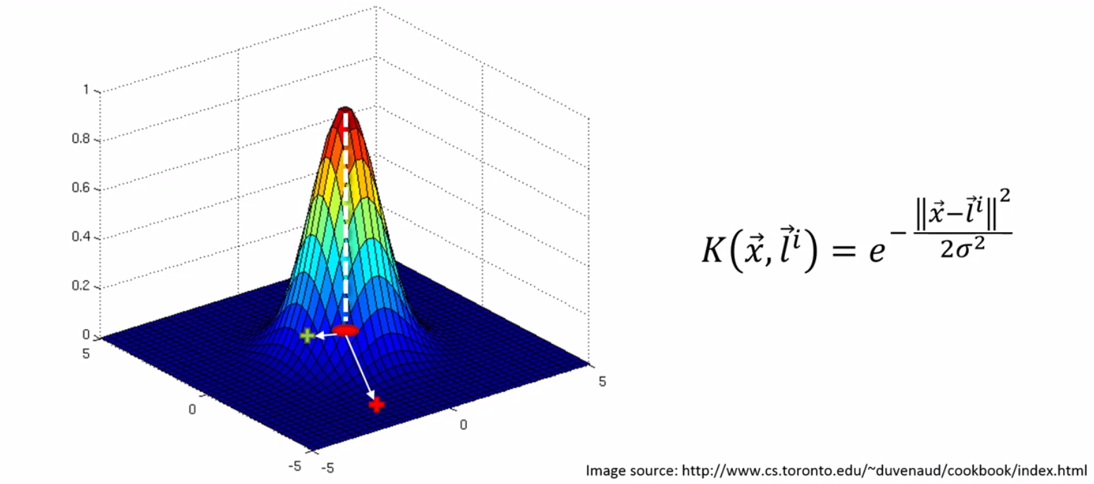
The gaussian rbf kernel

Slide 46
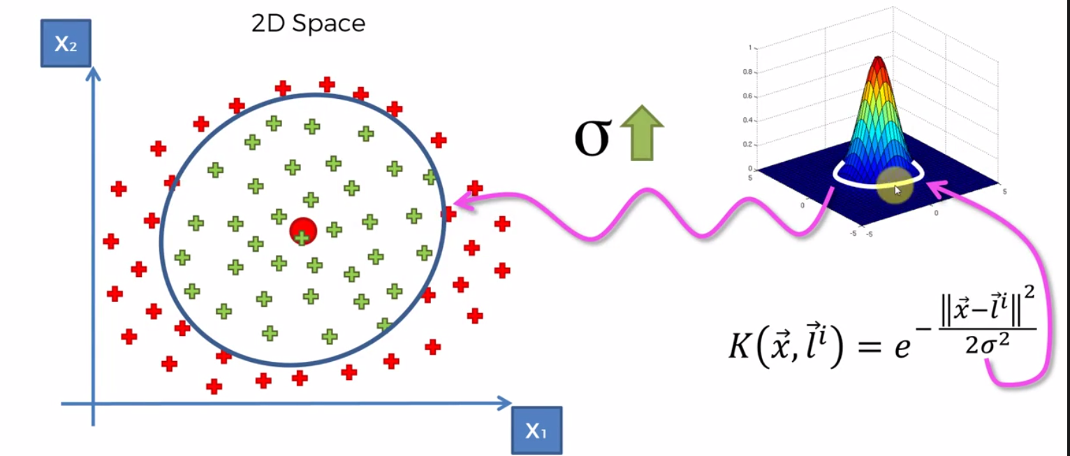
The gaussian rbf kernel

Slide 47
Image
Notes:
Have you ever seen first digital photo?

Slide 48
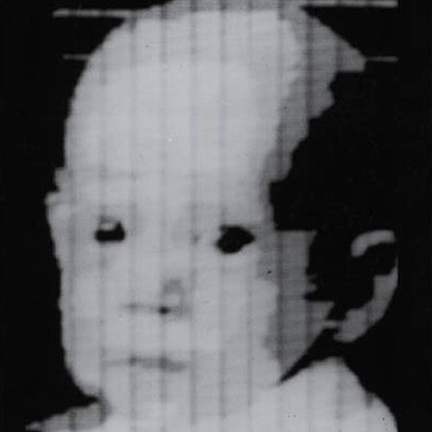
First Digital Photograph

Slide 49
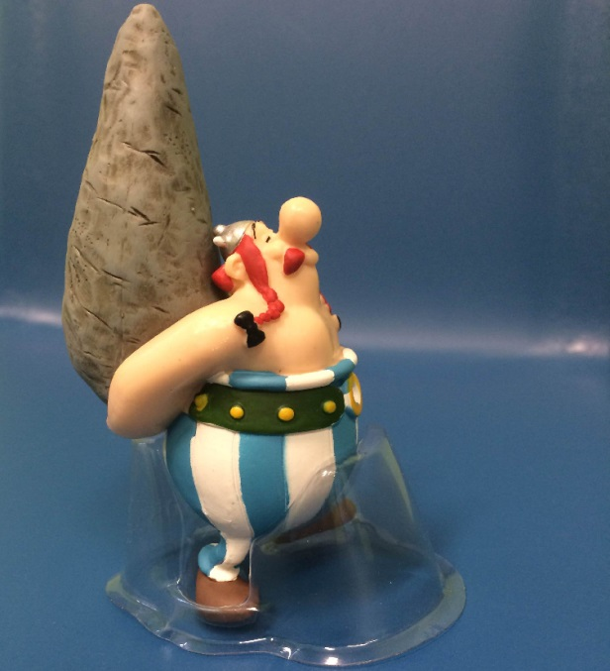
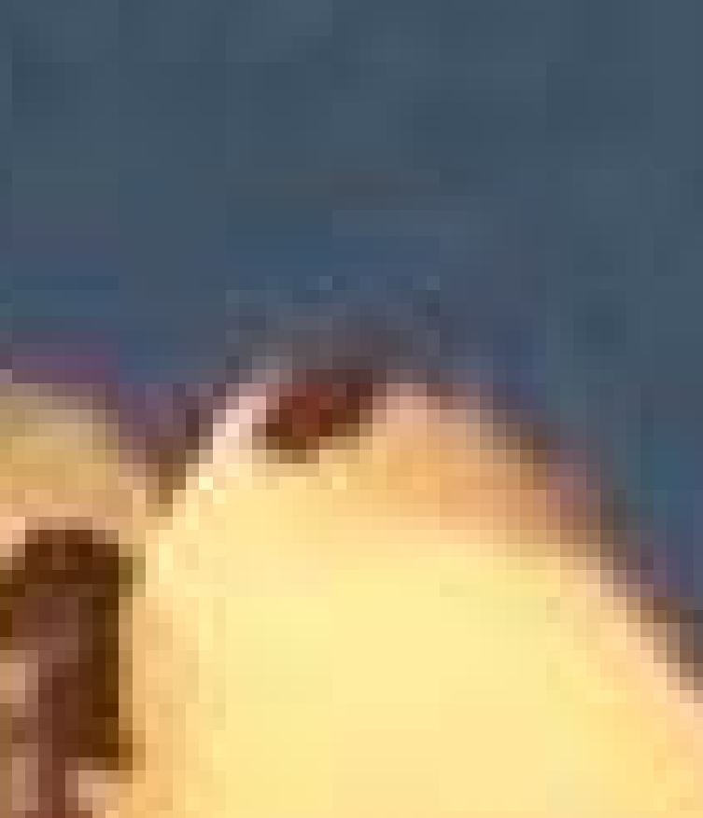
Digital Image pixel
A pixel is the smallest unit of a digital image or graphic that can be displayed and represented on a digital display device
One pixel

Slide 50
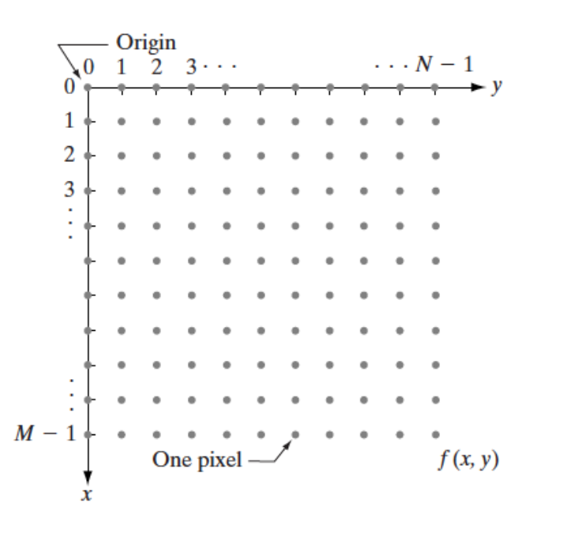
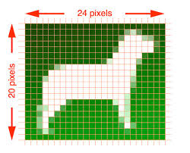
Representing digital images

Slide 51
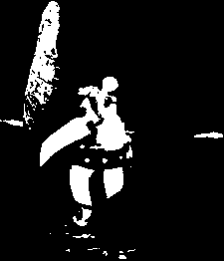
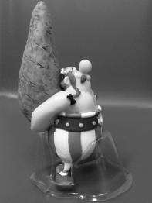

TYPES OF DIGITAL IMAGE
BINARY IMAGE
8-bit COLOR FORMAT
Gray Scale format
16-bit COLOR FORMAT
RGB format
BGR format

Slide 52
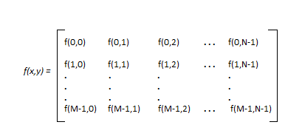
Digital Image as a Matrix
Every pixel have some value either it can be binary, integer or vector depend upon type of image format
Ex- image of M*N pixel

Slide 53
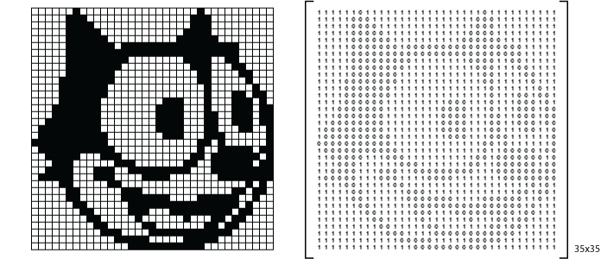

Binary image – 0 or 1
$$\left[\begin{matrix}1 & 0 \\ 1 & 1\end{matrix}\right]$$

Slide 54

gray image – Single channel
A grayscale or greyscale image is one in which the value of each pixel is a single sample representing only an amount of light, that is, it carries only intensity information.
Range – 0 – 255
0 – black
255 – white
$$\left[\begin{matrix}255 & 0 \\ 190 & 40\end{matrix}\right]$$

Slide 55
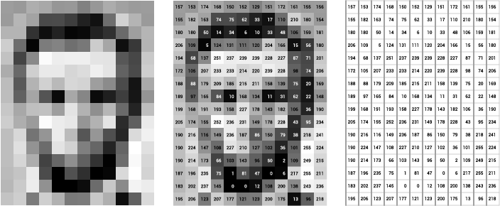
Gray image– 0 - 255

Slide 56

rgb image – 3 channel
The RGB color model is an additive color model in which red, green and blue light are added together in various ways to reproduce a broad array of colors.
Number of channel – 3 (Red, Green, Blue)
Range of each channel – 0 – 255
$$\left[\begin{matrix}[255, 255, 255] & [0, 255, 0] & [255, 51, 153] \\ [171, 237, 182] & [255, 0, 0] & [166, 166, 166] \\ [0, 153, 255] & [0, 0, 255] & [0, 0, 0]\end{matrix}\right]$$

Slide 57
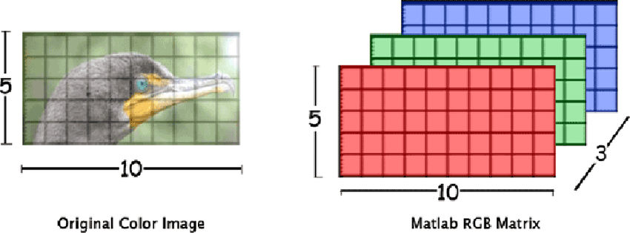
RGB image

Slide 58
Naïve Bayes

