Slide 1
Topology Optimization
ME 308
Industrial Engineering and Operation Research
Team Project Slayer - Group 2
Tanyut Sharma
Sumit Sureka
Shrihari Ravi Wattamwar
Aarush Billayia
Aman Kumar

Slide 2
Project Contents
Problem Formulation-Grid of Springs
Problem Statement
Introduction
Topology Optimization - Bridge Structure
Uncertainty Analysis
Challenges

Slide 3
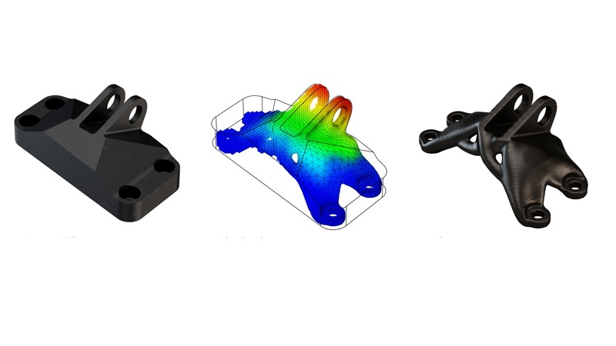
Introduction
Topology optimization is a mathematical method that optimizes material layout within a given design space, for a given set of loads, boundary conditions and constraints with the goal of maximizing the performance of the system.

Slide 4
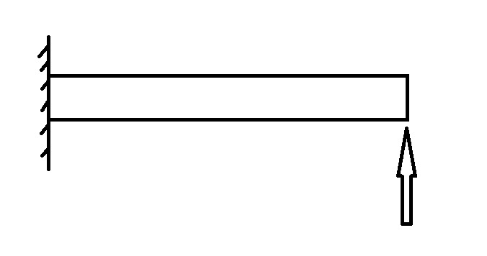
Problem Statement
To divide a given region into two parts, one with material and one, one without material. It enables the creation of designs with maximal stiffness for a given mass.
First we consider a horizontal cantilever beam loaded vertically at its tip.

Slide 5
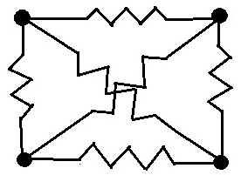
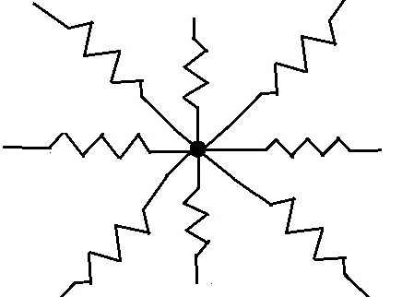
Problem Statement
Our method models the cantilever as a grid of nodes connected by a number of discrete linear springs.
The springs join points vertically, horizontally and diagonally, resulting in a maximum of 8 springs connected to any point.
The force on each point must be zero for the correct physics.

Slide 6
Problem Statement
Material Density ‘h’ is defined by the Weighted Average of the Spring Stiffnesses
Optimization is defined as the structure having Maximum Stiffness with the constraint on Maximum Total Weight
Maximizing Stiffness is the same as Minimizing Deflection with given Force or Maximizing Force with given Deflection
Notes:
A simple linear approximation is used to find the symmetric strain tensor from the deflections.
The normal strain is determined.
The stress tensor is obtained from the strains (using STVK)

Slide 7
Problem Formulation- Grid of Springs

Slide 8
Problem Formulation
Decision Variables
Nodes’ Absolute Position
Spring Deformation and Forces
Net Force at the Nodes
Normalized Spring Constants
Normalised Material Density
Parameters
Spring Constants
Meshing Size
Domain Dimensions
Normalized Minimum and Maximum Stiffness Coefficient
Constraints
Equation of Spring Forces
Left Edge Fixed
Deflection at a point or edge
Net Force Zero at each Node
Total Maximum Material Mass
Equal Spring Constants (Isotropic Material)
Objective Function
Stiffness Maximization
Notes:
A simple linear approximation is used to find the symmetric strain tensor from the deflections.
The normal strain is determined.
The stress tensor is obtained from the strains (using STVK)

Slide 9
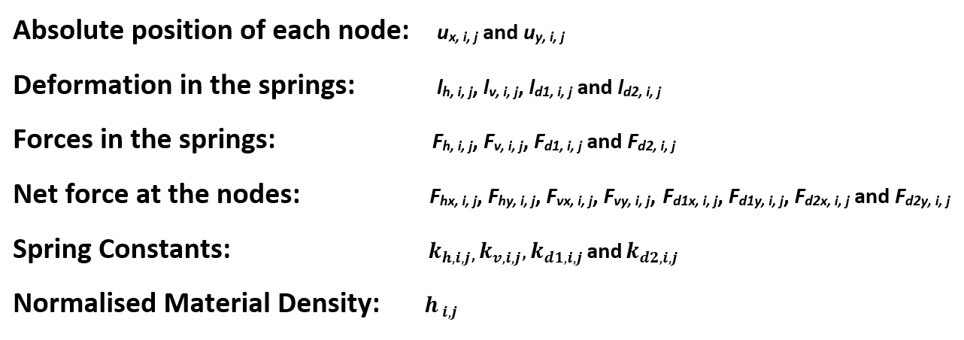
Decision Variables

Slide 10
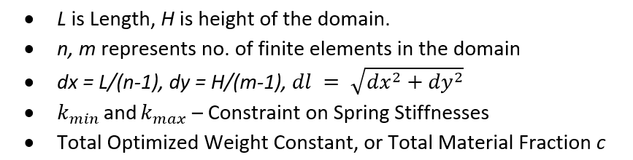
Parameters

Slide 11
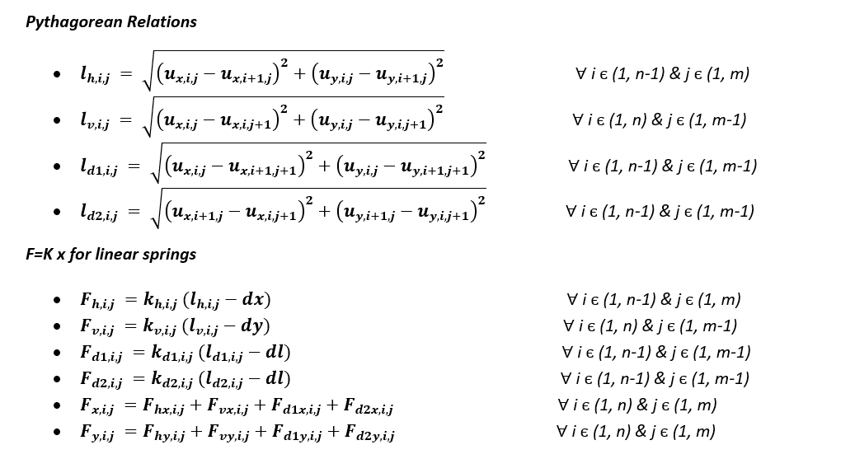
Constraints
Notes:
The left edge is fixed, and the bottom-right corner is displaced upwards (all other nodes receive the no-force condition):

Slide 12
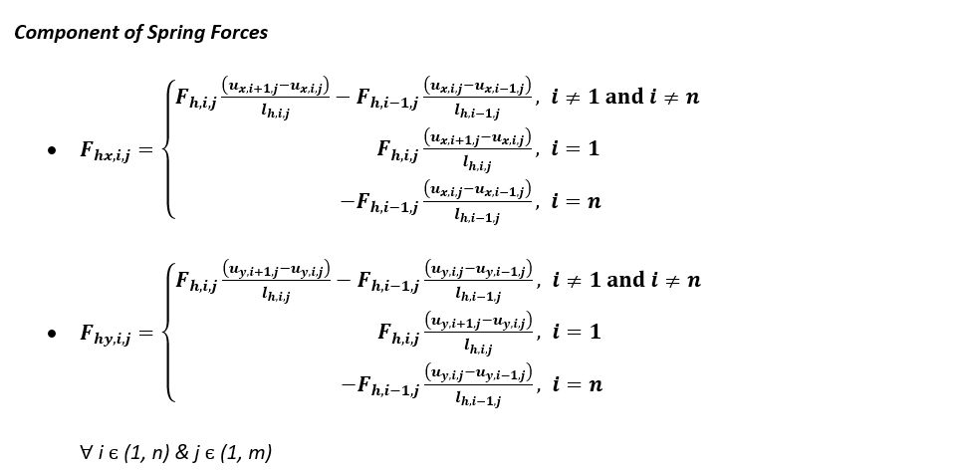
Constraints
Notes:
The left edge is fixed, and the bottom-right corner is displaced upwards (all other nodes receive the no-force condition):

Slide 13
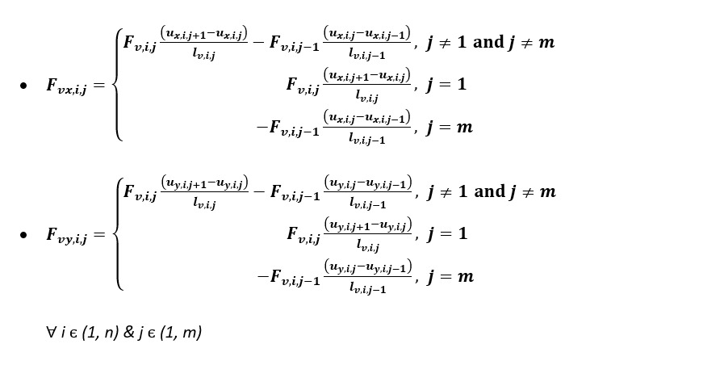
Constraints
Notes:
The left edge is fixed, and the right edge is displaced upwards (all other nodes receive the no-force condition):

Slide 14
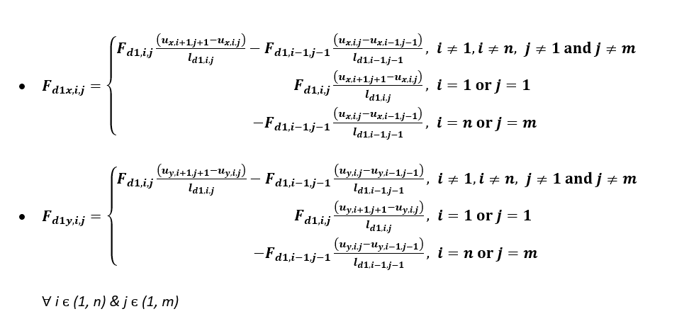
Constraints
Notes:
The left edge is fixed, and the right edge is displaced upwards (all other nodes receive the no-force condition):

Slide 15
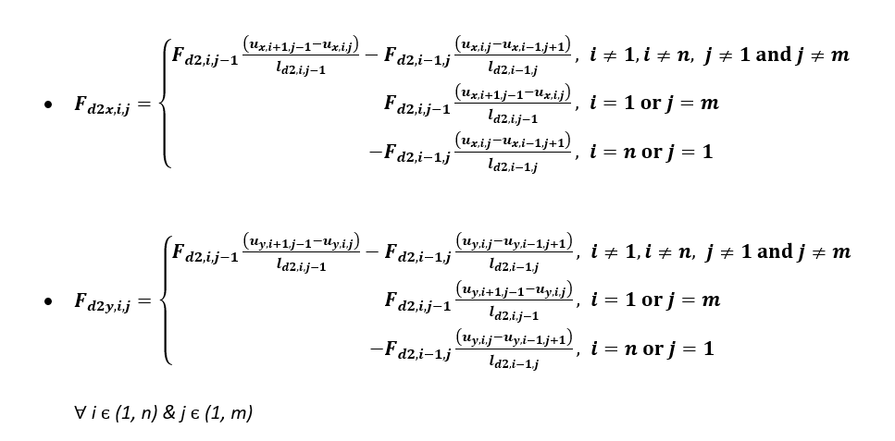
Constraints
Notes:
The left edge is fixed, and the right edge is displaced upwards (all other nodes receive the no-force condition):

Slide 16
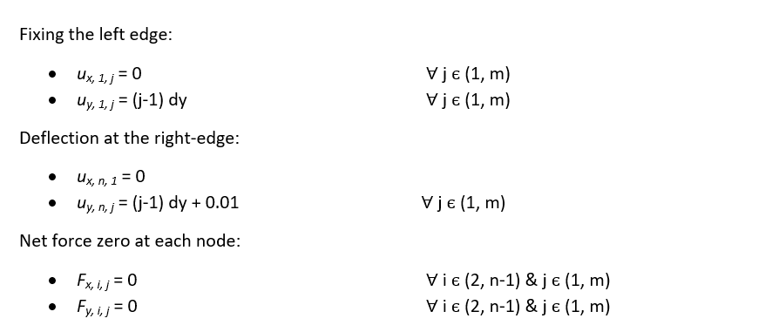

Constraints
Notes:
The left edge is fixed, and the right edge is displaced upwards (all other nodes receive the no-force condition):

Slide 17
Topology optimization
To define the presence or absence of material when only springs are present, we used two approaches:
1) Anisotropic method: Keep each spring constant variable and define presence of material as average of spring constants. We have constraint on springs.
2) Isotropic method: Define a variable from 0 to 1 indicating presence or absence of material, and derive all spring constants from it. All the spring constants are same. Constraint is on the normalized material density.
The left edge is fixed, and there is a fixed vertical displacement to the right edge.
Note that the Model Formulation is Non-Linear due to quadratic and trigonometric components

Slide 18
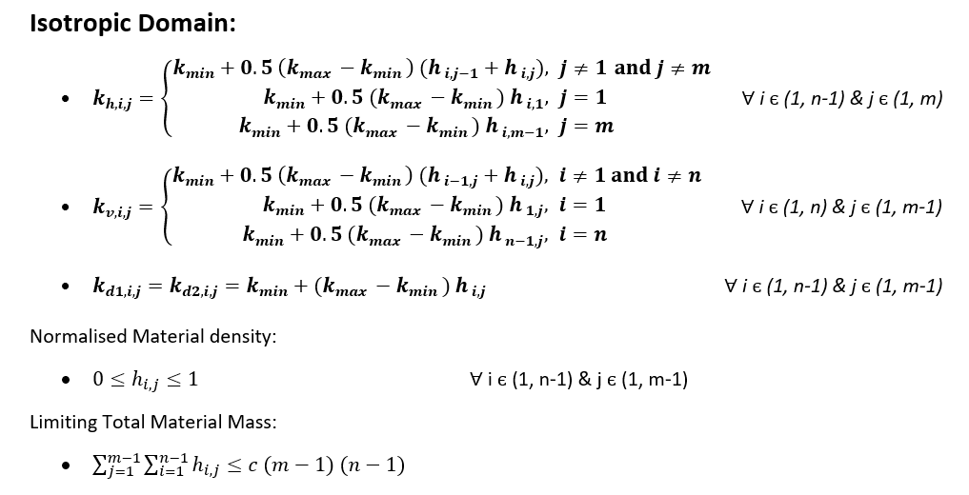
Isotropic Constraints

Slide 19
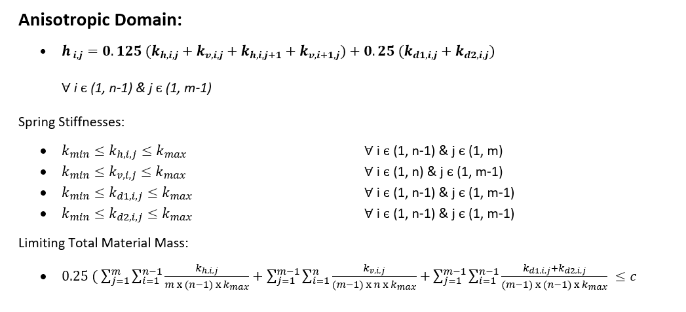
Anisotropic Constraints
Notes:
Note the weights assigned to each spring.

Slide 20
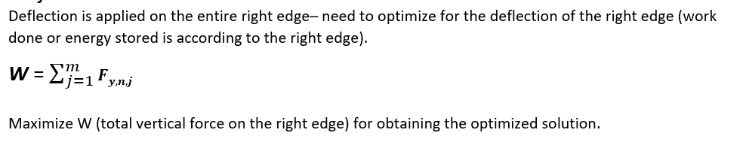
Objective Function

Slide 21
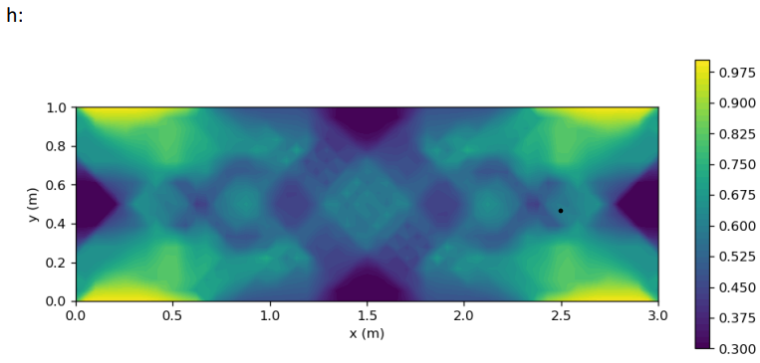
Anisotropic method:
Density of material (h is normalized):

Slide 22
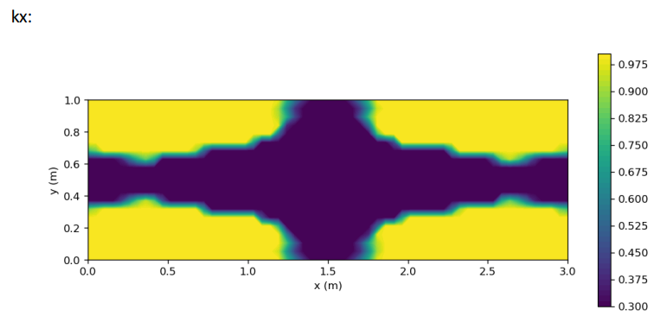
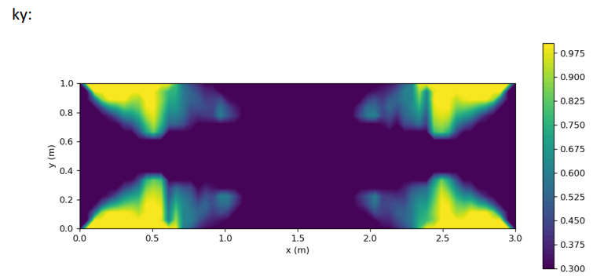
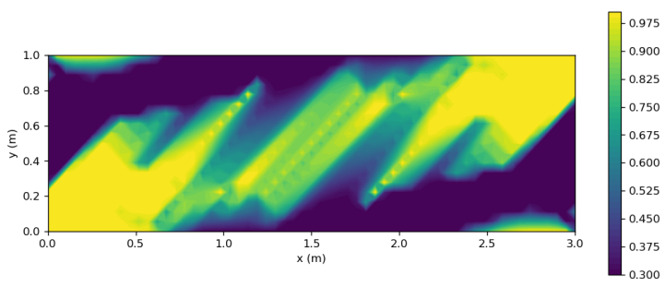
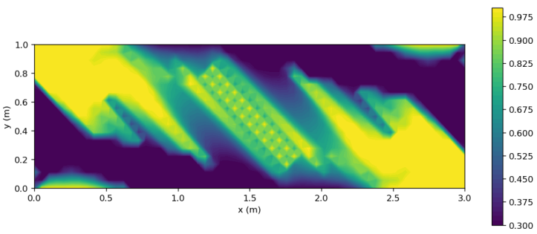
Anisotropic method
kx
ky
kd1
kd2

Slide 23
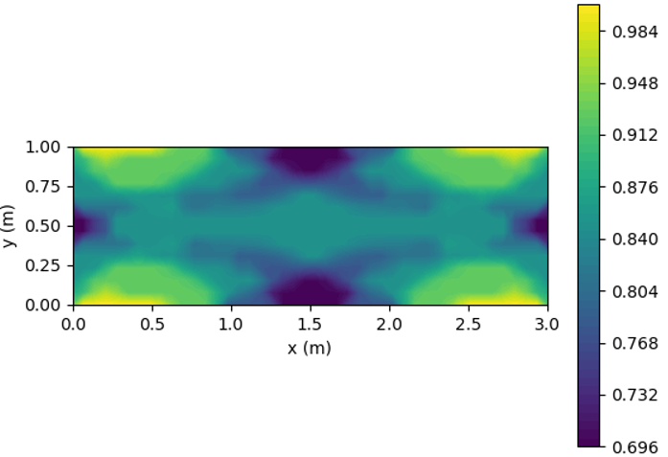
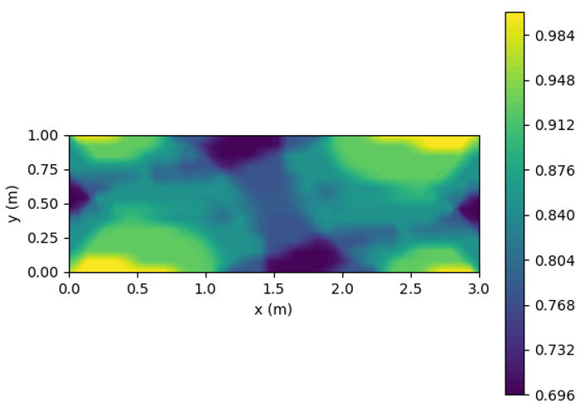
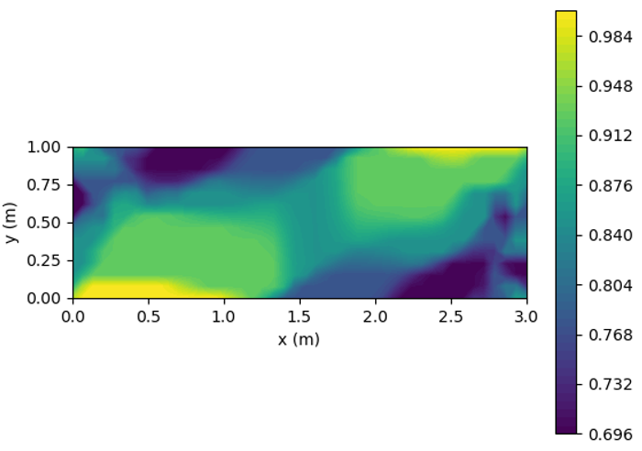
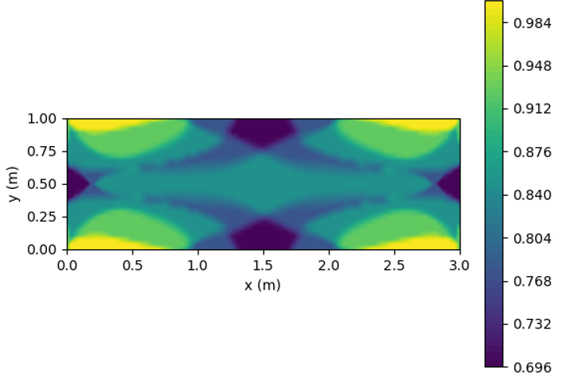
Anisotropic method:
Small deflection
Larger deflection
Much more deflection
Refined mesh

Slide 24
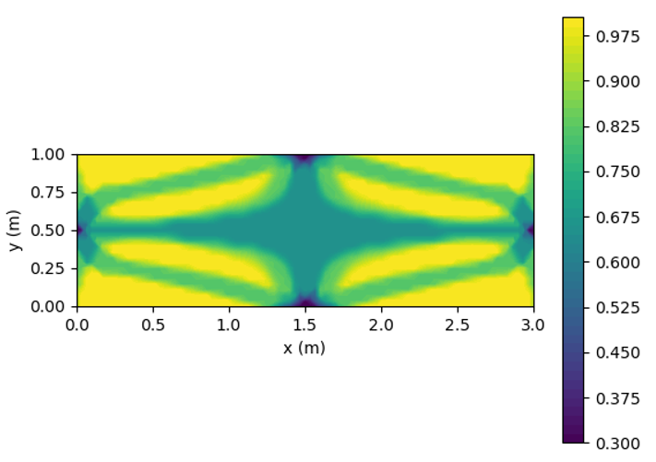
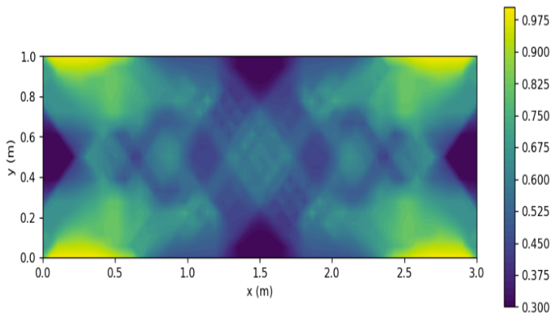
Anisotropic method
Low material fraction
High material fraction

Slide 25
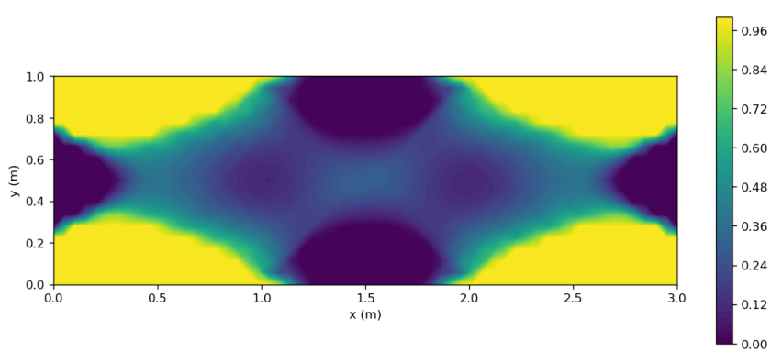
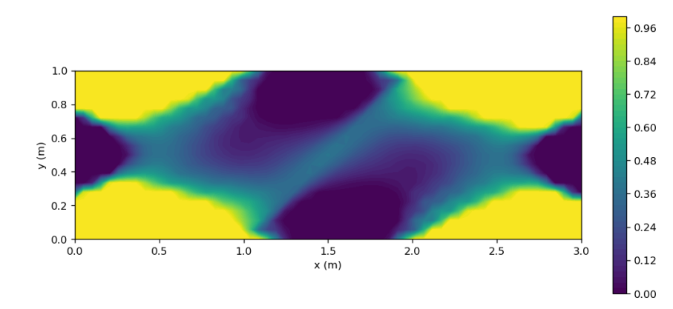
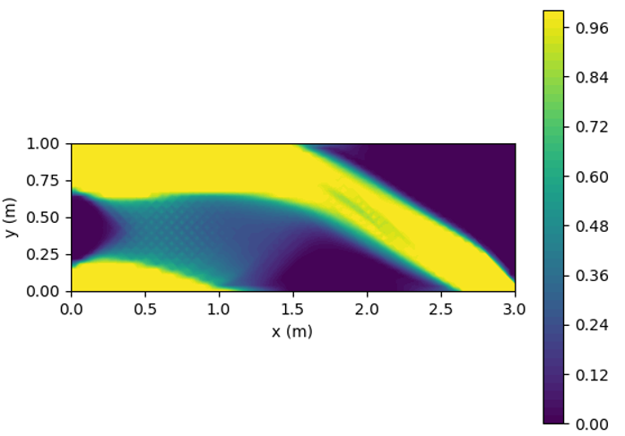
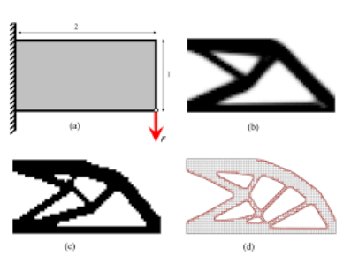
Isotropic method:
High deformation
Low deformation
Notes:
This structure appears to incorporate many of the elements seen in the anisotropic results. Overall, this seems to be a smoother, better result.

Slide 26
Topology Optimization - Bridge Structure

Slide 27
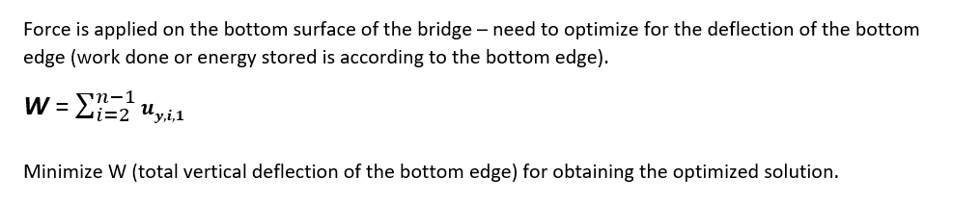
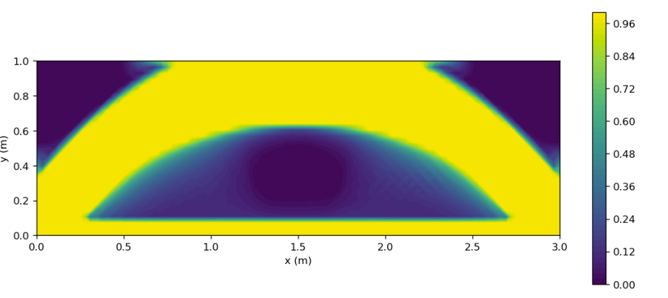
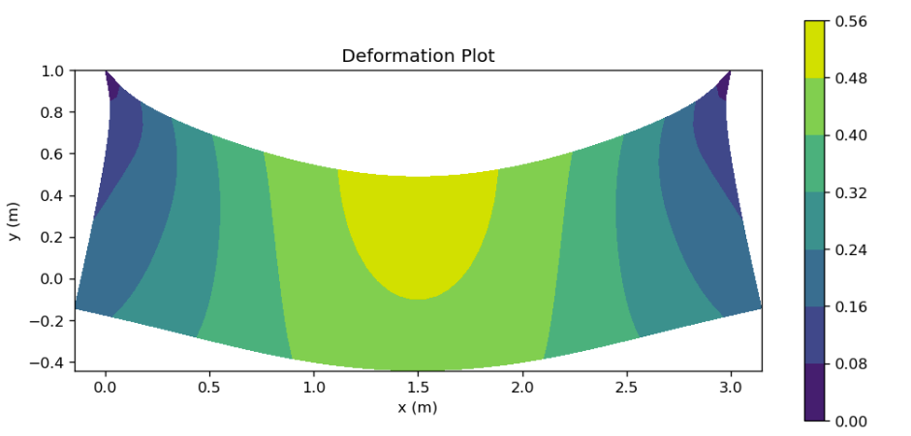
Bridge Analysis
Deformation of bridge
Optimized shape of bridge

Slide 28
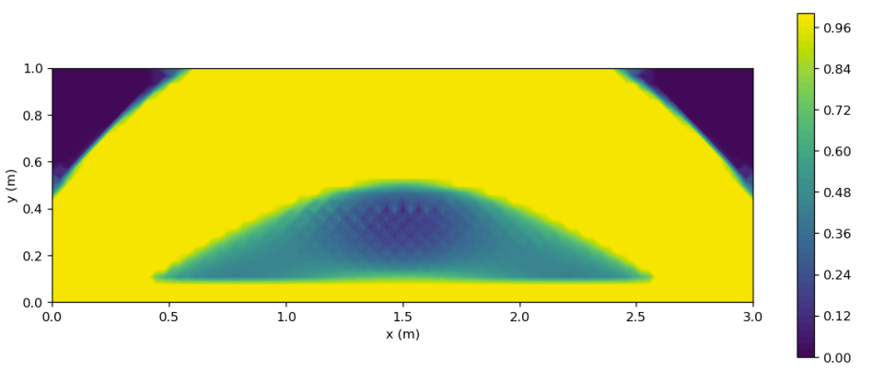
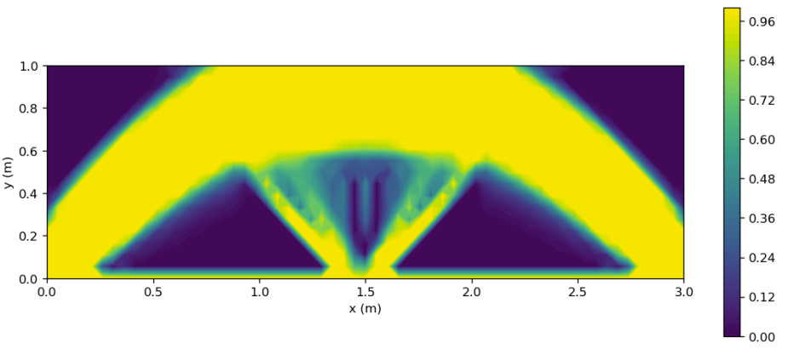
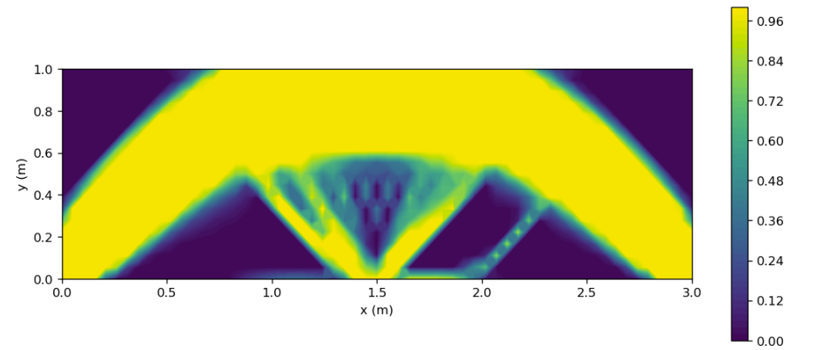
More material fraction
Energy optimization at centre

Slide 29
Uncertainty Analysis

Slide 30
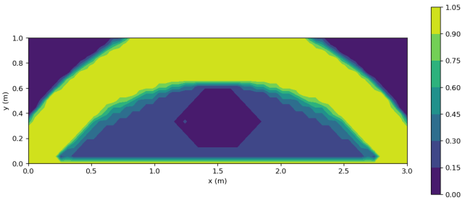
Uncertainty analysis
In the real world, springs are not available of all possible sizes. We did an uncertainty analysis for the bridge optimisation results:
The springs can only take 6 discrete values between kmin and kmax.
The stiffness of each individual spring will have a uniform distribution around the discretized value.

Slide 31
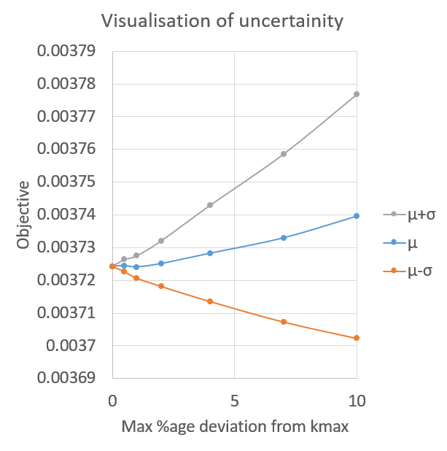
Uncertainty analysis
The y-axis denotes the objective (in our case energy) for the optimized geometry, while the x-axis represents the maximum permissible %age deviation from kmax for each spring
The mean of the result is moving upwards as we increase the uncertainty, that is, the structure is weakened more easily than it is strengthened, which we expect intuitively as well.

Slide 32
Challenges
Problems were encountered throughout this project, both due to our mistakes and the solver’s issues.
1. The spring constants must remain at a small, finite value in the regions where material is not present. Ideally for a vacuum, we would like these to be 0. As we have verified the physics of the results for other cases, we believe this issue is caused entirely by the solver, which does not converge when kmin is lowered.
2. Large deformations or forces caused the solver to not converge.
3. Due to memory limitations, we often could not use more than ~2000 points for the domain.
4. A large number of points slowed down the program significantly.
5. Certain boundary conditions simply do not converge. This has no apparent cause.
6. Apply compressive loads on springs can cause them to ‘flip over’ and switch the positions of two neighbouring nodes, resulting in non-physical results. This is caused by the formulation itself and all our attempts at solving this were fruitless.
7. Real materials are not made of springs, and our attempts to use STVK model failed

Slide 33
Problem Formulation- Stress Strain Analysis
Notes:
We model the elastic cantilever beam with the relations given by the Saint Venant-Kirchhoff model.
It is the simplest hyperelastic material model, which is just an extension of the geometrically linear elastic material model to the geometrically nonlinear regime.
It is thus a very good representation of the material characteristics in both the linear and nonlinear regime.
The displacement of the entire beam is found by minimizing the energy contained in the beam.

Slide 34
Problem Formulation
Decision Variables
Strain Tensor
Stress Tensor
Deflections
Constraints
Fixing the left edge
Neumann or Dirichlet
Parameters
Elastic Coefficients
Meshing size
Dimensions of the domain
Objective Function
Energy Minimization
Notes:
A simple linear approximation is used to find the symmetric strain tensor from the deflections.
The normal strain is determined.
The stress tensor is obtained from the strains (using STVK)

Slide 35
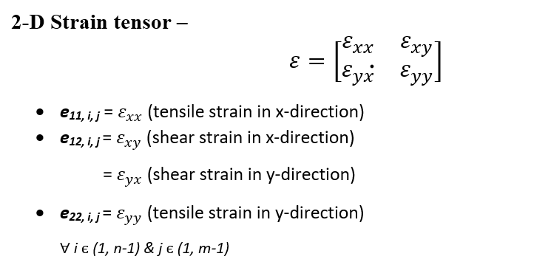
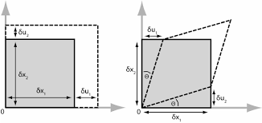
Decision Variables

Slide 36
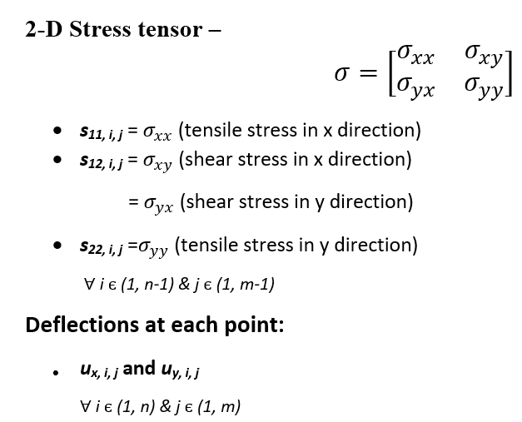
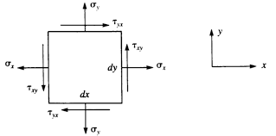
Decision Variables

Slide 37
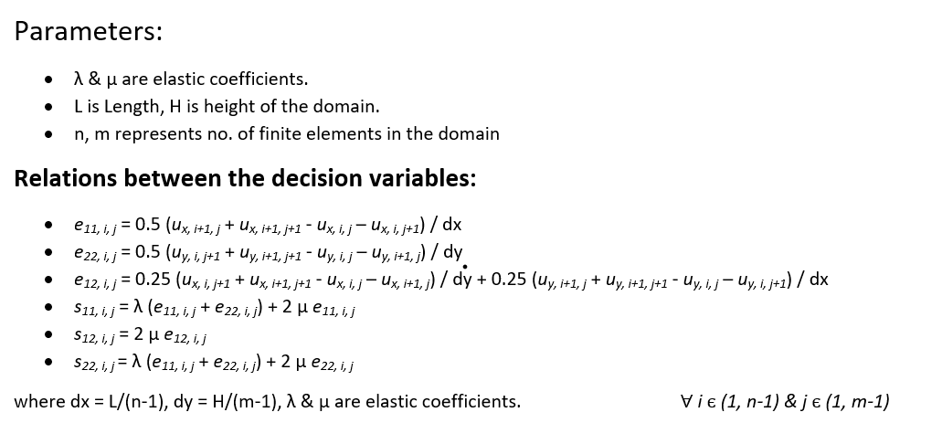
Constraints

Slide 38
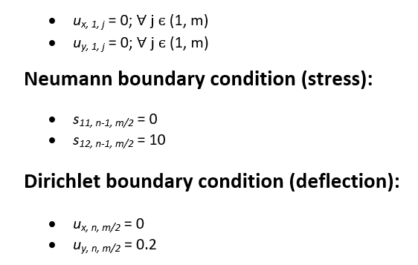
Constraints
Notes:
Apply the boundary condition to fix the left edge of the domain.
We also need to ensure that the domain will bend. 2 possible ways:
Neumann boundary condition
Dirichlet boundary condition

Slide 39

Objective Function
The energy stored in the beam should be the least possible for the correct deformation. This is our objective function.
The energy density is given by the inner product of the stress and strain tensors

Slide 40
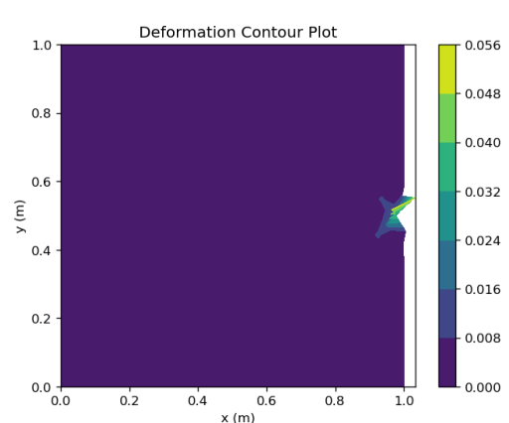
Results - Neumann
Only the points near the application of force have any displacement at all.

Slide 41
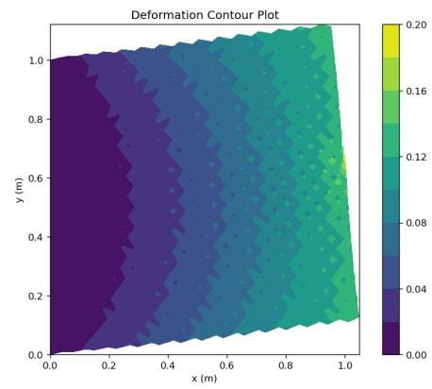
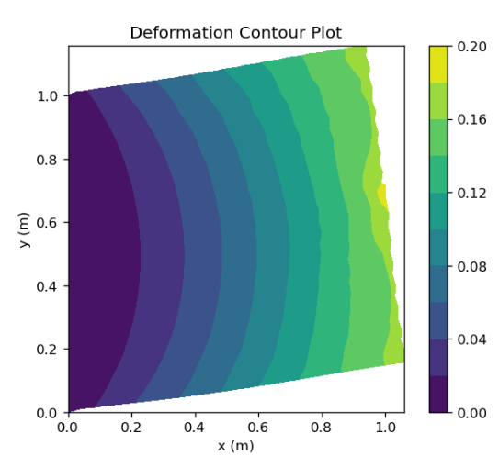
Results - Dirichlet
Better results though still incorrect due to presence of waviness.
Specifying the displacement at an additional point somewhat smoothens the result.
Notes:
Specify displacement at all boundary points (Neumann to Dirichlet convert).
The domain was extended into the free space (presumed vacuum) outside of the beam.
Negligible Elastic coefficients values given to vacuum ensured that it could apply no force on the beam’s surface, thus making them stress-free surfaces.
The results showed that stress-strain relationships suffered from the same errors as seen before thus we immediately rejected this method.

Slide 42
Conclusion
Minimization of energy method did not work when solving using stress and strain relationships. Spring method used here, can alternatively be used in place of the material properties for getting topology optimization.
From the topology optimization results:
a. For small loads, the distribution for cantilever beam tends to be symmetric.
b. As the resolution increases, more fine plots can be seen, which means more finely distributed materials.
c. Different objectives can easily influence the final structure, as we saw when many supports appeared in the bridge optimization going from the bottom-centre to the arc.
d. Similarly, varying the loads at different locations yields different pattern results.
e. Applying uncertainty to the spring constants weakens the structure on average.

Slide 43
THANK YOU

