Slide 1
Python

Slide 2
The Definitive Guide
Python is a powerful high-level, object-oriented programming language created by Guido van Rossum.
It has simple easy-to-use syntax, making it the perfect language for someone trying to learn computer programming for the first time.

Slide 3
What is Python (Programming)? - The Basics
Before getting started, lets get familiarized with the language first.
Python is a general-purpose language. It has wide range of applications from Web development (like: Django and Bottle), scientific and mathematical computing (Orange, SymPy, NumPy) to desktop graphical user Interfaces (Pygame, Panda3D).
The syntax of the language is clean and length of the code is relatively short. It's fun to work in Python because it allows you to think about the problem rather than focusing on the syntax.

Slide 4
History of Python
Python is a fairly old language created by Guido Van Rossum. The design began in the late 1980s and was first released in February 1991.

Slide 5
Why Python was created?
In late 1980s, Guido Van Rossum was working on the Amoeba distributed operating system group. He wanted to use an interpreted language like ABC (ABC has simple easy-to-understand syntax) that could access the Amoeba system calls. So, he decided to create a language that was extensible. This led to design of a new language which was later named Python.

Slide 6
Why the name Python?
No. It wasn't named after a dangerous snake. Rossum was fan of a comedy series from late seventies. The name "Python" was adopted from the same series "Monty Python's Flying Circus".

Slide 7
Release Dates of Different Versions
Version | Release Data
Python 1.0 (first standard release) Python 1.6 (Last minor version) | January 1994 September 5, 2000
Python 2.0 (Introduced list comprehensions) Python 2.7 (Last minor version) | October 16, 2000 July 3, 2010
Python 3.0 (Emphasis on removing duplicative constructs and module) Python 3.5 (Last updated version) | December 3, 2008 September 13, 2015

Slide 8
Features of Python Programming
A simple language which is easier to learn
Python has a very simple and elegant syntax. It's much easier to read and write Python programs compared to other languages like: C++, Java, C#. Python makes programming fun and allows you to focus on the solution rather than syntax. If you are a newbie, it's a great choice to start your journey with Python.
Free and open-source You can freely use and distribute Python, even for commercial use. Not only can you use and distribute softwares written in it, you can even make changes to the Python's source code. Python has a large community constantly improving it in each iteration.

Slide 9
Features of Python Programming… Cont.
Portability You can move Python programs from one platform to another, and run it without any changes. It runs seamlessly on almost all platforms including Windows, Mac OS X and Linux.
Extensible and Embeddable Suppose an application requires high performance. You can easily combine pieces of C/C++ or other languages with Python code. This will give your application high performance as well as scripting capabilities which other languages may not provide out of the box.

Slide 10
Features of Python Programming… Cont.
A high-level, interpreted language Unlike C/C++, you don't have to worry about daunting tasks like memory management, garbage collection and so on. Likewise, when you run Python code, it automatically converts your code to the language your computer understands. You don't need to worry about any lower-level operations.

Slide 11
Features of Python Programming… Cont.
Large standard libraries to solve common tasks Python has a number of standard libraries which makes life of a programmer much easier since you don't have to write all the code yourself. For example: Need to connect MySQL database on a Web server? You can use MySQLdb library using import MySQLdb. Standard libraries in Python are well tested and used by hundreds of people. So you can be sure that it won't break your application.

Slide 12
Features of Python Programming… Cont.
Object-oriented Everything in Python is an object. Object oriented programming (OOP) helps you solve a complex problem intuitively. With OOP, you are able to divide these complex problems into smaller sets by creating objects.

Slide 13
Applications of Python
Web Applications You can create scalable Web Apps using frameworks and CMS (Content Management System) that are built on Python. Some of the popular platforms for creating Web Apps are: Django, Flask, Pyramid, Plone, Django CMS. Sites like Mozilla, Reddit, Instagram and PBS are written in Python.
Scientific and Numeric Computing There are numerous libraries available in Python for scientific and numeric computing. There are libraries like: SciPy and NumPy that are used in general purpose computing. And, there are specific libraries like: EarthPy for earth science, AstroPy for Astronomy and so on. Also, the language is heavily used in machine learning, data mining and deep learning.

Slide 14
Applications of Python.. Cont..
Creating software Prototypes Python is slow compared to compiled languages like C++ and Java. It might not be a good choice if resources are limited and efficiency is a must. However, Python is a great language for creating prototypes. For example: You can use Pygame (library for creating games) to create your game's prototype first. If you like the prototype, you can use language like C++ to create the actual game.
Good Language to Teach Programming Python is used by many companies to teach programming to kids and newbies. It is a good language with a lot of features and capabilities. Yet, it's one of the easiest language to learn because of its simple easy-to-use syntax.

Slide 15
What is Python?
Python is a cross-platform programming language, meaning, it runs on multiple platforms like Windows, Mac OS X, Linux, Unix and has even been ported to the Java and .NET virtual machines. It is free and open source.
Even though most of today’s Linux and Mac have Python preinstalled in it, the version might be out-of-date. So, it is always a good idea to install the most current version. You can download the latest version of Python and install it.

Slide 16
Starting The Interpreter
After installation, the python interpreter lives in the installed directory.
By default it is /usr/local/bin/pythonX.X in Linux/Unix and C:\PythonXX in Windows, where the 'X' denotes the version number. To invoke it from the shell or the command prompt we need to add this location in the search path.
Search path is a list of directories (locations) where the operating system searches for executables. For example, in Windows command prompt, we can type set path=%path%;c:\python33 (python33 means version 3.3, it might be different in your case) to add the location to path for that particular session.
In Mac OS we need not worry about this as the installer takes care about the search path.

Slide 17
Various ways to start Python
Immediate mode Typing python in the command line will invoke the interpreter in immediate mode. We can directly type in Python expressions and press enter to get the output. >>> is the Python prompt. It tells us that the interpreter is ready for our input. Try typing in 1 + 1 and press enter. We get 2 as the output. This prompt can be used as a calculator. To exit this mode type exit() or quit() and press enter.

Slide 18
Various ways to start Python.. Cont..
Script mode This mode is used to execute Python program written in a file. Such a file is called a script. Scripts can be saved to disk for future use. Python scripts have the extension .py, meaning that the filename ends with .py.
For example: helloWorld.py
To execute this file in script mode we simply write python helloWorld.py at the command prompt.

Slide 19
Various ways to start Python.. Cont..
Integrated Development Environment (IDE) We can use any text editing software to write a Python script file. We just need to save it with the .py extension. But using an IDE can make our life a lot easier. IDE is a piece of software that provides useful features like code hinting, syntax highlighting and checking, file explorers etc. to the programmer for application development. Using an IDE can get rid of redundant tasks and significantly decrease the time required for application development. IDEL is a graphical user interface (GUI) that can be installed along with the Python programming language and is available from the official website. We can also use other commercial or free IDE according to our preference. We have used the PyScripter IDE for our testing and we recommend the same. It is free and open source.

Slide 20
Hello World Example
Now that we have Python up and running, we can continue on to write our first Python program. Type the following code in any text editor or an IDE and save it as helloWorld.py
print("Hello world!")
Now at the command window, go to the location of this file. You can use the cd command to change directory.
To run the script, type python helloWorld.py in the command window. We should be able to see the output as follows:
Hello world!
If you are using PyScripter, there is a green arrow button on top. Press that button or press Ctrl+F9 on your keyboard to run the program.
In this program we have used the built-in function print(), to print out a string to the screen. String is the value inside the quotation marks, i.e. Hello world! . Now try printing out your name by modifying this program.
Congratulations! You just wrote your first program in Python.
As we can see, it was pretty easy. This is the beauty of Python programming language.
Check out these examples to learn more:

Slide 21
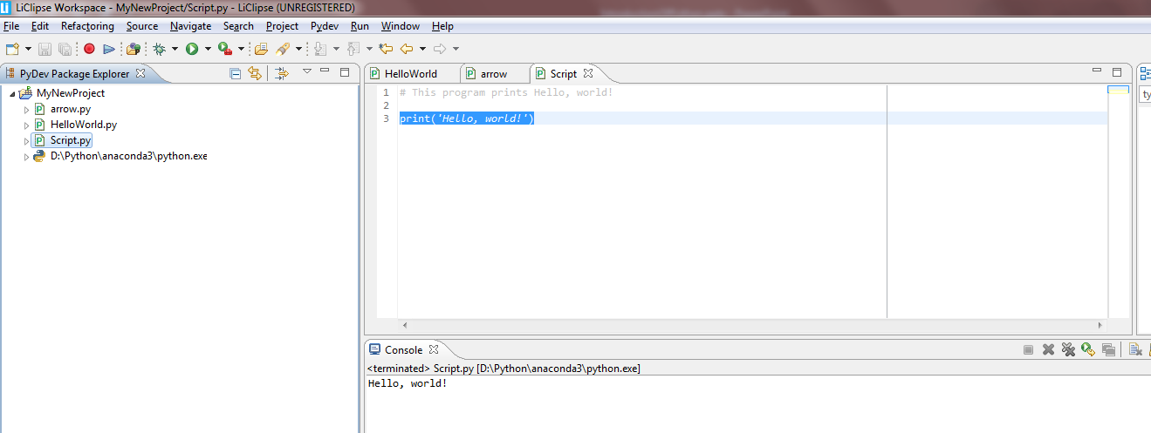
Hello World Example

