Slide 1
Python Keywords and Identifier

Slide 2
Python Keywords
Keywords are the reserved words in Python. We cannot use a keyword as variable name, function name or any other identifier. They are used to define the syntax and structure of the Python language. In Python, keywords are case sensitive. There are 33 keywords in Python 3.3. This number can vary slightly in course of time. All the keywords except True, False and None are in lowercase and they must be written as it is. The list of all the keywords are given below.

Slide 3
Python Keywords.. Cont..
False | class | finally | is | return
None | continue | for | lambda | try
True | def | from | nonlocal | while
and | del | global | not | with
as | elif | if | or | yield
assert | else | import | pass
break | except | in | raise

Slide 4
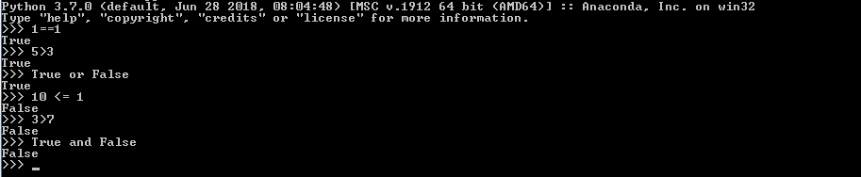

Python Keywords.. Cont..
True, False True and False are truth values in Python. They are the results of comparison operations or logical (Boolean) operations in Python. For example:
Here we can see that the first three statements are true so the interpreter returns True and returns False for the remaining three statements. True and False in python is same as 1 and 0. This can be justified with the following example:

Slide 5
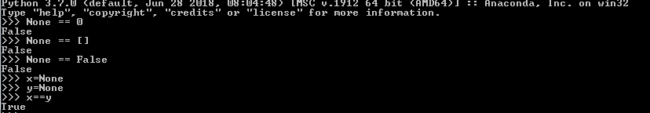
Python Keywords.. Cont..
None None is a special constant in Python that represents the absence of a value or a null value. It is an object of its own datatype, the NoneType. We cannot create multiple None objects but can assign it to variables. These variables will be equal to one another. We must take special care that None does not imply False, 0 or any empty list, dictionary, string etc. For example:

Slide 6
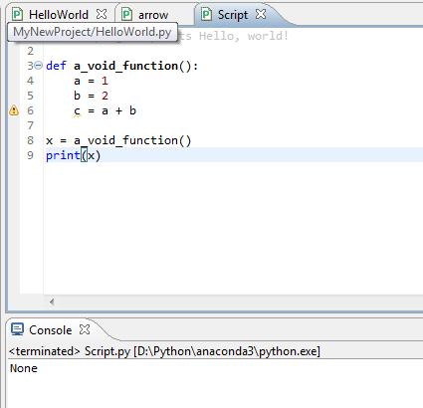
Python Keywords.. Cont..
None Void functions that do not return anything will return a None object automatically. None is also returned by functions in which the program flow does not encounter a return statement. For example:

Slide 7
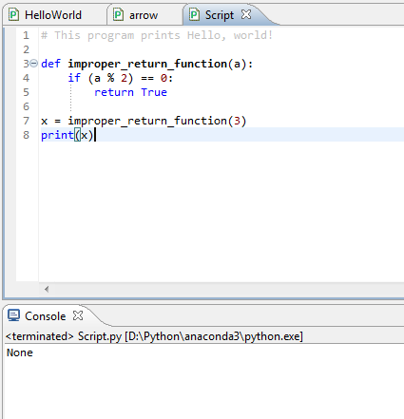
Python Keywords.. Cont..
None This program has a function that does not return a value, although it does some operations inside. So when we print x, we get None which is returned automatically (implicitly). Similarly, here is another example:
Although this function has a return statement, it is not reached in every case. The function will return True only when the input is even.If we give the function an odd number, None is returned implicitly.

Slide 8
Python Keywords.. Cont..
and, or , not and, or, not are the logical operators in Python. and will result into True only if both the operands are True. The truth table for and is given below: Truth table for and
A | B | A and B
True | True | True
True | False | False
False | True | False
False | False | False

Slide 9
Python Keywords.. Cont..
and, or , not or will result into True if any of the operands is True. The truth table for or is given below:
A | B | A or B
True | True | True
True | False | True
False | True | True
False | False | False

Slide 10
Python Keywords.. Cont..
and, or , not not operator is used to invert the truth value. The truth table for not is given below:
A | not A
True | False
False | True

Slide 11

Python Keywords.. Cont..
as as is used to create an alias while importing a module. It means giving a different name (user-defined) to a module while importing it.
As for example, Python has a standard module called math. Suppose we want to calculate what cosine pi is using an alias. We can do it as follows using as:
Here we imported the math module by giving it the name myAlias. Now we can refer to the math module with this name. Using this name we calculated cos(pi) and got -1.0 as the answer.

Slide 12
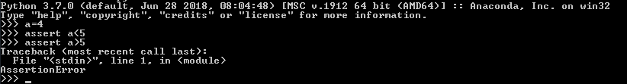

Python Keywords.. Cont..
assert assert is used for debugging purposes.
While programming, sometimes we wish to know the internal state or check if our assumptions are true. assert helps us do this and find bugs more conveniently. assert is followed by a condition. If the condition is true, nothing happens. But if the condition is false, AssertionError is raised. For example:
For our better understanding, we can also provide a message to be printed with the AssertionError.

Slide 13
Python Keywords.. Cont..
assert At this point we can note that,
assert condition, message
is equivalent to,
if not condition:
raise AssertionError(message)

Slide 14
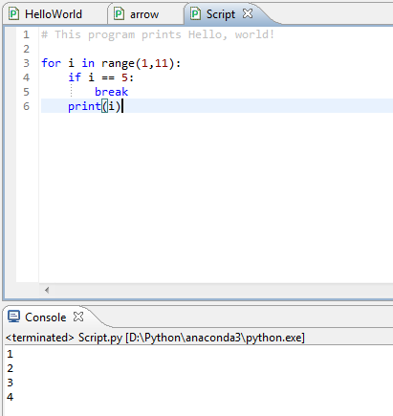
Python Keywords.. Cont..
break, continue
break and continue are used inside for and while loops to alter their normal behavior. break will end the smallest loop it is in and control flows to the statement immediately below the loop. continue causes to end the current iteration of the loop, but not the whole loop. This can be illustrated with the following two examples:
Here, the for loop intends to print numbers from 1 to 10. But the if condition is met when i is equal to 5 and we break from the loop.
Thus, only the range 1 to 4 is printed.

Slide 15
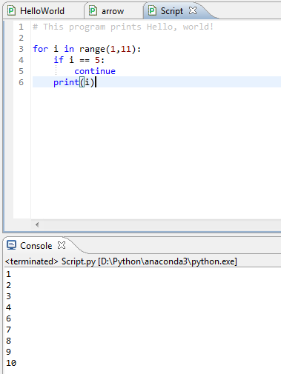
Python Keywords.. Cont..
break, continue
Here we use continue for the same program. So, when the condition is met, that iteration is skipped. But we do not exit the loop. Hence, all the values except 5 is printed out.

Slide 16
Python Keywords.. Cont..
class
class is used to define a new user-defined class in Python. Class is a collection of related attributes and methods that try to represent a real world situation. This idea of putting data and functions together in a class is central to the concept of object-oriented programming (OOP). Classes can be defined anywhere in a program. But it is a good practice to define a single class in a module. Following is a sample usage:
class ExampleClass:
def function1(parameters):
…
def function2(parameters):
…

Slide 17
Python Keywords.. Cont..
def
def is used to define a user-defined function.
Function is a block of related statements, which together does some specific task. It helps us organize code into manageable chunks and also to do some repetitive task.
The usage of def is shown below:
def function_name(parameters):

Slide 18
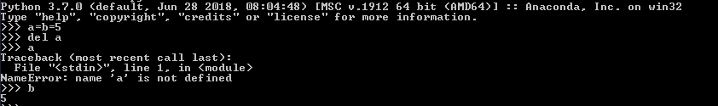

Python Keywords.. Cont..
del
del is used to delete the reference to an object. Everything is object in Python. We can delete a variable reference using del
Here we can see that the reference of the variable a was deleted. So, it is no longer defined. But b still exists.
del is also used to delete items from a list or a dictionary:

Slide 19
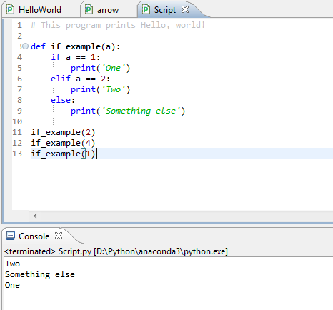
Python Keywords.. Cont..
if, else, elif
if, else, elif are used for conditional branching or decision making.
When we want to test some condition and execute a block only if the condition is true, then we use if and elif. elif is short for else if. else is the block which is executed if the condition is false. This will be clear with the following example:
Here, the function checks the input number and prints the result if it is 1 or 2. Any input other than this will cause the else part of the code to execute.

Slide 20
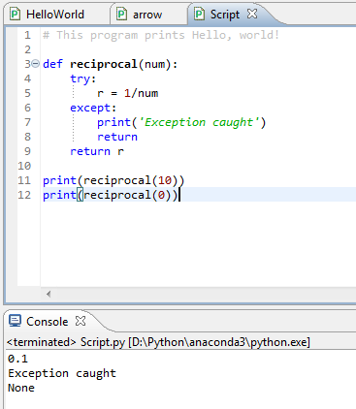
Python Keywords.. Cont..
except, raise, try
except, raise, try are used with exceptions in Python.
Exceptions are basically errors that suggests something went wrong while executing our program. IOError, ValueError, ZeroDivisionError, ImportError, NameError, TypeError etc. are few examples of exception in Python. try...except blocks are used to catch exceptions in Python.
We can raise an exception explicitly with the raise keyword. Following is an example:
Here, the function reciprocal() returns the reciprocal of the input number.When we enter 10, we get the normal output of 0.1. But when we input 0, a ZeroDivisionError is raised automatically. This is caught by our try…except block and we return None. We could have also raised the ZeroDivisionError explicitly by checking the input and handled it elsewhere as follows:
if num == 0: raise ZeroDivisionError('cannot divide')

Slide 21
Python Keywords.. Cont..
finally
finally is used with try…except block to close up resources or file streams.
Using finally ensures that the block of code inside it gets executed even if there is an unhandled exception. For example:
Here if there is an exception in the Try-block, it is handled in the except or else block. But no matter in what order the execution flows, we can rest assured that the Finally-block is executed even if there is an error. This is useful in cleaning up the resources.
try:
Try-block
except exception1:
Exception1-block
except exception2:
Exception2-block
else:
Else-block
finally:
Finally-block

Slide 22
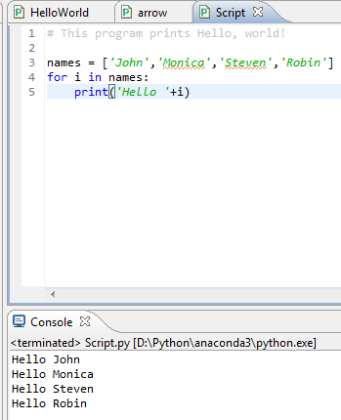
Python Keywords.. Cont..
for
for is used for looping. Generally we use for when we know the number of times we want to loop.
In Python we can use it with any type of sequence like a list or a string. Here is an example in which for is used to traverse through a list of names:

Slide 23
Python Keywords.. Cont..
from, import
import keyword is used to import modules into the current namespace. from…import is used to import specific attributes or functions into the current namespace. For example:
import math
will import the math module. Now we can use the cos() function inside it as math.cos(). But if we wanted to import just the cos() function, this can done using from as from math import cos. now we can use the function simply as cos(), no need to write math.cos().

Slide 24
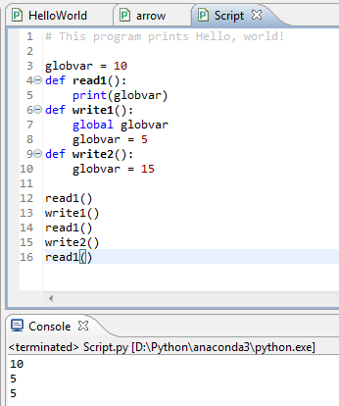
Python Keywords.. Cont..
global
global is used to declare that a variable inside the function is global (outside the function).
If we need to read the value of a global variable, it is not necessary to define it as global. This is understood.
If we need to modify the value of a global variable inside a function, then we must declare it with global. Otherwise a local variable with that name is created.
Following example will help us clarify this.

Slide 25
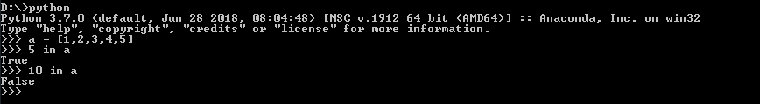
Python Keywords.. Cont..
in
in is used to test if a sequence (list, tuple, string etc.) contains a value. It returns True if the value is present, else it returns False. For example:

Slide 26
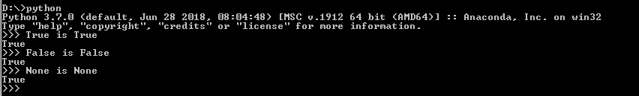
Python Keywords.. Cont..
is
is is used in Python for testing object identity. While the == operator is used to test if two variables are equal or not, is is used to test if the two variables refer to the same object.
It returns True if the objects are identical and False if not.

Slide 27
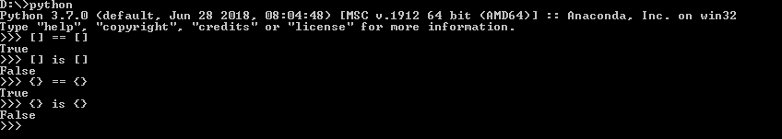
Python Keywords.. Cont..
is
We know that there is only one instance of True, False and None in Python, so they are identical.

Slide 28
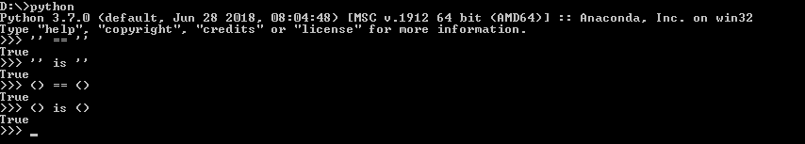
Python Keywords.. Cont..
is
An empty list or dictionary is equal to another empty one. But they are not identical objects as they are located separately in memory. This is because list and dictionary are mutable (value can be changed).
Unlike list and dictionary, string and tuple are immutable (value cannot be altered once defined). Hence, two equal string or tuple are identical as well. They refer to the same memory location.

Slide 29
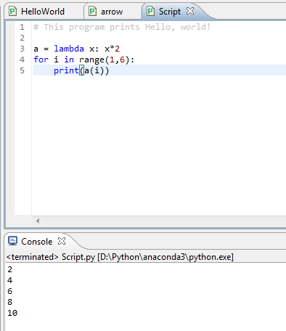
Python Keywords.. Cont..
lambda
lambda is used to create an anonymous function (function with no name). It is an inline function that does not contain a return statement. It consists of an expression that is evaluated and returned. For example:

Slide 30
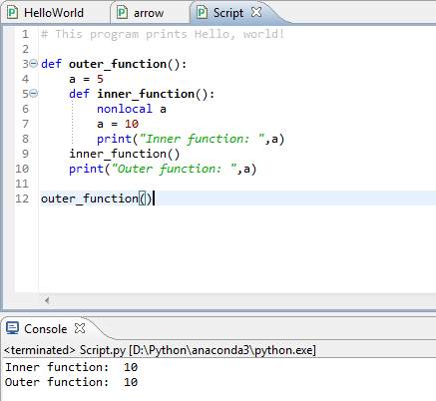
Python Keywords.. Cont..
nonlocal
The use of nonlocal keyword is very much similar to the global keyword. nonlocal is used to declare that a variable inside a nested function (function inside a function) is not local to it, meaning it lies in the outer inclosing function. If we need to modify the value of a non-local variable inside a nested function, then we must declare it with nonlocal. Otherwise a local variable with that name is created inside the nested function. Following example will help us clarify this.
Here, the inner_function() is nested within the outer_function.

Slide 31
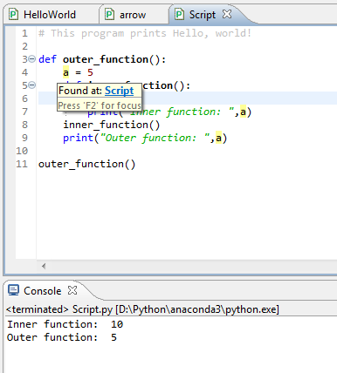
Python Keywords.. Cont..
nonlocal
The variable a is in the outer_function(). So, if we want to modify it in the inner_function(), we must declare it as nonlocal. Notice that a is not a global variable.
Hence, we see from the output that the variable was successfully modified inside the nested inner_function(). The result of not using the nonlocal keyword is as follows:
Here, we do not declare that the variable a inside the nested function is nonlocal. Hence, a new local variable with the same name is created, but the non-local a is not modified as seen in our output.

Slide 32
Python Keywords.. Cont..
nonlocal
The variable a is in the outer_function(). So, if we want to modify it in the inner_function(), we must declare it as nonlocal. Notice that a is not a global variable.
Hence, we see from the output that the variable was successfully modified inside the nested inner_function(). The result of not using the nonlocal keyword is as follows:
Here, the inner_function() is nested within the outer_function.

Slide 33
Python Keywords.. Cont..
pass
pass is a null statement in Python. Nothing happens when it is executed. It is used as a placeholder.
Suppose we have a function that is not implemented yet, but we want to implement it in the future. Simply writing,
def function(args):
in the middle of a program will give us IndentationError. Instead of this, we construct a blank body with the pass statement.
def function(args):
pass
We can do the same thing in an empty class as well.
class example:
pass

Slide 34
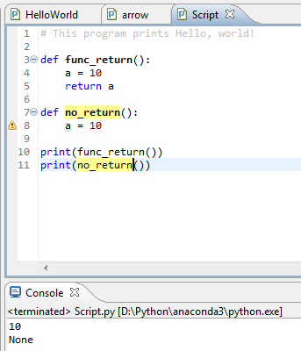
Python Keywords.. Cont..
return
return statement is used inside a function to exit it and return a value.
If we do not return a value explicitly, None is returned automatically. This is verified with the following example.

Slide 35
Python Keywords.. Cont..
return
return statement is used inside a function to exit it and return a value.
If we do not return a value explicitly, None is returned automatically. This is verified with the following example.

Slide 36
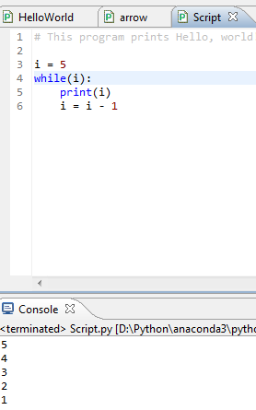
Python Keywords.. Cont..
while
while is used for looping in Python.
The statements inside a while loop continue to execute until the condition for the while loop evaluates to False or a break statement is encountered. Following program illustrates this.

Slide 37
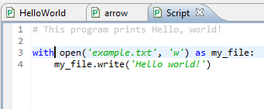

Python Keywords.. Cont..
with
with statement is used to wrap the execution of a block of code within methods defined by the context manager.
Context manager is a class that implements __enter__ and __exit__ methods. Use of with statement ensures that the __exit__ method is called at the end of the nested block. This concept is similar to the use of try…finally block. Here, is an example.

Slide 38
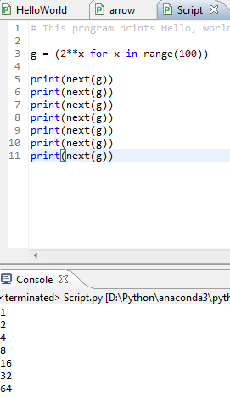
Python Keywords.. Cont..
yield
yield is used inside a function like a return statement. But yield returns a generator.
Generator is an iterator that generates one item at a time. A large list of value will take up a lot of memory. Generators are useful in this situation as it generates only one value at a time instead of storing all the values in memory. For example,
Generator is an iterator that generates one item at a time. A large list of value will take up a lot of memory. Generators are useful in this situation as it generates only one value at a time instead of storing all the values in memory. For example,
will create a generator g which generates powers of 2 up to the number two raised to the power 99. We can generate the numbers using the next() function as shown below.

Slide 39
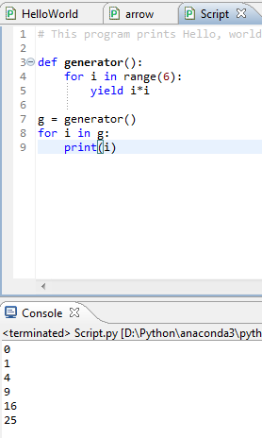
Python Keywords.. Cont..
yield
And so on… This type of generator is returned by the yield statement from a function. Here is an example.
Here, the function generator() returns a generator that generates square of numbers from 0 to 5. This is printed in the for loop.

Slide 40
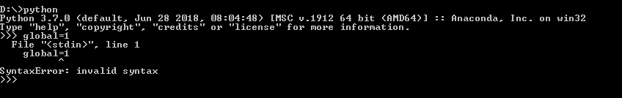
Python Identifiers
Identifier is the name given to entities like class, functions, variables etc. in Python. It helps differentiating one entity from another.
Rules for writing identifiers
Identifiers can be a combination of letters in lowercase (a to z) or uppercase (A to Z) or digits (0 to 9) or an underscore (_). Names like myClass, var_1 and print_this_to_screen, all are valid example.
An identifier cannot start with a digit. 1variable is invalid, but variable1 is perfectly fine.
Keywords cannot be used as identifiers.

Slide 41
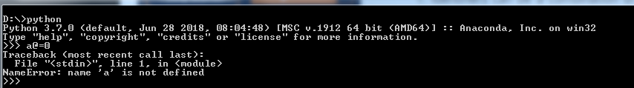
Python Identifiers
We cannot use special symbols like !, @, #, $, % etc. in our identifier.
Identifier can be of any length.

Slide 42
Python Identifiers
Things to care about
Python is a case-sensitive language. This means, Variable and variable are not the same. Always name identifiers that make sense.
While, c = 10 is valid. Writing count = 10 would make more sense and it would be easier to figure out what it does even when you look at your code after a long gap.
Multiple words can be separated using an underscore, this_is_a_long_variable.
We can also use camel-case style of writing, i.e., capitalize every first letter of the word except the initial word without any spaces. For example: camelCaseExample

