Slide 1
Spotify Analytics Project
Data Cleaning • Engagement • Performance • Strategy • Campaigns • Retention

Slide 2
Task 1: Data Cleaning
• Removed duplicates and missing values
• Standardized formats
• Prepared clean dataset for analysis

Slide 3
Task 2: Engagement Analysis
• Analyzed likes, shares, and comments
• Identified top-performing posts
• Found key engagement drivers

Slide 4
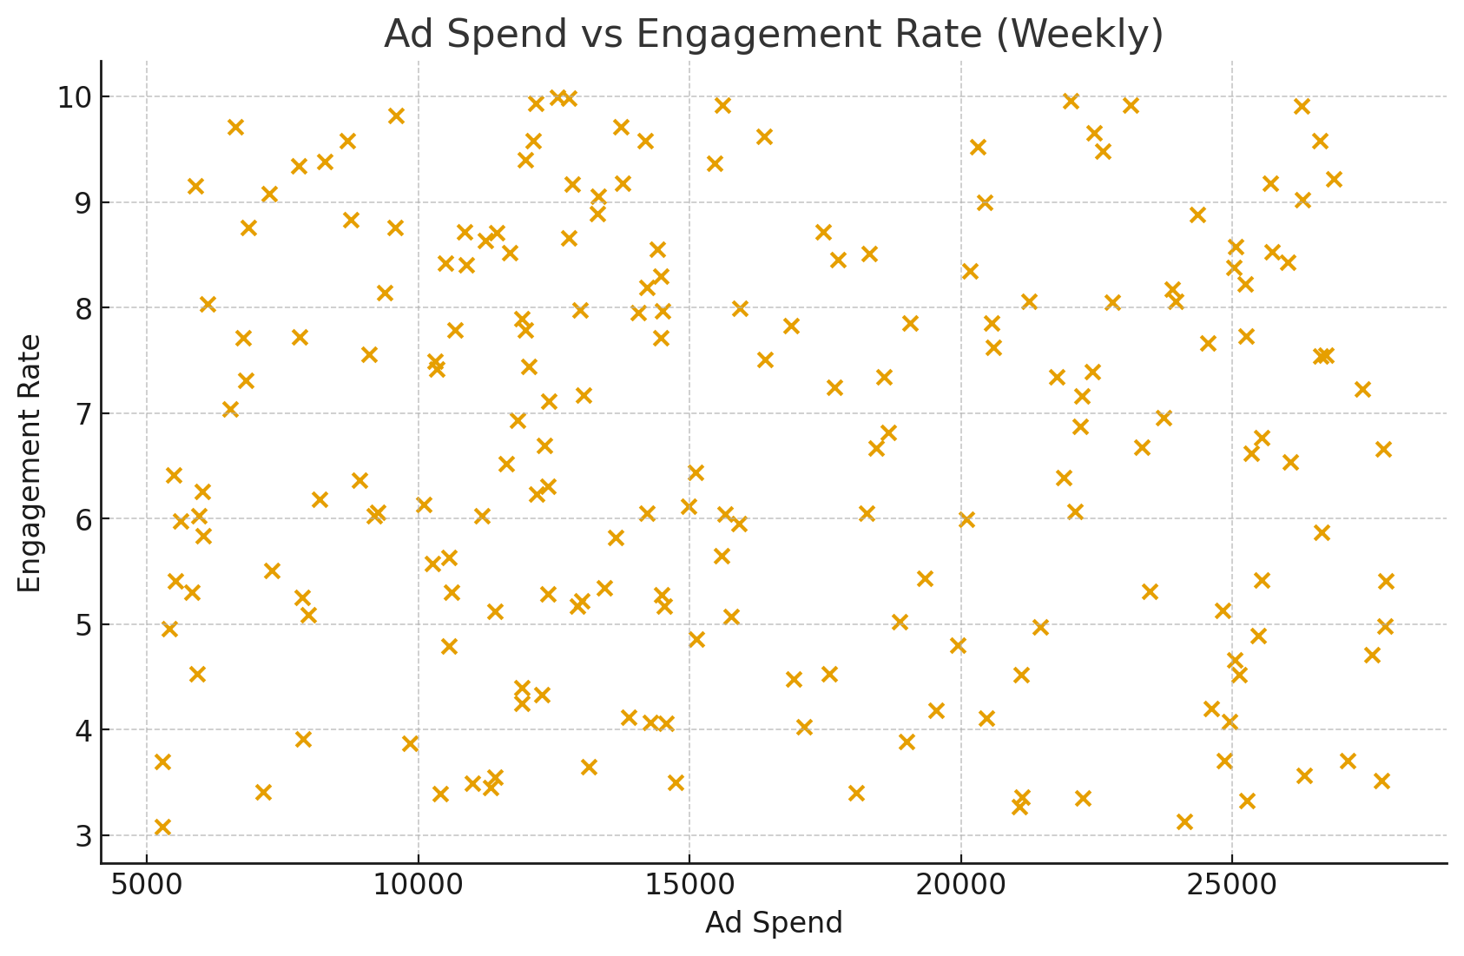
Task 3: Platform Performance
• Compared performance across Instagram, Twitter, YouTube
• Evaluated ad spend vs engagement
• Found best-performing platforms

Slide 5
Task 4: Hashtag & Content Strategy
• Analyzed hashtag performance
• Music-related hashtags performed best
• Suggested optimized content strategy

Slide 6
Task 5: Campaign Effectiveness
• Compared reach, impressions, and conversions
• Identified campaigns with best ROI
• Recommendations for future campaigns

Slide 7
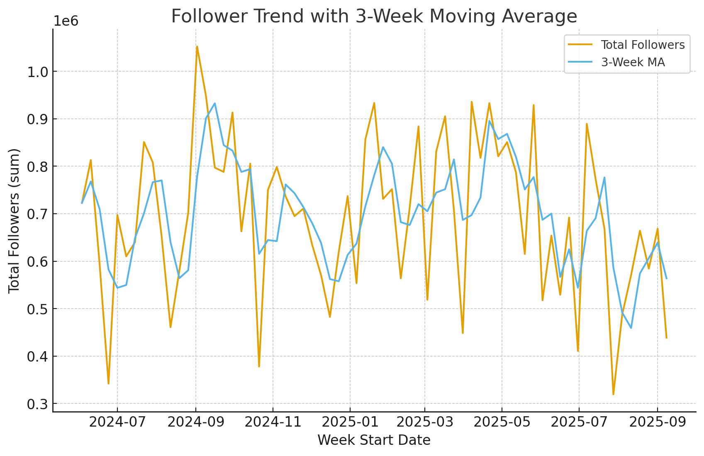
Task 6: Follower Retention
• Analyzed follower growth trends
• Measured retention over time
• Linked campaign impact to follower loyalty

Slide 8
Conclusion
• Engagement analysis highlighted top-performing content
• Platform comparison revealed where to focus efforts
• Campaign analysis guided ROI optimization
• Retention analysis showed long-term audience loyalty
Recommendations:
✔ Focus on high-performing platforms
✔ Use effective hashtags
✔ Invest in proven campaigns
✔ Track follower trends

