Slide 1
1.3. Environment Setup: Python, IDEs & Dev Tools

Slide 2


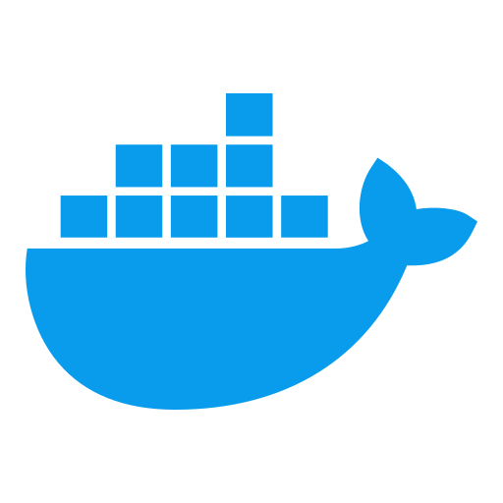
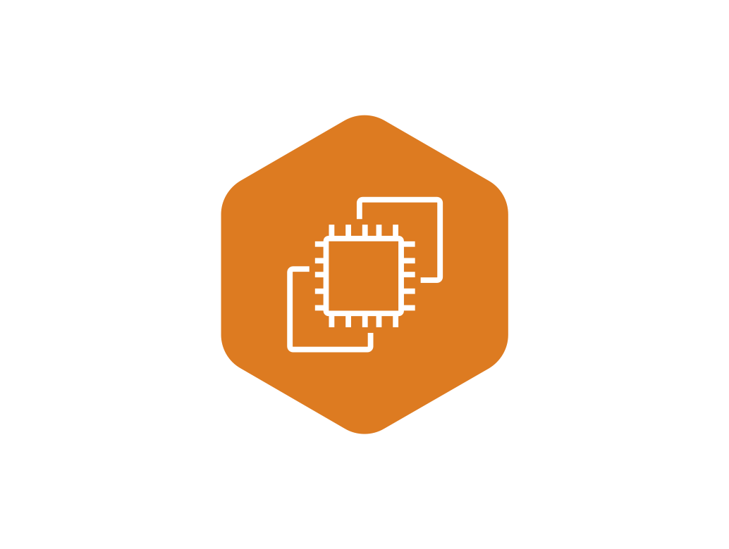
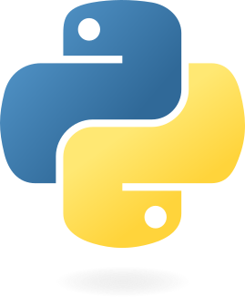
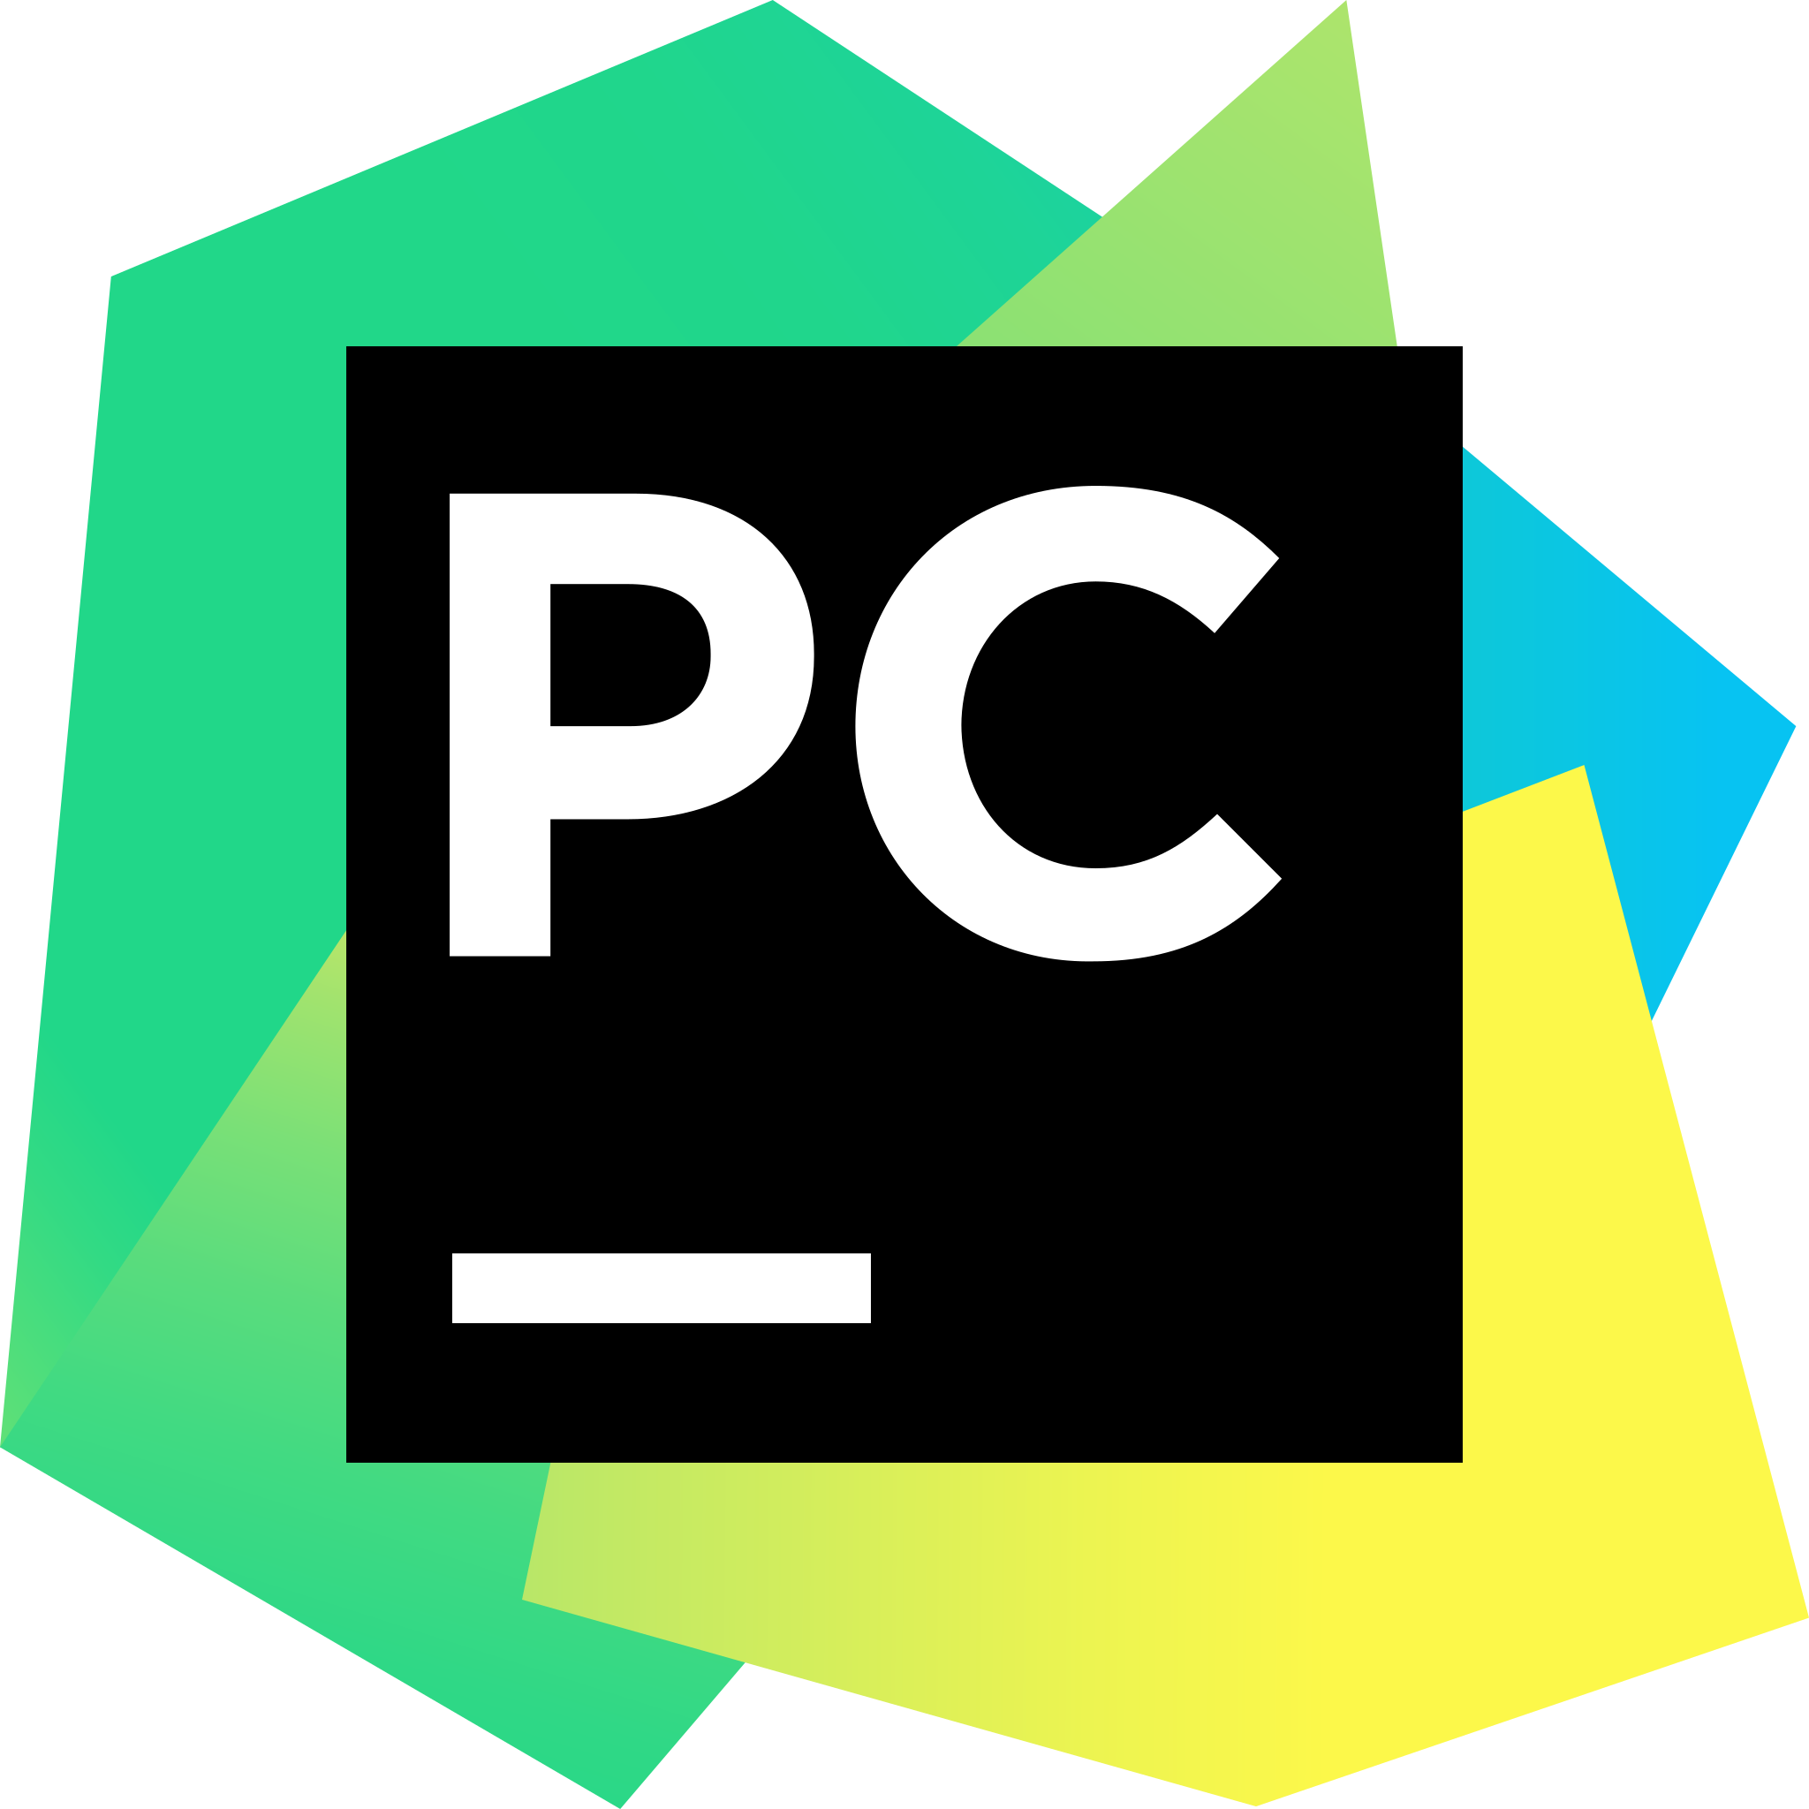
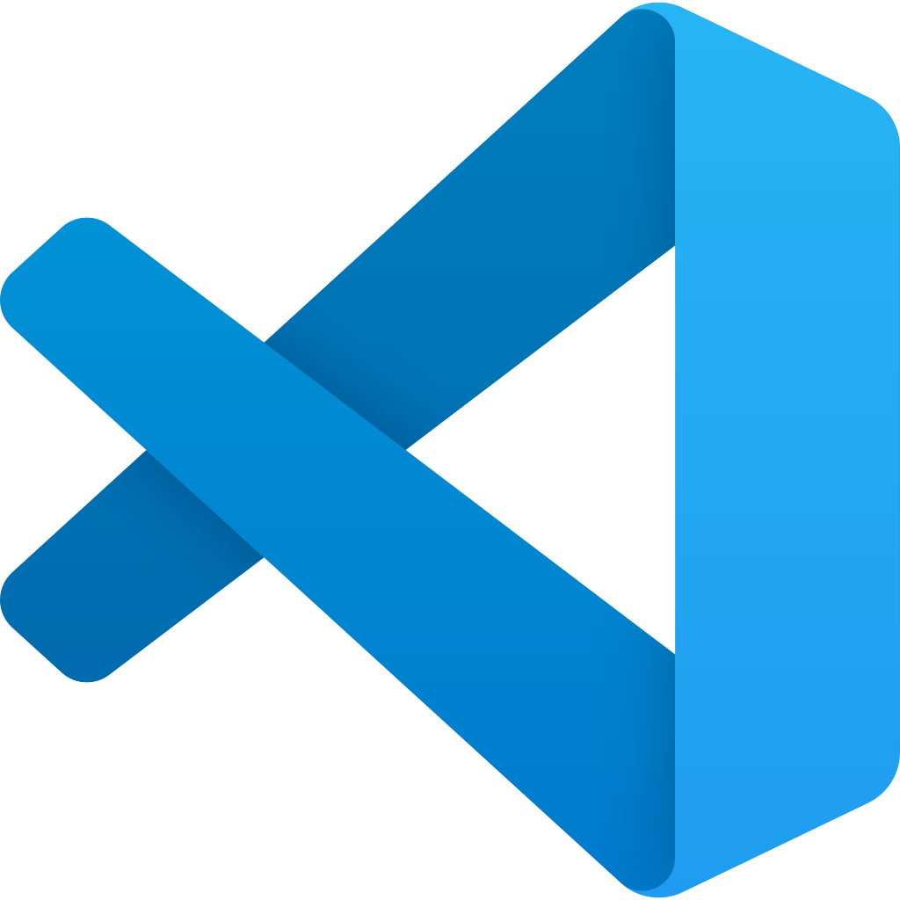
Tools We’ll Use
Jupyter Lab /
Google Colab
PyCharm /
VS Code
Docker / EC2
Python

