Slide 1
Honey Badger Algorithm
Metaheuristics for Search & Optimization
Sumit
Anto

Slide 2
Paper Details
Title: Honey Badger Algorithm: New metaheuristic algorithm for solving optimization problems
Authors: Fatma A. Hashim, Essam H. Houssein, Kashif Hussain, Mai S. Mabrouk, Walid Al-Atabany
Published on: Feb 2022
Citations: 176
PDF: https://sigmaland.ir/wp-content/uploads/2022/01/Sigmaland-Honey-Badger-Algorithm-New-metaheuristic-algorithm-for-solving-optimization-problems.pdf

Slide 3
Why Honey Badger Algorithm?
The Honey Badger Algorithm is an efficient search strategy for solving optimization problems.
Honey Badger Algorithm (HBA) is a new swarm-based metaheuristic optimization algorithm, which mimics the behavior of honey badgers.
HBA has been tested on 24 standard benchmark functions, CEC’17 test-suite, and four engineering design problems and has been found to be effective for solving optimization problems with complex search-space.
HBA has been found to be superior to other methods in terms of convergence speed and exploration–exploitation balance.
HBA outperforms other competitor algorithms on hard optimization problems.

Slide 4
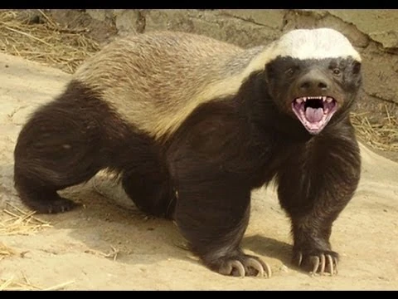
Honey Badger
Honey badger is a mammal with black and white fluffy fur often found in the semi-deserts and rainforests of Africa, Southwest Asia, and the Indian subcontinent — known for its fearless nature.
This dog size fearless forager preys sixty different species including the dangerous snakes.
It is an intelligent animal able to use tools, and it loves honey.
Fig: Honey Badger (https://allspecies.fandom.com/wiki/Honey_badger)

Slide 5
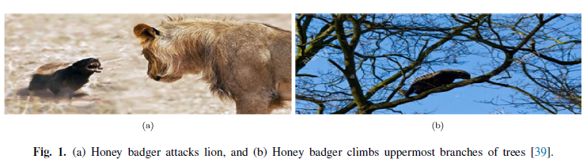
Honey Badger
Because of their courageous nature, it never hesitates attacking even much larger predators when it cannot escape (see Fig. 1a). This animal also can easily climb on trees, as shown in Fig. 1b, for reaching bird nests and beehives for food.

Slide 6
Biological inspiration
Honey Badger Algorithm (HBA) imitates the foraging behavior of honey badger
For locating food source, the honey badger either smells and digs or follows honeyguide bird. We call the first case as digging mode while the second as honey mode
In the prior mode, it uses its smelling ability to approximate prey location; when reaching there, it moves around the prey to select the appropriate place for digging and catching the prey
In latter mode, honey badger takes the guide of honeyguide bird to directly locate beehive

Slide 7
Mathematical Model & Algorithm Steps
Initialization Phase
Defining Intensity (I)
Density Factor
Escaping from local optimum
Updating the agent’s positions
Digging Phase
Honey Phase

Slide 8
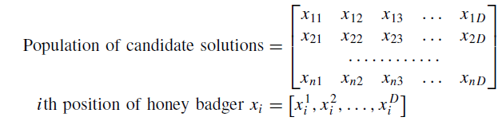
Initialization Phase
Initialize the number of honey badgers (population size N) and their respective positions based on eq:
xi = lbi + r1 × (ubi − lbi ), r1 is a random number between 0 and 1 (1)
where xi is ith honey badger position referring to a candidate solution in a population of N, while lbi and ubi are respectively lower and upper bounds of the search domain.

Slide 9
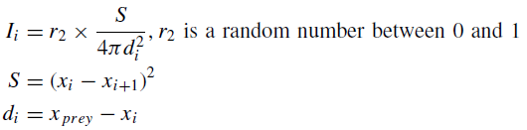
Defining Intensity (I)
Intensity is related to concentration strength of the prey and distance between it and ith honey badger
If the smell is high, the motion will be fast and vice versa, is given by Inverse Square Law
where S is source strength or concentration strength & di denotes distance between prey and the ith badger.

Slide 10

Update density factor
The density factor (α) controls time-varying randomization to ensure smooth transition from exploration to exploitation
Update decreasing factor α that decreases with iterations to decrease randomization with time, using Eq.:
where C is a constant ≥ 1 (default = 2) & tmax = maximum number of iterations.

Slide 11

Other key parameters
Xprey - best candidate solution so far
Fprey - fitness value of the best solution
The proposed algorithm uses a flag F which alters search direction for availing high opportunities for agents to scan the search-space rigorously
Beta (β) ≥ 1 (default = 6) is ability of the honey badger to get food.

Slide 12
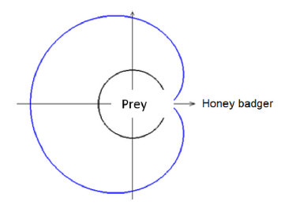
Updating agent’s position: Digging Phase
In digging phase, a honey badger performs action similar to Cardioid Motion which can be simulated by equation
Here, a honey badger heavily relies on smell intensity I of prey Xprey , distance between the badger and prey di , and time-varying search influence factor α.
Moreover, during digging activity, a badger may receive any disturbance F which allows it to find even better prey location.
Fig.: blue outline is smell intensity, black circular line shows prey location.

Slide 13
Updating agent’s position: Honey Phase
In digging phase, a honey badger performs action similar to Cardioid Motion which can be simulated by equation
It can be observed that a honey badger performs search close to prey location xprey found so far, based on distance information di .
At this stage, the search is influenced by search behavior varying by time (α).
Moreover, a honey badger may find disturbance F.

Slide 14
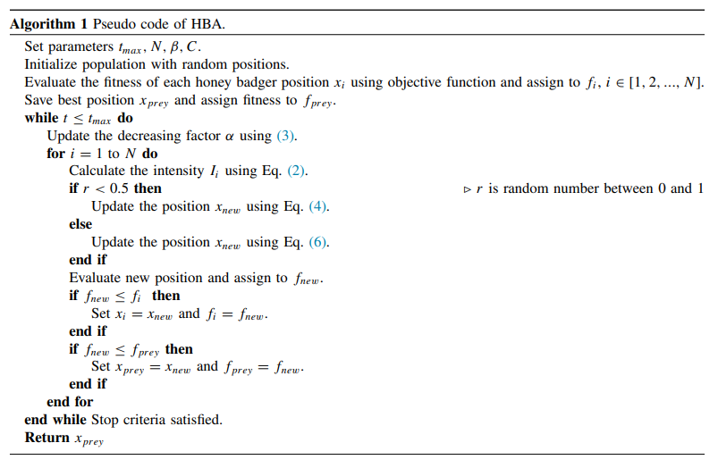
HBA: Algorithm

Slide 15
Experimental Section
24 - Standard Benchmark Functions
Statistical Analysis
Convergence Analysis
Exploration - Exploitation Analysis
29 - CEC’17 Test-suite Functions
Statistical Analysis
Convergence Analysis
Exploration - Exploitation Analysis

Slide 16
Comparison
The solutions obtained using the HBA have been compared with ten well-known metaheuristic algorithms including:
Elephant Herding Optimization (EHO)
Whale Optimization Algorithm (WOA)
Grasshopper Optimization Algorithm (GOA)
Thermal Exchange Optimization (TEO)
Harris hawks optimization (HHO).
Simulated annealing(SA)
Particle Swarm Optimization (PSO)
Covariance Matrix Adaptation Evolution Strategy (CMA-ES)
Success-History based Adaptive Differential Evolution variants with linear population size reduction (L-SHADE)
Moth-flame Optimization (MFO)

Slide 17
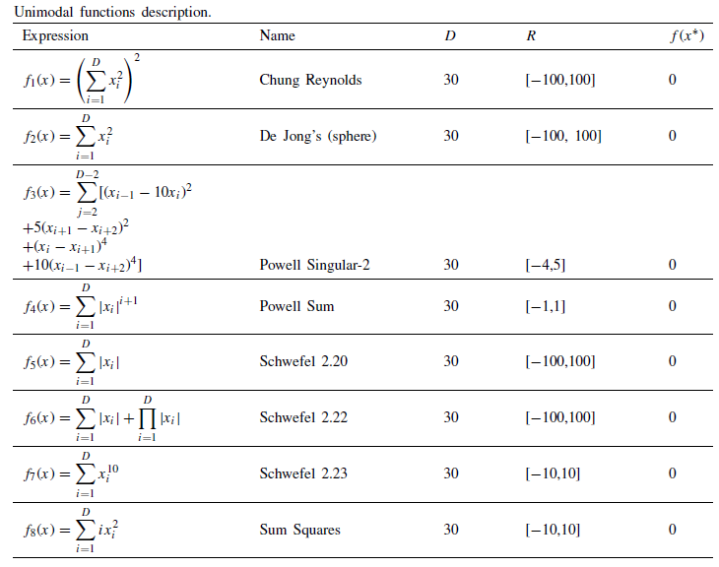
Benchmark Function: Unimodal
Parameter Settings:
N = 50
T-_max = 1000
Simulation = 30
Case:1 Dimension = 30
Case:2 Dimension = 50

Slide 18
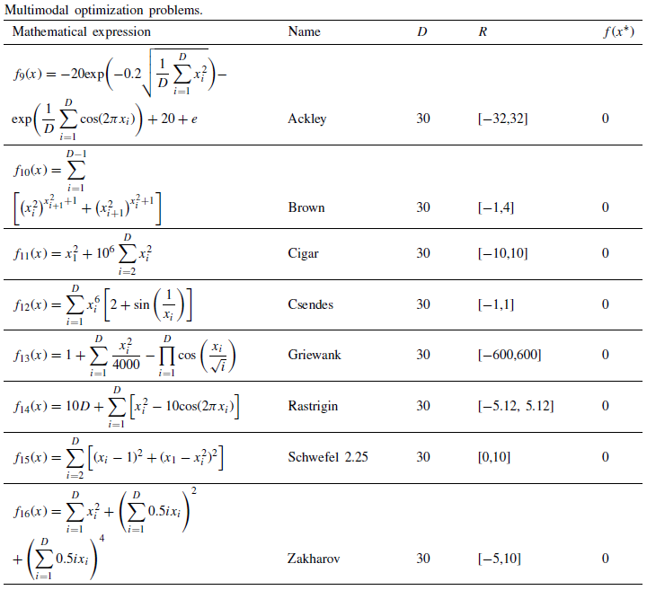
Benchmark Function: Multimodal
Parameter Settings:
N = 50
T-_max = 1000
Simulation = 30
Case:1 Dimension = 30
Case:2 Dimension = 50

Slide 19
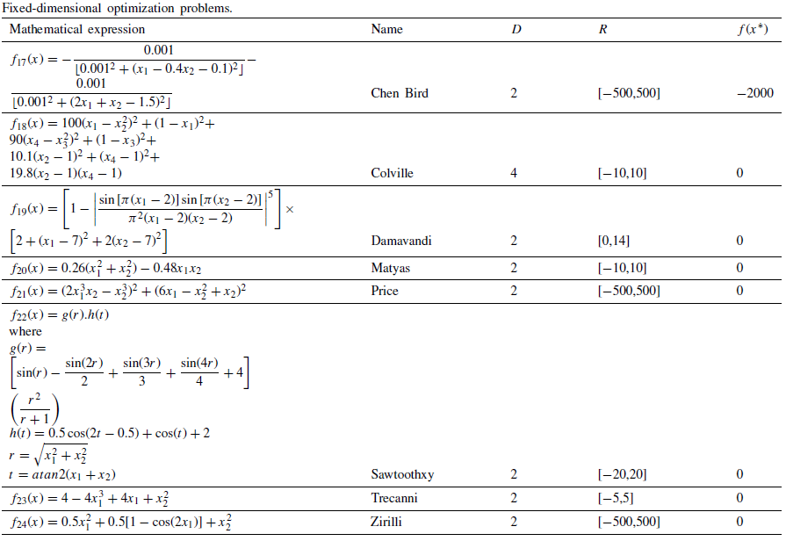
Benchmark Function: Fixed Dimension
Parameter Settings:
N = 50
T_max = 1000
Simulation = 30
Dimension : Fixed dimensions (different)

Slide 20
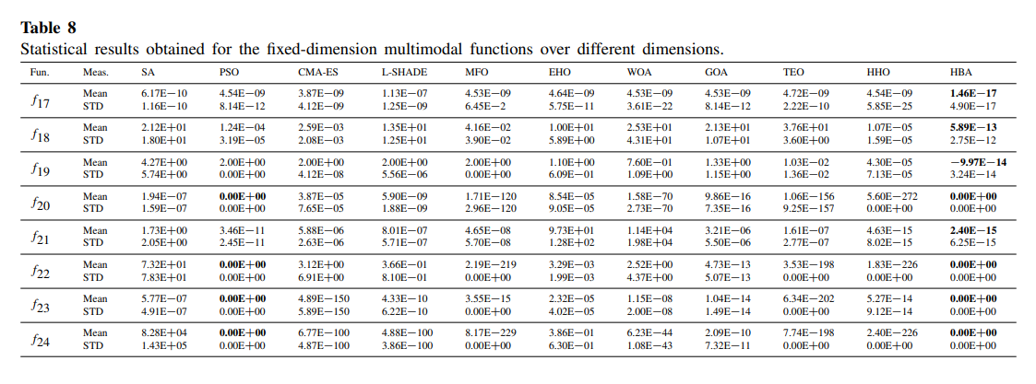
Mean and SD

Slide 21
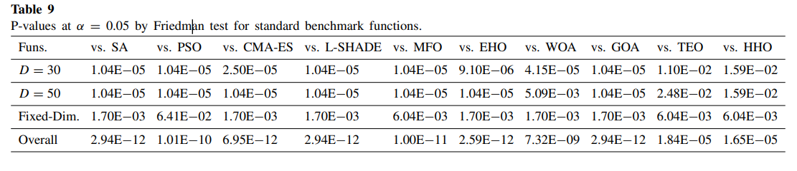
Statistical Analysis
Friedman Test Result: Show the significant gap between the results of HBA vs other algorithms

Slide 22
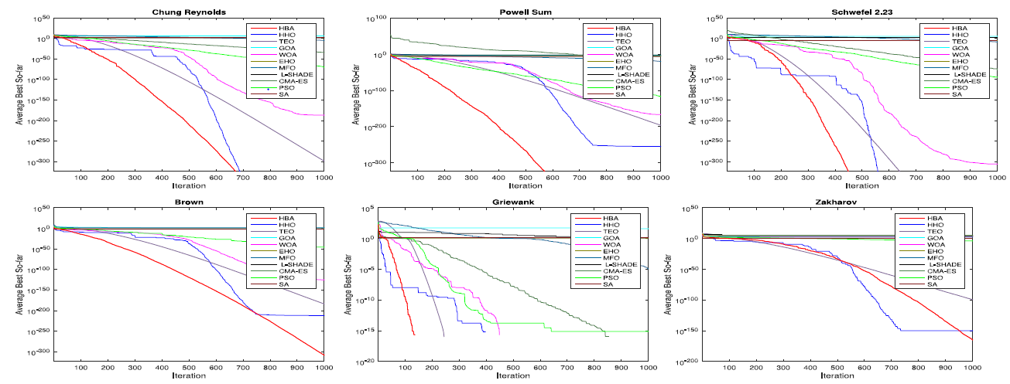
Convergence Analysis Comparison (1/2)
Convergence graphs shows how efficiently the algorithm progressed during the course of search process

Slide 23
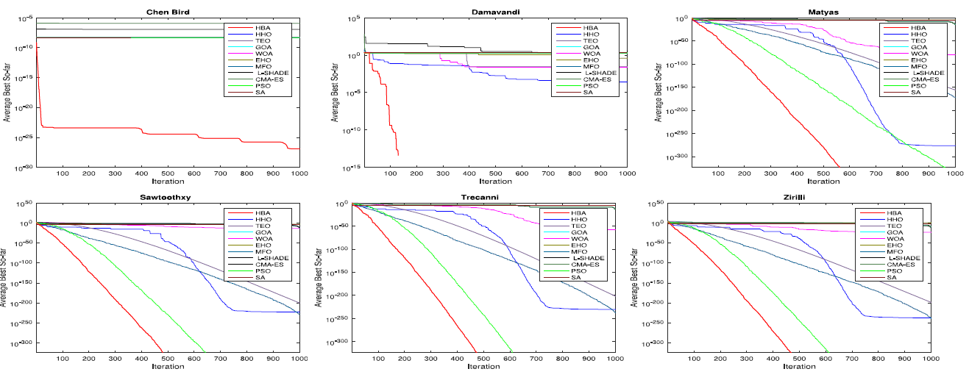
Convergence Analysis Comparison (2/2)
Convergence graphs shows how efficiently the algorithm progressed during the course of search process

Slide 24
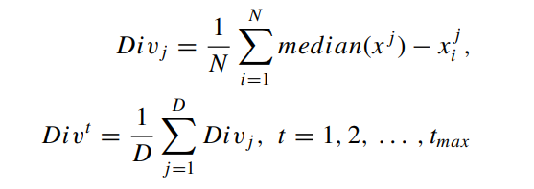
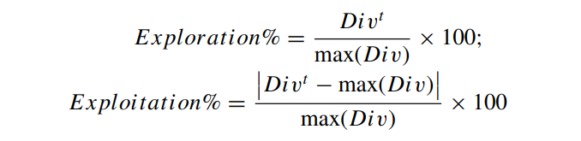
Exploration vs Exploitation
The analysis measures exploration and exploitation phases during a search process based on the mean value of distance within dimensions of the population.
Increase in mean value - Exploration
Decrease in mean value - Exploitation
Constant reduced mean values - Convergence
HBA remain best with 50% exploration in 10 out of 16 standard benchmark functions

Slide 25
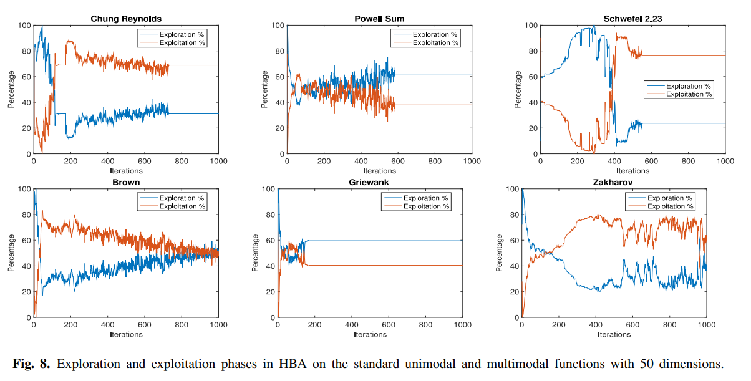
Exploration vs Exploitation

Slide 26
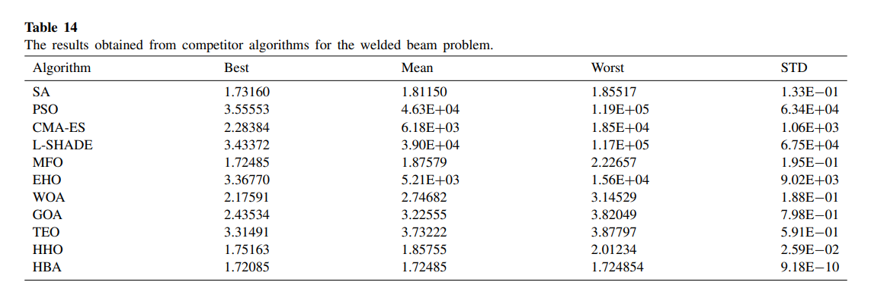
Engineering Problems
Three engineering design problems were solved by HBA
Welded beam design problem - Cost minimization
Tension/compression spring design problem - Cost minimization
Speed reducer design problem - Weight minimization

Slide 27
Conclusion & Future Works
HBA aims to balance the exploration and exploitation abilities by efficiently traversing the search-space and avoiding suboptimal regions
The empirical study also affirmed the superiority in terms of convergence speed and trade-off exploration–exploitation balance.
The experimental result revealed that the HBA is effectively applicable to solve problems with complex search-space.
Future studies will be made to HBA, such as adding chaotic maps, binary and multi-objective capabilities, to solve other real-scale optimization problems.

