Slide 1
SERVLETS

Slide 2
SERVLET
Servlet technology is used to create a web application (resides at server side and generates a dynamic web page).
Servlet technology is robust and scalable because of java language.
Servlet is a technology which is used to create a web application.
Servlet is an API that provides many interfaces and classes including documentation.
Servlet is an interface that must be implemented for creating any Servlet.
Servlet is a class that extends the capabilities of the servers and responds to the incoming requests. It can respond to any requests.
Servlet is a web component that is deployed on the server to create a dynamic web page.

Slide 3
WEB APPLICATION
Web application (Web app) is an application program that is stored on a remote server and delivered over the Internet through a browser interface. Web services are Web apps by definition and many, although not all, websites contain Web apps. According to Web.AppStorm editor Jarel Remick, any website component that performs some function for the user requests qualifies as a Web app.
Web applications can be designed for a wide variety of uses and can be used by anyone; from an organization to an individual for numerous reasons. Commonly used Web applications can include webmail, online calculators, or e-commerce shops. Some Web apps can be only accessed by a specific browser; however, most are available no matter the browser.

Slide 4
HOW DOES WEB APPLICATION WORKS
Web applications do not need to be downloaded since they are accessed through a network. Users can access a Web application through a web browser such as Google Chrome, Mozilla Firefox or Safari.
For a web app to operate, it needs a Web server and a database. Web servers manage the requests that come from a client. A database can be used to store any needed information.
Web applications typically have short development cycles and can be made with small development teams. Most Web apps are written in JavaScript, HTML5, or Cascading Style Sheets (CSS). Client-side programming typically utilizes these languages, which help build an applications front-end. Server-side programming is done to create the scripts a Web app will use. Languages such as Python, Java, and Ruby are commonly used in server-side programming.

Slide 5
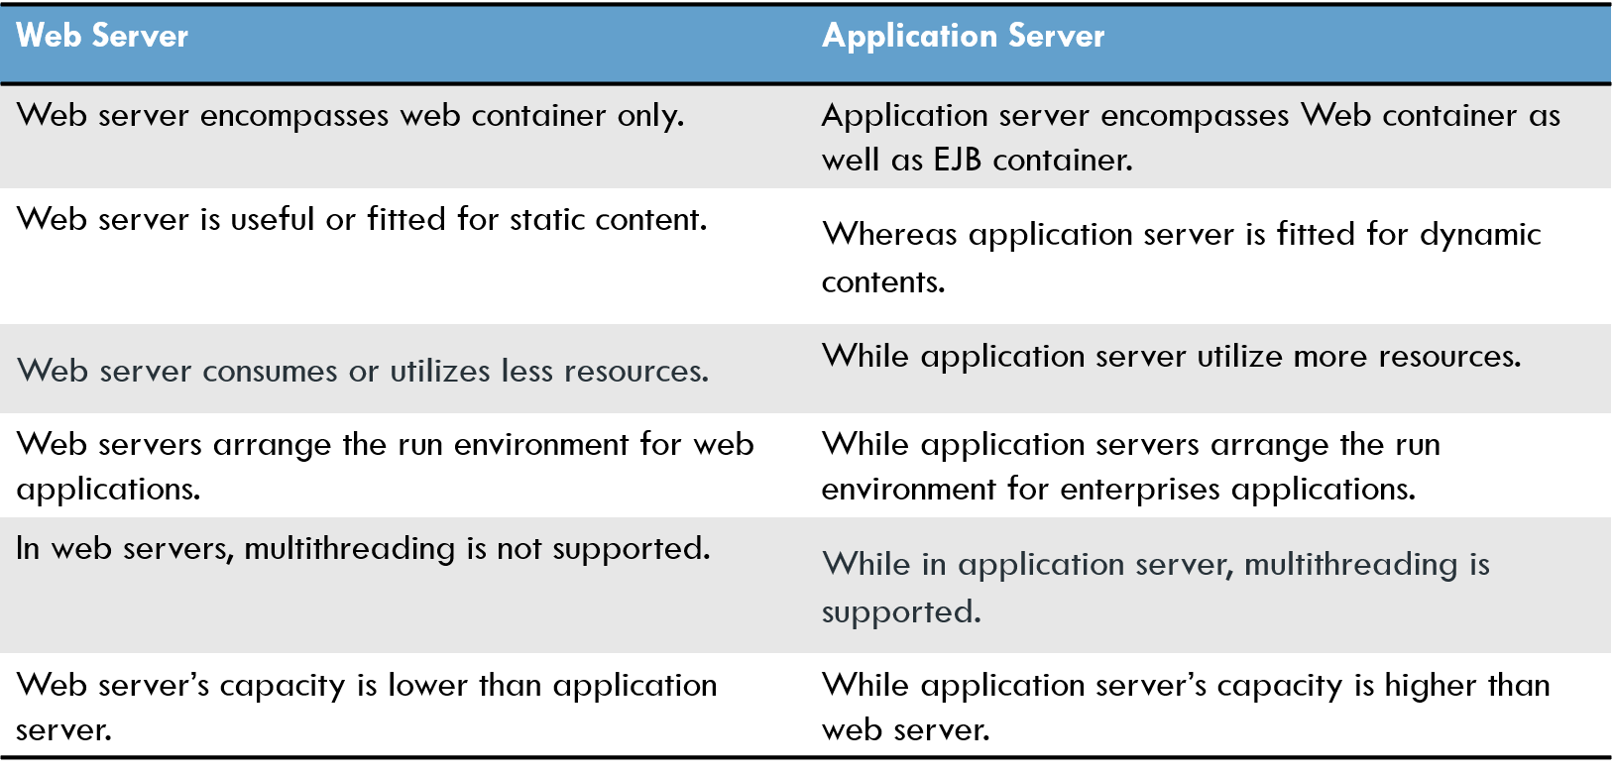

Slide 6
WORK FLOW OF SERVLET
WEB SERVER
WEB CONTAINER
REQUEST
CLIENT
SERVLET
RESPONSE

Slide 7
Web container
A web container is the component of a web server that interacts with the java servlet.
A web container manages the life cycle of servlets and it maps a URL to a particular servlet while ensuring that the requester has relevant access rights.
Java servlet do not have main method, so a container is required to load them. The servlet gets deployed on the web container.

Slide 8
Servlet life cycle
The web container maintains the life cycle of a servlet instance. Let's see the life cycle of the servlet:
Servlet class is loaded.
Servlet instance is created.
init method is invoked.
service method is invoked.
destroy method is invoked.

Slide 9
SERVLET
INTERFACE
GENERIC SERVLET
ABSTRACT CLASS
HTTP SERVLET
ABSTRACT CLASS

Slide 10
SERVLET
Servlet is an interface in javax.servlet package.
It has 5 abstract methods.
init()
service()
destroy()
getServletinfo()
getServletConfig()
You can create a servlet by implementing the Servlet interface and providing the implementation for all these methods.

Slide 11
GENERIC SERVLET
It is a abstract class in javax.servlet package .
Generic servlet implements Servlet, ServletConfig and Serializable interfaces. It provides the implementation of all the methods of these interfaces except the service method.
GenericServlet class can handle any type of request so it is protocol-independent.
You can create a servlet by inheriting the GenericServlet class and providing the implementation of the service method.

Slide 12
Disadvantages of generic servelet
Working with Generic Servlet is not that easy because we don’t have convenient methods such as doGet(), doPost(), doHead() etc in Generic Servlet that we can use in Http Servlet.
In Http Servlet we need to override particular convenient method for particular request, for example if you need to get information then override doGet(), if we want to send information to server override doPost(). However in Generic Servlet we only override service() method for each type of request which is not convinient.
Therefore it is recommended to use the HttpServlet instead of the GenericServlet.
HttpServlet is easier to work with, and has more methods to work with than GenericServlet.

Slide 13
HTTP SERVLET
It is a abstract class in javax.servlet.http package.
The HttpServlet class extends the GenericServlet class and implements Serializable interface. It provides http specific methods such as doGet, doPost, doHead, doTrace etc.
It is an abstract class with no abstract methods.

Slide 14
Important methods
A subclass of HttpServlet must override at least one method, usually one of these:
doGet , if the servlet supports HTTP GET requests.
doPost , for HTTP POST requests.
doPut , for HTTP PUT requests.
doDelete , for HTTP DELETE requests.
init and destroy , to manage resources that are held for the life of the servlet.

Slide 15
Difference between doget and dopost
doget() is request information.
In doget() parameters are appended to URL and sent with header information.
doget() is Faster.
In doget() only 1024 characters limit.
dopost() is provide information.
In dopost(), on the other hand, will send the information through socket back to the webservers and it won’t show in the URL bar.
dopost() Slower.
In dopost() doest not have limit.

Slide 16
Deployment descriptor
The deployment descriptor is the file used by the servlet container to define which servlets match up with which URLs. It also defines which servlet or resource provides the landing page for the root of the service.
Web.xml is Deployment Descriptor.
It consists of several tags like <servlet> , <servlet-mapping> , <welcome-file-list> …

Slide 17
Mapping url with servlet using web.xml
<web-app>
<servlet>
<servlet-name>servlet1</servlet-name>
<servlet-class>com.javatpoint.FirstServlet</servlet-class>
<load-on-startup>0</load-on-startup>
</servlet>
<servlet>
<servlet-name>servlet2</servlet-name>
<servlet-class>com.javatpoint.SecondServlet</servlet-class>
<load-on-startup>1</load-on-startup>
</servlet>
</web-app>

Slide 18
Print writer
Prints formatted representations of objects to a text-output stream. This class implements all of the print methods found in PrintStream. It does not contain methods for writing raw bytes, for which a program should use unencoded byte streams.
Unlike the PrintStream class, if automatic flushing is enabled it will be done only when one of the println, printf, or format methods is invoked, rather than whenever a newline character happens to be output. These methods use the platform's own notion of line separator rather than the newline character.
Methods in this class never throw I/O exceptions, although some of its constructors may. The client may inquire as to whether any errors have occurred by invoking checkError().

Slide 19
Request dispatcher
The RequestDispatcher interface provides the facility of dispatching the request to another resource it may be html, servlet or jsp. This interface can also be used to include the content of another resource also. It is one of the way of servlet collaboration.
The RequestDispatcher interface provides two methods. They are:
public void forward(ServletRequest request,ServletResponse response)throws ServletException,java.io.IOException:Forwards a request from a servlet to another resource (servlet, JSP file, or HTML file) on the server.
public void include(ServletRequest request,ServletResponse response)throws ServletException,java.io.IOException:Includes the content of a resource (servlet, JSP page, or HTML file) in the response.

Slide 20
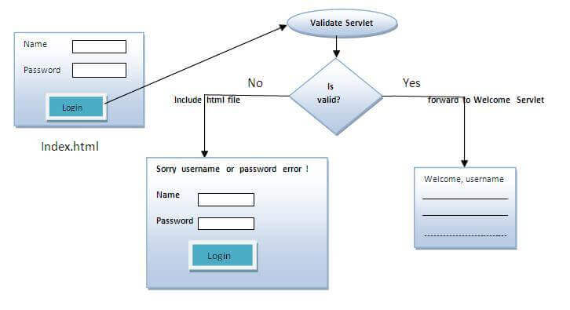
Request dispatcher

Slide 21
Servlet context
An object of ServletContext is created by the web container at time of deploying the project. This object can be used to get configuration information from web.xml file. There is only one ServletContext object per web application.
If any information is shared to many servlet, it is better to provide it from the web.xml file using the <context-param> element.
Advantage of ServletContext
Easy to maintain if any information is shared to all the servlet, it is better to make it available for all the servlet. We provide this information from the web.xml file, so if the information is changed, we don't need to modify the servlet. Thus it removes maintenance problem.

Slide 22
Servlet config
An object of ServletConfig is created by the web container for each servlet. This object can be used to get configuration information from web.xml file.
If the configuration information is modified from the web.xml file, we don't need to change the servlet. So it is easier to manage the web application if any specific content is modified from time to time.
Advantage of ServletConfig
The core advantage of ServletConfig is that you don't need to edit the servlet file if information is modified from the web.xml file.

Slide 23
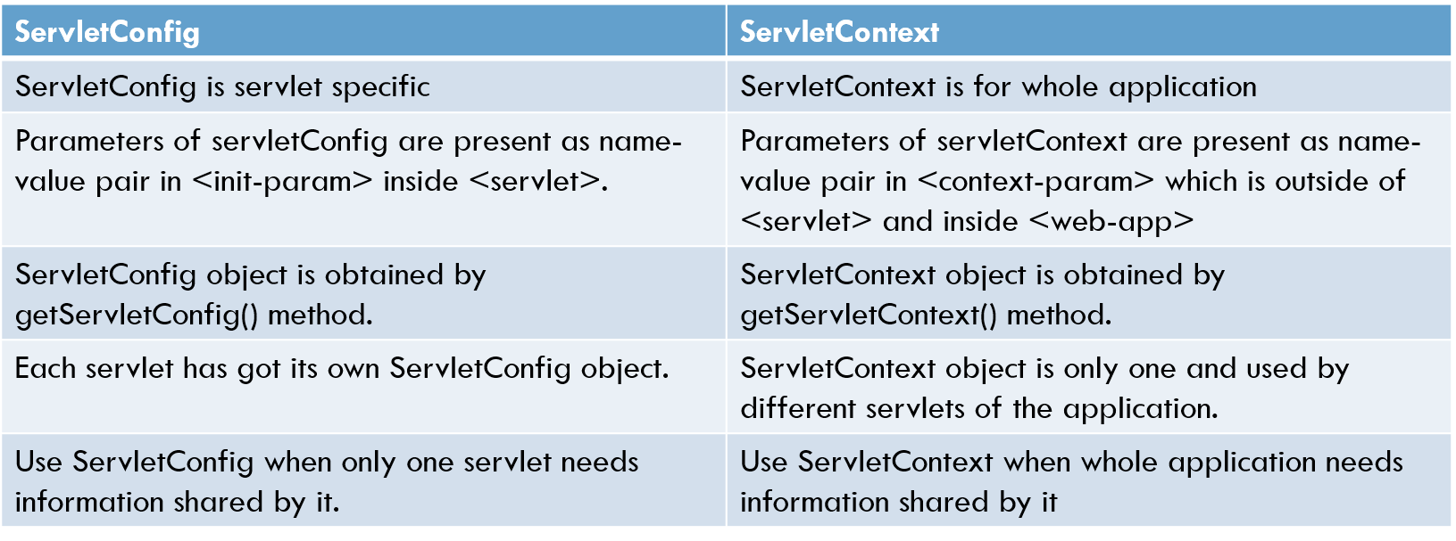
DIFFERENCE BETWEEN SERVLET CONFIG AND SERVLET CONTEXT

Slide 24
Session tracking
Some of the techniques used in Session tracking:
Cookies.
HttpSession.

Slide 25
Cookie in servlet
A cookie is a small piece of information that is persisted between the multiple client requests.
A cookie has a name, a single value, and optional attributes such as a comment, path and domain qualifiers, a maximum age, and a version number.
How Cookie works
By default, each request is considered as a new request. In cookies technique, we add cookie with response from the servlet. So cookie is stored in the cache of the browser. After that if request is sent by the user, cookie is added with request by default. Thus, we recognize the user as the old user.

Slide 26
drawbacks
It will not work if cookie is disabled from the browser.
Only textual information can be set in Cookie object.

Slide 27
http session in servlet
Http session is an interface in javax.servlet package.
request.getSession() will return you httpsession object.
By using setAttribute() of httpsession you can set one session in key-value pair.
getAttribute of httpsession gives you back the session by passing key as parameter.
It belongs on server side. Disabling cookies doesn’t affect session.

Slide 28
advantages
Any kind of object can be stored into a session, be it a text, object etc.
Usage of sessions is not dependent on the client’s browser.
Sessions are secure and transparent

Slide 29
disadvantages
Performance overhead due to session object being stored on server
Overhead due to serialization and de-serialization of data

Slide 30
Java server pages(jsp) :-
jsp stands for Java Server Pages.
It is a server side technology.
It is used for creating web application.
It is used to create dynamic web content.
In this JSP tags are used to insert JAVA code into HTML pages.
It is an advanced version of Servlet Technology.
It is a Web based technology helps us to create dynamic and platform independent web pages.
In this, Java code can be inserted in HTML/ XML pages or both.

